Slide 1
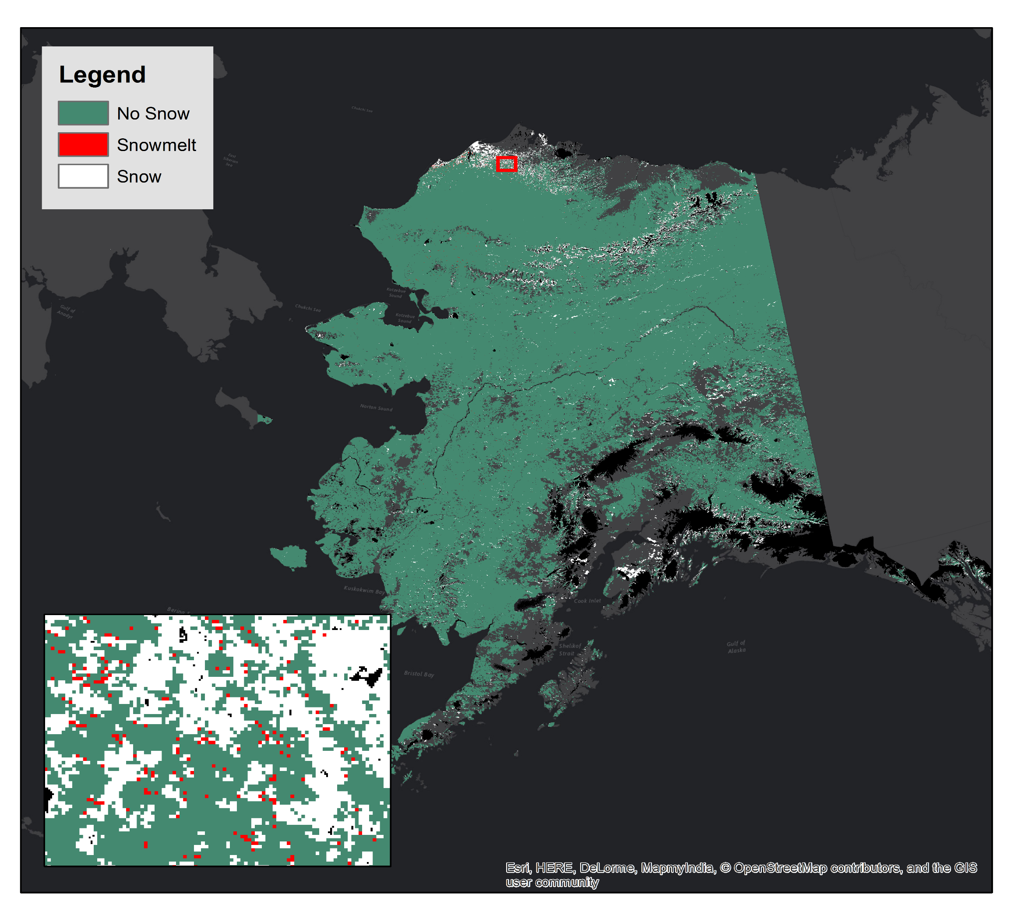
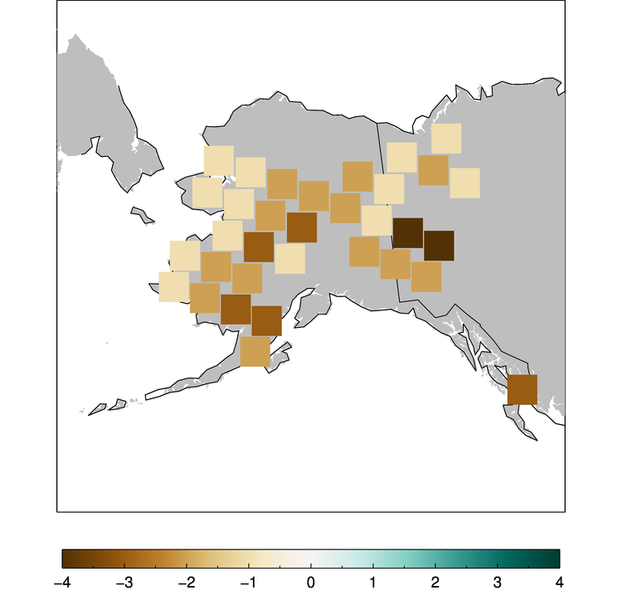
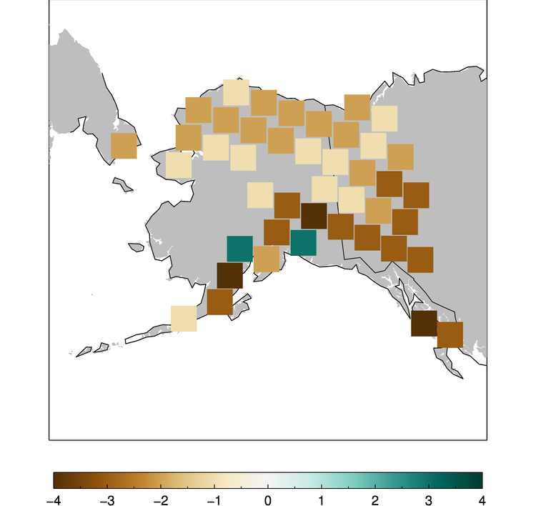
Development of a Snowmelt Monitoring Tool Using NASA MODIS and NOAA Climate Data Records to Aid Wildfire Managers in Alaska
Abstract
Study Area
Objectives
Alaska is warming twice as fast as the rest of the nation due to changes in the climate, causing shorter winters, thawing permafrost, and rapidly receding glaciers. All of these weather changes are lengthening wildfire seasons and increasing the number of wildfires experienced by the state. Due to a current lack of actionable-data, the Alaska Interagency Coordination Center (AICC) and fire risk managers have difficulty determining when various areas within Alaska become snow-free and necessitate fire risk assessment. This project used NASA and NOAA satellite data to inform and improve the current snow monitoring processes of the AICC. The DEVELOP team used MODIS Normalized Difference Snow Index data to map snow cover extent and create a near real-time tool to monitor snowmelt and aid wildfire managers in determining locality for future fire risks. The team also utilized Snow Cover Extent - Climate Data Record (SCE-CDR) to study climatological trends in historic seasonal snow cover melt to provide analysis of historic changes and trends in snowmelt. The results of this study give users the capacity to visualize maps of snow cover melt at a higher spatial resolution than previously utilized. These results will be distributed to and used by the AICC and the National Weather Service Alaska Region to mitigate wildfire risk.
Utilize both NASA Earth observations and NOAA climate data to fill the gaps in current data used by project partners
Create a snow cover monitoring tool to calculate the changes in the near-real-time using the MODIS Normalized Difference Snow Index
Distribute raw gridded snowmelt data to partners for use within existing mapping services
Revise tool to produce using VIIRS near real-time land cover data outputs for project partners
Study and document climatological trends in seasonal snow cover melt to provide insight on historic and expected changes in snowmelt
Earth Observations
Fetch near real-time land cover VIIRS data
Convert land cover to NDSI
Project & Clip to Alaska
Change Detection Analysis of each grid cell
Record & Store Day of Thaw
Output: Gridded Data and Map
Methodology
AQUA MODIS
Suomi NPP VIIRS
Results
Snowmelt for June 4th - 7th 2017 (Julian days 155-158)
Day 1
Day 2
Day 3
Day 4
Conclusions
Using this tool, the AICC and wildfire managers can better determine when to run wildfire indices to minimize disaster risk.
Revising the SnoCoM tool to run on VIIRS data will allow our partners to visualize data at a higher resolution.
The Historical Trend Analysis suggests that a greater amount of change in snow cover days is occurring during transition seasons.
Project Partners
Alaska Interagency Coordination Center
National Weather Service, Alaska Region
May Snow Trends 1967-2017
June Snow Trends 1967-2017
Acknowledgements
The Alaska Disasters team would like to thank our science advisor, Jake Crouch, as well as our Center Lead, Aaron Mackey, and Assistant Center Lead, Jonathan O’Brien. We would also like to acknowledge all of the NCEI employees, our partners, and fellows who dedicated their time and assistance to this project.
Team Members
Change in Snow Cover Days per Decade
Change in Snow Cover Days per Decade
Caroline Jahn
Project Lead
Laurel Mahoney
Daniel Lucas
Jeshua Pott
Alaska Disasters
North Carolina – NCEI | 2018

