Slide 1
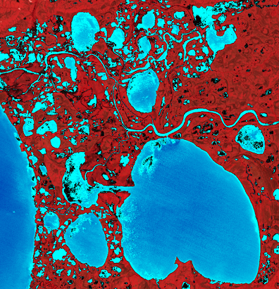
2018 Fall |California – JPL
ALASKA ECOLOGICAL FORECASTING
Automated Wetland Hydroperiod Mapping Integrating Optical Satellite Imagery and Synthetic Aperture Radar
Annemarie Peacock
Briant Fabela
Alice Lin
Adam Vaccaro
Notes:
Website Image of False Color Composite form Landsat Imagery of Yukon Delta in Alaska
Introduce project and members of team

Slide 2
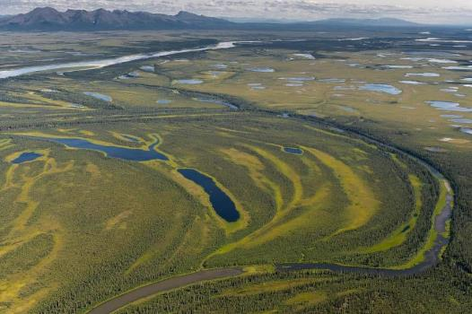
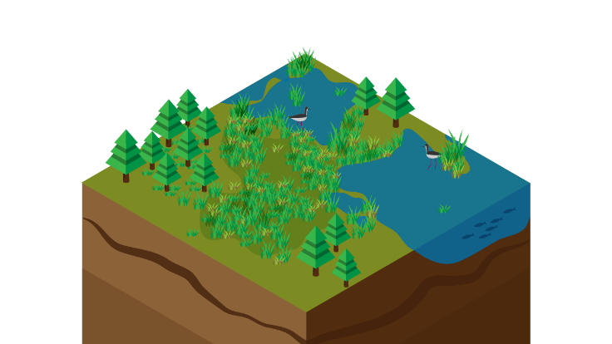
Alaska’s Wetlands
65% of US wetlands located in Alaska
174 million acres of wetlands cover Alaska, 43% of its total surface area
Many types of wetlands in Alaska: including forested, tundra, marshes
They provide ecosystem services such as flood control, water filtration, and crucial habitats
Image Credit: US NPS Kobuk, Alaska
Image Credit: Alice Lin
Notes:
Give introduction to Alaska Wetlands - their expanse and landcover
Description of important ecosystem services wetlands provide: Habitat for birds and fish, insulation from permafrost, water filtration, and flood regulation
Many types of wetlands: including forested, tundra, marshes, and permafrost areas
Image Source: Alice Lin (produced by team member)
Image Source: https://www.flickr.com/photos/alaskanps/8029770162 (Public Domain)

Slide 3
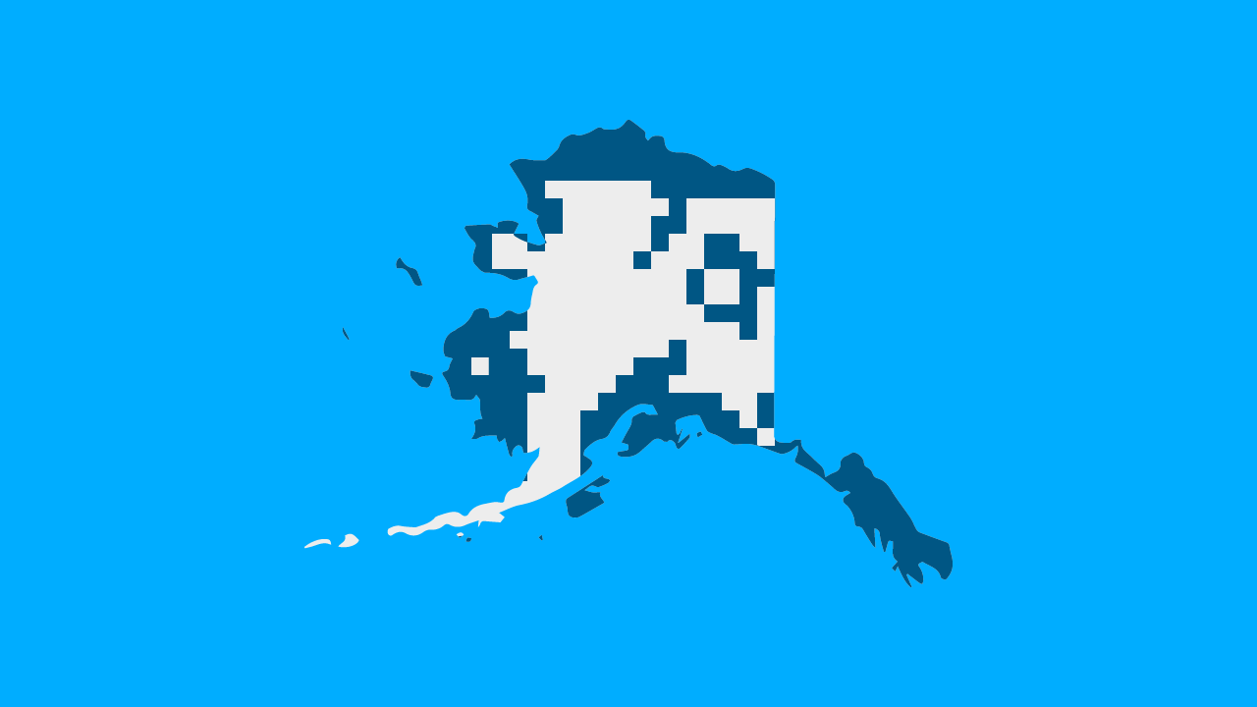
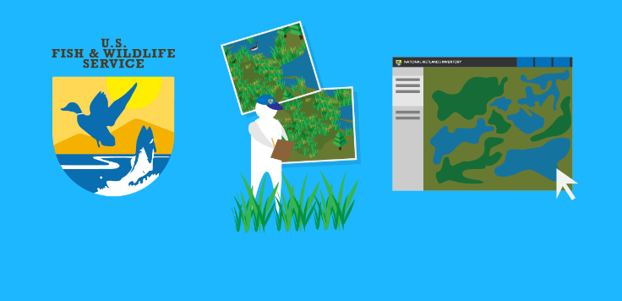
Community Concerns
Only one third of Alaska wetlands mapped
Important to monitor the extent, characteristics, and change of wetlands
Crucial ecosystems for plants and wildlife, inundation control and water quality
Adding SAR imagery to traditional mapping techniques
⅓ of Alaskan wetlands mapped
National Wetlands Inventory
Field Technicians & Optical Imagery
Wetlands Mapper
Image Credit: Alice Lin
Notes:
Speaker Notes:
Wetlands are very important ecosystems for humans and wildlife. In order to effectively protect wetlands, plan for emergency flooding events, and implement habitat conservation projects, it is important to know and study the extent, characteristics, and change in our nation’s wetlands. Currently, data on inundation of wetlands are collected through field technicians and aerial imagery, traditionally this is how the USFWS maps wetlands.
Radar backscatter is shown to be effective in detecting areas of inundated vegetation and can penetrate clouds - making it a good dataset to test and try to map inundation.
Image Source: Alice Lin (produced by team member)
Image Source: Alice Lin (produced by team member)

Slide 4
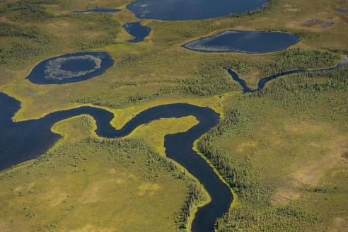
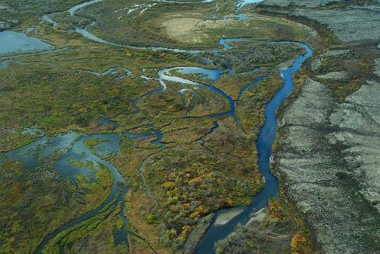
Project Partners
US Fish and Wildlife Service (USFWS), National Wetlands Inventory (NWI)
Megan Lang, Chief Scientist
Alaska Satellite Facility (ASF)
Jeremy Nicoll, Deputy Director
Franz Meyer, Chief Scientist
Kobuk River, Alaska Image Credit: US NPS
Bristol Bay, Alaska Image Credit: US EPA
Notes:
On this project, we worked with Megan Lang, Chief Scientist at the US Fish and Wildlife Service, National Wetlands Inventory. A national inventory of our nation’s wetlands. Only one third of Alaska is currently mapped and classified and Megan and the NWI were looking to automate and augment their mapping capacity.
We collaborated with the ASF, a facility that provides processed SAR data. We worked with the ASF to create an inundation algorithm and ultimately will add this inundation product to their current processing pipeline and capability.
Image Source: https://www.flickr.com/photos/75182224@N04/8029770506/ (public domain)
Image Source: https://www.flickr.com/photos/usepagov/6990838504/in/album-72157629587154514/ (U.S Government creative works)

Slide 5
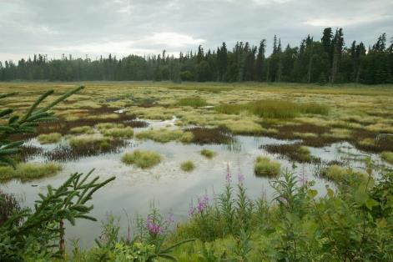
Objectives
Implement an algorithm to detect inundation extent in Alaska’s wetlands with Sentinel-1 C-SAR data
Validate algorithm using optical data
Integrate algorithm with Alaska Satellite Facility’s SAR processing tool, HyP3
Enhance the National Wetland Inventory’s mapping capability through efficient inundation map generation
Kenai, Alaska. Image Credit: US FWS
Notes:
Speaker Notes:
Our project objectives were to implement an algorithm to detect inundation extent with Sentinel-1 imagery in Alaska’s wetlands. Then to validate this inundation product with optical and field data. With this inundation product, we would augment the NWI’s mapping capacity and create maps of inundation.
Image Source: https://www.flickr.com/photos/usfws_alaska/5078517179 (CC BY-NC-ND 2.0)

Slide 6
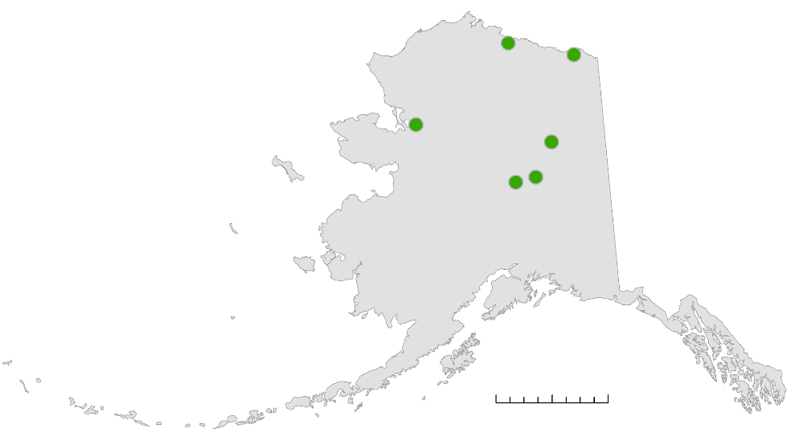
Study Area and Period
Crea Creek
Modeling site
Area 1002
NWI Project
Alaska
Study sites across different regions & types of wetlands
Time Period
June 2017 to September 2017
Selawik
NWI Project
Canvasback Lake
Potential NISAR cal/val site
Bear Lake
Goldstream Valley
Main algorithm testing site
Modeling site
0
125
250
500 km
Notes:
Speaker Notes:
To create and validate our algorithm we looked at 7 different study sites across Alaska, across a range of regions and wetland types. We focused on the Summer of 2017 at times with good overlap between our radar Sentinel-1 dataset and optical datasets. We used summer months to test inundation because Alaska wetlands freeze and become covered in ice and snow during much of the rest of the year.
We used Bear Lake as our main algorithm testing site. Selawik and Area 1002 are current active mapping areas for the National Wetlands Inventory, and our outputs can hopefully supplement their mapping. Crea Creek and Goldstream Valley are both modeling sites for the WaSIM model, which outputs information on hydrological processes.
And Canvasback lake is a potential NISAR cal/val site

Slide 7
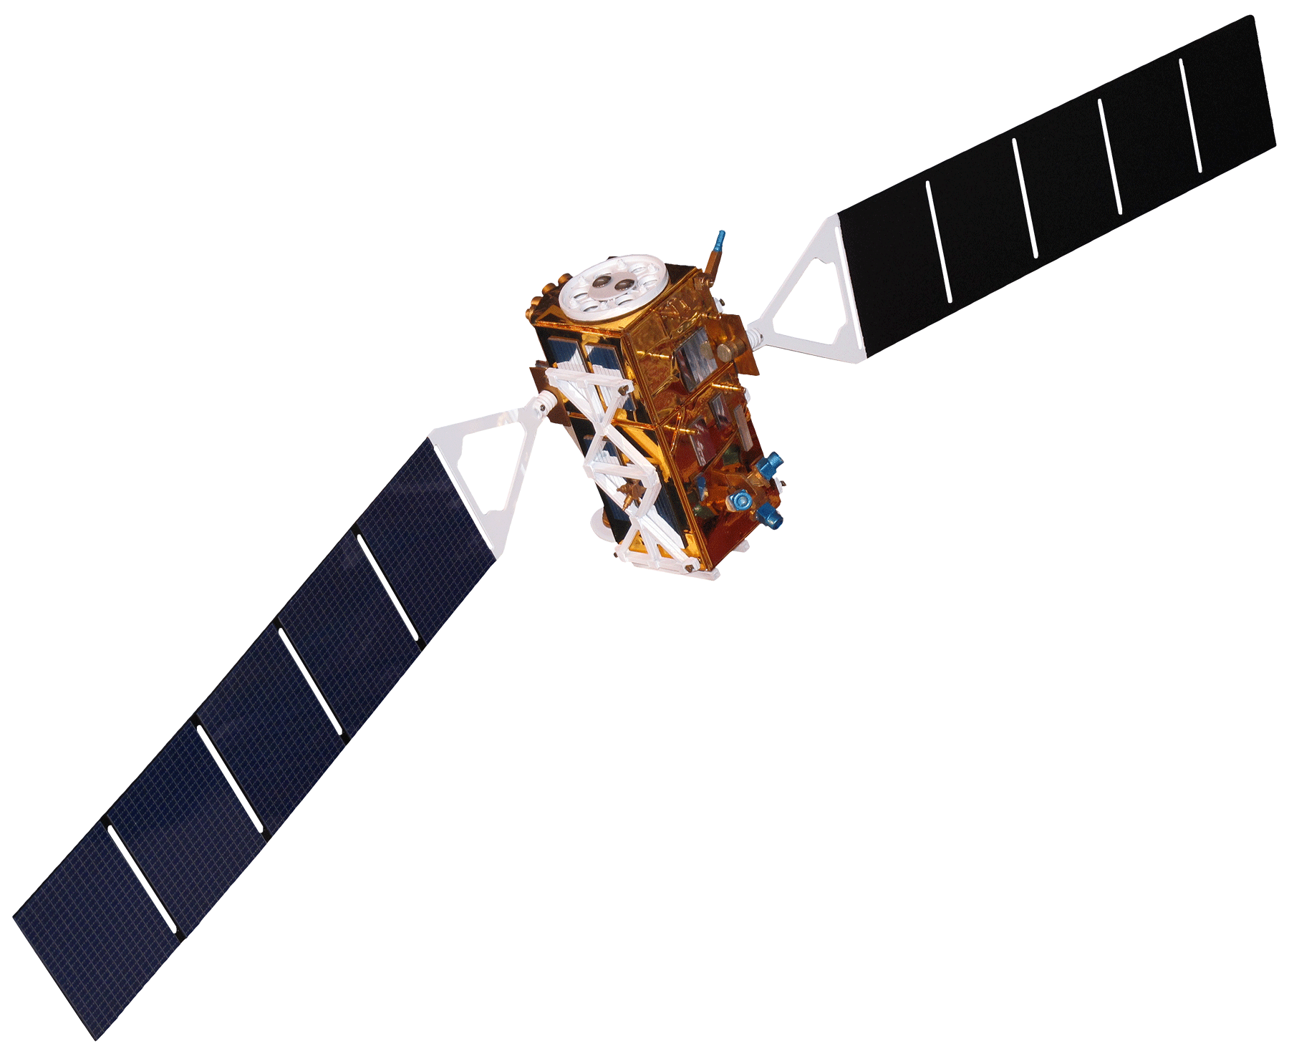
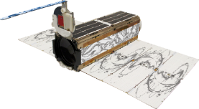
Earth Observations
Sentinel-1 C-SAR
Landsat 8 OLI
PlanetScope and RapidEye
Backscatter values
12 day return
10 meter resolution
Surface Reflectance
16 day return
30 meter resolution
Surface Reflectance
Varying temporal coverage
3 - 5 meter resolution
Notes:
Speaker Notes
our algorithm uses C-band SAR data from ESA’s Sentinel-1 satellite
we use optical imagery from NASA’s Landsat 8, Planet Labs’ PlanetScope and Rapid Eye to calibrate our thresholds and validate our outputs
https://en.wikipedia.org/wiki/Sentinel-1#/media/File:Sentinel_1-IMG_5874-white.jpg - Sentinel 1 (CC BY-SA 2.0 FR)
https://landsat.usgs.gov/sites/default/files/new_L8_1.png - Landsat 8 (public domain)
http://spaceflight101.com/pslv-c37/wp-content/uploads/sites/140/2017/02/3467077_orig-512x281.png - Planet Labs, Inc.

Slide 8
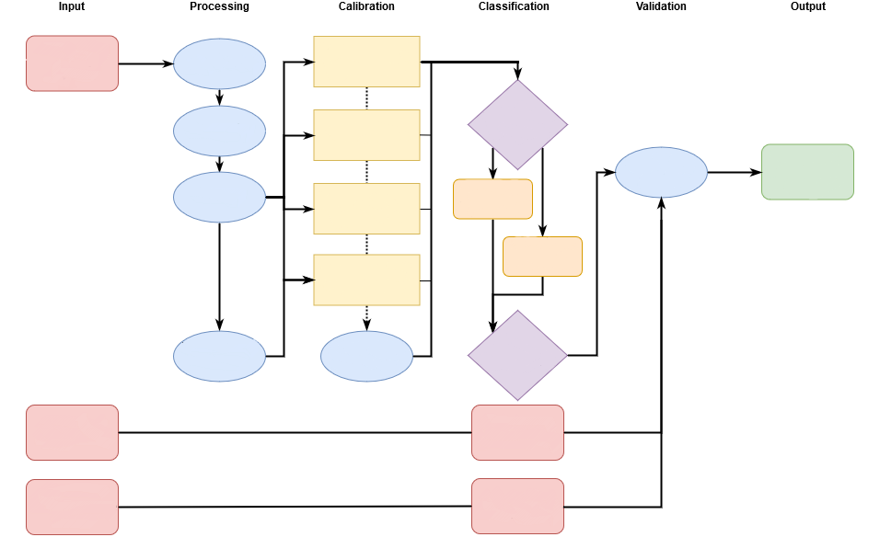
Methodology
Input
Processing
Calibration
Classification
Validation
Output
Sentinel - 1
C-SAR
VV VH
UTM Projection
Multi-Temporal
Mean Ratio
Image Coregistration
Thresholds
VV / VH
Ratio
Accuracy
Assessment
Wetland Inundation Map
Subset
Average Region
Brightness
Classification
Per Date
Multi-Temp
Classification
Average Pixel
Brightness
Multi-Temporal
Average
Refined
Classification
Calibrate
Landsat 8 OLI
DSWE
Classification
PlanetScope
Optical Data
Landcover
Classification
Use imagery or a workflow here.
Keep to a minimum.
The font should be easily readable (minimum 16 point font stated above).
text box as appropriate to your workflow.
Notes:
Speaker notes:
Sentinel 1 data was processed, calibrated, and classified using a Jupyter notebook that will be integrated into HyP3. We classified using thresholds, both multi-temporal averages and classifications per dae.
Landsat 8 was processed and classified using Google Earth Engine with an algorithm based on the work of John Jones (USGS) called DSWE, Dynamic Surface Water Extent.
PlanetScope data was processed and classified with NDWI thresholds and unsupervised classification

Slide 9
Jupyter Notebook
Used Python to create inundation mapping algorithm with thresholding and multi-temporal averages
Inputs: Sentinel-1 C-SAR imagery VV and VH polarization bands
Outputs: multi-temporal and single-date classifications
Image Credit: Jupyter Notebook interface
Notes:
We used Python 2. 7 in the Jupyter notebook to write and comment our code. We used this platform for its easy sharing and ease of adding comments and adding interactivity.
http://jupyter.org/

Slide 10
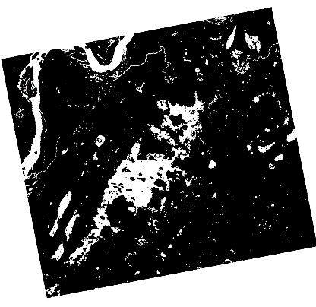
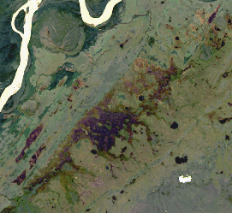
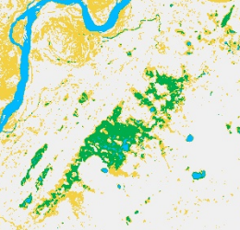
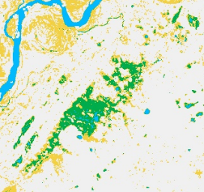
Google Earth Engine
Objective:
Generate inundation extent products from Landsat images
Based on Dynamic Surface Water Extent algorithm (John Jones, USGS)
Prepare products for accuracy assessments
RGB image
DSWE raw
DSWE filtered
Binary classification
not inundated
potential wetland
not inundated
open water
low confidence water/wetland
inundated
Notes:
Speaker Notes
We used Google Earth Engine to implement the DSWE (Dynamic Surface Water Extent Model). This model uses Landsat 8 OLI imagery and thresholds different indexes to distinguish between pixels of no inundation, open water, potential wetland, and low confidence wetland. Google Earth Engine can easily access and pull Landsat 8 imagery, making it an efficient way to apply the model across large areas in Alaska. We then converted DSWE output to binary for better comparison to SAR classifications.

Slide 11
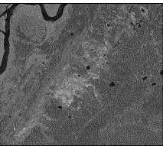
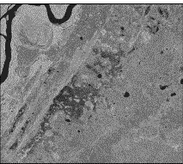
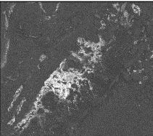
Finding Typical Inundation:
SAR Multi-Temporal Classifications
Multi-Temporal Average of Sentinel-1 C-SAR
Multi-Temporal Average Classification
June 12 2017 - September 28, 2017
Using VV, VH, VV/VH Thresholds
VV Polarization
VH Polarization
high
Inundated vegetation
low
Not inundated
VV/VH Ratio
Open water
Bear Lake, Alaska
Notes:
Speaker Notes
To find typical inundation at a wetland site, we classified multi-temporal averages of SAR imagery. On the right you can see the multi-temporal averages from June to September 2017 in the VV and VH polarizations and their ratio. The brighter areas indicate higher backscatter. Then to get the classification on the left, the algorithm uses VV, VV, and VV/VH brightness thresholds to separate into inundated vegetation, open water, and not inundated areas.
** CHANGE AVERAGE CLASSIFICATION COLOR GRADIENT

Slide 12
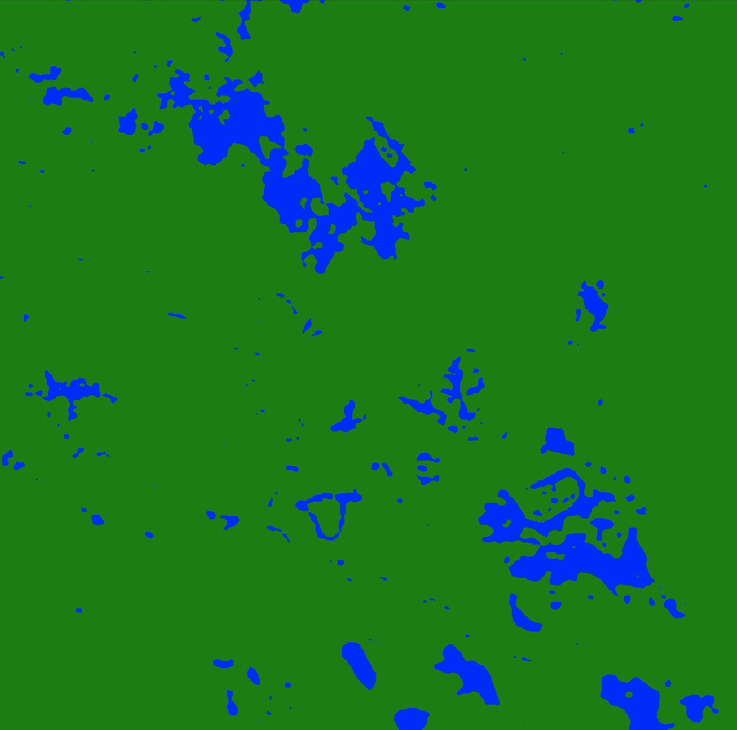
SAR Multi-Temporal Classifications
Bear Lake
Canvasback Lake
Crea Creek
Inundated vegetation
0 2.5 5 10 km
0 2.5 5 km
0 1.5 3 km
Not inundated
Goldstream Valley
Selawik
Open water
0 1 2 4 km
0 5 10 20 km
Notes:
Speaker Notes
These are the 5 study sites we focused on this term with the output “typical inundation” for the summer of 2017, or the multi-temporal average.
In the end Bear Lake, our main testing site, and Selawik would be the ”most successful”
Crea images had co-registration errors
Canvasback Calibration errors?
Goldstream valley turned out to be just smaller bodies of water
** CHANGE COLOR GRADIENT TO 3 CLASSES (EXCLUDE UNCLASSIFIED)

Slide 13
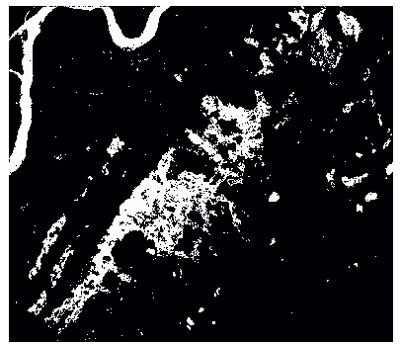
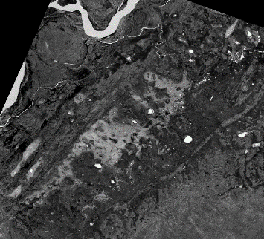
Bear Lake
SAR Single-Date Classification
Sentinel-1 C-SAR
7/6/2017
Landsat 8 OLI DSWE
7/6/2017
RapidEye NDWI
7/7/2017
Image Credit: Planet Labs Inc.
not inundated
not inundated
not inundated
inundated
(open water + inundated vegetation)
inundated
(open water + inundated vegetation)
inundated vegetation
open water
Notes:
Speaker Notes
This is Bear Lake again, the main site we used to test our algorithm. This is a single-date classification from July 7th 2017.
On the left is the binary classification of SAR (where we aggregated open water and inundated into one class), compared to Landsat DSWE, and RapidEye NDWI (normalized difference water index) where brighter values have more water.
RapidEye Image Source: Planet Labs, Inc. Planet Team (2018). Planet Application Program Interface: In Space for Life on Earth. San Francisco, CA. https://api.planet.com.

Slide 14
Accuracy Assessment
Bear Lake Single-Date Classification
Ground Truth = Landsat 8 DSWE July 6, 2017
Comparison = Sentinel-1 C-SAR Classification July 6, 2017
Overall agreement: 94.54%
 | Landsat 8 DSWE
 | Non Inundated | Inundated
Non Inundated | 95.9% | 17.9%
Inundated | 4.1% | 82.2%
Higher overall agreement between non-inundated areas than for inundated areas.
The SAR classifications classified less areas as inundated than Landsat DSWE
SAR Classification
Notes:
Speaker Notes
Discuss results of confusion matrices.
Discuss any trends and results of validations.
in absence of ground truth data, we relied on optical data for validation purposes
Errors of omission = classes left out of SAR in comparison to DSWE
Errors of commission = classes incorrectly classified

Slide 15
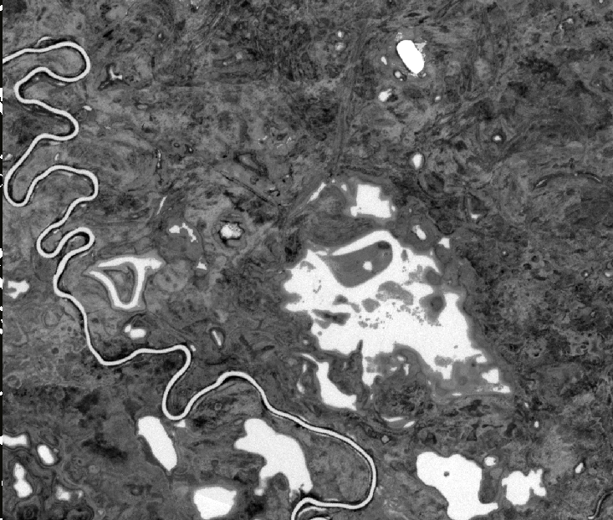
Canvasback Lake
SAR Single-Date Classification
Sentinel-1 C-SAR
6/12/2017
Landsat 8 OLI DSWE
6/4/2017
RapidEye NDWI
6/14/2017
Image Credit: Planet Labs Inc.
not inundated
not inundated
not inundated
inundated
(open water + inundated vegetation)
inundated
(open water + inundated vegetation)
inundated vegetation
open water
Notes:
Speaker Notes
This is a single-date classification from June 12th 2017. Here, the Landsat 8 and RapidEye are a little further apart in date, which highlights the problem of finding sufficient dates cloudless optical imagery. This is one advantage of SAR in Alaska that it can capture data regardless of time of day or weather, something that can be difficult for optical imagery in a place like Alaska.
On the left is the binary classification of SAR (where we aggregated open water and inundated into one class), compared to Landsat DSWE, and RapidEye NDWI (normalized difference water index) where brighter values have more water.
RapidEye Image Source: Planet Labs, Inc. Planet Team (2018). Planet Application Program Interface: In Space for Life on Earth. San Francisco, CA. https://api.planet.com.

Slide 16
Accuracy Assessment
Canvasback Lake Single-Date Classification
Ground Truth = Landsat 8 DSWE June 4, 2017
Comparison = Sentinel-1 C-SAR Classification June 12, 2017
Overall agreement: 88.08%
 | Landsat 8 DSWE
 | Non Inundated | Inundated
Non Inundated | 96.77% | 59.77%
Inundated | 3.23% | 40.23%
Higher overall agreement between non-inundated areas than for inundated areas.
The SAR classifications omitted the river, possibly due to multi-look pixel smoothing
SAR Classification
Notes:
Speaker Notes
Discuss results of confusion matrices.
Discuss any trends and results of validations.
in absence of ground truth data, we relied on optical data for validation purposes
Errors of omission = classes left out of SAR in comparison to DSWE
Errors of commission = classes incorrectly classified

Slide 17
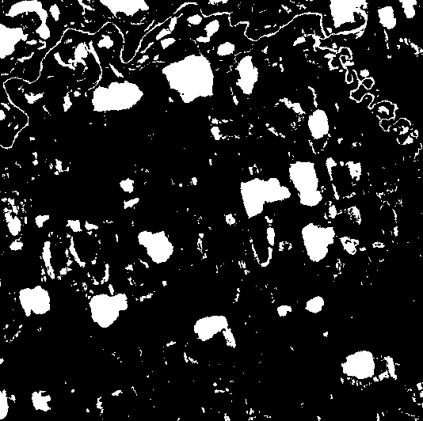
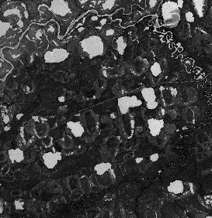
Crea Creek
SAR Single-Date Classification
Sentinel-1 C-SAR
7/4/2017
Landsat 8 OLI DSWE
7/9/2017
RapidEye NDWI
7/7/2017
Image Credit: Planet Labs Inc.
not inundated
not inundated
not inundated
inundated
(open water + inundated vegetation)
inundated
(open water + inundated vegetation)
inundated vegetation
open water
Notes:
Speaker Notes
Co-registration errors in SAR imagery
RapidEye Image Source: Planet Labs, Inc. Planet Team (2018). Planet Application Program Interface: In Space for Life on Earth. San Francisco, CA. https://api.planet.com.

Slide 18
Accuracy Assessment
Crea Creek Single-Date Classification
Ground Truth = Landsat 8 DSWE July 9, 2017
Comparison = Sentinel-1 C-SAR Classification July 4, 2017
Overall agreement: 89.03%
 | Landsat 8 DSWE
 | Non Inundated | Inundated
Non Inundated | 92.4% | 31.4%
Inundated | 7.66% | 68.6%
Higher overall agreement between non-inundated areas than for inundated areas.
The SAR classifications captured less of river and included more inundation in borders of open water.
SAR Classification
Notes:
Speaker Notes
Discuss results of confusion matrices.
Discuss any trends and results of validations.
in absence of ground truth data, we relied on optical data for validation purposes
Errors of omission = classes left out of SAR in comparison to DSWE
Errors of commission = classes incorrectly classified

Slide 19
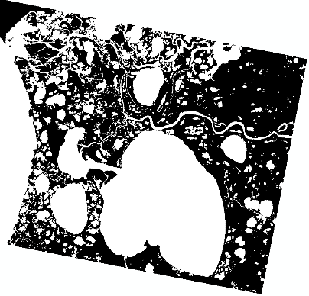
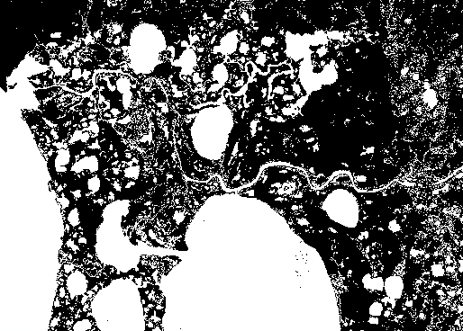
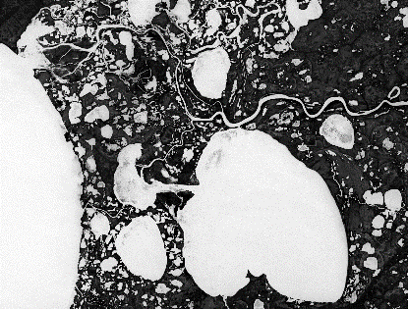
Selawik
SAR Single-Date Classification
Sentinel-1 C-SAR
7/16/2017
Landsat 8 OLI DSWE
7/21/2017
RapidEye NDWI
7/7/2017
Image Credit: Planet Labs Inc.
not inundated
not inundated
not inundated
inundated
(open water + inundated vegetation)
inundated
(open water + inundated vegetation)
inundated vegetation
open water
Notes:
Speaker Notes
This is Selawik, an NWI active site.
RapidEye Image Source: Planet Labs, Inc. Planet Team (2018). Planet Application Program Interface: In Space for Life on Earth. San Francisco, CA. https://api.planet.com.

Slide 20
Accuracy Assessment
Selawik Single-Date Classification
Ground Truth = Landsat 8 DSWE July 21, 2017
Comparison = Sentinel-1 C-SAR Classification July 16, 2017
Overall agreement: 83.2%
 | Landsat 8 DSWE
 | Non Inundated | Inundated
Non Inundated | 93.2% | 24.9%
Inundated | 6.7% | 75.1%
Higher overall agreement between non-inundated areas than for inundated areas.
The SAR classifications included fewer areas as inundated.
SAR Classification
Notes:
Speaker Notes
Discuss results of confusion matrices.
Discuss any trends and results of validations.
in absence of ground truth data, we relied on optical data for validation purposes
Errors of omission = classes left out of SAR in comparison to DSWE
Errors of commission = classes incorrectly classified

Slide 21
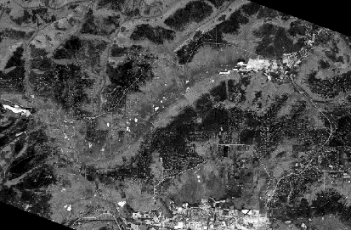
Goldstream Valley
SAR Single-Date Classification
Sentinel-1 C-SAR
6/12/2017
Landsat 8 OLI DSWE
6/13/2017
RapidEye NDWI
7/6/2017
Image Credit: Planet Labs Inc.
not inundated
not inundated
not inundated
inundated
(open water + inundated vegetation)
inundated
(open water + inundated vegetation)
inundated vegetation
open water
Notes:
Speaker Notes
not a very exciting site. We classified Goldstream to complement another researcher’s model outputs. However, can see that there just appears to be mostly smaller bodies of open water.
RapidEye Image Source: Planet Labs, Inc. Planet Team (2018). Planet Application Program Interface: In Space for Life on Earth. San Francisco, CA. https://api.planet.com.

Slide 22
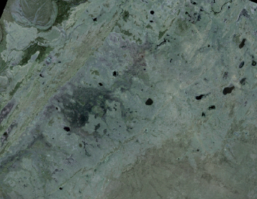
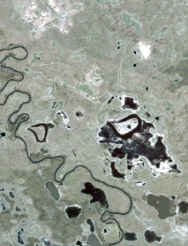
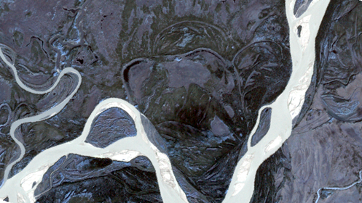
Conclusions
SAR classifications varied in agreement with Landsat and Planet classifications. Co-registration and calibration errors may contribute.
Compared to Landsat 8 DSWE, SAR generally underestimated inundation extent.
Landsat 8 OLI and Planet were limited by cloud cover and detection of inundation below canopy cover, but were helpful for validating Sentinel-1 C-SAR classifications.
Image Credit: Planet Labs Inc.
Notes:
Speaker Notes:
SAR effectively mapped wetland inundation, with its sensitivity to water and reliable data collection on cloudy days
Sentinel-1 incidence angle impacted inundation classification
Landsat 8 OLI and Planet were limited by cloud cover and detection of inundation below vegetation and canopy cover, but were helpful for validating Sentinel-1 C-SAR classifications
Image Source: Planet Labs, Inc. Planet Team (2018). Planet Application Program Interface: In Space for Life on Earth. San Francisco, CA. https://api.planet.com.

Slide 23
Errors & Uncertainties
Sentinel-1 calibration and image co-registration
Lack of ground truth data
Winter conditions of snow and ice
Impacts of Sentinel-1 incidence angle
?
?
?
Image Credit: Alice Lin
Notes:
Speaker Notes:
Winter conditions in Alaska such as snow and ice can not be used with this product
The angle of Sentinel-1 may affect backscatter values on certain images
Sentinel-1 calibration errors
Image Source: Alice Lin (made by team member)

Slide 24
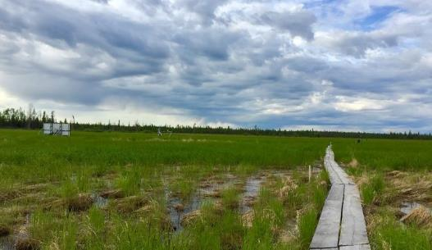
Future Work
Calibrate algorithm with ground data and ancillary datasets
Automate class thresholding
Integrate product with ASF’s SAR Processing Pipeline (HyP3)
Forecast modeling of wetland extent
Image Credit: Franz Meyer
Notes:
Continue validating the algorithm with more validation sites and apply inundation product to further sites in Alaska
Evaluate and find thresholds for different wetland types (forested, marsh, tundra etc)
Incorporate product with ASF’s SAR Processing Pipeline (HyP3)
Utilize product to augment NWI mapping efforts
Forecast modeling of wetland extent, as opposed to just inundation
Image Source: Franz Meyer (provided by partner)

Slide 25
Acknowledgements
Science Advisor
Bruce Chapman, Jet Propulsion Laboratory
Project Partners
Megan Lang, USFWS National Wetlands Inventory
Jeremy Nicoll, Alaska Satellite Facility
Franz Meyer, Alaska Satellite Facility
RapidEye and PlanetScope imagery courtesy of Planet Labs, Inc.
Notes:
Thank advisor, partners etc.
Planet Labs, Inc. Planet Team (2018). Planet Application Program Interface: In Space for Life on Earth. San Francisco, CA. https://api.planet.com.

