Slide 1
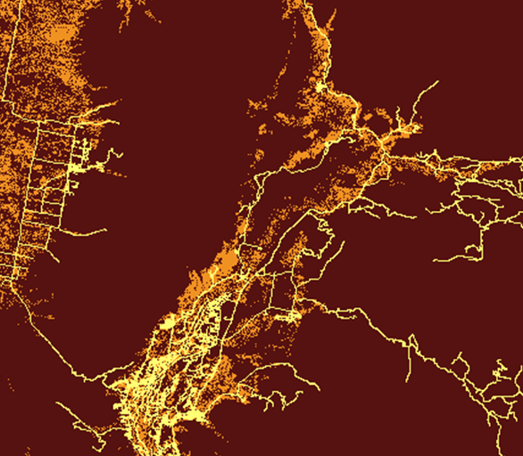
Arina Mardoukhi (Project Lead)
INTERMOUNTAIN WEST ECOLOGICAL FORECASTING
Paul Bushman
Caitlin Toner
Using NASA Earth Observations to Identify Current Habitat Areas and Forecast Habitat Suitability for the Yellow-Billed Cuckoo in Semiarid Environments
Courtney Ohr
BLM at Idaho State University GIS TReC
2017 Spring
Notes:
Hi I’m Arina let me introduce you to our team:
I am the project lead
Paul Bushman:
Caitlin Toner : NASA’s communications fellow
Courtney Ohr : our center lead
Lets talk about the western Yellow-billed Cuckoo (YBC) Habitat.

Slide 2
Introduction
Species of concern: yellow-billed cuckoo
Riparian habitat at risk
Semi-arid region and limited resources
Image Credit: Tamara Srader
Notes:
On the left side of this slide we can see a western YBC. The western yellow-billed cuckoo was once common along streams and rivers in the intermountain west, however due to habitat loss the population has been in decline. Due to the decline, western yellow-billed cuckoo’s western population was recently listed as a threatened species. (Dettling et al., 2015). The listing has brought increased attention to studying and conserving the bird, but the bird can be difficult to observe.
The needs of YBCs are hard to find in semi-arid region.
Image Source:
https://www.flickr.com/photos/justabirdthing/14390020449/

Slide 3
Community Concerns
Difficult to find
Limited survey observations
Short breeding period
Not known to repeat nesting sites
Costly and time consuming
Image Credit: USFWS Mountain-Prairie
Notes:
We don’t have much information on YBC population numbers because they are difficult to identify. Over the past forty years there has been less than 300 total observations of the western Yellow-billed cuckoo. In addition to declining populations, there are a few other factors of why they are hard to observe. The yellow-billed cuckoo is a migratory bird and has been reported to travel up to 94 kilometers a day from egg laying to fledging. The cuckoo’s large range makes difficult to pinpoint where the bird is. Nesting season is the best time to see them, but breeding may only last seventeen days from egg laying to fledging. Additionally, YBC tend not to repeat nesting sites.
Many sightings of the YBC is due to chance. Efforts to go into the field and document the bird can be costly and time consuming.
94km: https://www.usbr.gov/uc/feature/yb-cuckoo/
17 days nesting season: https://www.nps.gov/articles/western-yellow-billed-cuckoo.htm
This has shown the need for further conservation efforts. Spatial modeling of suitable habitat and areas of low quality but restorable habitat will give site specific information to guide land management agencies on how they can manage more effectively for the Yellow-billed cuckoo.
Image source:
https://www.flickr.com/photos/usfwsmtnprairie/9241477995/in/photolist-f5CZrv-f5DkFR-f5TB67-ishEqE-ishjT1-ishD41-ishXCx

Slide 4
Project Goals
Habitat suitability model
Habitat suitability maps
Habitat Change maps
Ecological Forecast maps
Image credit: Matt Evans
Notes:
Currently our partners rely on field surveys to document the locations of YBC nesting areas, which is expensive, time consuming and needs experts knowledge. However, remote sensing and satellite imagery processing are low cost approaches to detect YBCs suitable habitat areas. Therefore, our main objectives were to use GIS and remote sensing techniques to build a model that can detect YBC habitat map. In addition, we created habitat change maps and an ecological forecasting map for the next two decade.
Image Source:
https://www.flickr.com/photos/mevans3/9624728993/

Slide 5
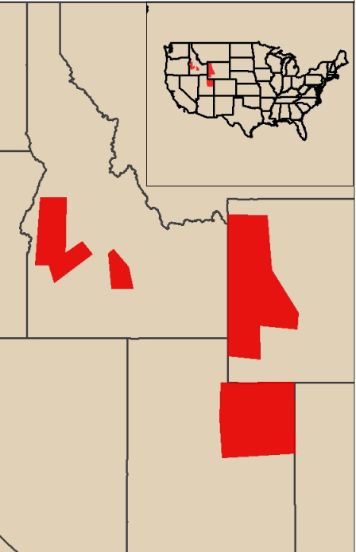
Study Area
Intermountain West Study Areas:
Central and Western Idaho around Boise
Western Wyoming
Uinta Mountains and Uinta Basin in Utah
Idaho
Wyoming
Utah
Image Source: ESRI ArcGIS Online
Notes:
Over the past couple of years, wildlife decision makers have tried to preserve suitable YBC habitat areas. Therefore, our partners in Idaho, Utah, and Wyoming are interested in YBC suitable habitat map. So, on the left side we can see our study areas in red.

Slide 6
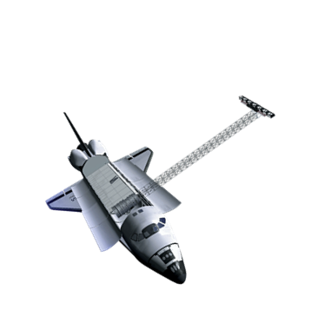
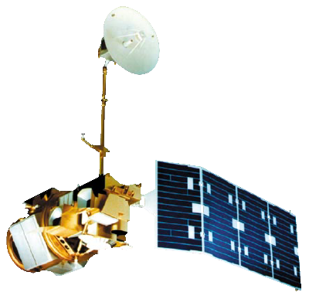
NASA Satellites & Software Used
Landsat 8 OLI and Landsat 5
Shuttle Rada Topography Mission (SRTM)
ArcMap
TerrSet IDRISI
Image Credit: NASA
Notes:
To create our YBC suitable habitat model:
1. We used Landsat 8 and 5 for spectral bands and SRTM for the topography component.
2. We also utilized ArcMap 10.4 and TerrSet IDRISI to create our model and the predicted map.

Slide 7
Method
Close to cottonwood willow, low elevation, low slope
Away from roads and recent wildfires
Variables
Variable
Windowed and atmospherically corrected images in IDRISI
Created NDVI composites in IDRISI
Identified variable thresholds with ArcMap ModelBuilder
Predicted future suitability habitats in TerrSet
Process
Process
Habitat suitability map for year 2003 and 2016
Change map in habitat suitability from 2003 to 2016
Eco-forecasting map for year 2030
Output
Notes:
This is the simplified workflow.
We began with Landsat 8 scenes for all three states to make a suitable habitat model and maps. We reviewed previous literature and came up with specific threshold for each variables. Elevation threshold was 6,000 feet for Idaho and Utah. It was also 6900 ft for Wyoming. YBC habitat shows that this specie want a flat area so we assigned less than 20% slope regions as suitable ones. In addition, Cottonwood and willow are the two main habitat resources. Loud noise and fire also can destroy their ideal environment.
We processed all those variables and made a model in ArcMap Model Builder. The output of our processes created habitat suitability maps, habitat suitability change maps, and forecasting maps.

Slide 8
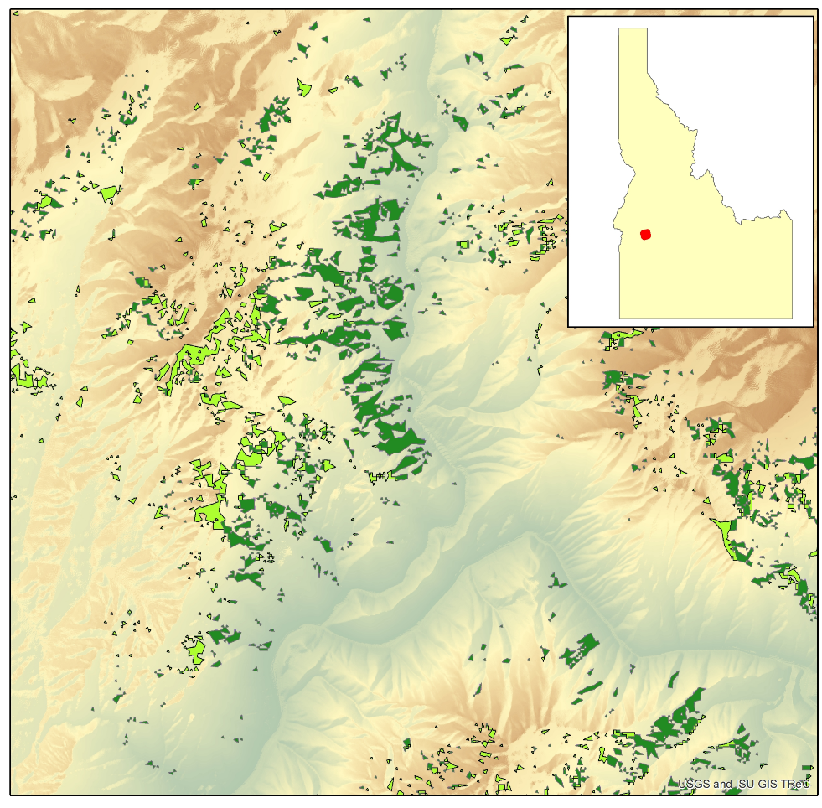
Habitat Suitability Maps
Map Elements
Displayed Extent
Foraging Habitat
Nesting Habitat
Elevation
Low: 195
High: 4198
Notes:
The suitable habitats are shown in green. They are in small fragments across the region which reflects the limitations of finding suitable habitat in the area.
The first products we developed were created to identify areas that are suitable habitats for the yellow billed-cuckoo. We used the variables we identified from the literature and put them into models for each study area in arcmap. These maps identify areas that we feel are suitable nesting habitat, improvable habitat, possible migratory or foraging habitat, and habitat that doesn’t meet enough conditions to expect an observation of a yellow-billed cuckoo.

Slide 9
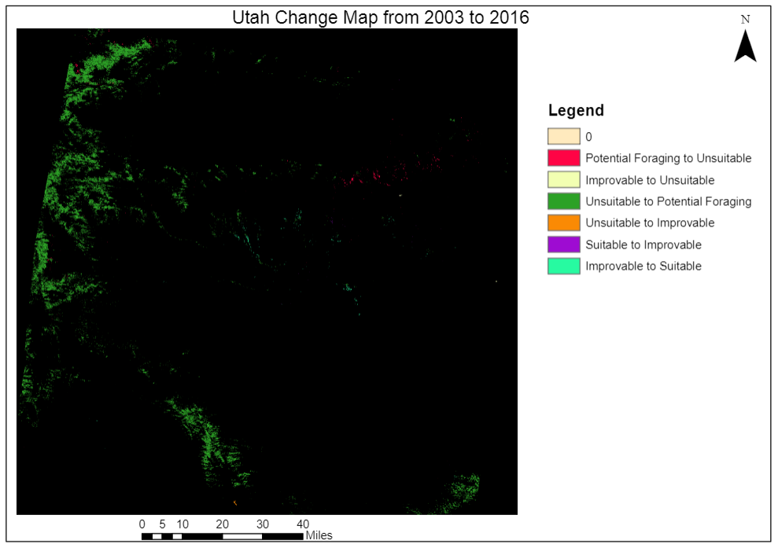
Suitability Change Maps
0
Potential Foraging to Unsuitable
Improvable to Unsuitable
Unsuitable to Potential Foraging
Unsuitable to Improvable
Suitable to Improvable
Improvable to Suitable
Notes:
In order to see how suitability has changed over time, we looked at years approximately 15 years in the past. We chose years for each study area that had a similar precipitation profile to represent similar vegetation so that we weren’t comparing a very dry year or a very wet year against the most recent 2016 maps we created. We wanted years with similar growing seasons because they would most likely have similar vegetation to compare against.
For change maps we saw an increase in suitable habitat from 2003 to 2016 for Utah and 2001 to 2016 for Idaho. This went against our assumption that there would be a decrease in habitat, so we wanted to investigate it further. We realized that Landsat 5, the satellite used for the early 2001 and 2003 years, had different NDVI values than Landsat 8, the satellite used for 2016. Landsat 8 collects higher NDVI values, so this could affect our results by falsely suggesting there has been a strong increase in vegetation.

Slide 10
Limitations
Limited vegetation maps for habit delineation
Limited presence/absence data for study areas
Limitations on habitat predictions
Ecosystems are dynamic (place holder)
Landsat 5 and Landsat 8 show different NDVI levels
Notes:
To improve the model, real world data is needed for calibration and testing but due to the limited number of observations of the Yellow-billed Cuckoo throughout the Intermountain West very little information on current suitable habitat is available.
Also, there are limitations on the ecological forecasting due to dams and strict water management practices. Cottonwoods require periodic flooding in order to allow new growth, and any new dams created or removed in the study area between our selected time frames may result in our model showing lesser or greater growth than what has actually happened.
The change map and ecoforecasting maps were strongly compromised due to the different NDVI values in Landsat 5 and Landsat 8. We hope to better understand the difference between these two so that we can improve our calculations.
We want to use Pheno-calc to show us the 2003 and 2016 precipitation data to see if there is a big difference in growing seasons for those years . That way we could know if we just chose an incorrect year to compare against or if it is the differences caused by the satellites.

Slide 11
Conclusions
NASA Earth Observations can be used for determining suitable habitat for threatened or endangered species when ground data are scarce
Habitat change maps can identify areas where management has been successful and those in need of more attention
Habitat prediction can help determine areas that are the most in need of attention
Notes:
In Conclusion we found that suitable habitat can be located using NASA Earth observations. They can also be used to indicate areas where habitat is declining or where habitat has been increasing.

Slide 12
Future Work
Have more survey data to further validate the model
Including canopy layers using LiDAR
Include higher resolution imagery such as sentinel-2
Create a more user-friendly tool
Adjust NDVI values with respect to the Earth observation
Image Source: Kenneth Freeman
Notes:
Validation
LiDAR inclusion
Higher resolution data
Design a better tool
Include ecological factors such as patch size & width, habitat cooridors, and habitat fragmentation to further refine the most suitable habitat.
Image source:
https://www.flickr.com/photos/kencf0618/3767414911/

Slide 13
Project Partners
Evan Ohr, US Fish and Wildlife Service – Eastern Idaho Field Office
Patricia Sweanor, US Fish and Wildlife Service – Wyoming Ecological Services Field Office
Amy Defreese, US Fish and Wildlife Service – Utah Ecological Services Field Office
Scott Bergen, Idaho Department of Fish and Game – Southeast Regional Office
Becky Abel, Idaho Department of Fish and Game – Southeast Regional Office
Notes:
We would like to thank our project partners for the valuable knowledge, advise and assistance throughout this project.

Slide 14
Science Advisors
Keith Weber, Lead Science Advisor (GIS Training and Research Center at Idaho State University)
Mark Carroll, NASA GSFC
Chuck Peterson, Idaho State University
Notes:
Also, we would like to thank the science advisors for their insight and help throughout the term.

