Slide 1
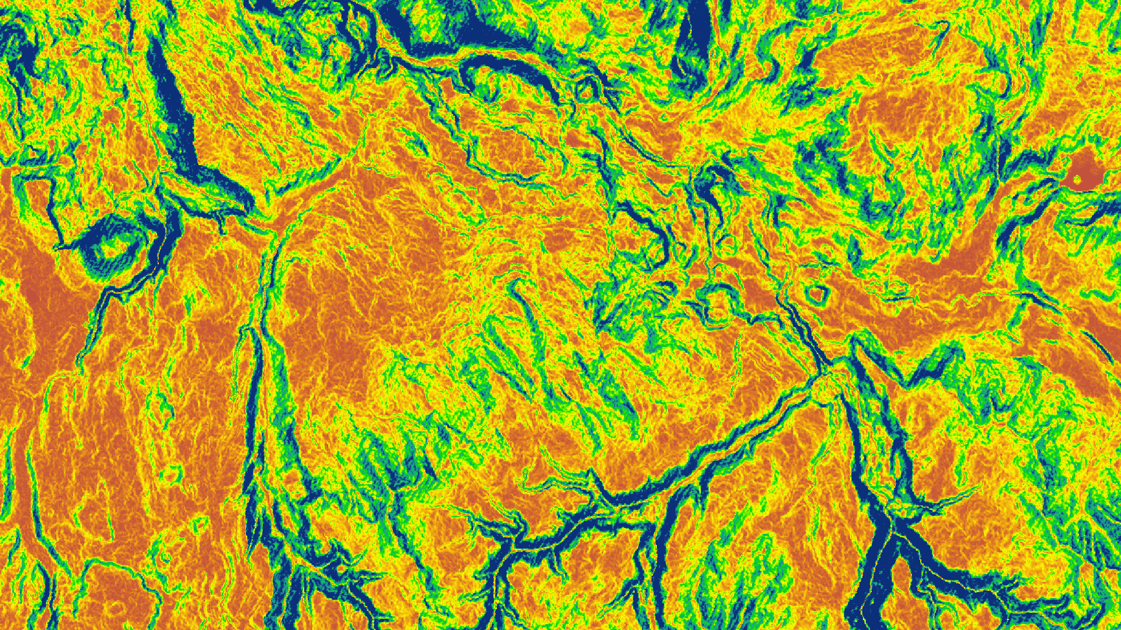


YELLOWSTONE
ECOLOGICAL FORECASTING
Identifying Spatial and Temporal Patterns of Early-Season Invasive Grasses in Yellowstone National Park by Incorporating NASA Earth Observations
Man Kumari Giri
Audrey White
Zhe Wang
Virginia – Wise
Fall 2017

Slide 2
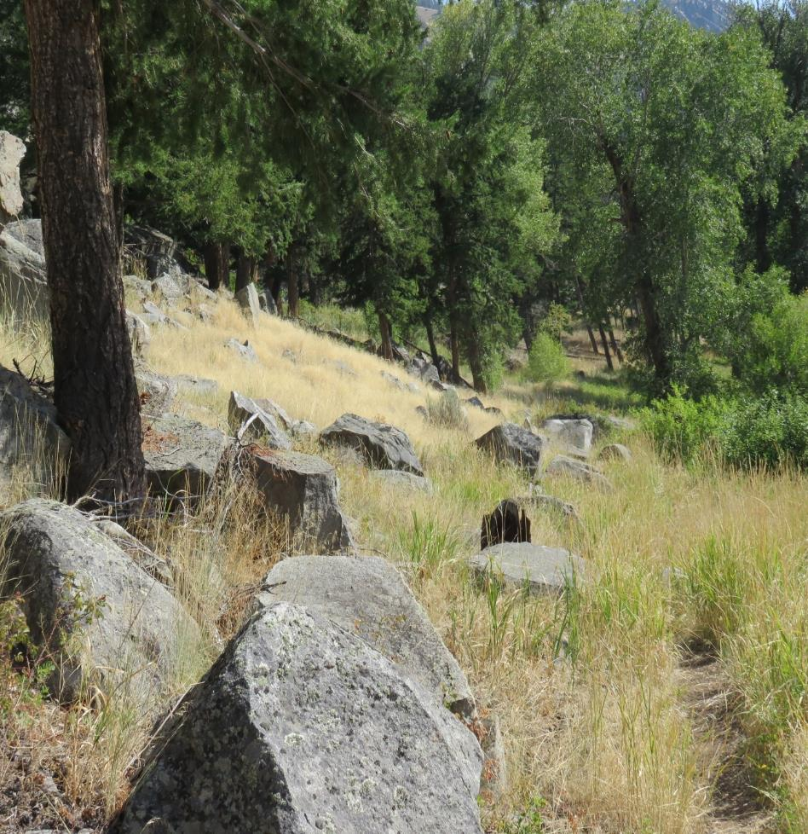
Community Concerns
Fires and disturbances in Yellowstone National Park have led to an increase in susceptibility to annual early season grass invasion.
Areas with high populations of early season invasive species have an increased fire risk.
Early season invasive grasses outcompete endemic species leading to lower biodiversity.
Image Credit: NPS
Notes:
Early-season invasive annual grass species, referred to as ESI hereafter, are widely distributed across the western United States. Accelerated in growth by climate change and human disturbance, early germination and shallow, nitrogen-fixing, root systems allows ESI species to outcompete endemic grass and forb species.
Community Concerns (slide 2):
Recent fires and disturbance due to park expansion and visitor use has rendered Yellowstone National Park highly susceptible to continued early season invasion, as well as increased fire frequency and severity in areas populated by these grasses, as many are flammable in nature such as cheatgrass. Competition between early season invasive and endemic species leads to lower biodiversity and possible changes in the ecology of the landscape and fire regime, ultimately affecting wildlife populations, such as bison, bighorn sheep, and elk that are dependent upon native flora.

Slide 3
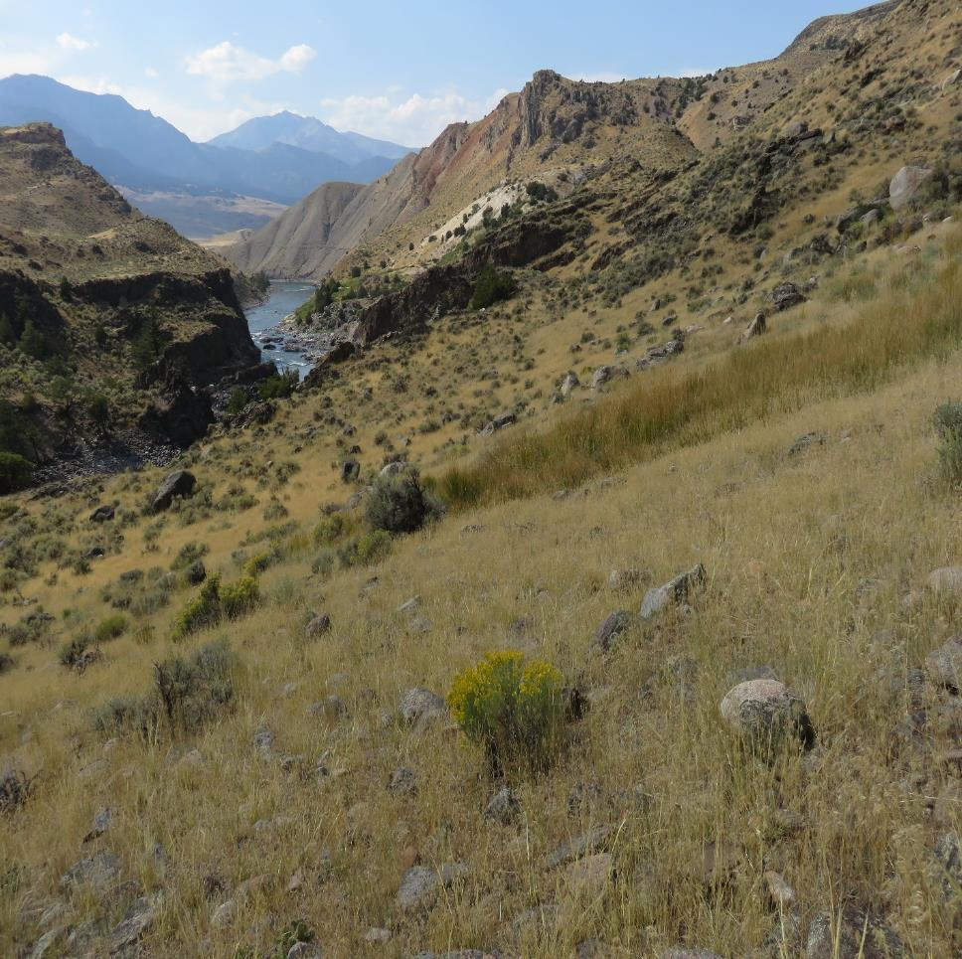

Partners and Objectives
Partner: National Park Service
at Yellowstone National Park
Objectives:
  Identify the spatial and temporal progression of the ESI species in Yellowstone National Park
  Forecast the progression of ESI species up to 2050 based on future climatic conditions
Image Credit: NPS
Notes:
The Yellowstone Ecological Forecasting team partnered with the National Park Service at Yellowstone National Park with the goal in mind to map early season invasive (ESI) species inside Yellowstone National Park. The main objectives of this project were to generate a Cover Time Series Map showing the spatial and temporal distribution of ESI species from 1985 to 2017 and to generate the bioclimatic Forecasting Map that will allow our partners to track the future progression of the ESI species to the year 2050 based on projected climatic conditions.

Slide 4
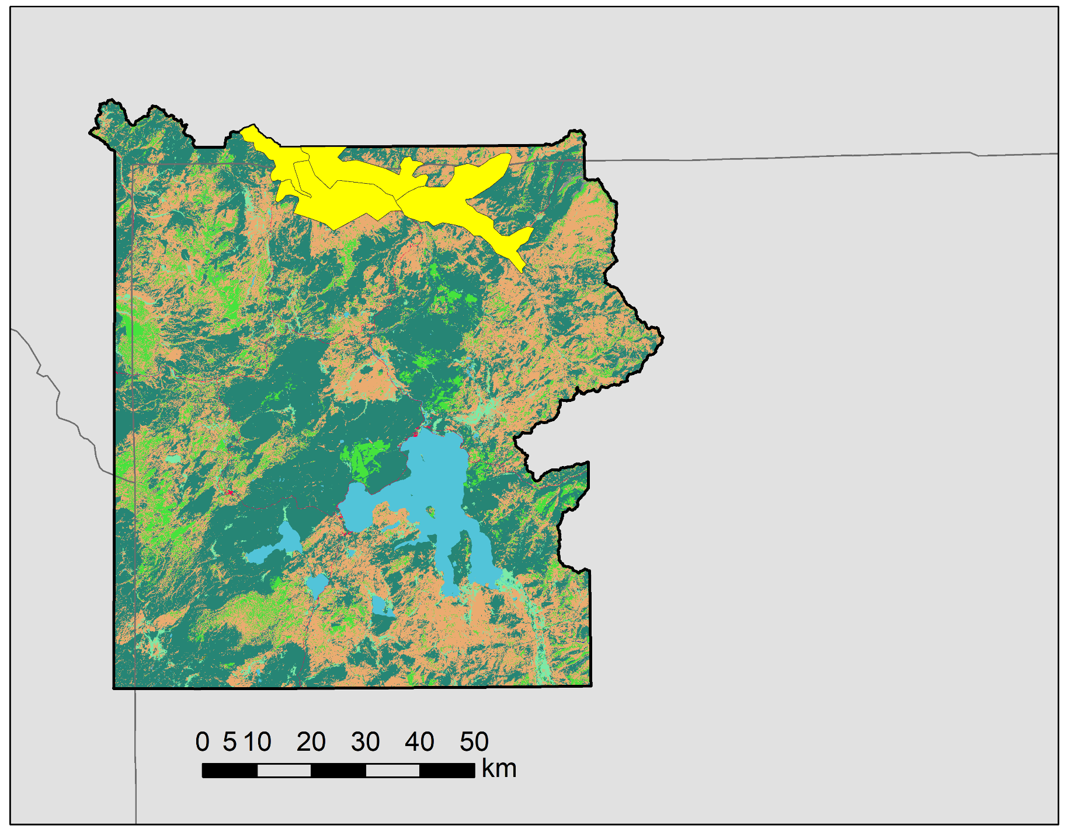
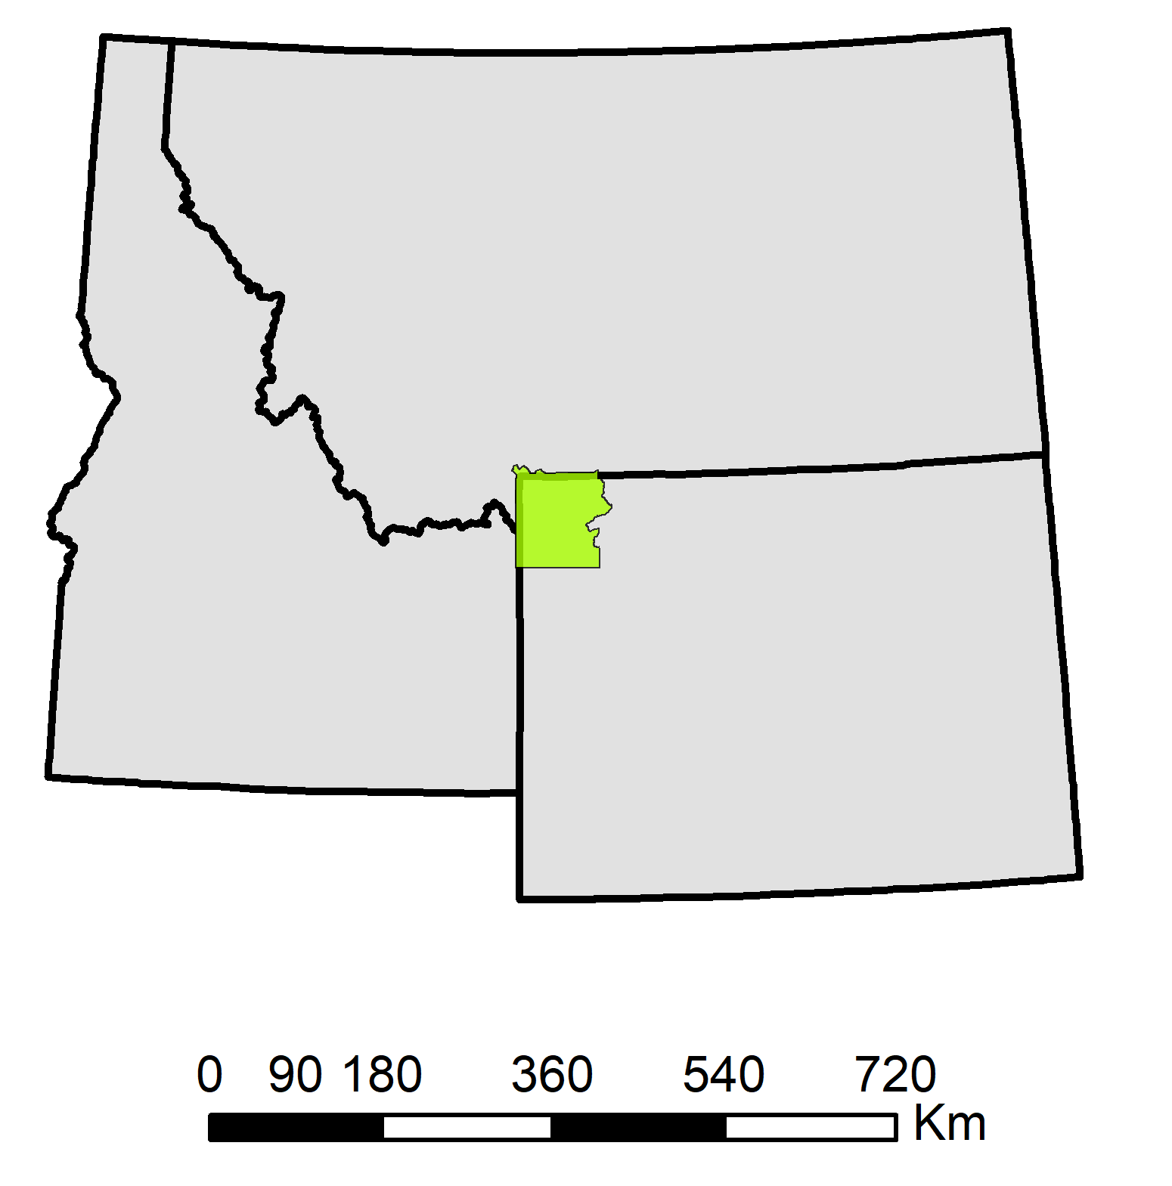
Study Area and Period
Study Period:1985 - 2017; Forecasting to 2050
Yellowstone National Park Land Cover (NLCD 2011)
MT
Land Cover
ESI Zones
Park Boundary
State Boundary
MT
WY
Open Water
Ice/Snow
Developed
ID
ID
Barren
WY
Forest
Shrub/Scrub
Grassland
Pasture
Wetlands
Notes:
As previously stated, Yellowstone National Park located mostly in Wyoming is the study area for this project. The park expands 9000 square Kilometers across three congressional districts. Yellowstone National Park is rich in biodiversity as shown in this 2011 National Land Cover map. The bright green color displaying the grassland that covers approximately 10% of the national park area. Both shrub and grasslands were of primary concern for tracking ESI species, particularly in the park's Northern Range and areas of low elevation. The EZI zones pictured above are recorded areas of ESI species inhabitation.

Slide 5

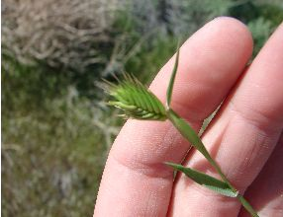
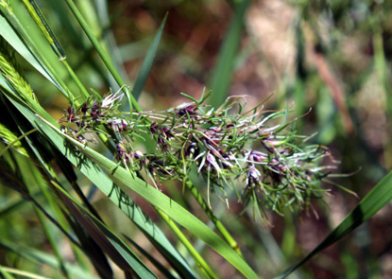
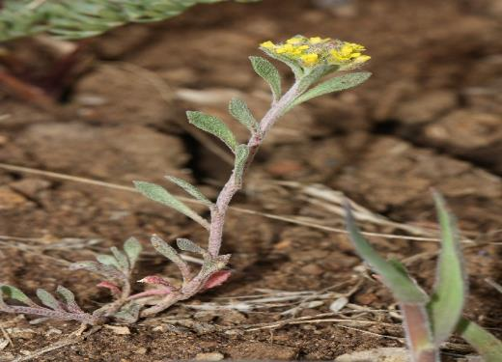
Early Season Invasive (ESI) Species
Cheatgrass (Bromus tectorum)
Annual Wheatgrass (Agropyron triticeum)
Image Credit: NPS
Image Credit: USDA
Image Credit: NPS
Bluegrass (Poa bulbous)
Alyssum (Alyssum desertorum)
Image Credit: NPS
Image Credit:Alchetron
Notes:
These are some examples of early season invasive species our partners have collected field data in the park. As I have mentioned there is cheatgrass displayed in the top left corner is the most problematic, another widely distributed invasive grass on the top right is annual wheatgrass, and then Bluegrass, in the left corner, which is less common but still crowds out native grasses. Lastly we have Alyssum, which is a long blooming annual plant.
Cheatgrass image: https://www.nps.gov/media/photo/gallery.htm?id=02DE9718-155D-4519-3E711C30B6E089DB
Bluegrass images: https://www.nps.gov/wica/learn/nature/grasses-bulbous-bluegrass.htm, https://plants.usda.gov/java/largeImage?imageID=pobu_007_avp.jpg
Wheatgrass image: https://plants.usda.gov/java/largeImage?imageID=ertr13_001_ahp.jpg (Credit: Cassondra Skinner, hosted by the USDA-NRCS PLANTS Database)
Alyssum species: https://upload.wikimedia.org/wikipedia/commons/e/ec/Alyssum_desertorum_7702.JPG

Slide 6
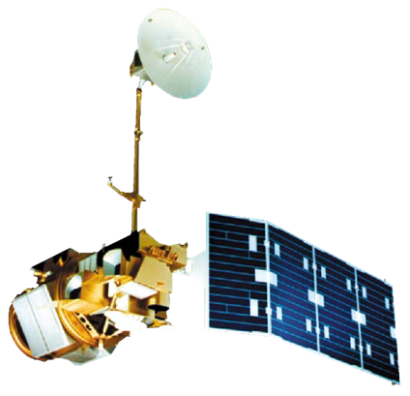
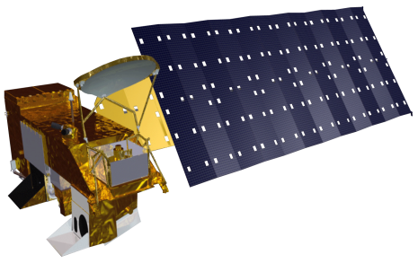



Earth Observations
Landsat 5 TM
Shuttle Radar Topography Mission
Aqua MODIS
Landsat 8 OLI/TIRS
Terra MODIS
Source: NASA DEVELOPedia
Notes:
Here are the NASA Earth observations we used for both mapping the past and current ESI coverage and forecast coverage of ESI species within the park ; Landsat 8 OLI, Landsat 5 TM, Terra and Aqua Modis, and the Shuttle Radar Topography mission satellite. From here, Zhe will explain how we incorporated the data we collected from these satellites into our study.
The NASA Earth observations incorporated in this study were: Landsat 5 Thematic Mapper (TM), Landsat 8 Operational Land Imager (OLI) and Thermal Infrared Sensors (TIRS), Terra Moderate Resolution Imaging Sepctroradiometer (MODIS) and Shuttle Radar Topographic Mission (SRTM).
Satellite Image Source: NASA’s Developedia

Slide 7
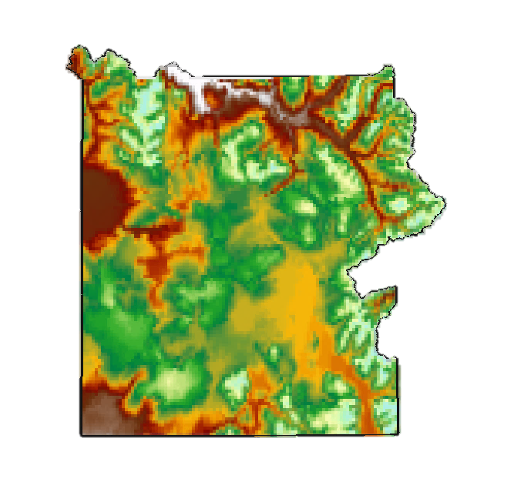
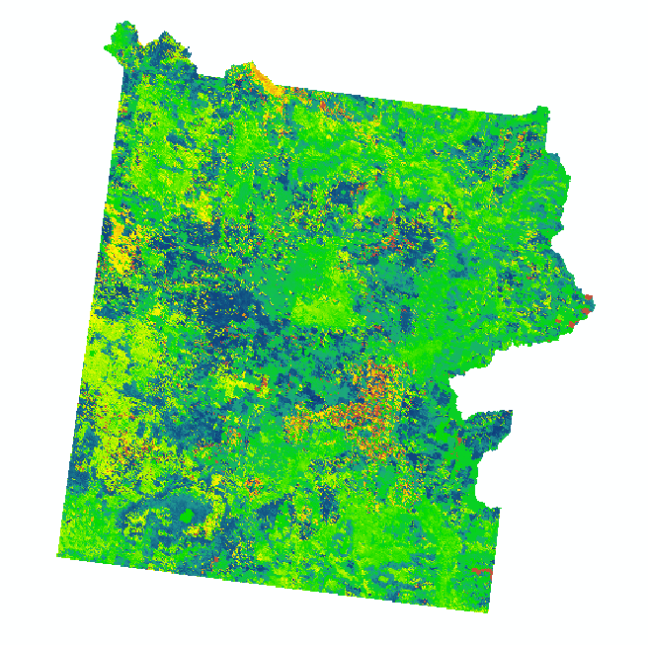
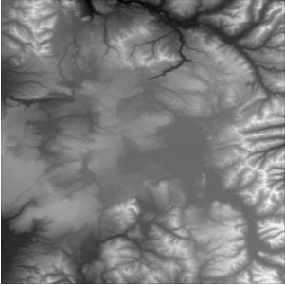
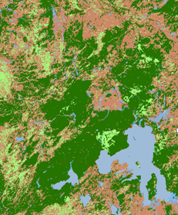
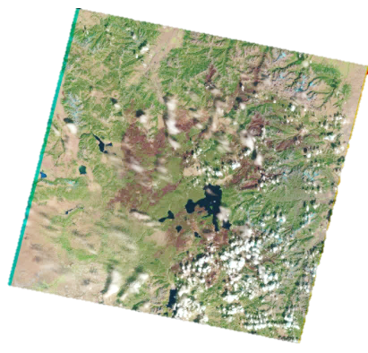
Methodology
Derivation of vegetation and topographic Indices
In-situ
Data
SRTM DEM
Landsat 5 TM
Landsat 8 OLI
Data
Acquisition
Data Processing
Image Credit:USFS
Image Credit: MLRC
Image Credit: USGS
Image Credit:WorldClim
Image Credit: USGS
NLCD Data
Climate Data
USFS ForWarn MODIS Pheonology dataset
Identification of temporal growth patterns
Notes:
In methodology, first we will talk about data acquisition and data processing. We obtained field data from our partners.
The USFS ForWarn MOSDIS Phenology data set were acquired and utilized to identify the early blooming, peak green-up and brown down period of Early Season Invasive species. We obtained Landsat 5 and Landsat 8 for the month ranging from April to October from 1985 to 2017. National Land Cover Data were obtained for 4 different years, 1992, 2001, 2006, 2011. SRTM 30 meter void filled elevation data was acquired as well. Similarly, the climate data were obtained from the WorldClim.
After the data acquisition, the data were processed to obtain the predictor variables.

Slide 8
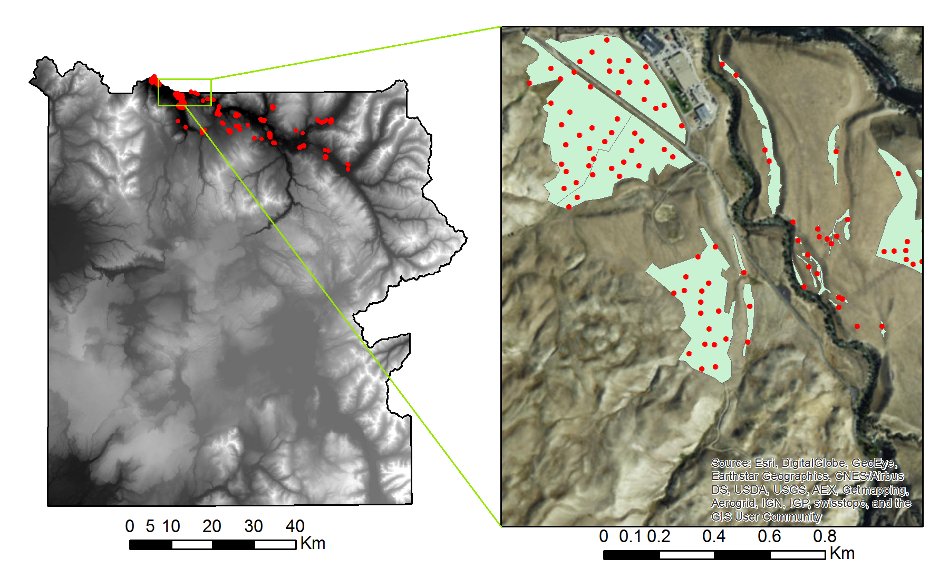
Field Data
Field Data
Train data
ESI Polygon
DEM
High : 3449
Low : 1562
Notes:
We obtained field data in the form of polygons from our partner. They included 260 polygons with ESI species and 22 polygons with native vegetation. Based on this, we generated 1106 random points with the interval of 30 meter in the form of presence and absence data for modeling. As we can see on the map, the points in red inside the polygon represents presence points and outside the polygon represents absence points.

Slide 9
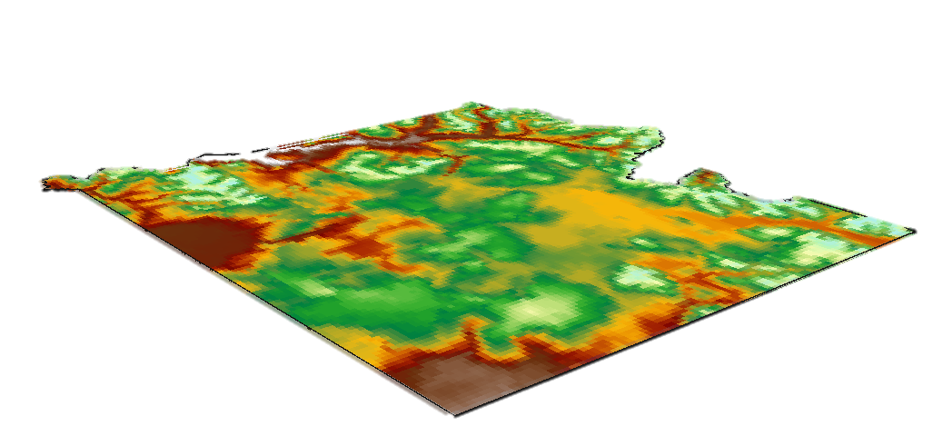
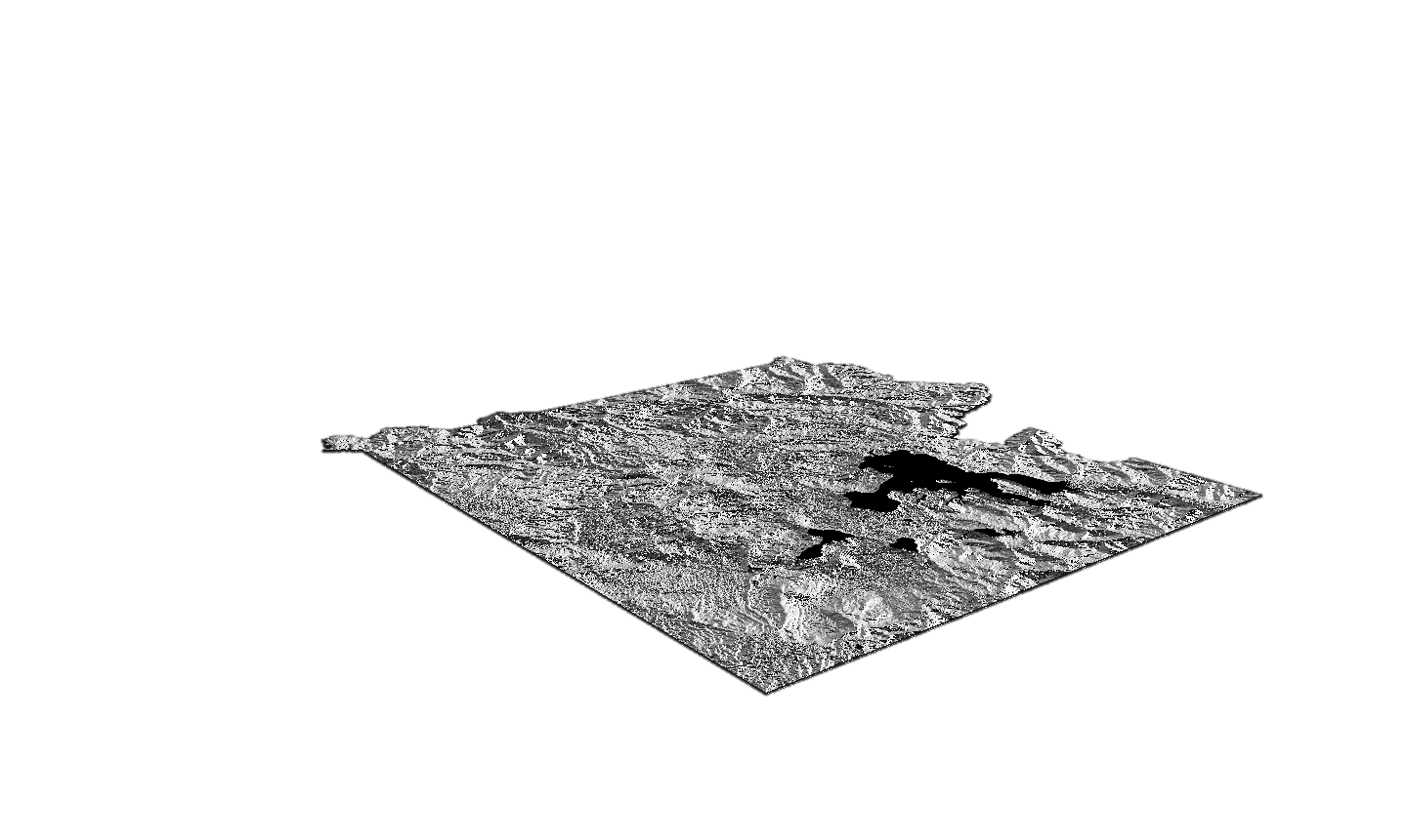
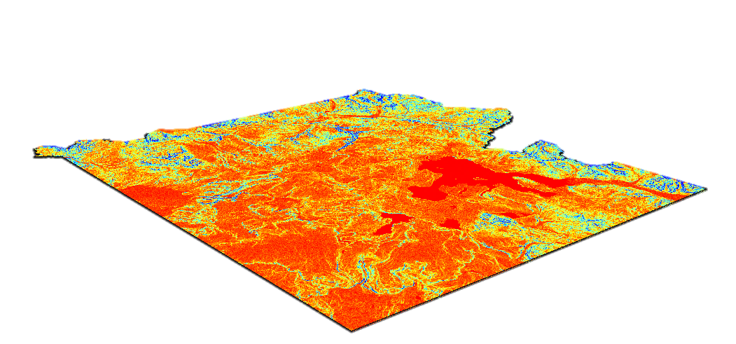
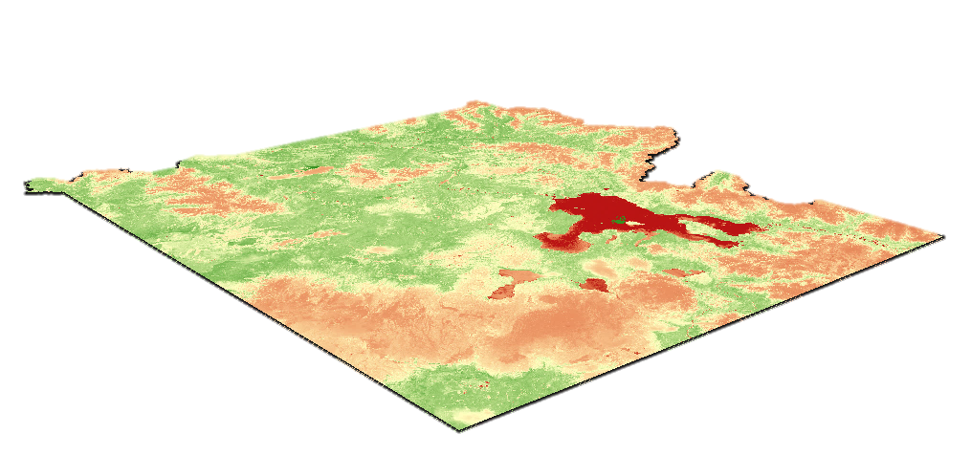
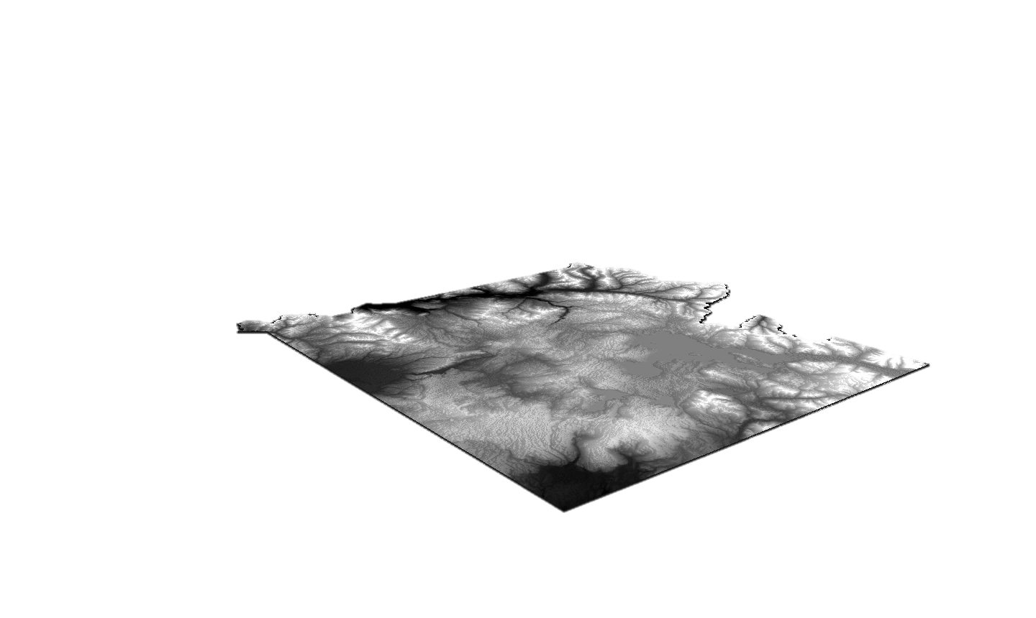
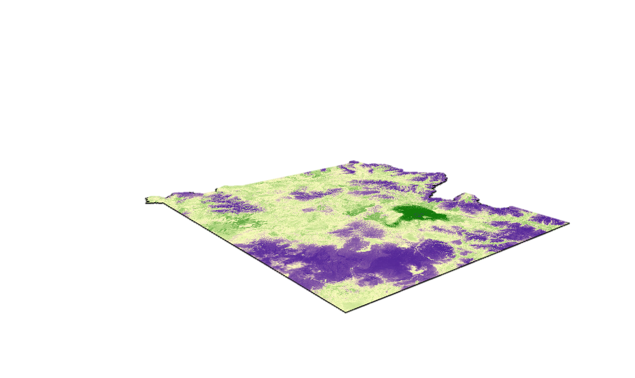
Predictor Variables
  Mean Annual Temperature
  Aspect
  Slope
  NDVI
  DEM
  NDMI
Notes:
Here are few of the variable layers we used in modeling. For example, the first one is the mean annual temperature, the last one is NDMI (Normalized Difference Moisture Index).

Slide 10
Software for Assisted Habitat Modeling (SAHM)
Input Data
Preliminary Analysis
Correlative Models
Predictors
Field Data
Generalized Linear Model
Random Forest
Boosted Regression Tree
Multivariate Adaptive Regression Splines
MaxEnt
Template Layer
Covariate Correlation And Selection
Field Data Query
PARC
Field Data Aggregate & Weight
Pre-processing
MDS Builder
Notes:
ESI distribution models were constructed using the USGS Software for Assisted Habitat Modeling (SAHM). Input different data here and data would be pre-processed in certain modules.
In SAHM, we use the CovariateCorrelationAndSeleciton module to perform a detailed inspection of the data and to filter out highly correlated predictors. In this module, it is shown that the relationship between each predictor and the response of each predictor to dependent variable.
Finally, we used NDMI, NDVI, elevation, aspect, slop, mean temperature, mean precipitation, Near Infrared band and tasseled cap brightness as predictors in our study.
For modeling invasive grass distribution, five different Species Distribution Models (SDM) incorporated by SAHM software were used. The SDMs included Boosted Regression Trees (BRT), Random Forest (RF), multivariate adaptive regression splines (MARS), generalized linear model (GLM), and MaxEnt (West et al., 2017).
Parc(The Projection, Aggregation, Resampling, and Clipping (PARC) module is a powerful utility that automates the preparation steps required for using raster layers in most geospatial modeling packages.)

Slide 11
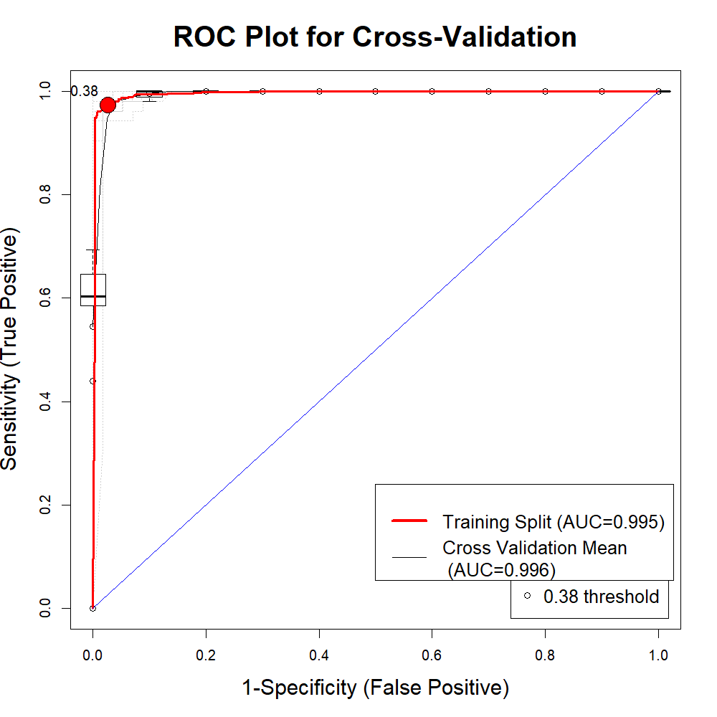
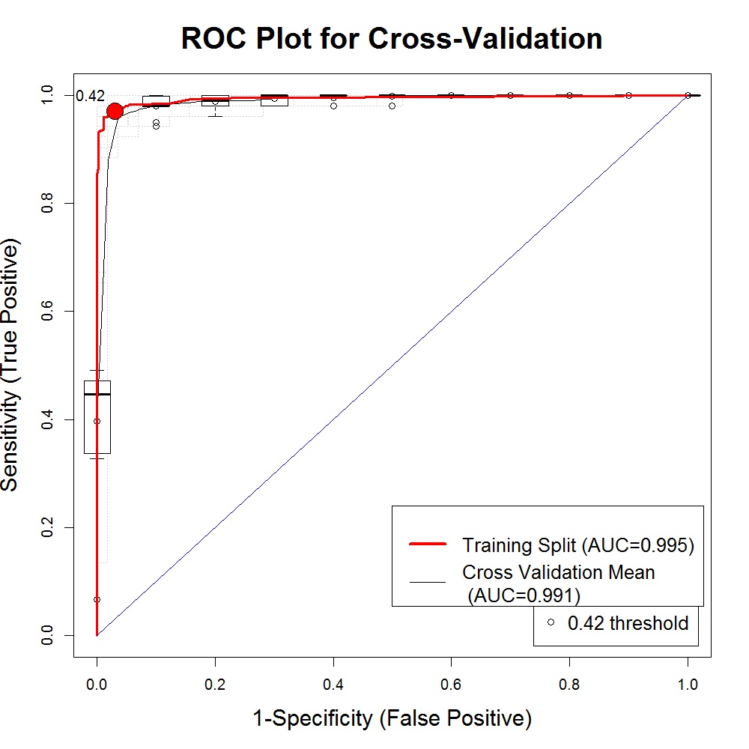
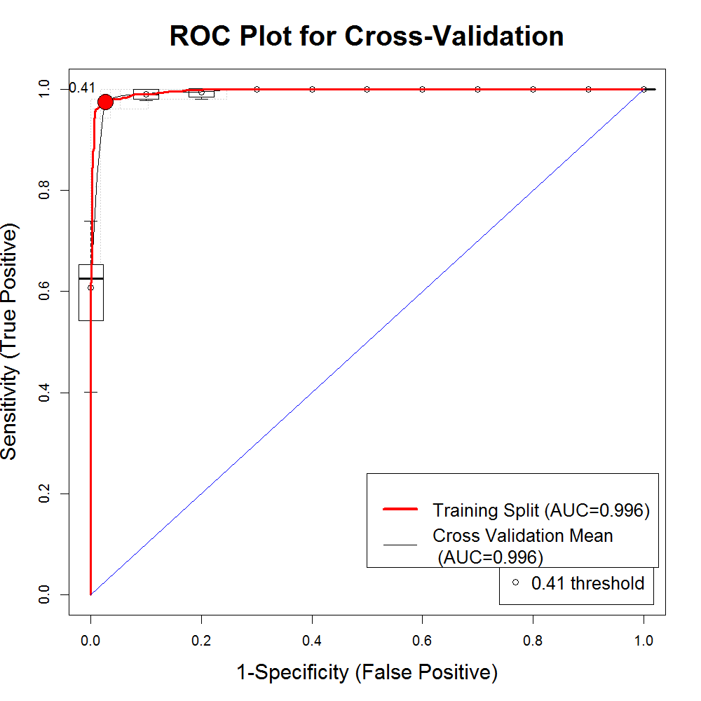


SAHM Output
MARS
RF
BRT
GLM
Maxent
Notes:
The SAHM software produces several graphics that can be used to compare various aspects of model evaluation. The main metric we used to evaluate models’ results was Test Area Under the Receiver Operating Characteristic Curve (AUC), to be simple, the value to adjust the ability to discriminate between presence and absence.

Slide 12
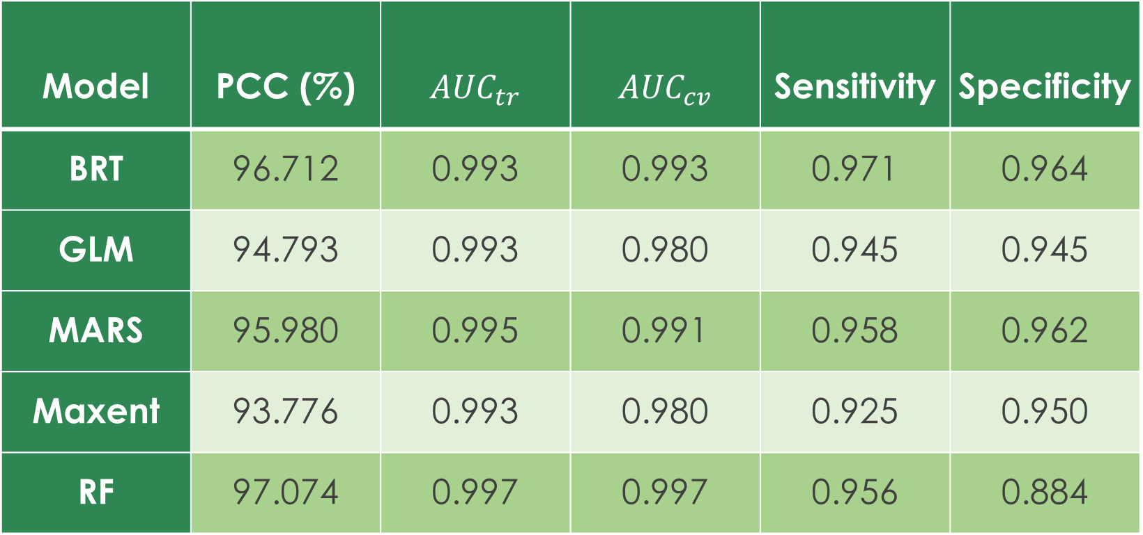
SAHM Model Outputs
Model | PCC (%) | $${AUC}_{tr}$$ | $${AUC}_{cv}$$ | Sensitivity | Specificity
BRT | 96.712 | 0.993 | 0.993 | 0.971 | 0.964
GLM | 94.793 | 0.993 | 0.980 | 0.945 | 0.945
MARS | 95.980 | 0.995 | 0.991 | 0.958 | 0.962
Maxent | 93.776 | 0.993 | 0.980 | 0.925 | 0.950
RF | 97.074 | 0.997 | 0.997 | 0.956 | 0.884
Notes:
The standard recommendation for AUC scores is that scores between 0.9 and 1.0 are excellent, between 0.8 and 0 .9 are good and anything less than 0.6 is poor. We further used Percent Classified Correctly (PPC), Sensitivity, and specificity as our evaluation metrics.
Based on the metric outputs, it shows that random forest model performs the best to distinguish ESI distribution, with elevation and mean temperature in June the most important predictors.
If there is a strong disparity between the curves for the training data and either the testing split or cross validation standard deviation curves, this can be indicative of model overfitting.

Slide 13
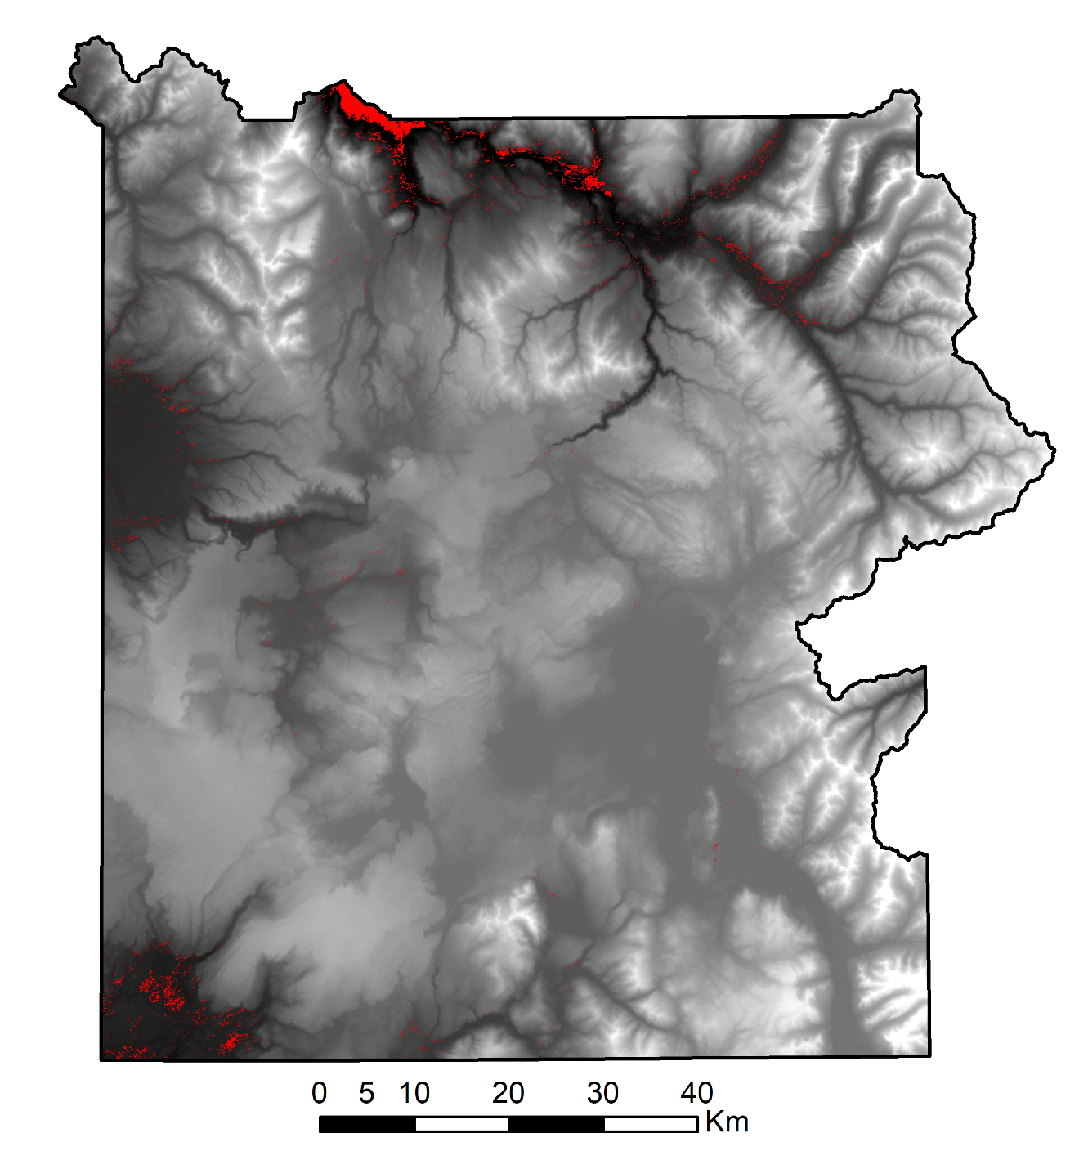
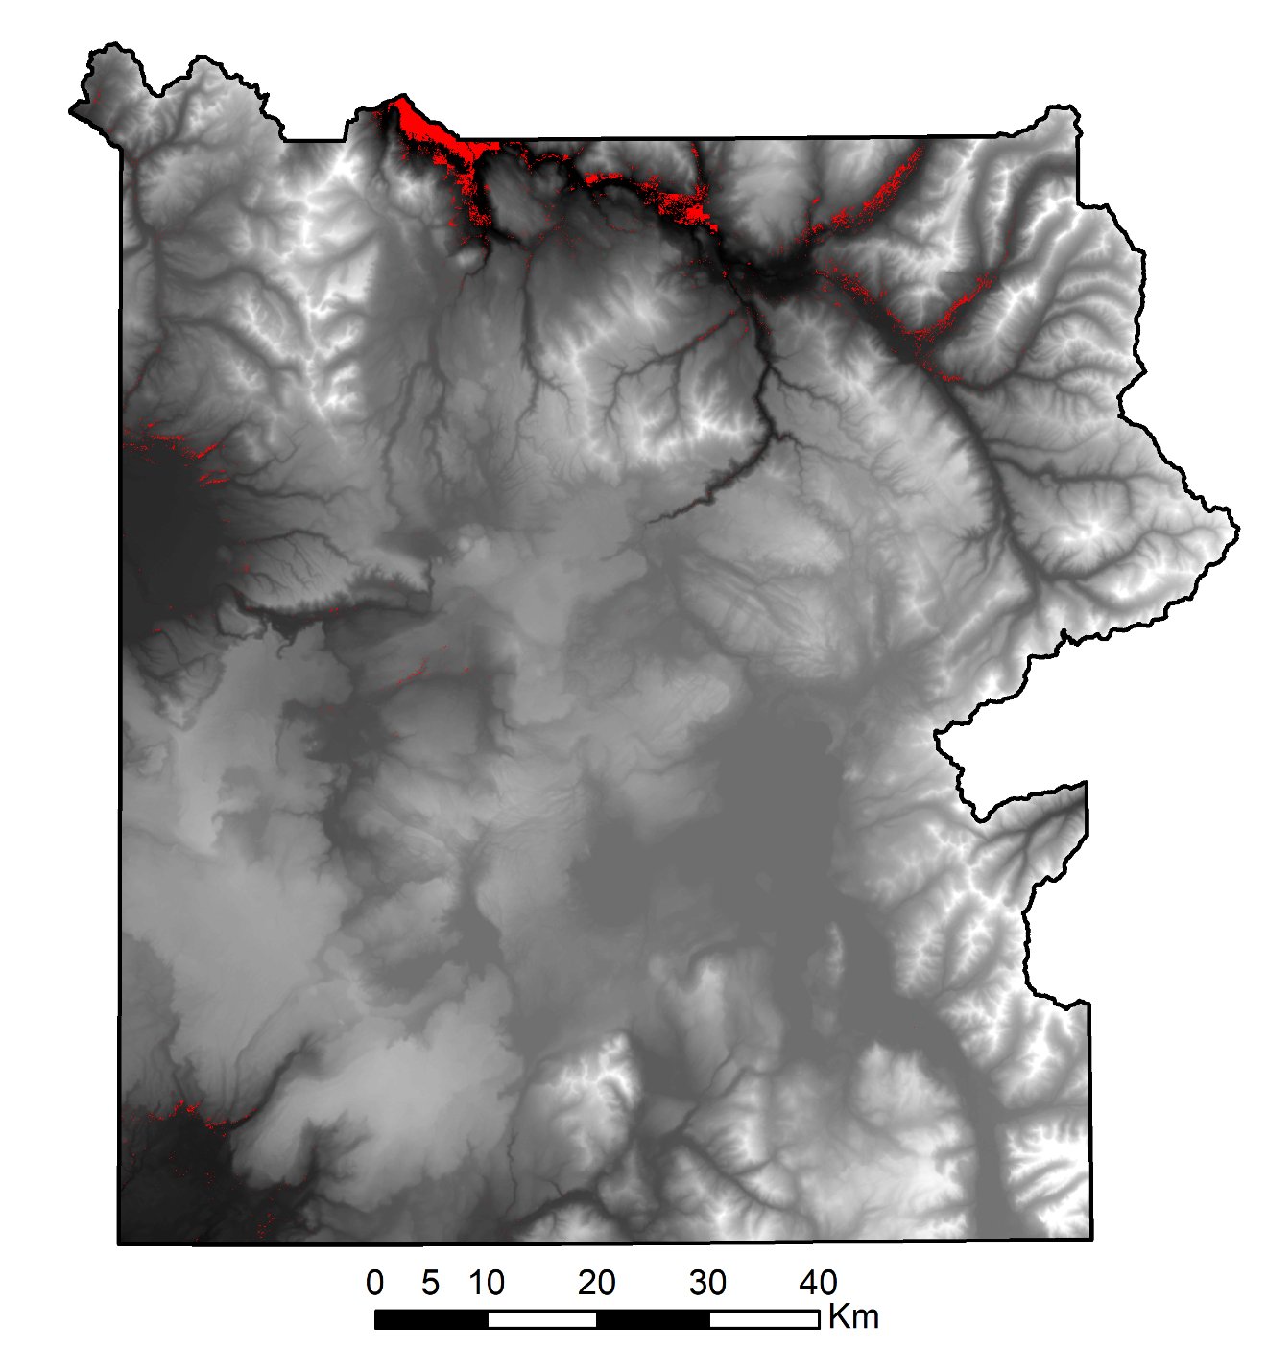
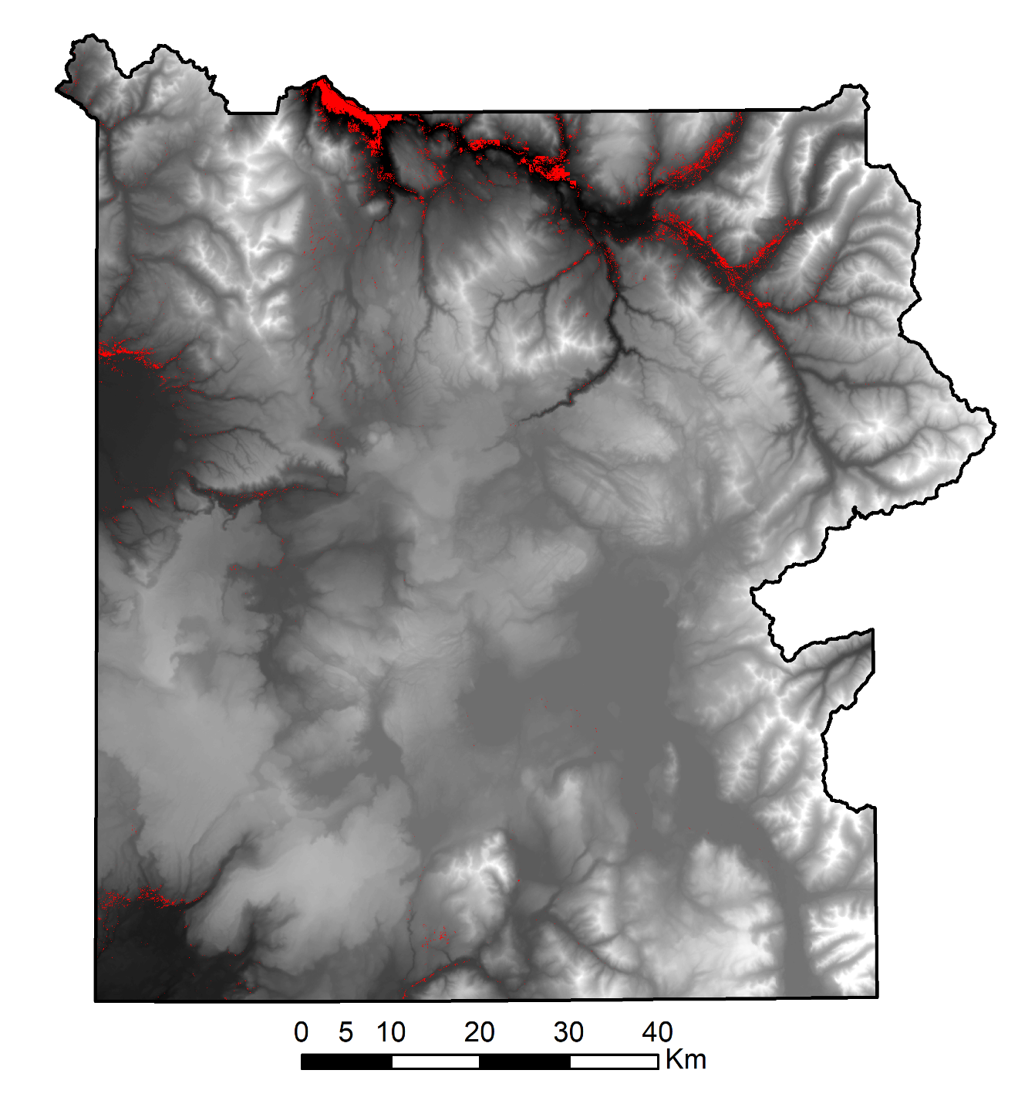
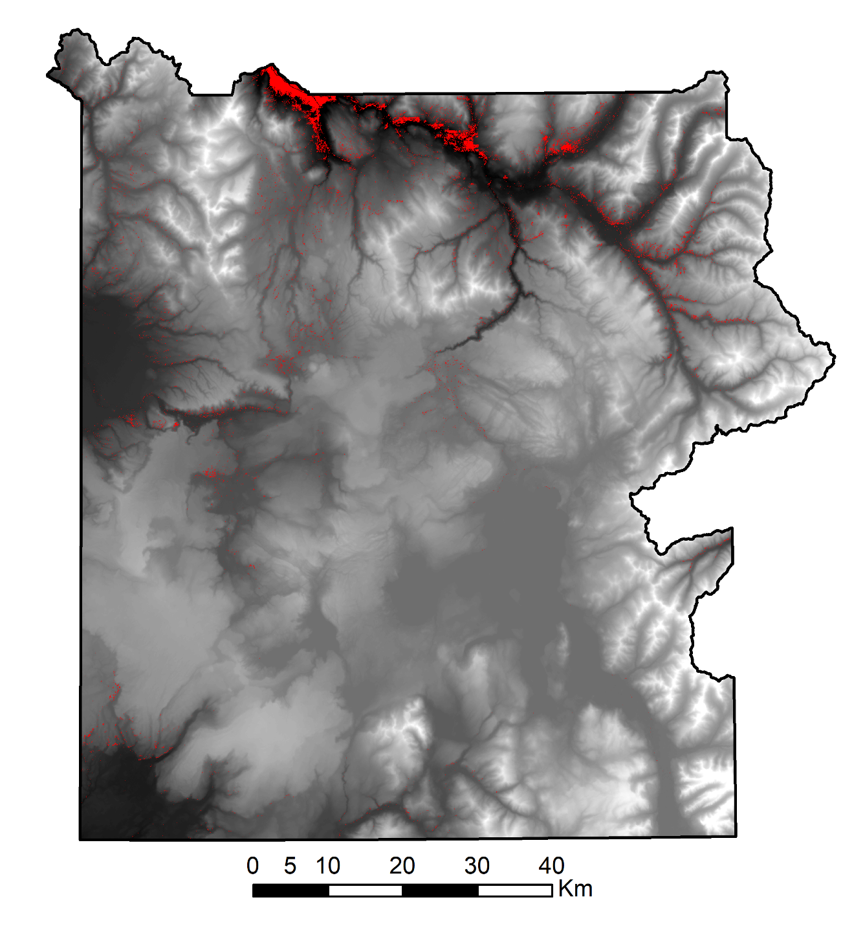
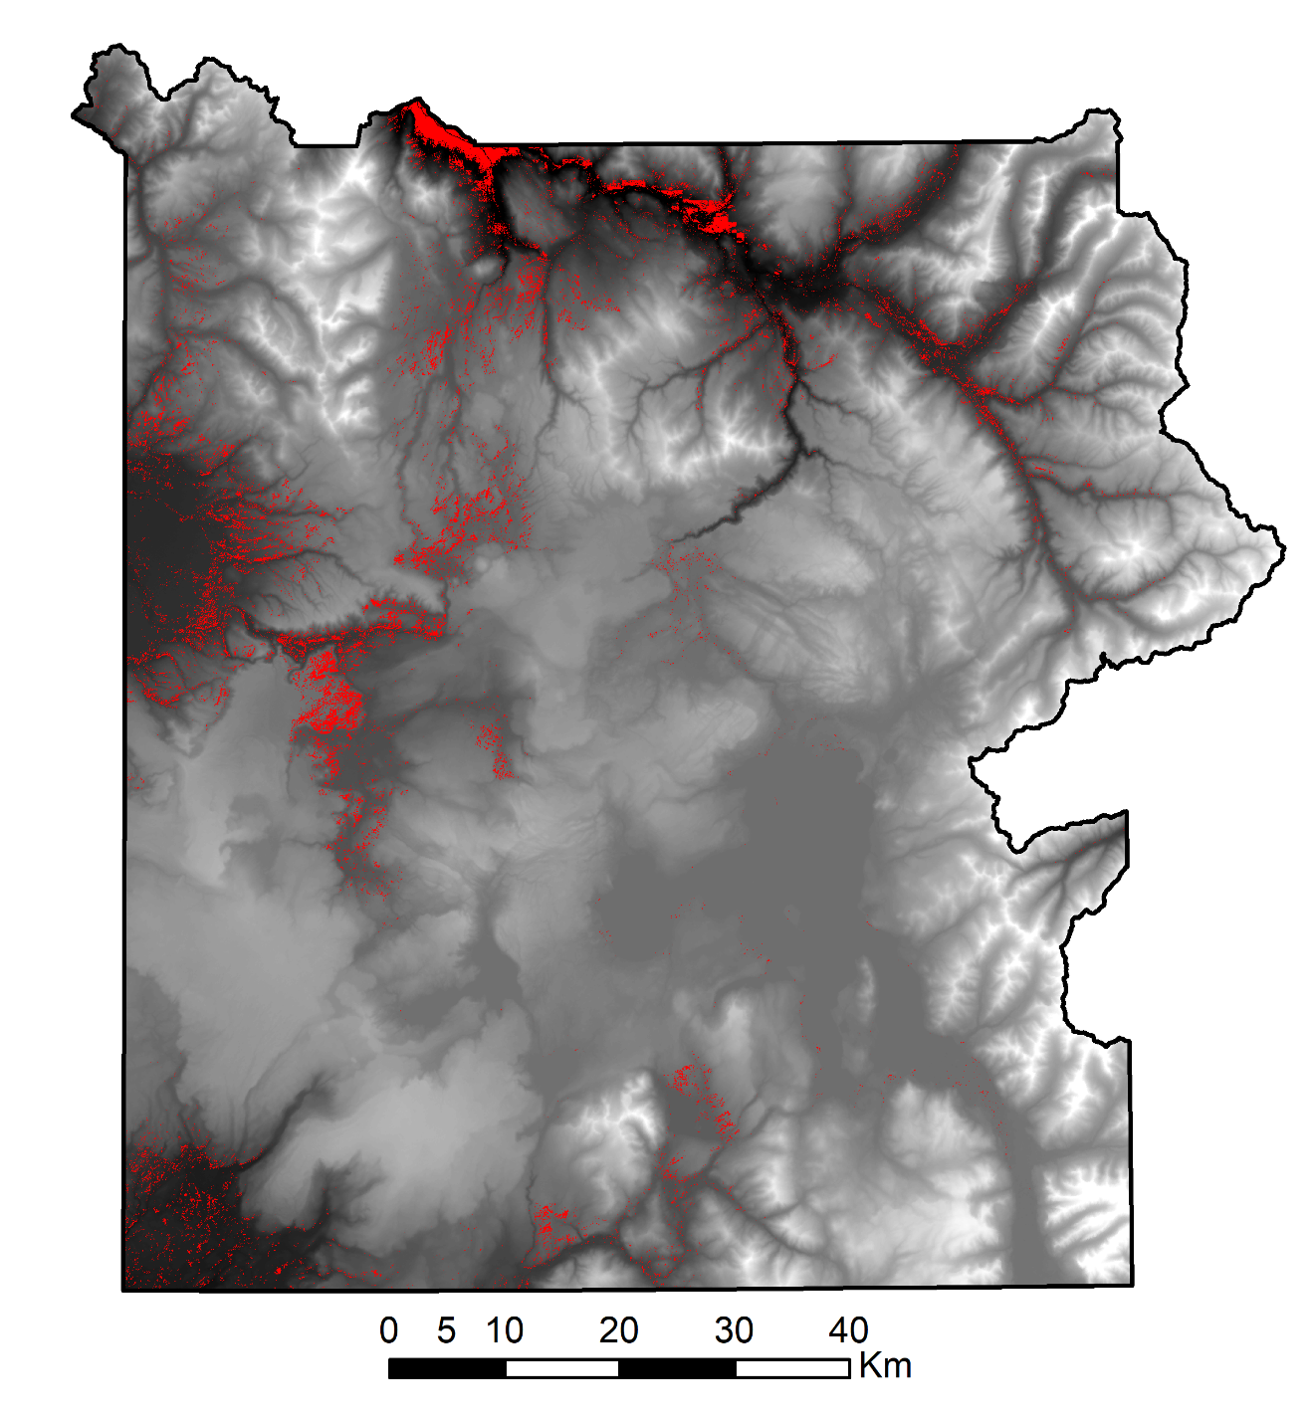
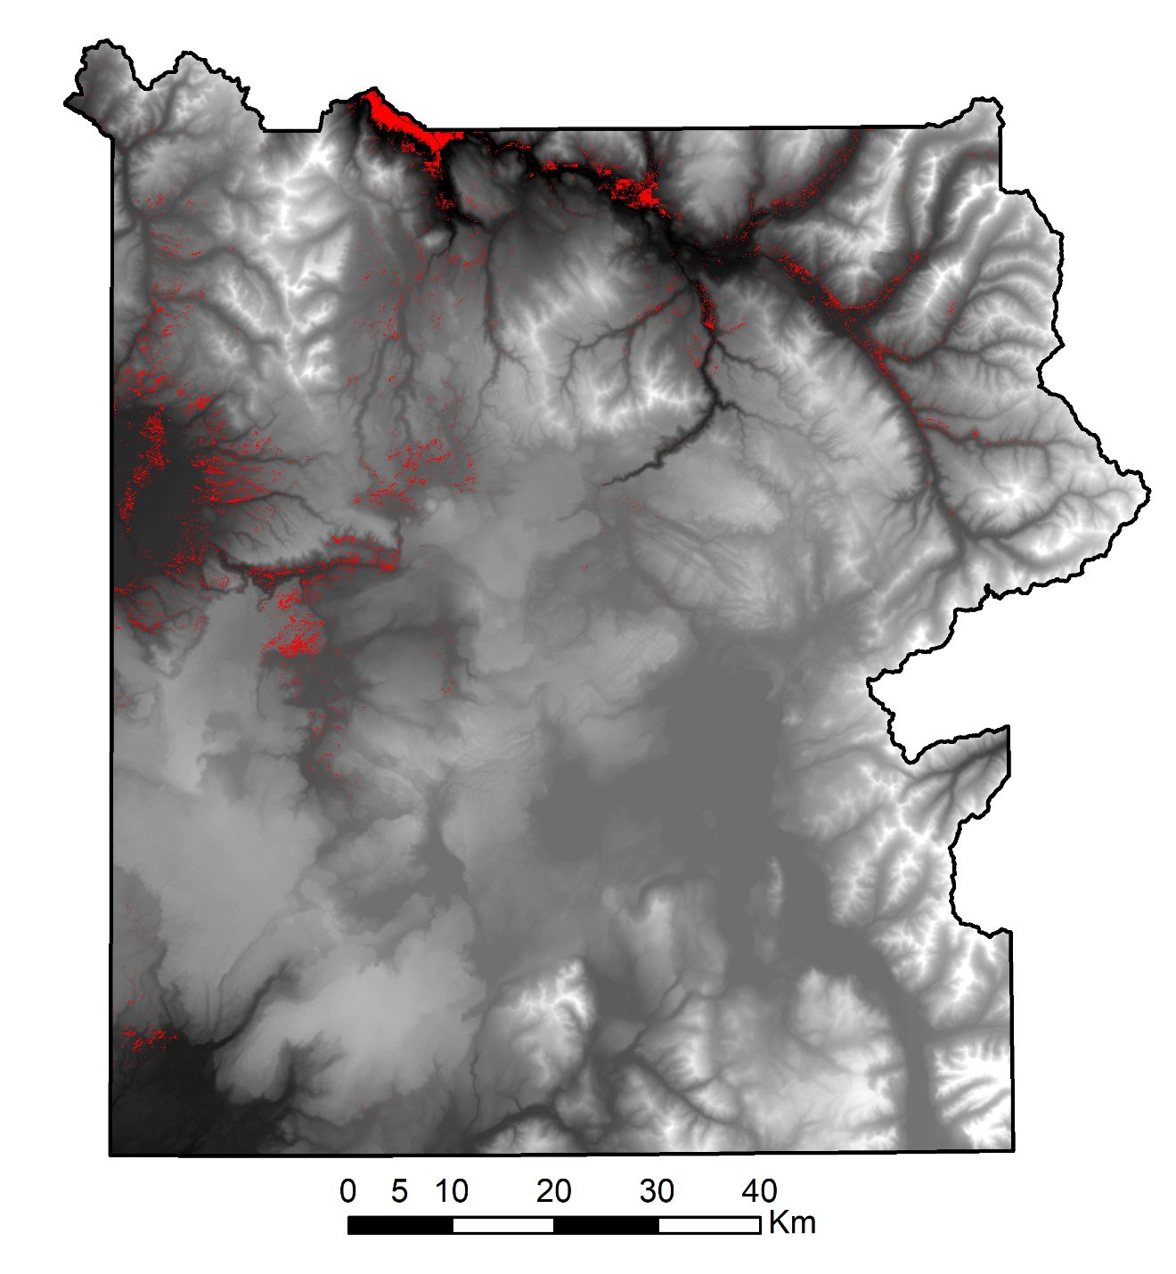

ESI Time Series Cover Maps (1986-2009)
1986
1989
1996
2000
2006
2009
ESI Potential Coverage
0.67 - 0.99
DEM
High : 3449 m
Low : 1562 m
Notes:
This is the final map generated from the output of our model. The maps are overlaid on DEM map. We masked the areas based on the elevation and landcover. Provided the information from our partner and locating the places with ESI presence, all areas above 8000 feet (2400 meters) were considered the No-ESI zone and were removed. In addition, the map was masked for grassland and shrubland referring to the field data. Since we conducted the model for seven years due to time constraint, here are six of the cover maps for past years from 1986 to 2009. The final map we obtained were probability map. Lets begin with the year 1986. The ESI coverage higher than 0.8 probability values are shown in the map and we can see the changes gradually. Keeping in mind that we used the present data to estimate the past coverage, you can see the odd in the years 2000, 2006 and 2009.

Slide 14
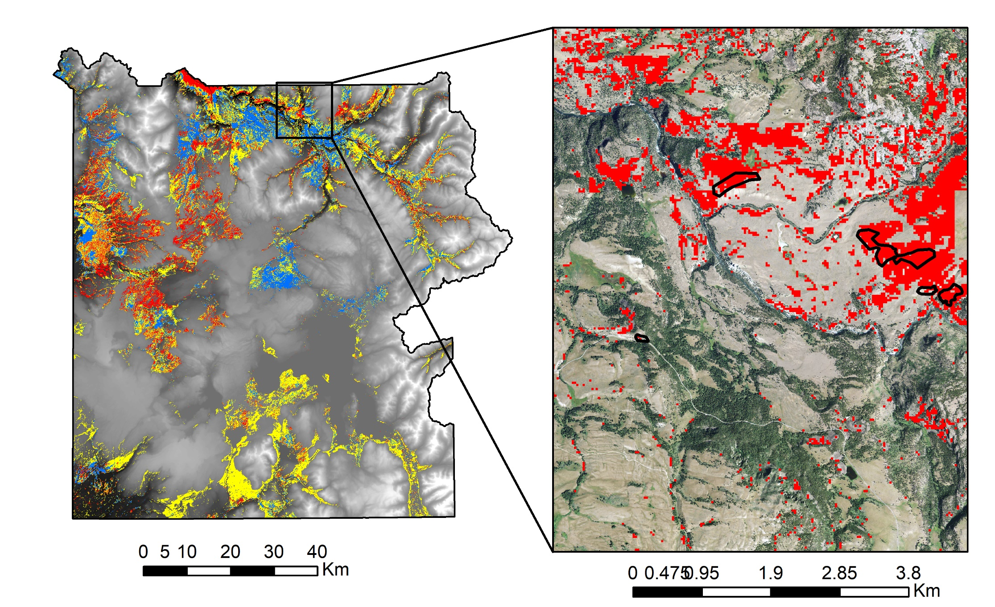
2017 ESI Cover Map
ESI Potential Coverage
Low (0.00 - 0.33)
Medium (0.34 - 0.66)
High (0.67 - 0.99)
ESI Polygons
DEM
High : 3449 m
Low : 1562 m
Notes:
This is the present cover map overlaid on DEM map showing the presence of ESI species in three different hierarchy. The probability from 0 to 1 was classified into low, medium and high based on equal intervals. Below 0.33 represented by blue color shows the lower coverage of ESI species, 0.34 to 0.66 represented by yellow color show the intermediate ESI species coverage and anything above 0.67 represented by red color show the highest ESI coverage in this map. In the inset map, you can see the highest ESI coverage overlaid on National Agriculture Imagery Program(NAIP) aerial images with 1 meter spatial resolution. Here, ESI polygons, field data having invasive species, are shown with black boundary.

Slide 15

ESI Bioclimatic Forecast (2050)
ESI Potential Coverage
0.34 - 0.66
0.67 – 0.99
ESI Polygons
DEM
High : 3449 m
Low : 1562 m
Notes:
This is ESI Bio-climatic forecasting map for 2050.
The climatic data obtained from WorldClim and generated by Geophysical Fluid Dynamics Laboratory (GFDL-CM3) was used in modeling the forecast. 19 different bioclimatic variables derived from temperature and precipitation were used. Here, we can see the forecasted map for 2050 for the climate scenario RCP 2.6. Representative Concentration pathways (RCPs) are climate change scenarios based off time-dependent projections of the atmosphere’s increase of greenhouse gases. Each scenario varies by concentration of atmospheric carbon dioxide. Here in the map, the probability from 0.4 to 0.7 is represented by orange color and probability from 0.71 to 1 are represented by red color showing the extremity.

Slide 16
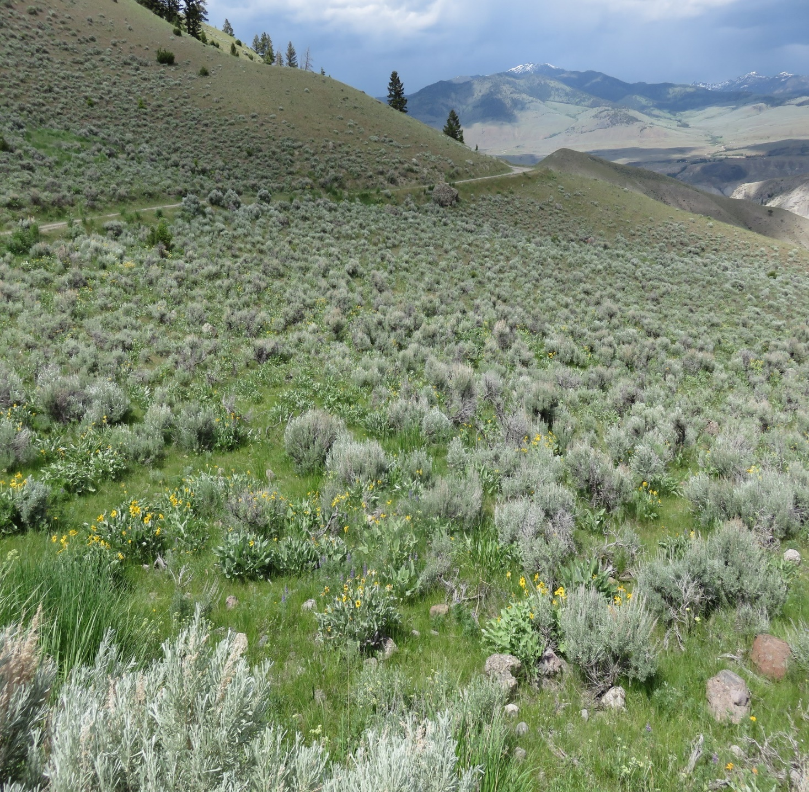
Conclusions
Random Forest model using Landsat and SRTM data as inputs yielded the most realistic results of all tested models.
ESI species cover maps from the project show that ESI species have become more extensive, especially at the northern border of YNP.
The forecast model based on bioclimatic data shows an expansion of ESI areas by 2050.
Image Credit: NPS
Notes:
Random Forest performed the best among the five models using the Landsat and SRTM data as inputs. ESI species coverage have increased especially at the norther boarder of YNP as shown by the cover maps. And, the bio-climatic forecasting map suggest that the ESI species coverage will grow extensively in the park.

Slide 17
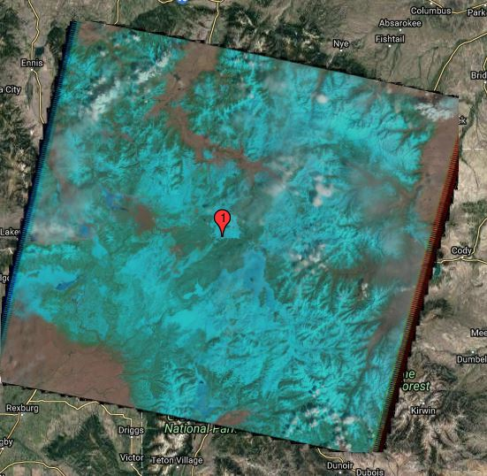
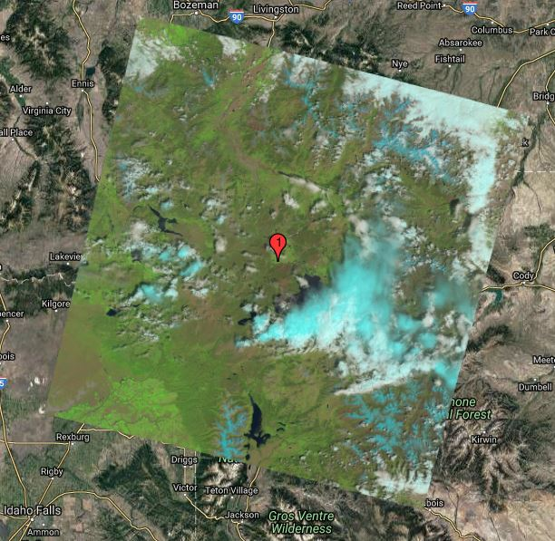
Limitations
Limited field/reference data of and outside study area
High snow and cloud cover satellite images
Limited yearly range of future climate data
High Snow Cover (2003 April)
High Cloud Cover (2015 June)
Image Credit: USGS
Notes:
Some of the limitations of our study are inadequate field data, high snow cover and high cloud cover during the growing season of ESI species.
Our future climate data were limited to the year 2050 for forecast model running.

Slide 18
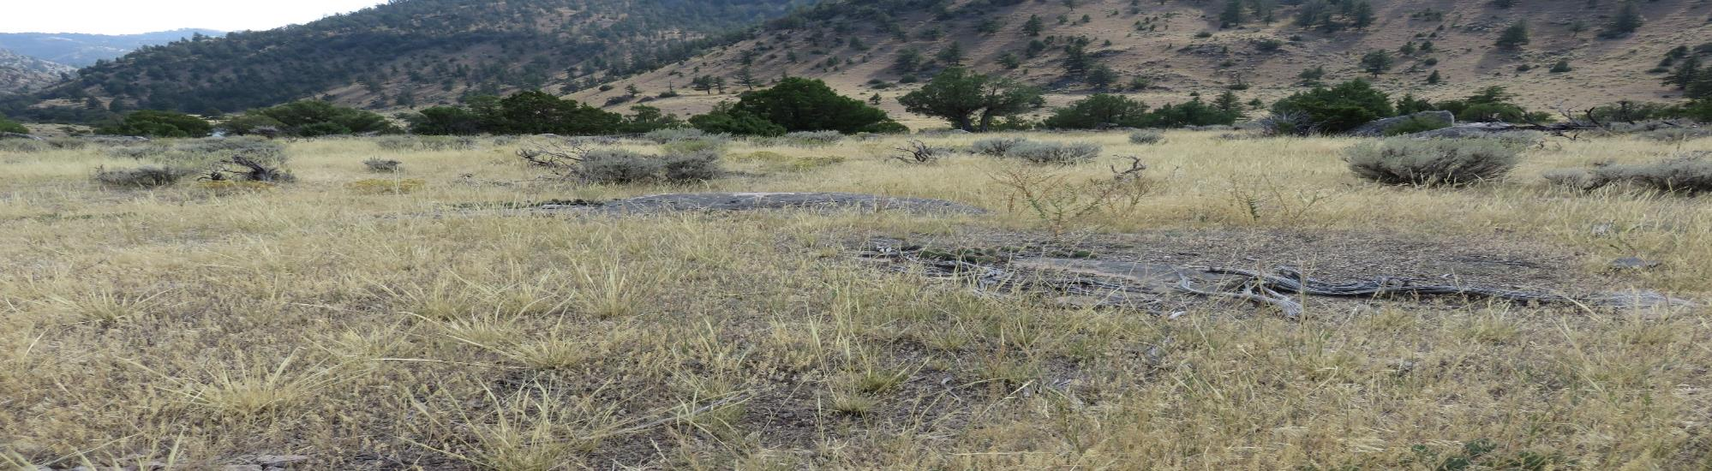
Future Work
More field data is needed to validate current ESI map from project.
More research is needed to assess if higher resolution imagery than Landsat could be used to improve ESI maps.
Maps could be improved with better cloud and snow masks.
Higher resolution climate data could be used to improve results if available.
Image Credit: NPS
Notes:
In future, we can incorporate adequate field data for accuracy. More research can be done to assess the higher resolution than Landsat utility to improvise ESI maps. Can work on the techniques of masking cloud and snow cover to make better maps. And, higher resolution of climate data, if possible, can be used to increase the precision of current and future maps.

Slide 19
Acknowledgements
Joseph Spruce, Science Systems & Applications, Inc
Dr. L. DeWayne Cecil, NOAA National Centers for Environmental Information, Global Science & Technology, Inc.
Bob VanGundy, , The University of Virginia’s College at Wise
Dr. Amanda West, Colorado State University
Dr. Kenton Ross, NASA Langley Research Center
Heidi Anderson, Botanist/Ecologist, Yellowstone National Park
Samantha Yeo, Cartographic specialist, Yellowstone National Park
Stefanie Wacker, Ecologist, Yellowstone National park
Ann Rodman, Ecologist, Yellowstone National Park.
Dr. Bill Hargrove and William Christie, USDA Forest Service – Southern Research Station
Virginia – Wise node
Notes:
Our team like to acknowledge Joseph Spruce, Dr. Cecil, Bob and Dr. West for their continuous support, feedback and suggestions throughout the project. We would also like to thank our partners, National Park Service, Yellowstone National Park especially Heidi, Sam, Stefanie and Ann for their constructive feedback, enthusiasm, support as well as for providing the great video clips for the project video. We are grateful to Dr. William Christie and Dr. Bill Hargrove from USDA Forest Service-Southern Research Station for providing the USFS ForWan Phenology dataset.
Thank you all.

Slide 20
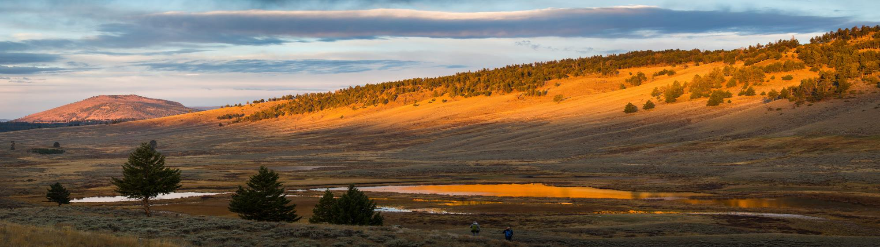

Questions?
Image Credit: NPS Flickr
Notes:
Sunrise at Blacktail Pond, URL: https://www.flickr.com/photos/yellowstonenps/15140421613/in/dateposted/

