Slide 1


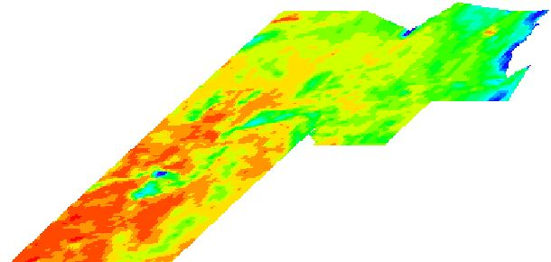

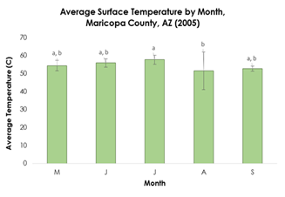
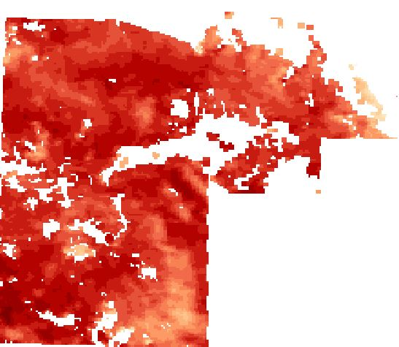
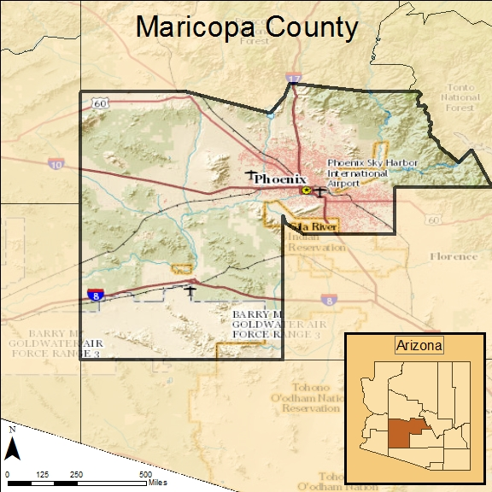
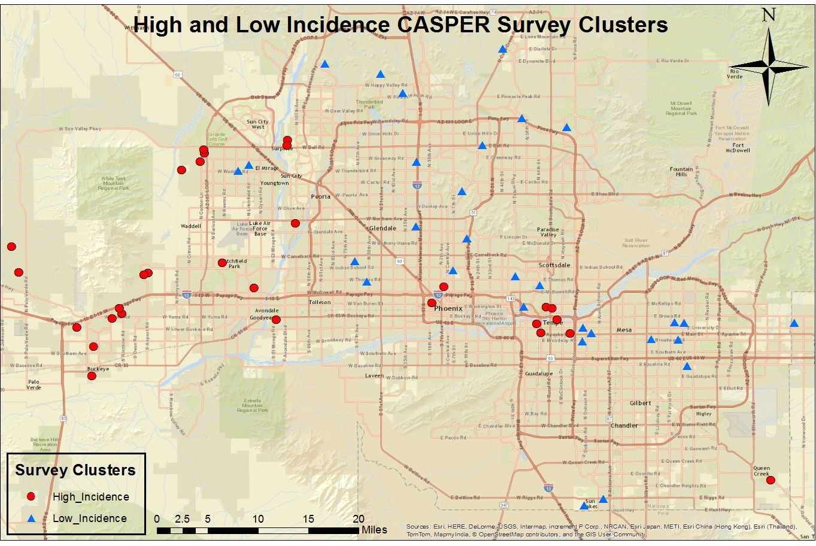
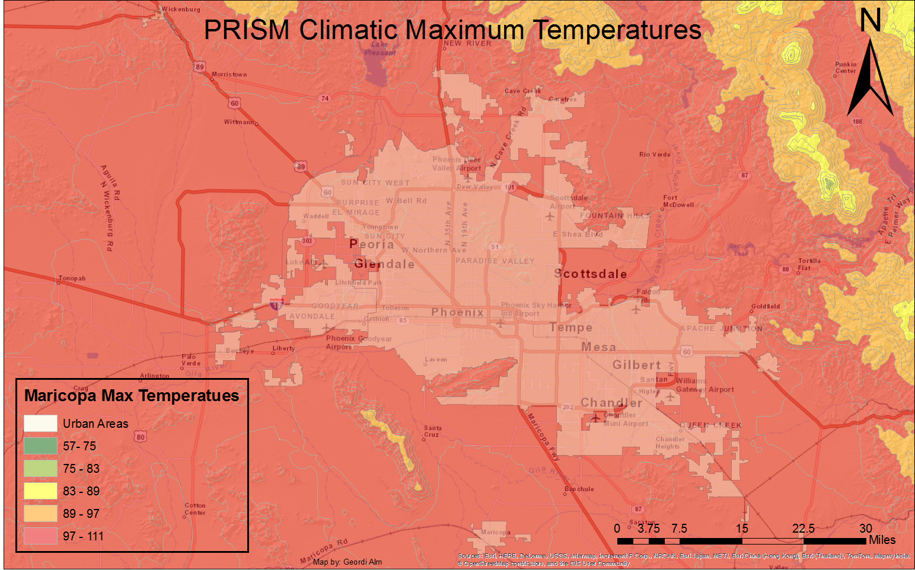
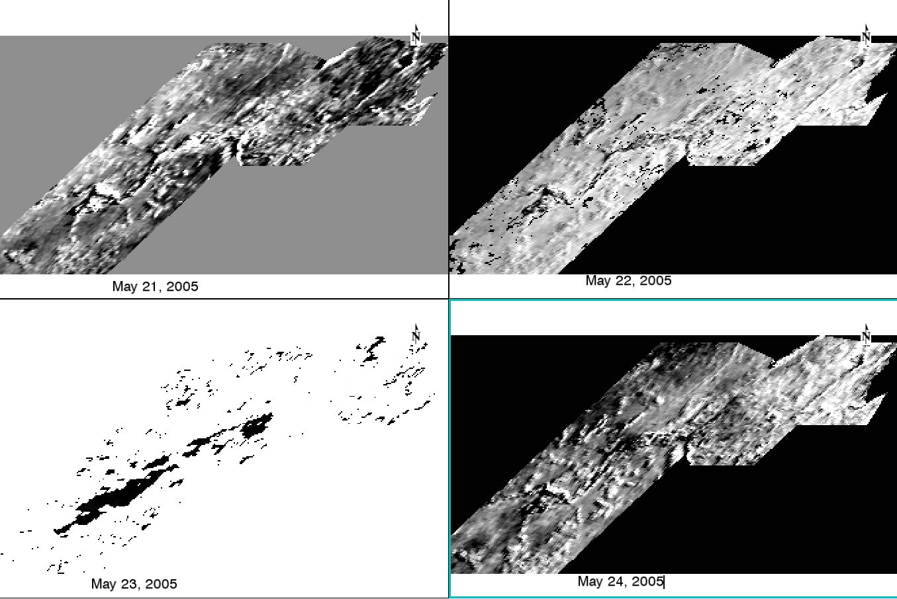
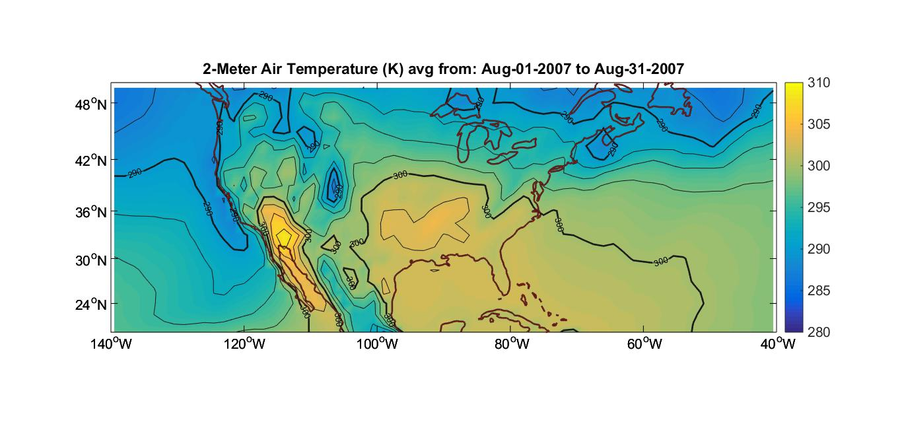

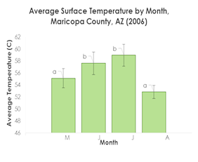
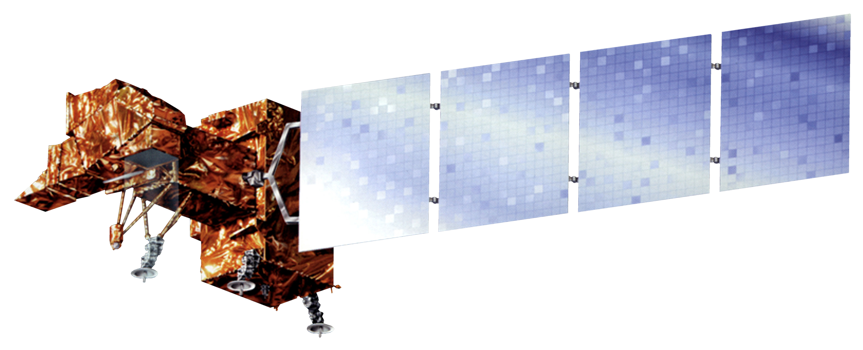











Heat-Health & Spatial Variation in Maricopa County, Arizona
Enhancing Extreme Heat Intervention and Preparedness Activities Using Remote Sensing and Spatial Analysis of Heat-Related Risks and Mortality
Amy Stuyvesant, Geordi Alm (Arizona State University), Rocky Garcia (Arizona State University), Emma Baghel, April Rascon, and Bernardo Gracia
NASA Langley Research Center
Abstract
Methods
Conclusions
Extreme heat causes more human fatalities in the United States than other natural disasters, elevating the concern of heat-related mortality. Maricopa County, Arizona is specifically known for its high heat index and is the leading megapolitan area in the U.S. for population growth and urbanization. As Phoenix expands, the increase in an urban environment raises nighttime temperatures and induces a positive feedback loop by further raising daytime temperatures, creating an urban heat island (UHI) effect. Individuals at higher risk are unequally distributed, leaving the poor, homeless, non-native speakers, elderly, and the socially isolated vulnerable to heat events. While this is a devastating incidence, it can be prevented. The Arizona Department of Health Services and the Phoenix Heat Relief Network, among others, are working to create more effectively placed cooling centers and heat warning systems to aid those with the highest exposure. Using Earth observation technology from Landsat 8 and MODIS satellites, the daily variability within the UHI was quantified in terms of spatial distribution and average surface temperature shifts. A series of one-way ANOVAs revealed significant differences between daily surface temperature averages of the top 30% of census tracts by month within a single season. These results provide detailed information regarding nuances within the UHI effect and allow pertinent recommendations regarding the health department’s adaptive capacity. They also hold essential components for future policy decision-making regarding appropriate locations for cooling centers and efficient warning systems.
Preparing Surface Temperature Data
Surface Temperature Data Analysis
Survey Data Analysis
There is significant clustering that shifts throughout the season
  Relief efforts should shift correspondingly
Average values within a month in a season and between a single month throughout the years does significantly vary
  Relief efforts should intensify for a consistently hot July and be prepared for large variability in the early season.
1.
Download MODIS/Aqua Land Surface Temperature Data
Surface Temperature Averages
Surface Temperature Averages
2.
Extract dates from MesoWest weather data where maximum temperature was above 104°F
One-Way ANOVA for monthly averages 1) within a season and 2) months between years
Figure 7. Shifts in heat waves.
Cluster Analysis by K function over all days of interest
Binary Logistic Regression
Ordered Logistic Regression
3.
Use these dates to extract MODIS images of interest
4.
Calculate surface temperature average for each census tract in Maricopa County
Nuances within UHI
Who uses AC or relief networks
What makes user more/less likely to use relief network
Results
Study Area
Heat Anomalies
Surface Temperature
Heat-Health and Spatial Variation
Figure 8. Maricopa County, Arizona with inset map of the state (Left).
Figure 9. Special focus on one of Maricopa County’s urban heat islands: Phoenix (Right).
 | Study Years
Month | 2005 | 2006 | 2007 | 2008 | 2009 | 2010 | 2011 | 2012 | 2013 | 2014
May | 5 | 7 | 2 | 3 | 4 | 0 | 0 | 6 | 0 | 6
June | 12 | 27 | 20 | 19 | 8 | 19 | 15 | 22 | 29 | 25
July | 28 | 22 | 21 | 25 | 26 | 27 | 24 | 22 | 22 | 25
August | 13 | 13 | 20 | 20 | 24 | 21 | 27 | 20 | 21 | 15
September | 8 | 2 | 12 | 5 | 10 | 18 | 14 | 7 | 11 | 10
Total | 66 | 71 | 75 | 72 | 72 | 85 | 80 | 77 | 83 | 81
Figure 4. Map of
Maximum
temperatures
for Maricopa
County (Far
Left).
Figure 5. Area of interest highlighted within circle (Left).
Table 1: Temperature heat anomaly days (n = 768) for month (May – September) and year (2005–2014). Note: Bold values indicate entries where the standard residual indicated a value very different from the expected value. Source: University of Utah’s MesoWest database.
Within a single season, average surface temperature significantly differ between summer months.
Figure 6. The month of
August showing an average surface temperature contour map with yellows being hottest and blues representing coldest temperatures (Below).
Figure 1. MODIS surface temperature data (Left).
Figure 2. Graph of average daily surface temperatures for 2005 (Top Right).
Figure 3.Graph of average daily surface temperatures for 2006 (Bottom Right).
Earth Observations
Landsat 7
Aqua MODIS
Landsat 8
Terra MODIS
(MODIS/Aqua - MODIS/Terra) / (MODIS/Aqua + MODIS/Terra)
Objectives
Team Members
Project Partners
Acknowledgements
Create a climatology map of Maricopa County, Arizona to detect extreme heat anomalies on various scales (i.e. daily, monthly, seasonal) and the consistency between such events (where, how, and why variations between extreme heat events occur)
Determine current use and frequent users of relief resources in order to establish how this correlates with current socioeconomic vulnerability assumptions
Analyze these anomalies and survey results to determine where, when, and how relief efforts should intervene
Arizona Department of Health Services (ADHS). ADHS coordinates the statewide heat safety task force, for which the Maricopa County Department of Public Health and ASU are active participants, and leads the state’s participation in CDC’s Building Resilience against Climate Effects initiative.
Environmental Remote Sensing and Informatics Lab (ERSL) at Arizona State University (ASU)
Center for Policy Informatics (CPI) at ASU.
Special thanks to Dr. David Hondula for his heavy involvement as the science advisor, helping to guide the project through completion and Dr. Kenton Ross as our NASA science advisor, providing logical and step-wise methods to complete certain aspects of the project and stay on task. Additional thanks go out to Emily Adams and Dan Wozniak, our Center Lead and Assistant Center Lead, for keeping our project progressing, as well as to Jeff Ely, whose geoinformatic expertise of the dnppy module made our data processing of large data sets possible. A special thanks to fellow participant Grant Mercer, whose python expertise has been invaluable to our team. This material is based upon work supported by NASA through contract NNL11AA00B and cooperative agreement NNX14AB60A.

