Slide 1
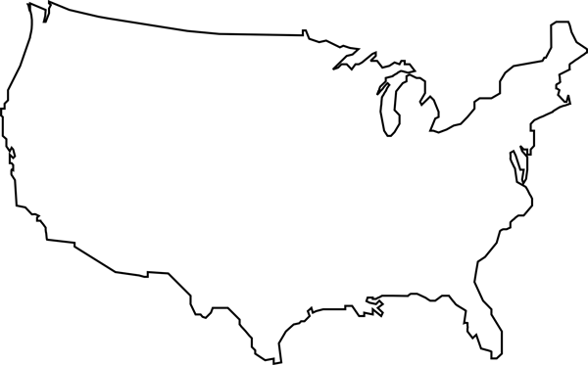
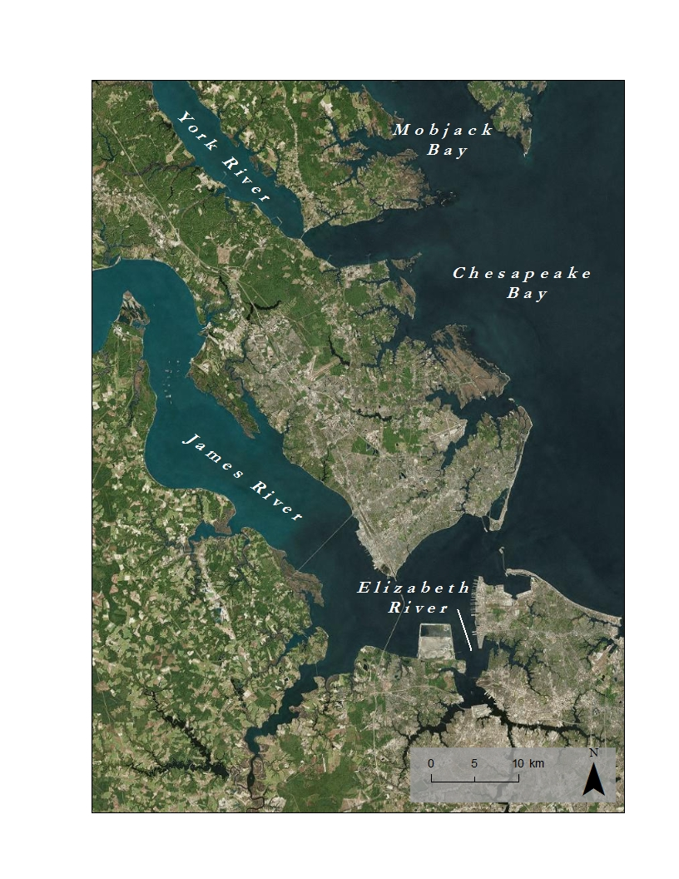
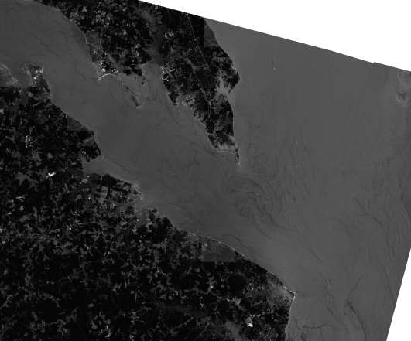
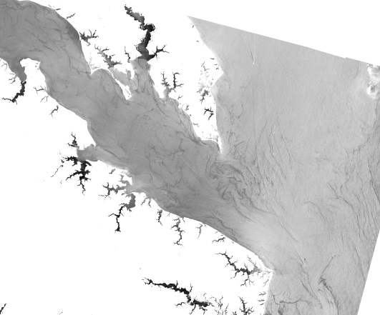
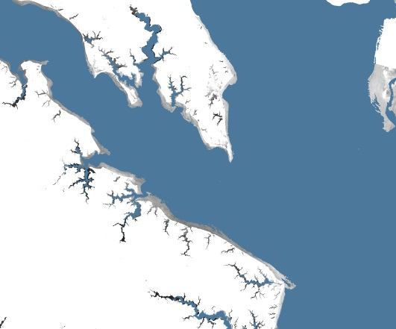
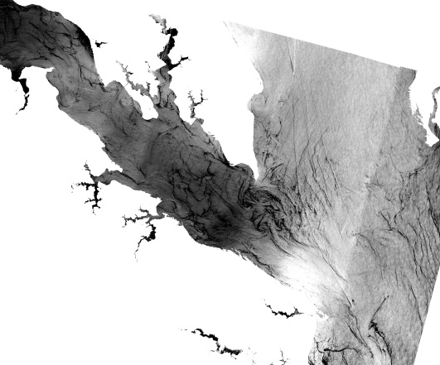
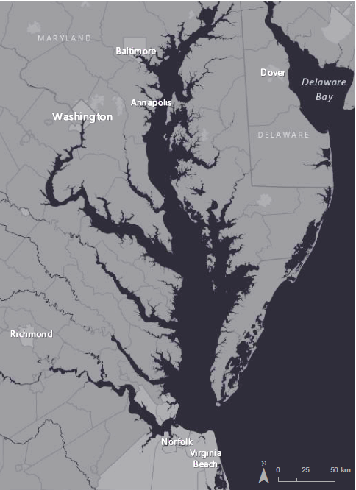
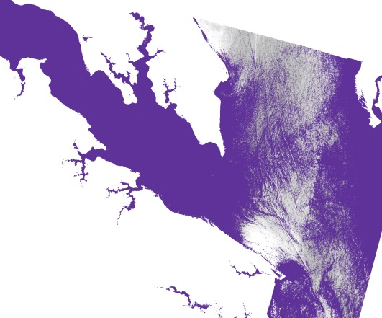
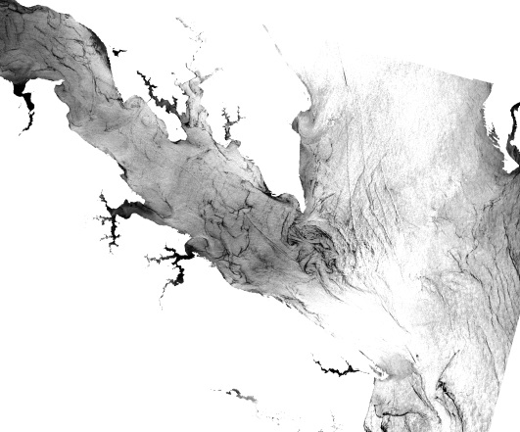
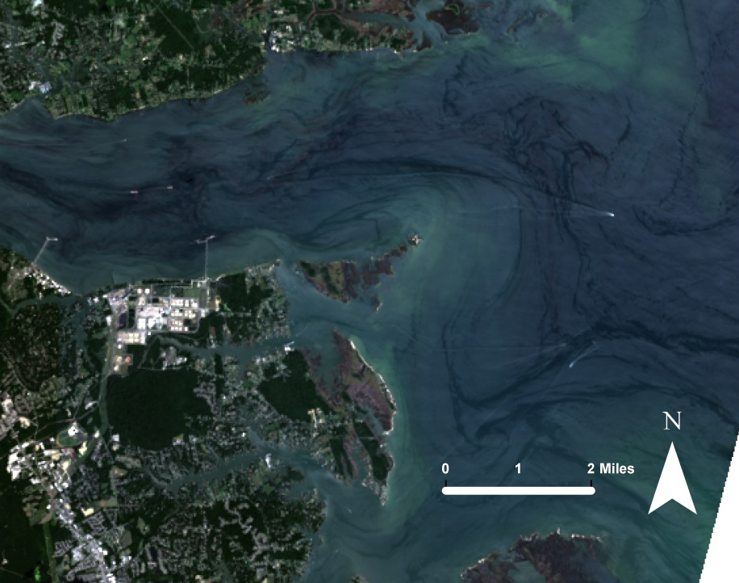
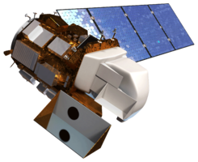
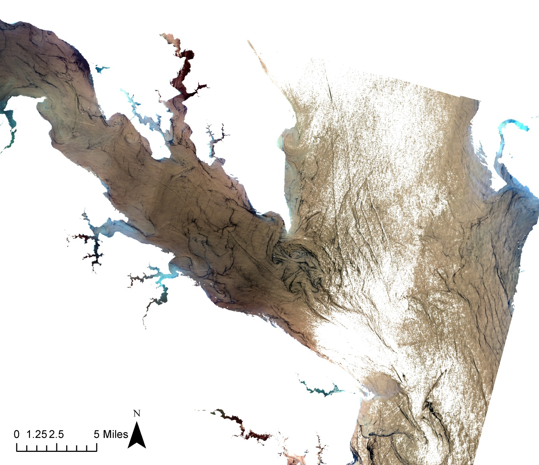
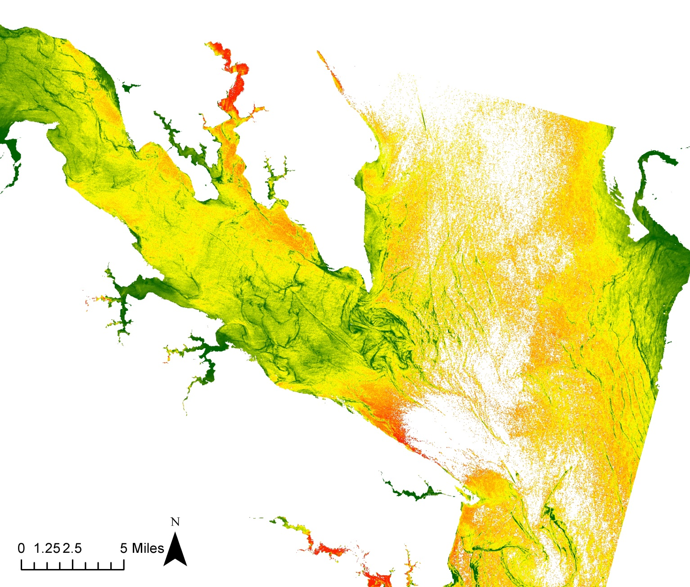
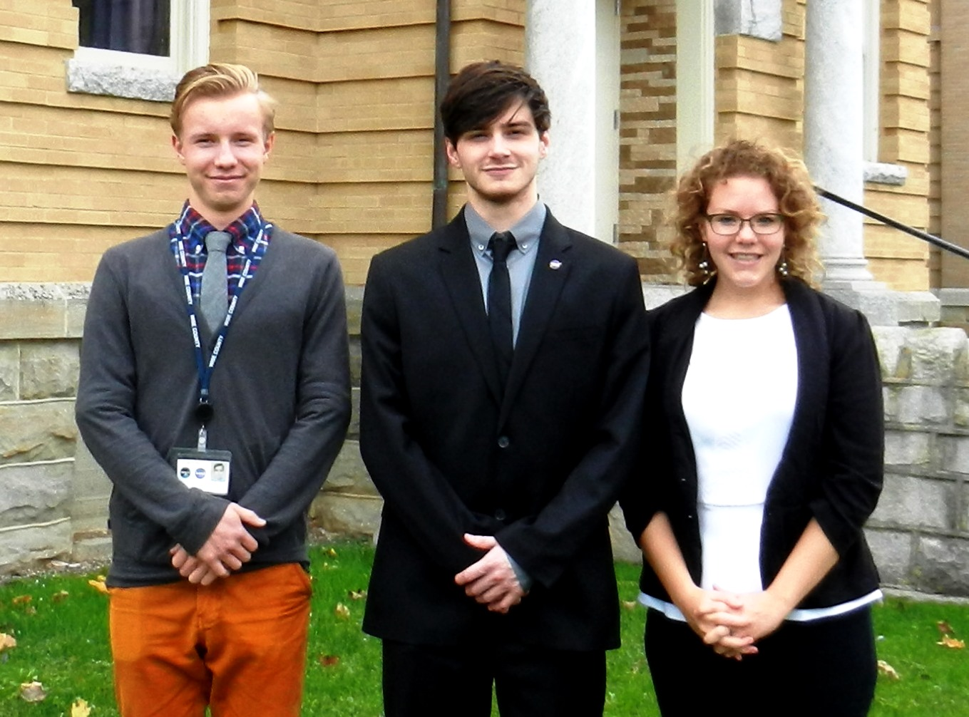
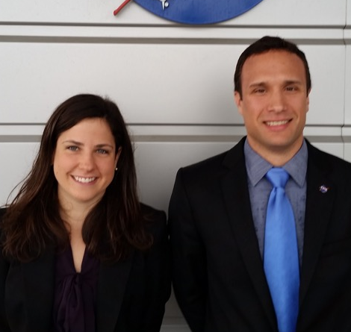
Virginia Water Resources II
Utilizing NASA Earth Observations to Monitor the Extent of Harmful Algal Blooms in the Lower Chesapeake Bay Watershed
Arika Egan¹ (Project Lead), Zachary Tate¹, Jakub Blach¹, Jessica Jozwik², Tyler Rhodes²
NASA DEVELOP National Program at ¹Wise County and ²Langley Research Center
Abstract
Objectives
Harmful Algal Blooms (HABs) in the Chesapeake Bay Watershed have an increasingly negative effect on the ecosystems in which they grow. They deprive their ecosystem of oxygen, produce harmful toxins, and mechanically damage other organisms. This disrupts the natural water chemistry and causes large-scale fish mortality events. Scientists from the Virginia Institute of Marine Science (VIMS) and Old Dominion University (ODU) monitor HABs and their effect on the water quality; however, the Chesapeake and its estuaries are geographically too large for the groups to continuously monitor HABs. This limits the group’s ability to monitor up-to-date locations of HABs and the water quality associated with them. To remedy this, surface reflectance data from Landsat 8 obtained from the USGS Earth Explorer and in-situ data from VIMS and ODU were combined to create a tool that produces a map of algal hotspots in the Chesapeake Bay area. Data were collected from August 17th, 2015. This tool will allow scientists at VIMS and ODU to identify the location of algal hotspots using current Landsat 8 data, as well as give them the ability to assess the timing, magnitude, duration, and frequency of HABs in the Chesapeake Bay Watershed.
Create a python tool to estimate chlorophyll-a concentrations for the Chesapeake Bay Watershed, using data from Landsat 8 OLI
Cultivate a better understanding of the causes and impacts of Harmful Algal Blooms to better inform policies that combat pollution of the Chesapeake Bay.
Improve routine and emergency assessment of Harmful Algal Blooms in the Chesapeake Bay
Study Area
Study Period: August 17th, 2015
Methodology
Landsat 8 OLI/TIRS reflectance bands
Aqua MODIS chlorophyll-a
VECOS in situ water quality data
NOAA bathymetry data
Acquisition
Raw Landsat 8 Band 1
Land and cloud pixels are removed
Remove land and cloud pixels
Remove shallow and high sediment pixels
Create NDVI and 5, 4, and 3 color composition
ArcGIS
ArcMap
Bathymetry Mask
Shallow (<2m) pixels are removed
Python
Chesapeake Bay
Chlorophyll Hotspot Identifier
Sediment Mask
High sediment concentrations are removed
Results
The Chesapeake Bay Chlorophyll Hotspot Identifier takes in raw Landsat 8 data
Two final maps are created: a 543 color composition and a normalized difference vegetation index (NDVI)
Preconfigured symbology stretches for each map are applied to view chlorophyll concentrations
Earth Observations
Landsat 8 OLI
True color composition of York River mouth and Chesapeake Bay
Conclusions
The objective of this project was to provide the Virginia Institute of Marine Science with a code that identifies hotspots of chlorophyll in the Chesapeake Bay.
The Chesapeake Bay Chlorophyll Hotspot Identifier creates maps displaying chlorophyll concentration for different areas in the Chesapeake Bay Watershed, thereby highlighting the presence of harmful algal blooms.
These maps may be used to help identify and track the occurrence, timing, duration, and magnitude of harmful algal blooms.
It’s uncertain which final product map produces the best gradient of chlorophyll concentration.
It’s uncertain that a single statistical stretch is applicable to the entire watershed, nor what range of statistical parameters provides the best stretch for displaying chlorophyll concentrations.
More data is required to create a more robust chlorophyll prediction model that can provide predictions of chlorophyll concentration.
Landsat 8 bands 5, 4, and 3 color composition, highlighting chlorophyll concentration
Landsat 8 bands 5 and 4, combined in a normalized difference vegetation index composition, highlighting chlorophyll concentration
Team Members
Project Partners
Acknowledgements
Dr. Kim Reece, Virginia Institute of Marine Science
Russ Baxter, Virginia Deputy Secretary of Natural Resources for the Chesapeake Bay
Will Hunley, Hampton Roads Sanitation Department
Todd Egerton, Department of Biological Sciences, Old Dominion University
Advisors
Dr. Kenton Ross, NASA DEVELOP National Science Advisor
Bob Vangundy, University of Virginia’s College at Wise
Dr. DeWayne Cecil, Global Science and Technology Inc.
Melanie Salyer, Mentor at Wise County Clerk of Court’s Office
Jessica Jozwik & Tyler Rhodes
Langley Research Center
Previous Contributors
Arika Egan, Zachary Tate, & Jakub Blach
Wise County Clerk of Court
Dr. Sara Lubkin, University of Mary Washinton
Cassandra Morgan
Wise County and NASA Langley Research Center

