Slide 1
The Levant and Central American Climate I
Monitoring Precipitation and Drought to Enhance U.S. Air Force Predictions and Decision-Making in the Levant and Central America
Alec Courtright (Project Lead)
Hayley Hajic
Christie Stevens

Slide 2
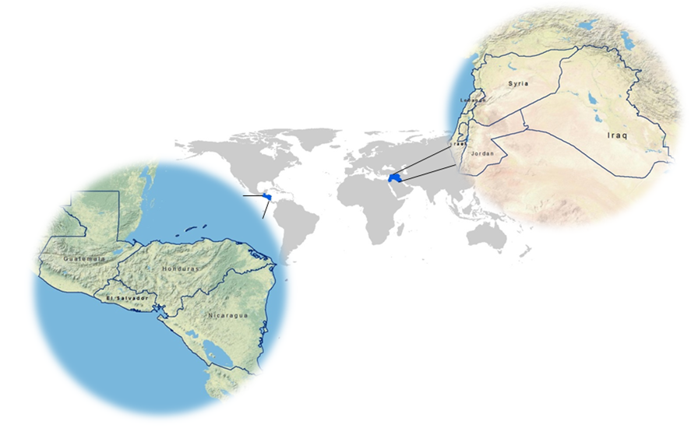
Study Area
Image Credit: Christie Stevens and Hayley Hajic
The Levant: Syria, Lebanon, Israel, Jordan and Iraq
Central America: Guatemala, Honduras, El Salvador and Nicaragua
Study period:
June 1981- December 2015

Slide 3
Nicaragua Drought 2014
Dry Las Canoas Reservoir
Image Credit: Diana Ulloa
Community Concerns
Heavy Precipitation
Flooding, water contamination, landslides
Drought
Depletion of water resources
Crop failure and livestock die off
Water Stress
Agricultural stress, strain on resources, catalyst to conflict
Notes:
Image source: http://www.ticotimes.net/wp-content/uploads/2014/08/140807NicaraguaDrought01-1000x666.jpg

Slide 4
Background
Changing Climates
Both Central America and the Levant are vulnerable to drought and changing precipitation patterns
USAF 14th Weather Squadron
Weather and climate data is used to aid in military decision-making
Water stress in both Central America and the Levant Region can catalyze conflict – as seen in Syria in 2011
Conflict
Notes:
explain NDVI and discuss the goals of the 14th weather squadron.

Slide 5
Objectives
1
Analyze Normalized Difference Vegetation Index (NDVI) data and create climatologies from 1981-2015 of both Central America and the Levant region to enhance the 14th Weather Squadron’s decision-making capabilities.
2
3
Document normal and anomalous conditions to assess trends in extreme-weather events
Evaluate and compare capabilities of both NOAA AVHRR and NASA MODIS NDVI in drought and heavy precipitation monitoring
Image credit: Zachi Evenor
Notes:
Image source: http://www.ancient-origins.net/news-history-archaeology/scientists-discover-earliest-known-evidence-plant-cultivation-levant-003494
very clearly list in bullet point format the objectives

Slide 6
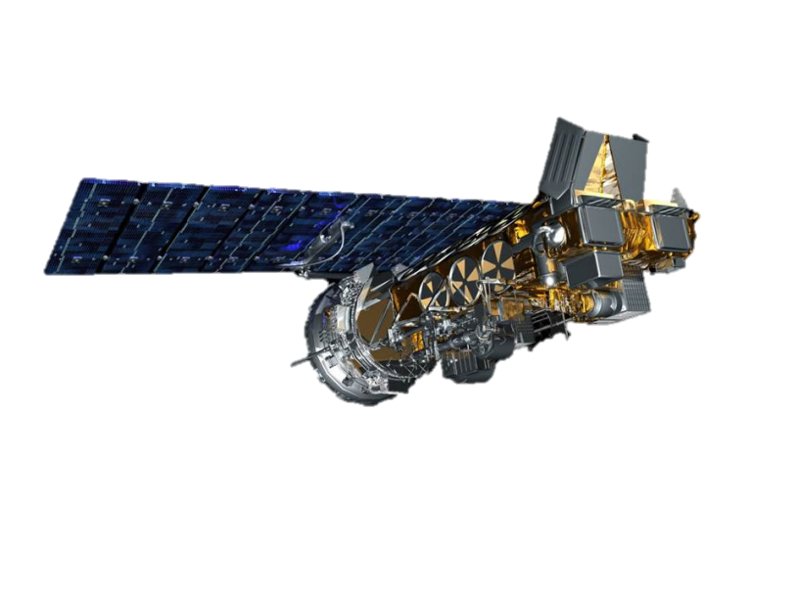
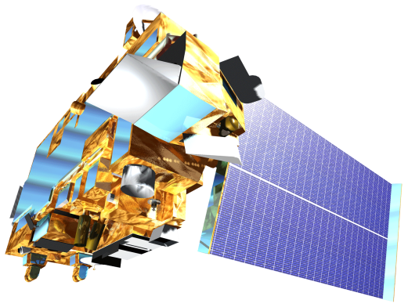
Earth Observations
AVHRR – National Oceanic and Atmospheric Administration (NOAA) – multiple NOAA satellites, NDVI
MODIS – NASA product– Terra satellite, NDVI
Notes:
pictures of our satellites

Slide 7
Project Partners
United States Air Force 14th Weather Squadron

Slide 8
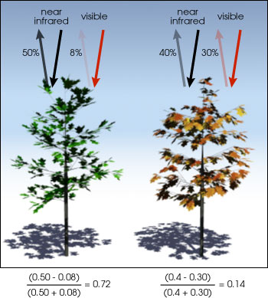
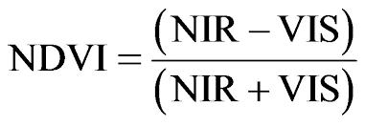
NDVI
Normalized
Difference Vegetation
Index

Slide 9
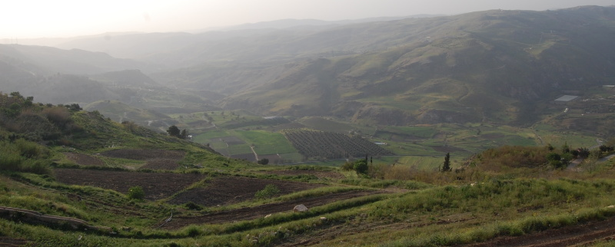
Image Credit: Paul
Methodology
Data Acquisition and Processing
Data Analysis
Results
Notes:
Image Source: http://spankyford.aminus3.com/image/2012-05-08.html
https://imgflip.com/i/zvsq4
https://imgflip.com/i/zvtc4

Slide 10
Data Analysis
Climatologies
Created daily and monthly baseline climatology maps averaging 1981-2015
Anomalous Months/Seasons
Identified anomalous months and seasons
Seasonality Trends
Analyzed anomalies for season and ENSO event related trends

Slide 11
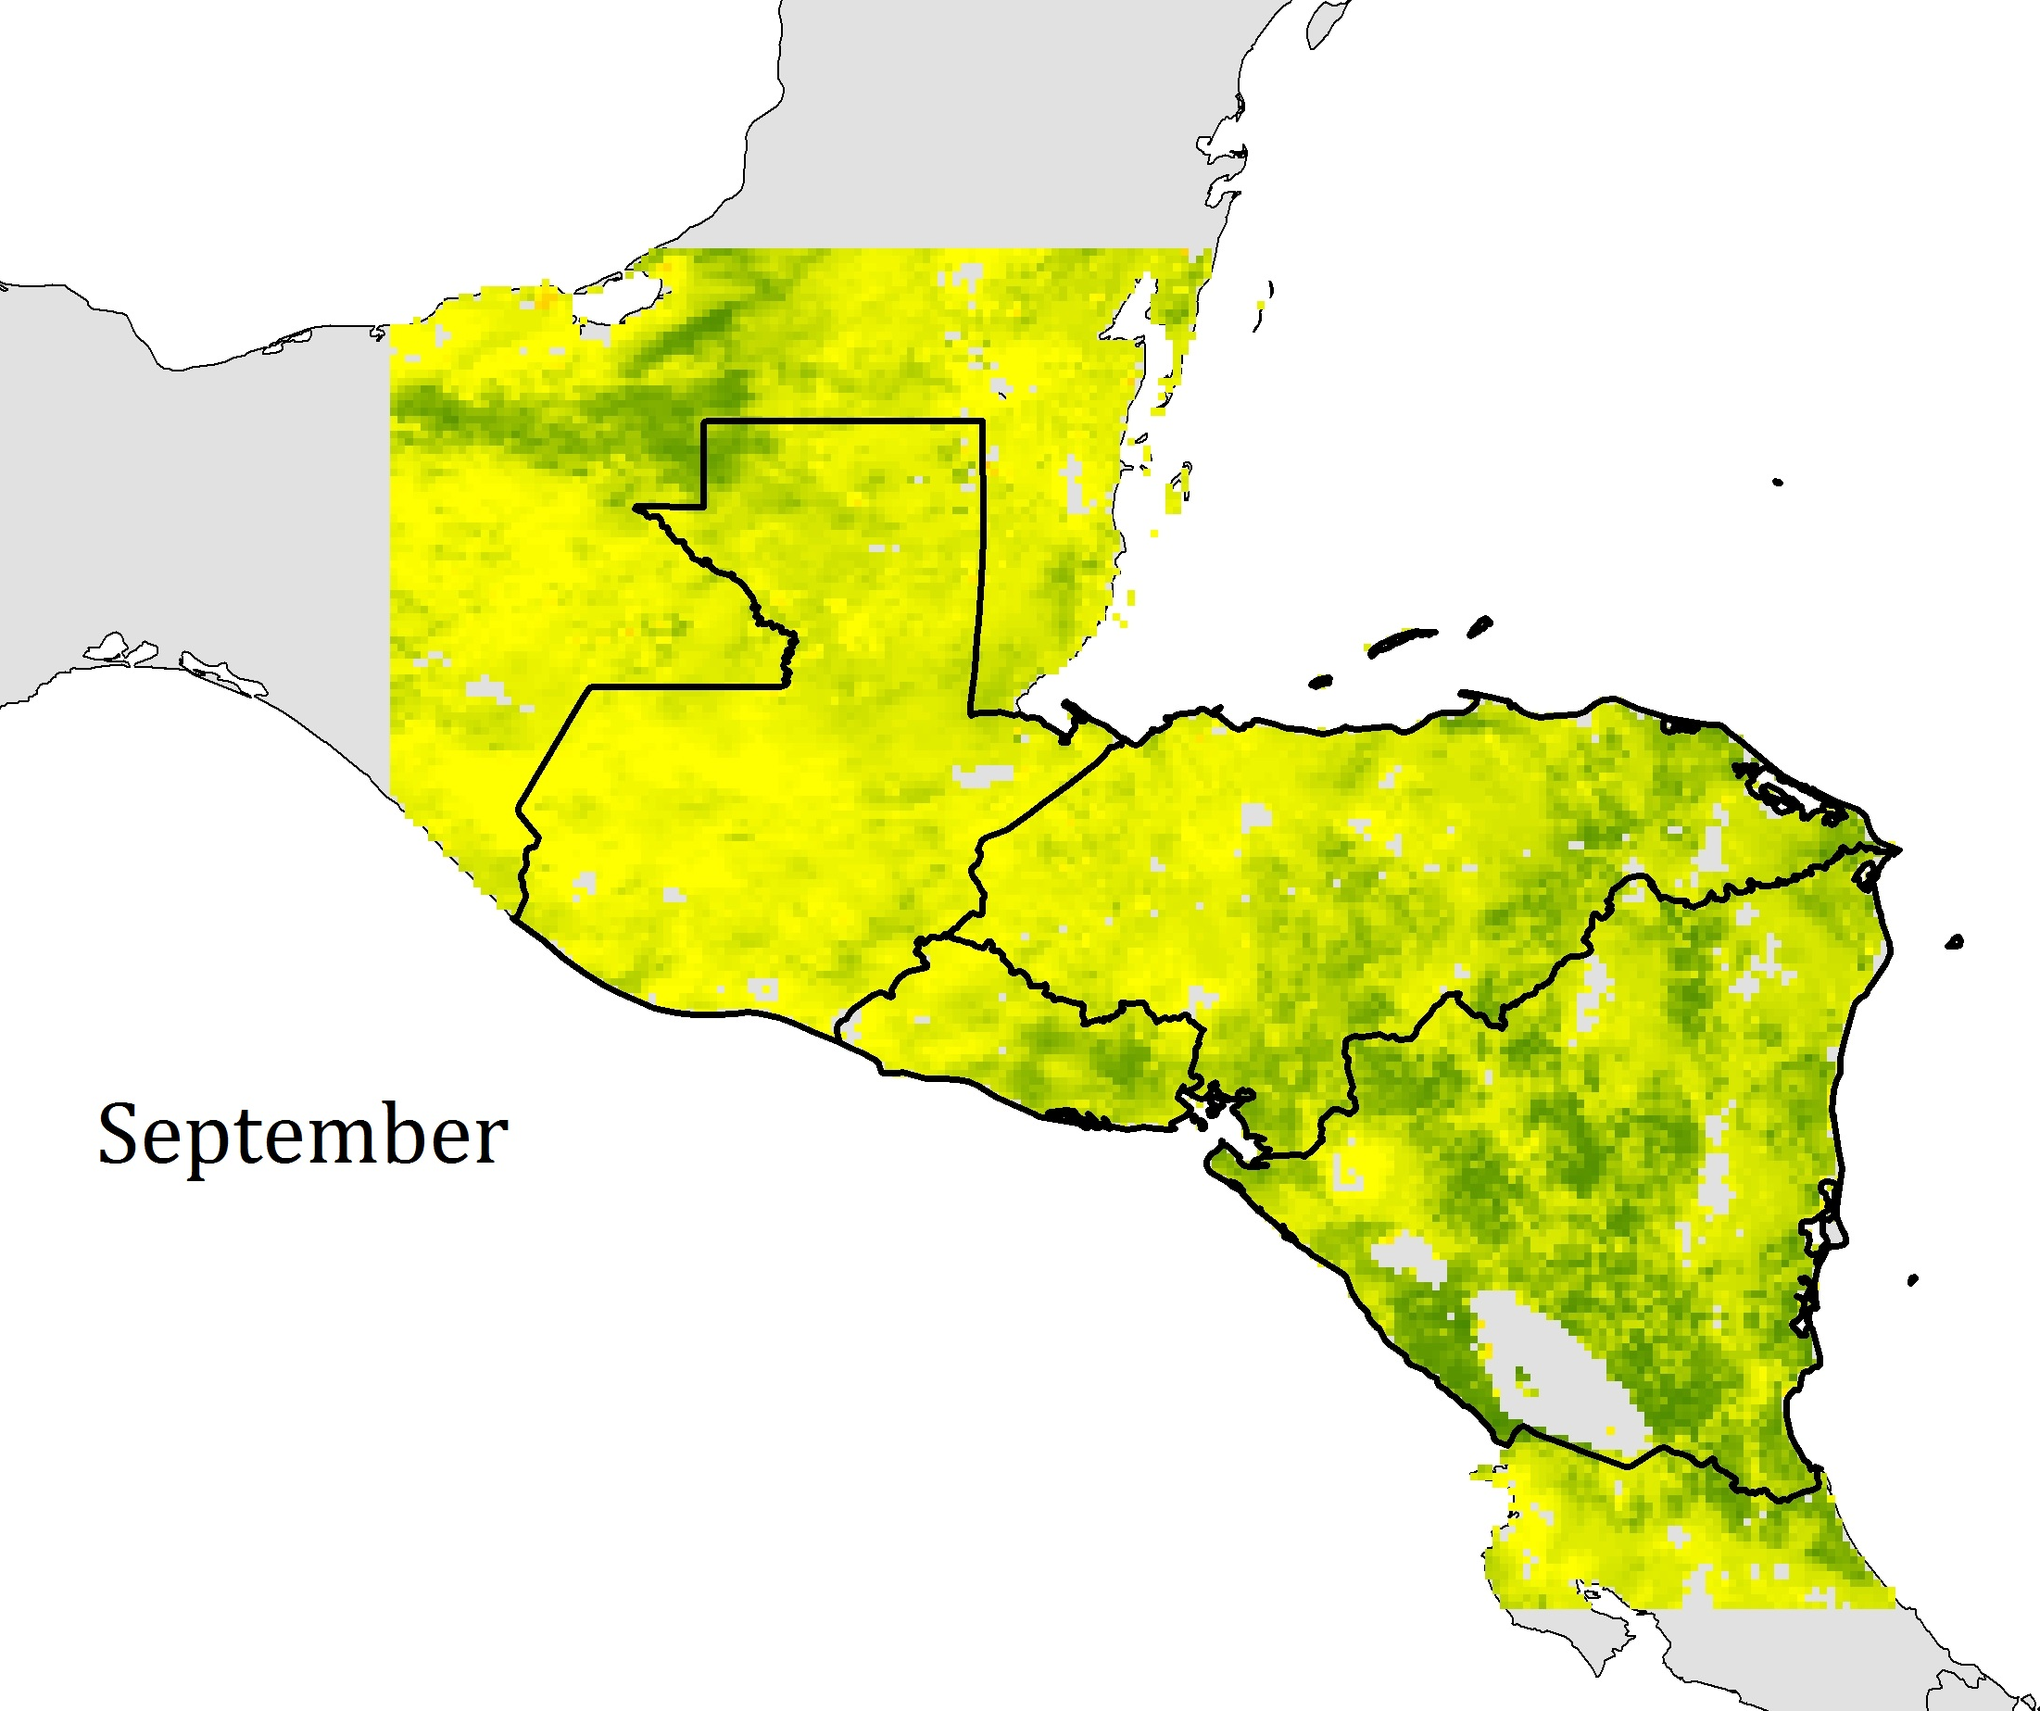
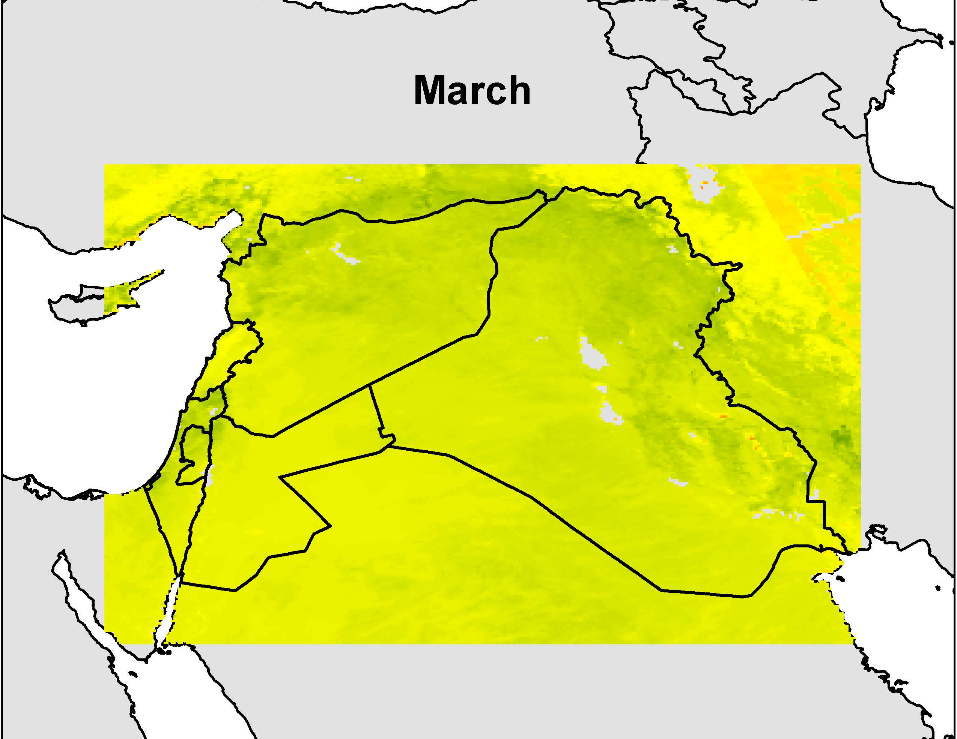
Images made by team
Climatologies
Create Climatologies
Daily and Monthly NDVI
For both Levant and Central American regions
Central America (Placeholder)
Levant Region (Placeholder)

Slide 12
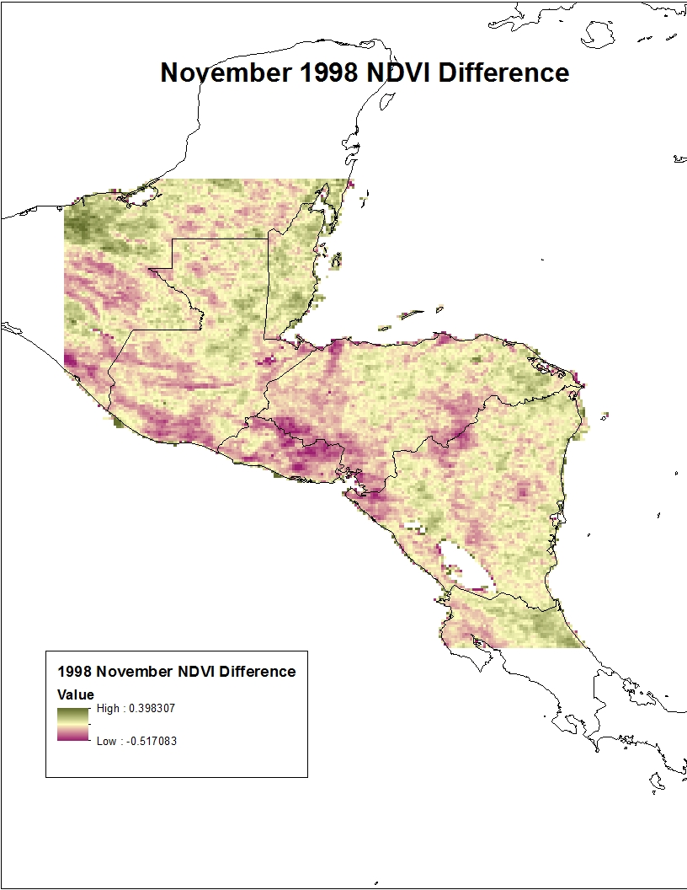
Images made by team
Anomalous
Months and Seasons
Calculated difference maps
Monthly difference from climatologies
Seasonal (wet and dry as well as traditional) differences
Image made by Team

Slide 13
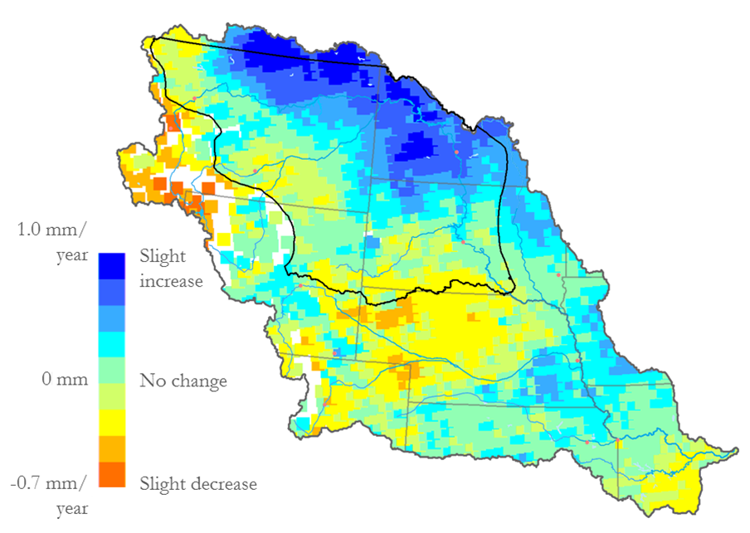
Seasonality Trends
Assess Seasonality
Examine seasonality for 90-day comparisons
Evaluate NDVI trends in wet and dry seasons
Evaluate ENSO event NDVI trends
Example Trend Map Image

Slide 14
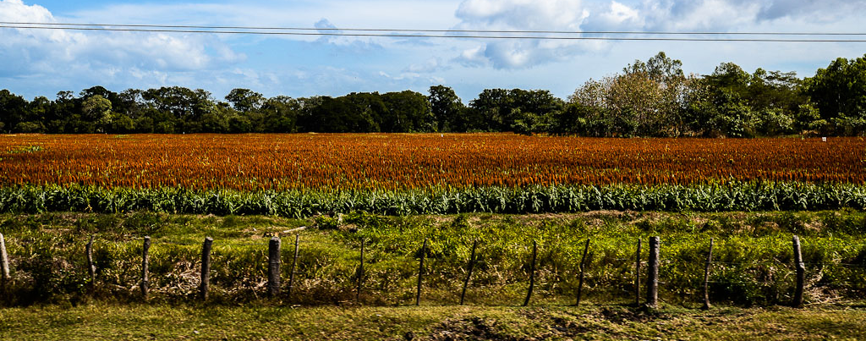
Results
Climatology Maps
Anomaly Maps and Graphs
Seasonal Trend Maps and Graphs
Image Credit: Ben Moffitt and Pegah Pourkarimi
Notes:
Image Source: http://www.tothenextjourney.com/2012/12/28/nicaragua-a-land-of-volcanoes-wind-and-waves/

Slide 15
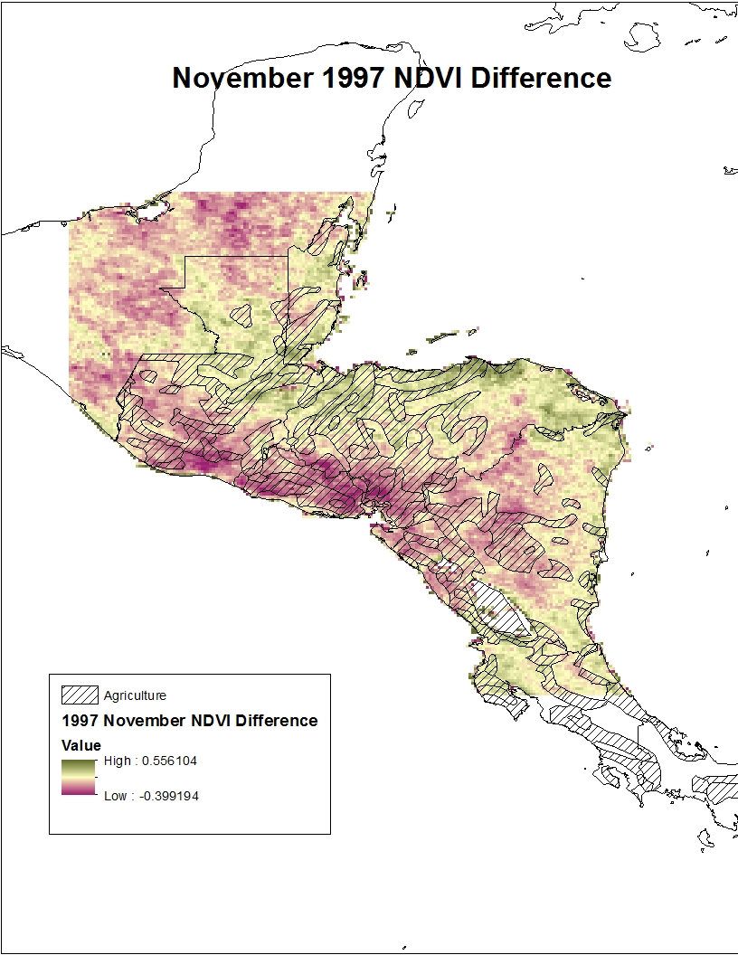
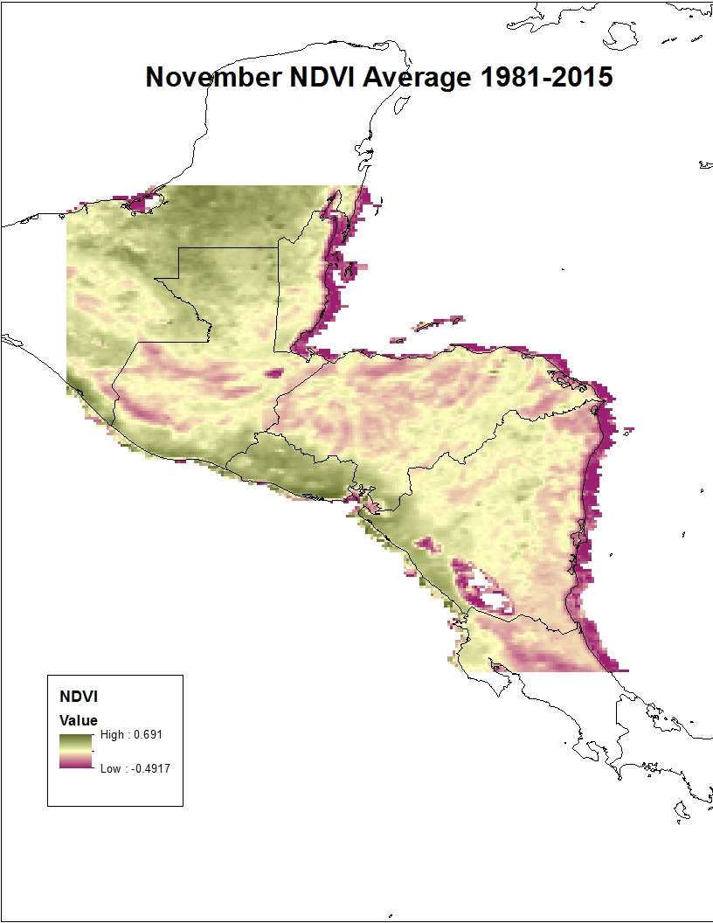
Climatologies
Figures X-Y: (Examples) show the climatology of NDVI in Central America

Slide 16
Seasonality
Figure X: Example Trend Map Image

Slide 17
Conclusions

Slide 18
Limitations

Slide 19
Future Work

Slide 20
Advisors
Dr. DeWayne Cecil, NOAA NCEI
Partners
US Air Force, 14th Weather Squadron
POC: Major Ryan Harris
Raymond Kiess
David Ramsaur
Ryan Smith
Jeremy Anthony
Others
Jessica Sutton, Center Lead, NASA DEVELOP National Program
Emma Baghel, Assistant Center Lead, NASA DEVELOP National Program

