Slide 1

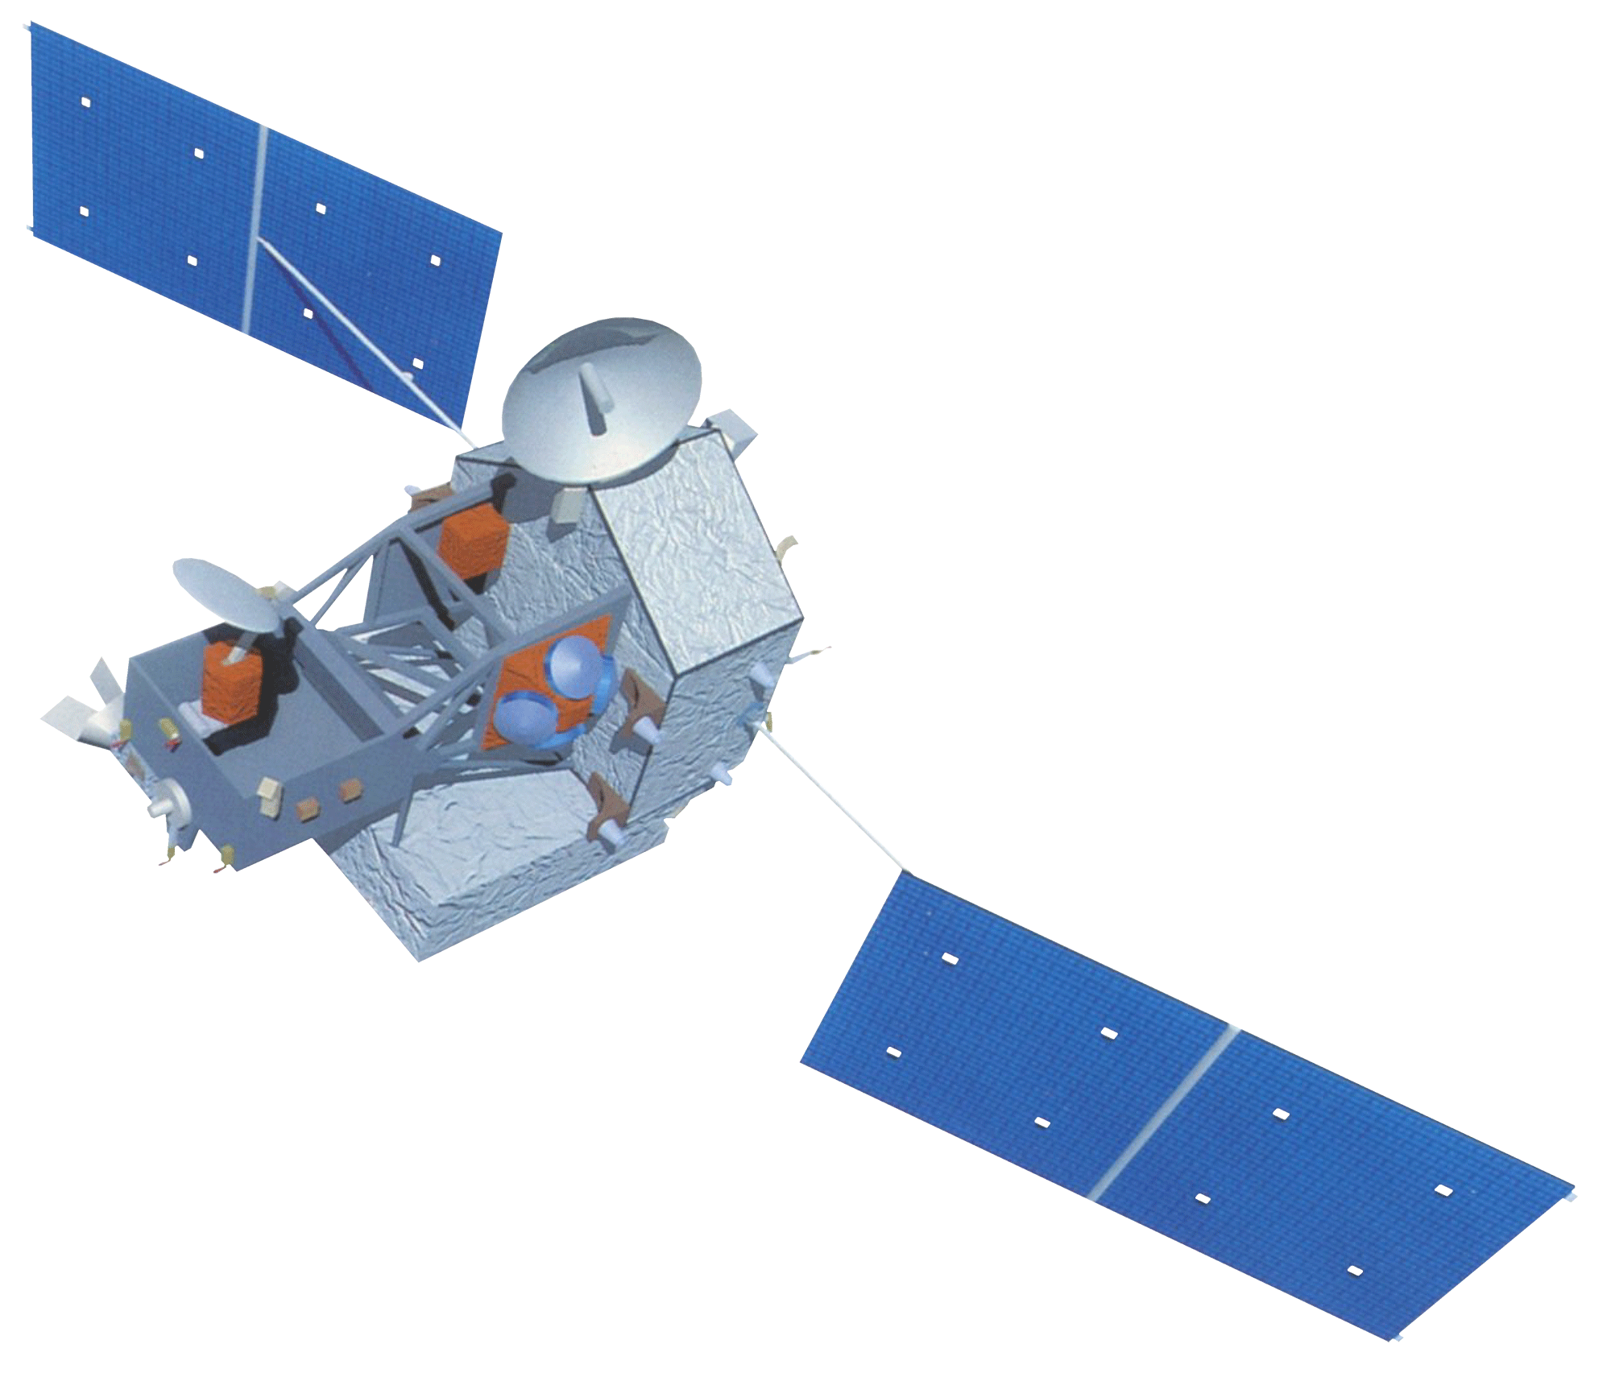


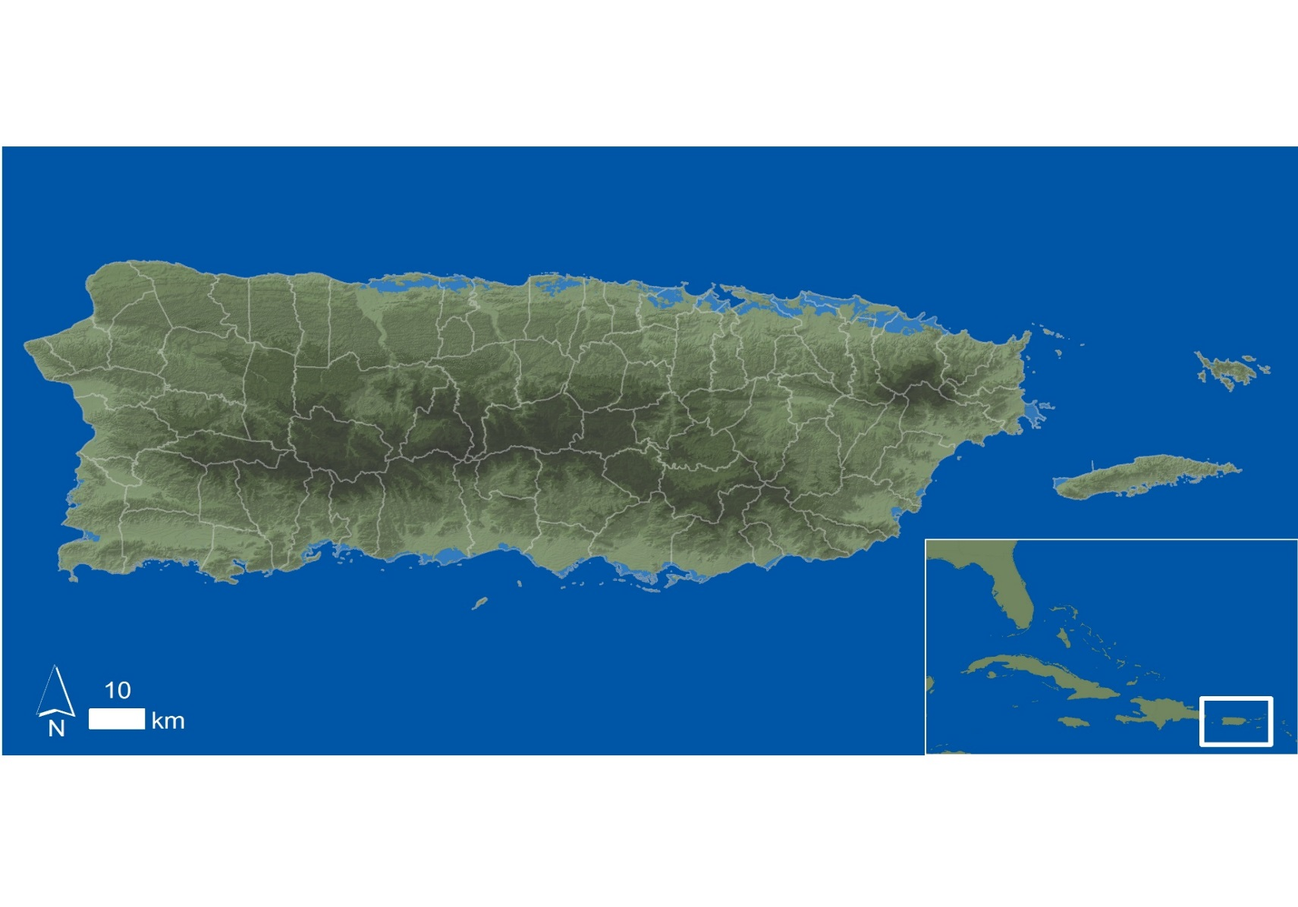


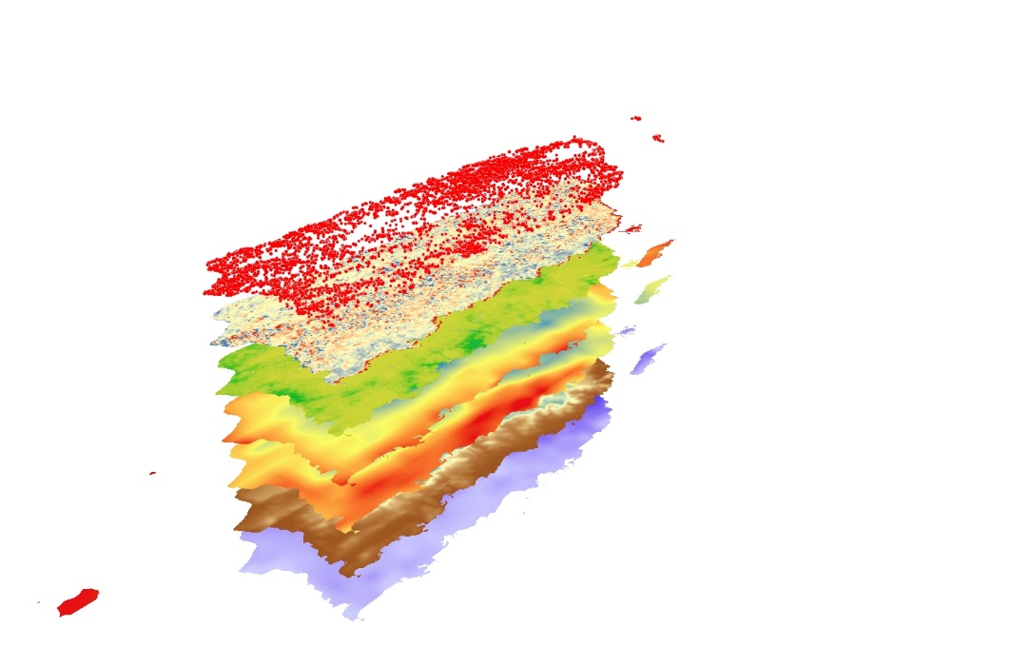
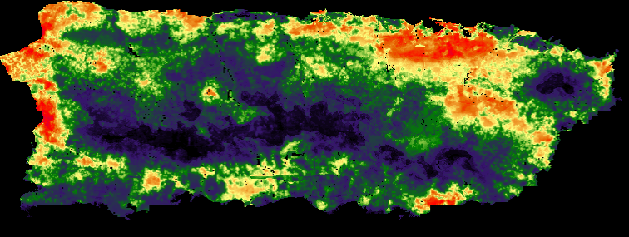
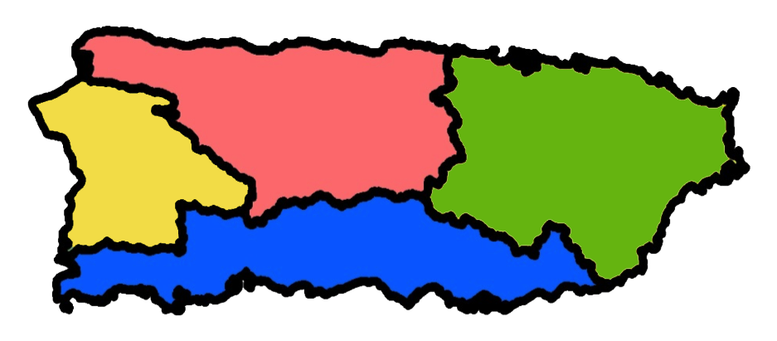
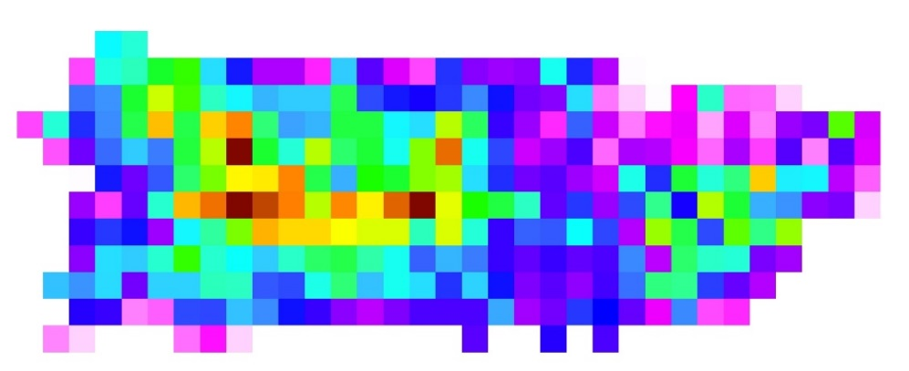
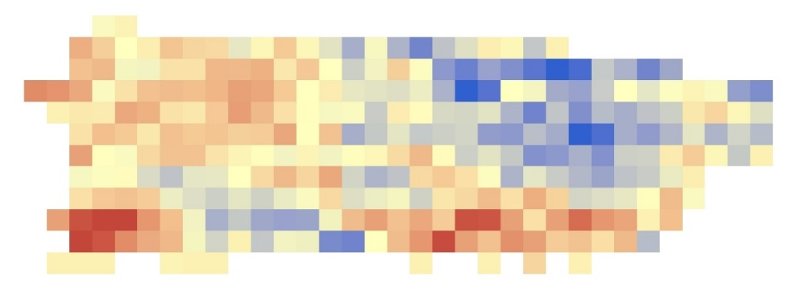

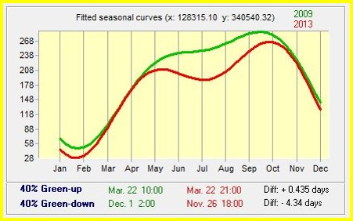
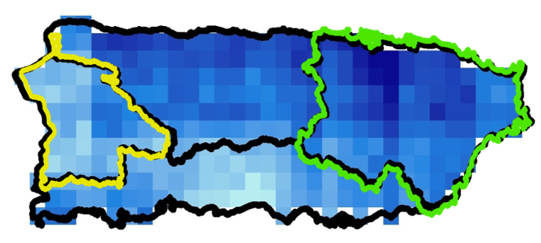
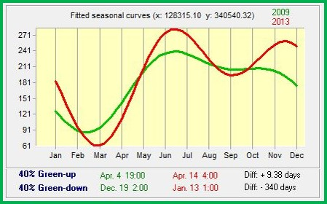
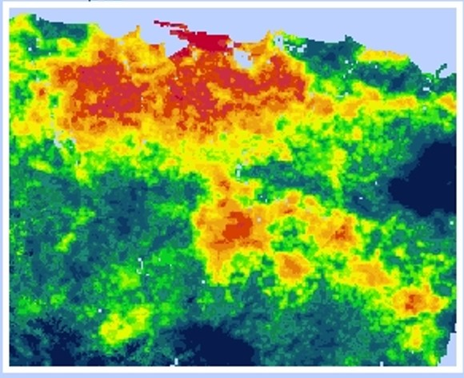
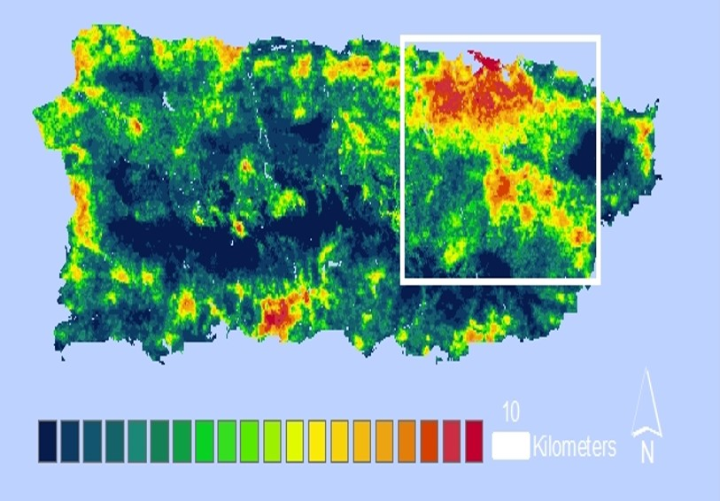
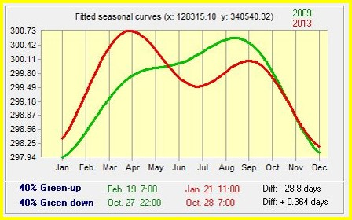
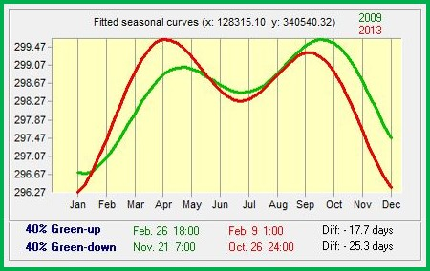
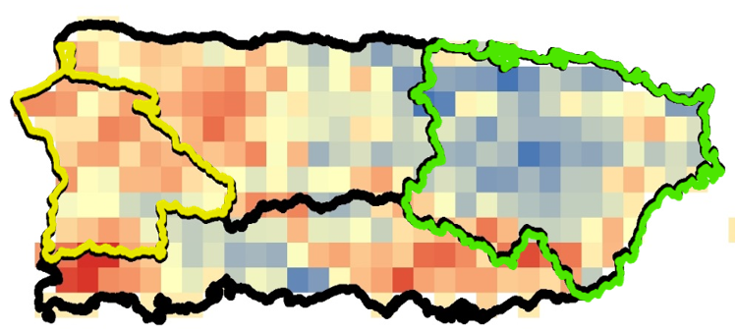
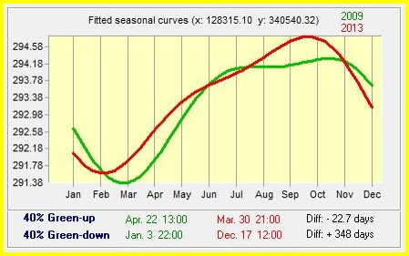
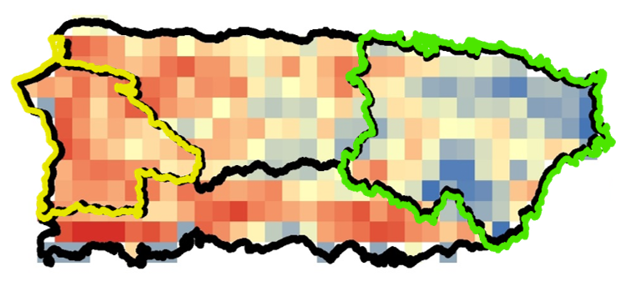
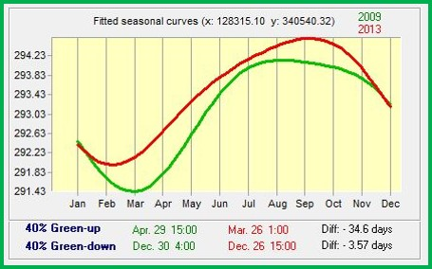
Puerto Rico Health & Air Quality II
A Geospatial Assessment of Environmental Variability in Puerto Rico and its Relation to Confirmed Dengue Fever Cases
Andrew Nguyen (Project Lead^{)1,}, Martha Sayre¹
¹NASA Ames Research Center
Abstract
Earth Observations
Vector-borne diseases such as dengue fever, chikungunya, and Zika pose a major threat to the health of Caribbean communities. Aedes aegypti (A. aegypti), the primary vector of these viruses, is dependent on humans for reproduction, and has been detected in populated areas within Puerto Rico. The vector’s lifecycle and its transmission of dengue in Puerto Rico have been connected to specific environmental conditions. This study examined environmental conditions related to Confirmed Dengue Fever Cases (CDFC) for Puerto Rico from January 2009 - December 2013 to model the distribution of dengue-infected A. aegypti and its relationship to these conditions. This project used monthly NASA Terra/ Aqua MODIS Normalized Difference Water Index (NDWI), along with day and night land surface temperature (DLST / NLST) products, Geostationary Operational Environmental Satellite system Puerto Rico Water Energy Balance (GOES-PRWEB) relative humidity (RH), Climate Hazards Group InfraRed Precipitation with Stations (CHIRPS) total precipitation (TP) modeled data, and Population Density (PopD) data from WorldPop. A Maximum Entropy Species Distribution Model and Earth Trends Modeler within Clark Labs’ TerrSet were used to spatially delineate monthly A. aegypti habitat suitability, determine the permutation importance of the environmental conditions, and quantify island-wide environmental trends. Population density and elevation had the highest mean relative importance above all other variables, which supports our background knowledge. TP had the highest mean relative importance of the dynamic environmental variables, while CDFC seasonality and environmental conditions moderately coincide with one another in the more recent years of the project time period. This agrees with several studies that climatic environmental conditions play a significant role in disease transmission from a geospatial standpoint.
Aqua-MODIS
TRMM-PR
Terra-MODIS
Landsat 5-TM
Objectives
Study Area
Project Partners
Team Members
Develop methods to examine the relationship between environmental conditions and A. aegypti proliferation throughout the island.
Use the Maximum Entropy Species Distribution Model to determine the contribution of environmental conditions to CDFC epidemics and produce A. aegypti habitat suitability maps.
Analyze seasonal and inter annual changes regarding environmental conditions to better understand the relationship between CDFC and environmental seasonality.
University of Puerto Rico, Graduate School of Medical Sciences
Center for Disease Control (CDC) – Dengue Branch
Puerto Rico Department of Health
The Commonwealth of Puerto Rico has an area of appx. 9,104 km². It is divided into 78 municipalities. The climate is tropical with annual average temperatures between 21°C and 27°C, and a rainy season from April to November. Climate varies along the length of the island, with the drier regions predominantly occurring in the south.
Methodology
Andrew Nguyen (Project Lead, left), Martha Sayre (right)
Maximum Entropy Habitat Suitability Model
Relative Importance of variables
to CDFC
Geospatial Assessment of A. aegypti Suitability
Monthly Jan 2009- Dec 2013
&
1) CDFC (CDC, In-Situ)
2) NDWI (MODIS)
3) TP (CHIRPS)
4) PopD (WorldPop)
5) DLST (MODIS)
6) NLST (MODIS)
7) RH (GOES-PRWEB)
8) Elevation (USGS)
ETM Study Regions
Seasonal Trend Analysis (STA)
Inter-Annual Trend Analysis
HUC-8 (Watershed Boundary)
The data project workflow. Two approaches were taken (upper and lower sections). The upper section outlines the environmental conditions as inputs into the Maximum Entropy model along with potential model results. The lower section outlines the use of Hydrological Unit Code 8 (HUC-8) as study regions for Earth Trends Modeler to delineate seasonal and inter annual trends.
TP Monotonic trends suggest decreasing rain in the west and increasing rain in the east. STA results for the west (yellow outline, left graph) and east (green outline, right graph) indicate drier seasons in the west, with more intense and earlier rainy seasons in the east.
Results
DLST Monotonic trends suggest increasing LST in the west and decreasing LST in the east. STA results for the west (yellow outline, left graph) and east (green outline, right graph) indicate more intense warmer seasons for both regions, with earlier and longer warmer seasons in the west.
PopD | 75%
Elevation | 9%
TP | 6%
DLST | 3%
NLST | 3%
RH | 3%
NDWI | 1%
MaxEnt Map outputs for dengue-infected A. aegypti during August 2010, the peak month of the largest epidemic (above figure). Red shades indicate higher suitability, while deep blue shades indicate lower suitability. The largest cluster of higher suitability can be seen in the upper right figure (boxed in red) within the San Juan metropolitan area. Areas with highest suitability correspond to low-elevation urban and developed areas, and areas with the lowest suitability are at higher elevations.
The mean relative importance results (above table) of each variable for each month during epidemic years. Population density was by far the most important contributor in epidemic years, followed by elevation and TP.
NDST Monotonic trends suggest increasing LST in the west and decreasing LST in the east. STA results for the west (yellow outline, left graph) and east (green outline, right graph) indicate more intense warmer and earlier seasons for both regions.
Acknowledgements
We would like to thank Emily “Chippie” Kislik and Victoria Ly from Ames DEVELOP for their input and guidance throughout this project, along with Nirav Nikunji Patel from WorldPop for providing gridded population density data for Puerto Rico. We would also like to thank Alannah Johansen from Ames DEVELOP for her vast contributions to the project during the previous term.
We would like to acknowledge Dr. Pablo Méndez-Lázaro from the University of Puerto Rico, Graduate School of Medical Sciences, and Dr. Roberto Barrera from the U.S. Centers for Disease Control and Prevention (CDC) Dengue Branch for project advisement and data sources. Lastly, we would like to thank Jessica Cabrera from the Puerto Rico Department of Health for her overall support on the project.
Conclusions
Population Density, Elevation, and TP have the highest importance for A. aegypti suitability
TP, DLST, and NLST seasons are closely related to Dengue seasons (May to November/ December time frame) when accounting for proper lag times
Its is Warmer and drier in the West overall during the most recent years for the study period
It is Warmer and wetter in the East during spring during the most recent years for the study period
NASA Ames Research Center

