Slide 1
Southeast Idaho Disasters
Juniper Encroachment and Management in the Western U.S. Relative to Catastrophic Wildfires
Zachary Simpson (Project Lead)
Jenna Williams
Sara Ramos
Notes:
The Southeast Idaho Disasters project began during the Fall 2015 DEVELOP term and will continue for one additional term. This project has focused on the expansion of juniper species across the Intermountain West and Great Basin. Team members include Zachary Simpson (project lead), Jenna Williams, and Sara Ramos.

Slide 2

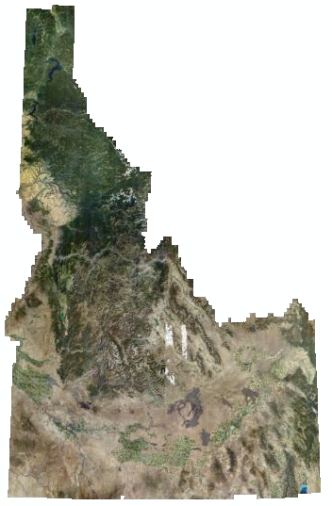
Datasets Used
NASA Earth Observations
Landsat 8 (OLI)
Ancillary Datasets
2011 NAIP
2013 NAIP
2014 RSAC
2014 SMA
2014 Idaho Cropland
NAIP 2013 0.5m Aerial Imagery
Svs.gsfc.nasa.gov
Notes:
This project focused on a variety of methods to detect juniper species. The project took a multi-scale approach using 30 meter Landsat 8 (provided by NASA Earth Observing Systems) and 1 meter 2011 National Agricultural Imagery Program (NAIP) imagery (provided by Inside Idaho) to detect juniper stands. Additional layers like SMA (Surface Management Agency) (provided by NASA RECOVER), and Idaho Cropland (provided by Inside Idaho) were used to mask out private land and agriculture. RSAC (US Forest Service’s Remote Sensing Application Center) (provided by the U.S. Forest service) was used to correctly identify juniper training and validation sites. .

Slide 3
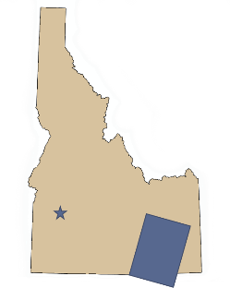
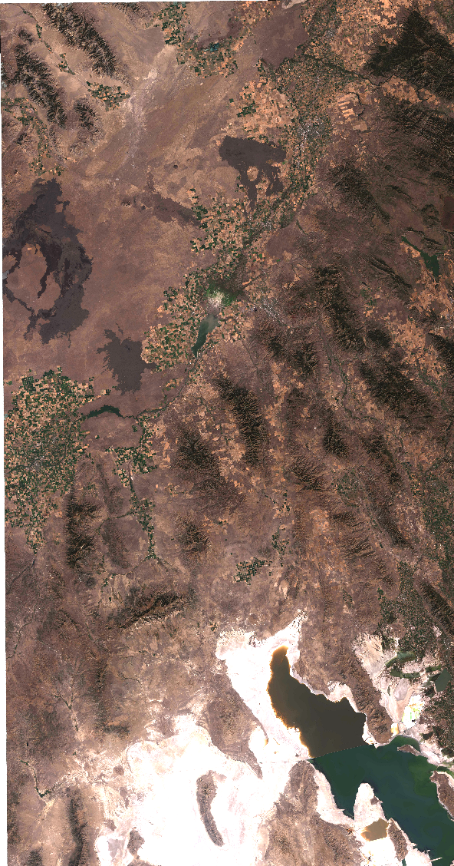
Study Area
Study Area
Southeast Idaho
WRS Path 39 Row 30
WRS Path 29 Row 30
Study Period
September 2015
Summer 2011
Notes:
Our study area was located in Southeast Idaho. Landsat 8 OLI satellite imagery was acquired for late September 2015 comprising Landsat WRS path 39 row 30 and 31. The study area encompasses the Snake River Plain, an area classified as a ‘cold desert’ that sustains much of the plant and animal life unique to this area. The ecology of this region include simi-arid savanna rangelands, sagebrush steppe ecosystems, and mountainous forest regions. A focused study area was provided by the BLM due to their interest in future management of areas effected by juniper encroachment.

Slide 4
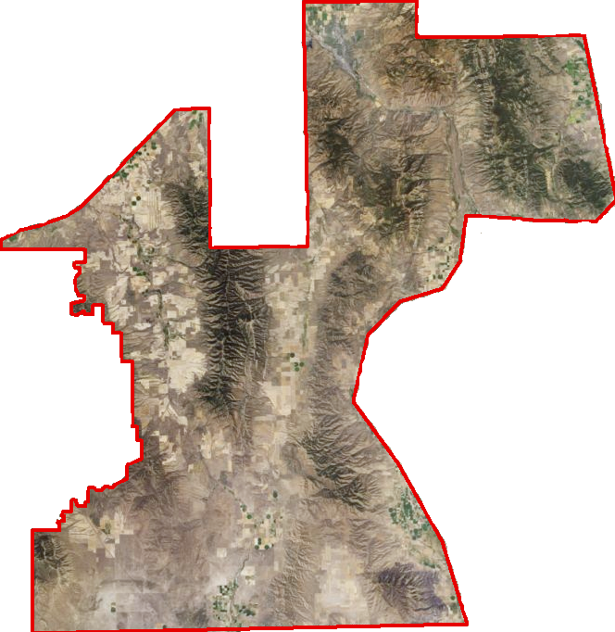
Focused
Study Area
Pocatello Creek
Inkom
A focused study area provided by the Bureau of Land Management was analyzed to determine existing juniper stands.
This areas extends from American Falls reservoir in the north to the Curlew National Grassland in the south.
Arbon
Holbrook
NAIP 2013
Notes:
The BLM wanted to evaluate the area that surrounds the Curlew National Grassland which is under direct threat from juniper encroachment and wildfire. The Curlew National Grassland also provides critical habitat for greater sage-grouse (C. urophasianus). The BLM wants to have information about areas that have phase I, II and III juniper stands so they can better allocate funds for encroachment management. Phase I <15% juniper cover where Phase II has between 15 and 45% cover and Phase III are areas with >45% juniper cover.

Slide 5
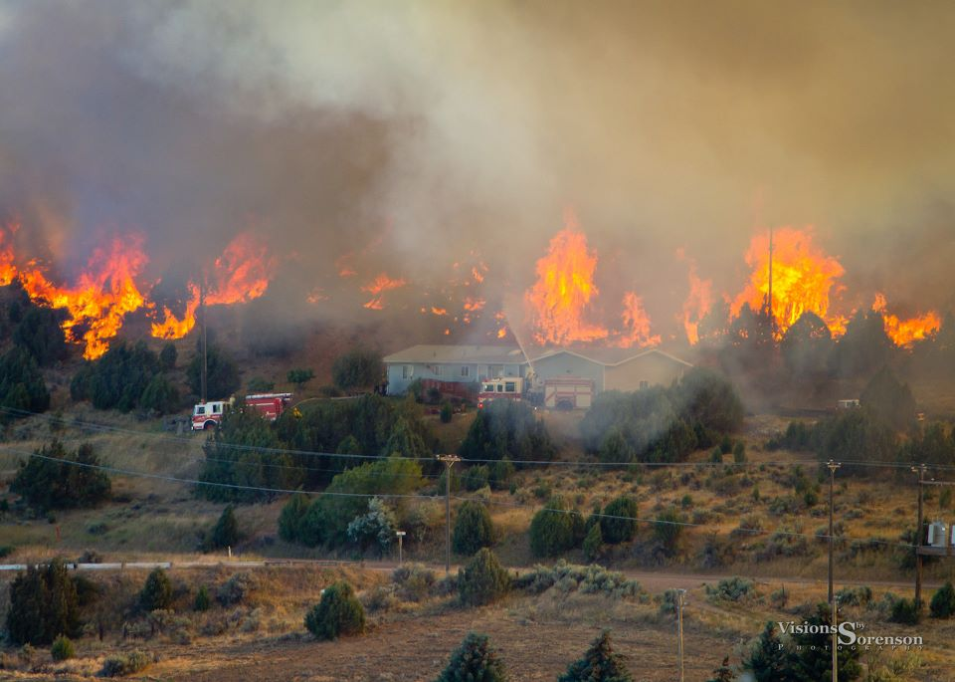
Source:abook.org
Community Concerns
The 2012 Charlotte Fire cost Idaho $211 million dollars in fire suppression expenditures.
In Idaho, juniper species have extended beyond their native habitats and are increasing wildfire severity and duration.
Expanded wildfire regimes significantly alter semi-arid savanna ecosystems.
Notes:
According to Miller and Tausch over the past 130 years the Great Basin and Intermountain West has seen juniper stands increase tenfold, fundamentally altering this landscape. The accumulation of juniper has increased the severity and duration of wildfire. Wildfire has altered many of the ecosystems in this area, especially detrimental to the sage brush obligate species, the greater sage grouse (Centrocercus urophasianus). With the expansion of the Wildland Urban Interface (WUI) more humans are at risk of catastrophic wildfire events like Charlotte Fire that occurred just outside of Pocatello, Idaho in 2012.
This fire destroyed 66 homes, 96 out buildings and caused the evacuation of 5,688 people. Mapping fire severity will help to identify communities-at-risk throughout the wildland urban interface and mitigate this risk. Wildfire disturbance can also alter entire ecosystems and further promote invasive species leading negative consequences for semi-arid ecosystem if not appropriately monitored and controlled.

Slide 6
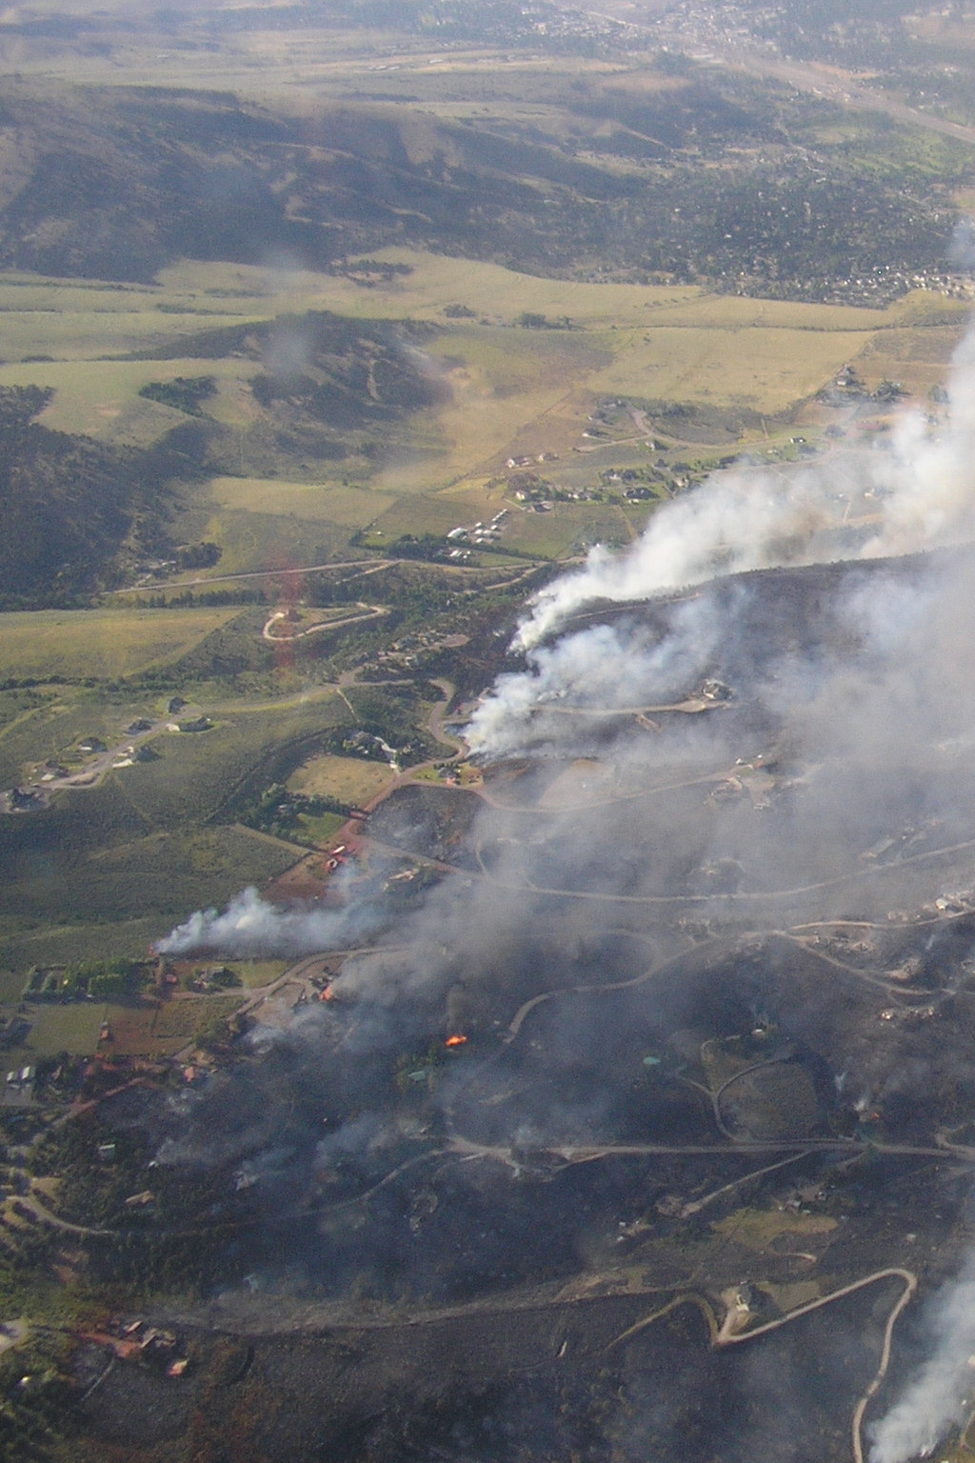
Objectives
Create a Juniper spp. distribution map to determine areas were there are high concentrations of juniper.
Overlay populated areas to juniper distribution map to determine areas where high wildfire severity is possible.
Credit: Chris Burger
Source: Greg Haxby
Notes:
The Bureau of Land Management is eager to map existing stands of juniper, in order to manage the encroachment of juniper. A juniper density map will help land managers allocate resources more efficiently and determine areas where ground truth studies will be most effective.
A fire severity map will identify areas where there is an abundance of juniper and other long burning heavy fuels. When high fire severity areas burn they burn longer and with greater intensity destroying soil nutrients, creating a water resistant layers that make it hard for native species to reestablish, and potentially destroy seed banks. Identifying these areas will help our end users in land restoration planning. Also by classifying these areas and overlaying population data will help determine communities at risk of wildfire events.

Slide 7
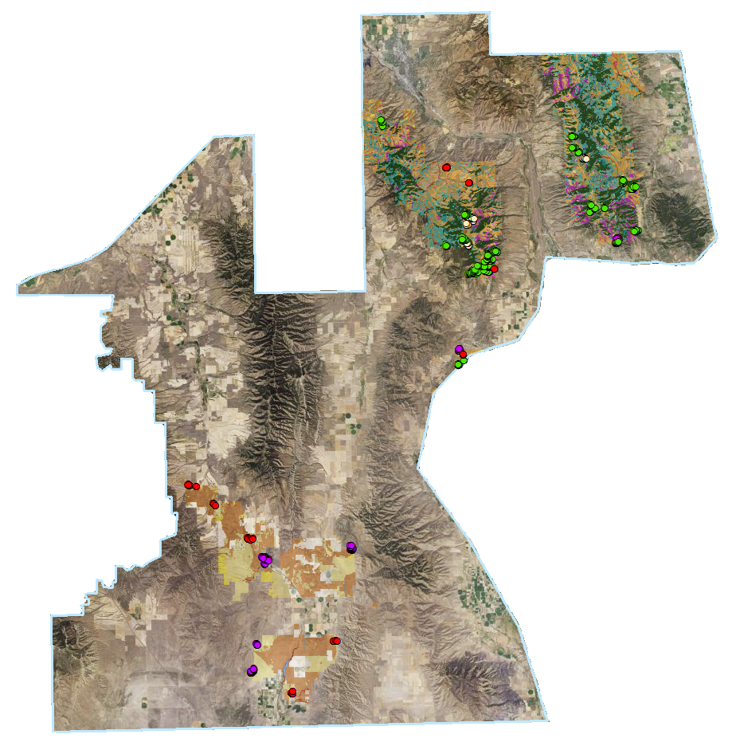
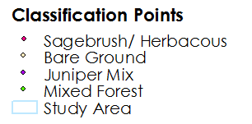
Methods
Classification site creation
Classification points were created in using;
2013 NAIP imagery with a 0.5 meter resolution
Remote Sensing Applications Center (RSAC) data was used identify known juniper dominant areas
Vegetation Type | Number of points
Sagebrush/ Herbaceous | 234
Bare ground | 211
Juniper Mix | 214
Mixed Forest | 276
Notes:
Four vegetation classes were selected; sagebrush/ herbaceous, bare ground, juniper mix, and mixed forest. Juniper mix included Western Juniper, Utah Juniper, and Pinyon-juniper because all of these grow within this region. Conifer, Douglas fur, and all other common woody trees are grouped into mixed forest. These points were digitized using 2013 NAIP imagery and correlated with 2014 Caribou-Targhee National Forest mid-level vegetation data from the US Forest Service Remote Sensing Application Center RSAC to correctly identify species type. The 935 classification sites were randomly divided, 60% were used to train the CTA model and the remaining 40% were used for validation.

Slide 8
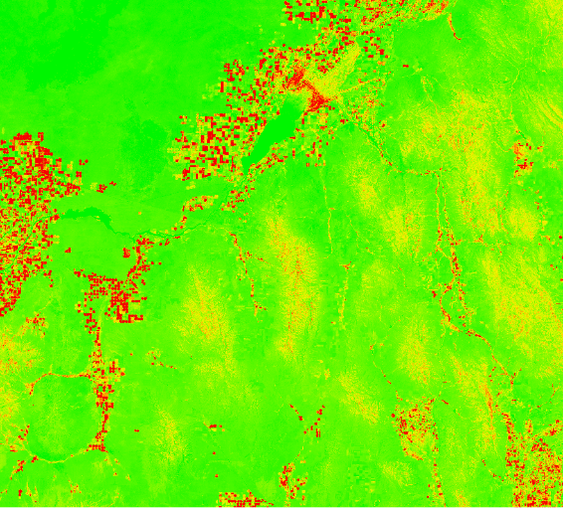

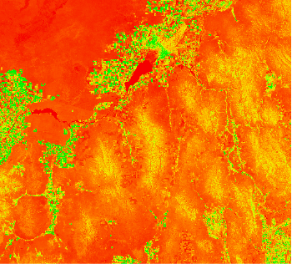
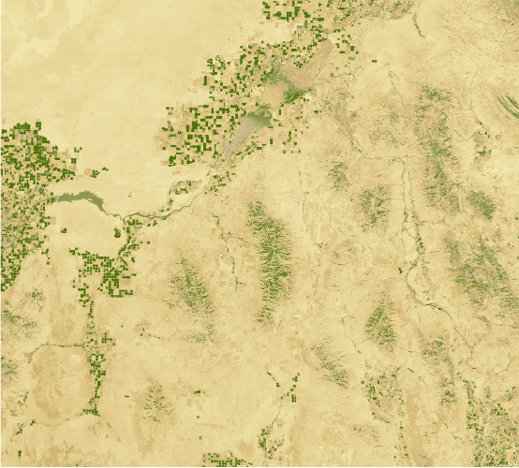
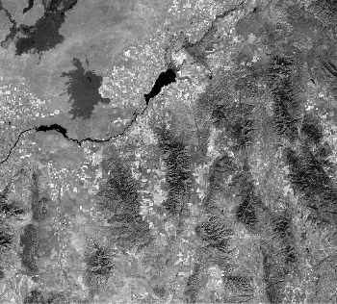

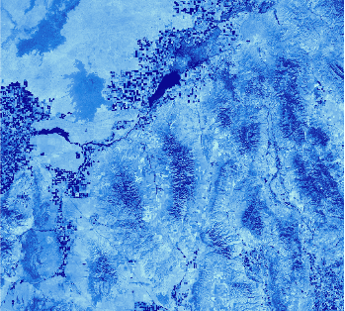



Methods
Image Processing
mSAVI2 and TCT were derived using IDRISI TerrSet VegIndex Modules
NDBSI = (TM6 – TM5) / (TM6 + TM5 + 0.001) * Baraldi et al., 2006
Modified Soil-Adjusted Vegetation Index | Tasseled Cap Transformation | Normalized Differenced Bare Soil Index
Notes:
Images were standardized and atmospherically corrected using the C-Cost model prior to being put into the CTA. Due to the semiarid ecosystem this area has a lot of bare soil so a normalized differenced bare soil index was created (Baraldi et al., 2006) in addition to mSAVI2 and Tasseled cap modules.

Slide 9
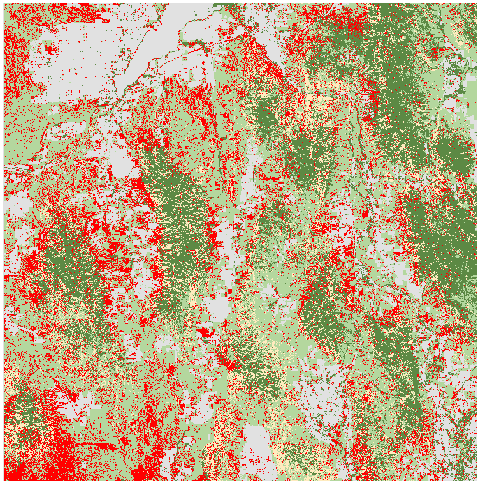

Methods
Classified Fuel Model
Classification Tree Analysis was used to differentiate areas with high concentrations of juniper.
Classification Points
Normalized Differenced Bare Soil Index
Modified Soil-Adjusted Vegetation Index
Sagebrush/Herbaceous
Bare Ground
Juniper
Mixed Forest
Mask
Notes:
Classification Tree Analysis was used to differentiate areas with high concentrations of juniper. CTA utilizes known classes and constructs a decision tree based upon similar values of reflectance. This CTA compared spectral signatures form sagebrush, bare ground, juniper and mixed forest pixels.

Slide 10
Classification Results
Accuracy Assessment for Classified Fuel Model
Error Matrix Analysis – CTA Results
 | Sagebrush/ Herbaceous | Bare Ground | Juniper Mix | Mixed Forest | Total | ErrorC
Sagebrush/ Herbaceous | 60 | 2 | 1 | 0 | 63 | 0.04
Bare Ground | 1 | 53 | 7 | 6 | 67 | 0.21
Juniper Mix | 7 | 4 | 60 | 1 | 72 | 0.16
Mixed Forest | 0 | 10 | 6 | 108 | 124 | 0.12
Total | 68 | 69 | 74 | 115 | 326
ErrorO | 0.12 | 0.23 | 0.19 | 0.06 |  | 0.13
Kappa coefficient: 0.81
Notes:
An error matrix compares correctly classified points to incorrectly classified points. The Kappa coefficient uses this error matrix and gives an inter-rater agreement taking into account agreement occurring by chance. A Kappa coefficient of 1 represent perfect classification.
Accuracy assessment of the fuel model produced an overall accuracy of 86% with a kappa coefficient of 0.81. The model is able to accurately identify dense juniper stands while leveraging 30 meter Landsat 8 imagery. Using these results a pixel-based fire severity model was produced that and overlaid with BLM community concerns highlighting towns that are at greatest risk for catastrophic wildfire event especially communities that are building in the WUI.

Slide 11
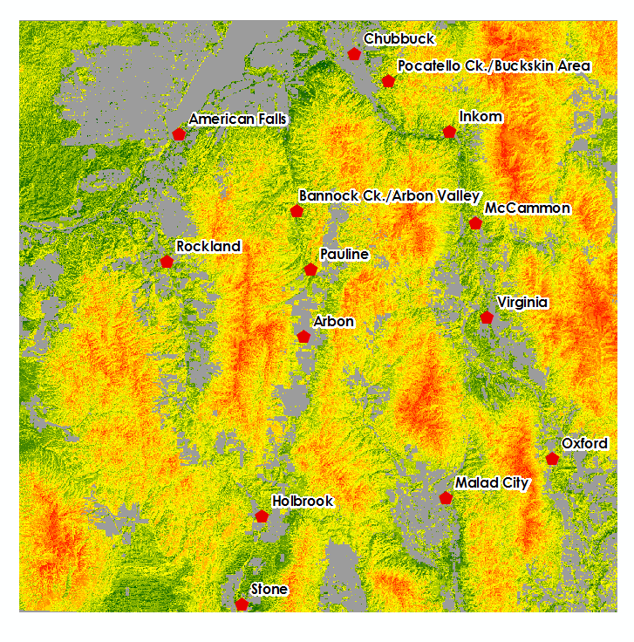
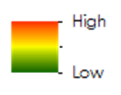
Methods
Fire Severity Model
Combines
  Classified fuel model
  Slope
  Aspect
  Communities at risk data
Notes:
A Fire Severity Model was produced using topographical variables such as slop and aspect. Where these values were given weights that classified areas most likely to burn, a land cover layer was overlaid on the elevation data. This model produces a map that identifies areas (on a per pixel bases) that will burn longer and hotter based on fuel type. Risk assessment data was then used to map communities of risk from a catastrophic wildfire.

Slide 12
Methods
Pocatello Creek
Object Based Image Analysis
The southern portion was isolated to calculate juniper density.
1 meter approach
Calculates phase I,II,III
Inkom
Arbon
Holbrook
Notes:
Object-based analysis was preformed on the bottom half of the study area to reduce amount data processing. Unlike CTA, this method compares the visual spectrum with the near infrared giving less spectral reflectance variation.

Slide 13
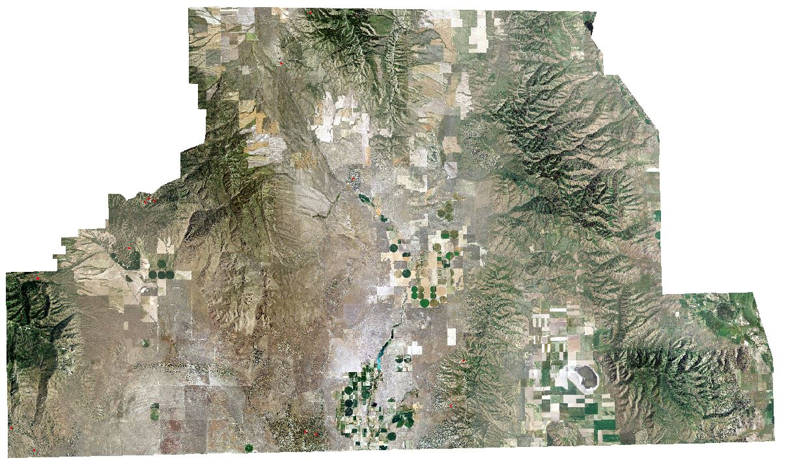
Methods
Object-based image analysis
Training and Validation sites
Polygons were created in using;
2011 NAIP imagery with a 1 meter resolution
Remote Sensing Applications Center (RSAC) data was used identify known juniper dominant areas
Vegetation Type | Training points | Validation Points
Juniper | 180 | 120
Bare ground | 180 | 120
Sagebrush | 180 | 120
Mixed Forest | 180 | 120
Shadows | 180 | 120
Notes:
Training and validation polygons (7m2-50m2) were created (using the image classification toolbar) for 5 different classes: Juniper, Bare ground, Sagebrush, Mixed Forest and shadows. The additional class of shadows was created to reduce error when calculating canopy cover and increase variance between juniper and mixed forest.
To achieve a 60/40 mix of classification and validation points, 180 training polygons and 120 validation polygons were created for each class.

Slide 14

Methods
Object-based image analysis
Segmented raster was created and compared to the different bands to determine highest variance.
Maximum Likelihood classification was used to complete classification
Notes:
After preparing the data through mosaic, training site and validation site creation, a segmented raster was created. The model segmented imagery according to the spectral and spatial details of the objects. Like areas were grouped together (e.g. grasses) creating an object-based discrimination raster. The segmented raster in combination with the different bands were then used to create signatures which calculated a covariance matrix and other statistical values of the raster. The signature file, segmented raster, and individual NAIP bands were then used in Maximum Likelihood Classification for the final classification.

Slide 15
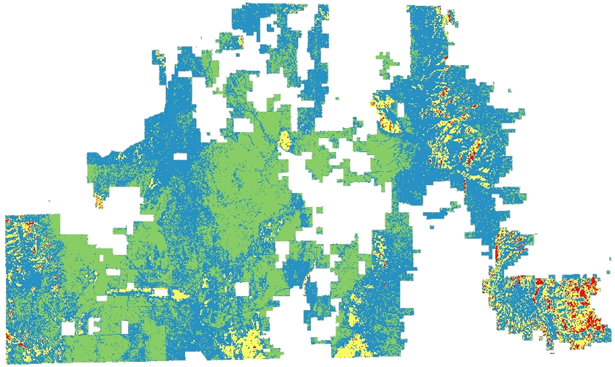
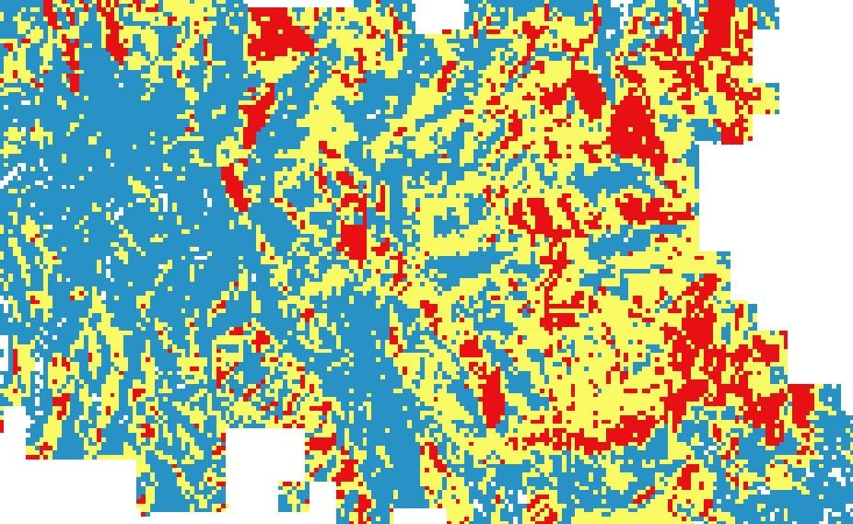

Methods
Juniper Phases
Object-based classification was used to calculate juniper density.
Density was calculated in one acre parcels
Resulting density was symbolized as
Juniper Phases
Phase I | 0.01% to15%
Phase II | 15% to 45%
Phase III | >45%
Phase I
Phase II
Phase III
Notes:
Juniper phase were calculated by counting the sum of all juniper classified cover and dividing that sum by the total area. The area of 1 acre was chosen due to data processing time. This was calculated for each acre, creating a raster like appearance. Resolution can be changed and calculated for any desired size. Different symbolization is also available because raster contains % cover calculations for each individual acre area.

Slide 16
Classification Results
Accuracy Assessment for Object-Based Image Analysis
Error Matrix Analysis – Object-based Results
 | Juniper | Mixed Forest | Sagebrush | Bare ground | Shadows | Total | ErrorC
Juniper | 106 | 28 | 0 | 0 | 3 | 137 | 0.20
Mixed Forest | 11 | 92 | 0 | 0 | 5 | 108 | 0.10
Sagebrush | 3 | 0 | 120 | 0 | 2 | 125 | 0.02
Bare ground | 0 | 0 | 0 | 120 | 0 | 120 | 0
Shadows | 0 | 0 | 0 | 0 | 110 | 110 | 0
Total | 120 | 120 | 120 | 120 | 120 | 600
ErrorO | 0.11 | 0.23 | 0 | 0 | 0.08
Kappa coefficient: 0.89
Notes:
An error matrix compares correctly classified points to incorrectly classified points. The Kappa coefficient uses this error matrix and gives an inter-rater agreement taking into account agreement occurring by chance. A Kappa coefficient of 1 represent perfect classification. With an overall kappa coefficient of 89% we were able to distinguish juniper from the surrounding land cover. The largest error was produced by miss identifying mixed forest as mixed forest.

Slide 17
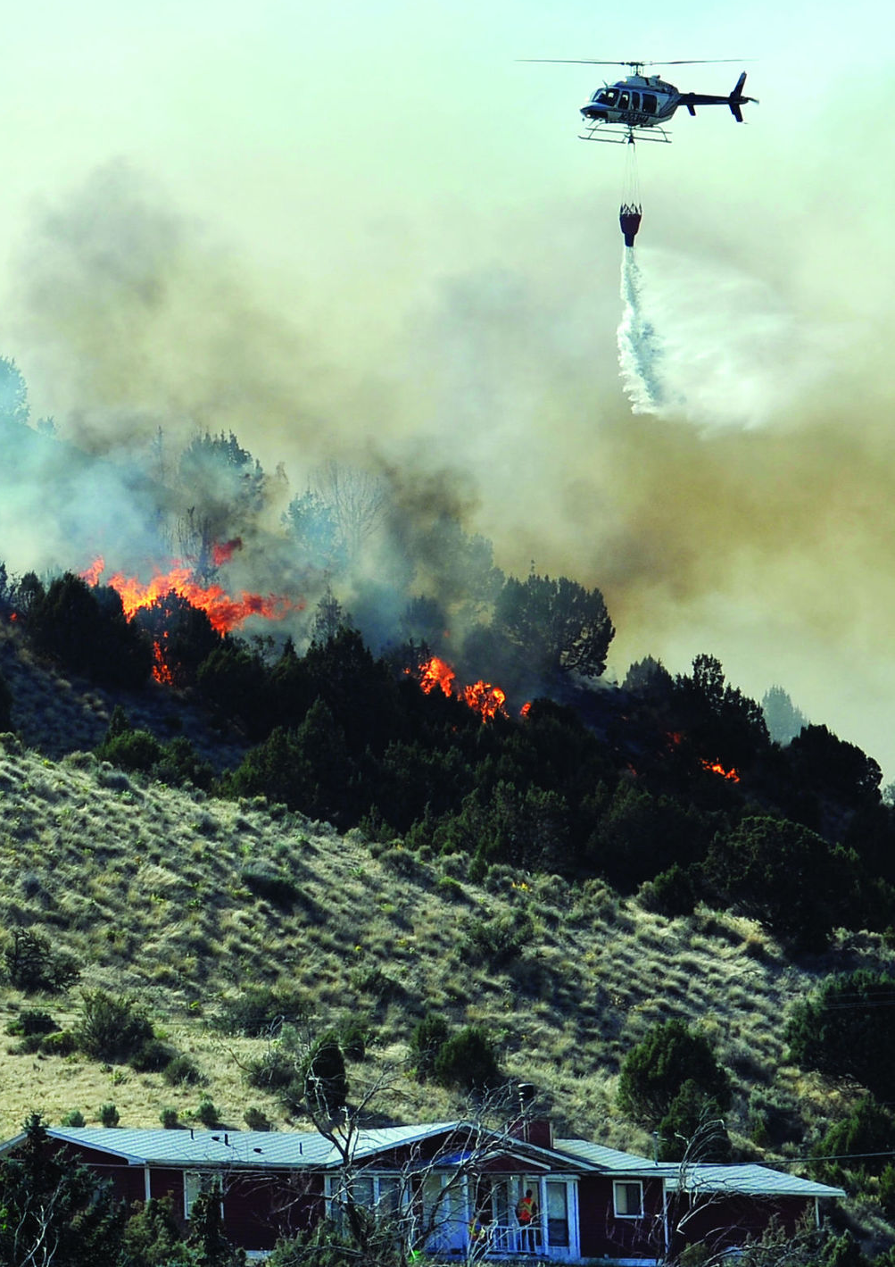
Conclusions
Classification
The multi-scale approach was useful to identify phases of juniper.
30 meter Landsat 8 imagery, CTA approach quickly identifies juniper dense areas.
1 meter Object-based approach precisely identifies phase I, phase II, and phase III juniper.
Source:abook.org
Notes:
This study demonstrates usefulness of multi-scale approach when identifying phases of juniper density.
Landsat 8, 30 meter CTA approach offers quick analysis of areas with high concentrations of juniper.
NAIP 2011, 1 meter object-based approach offers precise analysis of phase I, phase II, and phase III juniper areas.
These methods will be advantageous for land managers in fire prevention planning and allocation of resources used for juniper reduction that will help to reduce wildfire severity and intensity by reducing heavy fuel loads.
These methods will also be advantageous to land mangers working in vegetation restoration after a wildfire event.

Slide 18
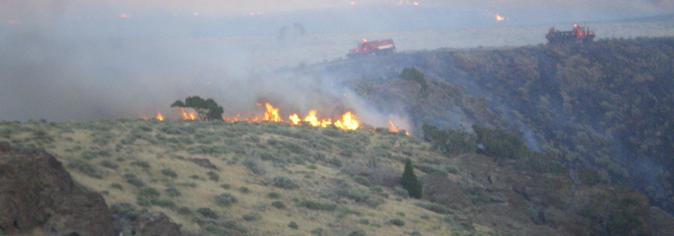
Project Continuation
Source: Chris Burger
Characterize historic juniper encroachment and expansion
Use SMAP satellite imagery to assess temporal changes in cheatgrass dominated sites and compare these changes in soil moisture to sagebrush-dominated sites
Notes:
Continued research will use these methods to calculate the encroachment of juniper from native fire safe zones to fire dependent zones. This term will use SMAP satellite imagery to assess temporal changes in cheatgrass dominated sites and compare these changes in soil moisture to sagebrush-dominated sites.

Slide 19
Advisors
Keith Weber (Idaho State University GIS TReC)
Mark Carroll (NASA Goddard Space Flight Center)
John Schnase (NASA Goddard Space Flight Center)
Partners
Mike Kuyper & Chris Burger, Bureau of Land Management
Robin Dunn, Idaho Department of Lands
Scott Bergen, Idaho Fish and Game
Chris Colt, US Forest Service Caribou-Targhee
Others
Kindera Serr, GIS Training and Research Center, Idaho State University
Ryan Howerton, Idaho State University
Jeff May, GIS Training and Research Center, Idaho State University
Notes:
We would like to thank the following people for their contributions to this project.

