Slide 1
Expectations
DEVELOPers embody the DEVELOP core values: collaboration, innovation, passion and discovery
Be strategic – identify objectives, help where you are needed, identify potential solutions and paths forward
Collaboration is key – each team will work together cohesively and support each other
Flexibility– be able to adapt, accept that change will happen, be nimble & open-minded
Innovation – look for innovative solutions and ideas, try new things, make positive changes, envision future achievement
Pay attention to detail – strive for the highest quality
Don’t give up! Keep at it. DEVELOPers never say die.

Slide 2
Professionalism
DEVELOP’s signature is based on professionalism & collaboration
Professionalism: “the conduct, aims, or qualities that characterize or mark a profession or a professional person”
DEVELOP is an opportunity for all participants to improve in their professionalism!
Appearance
Demeanor
Reliability
Competence
Ethics
Poise
Organizational Skills
Written Correspondence
Phone Etiquette
Accountability

Slide 3
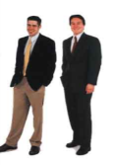
Professionalism & Dress Code
Business Casual:
Pants: Khakis or slacks
Skirts: Appropriate business skirts at/near knee length
Dresses: Appropriate length (at/near knee) dresses, no spaghetti straps
Shirt: Collared shirts, polo shirts, blouses, sweaters
Shoes: Dress shoes (no sandals, no sneakers, no flip flops)
Accessories & Make Up: Be conservative
Formal Presentations:
Formal Suits (Dark Colored - Black, Navy, Gray) & Dress Shoes
Dress Code Don’ts:
Jeans, tennis/running shoes (except on designated days)
Pants that droop and display underwear
Shorts
Shirks shorter than 3 inches above the knee when seated
Halter tops or exposed midriffs
Revealing, too tight clothing
Shirt straps narrower than 2 inches wide
Sweat pants, sweatshirts, T-shirts
Attire with vulgar, violent or explicit language or images
Multiple body piercings, hats, bandanas, etc.
No flip-flops of any kind
Unkempt attire

Slide 4
Travel
Any travel funded by the DEVELOP Program will be coordinated and originate through the DEVELOP NPO.
Travel is a privilege and the program does it’s best to provide opportunities to present DEVELOP work and engage with partners when appropriate and resources and timing allow.
Travel Process:
DEVELEOPer identifies a conference or meeting they are interested in attending
Talk to the Center Lead about the opportunity, if they approve of the opportunity then they will work with you to submit a request to NPO (includes description, attendee info, justification for travel, cost estimate – if applicable)
NPO will assess merit of the event and funds available
If NPO approves the travel, NPO will input the traveler and event into the NASA Conference Tracking System to gain agency approval
Once agency approvals are received, travel requests must be submitted for the travel to be approved by the funding contract
Once funding organizations approve, travel arrangements (if needed) will be made by NPO and reimbursements will be processed upon the travelers’ return

Slide 5
Reapplication & Eligibility
Participants:
Term: 10-weeks
Classifications: 1) Currently enrolled, 2) Recent Graduate, 3) Early or Transitioning Career Professional
Eligibility Requirements: 18+, able to provide personal transportation to and from DEVELOP location, strong interest in Earth science and remote sensing, U.S. citizenship is required to apply to DEVELOP locations at NASA Centers
Reapplication Eligibility:
Currently Enrolled: as long as enrolled
Recent Graduates: within two years of graduation
Early/Transitioning Career Professionals: not a current student or within 2 years of previous graduation
Center Leads & Fellows:
Term: One year award (renewable for up to two years) for Center Lead, One year award for Fellow (not renewable)
Eligibility Requirements: minimum 3.0 GPA, participation in at least one term with DEVELOP (two or more terms preferable), ability to begin in September
Reapplication Eligibility: Fellow positions are a one time opportunity, but Fellows & Center Leads can apply for Center Lead or Senior Fellow position, or reapply as a participant
Senior Fellows:
Term: One year award (renewable for up to three years)
Eligibility Requirements: college graduate, previous DEVELOP Fellow or Center Leadership, U.S. citizenship required
Reapplication Eligibility: up to three years reapplying as a Senior Fellow

Slide 6
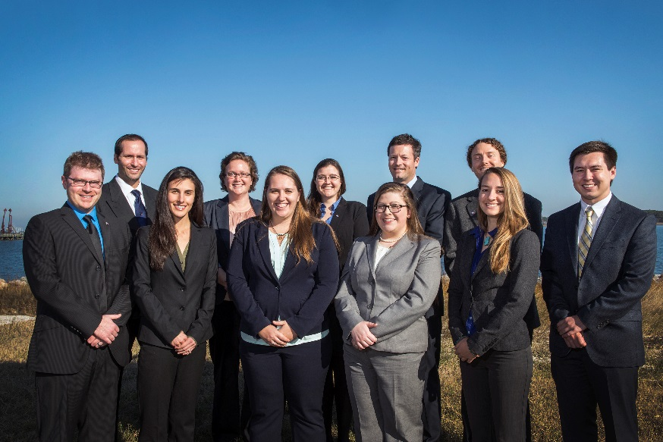
Center Leads
What is a DEVELOP Center Lead?
The Center Lead (CL) is an integral piece of the leadership team in the DEVELOP model. The people who assume this role are responsible for managing the majority of the day-to-day operations at their individual nodes, providing guidance and direction to their teams, and supporting strategic planning for their node and the program as a whole.
Center Lead Term: One year
Eligibility Requirements:
Minimum 3.0 GPA, cumulative or most recent semester
Participation in at least one term with DEVELOP (two or more terms preferable)
Ability to work 20-40 hours per week
U.S. Citizenship
Limited to two terms

