Slide 1
Georgia Water Resources
Assessing Groundwater Storage Change and Contamination Risk in Southwest Georgia
Wenjing Xu (Project Lead)
Doori Oh
Jason Reynolds(Co-lead)
Mingshu Wang
Linli Zhu

Slide 2
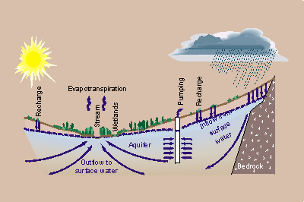
Community Concerns
Groundwater supports the majority of domestic, industrial, and agricultural water use in Southwest GA
Heavy pumping from wells causes dramatic groundwater-level changes
A monitoring approach is needed to capture real-time changes and improve management strategies
Image Credit: USGS
Notes:
Located in southwest Georgia, Dougherty County has a growing populace in an agricultural region with restrictions on surface water extraction due in part to recent drought conditions. Subsequently, demand for groundwater resources has increased. To sustainably manage water resources, it is important to quantify trends in groundwater storage change. This area has also experienced an increase in sinkhole development over the last decade. Sinkholes pose a threat to groundwater pollution, as they can quickly introduce contaminants to karst aquifer systems (i.e., the Upper Floridan Aquifer) which supply a large percentage of drinking and agricultural water in the study area. This knowledge will be useful for farmers who rely on groundwater resources, land use and city planners responsible for infrastructure development, and municipalities responsible for delivering safe drinking water to consumers.
Image credit URL: http://water.usgs.gov/ogw/gwrp/stratdir/activities.html

Slide 3
Objectives
QUANTITY
Groundwater Storage Change
Time Series
2002
2009
QUALITY
Compare
Groundwater
Contamination Risk 1
Groundwater
Contamination Risk 2
Notes:
The objectives of this project were to:
1.) Assess groundwater storage changes from 2002 and 2009 in the UFA (Upper Floridan Aquifer) portion of southwestern Georgia using NASA Earth Observations.
2.) Develop contamination vulnerability maps using Dougherty County as the focal area. Building upon the traditional DRASTIC model, sinkhole susceptibility was incorporated to assess groundwater contamination vulnerability. The sinkhole susceptibility results from the Summer 2015 Georgia Disasters project were utilized in the team’s modified DRASTIC model.

Slide 4
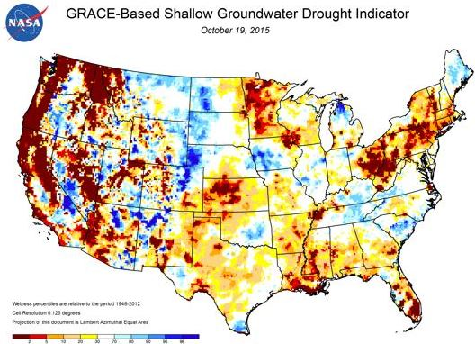
Gravity Recovery and Climate Experiment (GRACE)
Groundwater was one of the last research areas to benefit from remote sensing applications
GRACE has become a valuable asset to the study of water resources
Image credit: NASA
Notes:
Before NASA’s Gravity Recovery and Climate Experiment (GRACE) mission began, it was extremely difficult to measure changes in water quantity over large regions. Groundwater studies were one of last research areas to benefit from remote sensing applications. Innovative remote sensing applications have allowed large-scale groundwater research projects to become feasible. Multiple studies have demonstrated the value of GRACE data to water resource science and management. In particular, NASA Scientist Matthew Rodell (2007) first demonstrated the use of GRACE total water storage data with soil moisture and snow water equivalent data to quantify groundwater changes for a given region. Remote sensing applications are a valuable resource to monitor water quantity changes.
Image credit URL: https://www.nasa.gov/topics/earth/features/tx-drought.html#.Vifeyn6rT0M

Slide 5
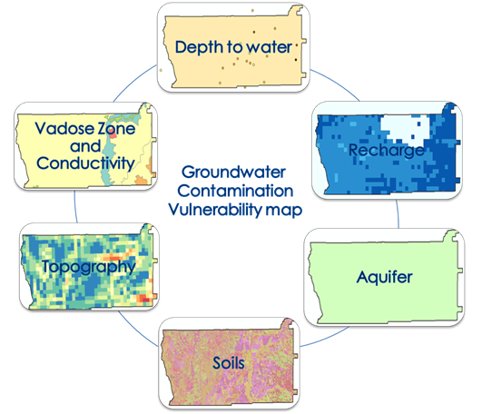
The DRASTIC Model
Developed by the United States Environmental Protection Agency (EPA)
Employs overlay and indexing methodologies
Widely-recognized and used to assess groundwater vulnerability
Image credit: Georgia Water Resources Team
Notes:
Overview of DRASTIC: The DRASTIC model, which employs overlay and indexing methodologies, is widely-recognized and is mainly used to assess groundwater vulnerability. DRASTIC was first developed by the United States Environmental Protection Agency (EPA) and later modified by researchers to account for a range of different environmental settings. DRASTIC has been developed into various GIS-based modifications for many groundwater studies.

Slide 6
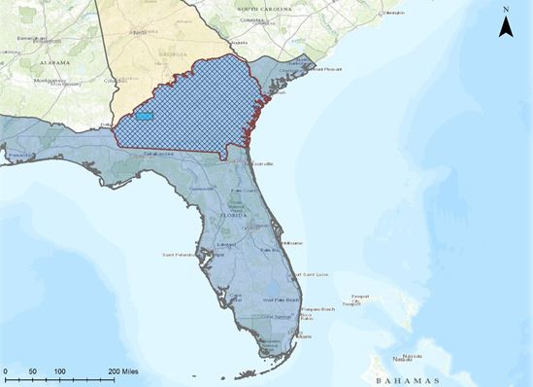
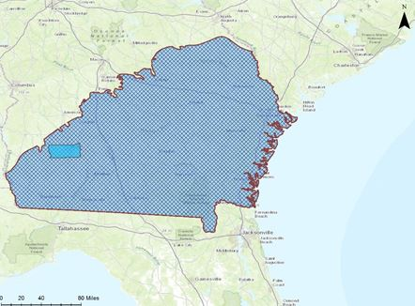
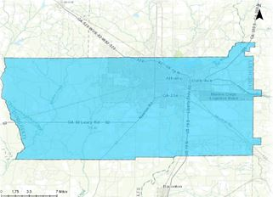
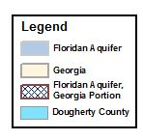
Study Area
Image Credit: Georgia Water Resources Team
Notes:
Dougherty County is located within the Dougherty Plain of southwest Georgia and is at the northern edge of Georgia’s portion of the Upper Floridan Aquifer (UFA). The county has a growing population that relies on groundwater resources from the UFA, the Flint River, and Lake Chehaw. Albany is Dougherty County’s largest metropolitan area with a population of approximately 76,000 residents. The local topography is generally flat and underlain by the Ocala Limestone, making this area an importance source of groundwater quantity change and prone to contamination. To address the increased demand for sustainable groundwater supply in Dougherty County, an effective groundwater monitoring and evaluation tool is critical for local water resources management.
Base Layer Source: ESRI, HERE, DeLorme, TomTom, Intermap, increment P Corp., GEBCO, USGS, FAO, NPS, NCRCAN, GeoBase, IGN, Kadaster NL, Ordnance Survey, ESRI Japan, METI, ESRI China (Hong Kong), swisstopo, MapmyIndia, Copyright OpenStreetMap contributors, and the GIS User Community.

Slide 7
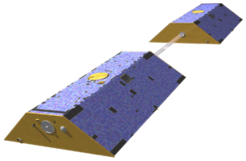
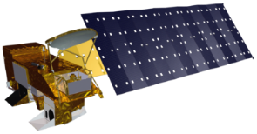
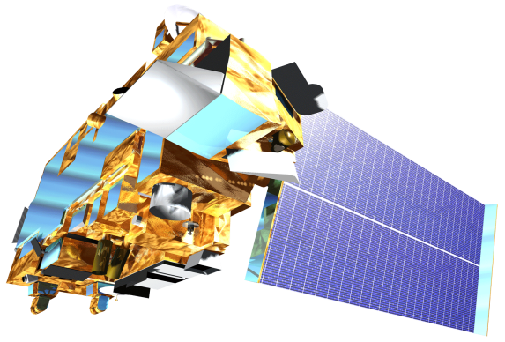
NASA Earth Observations
Gravity Recovery and Climate Experiment (GRACE)
Aqua Advanced Microwave Scanning Radiometer for the Earth Observing System (AMSR-E)
Terra Moderate Resolution Imaging Spectroradiometer
(MODIS)
Notes:
Three NASA Earth Observations were used in this project.
GRACE and Aqua AMSR-E were used to quantify groundwater changes and develop the groundwater storage change map in this project. The GRACE satellite provided total water storage data while the Aqua AMSR-E sensor provided data for the snow water equivalent and soil moisture indices.
The Terra MODIS Earth Observation was used to assess the recharge parameter of the DRASTIC model. We obtained yearly evapotranspiration data from MODIS to accurately rate the recharge parameter of our model.
Image credit URL: http://www.devpedia.developexchange.com/dv/index.php?title=List_of_Satellite_Pictures

Slide 8
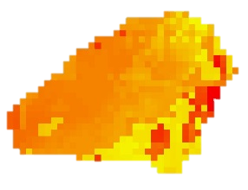
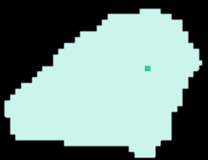
Methodology (Quantity)
Water Storage data (GRACE)
Soil Moisture and Snow data (NLDAS / Aqua AMSR-E)
Groundwater Storage (GW)
Total Water Storage (TWS)
Soil Moisture (SM)
Snow Water Equivalent (SWE)
$$\text{ΔGW}\text{ = }\text{ΔTWS}\text{(}\text{GRACE}\text{) − (}\text{ΔSM}\text{(}\text{NLDAS}\text{) }\text{+} \text{ΔSWE}\text{(}\text{NLDAS}\text{))}$$
$$\text{−}$$
$$\text{+}$$
Groundwater Storage Variability
Notes:
To calculate the total groundwater storage in our study area region, we downloaded datasets from the GRACE mission and the NLDAS (North American Land Data Assimilation System) data platforms. We acquired monthly averages from the years 2002 and 2009.
Re-projecting, re-sampling, and masking the data to our study area were the basis of our data processing scheme. A major discrepancy we had to fix was that the NLDAS-2 parameters had a different unit measurement (kg/m²) than the GRACE data (cm). To convert the NLDAS-2 parameters from (kg/m²) to (cm), the data was multiplied by a 0.1 factor using Raster Calculator. To calculate the changes in groundwater depth, we performed the following equation in Raster Calculator:
∆GW=∆TWS-(∆SM+∆SWE)
Data analysis included computation of variations in groundwater storage allowed comparisons of the results from 2002 and 2009. Assessment of the correlation between sinkhole formation and groundwater storage variation was done using a simple linear regression model. All statistical analysis was performed in the R statistical program.

Slide 9
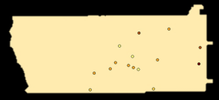
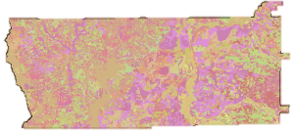
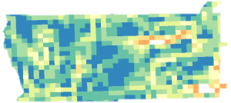
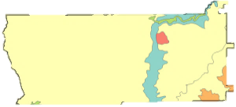
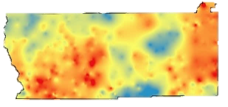
Methodology (Quality)
Well log data (USGS)
Precipitation data (PRISM)
Evapotranspiration (MODIS 16)
Geological data(USGS)
DEM data (NED)
Soil Data (USDA)
Depth to Water
Recharge
Aquifer Media
Soil Media
Topography
Impact of Vadose Zone and Conductivity
Sinkhole Susceptibility
Groundwater Contamination
Risk Maps
Notes:
Groundwater Vulnerability map:
Implementation of the DRASTIC model required obtaining multiple datasets from different sources. Six of the seven parameters in this model were obtained from government research databases. The final parameter was retrieved from the results of the 2015 Summer Georgia Disasters project.
Processing the data for the DRASTIC model included: Resampling all of the data sources to 1 km, creating a 10 km buffer around the study area, masking the datasets to this area, and using the Raster Calculator tool in ArcGIS.
A DRASTIC model value, including the rate (r) and weight (w), was assigned to each parameter for each pixel (1 km). Once the DRASTIC ratings were assigned, the pollution vulnerability for each pixel was estimated by calculating the DRASTIC Index value, from which the groundwater susceptibility map was generated for the years 2002 and 2009. Building upon the traditional DRASTIC model, sinkhole susceptibility was incorporated as a multiplier term to calculate a final, modified DRASTIC index (DRASTICS).
DRASTIC data analysis: Using sinkhole susceptibility maps from the Georgia Disasters team, groundwater contamination vulnerability can be associated with sinkhole formation, offering comprehensive details for groundwater quality.

Slide 10
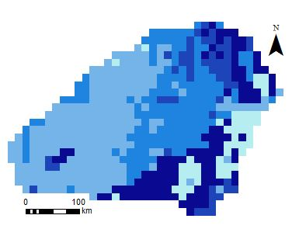
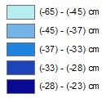
Results
GRACE-based Groundwater Storage Change (April 2002)
Legend
Notes:
This is a preliminary result of the groundwater storage analysis. In the month of April 2002, groundwater storage was low, with a minimum depth of -65 cm and a maximum depth of -23 cm. The eastern region of the study area experienced the most depletion of groundwater storage compared to other regions.

Slide 11
Conclusion

Slide 12
Advisors
Dr. Adam Milewski, Water Resources and Remote Sensing Laboratory, Department of Geology, The University of Georgia
Matthew Cahalan, The University of Georgia
Partners
Randy Weathersby, City of Albany and Dougherty County Planning and Development Services
Randy Weathersby, Southwest Georgia Water Resources Task Force
Past Contributors
Kimberly Berry, Mohamed Amin, and Tunan Hu, Georgia Disasters and Water Resources Team, DEVELOP Summer 2015

