Slide 1
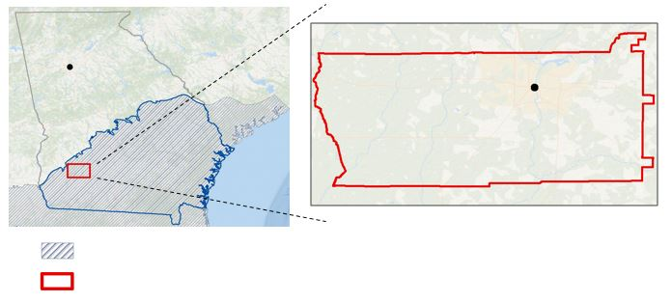
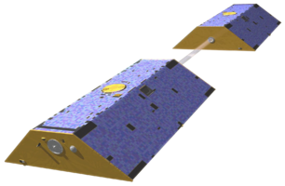
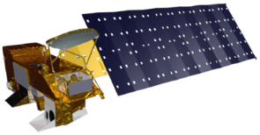

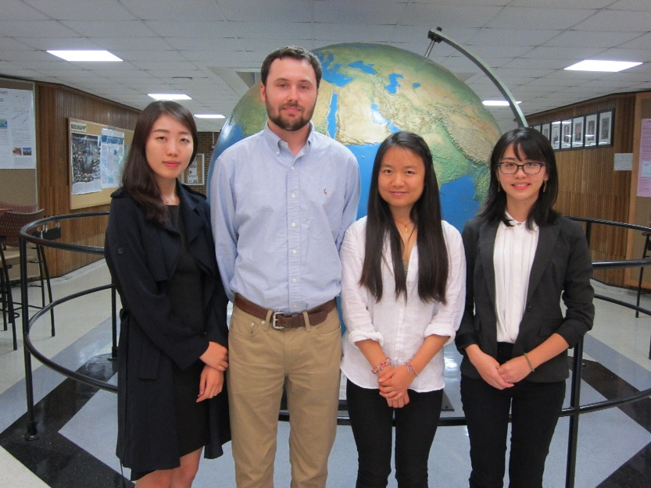
Georgia Water Resources
Assessing groundwater storage change and contamination risk in southwest Georgia
Wenjing Xu (Project Lead), Jason Reynolds (Project Co-Lead), Doori Oh, Linli Zhu, Mingshu Wang
University of Georgia
Abstract
Objectives
Keep this blank for now.
Body text point size should be at least 24.
Caption text point size should be at least 16.
Feel free to rename, move, and resize sections as needed.
Develop groundwater storage change map of southern Georgia using GRACE satellite data
Assess groundwater quality and produce risk maps using a modified DRASTIC model accounting for sinkhole proximity to identify areas susceptible to groundwater contamination
Methodology
Study Area
Data Acquisition
Data Analysis
End Products
Atlanta
Albany
Water Storage data (GRACE)
Soil Moisture and Snow data (NLDAS / Aqua AMSR-E)
Groundwater Storage (GW)
Total Water Storage (TWS)
Soil Moisture (SM)
Snow Water Equivalent (SWE)
Groundwater Storage Variability Map
$$\text{ΔGW}\text{ = }\text{ΔTWS}\text{(}\text{GRACE}\text{)}\text{− (}\text{ΔSM}\text{(}\text{NLDAS}\text{) + }\text{ΔSWE}\text{(}\text{NLDAS}\text{))}$$
Upper Floridan Aquifer
Well log data (USGS)
Precipitation data (PRISM)
Evapotranspiration data (MODIS 16)
Geological data(USGS)
DEM data (NED)
Soil Data (USDA)
Depth to Water
Recharge
Aquifer Media
Soil Media
Topography
Impact of Vadose Zone
Conductivity
Doughtery County
DRASTIC Model
DRASTICS Groundwater contamination susceptibility map
Earth Observations
Sinkhole susceptibility
GRACE
Aqua AMSR-E
Terra MODIS
Results
Conclusions
Use images.
Make sure that it has some sort of flow, that it makes sense. Show your results in a logical order.
No bullets.
Use bullets.
Use complete sentences with periods.
Team Members
Project Partners
Acknowledgements
City of Albany and Dougherty County Planning and Development Services
Southwest Georgia Water Resources Task Force
We would like to thank our Science Advisors, Dr. Adam Milewski and Matthew Cahalan for their guidance on this project.
We would like to acknowledge past contributors Mohamed Amin, Kimberly Berry, and Tunan Hu.
We would like to extend our appreciation to our main contact from our partner organizations, Randy Weathersby.
From left to right: Doori Oh, Jason Reynolds, Wenjing Xu, Linli Zhu, Mingshu Wang (not pictured)
The University of Georgia

