Slide 1
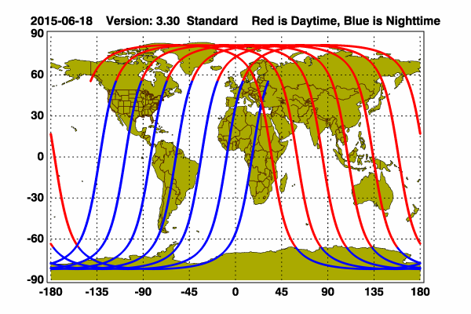
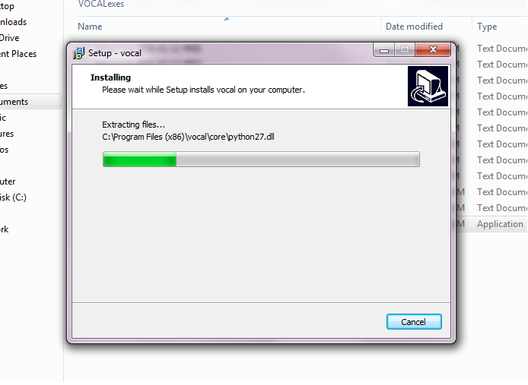
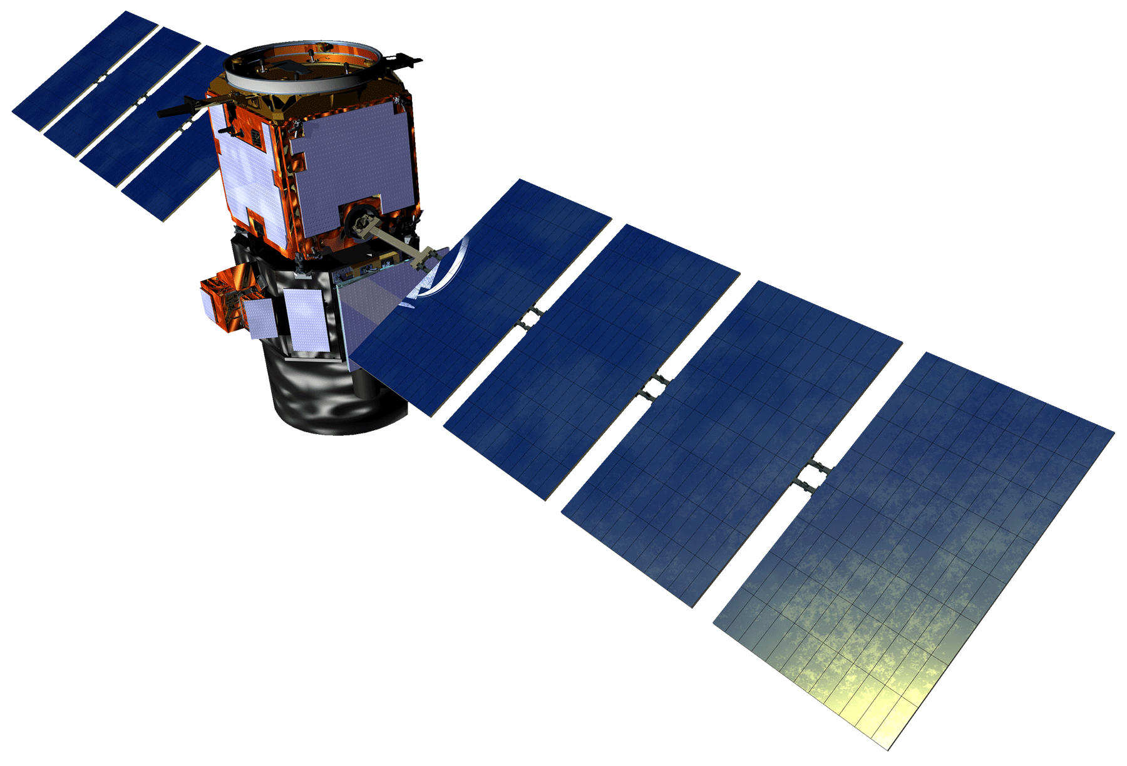
CALIPSO Cross-Cutting III
Interacting with CALIPSO data through a graphical user interface (GUI)
Kathleen Moore (Project Lead) & Jordan Vaa
NASA DEVELOP National Program at NASA Langley Research Center
Abstract
Objectives
Keep this blank for now.
Body text point size should be at least 24.
Caption text point size should be at least 16.
Feel free to rename, move, and resize sections as needed.
Ease cross-platform installation of VOCAL
Enable OPeNDAP pipeline for data acquisition
Study Area
Methodology
Screenshot showing installer built for Windows 7.
OPeNDAP GUI for illustration purposes? Maybe soon.
Orbit path of CALIPSO
Earth Observations
Results
Use images.
Make sure that it has some sort of flow, that it makes sense. Show your results in a logical order.
No bullets.
Cloud-Aerosol Lidar and Infrared Satellite Observation (CALIPSO)
Conclusions
VOCAL has the potential to not only impact the efficiency of atmospheric science research collaboration, but also that of visually-based research, in general.
OPeNDAP is a fantastic resource.
This open-source project can spur further innovation.
Team Members
Project Partners
Acknowledgements
Kathleen Moore and Jordan Vaa need headshots.
CALIPSO Science Team
Dr. Charles Trepte
Dr. Amber Soja
CALIPSO Cross-Cutting II, LaRC Summer 2015
Grant Mercer
Nathan Qian
NASA DEVELOP National Program
Michael Bender
Dr. Kenton Ross
NASA Langley Research Center

