Slide 1
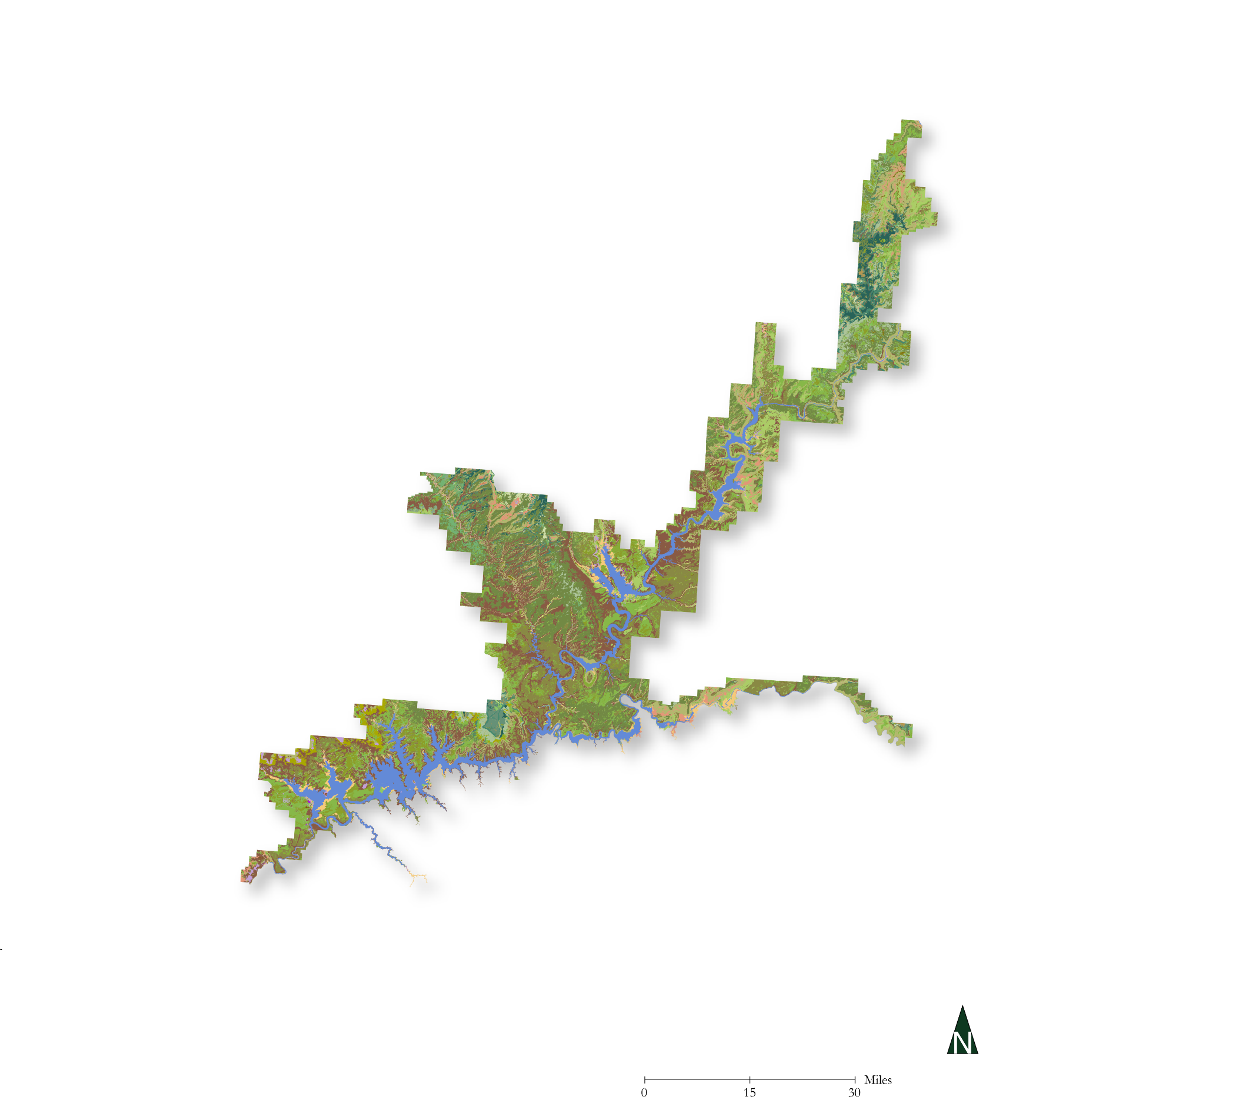
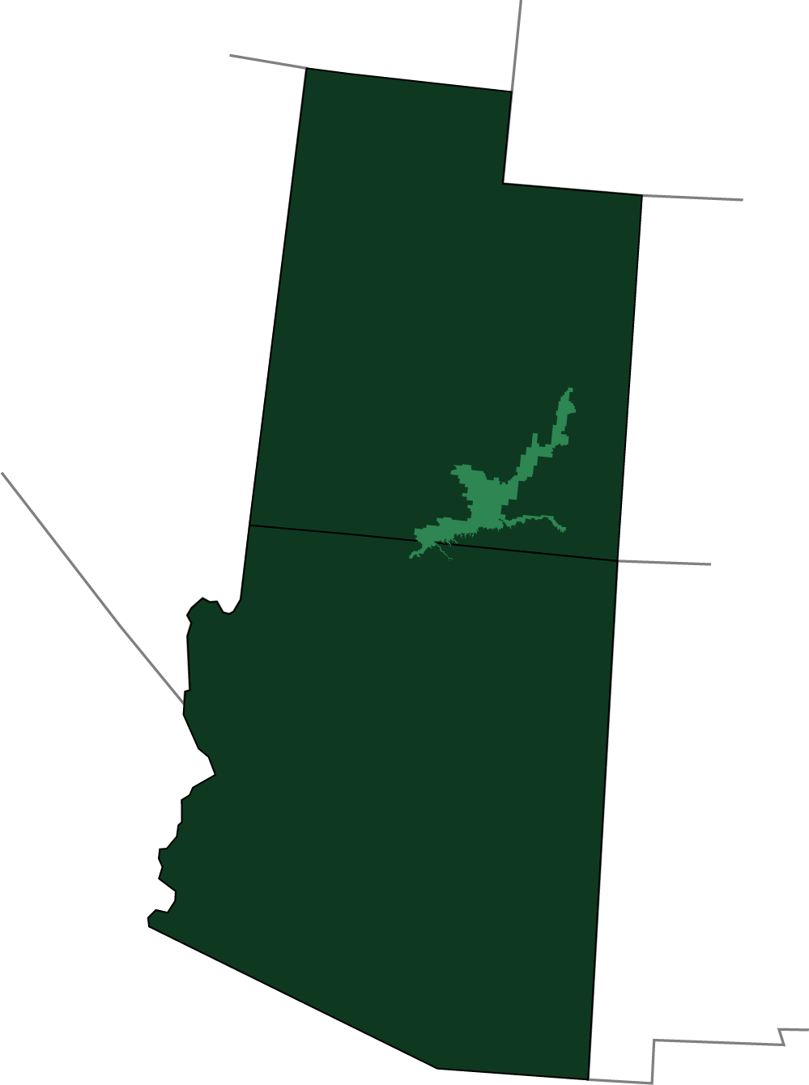
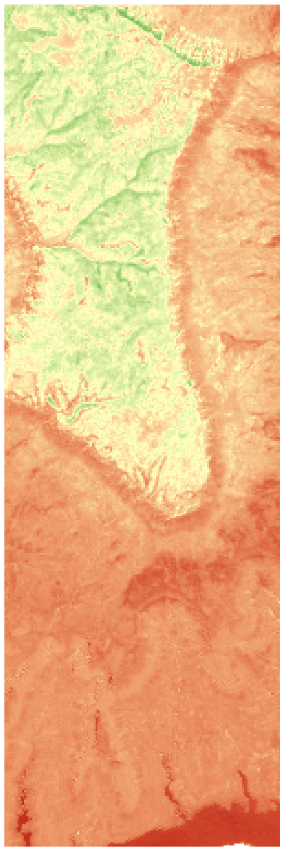
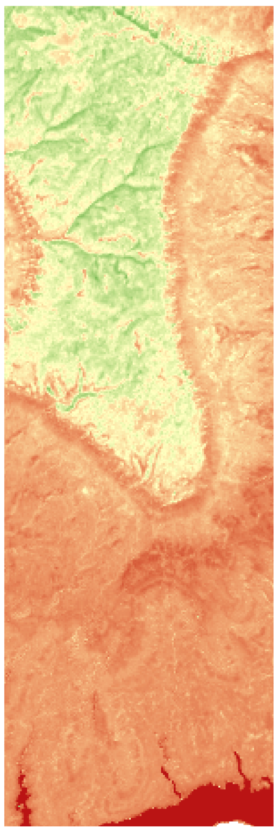
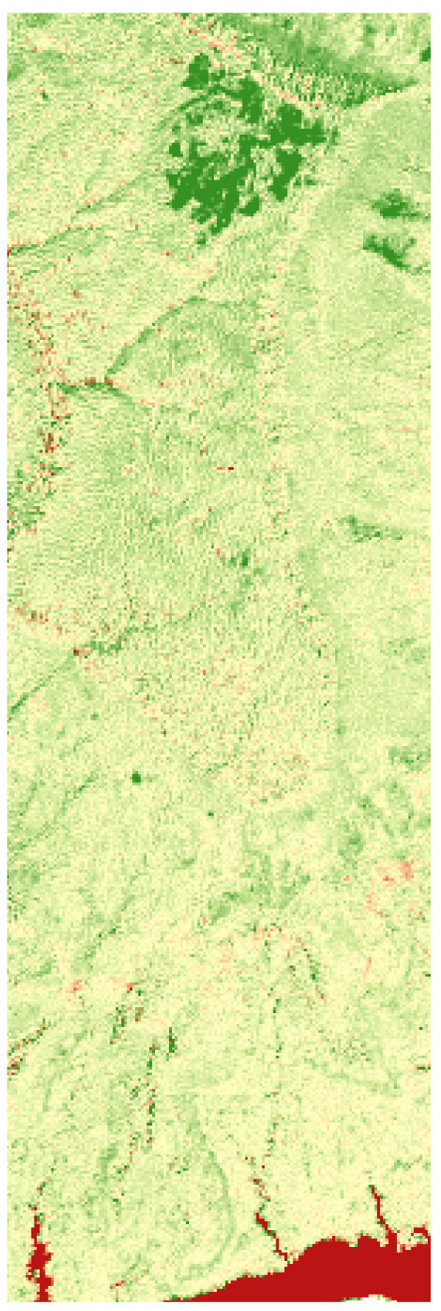
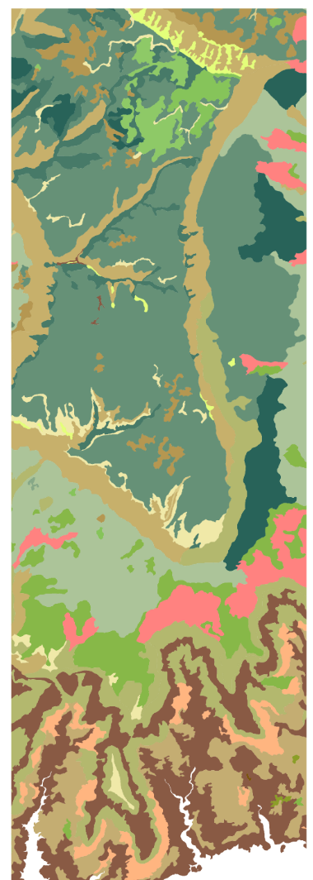
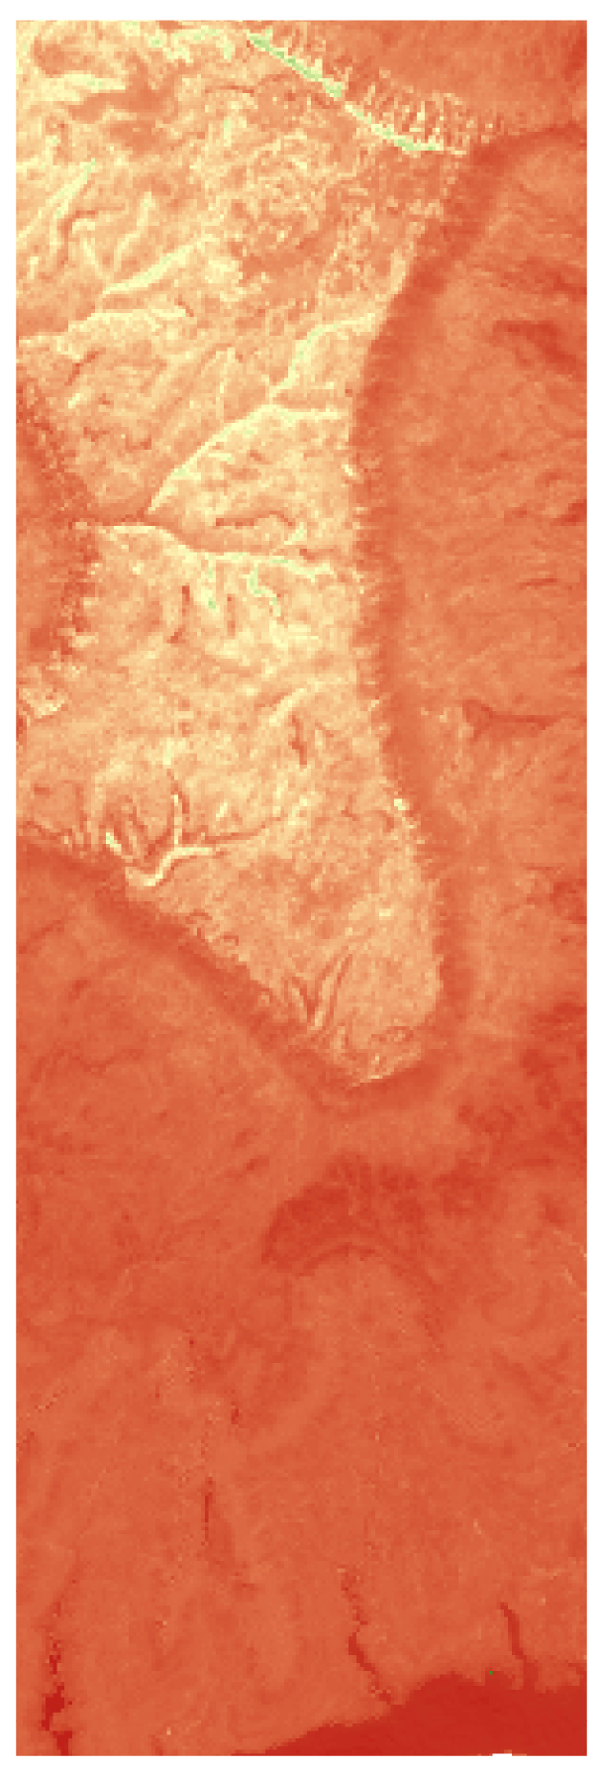
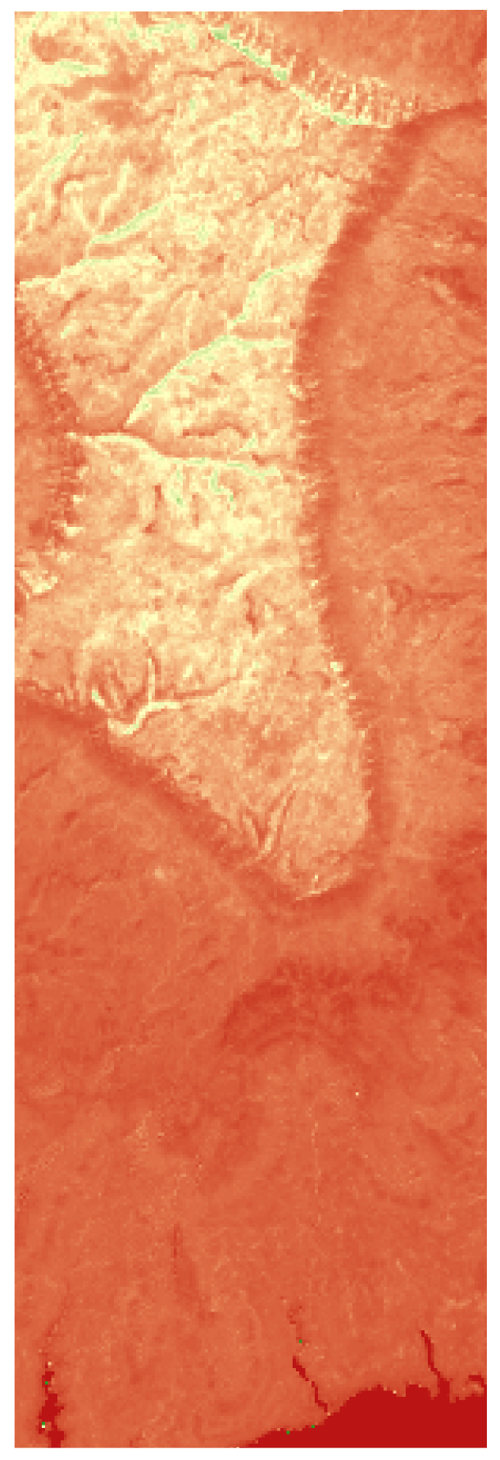
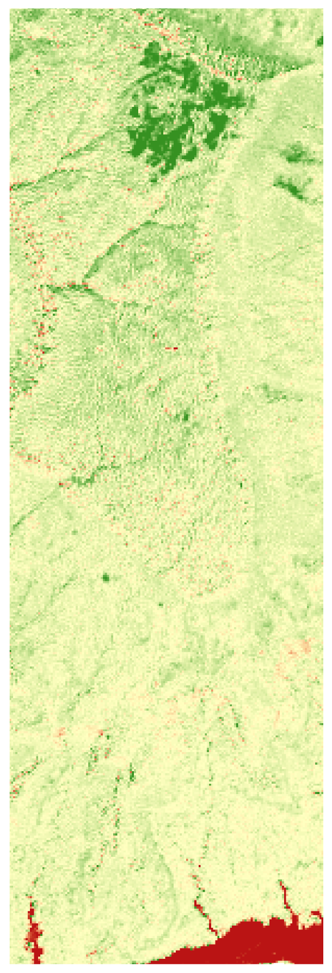

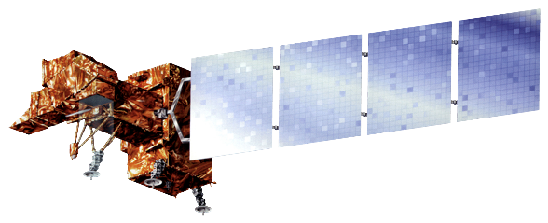






Using NASA Earth Observations to Prioritize Locations for the Further Monitoring and Management of Cultural Resources in Glen Canyon National Recreation Area
Abstract
Study Area
Glen Canyon National Recreation Area (NRA) contains a diverse suite of culturally and historically significant archeological sites that are threatened by erosion and changing land cover dynamics. The National Park Service (NPS) is tasked with monitoring, studying, and preserving these archeological sites, many of which reside in extremely remote locations. At Glen Canyon NRA, perennial vegetation helps stabilize soils and mitigate erosion. The loss of such soil stabilizers is indicative of high erosion potential. This project calculated vegetation indices and generated a time series of vegetation maps across the entire extent of Glen Canyon NRA using Landsat 5 Thematic Mapper (TM), Landsat 7 Enhanced Thematic Mapper Plus (ETM+), and Landsat 8 Operational Land Imager (OLI) data for the years 1995 to 2017. The project team then used multiple vegetation analyses from across the study period to provide an assessment of year-to-year change in the abundance and distribution of soil-stabilizing vegetation. This approach allowed for a comprehensive assessment of vegetation and soil stabilization across a broad region that could not be assessed by traditional ground-based means. Finally, the team used these vegetation analyses to assess the rate of change of vegetation cover and to predict future vegetation distribution. Land managers and archeologists at the NPS can use the results of this work to prioritize the monitoring and management of important archeological sites that could otherwise be lost to erosion.
0
60
Miles
UT
Objectives
AZ
Create vegetation distribution maps of Glen Canyon National Recreation Area for the years 1995 - 2018
Analyze spatial trends in gains and losses of vegetation over the study period
Provide a reproducible means by which such analysis can be conducted by park officials in the future
Evaluate locations within the park at high risk for erosion
Apply vegetation loss information to cultural resource assessment
Results
Methodology
2013
2014
Difference
Acquire Landsat imagery
Preprocess imagery: composite bands, clip to study area, and mosaic images
Produce vegetation indices with the Modified Soil Adjusted Vegetation Index (MSAVI)
Compare annual MSAVI maximums to baseline
The spatial distribution of vegetation loss is unevenly concentrated based on topographic features (i.e. mesa tops)
The spatial distribution of vegetation loss coincides with the apparent distribution of different plant/ecological communities → exposed grasses vs. riparian vegetation
MSAVI
Analyze spatial and temporal trends in MSAVI across the park
Identify locations experiencing vegetation loss
Assessment and evaluation relative to cultural resources
High
Earth Observations
1 mi
Low
Pinyon Juniper woodland/ Wyoming sagebrush
Landsat 5 TM
Native grassland/ herbaceous vegetation
Landsat 7 ETM+
Landsat 8 OLI
NDVI
Conclusions
Archeological sites on mesa tops may be at a higher risk of erosion than other regions of the park due to concentrated vegetation loss in those areas.
Certain plant communities are more susceptible to vegetation loss than others (grasses vs. shrubs and trees) → Archeological sites in these areas could be at higher risk of vegetation than others.
Park resources staff could incorporate moisture sensitivity and susceptibility to vegetation loss of different plant communities into their management of archeological sites
The methods outlined herein provide a reproducible method for vegetation monitoring
Blackbrush woodland
High
1 mi
1 mi
Low
Vegetation survey created by National Park Service, 2014
Acknowledgements
Team Members
Project Partner
Dr. Kenton Ross – NASA DEVELOP, Science Advisor
Jonathan O’Brien – NASA DEVELOP, Center Lead
Brian Harmon – Glen Canyon National Recreation Area, Lead Archeologist
Alahna Moore – Glen Canyon National Recreation Area, Photogrammetry and Archeology Intern
John Spence – Glen Canyon National Recreation Area, Chief Scientist and Terrestrial Natural Resources Branch Chief
Vanessa Glynn-Linaris – Glen Canyon National Recreation Area, GIS Coordinator and Biologist
William Patrick Frier
Project Lead
Robert Cecil Byles
Robert Maxwell Stewart
Glen Canyon National Recreation Area
Glen Canyon Ecological Forecasting
Virginia – Langley| Summer 2018

