Slide 1
NASA Ames Research Center
Node Leadership
Chippie Kislik
Center Lead
Vickie Ly
Fellow/Assistant Center Lead
Juan Torres-Pérez
Lead Advisor
Project Teams & Contact Information
Puerto Rico Health & AQ
Caribbean Oceans
Andrew Nguyen
Project Lead
andrew.nguyen@nasa.gov
Jordan Ped
Project Lead
jwesleyped@gmail.com
Martha Sayre
Erica Scaduto
Pablo Mendez Lazaro
Project Advisor
Emma Accorsi
Porfirio Alvarez
Project Advisor

Slide 2
USGS at Colorado State University Fort Collins
Node Leadership
Brian Woodward
Center Lead
Dr. Paul Evangelista
Lead Advisor
Project Teams & Contact Information
Gunnison NF Agriculture
Laramie Mountains Eco
Eric Rounds
Project Lead
erounds202@gmail.com
Stephanie Krail
Project Lead
StephanieAKrail@gmail.com
Peder Engelstad
Darin Schulte
Oliver Miltenberger
Alexa Grafton
Sarah Carroll
Aubrey Hilte
Tony Vorster
Project Advisor
Amanda West
Project Advisor

Slide 3
NASA Goddard Space Flight Center
Node Leadership
Sean McCartney
Center Lead
Amanda Clayton
Assistant Center Lead
John Bolten
Lead Advisor
Project Teams & Contact Information
GOM Health & Air Quality
Indonesia Agriculture
Great Lakes Eco-Forecasting
Amanda Clayton
Project Lead
amanda.l.clayton@nasa.gov
Kyle Peterson
Project Lead
kylepeterson777@gmail.com
Carl Kinton
Project Lead
issackinton@gmail.com
Lori Mandable
Abigail Childs
Peter Jacobs
Dr. Pawan Gupta
Project Advisor
Michael Riedman
Sean McCartney
Dr. Naikoa Aguilar-Amuchastegui
Project Advisor
Laura Bourgeau-Chavez
Project Advisor

Slide 4
BLM at Idaho State University GIS TReC
Node Leadership
Jenna Williams
Center Lead
Keith Weber
Lead Advisor
Project Teams & Contact Information
Southeast Idaho Disasters II
Jenna Williams
Project Lead
will55200@gmail.com
Team Member
Team Member
Team Member
Keith Weber
Project Advisor

Slide 5
International Research Institute for Climate and Society
Node Leadership
Jerrod Lessel
Center Lead
Dr. Pietro Ceccato
Lead Advisor
Project Teams & Contact Information
Uruguay Agriculture III
Jerrod Lessel
Project Lead
Jerrod.lessel@gmail.com
Andrew Kruczkiewicz
Dr. Pietro Ceccato
Project Advisor

Slide 6
NASA Jet Propulsion Laboratory
Node Leadership
Nick Rousseau
Center Lead
Brittany Zajic
Fellow/Assistant Center Lead
Ben Holt
Lead Advisor
Project Teams & Contact Information
Bolsa Chica Ecological Forecasting
Los Angeles Oceans II
Louisiana Ecological
Forecasting
Christine Elowitt
Project Lead
Christine.elowitt.63@my.csun.edu
Rebecca Trinh
Project Lead
Fish.r.awesome@gmail.com
Erika Higa
Project Lead
ehigaearth@gmail.com
Steven Kerns
Lindsay Almaleh
Emily Beck
Nick Rousseau
Ben Holt
Project Advisor
Mark Barker
Cedric Fichot
Project Advisor
Marc Simard
Project Advisor

Slide 7
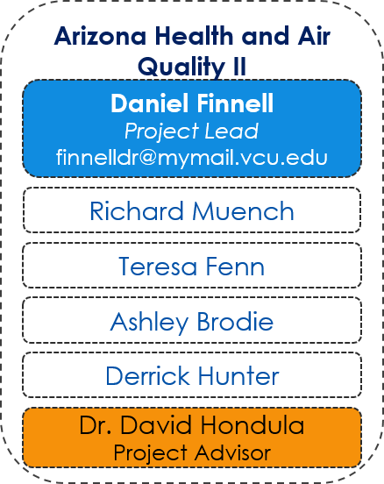
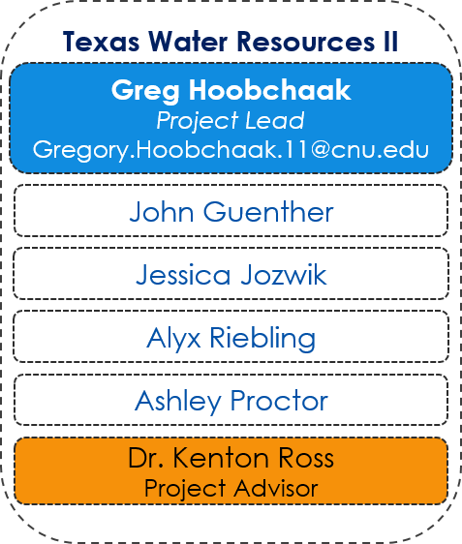
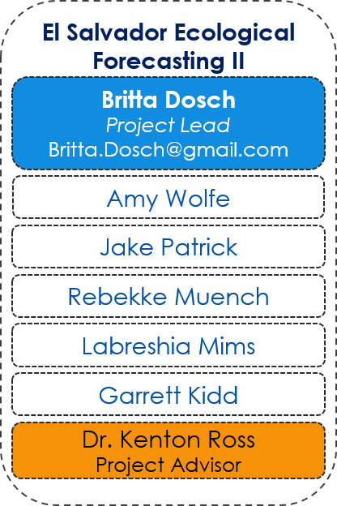
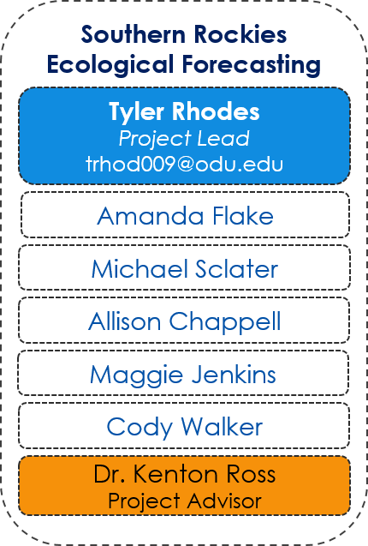
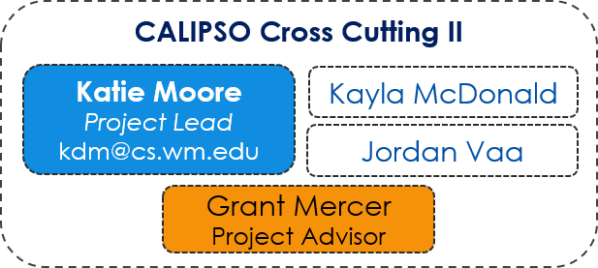
NASA Langley Research Center
Node Leadership
Emily Adams
Center Lead
Rebekke Muench
Assistant Center Lead
Jordan Vaa
IT Fellow
Teresa Fenn
PC Fellow
Dr. Kenton Ross
Lead Advisor
Project Teams & Contact Information

Slide 8
Mobile County Health Department
Node Leadership
Tyler Lynn
Center Lead
Vishal Arya
Project Coordination Fellow/Assistant Center Lead
Dr. Bert Eichold
Mentor
Project Teams & Contact Information
Mobile Bay Eco Forecasting
Saranee Dutta
Project Lead
saranee.dutta@gmail.com
Jeanette Bosarge
Courtney Kirkham
Tyler Lynn
Dr. Kenton Ross
Project Advisor

Slide 9
NASA Marshall Space Flight Center
Node Leadership
Leigh Sinclair
Center Lead
Daryl Ann Winstead
Assistant Center Lead
Ryan Schick
Fellow
Dr. Jeffrey Luvall
Lead Advisor
Project Teams & Contact Information
Alabama Ecological Forecasting
Lake Victoria Water Resources II
Ryan Schick
Project Lead
ryanschickwx@gmail.com
Jeanné le Roux
Project Lead
jr0020@uah.edu
Leigh Sinclair
Daryl Ann Winstead
Maggi Klug
Sara Amirazodi
Kelsey Herndon
Christina Fischer
Dwight Tigner
Dr. Robert Griffin
Project Advisor
Dr. Robert Griffin
Project Advisor

Slide 10
NOAA National Centers for Environmental Information
Node Leadership
Jessica Sutton
Center Lead
Emma Baghel
Fellow/Assistant Center Lead
Dr. DeWayne Cecil
Lead Advisor
Project Teams & Contact Information
Cascade & Sierra Nevada Mountains Water Resources
Levant & Central American Climate I
Sam Swanson
Project Lead
sam.swanson@noaa.gov
Alec Courtright
Project Lead
alec.courtright@noaa.gov
Kevin Rapa
Christine Stevens
Jessica Sutton (part-time)
Hayley Hajic
Michael Kruk
Project Advisor
Jessica Sutton (part-time)
Major Ryan Harris
Project Advisor

Slide 11
University of Georgia
Node Leadership
Caren Remillard
Center Lead
Sean Cameron
Assistant Center Lead
Dr. Marguerite Madden
Lead Advisor
Project Teams & Contact Information
Atlanta Water Resources
Peru Climate II
Sean Cameron
Project Lead
cscameron89@gmail.com
Caren Remillard
Project Lead
carenremillard@gmail.com
Beatriz Avila
Veronica Fay
Brandon Hays
Benjamin Page
Jason Reynolds
Adam Salway
Alex Smith
Sam Weber
Jacob Spaulding
Wenjing Xu
Xuan Zhang
Dr. Rosanna Rivero &
Dr. Marguerite Madden
Project Advisors
Dr. Kenton Ross &
Dr. Marguerite Madden
Project Advisors

Slide 12
Wise County Clerk of Court’s Office
Node Leadership
Michael Brooke
Center Lead
Rajkishan Rajappan
Assistant Center Lead
Dr. Kenton Ross
Lead Advisor
April Huff
Mentor
Project Teams & Contact Information
African Great Lakes Weather II
Wise Disasters
Rajkishan Rajappan
Project Lead
rajkishan16@gmail.com
Kimberly Berry
Project Lead
kimberly.m.berry@nasa.gov
Katherine Dooley
Abhijeet Baghel
Annabel White
Grant Bloomer
Jakub Blach
Zachary Tate
Project Advisors
Dr. Kenton Ross
Dr. DeWayne Cecil
Bob VanGundy
Project Advisors
Dr. Kenton Ross
Kristopher Bedka
Bob VanGundy

