Slide 1
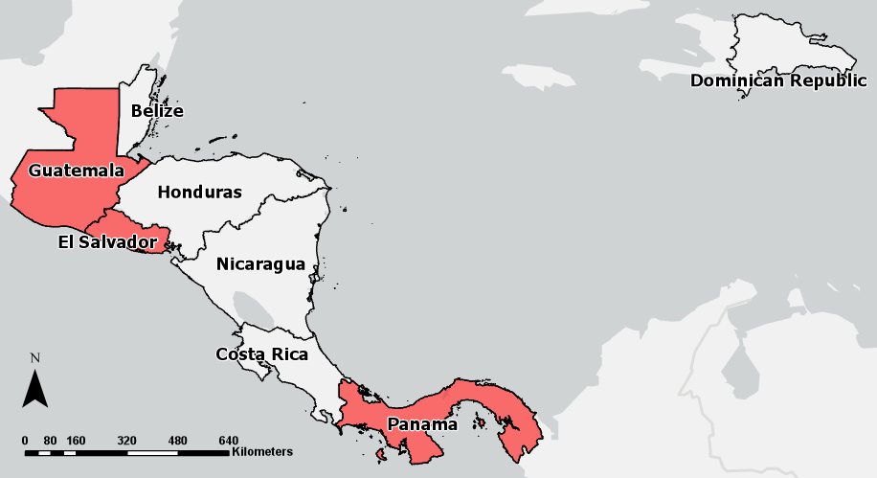




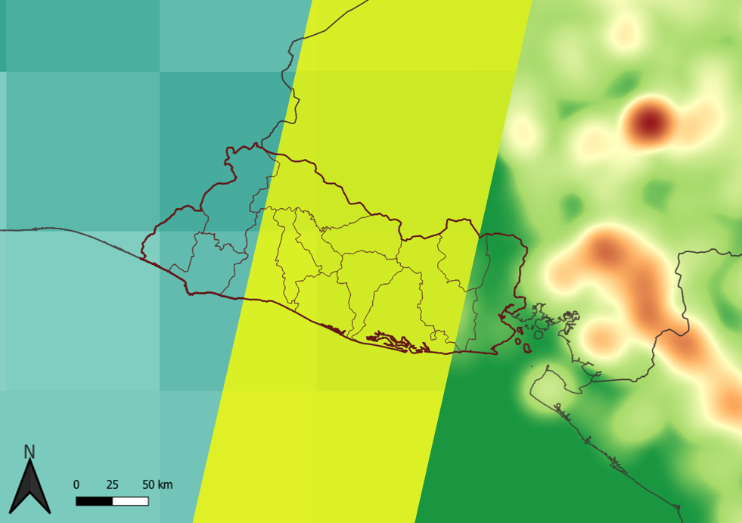
















Identifying Aerosols and Particulate Matter in Central America Using NASA Remote Sensing Data
Abstract
Central America Health & Air Quality
Aerosols, fine particulate matter expelled into the atmosphere, have become a major concern due to associated negative health impacts. Aerosols are commonly created by anthropogenic activities such as biomass and fossil fuel burnings, pyrotechnics, vehicle congestion, and mining operations, or by natural sources such as dust and salt particles. These contributors often release aerosols with a diameter of 2.5μm or less (PM_{2.5}) that degrade air quality, put populations at risk of adverse health effects, and can cause severe environmental problems. To assist policy makers in developing scientifically-based solutions to identify social and environmental issues relating to these aerosols, the Central America Health & Air Quality team partnered with organizations from El Salvador (Ministerio de Medio Ambiente y Recursos Naturales (MARN)), Guatemala (MARN), and Panama (Universidad Tecnológica de Panama, La Universidad Autónoma de Ciriquí, and Instituto Especializado de Análisis de la Universidad de Panama). Research was conducted using in situ PM_{2.5} data obtained from end users alongside NASA Earth observations, including Aqua and Terra Moderate Resolution Imaging Spectroradiometer (MODIS), Suomi National Polar-orbiting Partnership Visible Infrared Imaging Radiometer Suite (VIIRS), and CALIPSO Cloud-Aerosol Lidar with Orthogonal Polarization (CALIOP). The largest concentration of aerosols from 2008 – 2019 occurred during the transition from dry to wet season, particularly in the months of April and May. Data analysis identified associations between AOD and PM_{2.5} levels, fire events, and related health risks. Results indicate a significant correlation between AOD and PM_{2.5} for all three nations (P-value < 0.05), aerosols were positively correlated with increased fire occurrence, and a relationship was observed between AOD levels and the occurrence of health effects that are commonly associated with the presence of PM_{2.5}.
Study Area
Objectives
Quantify the relationship between PM_{2.5} and AOD
Develop an AOD distribution map
Conduct a case study to determine the air quality of SICA countries that have experienced intense air pollution events, such as fires
Demonstrate how NASA earth observations can be applied to the interests of SICA countries
Determine if a correlation exists between certain health conditions and high concentrations of PM_{2.5}
Project Partners
SICA Countries
Ministerio de Medio Ambiente y Recursos Naturales (MARN) El Salvador
Ministerio de Medio Ambiente y Recursos Naturales (MARN) Guatemala
Universidad Technológica de Panamá
La Universidad Autónoma de Ciriquí
Instituto Especializado de Análisis de la Universidad de Panamá
Countries that provided in situ data
Earth Observations
Results
MODIS08 Regression Analysis
COUNTRIES | B (SE) | BETA | R² | OBSERVATIONS (N)
El Salvador
Overall Model | 49.238(7.131)*** | 0.55 | 0.3043 | 111
Dry Season | 72.40 (16.304)*** | 0.51 | 0.2639 | 57
Wet Season | 46.21(12.643)*** | 0.45 | 0.2044 | 54
Guatemala
Overall Model | 32.180(13.331)* | 0.30 | 0.09274 | 59
Dry Season | 71.96(43.73) | 0.30 | 0.09115 | 29
Wet Season | 52.391(17.722)** | 0.49 | 0.2379 | 30
Panama
Overall Model | 34.532 (6.814)*** | 0.66 | 0.4376 | 35
Dry Season | 20.040(10.104) | 0.44 | 0.1973 | 18
Wet Season | 47.858(9.851)*** | 0.78 | 0.6114 | 17
Note: P-value <0.05 is *, P-value <0.01 is **, P-value <0.001 is*** | B – unstandardized regression weights (Raw coefficients) SE - standard error | Beta - the standardized regression weights (How strongly the predictor variable influences the dependent variable)
Aqua MODIS
Terra MODIS
Suomi NPP VIIRS
CALIPSO CALIOP
Methodology
Data
Processing
Analysis
End Product
MOD08 & MYD08
Monthly AOD & PM_{2.5} Baseline Maps
Aqua/Terra
MODIS
MOD04 & MYD04
Excel ENVI &
R
Statistical Analysis
AOD & PM_{2.5} Conversion
Aug 2019: Average Aerosol Values (MODIS08) & Fire Incidents in El Salvador
AOD Values
PM_{2.5} Values
Fire Data
Average AOD Values – Aug 2019
0.000 (Clear Atmosphere)
0.250
CALIOP
L2_05km_APro
Statistical Analysis, Data Validation
0.500 (Hazy Conditions)
0.750
Suomi NPP &
CALIPSO
VIIRS AERDB_L2
Python
Excel
& R
Statistical Analysis, Data Validation
1.000 (Very High Aerosol Load)
Average PM_{2.5} Values – Aug 2019
Good
(0 – 15.4 µg/m³ PM_{2.5})
Moderate
(15.5 – 40.4 µg/m³ PM_{2.5})
NASA FIRMS
Monthly Fire Baseline Maps
Harmful to Sensitive Groups
(40.5 – 65.9 µg/m³ PM_{2.5})
Harmful to Health
(66 – 159 µg/m³ PM_{2.5})
Fire & Health Data
Excel
ArcGIS
& QGIS
Very Harmful to Health
(160 – 250 µg/m³ PM_{2.5})
In situ
Health Data
Annual Health Baseline Maps
Conclusions
Dangerous
(251 – 500 µg/m³ PM_{2.5})
A moderate correlation (R² < 0.5) exists between AOD and PM_{2.5}.
AOD & PM_{2.5} are higher in the beginning of the wet season, during April & May.
Fires and high concentrations of aerosols factor into adverse health affects.
CALIPSO AOD data successfully validated AOD data from MODIS.
The lack of available in situ data limited AOD analysis.
A multi-variable linear regression would better capture atmospheric conditions.
Team Members
Acknowledgements
Alejandro Soria
Kaitlyn Bretz
Giancarlo DeMarco
Jay Oliver
Dr. Kenton Ross | NASA Langley Research Center
Dr. Travis Toth | NASA Langley Research Center
Sean McCartney | SSAI, NASA Goddard Space Flight Center
All contacts from our partner organizations
Carlos Gonzalez | CCAD
Steve Padgett-Vasquez | Translator
Emil Cherrington | SERVIR SCO
Virginia – Langley| Fall 2019

