Slide 1
Website & Booklet Imagery
2018 Summer
Project Short Title here
Node Name here

Slide 2
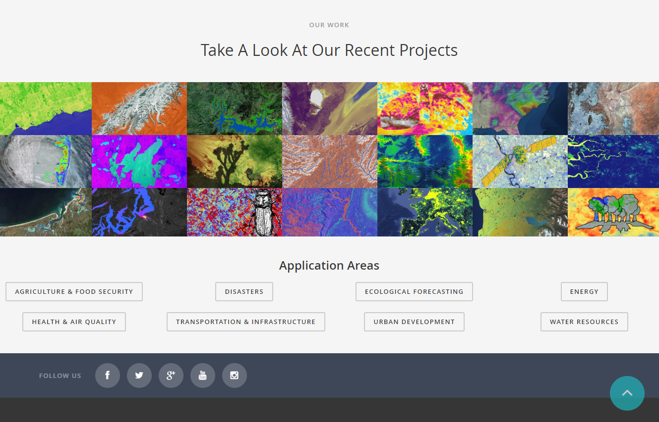
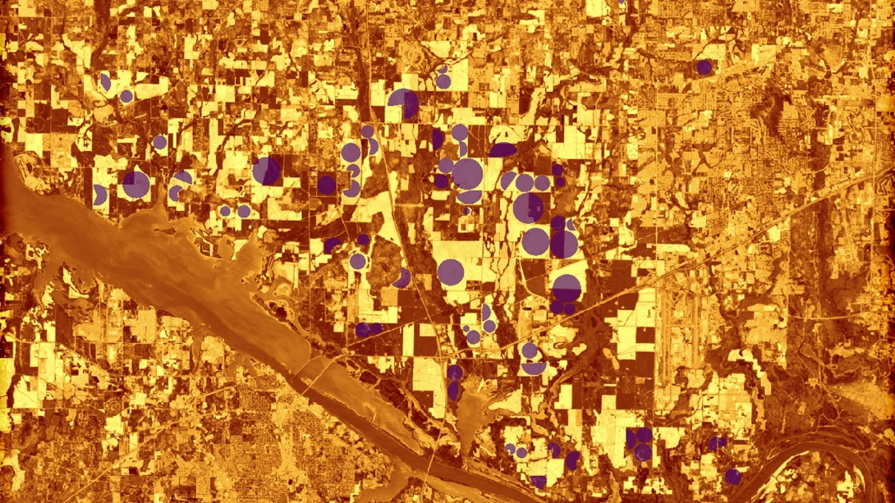


Purpose & Overview
This image should be an attractive, processed image of your study area that will be used to represent the project. This image will be used as a cover image on the project page of the DEVELOP website, the project’s presentation, project image on NASA’s Applied Sciences eBooks website, Summer Booklet image, and as Earth imagery that can be used by DEVELOP’s graphic design team for future publications and promotional materials.
1920 px
1080 px
Delete this slide before submission
Notes:
These notes should be thorough enough for someone not familiar with the project to clearly present the material.
NOTE: For every image on the slide include an image source in the speaker notes (ex. URL; Name, Affiliation, etc.)
Image Source: http://commons.wikimedia.org/wiki/File:Claude_Monet_-_The_Magpie_-_Google_Art_Project.jpg

Slide 3
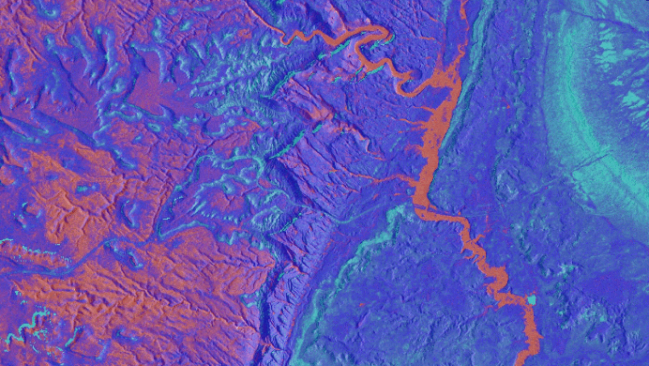
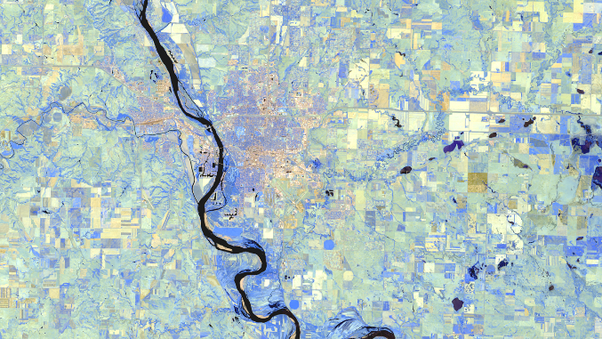
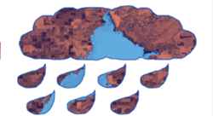
Web/Booklet Image Checklist: Requirements
High-resolution, 1920 x 1080 (over 300 dpi) – landscape orientation
  Not sure how to size your image? Use an online resizer like this one -> http://resizeimage.net/
Entire frame is filled with imagery – NO white space
Saved as a JPEG or PNG
Text, legends, etc. must be separate items that are typed and created in PowerPoint (NO imported legends or text)
No images that are clipped to a shape (see bottom right)
Derived from recent data (2017-2018)
Image is derived from NASA sensor data
  Why? DEVELOP is a NASA-funded program that is focused on highlighting NASA data applications. These images are used by NASA in a variety of communication materials.
  Exception: NCEI projects using CDRs
No use of photographs
Some kind of processing has taken place
Not just a raw satellite image or simple re-order of spectral bands
The team actually created the image – NO outside content included
There are map resources available on DEVELOPedia
For examples: https://develop.larc.nasa.gov/projects.php
Yes! →
Yes! →
NO! →
Delete this slide before submission
Notes:
These notes should be thorough enough for someone not familiar with the project to clearly present the material.
NOTE: For every image on the slide include an image source in the speaker notes (ex. URL; Name, Affiliation, etc.)
Image Source: http://commons.wikimedia.org/wiki/File:Claude_Monet_-_The_Magpie_-_Google_Art_Project.jpg

Slide 4
Delete this box and place image here
Project Short Title Here
Caption: 25 word limit.
Metadata Tags: List any keywords, or project participant names that you would like included in the photo’s metadata.

