Slide 1
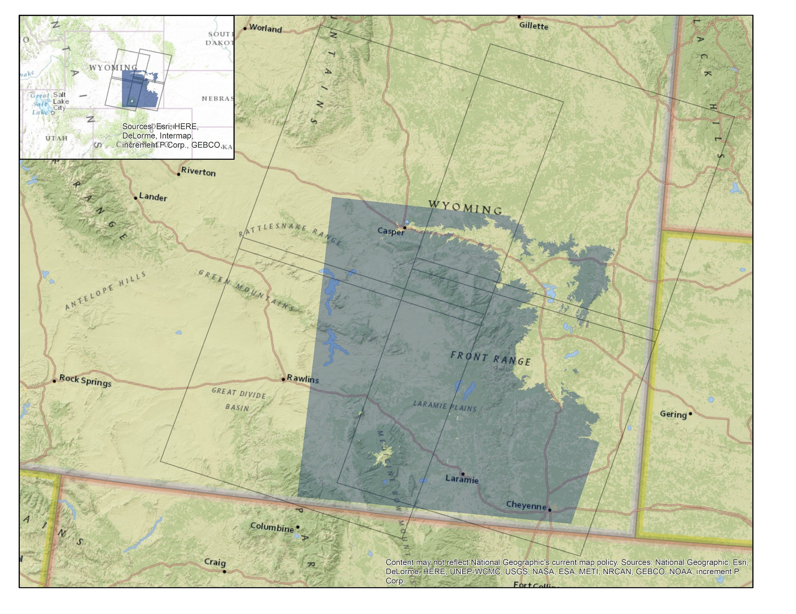

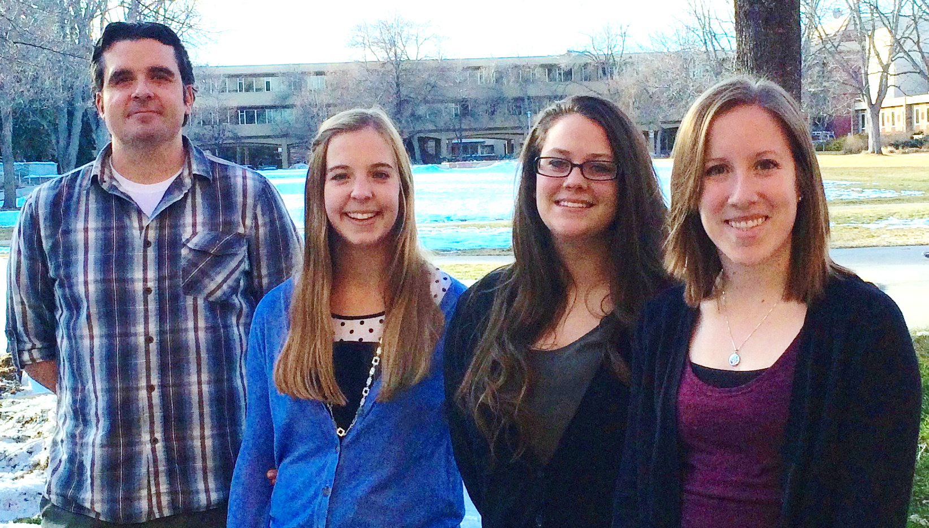
Laramie Mountains Ecological Forecasting
Mapping fire history in the Laramie Mountain Range, Wyoming with a 31-year Landsat time series
Stephanie Krail (Project Lead), Alexa Grafton, Aubrey Hilte, and Darin Schulte
NASA DEVELOP National Program at USGS Colorado State University
Abstract
Keep this blank for now.
Body text point size should be at least 24.
Caption text point size should be at least 16.
Feel free to rename, move, and resize sections as needed.
Objectives
Results
Conclusions
Delineate fire history of the Laramie Mountain Range
Classify severity of previous fire events
Calculate fire return interval through a 31-year time series
Analyze locations within study area for future fire risk
Coming soon!
Coming soon!
Study Area
Laramie Mountains Ecological Forecasting Study Area
Study area extent
Path, Row outlines
Figure 1: Study area map depicting the extent of the study area
Earth Observations
Methodology
Shuttle Radar Topography Mission (SRTM)
Landsat 5 Thematic Mapper (TM)
Data Acquisition
Data
Processing
Modeling
Results
Landsat
Data
LandsatLinkr
Tasseled
Cap
Time
Series
Vegetation
Indices
Extent
Severity
Return Interval
Risk Analysis
Ancillary
Data
Normalized
Burn Ratio
Adjust
Thresholds
Landsat 8 Operational Land Imager/Thermal Infrared Sensor (OLI/TIRS)
Set
Thresholds
Landsat 7 Enhanced Thematic Mapper Plus (ETM+)
Figure 2: Work flow displaying the methodology for the project. The work flow consists of four main stages and follows two distinct paths that are outlined from left to right.
Team Members
Project Partners
Acknowledgements
Wyoming Game and Fish Department
USDA Forest Service,
Laramie Ranger District
Colorado State University,
Natural Resource Ecology Laboratory (NREL)
We would like to thank Dr. Paul Evangelista, Dr. Amanda West, and Dr. Bill Romme, Colorado State University, Natural Resource Ecology Laboratory (NREL).
We would also like to thank Ryan Amundson, Wyoming Game and Fish Department, and Daron Reynolds, USDA Forest Service, Laramie Ranger District.
Brian Woodward, the Fort Collins Center Lead, deserves a big thank you for his support, advice, and guidance.
From left to right: Darin Schulte, Alexa Grafton, Aubrey Hilte, and Stephanie Krail
USGS at Colorado State University

