Slide 1
Southeast US Ecological Forecasting II
Using NASA Earth Observations to Map the Spatio-Temporal Distribution of Hydrilla verticillata
Benjamin Page (Project Lead)
Brandon Hays
Pradeep Kumar Ragu Chanthar
Linli Zu

Slide 2
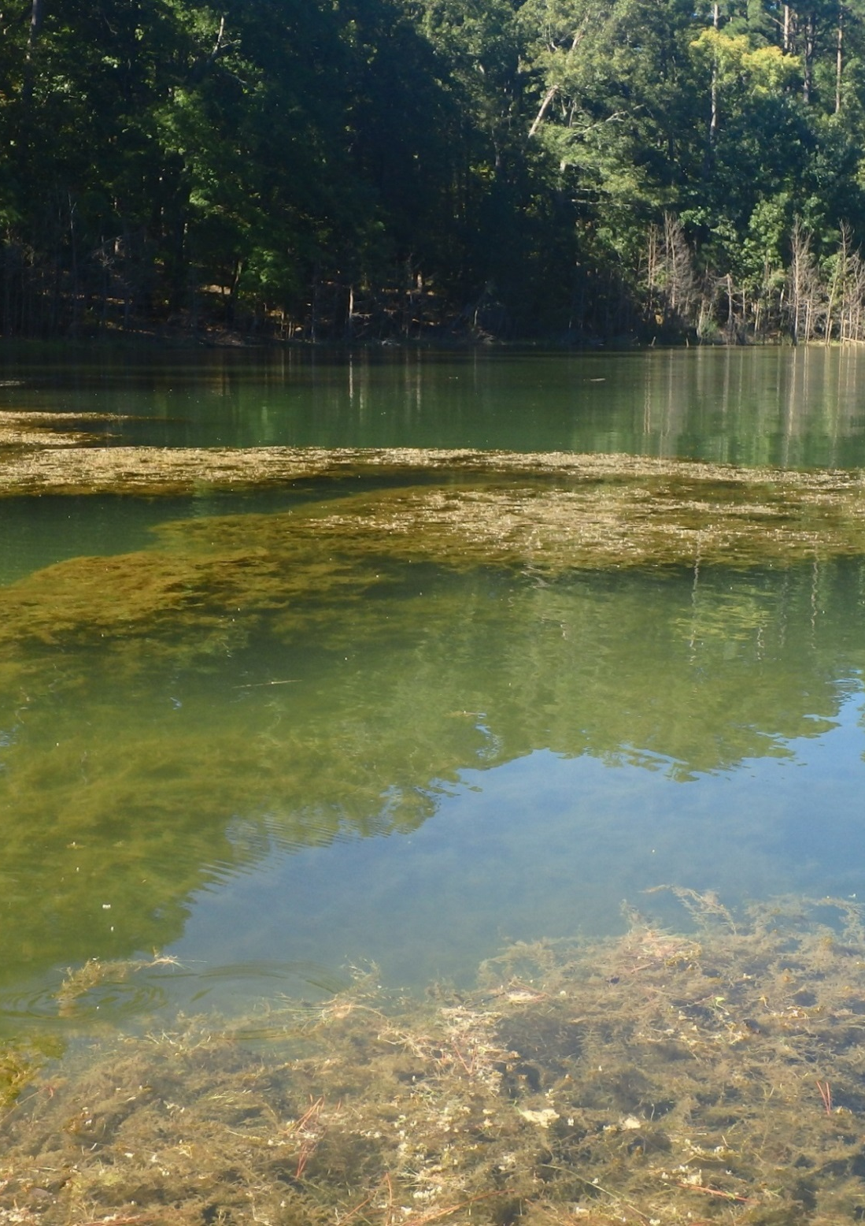
Hydrilla verticillata
Highly invasive aquatic plant
Introduced to Florida in 1950’s
Spread to 25 states across the U.S.
Costs millions of dollars in recreational and ecological damage each year
Image Source: SEUS Ecological Forecasting Team II
Notes:
Hydrilla verticillata is a highly invasive aquatic plant which has spread through inland waterbodies throughout many states in the US. It grows from as much as 20 feet deep, quickly sprouting to the surface where it branches horizontally to form thick mats. These mats shade out other native aquatic vegetation leading to mono-specific stands of Hydrilla.
There are two forms of Hydrilla with differing environmental tolerances, a monoecious and a dioecious. The monoecious form is found north of North Carolina and the dioecious form is found throughout the southeast and west to Texas.
Hydrilla was originally introduced to Florida from south India; it had been ordered as an aquarium plant but was rejected upon arrival. Instead it was dumped into Tampa Bay where it started a thriving colony. This colony served as a source from which other aquarium traders attained Hydrilla and shipped it throughout the southeast.
Today Hydrilla is found in freshwater sources in 25 of the lower 48 states. It costs millions of dollars in removal efforts, decreased recreational use, and decreased fish stocks.

Slide 3
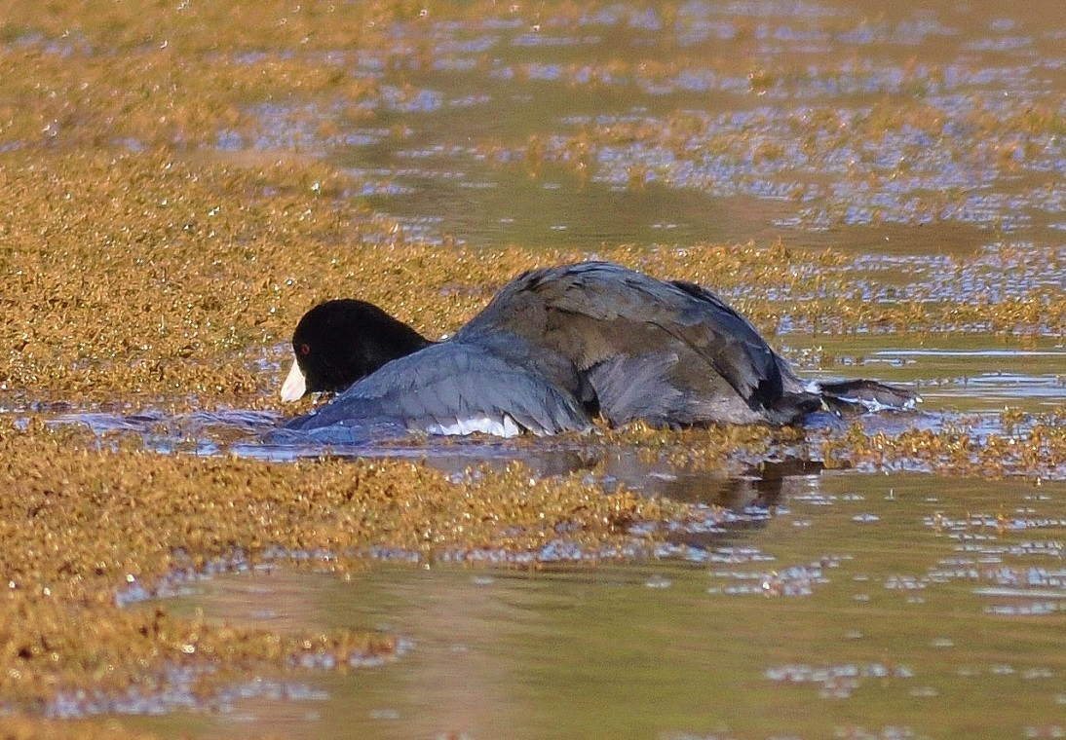
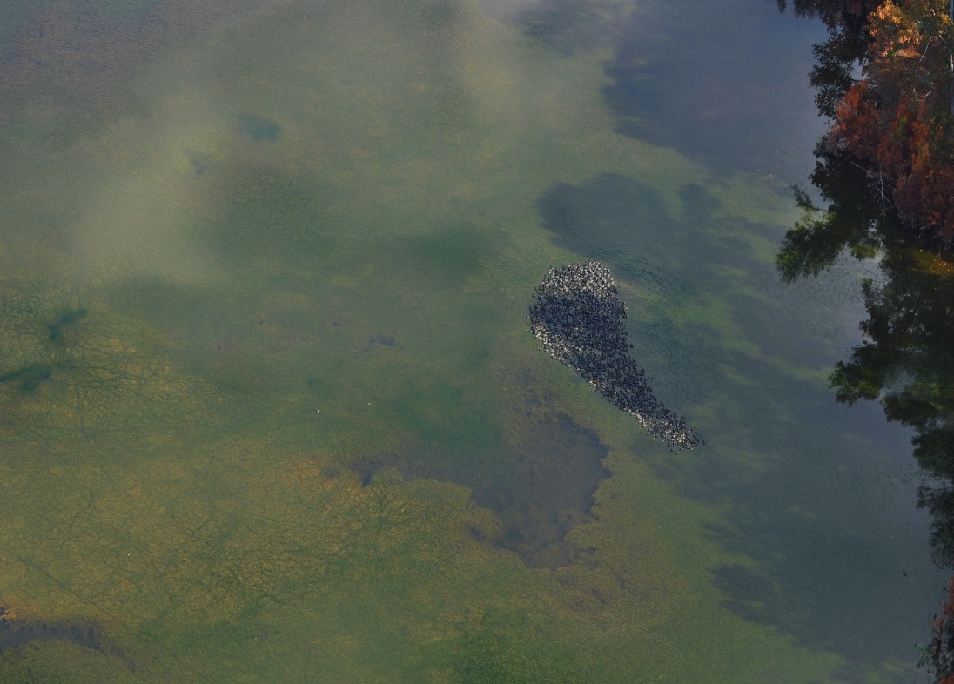
Community Concerns
Displaces native vegetation
Inhibits recreational use
Obstructs water withdrawal in reservoirs
Harbors toxic cyanobacteria which endangers wildlife
Image Credit: Brigette Nelson Haram
Notes:
Hydrilla can grow from 20 feet below the surface. It quickly grows a single stem up towards the surface and then branches out prolifically to form dense mats that block sunlight from reaching anything beneath it. This has the effect of quickly shading out and killing competing native aquatic plants. The dense mats also tangle swimmers and boat motors, making effected areas unnavigable. This is particularly troublesome when it grows rampantly around boat unloading areas. The dense Hydrilla mats can also cause major problems by blocking water uptake pipes for drinking water reservoirs and clogging intake filters on hydroelectric dams. Finally, the the cyanobacteria Aetokthonos hydrillicola inhabits the leaves of Hydrilla. This cyanobacteria produces a neurotoxin which, when the Hydrilla is eaten by waterfowl such as American coots (Fulica Americana), causes Avian Vacuolar Myelinopathy and leads to the death of the unfortunate birds. These waterfowl are frequently eaten by American bald eagles (Haliaeetus leucocephalus) who contract AVM after eating the stomach contents of their effected prey.

Slide 4
Objectives
Characterize the seasonal patterns of Hydrilla distribution
Quantify total area covered by topped-out/surface floating vegetation
Generate maps of photosynthetic active radiation (PAR)
Synthesize it all to create a predictive model to forecast future growth of Hydrilla
Notes:
The objective of this project was to map the current distribution of Hydrilla throughout the Southeastern US and create forecasting model to predict future spread. In order to predict future patterns we needed to understand the past spatio-temporal patterns of Hydrilla. After mapping the seasonal changes across our study lakes we quantified the total amount of topped out topped-out/surface vegetation. We then generated maps of PAR, to find areas of potential hydrilla growth. Finally we integrated all of this data to create a predictive model which could be used to forecast Hydrilla growth in inland water bodies throughout the SE US.

Slide 5
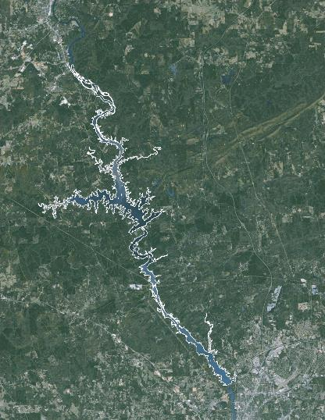
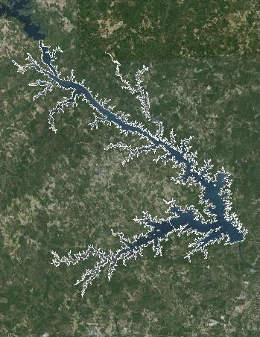
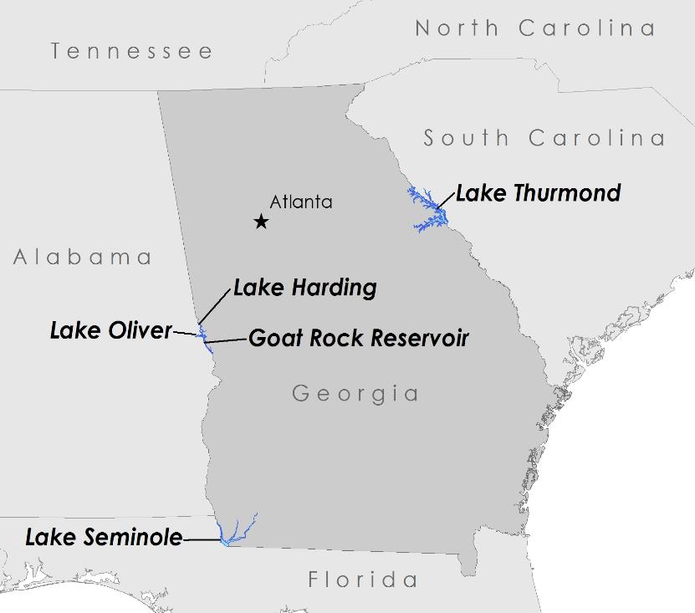
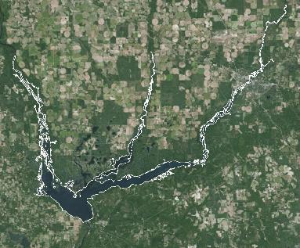
Study Areas
Lake Harding
Goat Rock
Lake Thurmond
Lake Oliver
US ACE
Georgia Power
Lake Seminole
Study Period: Oct. 2013 – Oct. 2015
Notes:
The US ACE has estimated that Hydrilla covers 7% of Lake Thurmond, which is itself 29 km2. At Lake Seminole, Hydrilla has been present almost since the impoundment of the lake more than 50 years ago. The US ACE has been attempting to exterminate with herbicides, mechanical removal, and biological controls-so far with little success.
In recent years, Georgia Power has reported the introduction in rapid spread of Hydrilla across Lakes Harding, Oliver, and Goat.
We analyzed satellite imagery from Oct. 2013 until Oct. 2015

Slide 6
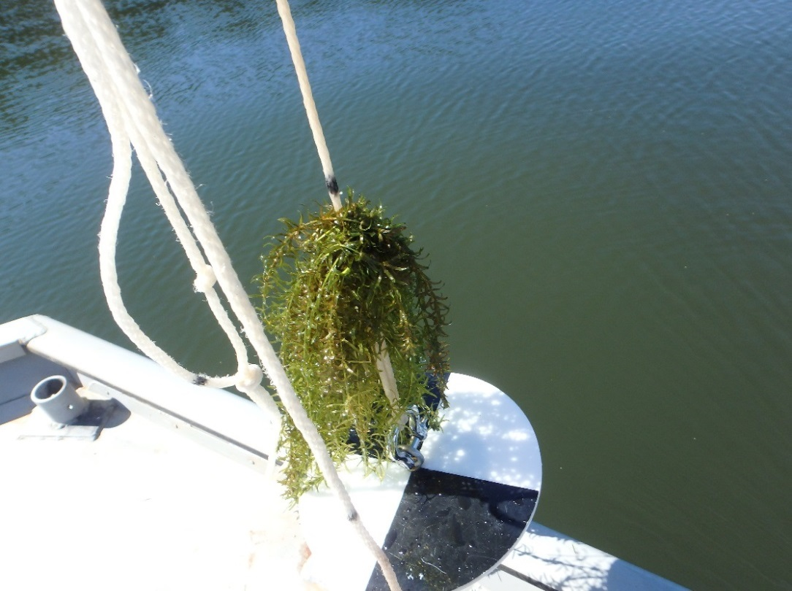
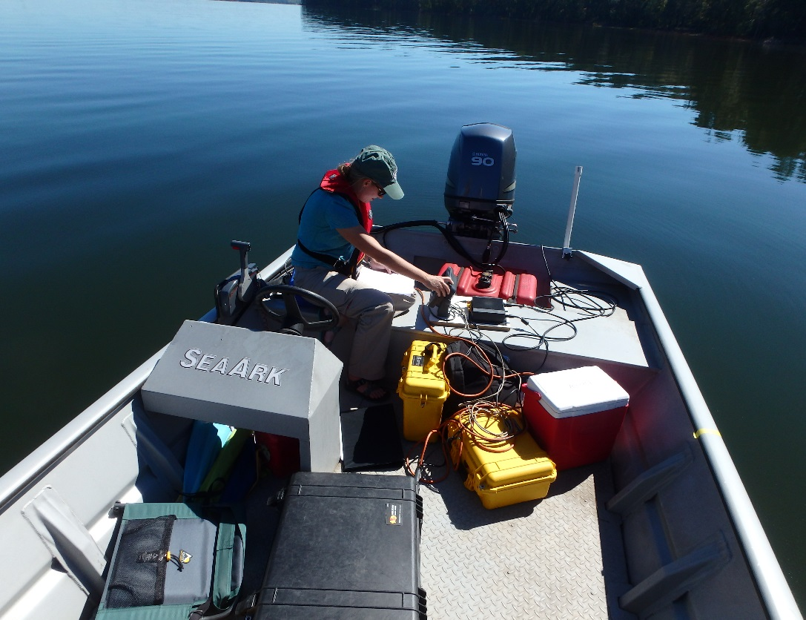
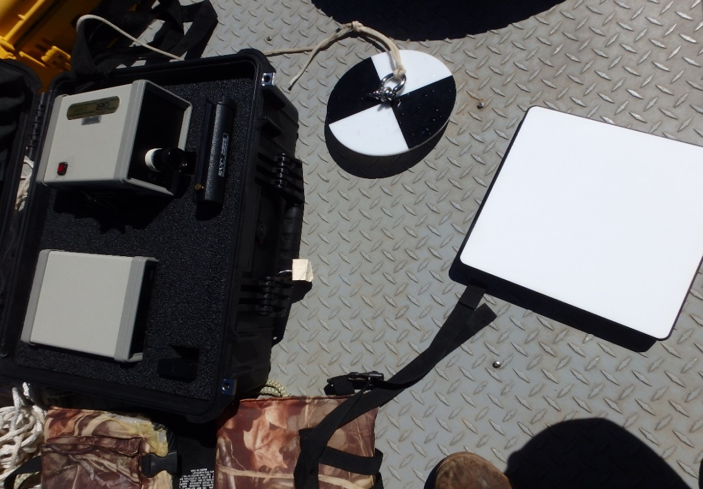
Field Data
Hyperspectral data
Secchi disk depth (SSD)
Sonar – biovolume & plant height
Image Credit: SEUS Ecological Forecasting Team II
Notes:
We traveled to Lake Thurmond and collected field data during a Landsat 8 overpass. We used sonar to measure bathymetric depth and biovolume. Then we physically measured depth at select sample areas for quality control of the sonar data. Using secchi disks we were able to measure the depth limit of the photosynthetically active zones and calculated the light attenuation coefficient. Finally we used a hyperspectrometer to measure the remote sensing reflectance value of hydrilla submerged at different depths.

Slide 7
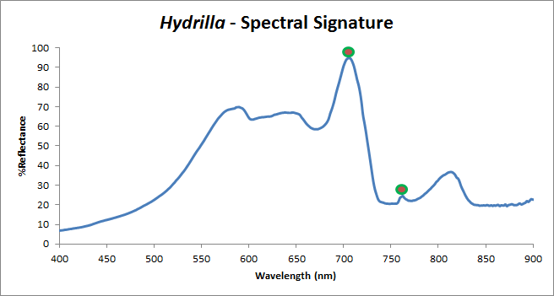
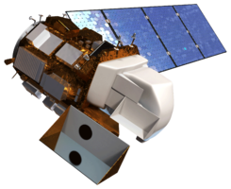
EOS Data
Landsat 8 Operational Land Imager (OLI)
9-band pushbroom multispectral sensor
Temporal resolution of 16 days
Detects light in VIS-NIR
Hydrilla reflects light most strongly at 710 nm and 765 nm wavelengths
Image Credit: NASA
Notes:
We acquired Landsat 8 imagery for all dates from Oct 2013-Oct 2015 through the USGS EarthExplorer portal as level 1 TIF files. We excluded any images that had more than 10% cloud cover over our study areas.
Unfortunately Landsat 8 OLI doesn’t sense light at the wavelengths that Hydrilla reflect most strongly at – that would have been too easy. We came up with an alternative method to map Hydrilla using the existing bands.

Slide 8
Methodology
Unsupervised Classification
Landsat 8 Data
Atmospheric Correction
Time Series
NDVI Maps
Forecasting Model
In Situ Data
PAR maps
Notes:
We processed the Landsat 8 imagery with 2 different atmospheric correction algorithms. The first was a publically available program called ACOLITE and the other was a custom built model. After comparing the products generated by each model we discovered that our custom atmospheric correction was more accurate and matched our field data better.
From the corrected imagery we produced true color composite images which we then collected into a time series. We also performed an unsupervised classification on the true color images to for the basis of our predictive model.
We performed a Normalized Difference Vegetation Index, overlaying the results on the Landsat 8 green band to show topped out Hydrilla.
Using the field data we collected we were able to validate our other products as well as create maps of Photosynthetically Active Radiation zones.
Finally we compiled all of these products into one final forecasting model.

Slide 9
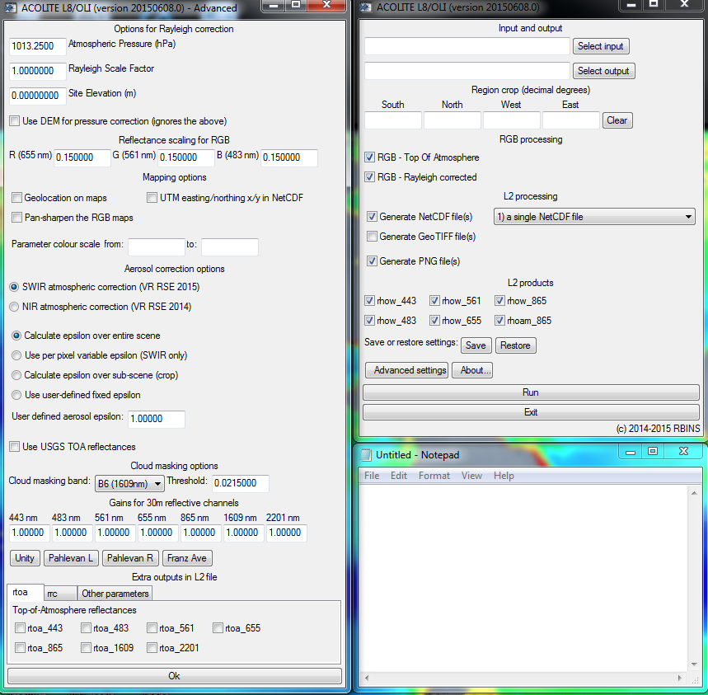
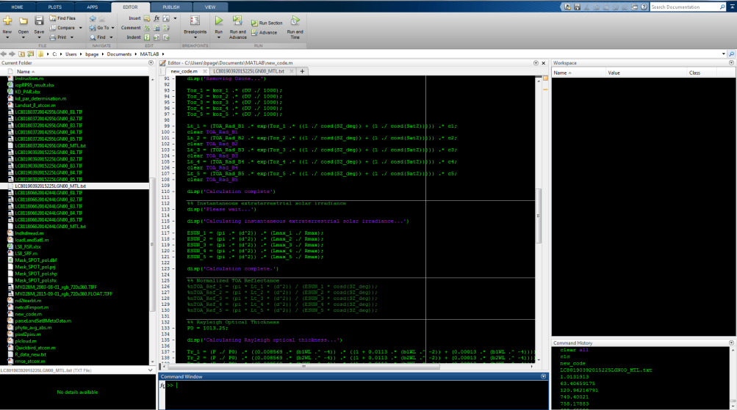
Atmospheric Correction
Two atmospheric correction procedures tested:
ACOLITE (Ruddick, Vanhellemont, 2015)
New Code
Data processing / analysis done on all three sets of images
Image Credit: SEUS Ecological Forecasting Team II
Notes:
Before any other processing could be performed, it was necessary to screen our images for the effects of atmospheric interference. To accomplish this, two different atmospheric corrections were performed on the raw imagery. The publically available ACOLITE software was compared against the methods provided by Dash/Mishra et. al. 2012. ACOLITE is designed to correct for scenes of marine water leaving reflectances and takes into account factors such as extraterrestrial solar irradiance, water absorption, Rayleigh optical scattering, ozone and aerosol optical thickness (Vanhellemont & Ruddick 2014). However, ACOLITE has not been validated within highly productive, turbid waters. We corrected all imagery between August 2013 and October 2015 with each model and performed all subsequent processing techniques on both sets. The results were compared after algorithm validation to determine the most effective model.

Slide 10
NDVI
Target topped-out/floating vegetation
Quantify total area of lake covered by floating Hydrilla
Can be used in time series analysis and forecasting models
NDVI
RNIR – Rred / RNIR + Rred
Notes:
NDVI maps provide images where healthy vegetation appears red and is mainly used for forest health and land change. NDVI values range from -1 to +1 and each pixel will hold one of these values, falling in a classification determined by the calculation. Dense vegetation will fall in the range from 0.3 to 0.8, whereas clouds and snow are usually represented as negative values. Therefore, a threshold was set from 0.2 to 0.5 to capture any vegetation that may be floating on the water surface. Each NDVI positive pixel that falls within this range is then multiplied by Landsat 8’s 30x30m resolution scale (900) and then divided by the total area pixel count of the study lake, providing a total floating vegetation coverage in percent of any lake for any time.

Slide 11
Kd(PAR)
Kd(PAR) = a / SDD
Collect Secchi Disk Depth (SDD)
Associate range of Secchi depths with range of Rrs
Predict “suitable” habitats for Hydrilla based on amount of PAR available
Notes:
Another useful measurement that the secchi disk provides is the estimation of Kd(PAR) (Photosynthetically Active Radiation), and explains the attenuation of light through the water column. With Kd(PAR) estimation, maps were generated to propose a weighted overlay of where Hydrilla could potentially thrive in regions where the plant may not be visibly noticeable.

Slide 12
Methodology
Unsupervised Classification
Landsat 8 Data
Atmospheric Correction
Time Series
NDVI Maps
Forecasting Model
In Situ Data
PAR maps

Slide 13
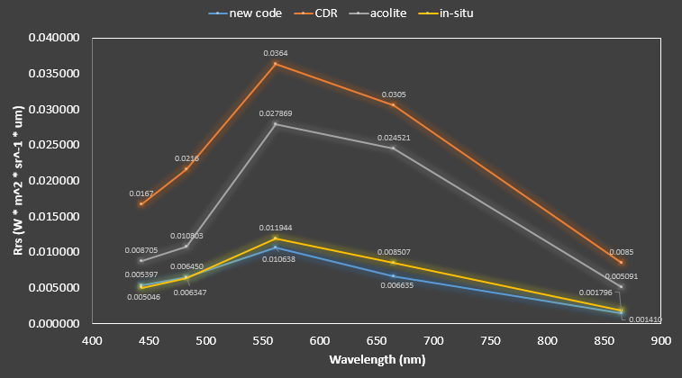
Results I
Time Series images
Maybe 4 images from late summer and late winter in 2014 and 2015?

Slide 14
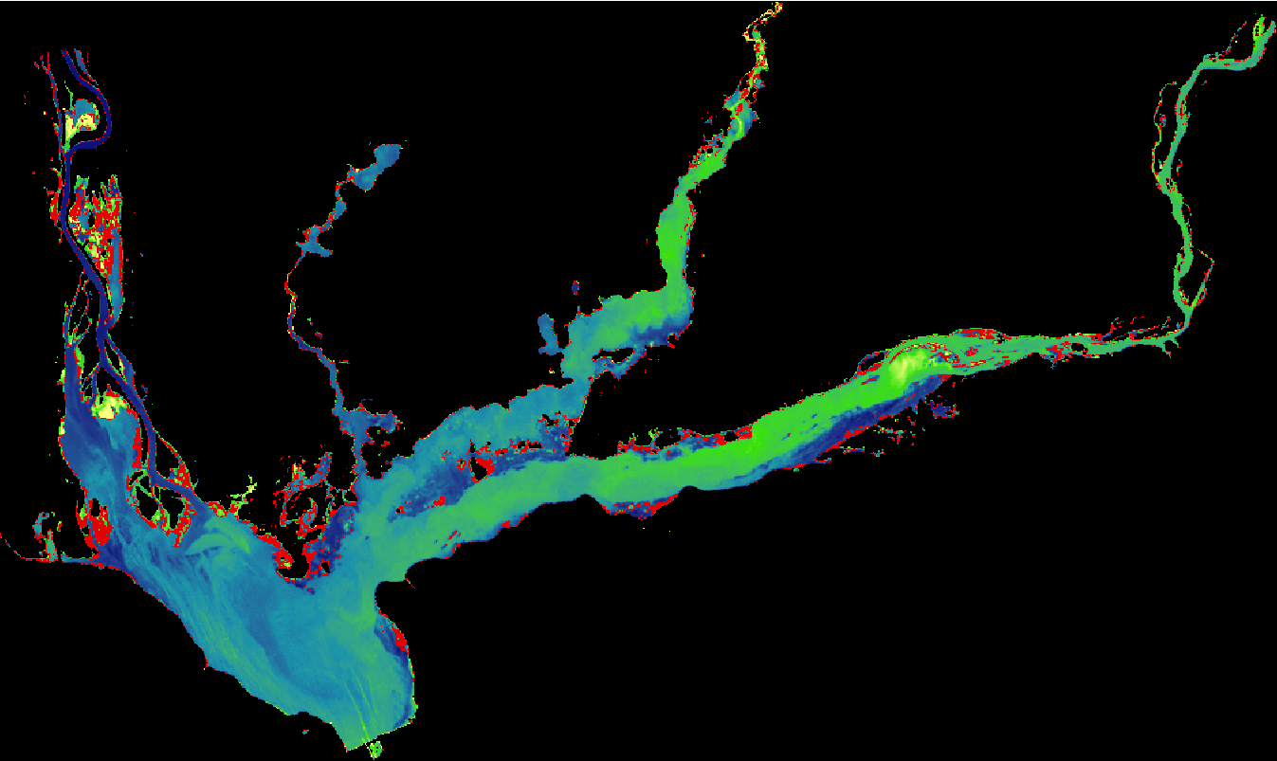
Results II
We were able to calculate X km2 of topped-out Hydrilla covering Lake Seminole
Insert graph of Hydrilla coverage vs time

Slide 15
Results III
PAR Maps

Slide 16
Results IV
Unsupervised classification
Validated/trained Unsupervised classification

Slide 17
Conclusion
We are the bomb
Hydrilla sucks

Slide 18
Future Work
Differentiate between species of aquatic vegetation
Do 30 year time-series since Hydrilla was introduced to Southeastern US
Map spread of Hydrilla through US since the initial invasion
Image ideas?
Notes:
Our current model cannot differentiate topped-out Hydrilla from other species of aquatic vegetation. NDVI scores cover a range of values. We can take further spectroscopy data of Hydrilla and other species to better define the spectral signature of our target plant.
Using 30 years of archived imagery from past Landsat satellites, it is possible to do a long-term time series of Lake Seminole to map the spread of Hydrilla almost since it’s initial introduction.
Similarly, we can use the same data on a larger scale to track the spread of Hydrilla throughout the Southeast and beyond in the rest of the US.

Slide 19
Advisors
Dr. Deepak Mishra, Department of Geography, University of Georgia
Dr. Susan Wilde, Warnell School of Forestry and Natural Resources, University of Georgia
Partners
Kenneth Boyd & Allen Dean, US Army Corps of Engineers
Anthony Dodd, Georgia Power
Others
Brigette Nelson Haram, Warnell School of Forestry and Natural Resources
Wuyang Cai, Elizabeth Dyer, Shuvankar Ghosh, Peter Hawman, SEUS Ecological Forecasting I Team

Slide 20
End Slide
Enter a Picture of the four of us on the lake, we should all be holding a handful of Hydrilla looking triumphant and glorious

Slide 21
General Guidelines I
Things that are typically included in a presentation:
The slides provided in the template are just a starting point for teams. Feel free to expand upon these topics, alter the headings, and change the order of the slides to fit your needs.
Study area
Study period
Objectives
Community concerns
NASA satellites/sensors used
Methodology
Results
Conclusions
Errors & uncertainties
Future work
Acknowledgements
Backup slides
Required Statement

Slide 22
General Guidelines II
Header text point size should be between 40 and 60 on most slides.
Body text point size should be at least 20.
Use Century Gothic.
Keep text to a minimum.
Try to use a consistent font size between slides.
Image Credit: Monet
Notes:
Image Source: http://commons.wikimedia.org/wiki/File:Claude_Monet_-_The_Magpie_-_Google_Art_Project.jpg

Slide 23
Image Credit: Monet
General Guidelines III
Include speaker notes for each slide (see below).
Include a visual on each slide, if possible.
Arrange content to minimize white space.
Notes:
These notes should be thorough enough for someone not familiar with the project to clearly present the material.
Image Source: http://commons.wikimedia.org/wiki/File:Claude_Monet_-_The_Magpie_-_Google_Art_Project.jpg

Slide 24
Maps & Logos
Maps
Import the legend separately.
Make sure all text is legible and editable.
Cite base layer source in speaker notes.
Logos
US Federal logos only.
No state, NGO, local and or international government logos, or software logos.

Slide 25
Photos & Figures I
You may only use images taken by your team, provided by your partners (as long as you have permission from them), from a Federal Agency, from the new DEVELOP stock imagery collection on DEVELOP’s Flickr page, or Creative Commons images.
Obtain a media release form from all people in photos that your team has taken — no children!
All image sources should be cited using a consistent format and should be visible on the slide.

Slide 26
Photos & Figures II
Please do not include the image URL in the source text box but rather place it in the notes section below.
If you use a border for your images include it on all photographs to keep your presentation consistent.
Keep all images and text boxes editable, including individual elements of flowcharts.
Background images are discouraged. If you use one, make sure that your text remains clear and legible.

