Slide 1
Texas Disasters II
Utilizing NASA Earth Observation to Assist the Texas Forest Service in Mapping and Analyzing Fuel Loads and Phenology in Texas Grasslands
Michael Brooke (Project Lead)
Meredith Williams
Teresa Fenn
Notes:
We are the Texas Disasters II team. My name is Michael Brooke, my name is Meredith Williams and my name is Teresa Fenn. We utilized NASA Earth Observations to assist the Texas Forest Service in mapping and analyzing fuel loads and phenology in Texas grasslands.

Slide 2
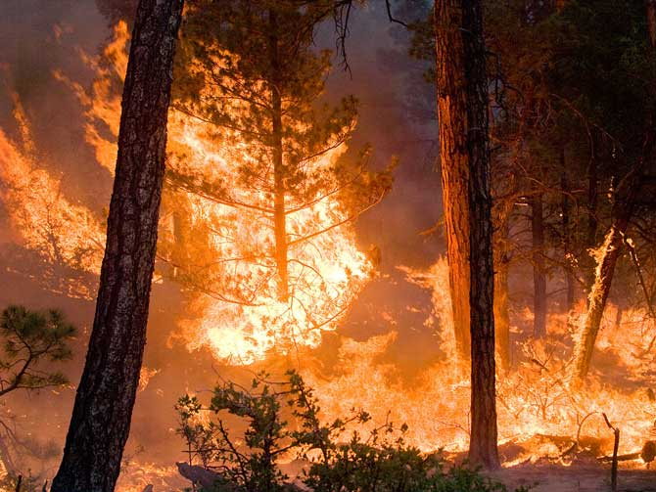
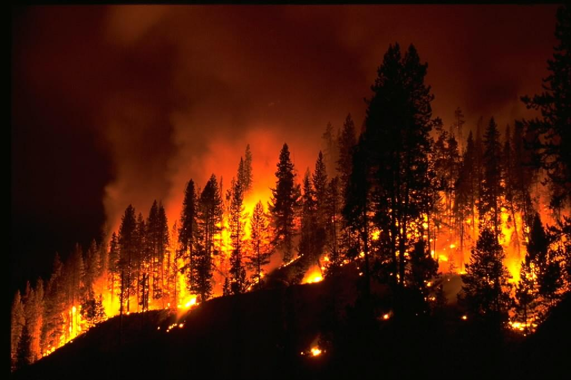
Objective
Assist the Texas Forest Service in Mapping and Analyzing Fuel Loads and Phenology in Texas Grasslands
Notes:
The objective of the project was to assist the TFS in mapping and analyzing fuel loads and phenology in Texas grasslands.
http://www.nasa.gov/images/content/710936main_climate-fire-670.jpg
http://scijinks.jpl.nasa.gov/review/imet/imet-6.jpg

Slide 3
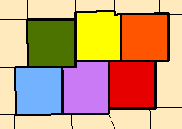
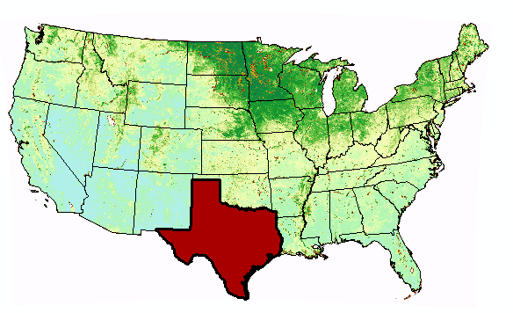
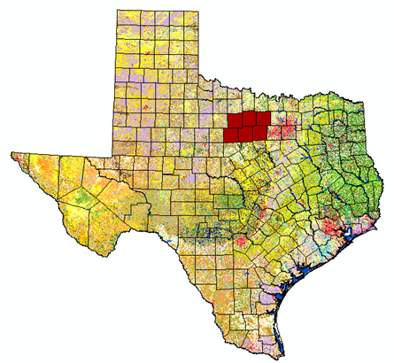
Study Area
Jack County
Palo Pinto County
Parker County
Stevens County
Wise County
Young County
Study Period
2001-Present
Notes:
The study area for the project was the state of Texas with an emphasis on a fire in 2011 called the Possum Kindgom complex which consisted of 6 counites. Jack, Palo Pinto, Parker, Wise and Young counties

Slide 4

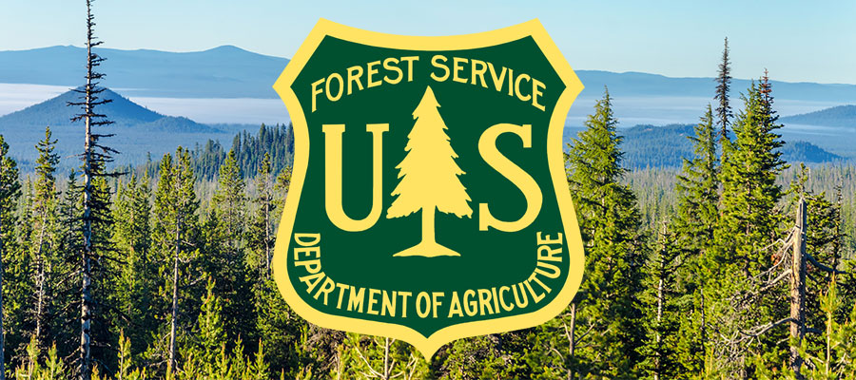
Partners
Texas Forest Service
USDA Forest Service
Notes:
The partners for our project were the Texas Forest Service and the USDA Forest Service.
http://deschutescollaborativeforest.org/wp-content/uploads/2015/07/forest-service-deschutes.jpg
http://texasforestservice.tamu.edu/

Slide 5
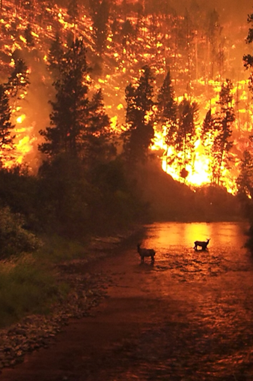
Community Concerns
Wildfires risk has increased due to climate change and recent development.
Texas grasslands are highly susceptible to wildfires.
In 2011 wildfires in Texas burned about 4,000,000 acres and destroyed nearly 3,000 homes.
Image: USDA Forest Service
Notes:
So why do this project? Wildfires effect the environment and are a large part of nature allowing for renewal and change. Wildfires can be deadly, destroying homes, wildlife habitat, timber, and polluting the air with emissions harmful to human health. Fires release carbon dioxide- a key greenhouse gas—into the atmosphere. Wildfire’s effect on the landscape may be long-lasting.

Slide 6
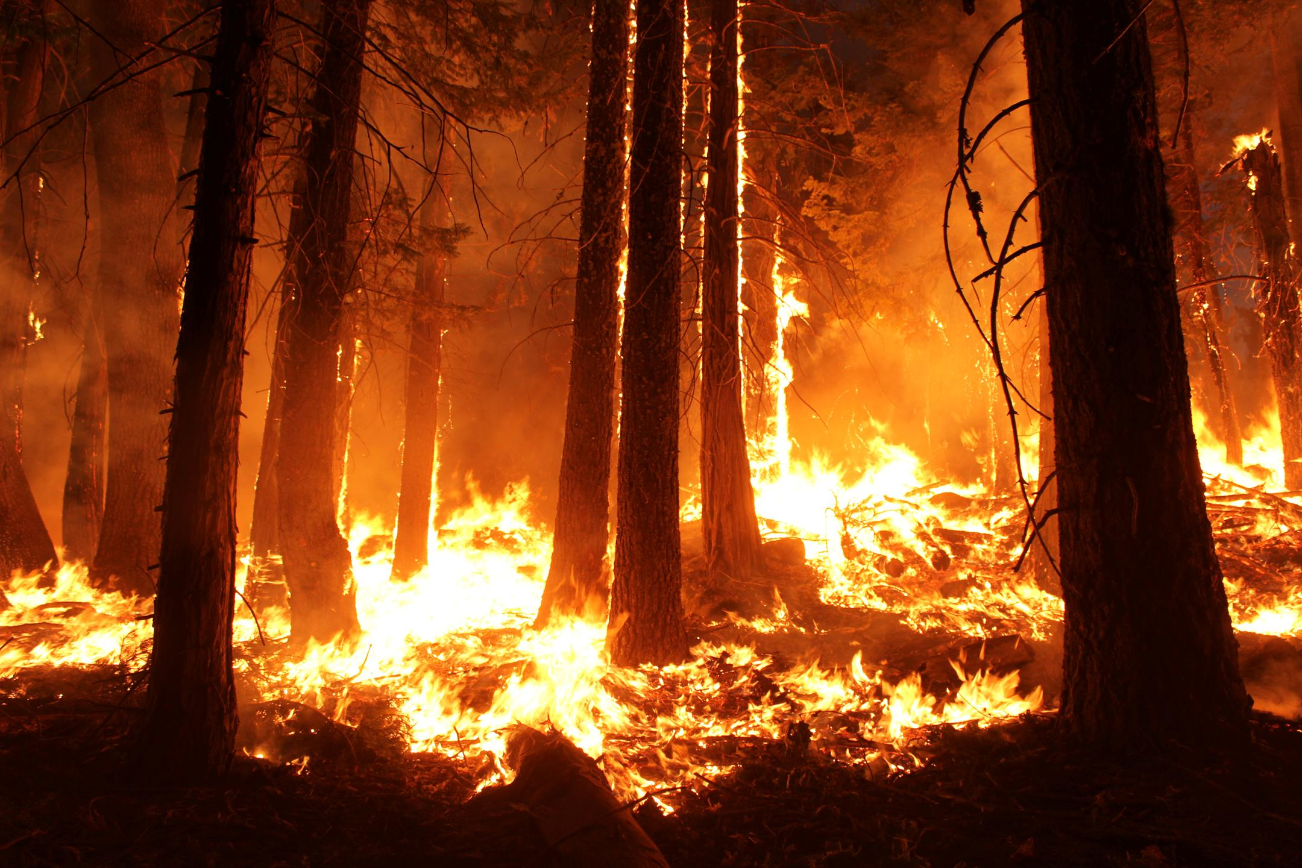
Background
80% wildfires occur within 2 miles development areas
Six of the 10 largest documented wildfires in state history occurred in April 2011
2011 Worst wildfire season
in history of state of Texas
In 2011, 31,453 wildfires burned 4 million acres and destroyed 2,947 homes
Notes:
According to the Texas Forest Service, 80% of wildfires in Texas occur within 2 miles of developed areas. In 2010, the lone star state recorded an above average rainfall year, the following year in 2011 a terrible drought occurred which lead to 2011 becoming the worst wildfire season in the history of the state. Roughly 31,000 wildfires burned 4 million acres and destroyed approximately 3,000 homes in 2011. 6 of the 10 largest documented wildfires in the history of the state occurred in April of 2011.
Image Source: http://www.jpl.nasa.gov/images/earth/fire/20150409/wildfire1.jpg

Slide 7
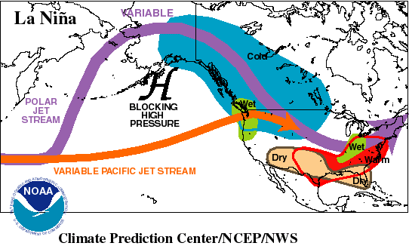

Background
La Niña events occur when there are cooler than normal sea surface temperatures from along the equator in the pacific ocean
Image Credit: NOAA
Notes:
So you might ask? What caused these conditions which lead to the worst wildfire season? A strong 2010-11 La Niña contributed to 2010 spring flooding with record breaking rainfall followed by an abnormally winter which lead to a severe drought into 2011.
Image Source: http://commons.wikimedia.org/wiki/File:Claude_Monet_-_The_Magpie_-_Google_Art_Project.jpg
http://www.cliparthut.com/clip-arts/869/fire-clip-art-869372.png

Slide 8
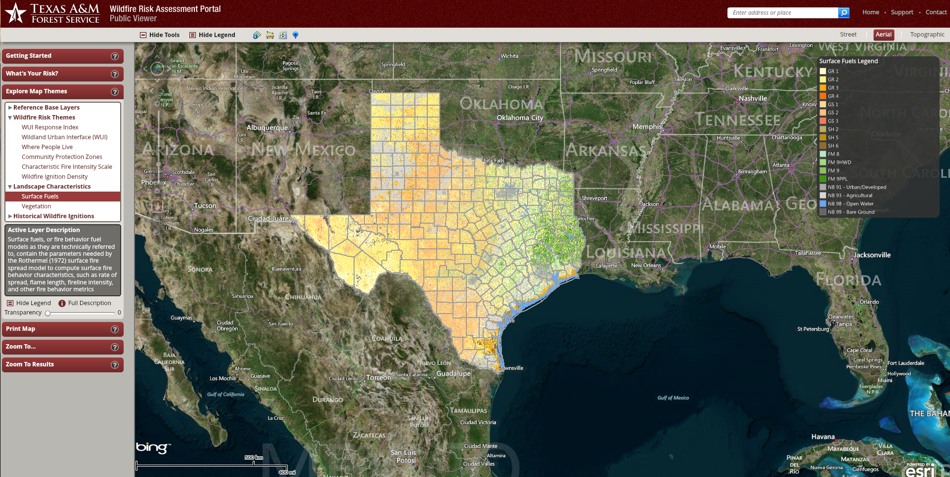
Texas Wildfire Risk Assessment
Fuel mapping – Landsat based 30m maps of vegetative fuels
Surface Fuels – GR, GS, SH, TU,TLSB, NB
Source: Texas Forest Service
Notes:
Methods for wildfire management have typically relied on models based on Landsat data to produce comprehensive fuel load and fuel type maps at 30 meter resolution.
This approach works well in relatively stable forested areas, but does not have the capability to accurately
depict seasonal changes in more dynamic fuel types such as grasslands.
The monitoring and forecasting of weather patterns, especially drought, is also an important component in used predicting fire behavior,
but drought is a cause of increased risk and is hard to quantify the actual response of fuel types on a large scale.
Image source: www.texaswildfirerisk.com

Slide 9
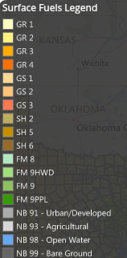
Texas Wildfire Risk Assessment
Surface Fuels – GR, GS, SH, TU,TLSB, NB
Type | Description
GR | Almost pure grass and/or forb type (Grass)
GS | Mixture of grass and shrubs, up to about 50% shrub coverage (Grass-Shrub)
SH | Shrub cover at least 50 % of the site (Shrub)
TU | Grass or shrubs mixed with litter from forest canopy (Timber-Understory)
TL | Dead and down woody fuel, litter, beneath a forest canopy (Timber Litter)
SB | Activity fuel, slash, or debris from wind damage (Slash-Blowdown)
NB | Insufficient wild land fuel to carry wild land fire under any condition (Nonburn-able)
Source: Texas Forest Service
Notes:
Originally the TFS had 13 fuel models known as the original 13 fuel models, this is the new set.

Slide 10
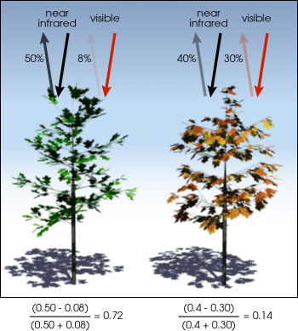
NDVI
Normalized
Difference
Vegetation
Index
NDVI = (NIR-Red/NIR+Red)
Measure plant productivity based on the density of greenness of vegetation
Notes:
In order to make these fuel maps sensitive to fluctuations NDVI was used.
NDVI
(Normalized Difference Vegetation Index) which is useful for quantifying the greenness of vegetation by comparing the amount visible and infrared wavelengths reflected back from the Earth to a satellite sensor.
http://earthobservatory.nasa.gov/Features/MeasuringVegetation/Images/ndvi_example.jpg

Slide 11
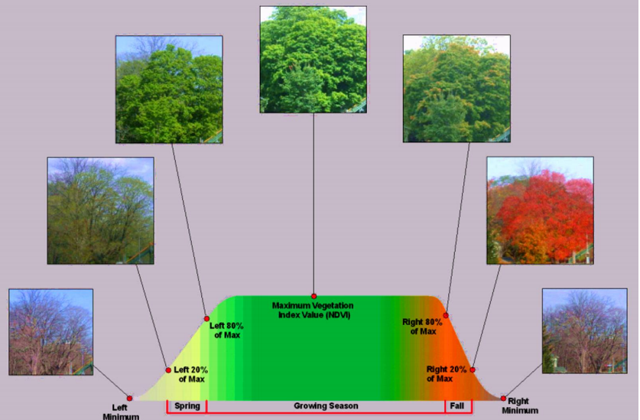
NDVI
http://ntrs.nasa.gov/archive/nasa/casi.ntrs.nasa.gov/20130000504.pdf
Notes:
This is the new national MODIS-derived phenology data set. An NDVI curve has seven parameters for which two maps are created at 231m resolution. The first map is the NDVI value and the second is the day of the year position within the season when it was attained.

Slide 12
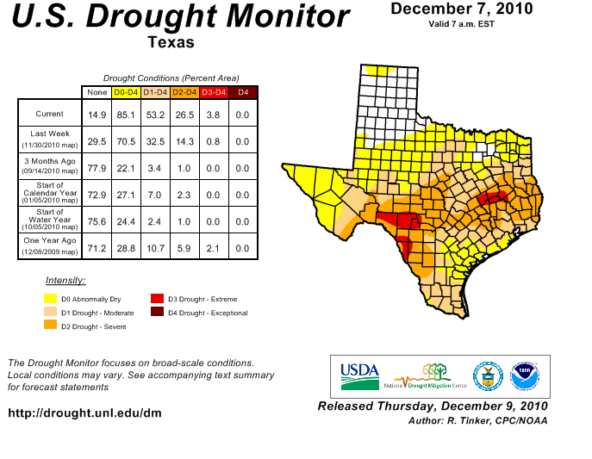
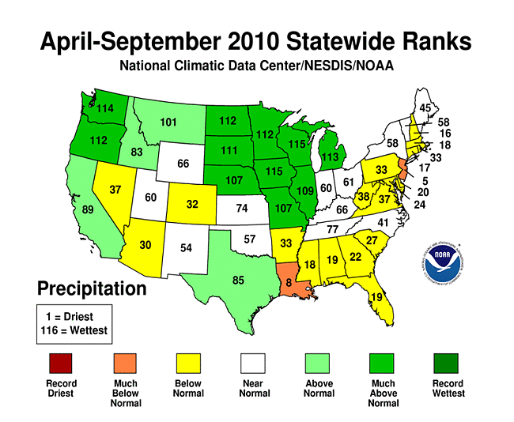
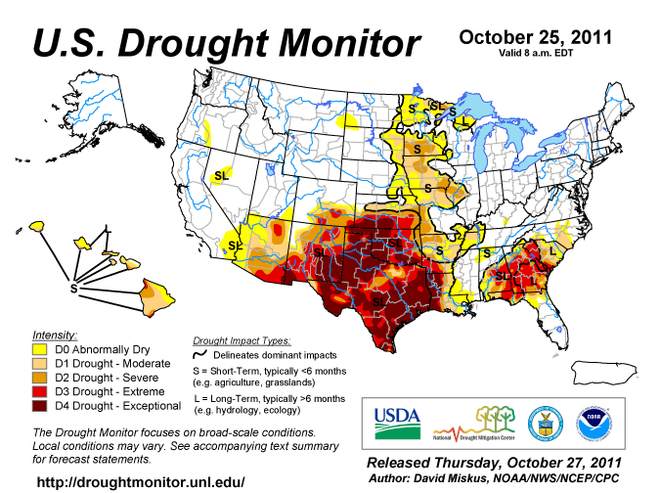
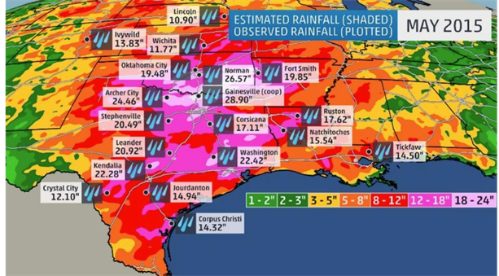
Background
Notes:
As one can see, the spring/summer of 2010 was above average rainfall. Followed by the beginning of the 2011 drought in the top right image. By October 2011 nearly the entire state of Texas is in an exceptional drought. So you might wonder what will occur this year in 2015-2016. The image to the bottom right is the weather channels May 2015 rainfall totals. May 2015 has been recorded as the wettest year in the history of the state.

Slide 13


NASA Satellites/Sensors
Sensor | Spatial Resolution | Temporal Resolution
MODIS (Terra and Aqua) Moderate Resolution Imaging Spectroradiometer | 250 m (bands 1-2) 500 m (bands 3-7) 1000 m (bands 8-36) | 1 Day
Landsat 8 OLI Operational Land Imager | 30 m | 16 Days
Notes:
NASA Earth Observations provide a good platform for evaluating wildfire fuel across varied temporal and spatial scales.
For this project the temporal advantages of daily pass MODIS data were combined with spatial advantages of 30-meter Landsat products.
Next………………………………….

Slide 14
Methodology
Final Image
Landcover
MODIS Phenology
Precipitation
Percent Canopy Cover
Notes:
Our methodologies consisted of land cover data, percent canopy cover, precipitation and MODIS Phenology data to acquire a final image.

Slide 15
Methodology – Fuel Type
Complete fuel type map for Texas was subset to include only grass (GR) grass/shrub (GS) and shrub (SH) types.
Notes:
Landcover data were acquired from Texas Parks & Wildlife Department

Slide 16
Methodology –
Canopy Cover
Areas over 30% canopy cover were excluded from the study
Notes:
Percent canopy cover data were acquired from USGS NLCD, National Landcover Dataset

Slide 17
Methodology - Precipitation
Precipitation data were downloaded from PRISM to help analyze the role amount and timing of rainfall play in greenup, browndown, maximum and integral NDVI values.
Notes:
Precipitation data were acquired from PRISM.

Slide 18
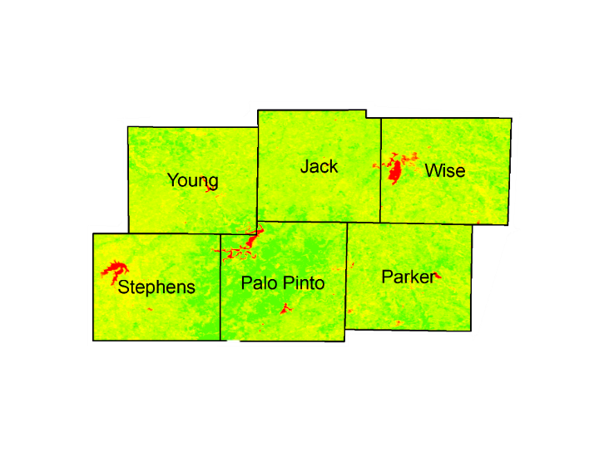
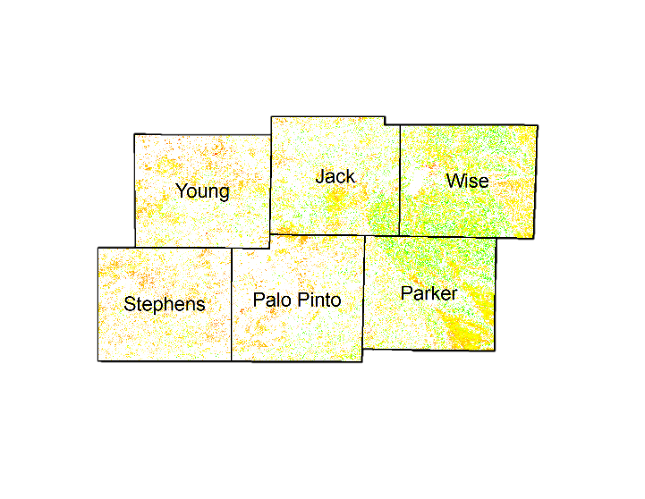
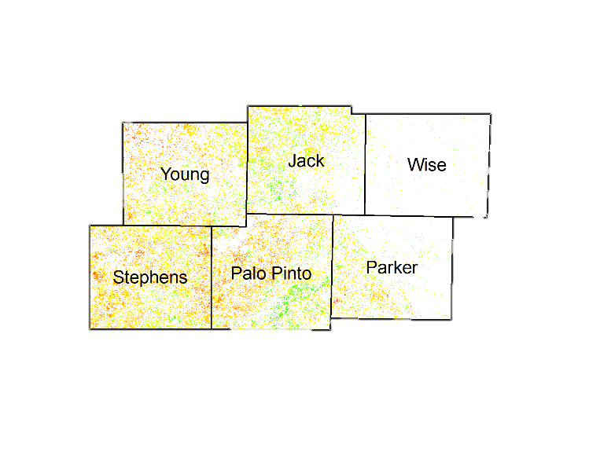
Methodology –
MODIS Phenology
Study Area NDVI
Study Area DOY
Fuel Types
Fuel Types
Fuel-Specific NDVI
Fuel-Specific DOY
Notes:
MODIS Phenology data were acquired from ForWarn

Slide 19


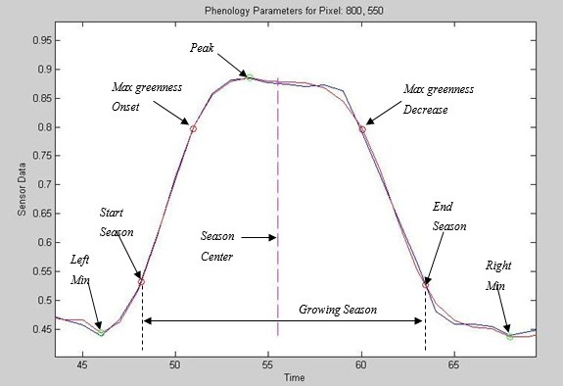
Methodology –
MODIS Phenology
Fuel-Specific NDVI
Fuel-Specific DOY
Fuel-Specific data were used to construct NDVI phenology charts for each fuel type studied.
Notes:
MODIS Phenology data were acquired from ForWarn

Slide 20
Results

Slide 21
Conclusion

Slide 22
Limitations and Future Work

Slide 23
Advisors
Joseph Spruce, NASA Stennis Space Center
James “Doc” Smoot, NASA Stennis Space Center
Dr. Kenton Ross, NASA Langley Research Center
Partners
Tom Spencer, Texas Forest Service
Curt Stripling, Texas Forest Service
Williams “Bill” Hargrove, USDA Forest Service
Others
Benjamin Beasley, NASA DEVELOP National Program
Alex Holland, NASA DEVELOP National Program
Kristen Kelehan, NASA DEVELOP National Program

Slide 24
References

Slide 25

Questions?

