Slide 1
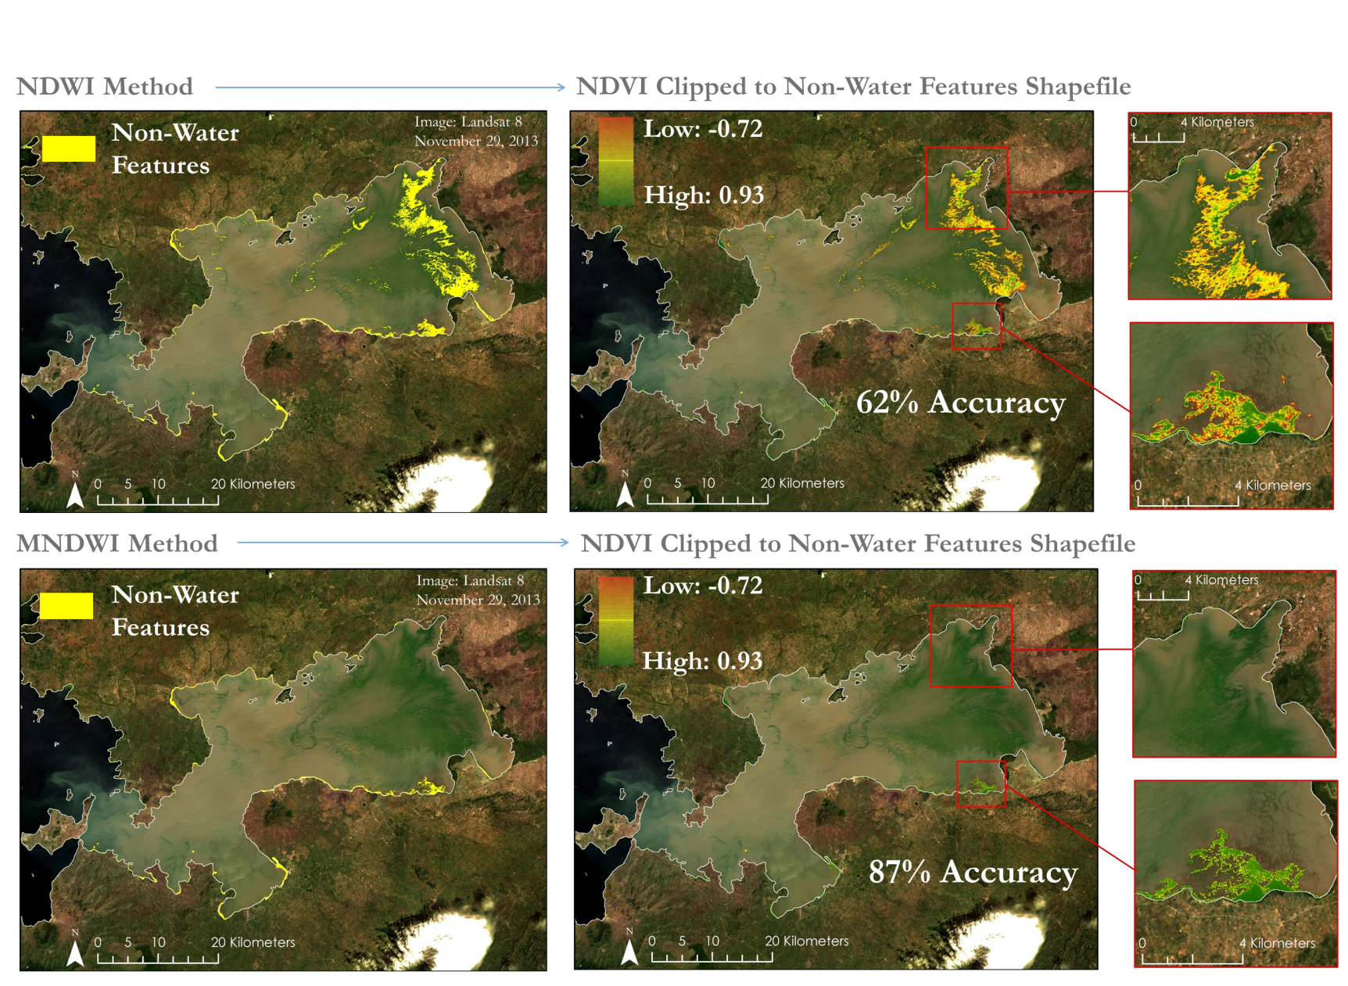
Lake Victoria
Water Resources
Spatio-Temporal Analysis of Lake Victoria Water Hyacinth and Algal Blooms Using NASA Earth Observations for Improved Water Management
Authors: Jeanné le Roux(Project Lead), Daryl Ann Winstead, Christina Fischer, Sara Amirazodi, and Austin Vacek
Normalized Difference Water Index (NWDI) and Modified Normalized Difference Water Index (MNDWI) algorithm outputs.
Community Concerns
Lake Victoria has a surface area of 68,800 square km, making it the largest lake in Africa. The lake is surrounded by Kenya, Tanzania, and Uganda and is home to more than 30 million people, making it one of the most densely populated rural areas in the world. These people rely on the lake for all aspects of their lives, including fishing, agriculture, and industrial applications. However, the increasing population has negatively impacted water quality through sewage, agricultural, and industrial run off. Furthermore, the introduction of Eichhornia crassipes, or water hyacinth, has been detrimental to the local communities by blocking fishing access and providing breeding grounds for disease carrying mosquitoes and snails.
DEVELOP Location
NASA Marshall Space Flight Center
Earth Observations
Landsat 5, Landsat 7, and Landsat 8
Partners
NASA SERVIR Coordination Office, NASA SERVIR Eastern and Southern Africa, Regional Centre for Mapping of Resources for Development
Advisors
Dr. Jeffrey Luvall [NASA at National Space Science and Technology Center],
Dr. Robert Griffin [University of Alabama in Huntsville]
Decision Support
Data collected was used to create an algorithm to detect aquatic vegetation that aided SERVIR and RCMRD in their ongoing efforts. This algorithm was then applied on imagery ranging from March 2000 to October 2015 which provided a historical context of the extent of water hyacinth growth in the Winam Gulf.

