Slide 1
DEVELOP National Program
DEVELOP Partners:
Partner Engagement & Communicating Results

Slide 2
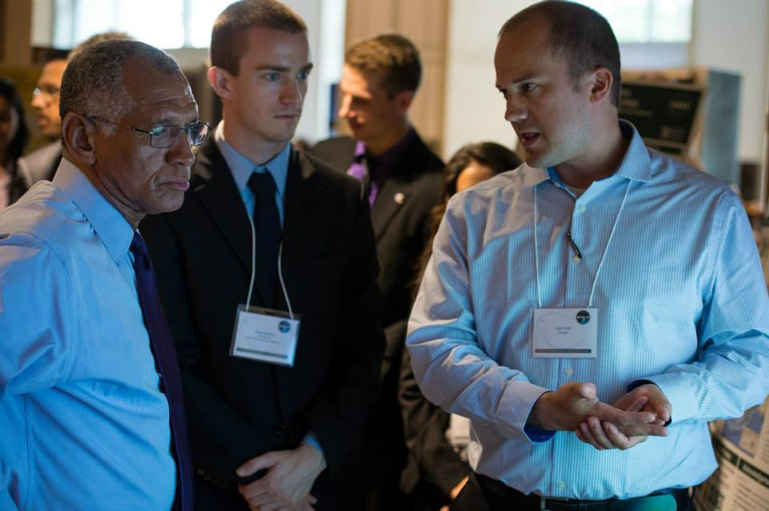
Partner Types
Often, DEVELOP teams use the terms ‘partner’ and ‘end-user’ interchangeably. However, there are some distinct differences relating to these terms, and thus the standardized definitions of typical DEVELOP partners are provided.
Partner: Umbrella term for any outside organization DEVELOP engages with through projects, nodes, or other activities
Types of Partners
End-User: Organization or individual that receives results and methodologies from DEVELOP (either directly from a DEVELOP project team or through a collaborator/boundary organization) and can use the project’s products or methodologies to make a decision or policy. They may also provide some kind of resources (advising, data, model, software, funding, etc.), but it is not required.
Ex. The Texas Forest Service’s Predictive Services that can use the products/methodologies from the DEVELOP project in their risk mapping creation.
Collaborator: Organization or individual that works directly with a DEVELOP project team and provides some kind of leveraged resource (advising, data, model, software, funding, etc.), but are not actually using the project’s products or methodologies to make a decision or policy.
Ex. A researcher from a university who provides a team with an ancillary dataset to validate their results.
All partners are either end-users (using the results or products to make a decision) or collaborators (not using the results or products to make a decision).

Slide 3
Partner Types
Both end-users and collaborators can also be “boundary organizations”. This is an additional classifier.
Boundary Organization: Organization or individual that disseminates the project’s results to other end-users, decision-makers, policy-makers, etc. The Applied Sciences Program defines a boundary organization as “an organization outside of your own that broadens your reach across the boundary into the operational domain (i.e. policy-makers, decision-makers, and other key stakeholders).”
Ex. The Smithsonian Conservation Biology Institute works with local groups in Myanmar and helped DEVELOP disseminate results from the Myanmar Ecological Forecasting project to those in-country groups.
All Partners
Collaborators
End-Users
Boundary Organizations

Slide 4
Partner Engagement & Communication
A cornerstone of DEVELOP projects is the engagement of management and policy makers who can benefit from the integration of NASA Earth observations in their decision making process. All DEVELOP projects strive to engage at least one decision-making organization to hand off project results and methodologies to.
Communication Strategies Commonly Employed
Open communication lines with your partners, see what their needs and meeting abilities are, devise a plan, then be flexible!
Team-Partner greeting telecon during the first or second week
Weekly or bi-weekly telecons & emails with status updates
Hand-off event at the end of the term

Slide 5
Partner Communication – Best Practices
Dependability – If you say you are going to call them Thursday at 1 PM, then be sure to call them at 1 PM on Thursday. If you say you are going to find them a piece of information, then be sure to find it and send it to them.
Honesty – Being candid with your partner is critical to gaining their trust. We all like sharing good news, but bad news is important in a partnership, too. Don’t omit information just because you feel that it won’t please the partner to hear. Don’t mask the truth just to paint the picture you think they want to see.
Passion – Show your enthusiasm for your work and their partnership. If they believe you are personally invested in the project and them as a partner, then they are much more likely to put their trust in you.

Slide 6
Checklist: Working with Partners
Ensure professionalism in all interactions - you are representing yourself, your team, your advisors, your node, DEVELOP, Applied Sciences, and NASA!
Have a plan and schedule.
Be realistic in what you promise and the expectations of the partner, in fact don’t “promise” anything, but ensure the plan you are working to is clear and that there is a healthy understanding of challenges and potential obstacles/risks.
Keep in mind the limitations of resolution (spatial and temporal) of NASA data and work within them.
Understand the partner’s needs - what kind of data/tools are useful, what software do they have access to, what tutorials or products would be helpful?
Keep communication lines open and ensure the team follows through. Generally speaking, the Project Lead should be the POC for communicating with a partner unless it is specifically delegated to another team member.
All emails to partners should be approved by the Center Lead, and you should always CC the Center Lead.
Include your project’s Science Advisor in partner communication as much as is possible per your advisor’s availability

Slide 7
Understanding Partner Needs
Prepare for your first team communication with your partner by:
Discussing previous communications with your Center Lead
Compile questions
Look at responses to the pre-project form (if submitted)
General questions like those below can guide you in understanding your partner’s needs:
Community Concern or Policy
Background, current policies, and upcoming/ongoing decisions relating to the issue at hand
Economic impact (ex. cost of fighting a wildfire or drought impacts to crops in a region)
Technology
Do they currently use GIS and/or remote sensing?
What data types are they familiar with?
Do they have access to Arc/ENVI/Matlab/etc. or whatever software you will use? If not, would they be able to purchase it? (this can guide the team’s use of open source software)
Partnership and Transition
Clarify expected level of involvement - how much can the partner interact with the team?
What organizations do they partner with?
What tutorials would be of use? What format should end-products be in to be useful?
What is the best transition approach? Email, telecon, videocon, in-person (consider distance for this one - if you’re 3000 miles apart choose a different option unless the partner can fund)

Slide 8
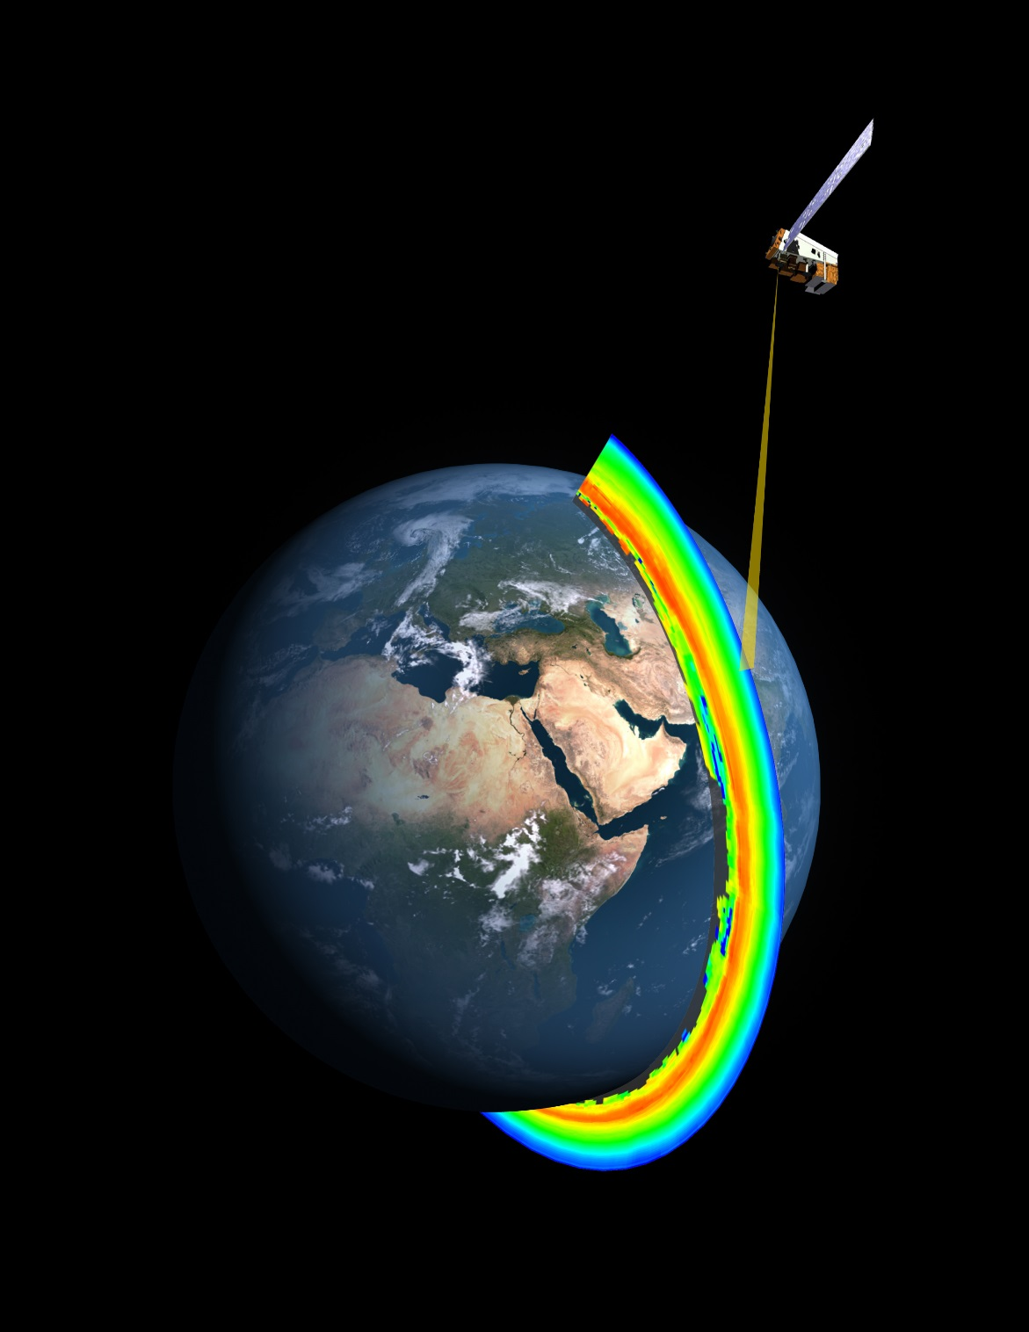
THANK YOU!
Partners are the foundation of DEVELOP projects.
What does your partner need?
How can NASA EO support their decision making?

