Slide 1
Lake Victoria Water Resources
Spatio-Temporal Analysis of Lake Victoria Water Hyacinth and Algal Blooms Using NASA Earth Observations for Improved Water Management
Jeanné le Roux (Project Lead)
Sara Amirazodi
Daryl Ann Winstead
Austin Vacek
Christina Fischer

Slide 2
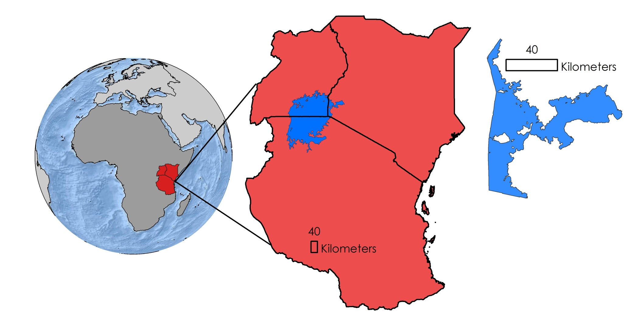
Study Area & Study Period
Uganda
Kenya
Lake
Victoria
Tanzania
Winam Gulf,
Kenya
Winam Gulf in Lake Victoria
March 2000 to October 2015
Notes:
Our project focused on Lake Victoria, the second largest freshwater lake in the world. The lake is bordered by the East African countries of Uganda, Kenya, and Tanzania. Water quality throughout the lake has declined, causing harmful algae blooms and water hyacinth growth. This study focused its efforts on the Winam Gulf from March 2000 to October 2015 due to its high prevalence of harmful algae blooms and water hyacinth growth. This area is particularly vulnerable due to its isolated inlet and the large population inhabiting its shores.

Slide 3
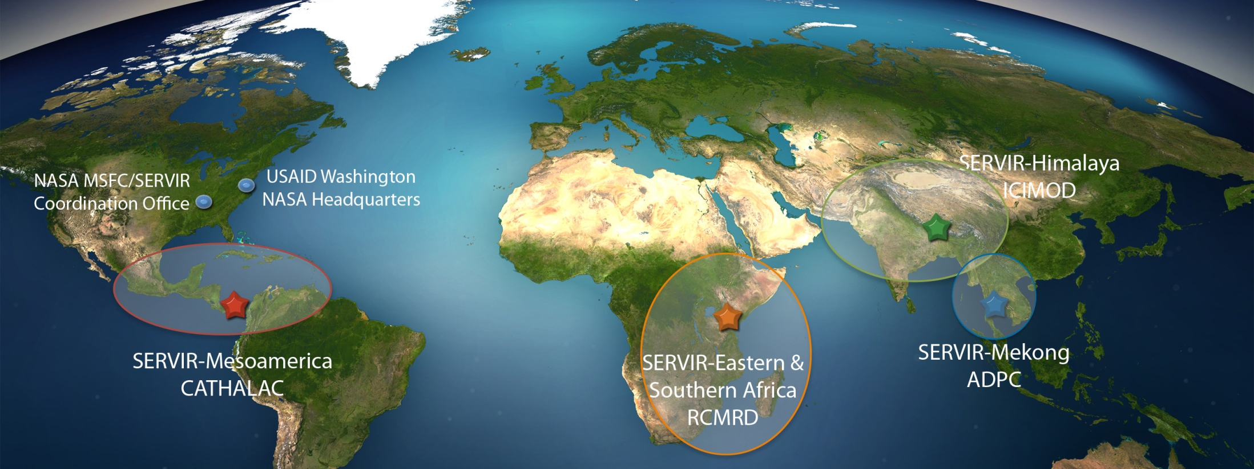
Project Partners
SERVIR Coordination Office
SERVIR – Africa
Regional Centre for Mapping of Resources for Development (RCMRD)
Image Credit: NASA
Notes:
We partnered with SERVIR East Africa and Regional Centre for Mapping of Resources for Development (RCMRD) for this project to assist with their current practices.
Image source: http://www.nasa.gov/mission_pages/servir/overview.html

Slide 4
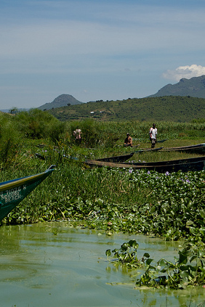
Objectives
Develop an empirical methodology to distinguish vegetative growth
Identify the extent of water hyacinth to enhance RCMRD methodologies
Create maps of aquatic vegetation to track over time
Image Credit: Nikki McLeod
Notes:
The objectives of this project are to:
Develop an empirical method to distinguish vegetative growth from non-vegetative growth
Identify the extent of water hyacinth in the Winam Gulf to enhance RCMRD methodologies
Create a time series map of aquatic vegetation
This will greatly aid in future mitigation efforts
Image credit: https://www.flickr.com/photos/mommypants/4770662508/in/photostream/

Slide 5
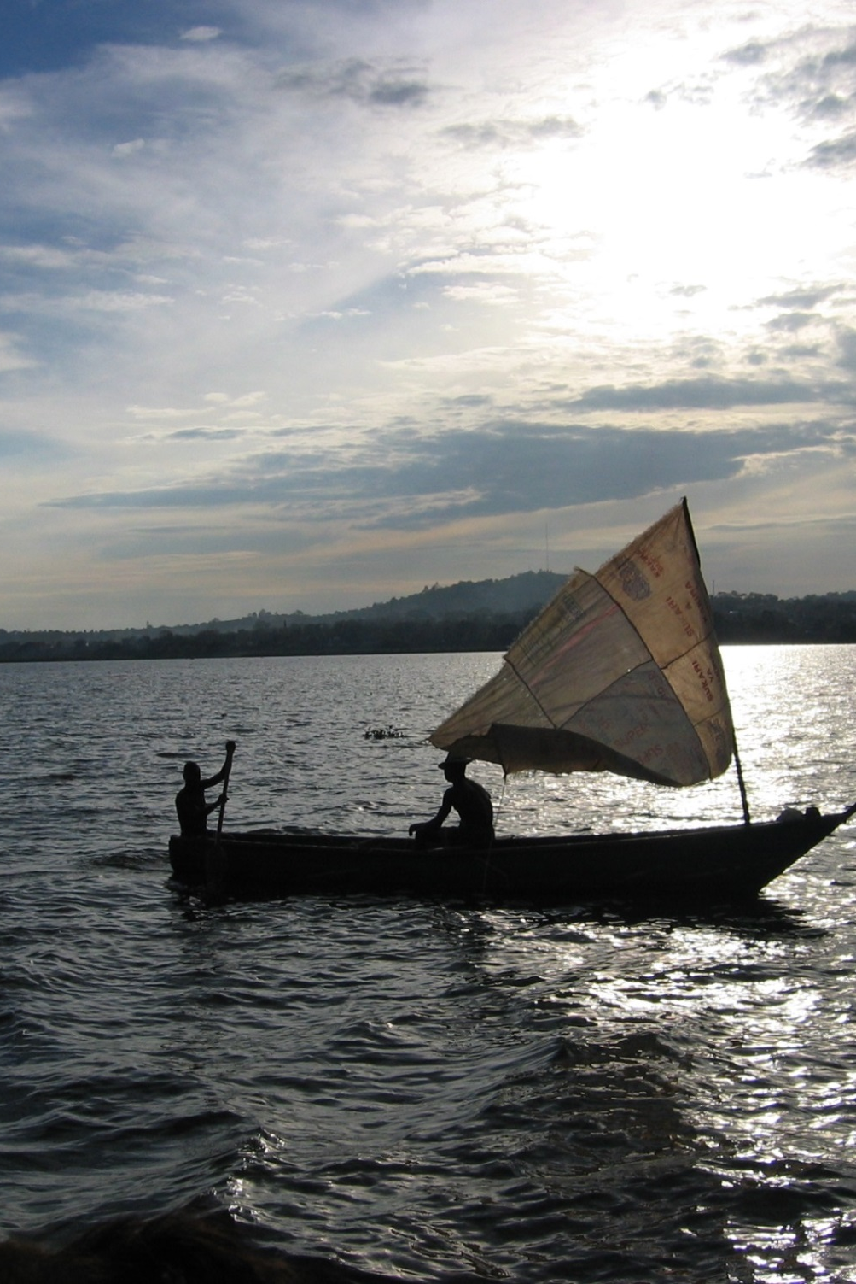
Community Concerns
Human and aquatic health risks from contaminated water
Vector-borne parasitic disease Schistosomiasis
Economic losses from blockage of boat traffic
Image Credit: Damiano Luchetti
Notes:
Many people in the community rely on this lake for their livelihoods. Using contaminated water for drinking or bathing poses a serious health risk.
The presence of the invasive species, water hyacinth, also provides a habitat for snails that carry Schistosomiasis, a vetor-born parasitic disease
Water hyacinth also grows in thick mats, which blocks boat traffic, which is a severe economic hindrance for the area that heavily relies on fishing.
Image Credit: https://commons.wikimedia.org/wiki/Lake_Victoria#/media/File:Victoria_lake.JPG

Slide 6

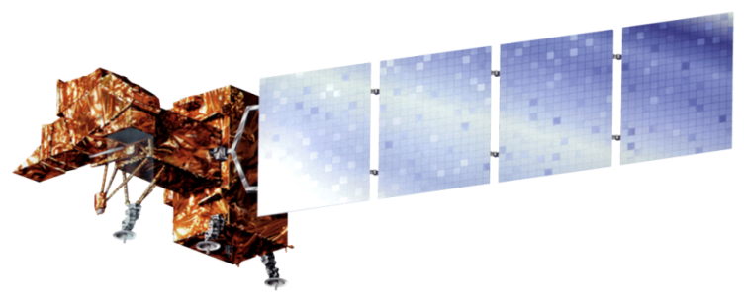

NASA Satellites & Sensors
Landsat 5 Thematic Mapper (TM)
Landsat 7 Enhanced Thematic Mapper Plus (ETM+)
Landsat 8 Operational Land Imager (OLI)
Auxiliary Data
Worldview
Notes:
The NASA satellites and sensors used for this project included: Landsat 5 Thematic Mapper (TM), Landsat 7 Enhanced Thematic Mapper Plus (ETM+), and Landsat 8 Operational Land Imager (OLI). Additionally high-resolution Worldview data was used to validate our methodologies.

Slide 7
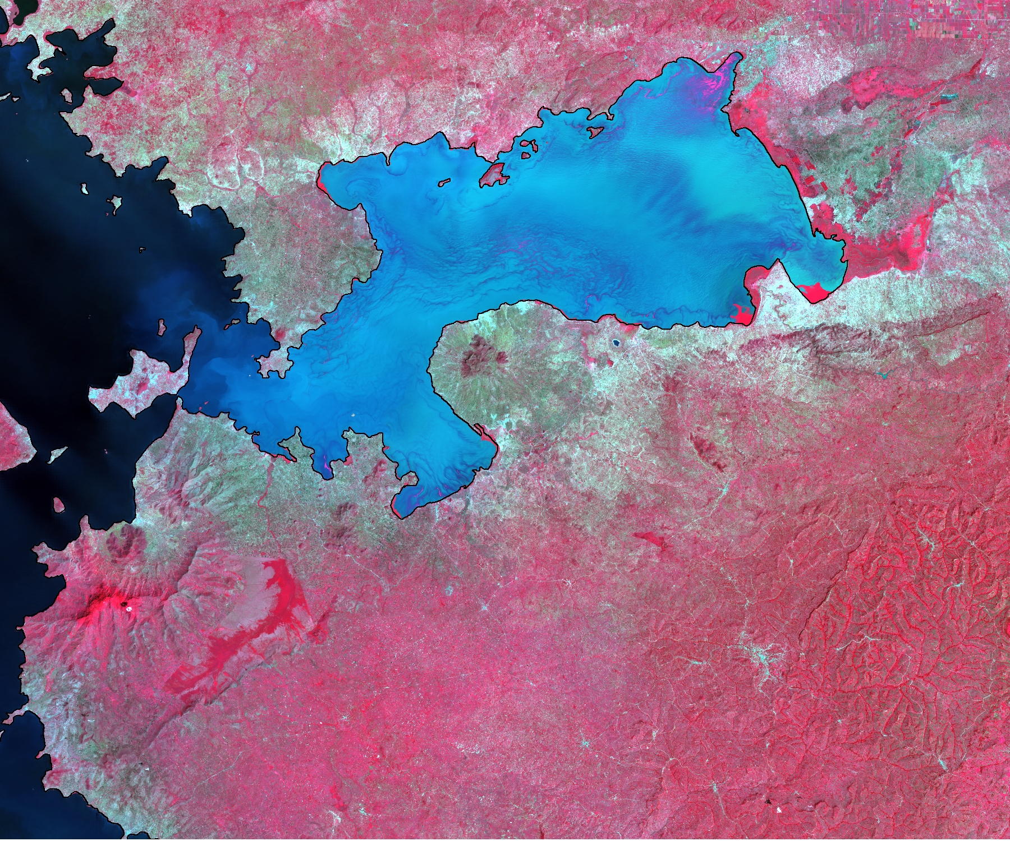
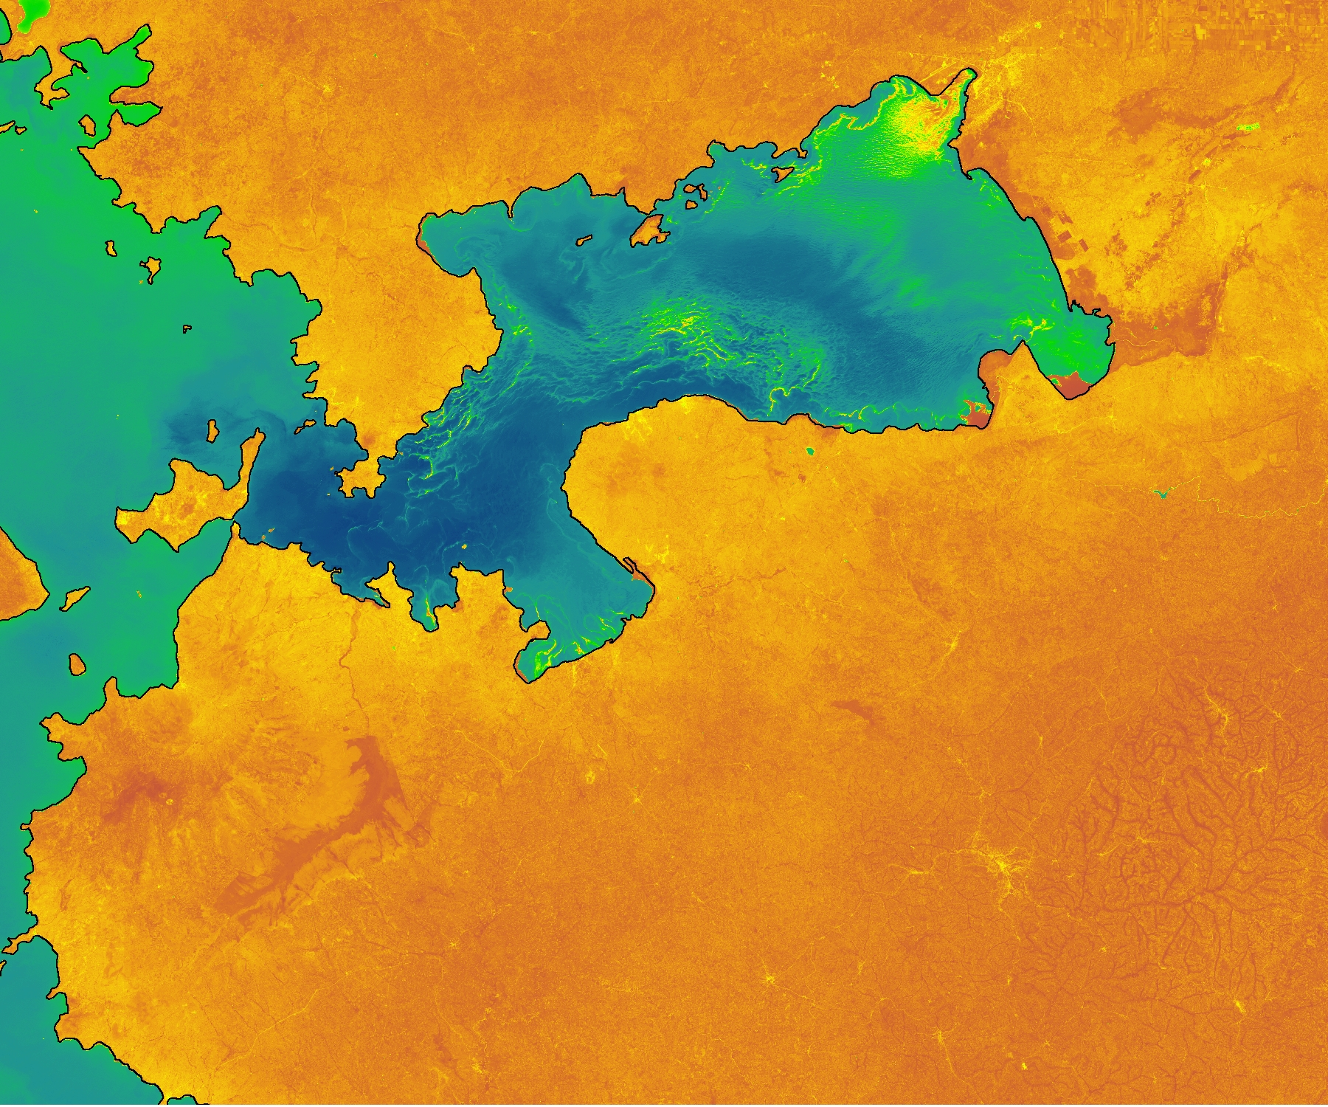
Methodology
Data Acquisition
Landsat 7 and 8 surface reflectance data product from USGS
Landsat 5 and 7 Level 1 data product from USGS
WorldView
Data Processing
NDWI
  NDWI < 0.1 = non-water features
NDVI
  Extract NDVI in areas classified as non-water
Notes:
Landsat surface reflectance products were ordered from the Earth Explorer website.
Level 1 Landsat product for pre 2008 imagery was downloaded from GLOVIS and converted to surface reflectance via the dnnpy module provided by DEVELOP, since the surface reflectance data product was not available for older imagery.
Worldview imagery (from a high resolution commercial satellite) was obtained by project partner Africa Flores.
2 different approaches were tested to pull out vegetation features on the lake’s surface.
The first method used NDWI to distinguish water features from non water features in the lake. Areas with an NDWI < 0.1 were extracted and converted to a shapefile representing non- water features. NDWI = (green – NIR)/(green + NIR).
The NDVI index looks at the contrast between red absorption and NIR reflectance to highlight features of vegetation health. NDVI of the entire area was clipped down to the “non-water features” shapefile for focus. NDVI = (NIR – red)/(NIR + red).
The NDVI was then categorized into 2 classes: NDVI ranging from min – 0.82 = algae, while NDVI > 0.82 = water hyacinth/ other macrophytes. The 0.82 threshold is based on Cho et al. 2008 study.

Slide 8
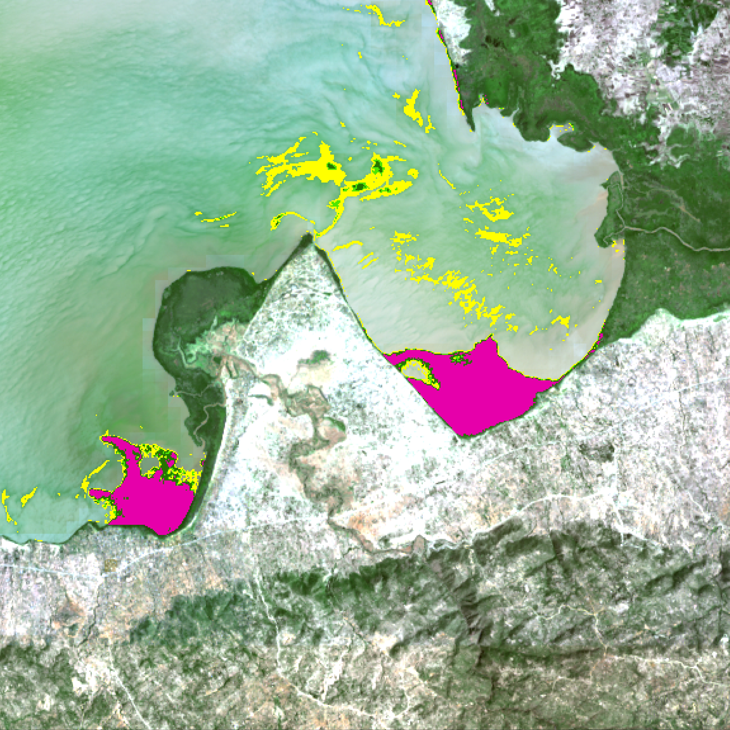
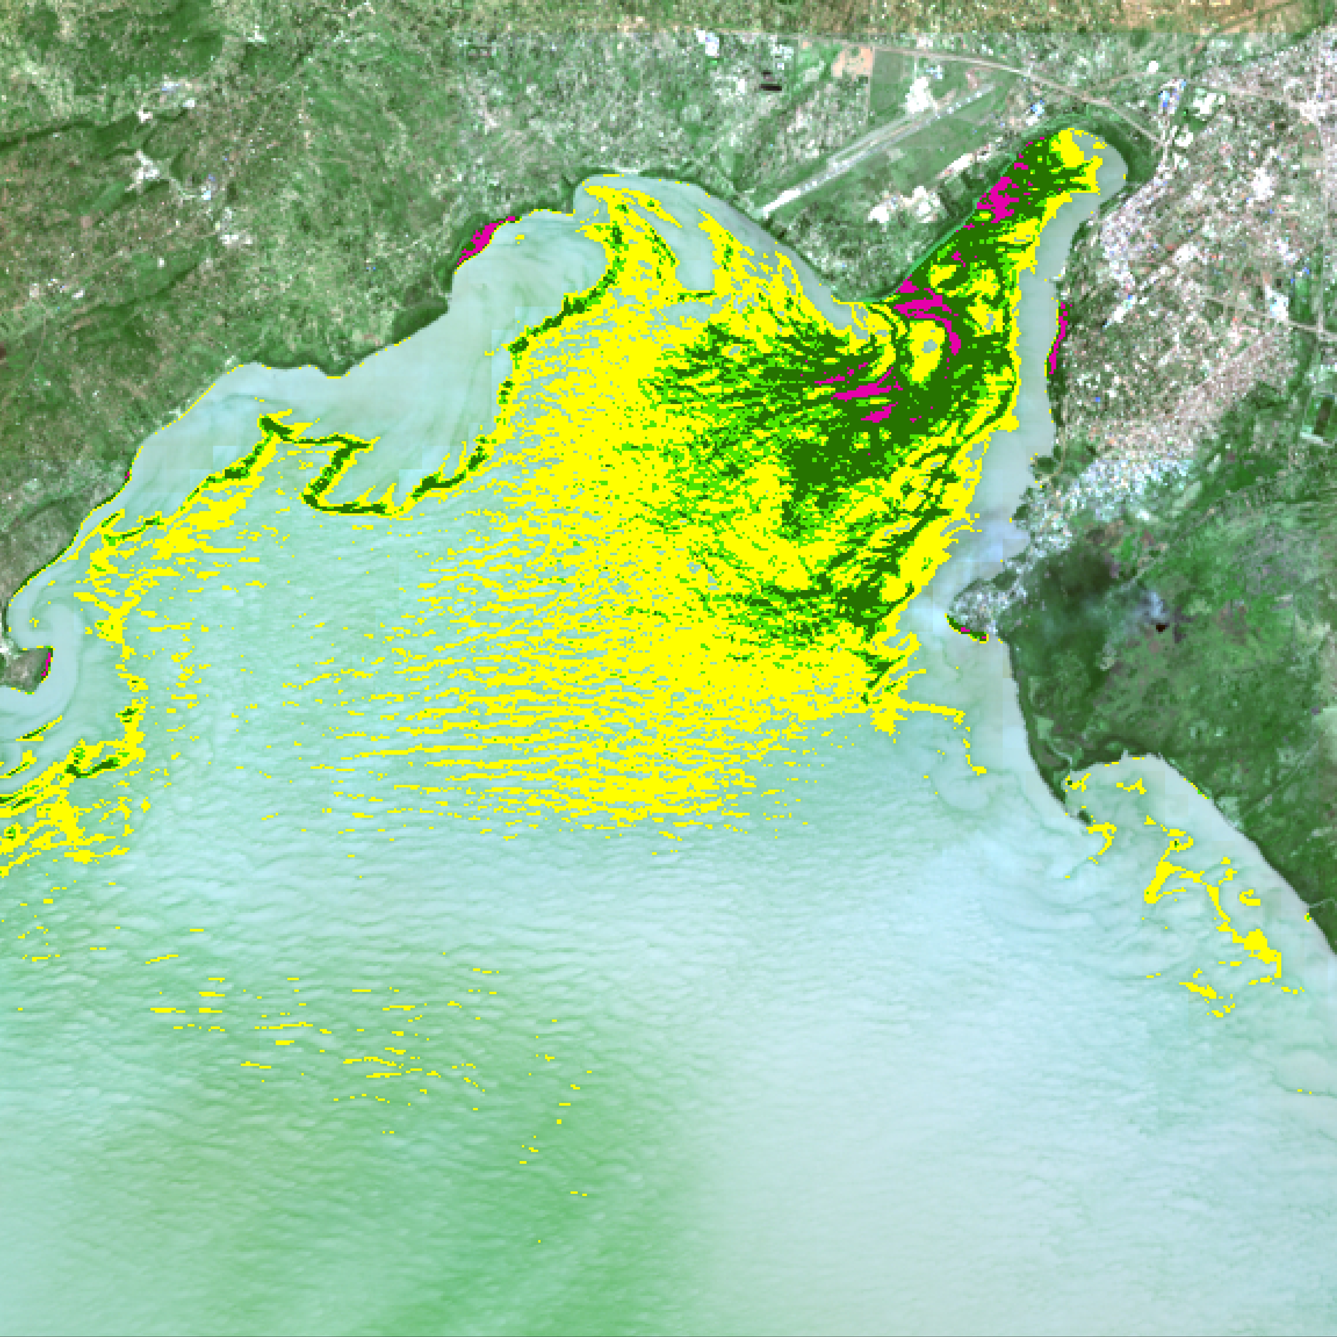
Methodology
Data Processing
MNDWI
  MNDWI < 0 = non-water features
NDVI
  Extract NDVI in areas classified as non-water
Data Processing
NDWI
  NDWI < 0.1 = non-water features
NDVI
  Extract NDVI in areas classified as non-water
Data Processing
Build model in ArcMap to automate data processing
Generate time series maps
  March 2000 – July 2015
Notes:
The second method used MNDWI to distinguish between water and non-water features. MNDWI = (green – SWIR)/(green + SWIR). Areas with an MNDWI < 0 were extracted and converted to a shapefile representing non- water features. NDVI was then clipped to this shapefile.
Modelbuilder in ArcMap was used to generate a model to automate both methodologies.
In order to build a time series of maps, both models were used on low cloud cover Landsat images dating from August 2000 – present (October 2015) and grouped together in a map package.

Slide 9
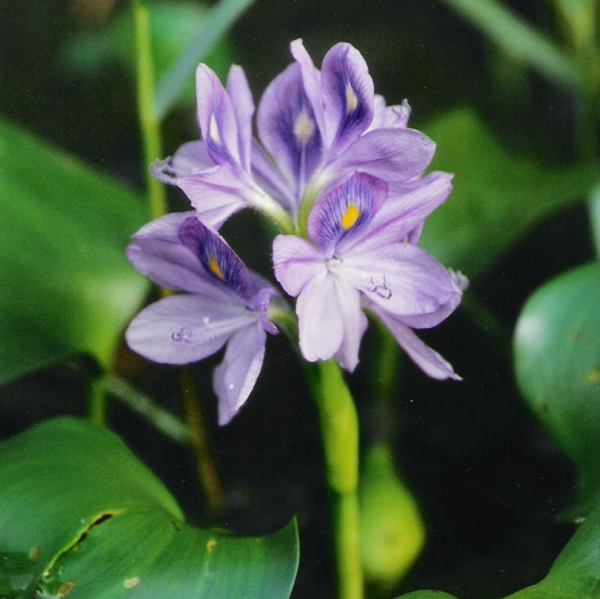
Methodology
Data Analysis
High resolution WorldView imagery to validate presence of algal blooms, water hyacinth, and other macrophytes
Confusion Matrix
  NDWI Method: 3 classes tested
    1. Water Hyacinth/ Macrophytes
    2. Algae
    3. Other (water)
  MNDWI Method: 2 classes tested
    1. Water Hyacinth / Macrophytes
    2. Other (water, land, etc.)
Image Credit: USDA
Notes:
Due to lack of in situ data, high resolution imagery from WorldView was used to validate the presence of algae and water hyacinth.
Imagery on a matching date (November 29, 2013) taken 45 minutes apart was used to test accuracy with a confusion matrix.
100 random points were generated for each class.
3 classes were tested for the NDWI method and 2 classes were tested for the MNDWI method.
Due to large difference in spatial resolution of Landsat and WorldView (30m and Xm, respectively) any point within 30m of water hyacinth was counted as water hyacinth.
Image Source: http://www.ars.usda.gov/Main/docs.htm?docid=14222

Slide 10
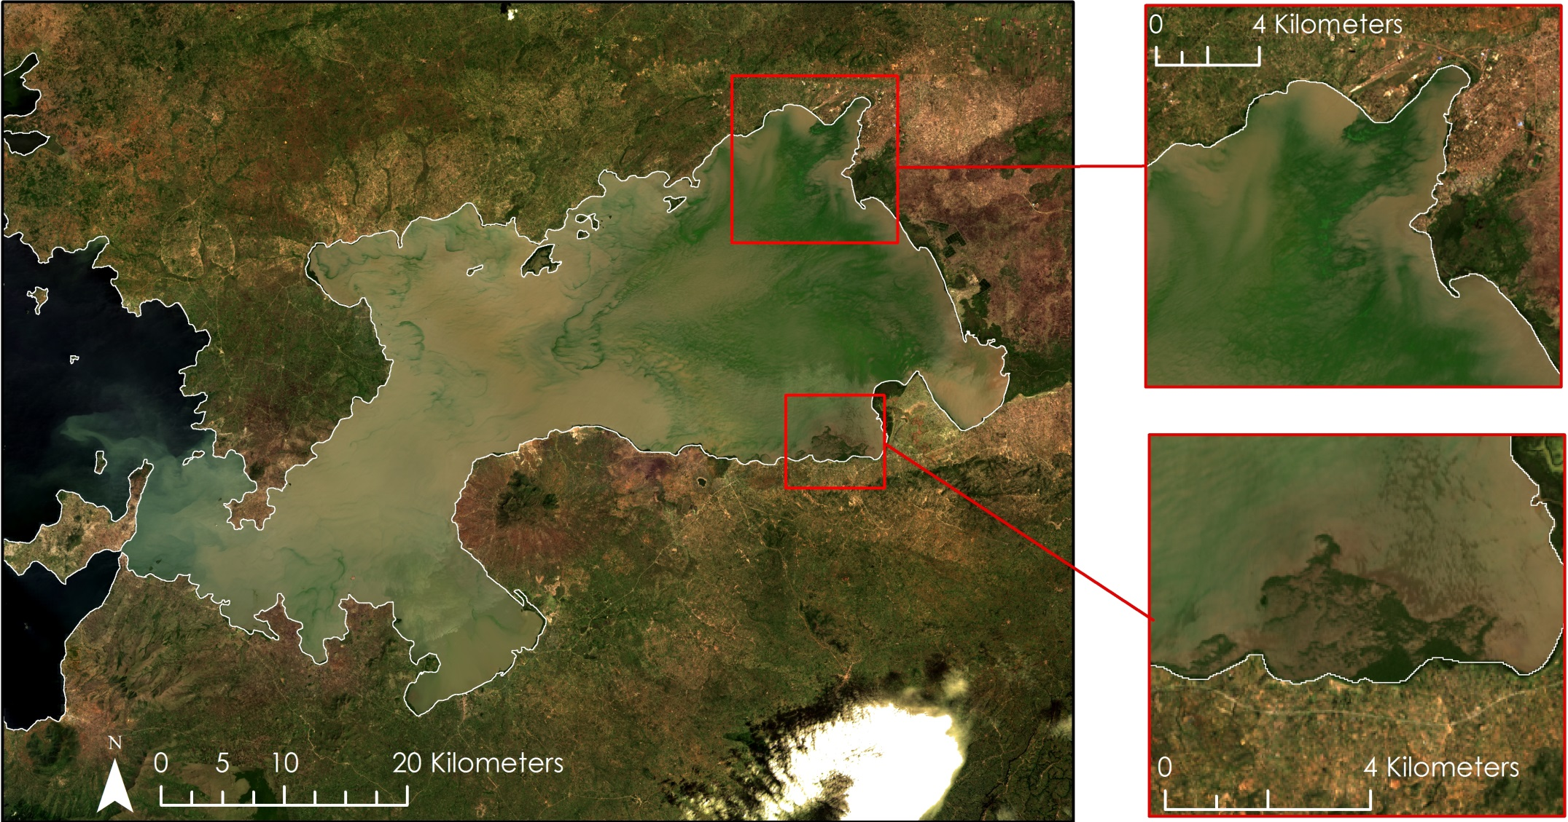
Results: NDWI Method
True Color Composite
Image: Landsat 8
November 29, 2013
Notes:
This slide shows a true color composite of Landsat 8 over the study area on November 29, 2013.

Slide 11
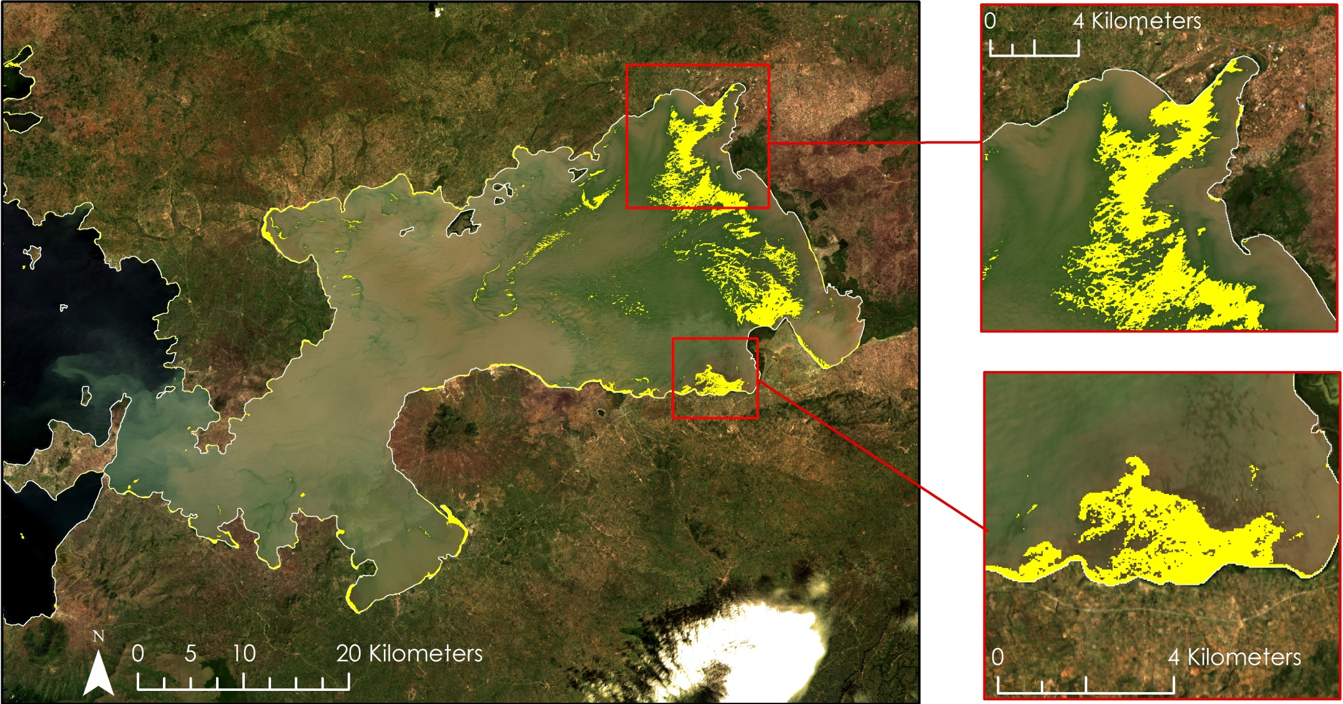
Results: NDWI Method
NDWI < 0.1
Image: Landsat 8
November 29, 2013
Non-Water Features
Notes:
Non-Water features as specified by an NDWI value of 0.1 or less are highlighted in yellow.

Slide 12
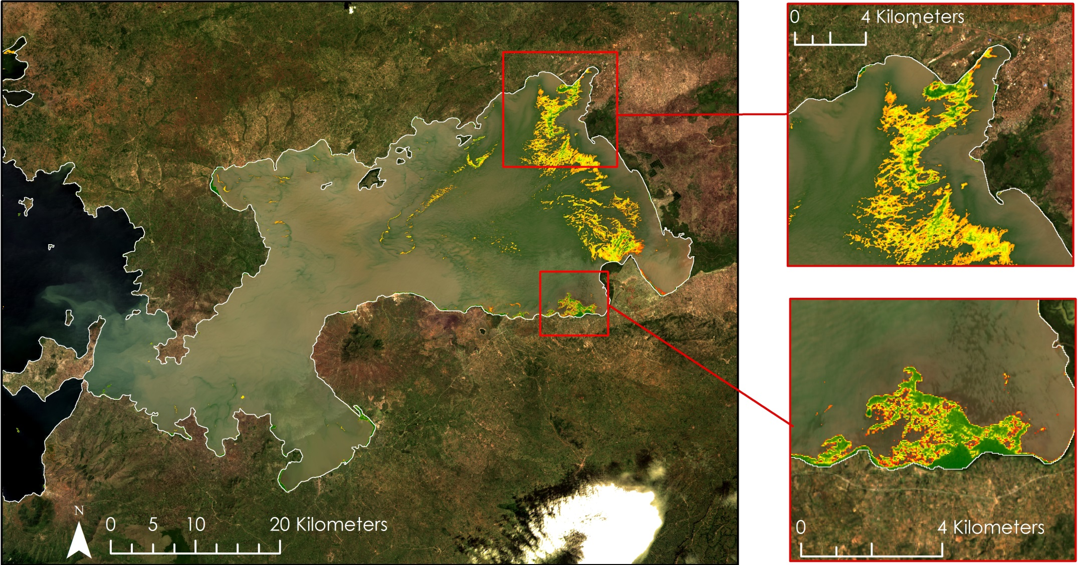
Results: NDWI Method
NDVI
Image: Landsat 8
November 29, 2013
Low: -0.72
High: 0.93
Notes:
NVDI clipped to non-water features shapefile.

Slide 13
Results: MNDWI Method
True Color Composite
Image: Landsat 8
November 29, 2013
Notes:
MNDWI Results.

Slide 14
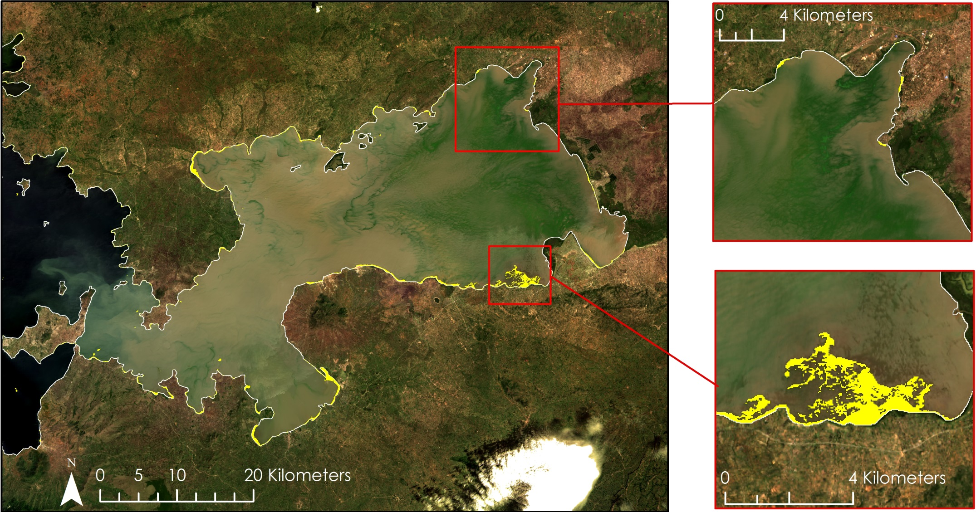
Results: MNDWI Method
MNDWI < 0
Image: Landsat 8
November 29, 2013
Non-Water Features
Notes:
Non-water features as specified by MNDWI values of 0 or less are highlighted in yellow.

Slide 15
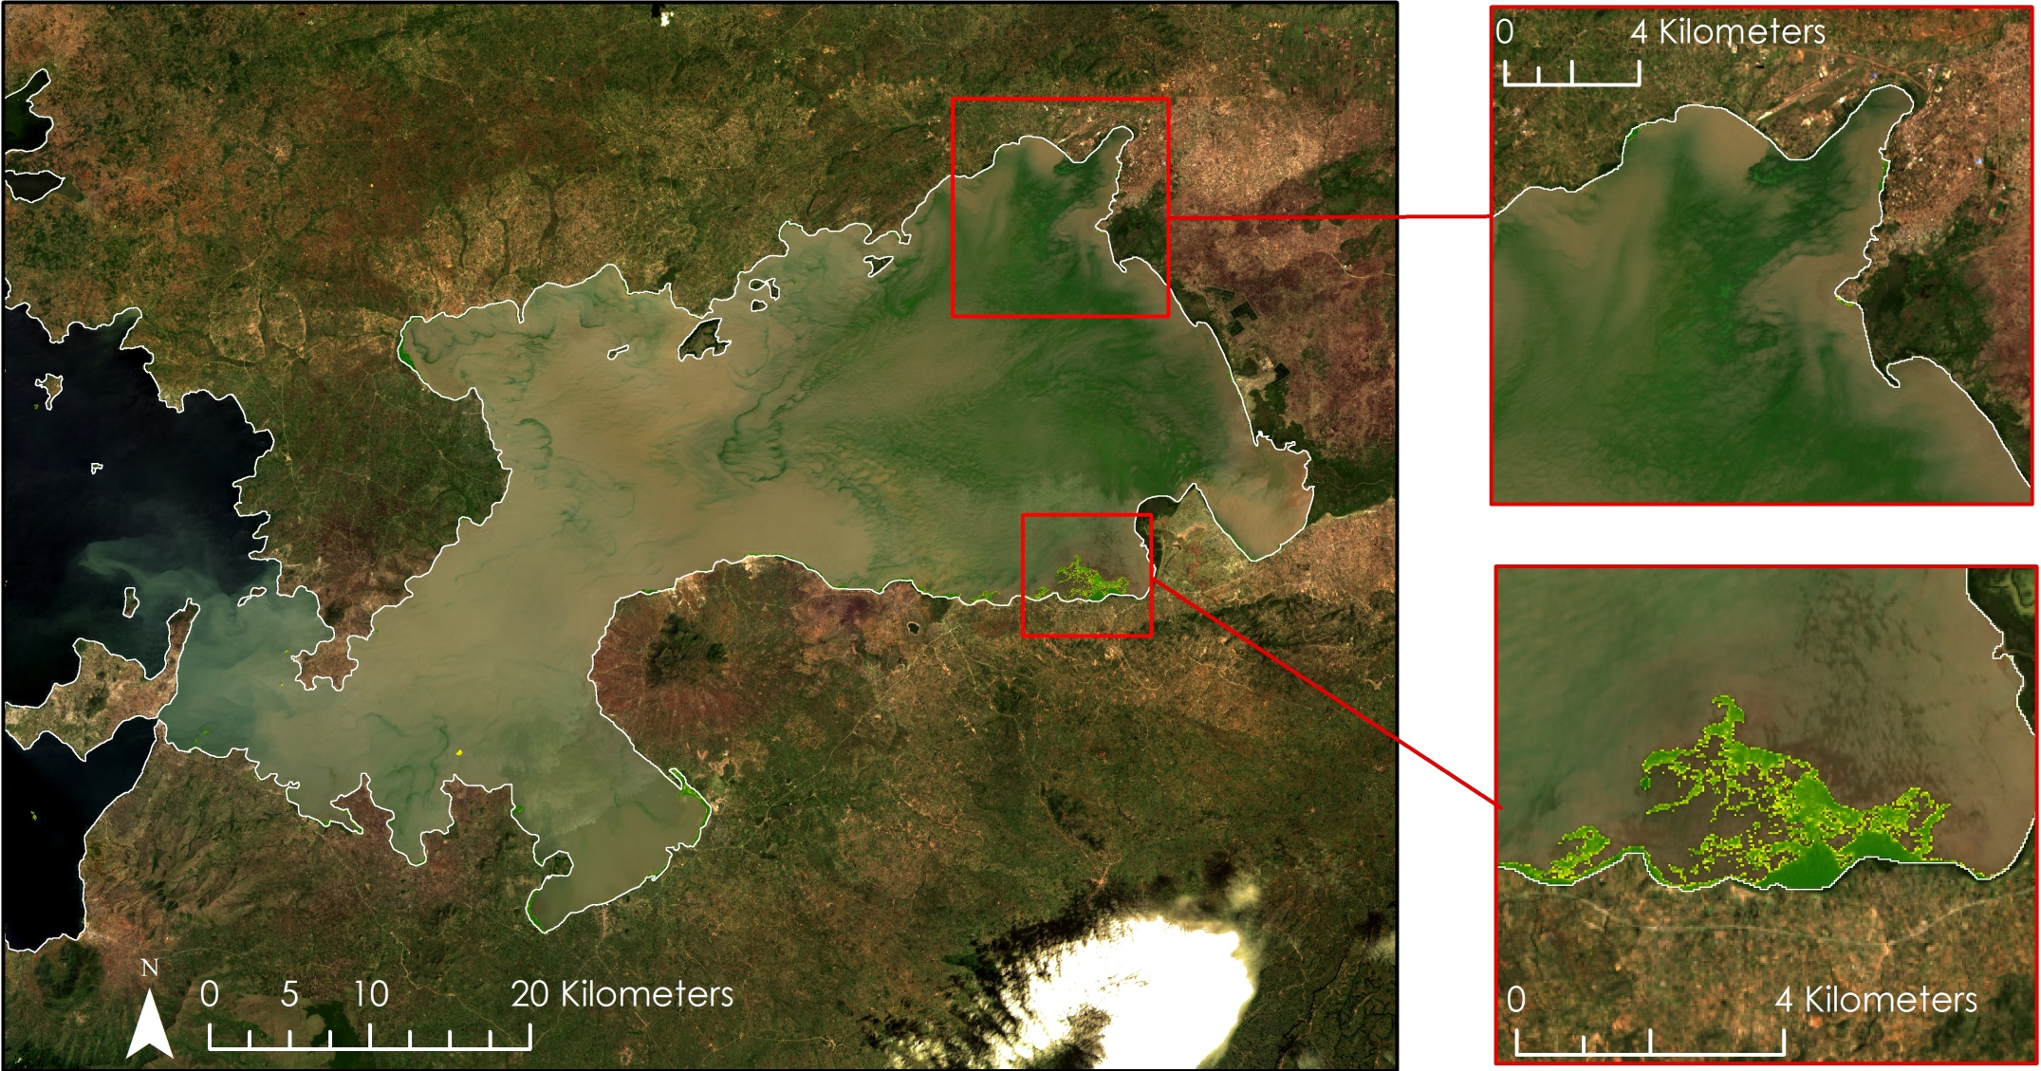
Results: MNDWI Method
NDVI
Image: Landsat 8
November 29, 2013
Low: -0.72
High: 0.93
Notes:
NDVI clipped to non-water features.
Note that MNDWI method pulls out considerably less vegetation than the NDWI method.

Slide 16
Results: NDWI Method
Predicted water hyacinth and algae presence vs actual presence
n = 300 | Hyacinth/ Macrophytes | Algae | Other / Water
Hyacinth / Macrophytes | 22 | 12 | 6
Algae | 13 | 75 | 5
Other / Water | 65 | 13 | 89
Accuracy = 62%
Notes:
Accuracy results for the MNDWI method:
The top row represents model predicted classes, while the left column represents actual presence as depicted in the high resolution imagery.
Class accuracies: hyacinth = 18.6%, algae = 63.6%, water = 50%
12% of the time the model classified water hyacinth as algae
Overall Accuracy = 62 %

Slide 17
Results: MNDWI Method
Predicted water hyacinth presence vs actual presence
n = 200 | Predicted NO | Predicted YES
Actual NO | TN = 94 | FP = 20
Actual YES | FN = 6 | TP = 80
Accuracy = 87%
Notes:
Accuracy results for the NDWI method:
True Positive (TP) = 80, True Negative (TN) = 94, False Positive (FP) = 20, False Negative (FN) = 6
Accuracy = 86.5 %

Slide 18
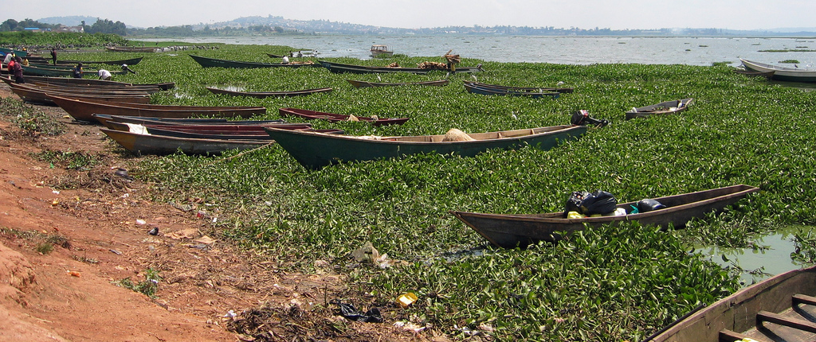
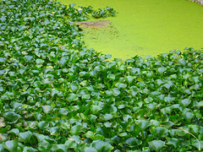
Conclusions
NDWI method works well for extracting hyacinth, other macrophytes, and surface algal blooms
MNDWI method works better for extracting only water hyacinth
MNDWI method more accurate
More accurate water shapefile will greatly increase accuracy for both methods
Provides baseline for automated water hyacinth monitoring
Image Credit: sarahemcc
Image Credit: leoplus
Notes:
The 2 different proposed methods are useful for accomplishing 2 different things:
The NDWI method pulls out both algae and macrophytes on the surface.
The MNDWI method pulls out only water hyacinth/ other macrophytes, and is overall more accurate than the NDWI method.
A more accurate shapefile distinguishing between land and water would greatly increase the accuracy of both models (especially NDWI), since many random points classified as water hyacinth fell on small islands and pieces of coast line that were included in the study area shapefile.
These methods will serve as a baseline for RCMRD to develop an automated water hyacinth detection system.
Image Sources: https://www.flickr.com/photos/sarah_mccans/229417707/in/photolist-mgPTH-9SeeHW
https://www.flickr.com/photos/leoplus/2744389784/in/photolist-5bvHtf-c9c7Ko-3oZYwp-53bq4w-fSoP6F-6yQnb7-6yLhDZ-6yLh9p-nxQt9Q-32nqy-q9fwWH-awL7me-iMNrv-FqPHh-3jpJHq-c9cdhG-r8dDUB- yJ34zX-zEVAgH-nxQmK5-ejDDES-825XEh-4ZQ5tR-iMNJU-6tTpwY-AoU97V-vA1QgC-nd6zoL-nd5yVy-zQt9VH-zQtaN4-AQBxDr-A6gdBG-AKdEwY-AwbFHG-AiiGzQ-ANgAvS-AQyRni-4zfYJt-zD21BC-nNhwnU-AkBw7J-nQ2UJF-zZnkZb-duxkci-MBqq-nd5Wee-nd6qwh-nf8ZHH-nf85Ur

Slide 19
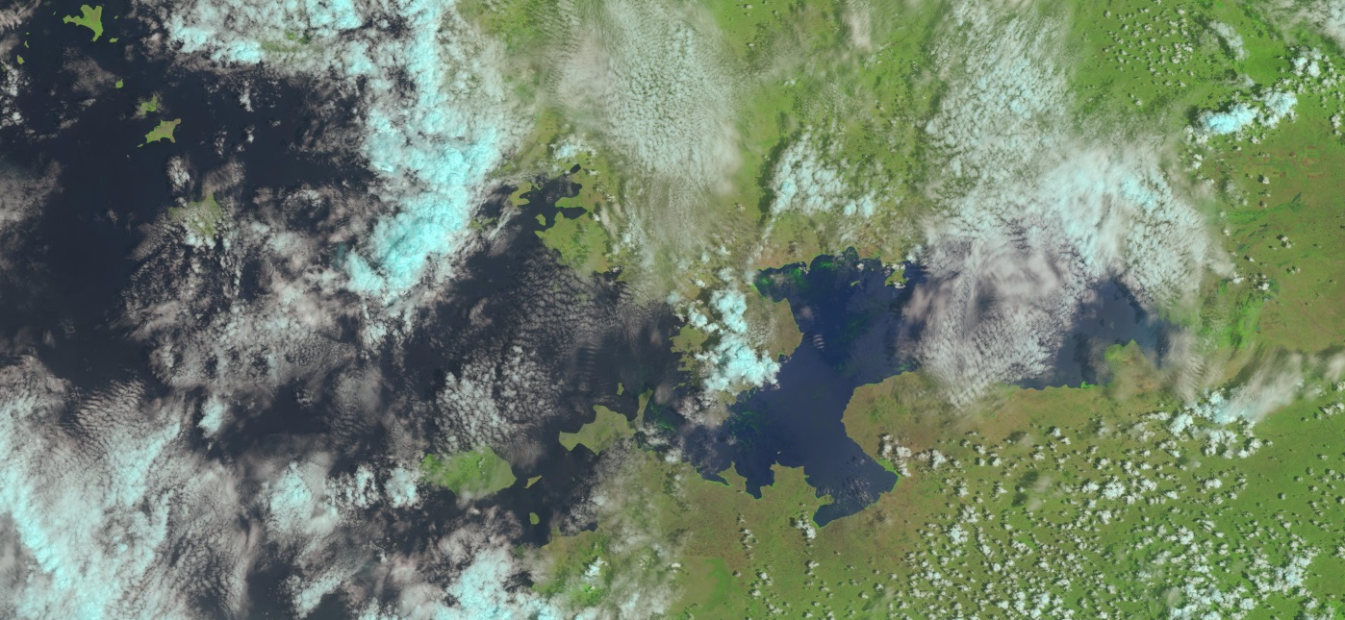
Errors and Uncertainties
Cloud cover in Landsat images
Shapefile of coastline may present inaccuracies
Landsat bands not sensitive enough to distinguish between aquatic species
Dense algal blooms also present high NDVI values, comparable to water hyacinth
Amount of in situ data for validation
Image Credit: USGS 8
Notes:
During the selected study period, a limited number of Landsat images could be implemented due to cloud cover over the Winam Gulf area of Kenya.
Since the water level of Lake Victoria is constantly changing, an accurate shapefile of Lake Victoria is difficult to attain.
There are small gaps of spatial data along the coastline of Lake Victoria that would provide water hyacinth and water quality values beneficial to the study.
It is difficult to distinguish between water hyacinth and other floating macrophytes on the lake using Landsat imagery alone.
A limited number of in-situ measurements and observations of water hyacinth correspond with the study period.
Image Source: "USGS Global Visualization Viewer." USGS Global Visualization Viewer. Web. 14 Oct. 2015.

Slide 20
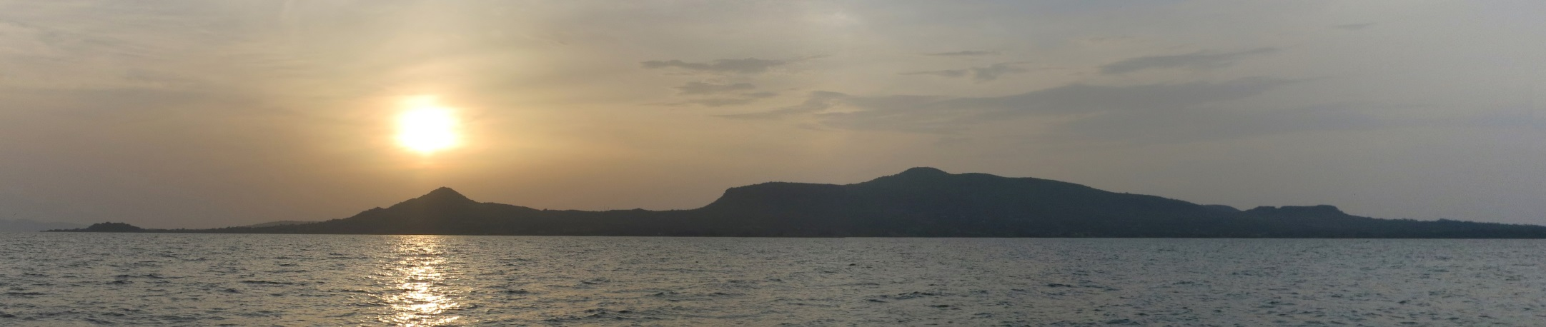
Image Credit: Küchenkraut
Future Work
Methodology application to expanded study period using additional satellite imagery dates
Further development of water quality monitoring system
Research into additional water quality parameters
Differentiation between water hyacinth and other vegetation
Multi- instrumental analysis for continuous monitoring
Notes:
This is a two-term project. So with our water vegetation extent map and accuracy assessment, the next term can focus more on distinguishing water hyacinth from other macrophytes and can further investigate other parameters that affect the lake’s water quality.
Image Source: https://commons.wikimedia.org/wiki/File:Rusinga_Island_-_Lake_Victoria_-_Kenya.jpg#/media/File:Rusinga_Island_-_Lake_Victoria_-_Kenya.jpg

Slide 21
Advisors
Dr. Jeffrey Luvall, NASA at National Space Science & Technology Center
Dr. Robert Griffin, University of Alabama in Huntsville
Partners
Africa Flores, SERVIR Coordination Office
Dr. Robinson Mugo, SERVIR Africa Team
James Wanjohi Nyaga, Regional Centre for Mapping Resource for Development (RCMRD)
Others
Leigh Sinclair, NASA DEVELOP
Dan Irwin, SERVIR
Timothy Klug, University of Alabama in Huntsville
Notes:
At this time we would like to thank the following people for all their efforts in helping with our project.

Slide 22
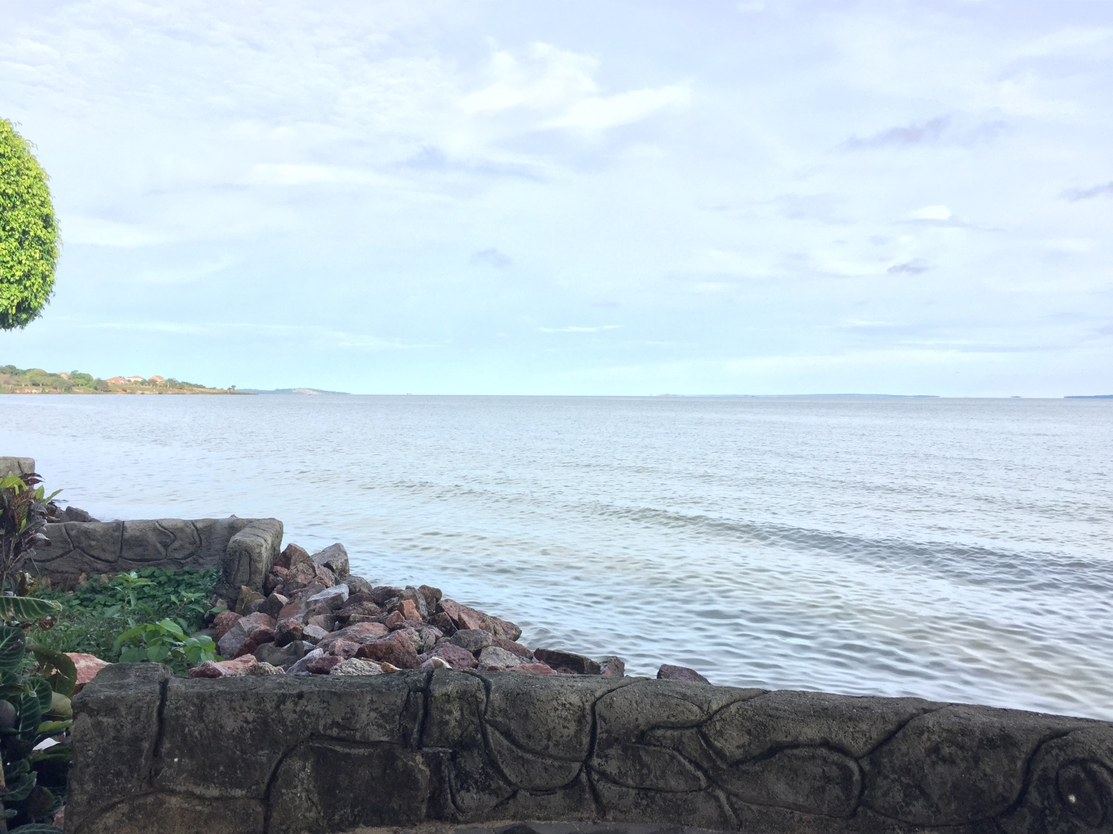
Questions?
Image Credit: Africa Flores
Notes:
Are there any questions at this time?
Image source: Emailed directly from Africa Flores

