Slide 1
Peru Climate
Monitoring and Forecasting Shifting Climate and Land Change Impacts in Peru’s Parque de la Papa for Enhanced Agricultural Management
Rebekke Muench (Project Lead)
Michael Sclater
Kayla McDonald
Richard Rose
Ryan Murphy
Dajon Begin

Slide 2
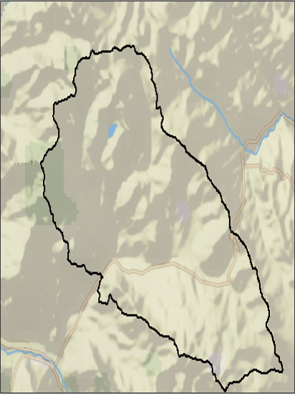
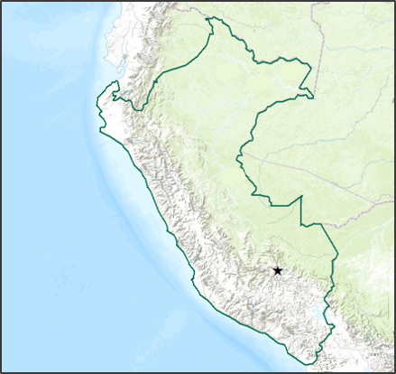
Study Area
Study Period
Temperature (MODIS)
  July, 2002 – June 2015
Precipitation
  November, 1997 – April, 2015
Land use
  Current and historic
Legend
Parque de
la Papa
Peru

Slide 3
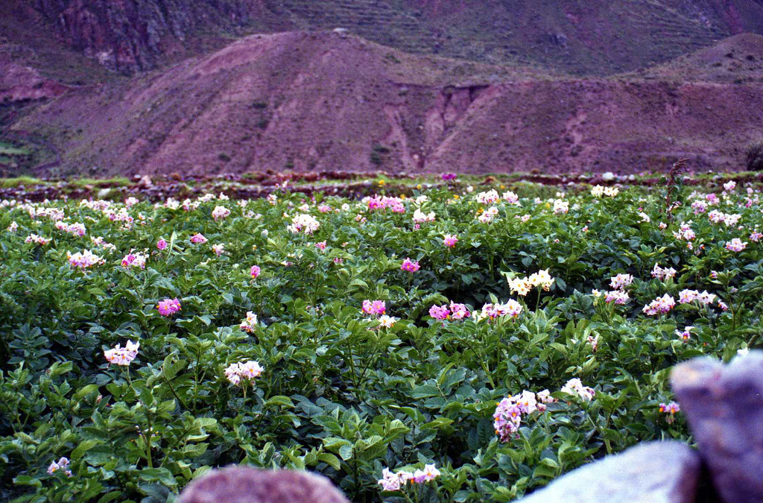
Community Concerns
The Parque de la Papa strives to conserve traditional potato varieties and agricultural practices.
Potato biodiversity is threatened by multiple environmental factors
Image Credit: Leonora Enking
Notes:
Peru is the center of origin for potatoes.
The Parque de la Papa strives to conserve traditional potato varieties and agricultural practices; however,
Potato biodiversity is threatened by
An increase in temperature.
A change in precipitation patterns.
Increased damage from pests.
These changes make it difficult for the potato farmers to maintain traditional agricultural practices and native potato varieties. Less potato types are able to survive within the park at the current altitudes. Therefore, farmers need to move their potato crops to higher elevations which creates additional problems.

Slide 4
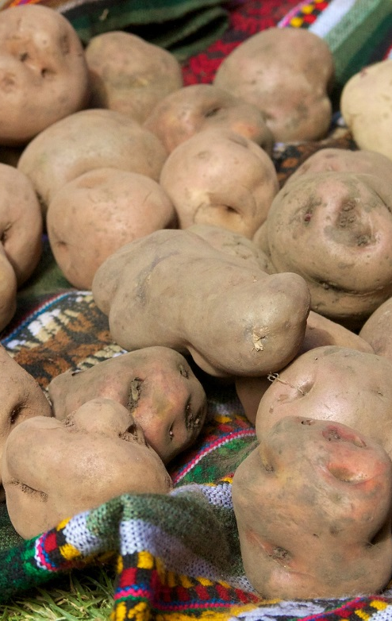
Objectives
Create growing degree days, chill hours, elevation, slope, and weevil suitability maps
Use Landsat imagery to determine how potato crop locations have changed
Develop a methodology that can be applied throughout Peru to determine potato suitability
Notes:
Create growing degree days, chill hours, elevation, slope, and weevil suitability maps
Use Landsat imagery to determine how potato crop locations have changed over the past 30 years
Develop a methodology that can be applied throughout Peru to determine potato suitability

Slide 5
Methodology
Acquisition
Processing
Analysis

Slide 6
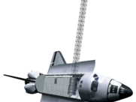
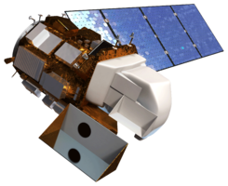
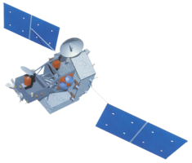
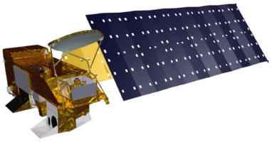

Data Acquisition
Notes:
Data was downloaded from Aqua MODIS for surface temperature, Landsat for land cover, TRMM for precipitation, and SRTM for a digital elevation model

Slide 7
Methodology
Acquisition
Processing
Analysis

Slide 8
Data Processing
Correct MODIS data using Python
Use the SRTM DEM and slope tool in ArcGIS to create slope
Create composite bands of the Landsat imagery using Arc Toolbox
Notes:
MODIS data was converted to degrees Celsius, cloud contaminated pixels were filled using values from previous days, and a daily average was constructed using Python
To develop process the Landsat imagery and the DEM, Arc Toolbox was used to create the composite bands for the Landsat and the slope tool was used to create the slope from the DEM

Slide 9
Methodology
Acquisition
Processing
Analysis

Slide 10

Data Analysis
Uninterpolated Imagery
Interpolated Imagery
Create growing degree days
Interpolate TRMM data to smooth edges
Create polygons of potato crop locations
Notes:
Growing degree days were created using reconstructed MODIS data
TRMM was stacked so a value could be given to each pixel for every day during their given study periods
TRMM data was interpolated

Slide 11

Growing Degree Days
** Photo of Growing Degree Days (GDD)**
$$GDD= \frac{T_{max}+ T_{min}}{2} − T_{base}$$
Notes:
Growing Degree Days (GDD) are the number of days that have an average max and min temperature above the a specified number dependent on the crop
The equation to calculate growing degree days incorporates the maximum and minimum temperatures for a given day as well as a set base temperature. The base temperature is typically 10 degrees Celsius

Slide 12
Results

Slide 13
Errors & Uncertainties
Future Work

