Slide 1
Southeast Idaho Disasters
Juniper Encroachment and Management in the Western U.S. Relative to Catastrophic Wildfires
Zachary Simpson (Project Lead)
Jenna Williams
Sara Ramos
Notes:
The Southeast Idaho Disasters project began during the Fall 2015 DEVELOP term. This project has focused on the expansion of juniper species across the Intermountain West and Great Basin. This accumulation of juniper has increased the severity and duration of wildfire. Wildfire has altered many of the ecosystems in this area, especially detrimental to the sage brush obligate species, the greater sage grouse (Centrocercus urophasianus). With the expansion of the Wildland Urban Interface, (W.U.I.) more humans have been in directly affected by increasing outbreaks of wildfire. The Bureau of Land Management is eager to map existing stands of juniper, in order to manage these areas efficiently. They also want to classify areas based on juniper cover/acre defined as Phase I (>15% juniper cover/acre), Phase II (15%-45% juniper cover/acre), and Phase III (<45% juniper cover/acre).

Slide 2
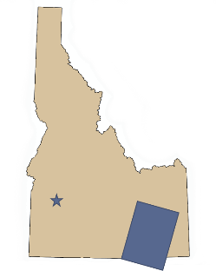
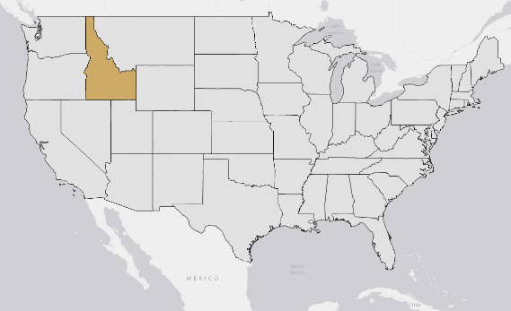
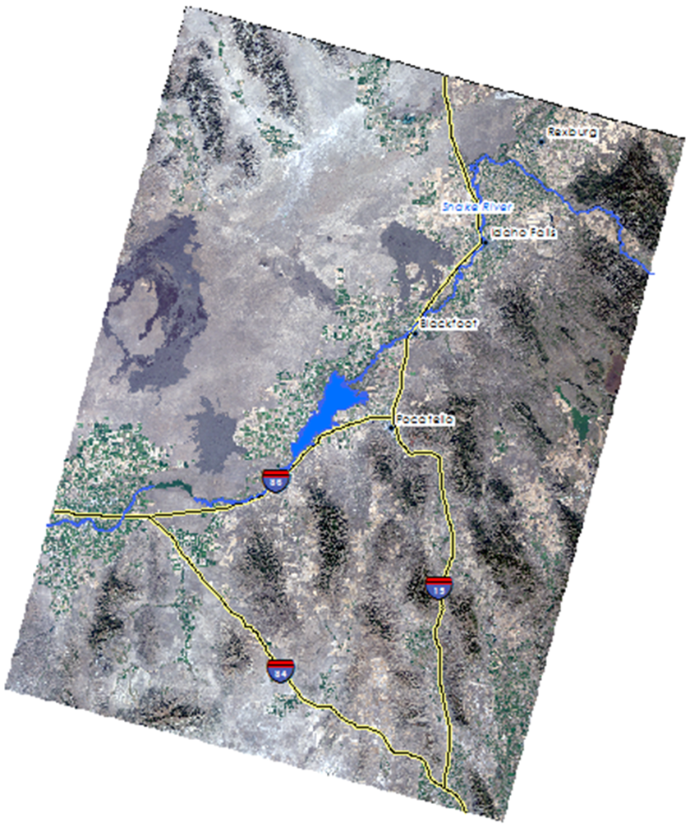
Project Overview
Study Area
Southeast Idaho
WRS Path 39 Row 30
WRS Path 29 Row 30
Study Period
July 2014 to October 2015
Notes:
This project focused on the area captured by Landsat WRS path 39 row 30 and WRS path 39 row 31 and is located in Southeast Idaho. This area is comprised of semi-arid, sagebrush steppe that contains many animal and plant species unique to this area. Along the Snake river, agricultural activity has dominated the economy and much of the population centers of Idaho are concentrated within the Snake River Plain.

Slide 3

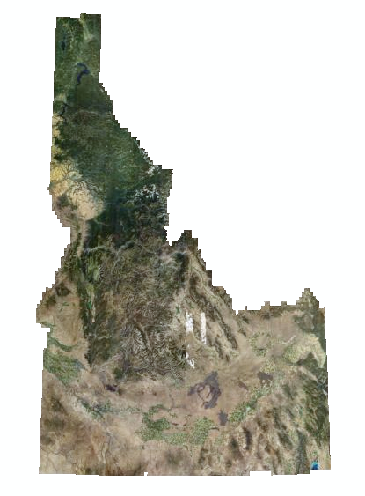
Datasets Used
NASA Earth Observations
Landsat 8 (OLI)
Ancillary Datasets
NAIP Imagery
RSAC
Census 2010
NAIP 2013 0.5m Aerial Imagery
Credit: Ron Exler
Notes:
This project focused on a variety of methods to detect juniper species. We compared results from Landsat 8, 0.5m National Agricultural Imagery Program, the US Forest Service’s Remote Sensing Applications Center data and Census data to determine WUI areas.

Slide 4
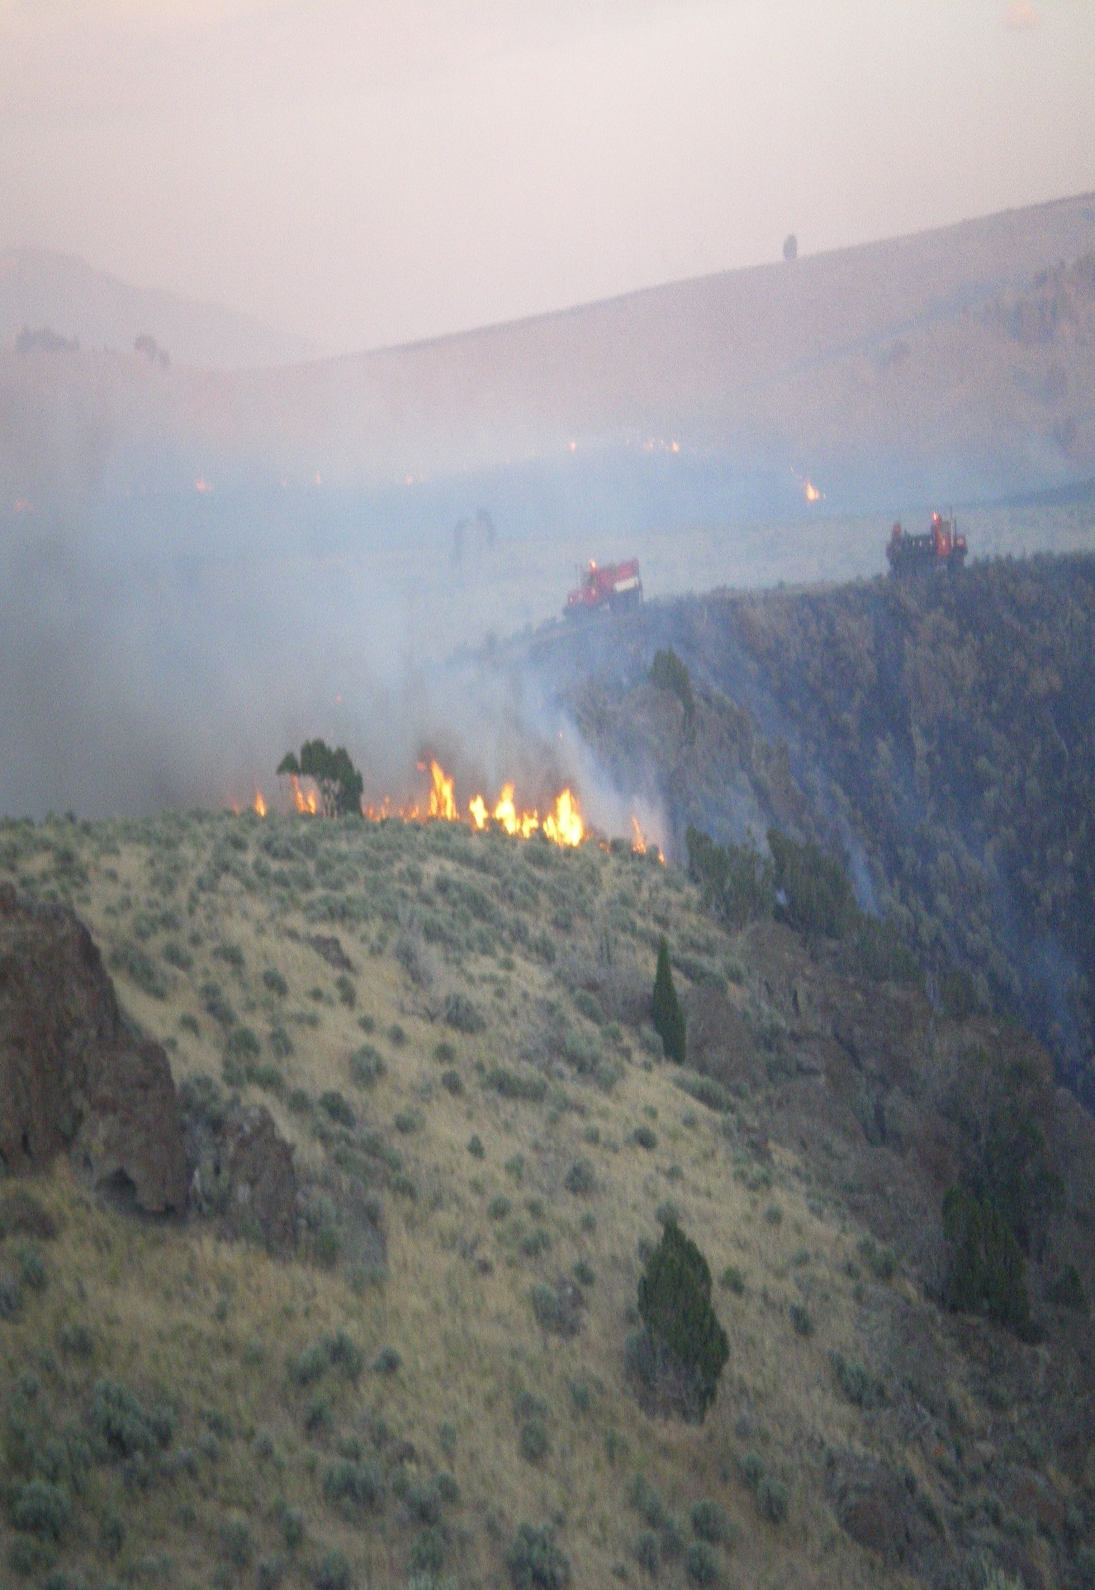
Objectives
Create a Juniper spp. distribution map to determine areas were there are high concentrations of juniper.
Overlay populated areas to juniper distribution map to determine areas with high wildfire susceptibility.
Credit: Chris Burger
Notes:
The objectives of this study are to determine how to detect areas that have abundant juniper stands, determine what classification to assign to these areas and overlay population data on these area to determine risk to human life and property.

Slide 5
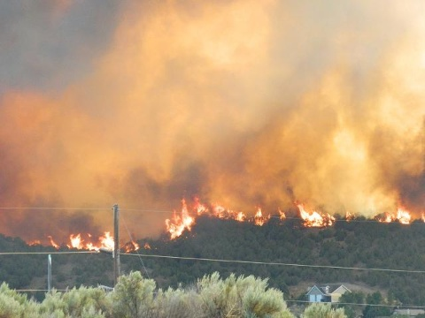
Community Concerns
Credit: Dawn Kratz
The 2012 Charlotte Fire cost Idaho $211 million dollars in fire suppression expenditures.
In Idaho, juniper species have extended beyond their native habitats and are increasing wildfire severity and duration.
Expanded wildfire regimes significantly alter semi-arid savanna ecosystems.
Notes:
The Charlotte fire was one of the most economically impacting wildfires that southeast Idaho had seen in decades. Suppression expenditures and lost property resulting from this fire totaled 9.5 million dollars. This fire destroyed 66 homes, 96 buildings in total and caused the evacuation of 5,688 people. The justification for mapping fire susceptibility is to identify communities-at-risk throughout the wildland urban interface and mitigate this risk. Wildfire disturbance can also alter entire ecosystems and further promote invasive species leading negative consequences for semi-arid ecosystem if not appropriately monitored and controlled.

Slide 6
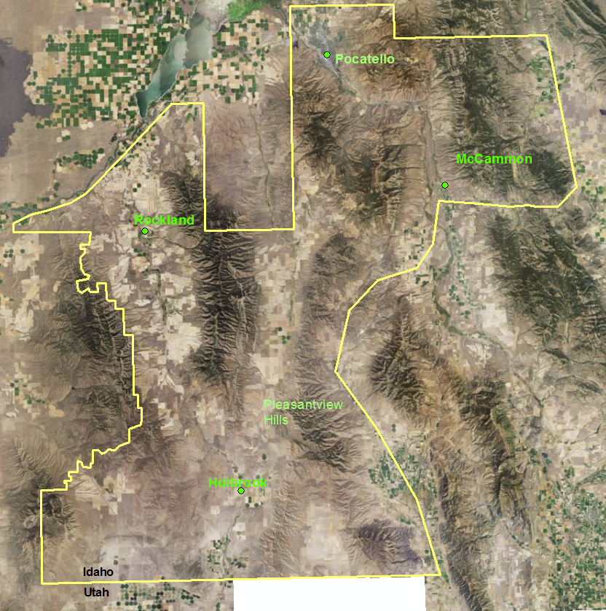
Focused
Study Area
A focused study area provided by the Bureau of Land Management was analyzed to determine existing juniper stands.
This areas extends from American Falls reservoir in the north to the Curlew National Grassland in the south.
NAIP 2013
Notes:
The BLM wanted to evaluate this area that surrounds the Curlew National Grassland. The Curlew National Grassland provides critical habitat for C. urophasianus and is under direct threat from juniper encroachment and wildfire. The BLM wants to have information about areas that have phase I, II and III juniper stands so that they are better equipped to allocate funds and manage resources.

Slide 7
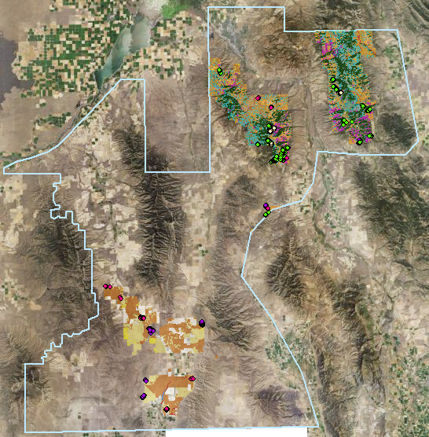
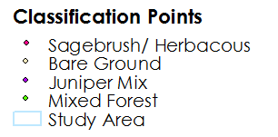
Methods
Classification site creation
Classification points were created in using;
2013 NAIP imagery with a .5 meter resolution
Remote Sensing Applications Center (RSAC) data was used identify known juniper dominant areas
Vegetation Type | Number of points
Sagebrush/ Herbaceous | 234
Bare ground | 201
Juniper Mix | 214
Mixed Forest | 276
Notes:
Four vegetation classes were selected; sagebrush/ herbaceous, bare ground, juniper, and mixed forest. Juniper mix included Western Juniper, Utah Juniper, and Pinyon-juniper because all of these grow within this region. Conifer, Douglas fur, and all other common woody trees are grouped into mixed forest.

Slide 8
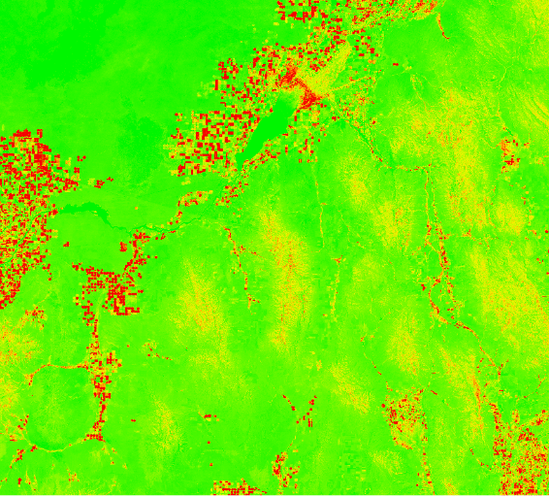

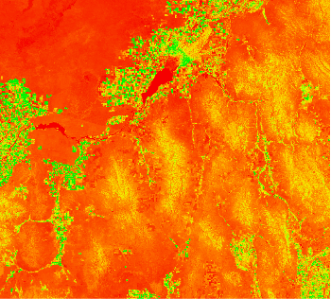
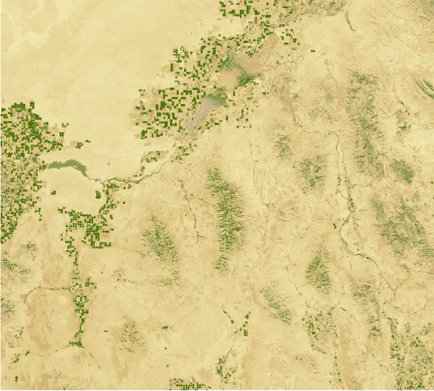
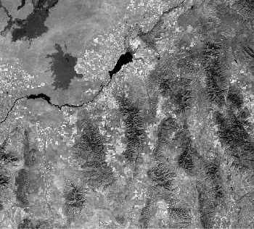

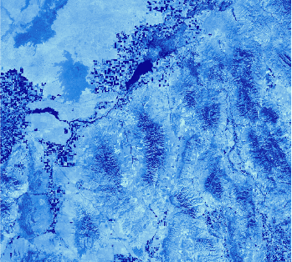



Methods
Image Processing
mSAVI2 and TCT were derived using IDRISI TerrSet VegIndex Modules
NDBSI = (TM6 – TM5) / (TM6 + TM5 + 0.001) * Baraldi et al., 2006
Modified Soil-Adjusted Vegetation Index | Tasseled Cap Transformation | Normalized Differenced Bare Soil Index
Notes:
Images were standardized and atmospherically corrected using the C-Cost model prior to being put into the CTA. Due to the semiarid ecosystem this area has a lot of bare soil so a normalized differenced bare soil index (Baraldi et al., 2006) in addation to mSAVI2 and Tasseled cap modules.

Slide 9
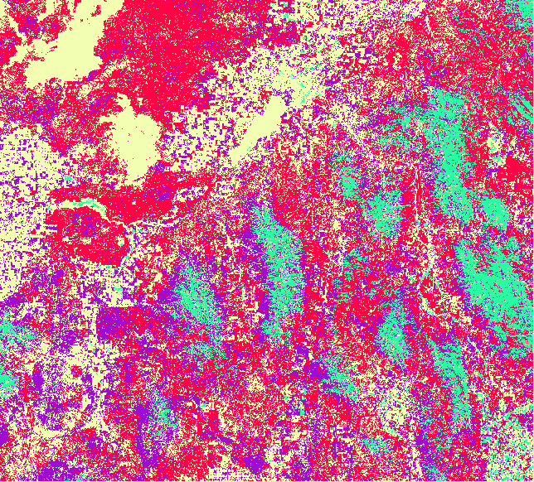
Methods
Classification Tree Analysis
Classification Tree Analysis was used to differentiate areas with high concentrations of juniper.
Classification Points
Normalized Differenced Bare Soil Index
Modified Soil-Adjusted Vegetation Index
Sagebrush Herbaceous
Bare Ground
Juniper
Mixed Forest
Notes:
Classification Tree Analysis was used to differentiate area with high concentrations of juniper. CTA utilizes known classes and constructs a decision tree based upon similar values of reflectance. This CTA compared spectral signatures form sagebrush, bare ground, juniper and mixed forest pixels. These juniper areas that are detected are most likely Phase III juniper stands.

Slide 10
Classification Results
Accuracy Assessment
Error Matrix Analysis – CTA Results
 | Sagebrush/ Herbaceous | Bare Ground | Juniper Mix | Mixed Forest | Total | ErrorC
Sagebrush/ Herbaceous | 59 | 6 | 7 | 0 | 72 | 0.18
Bare Ground | 4 | 41 | 2 | 6 | 53 | 0.22
Juniper Mix | 5 | 14 | 62 | 3 | 84 | 0.26
Mixed Forest | 0 | 8 | 3 | 106 | 117 | 0.09
Total | 68 | 96 | 74 | 115 | 326
ErrorO | 0.13 | 0.40 | 0.16 | 0.07 |  | 0.17
Kappa coefficient: 0.75
Notes:
With an overall kappa coefficient of 75% we are able to identify juniper while leveraging 30 meter Landsat 8 imagery.

Slide 11
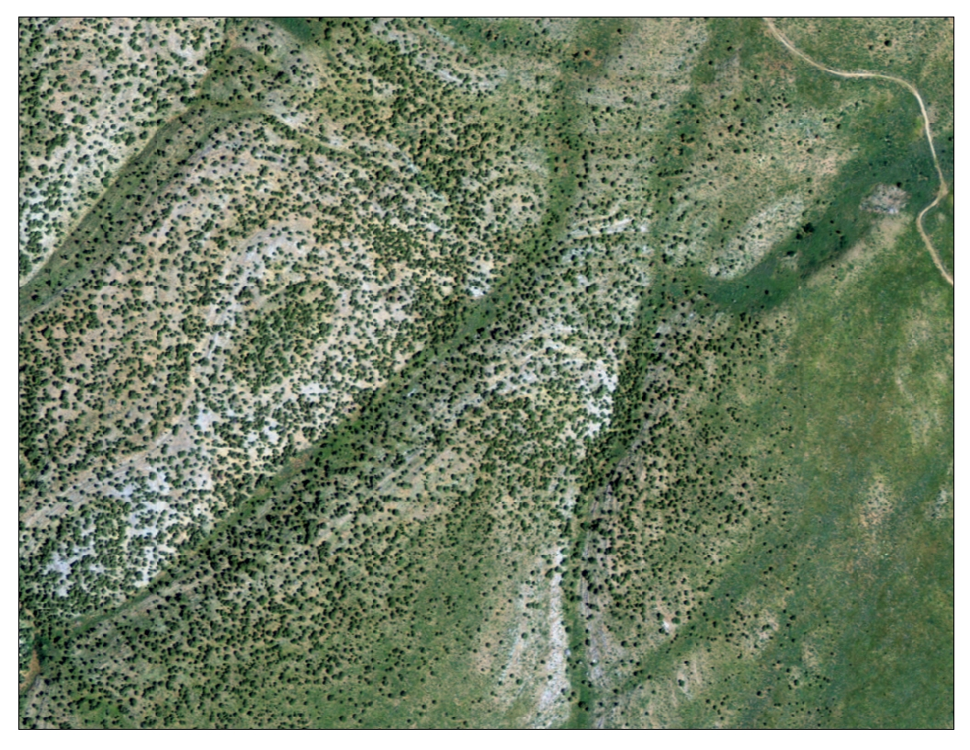
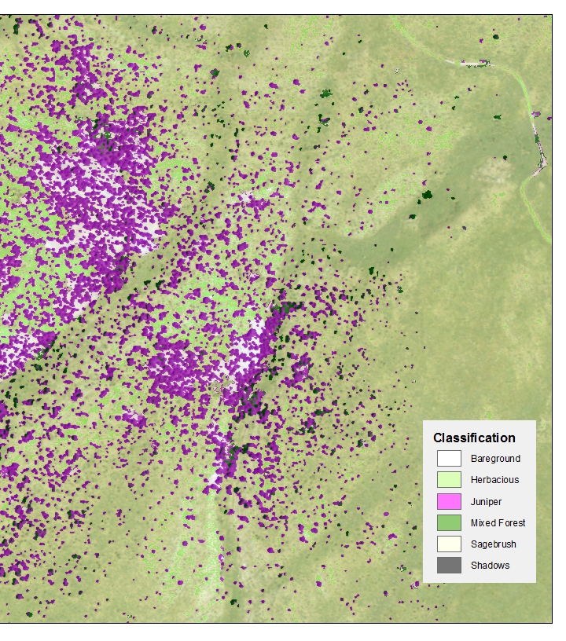
Methods
Object-Based Image Classification
Object-Based Image Classification (OBIA) segments data based on similar characteristics prior to classification using Bayes’ theorem.
Notes:
Object – based image analysis (OBIA), is based on information from a set of similar pixels and classifies those pixels that share unique properties such as size, shape and texture. Bayesian statistics were applied to differentiate the vegetation classes.

Slide 12
Classification Results
Accuracy Assessment for Object-Based Image Classification
Error Matrix Analysis – CTA Results
 | Juniper | Bare Ground | Shadow | Sagebrush | Herbaceous | Mixed Forest | Total | ErrorC
Juniper | 48 | 0 | 0 | 3 | 0 | 1 | 52 | 0.07
Bare Ground | 0 | 10 | 0 | 0 | 0 | 0 | 10 | 0
Shadow | 0 | 0 | 59 | 0 | 0 | 0 | 59 | 0
Sagebrush | 4 | 9 | 0 | 57 | 18 | 3 | 91 | 0.37
Herbaceous | 0 | 41 | 0 | 0 | 42 | 0 | 83 | 0.49
Mixed Forest | 2 | 0 | 1 | 0 | 0 | 56 | 59 | 0.05
Total | 54 | 60 | 60 | 60 | 60 | 60 | 354
ErrorO | 0.11 | 0.83 | 0.01 | 0.05 | 0.3 | 0.06
Kappa coefficient: 0.72
Notes:
With an overall kappa coefficient of 75% we were able to distinguish juniper from the surrounding land cover using 0.5 NAIP imagery.

Slide 13
Conclusions

Slide 14
Advisors
Keith Weber (ISU)
Partners
Mike Kuyper (BLM)
Chris Burger (BLM)
Others
Ryan Howerton (ISU)
Notes:
We would like to thank the following people for their contributions to this project.

