Slide 1
Antarctica Climate
Applying NASA Earth Observations to Assess the Seasonal and Inter-annual Variability of Sea Ice Dynamics in McMurdo Sound, Ross Sea, Antarctica
Elizabeth Benyshek (Project Lead)
Christopher Cameron
Caren Remillard
Eduardo Rendon
Notes:
This project was completed during the Fall 2015 term at the UGA NASA DEVELOP node. Antarctica Climate Team: Elizabeth Benyshek, Sean Cameron, Caren Remillard, and Eduardo Rendon

Slide 2
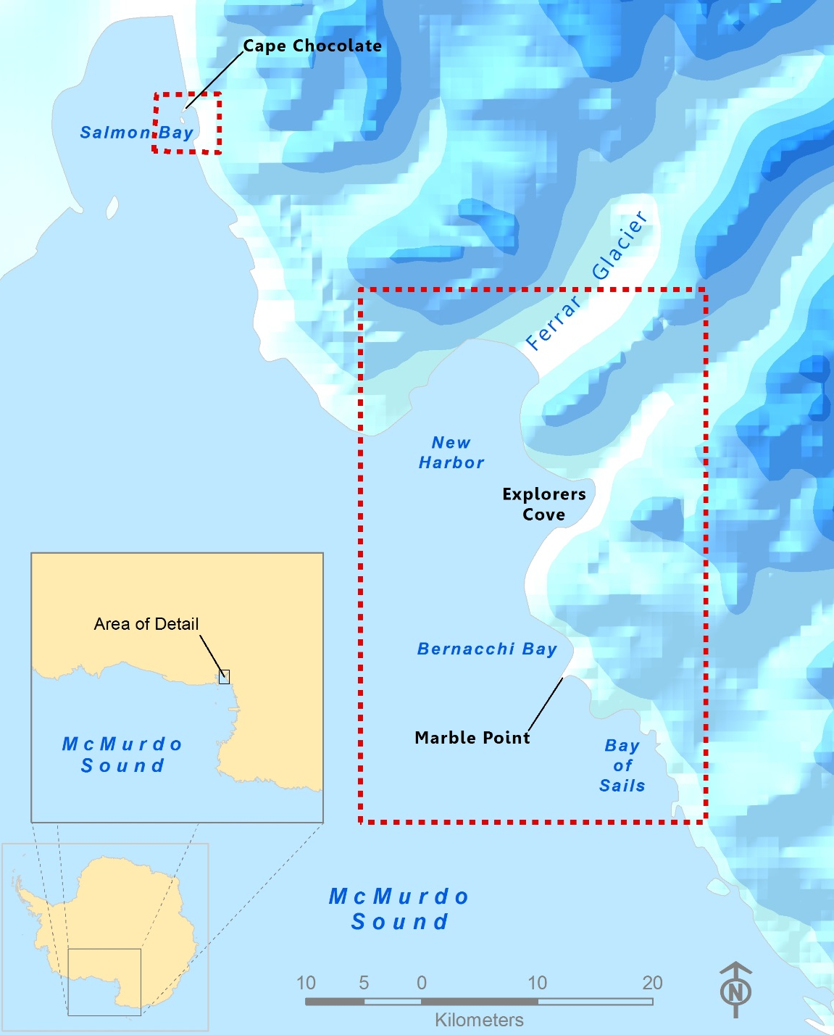

Study Area
McMurdo Sound, Ross Sea, Antarctica
Study Period: October 2003-October 2008
Image Credit: Brandon Adams & Caren Remillard
Notes:
The western coast of McMurdo Sound, Antarctica is rich in economically-important species. Our partners are specifically interested in sea ice dynamics in the regions of Explorers Cove, Ferrar Glacier, and Cape Chocolate. Due to restrictions in satellite data availability our study period was constrained to October 2003-October 2008.

Slide 3
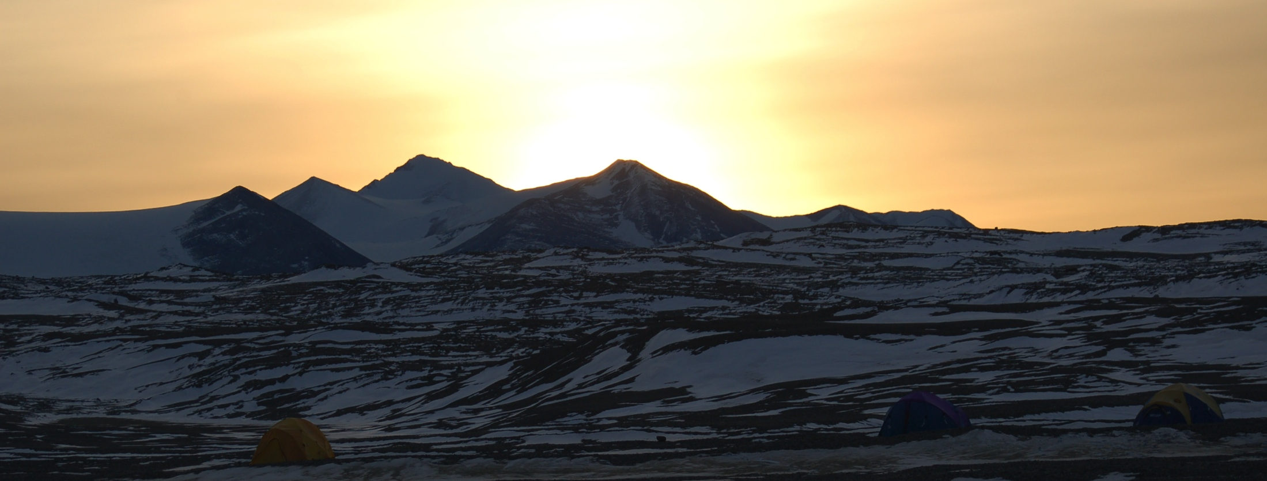
Image Credit: Sally Walker
Objectives
Examine Terra, Aqua and ICESat datasets to characterize seasonal and inter-annual variability in sea ice thickness, sea surface temperature, ice surface temperature, and sea ice extent
Evaluate potential spatio-temporal correlations between these parameters along the western coast of McMurdo Sound, Antarctica
Notes:
Main objective: Characterize seasonal and inter-annual variability of sea ice thickness, sea surface temperature, ice surface temperature, and sea ice extent along the western coast of McMurdo Sound

Slide 4
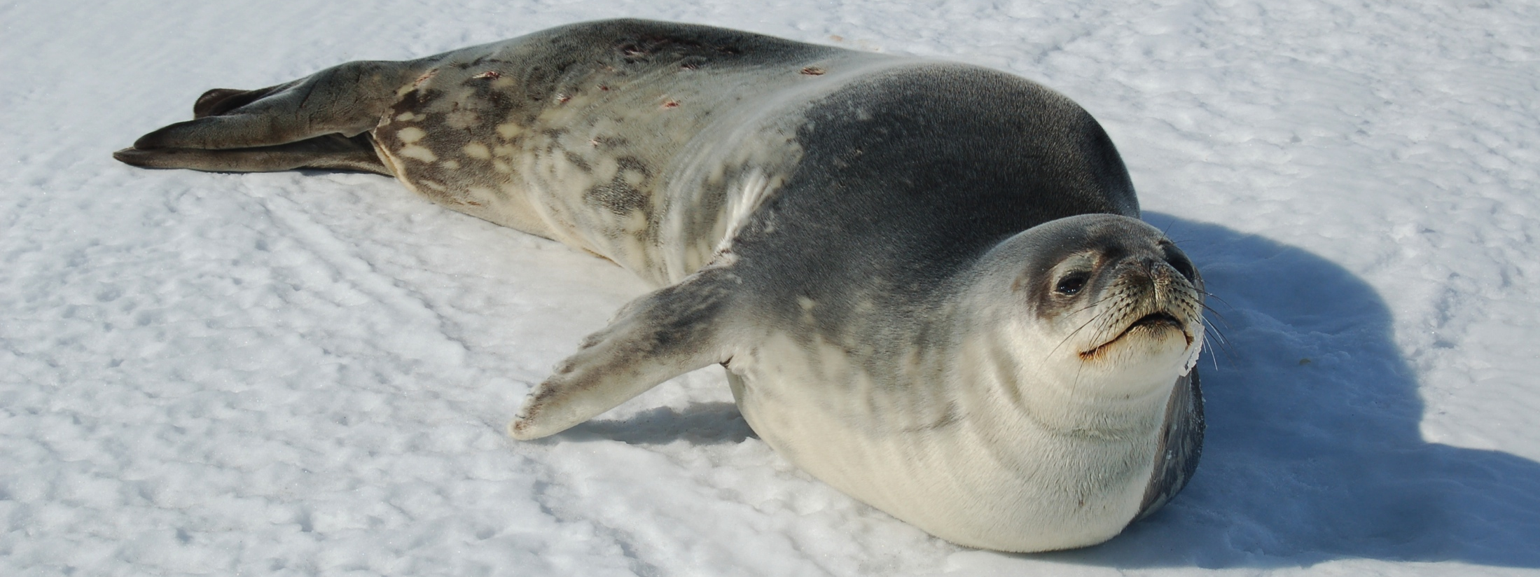
Image Credit: Sally Walker
Community Concern
The Antarctic coast of McMurdo Sound experiences important changes in ice dynamics as both glaciers and sea ice undergo melt-freezing cycles
Compounded changes in local ice regimes can affect vulnerable ecological communities in the Explorers Cove region
Notes:
Changes in sea ice dynamics can effect vulnerable ecological communities of McMurdo Sound, Antarctica

Slide 5
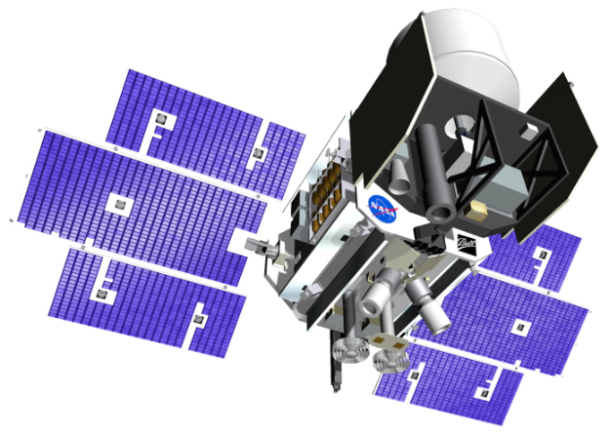

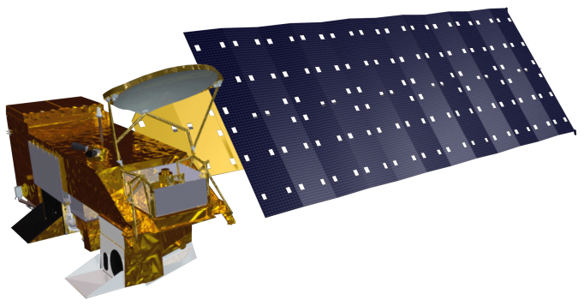
ICESat
Aqua
Terra
NASA Earth Observing Systems
ICESat, Aqua, and Terra were utilized in this project to characterize sea ice variability in western McMurdo Sound, Antarctica
Notes:
ICESat/GLAS sensor – Sea ice thickness data
Aqua/MODIS – Sea ice extent and sea ice surface temperature
Terra/MODIS – Sea surface temperature

Slide 6
Methodology
Data Acquisition
Data Processing and Analysis
End-Products
ICESat/GLAS
Cryosphere Science Research Portal
Extraction and aggregation of seasonal data
Seasonal sea ice topography maps
Aqua and Terra/MODIS
National Snow and Ice Data Center and NASA’s Giovanni
Georeferencing and extraction of sea and ice surface temperature data
Seasonal temperature maps
Spatio-temporal correlation visualizations
Notes:
ICESat sea ice thickness data was obtained from the Cryosphere Science Research Portal and aggregated to seasonal data to create seasonal sea ice topography maps.
Terra sea surface temperature data was obtained from NASA’s Giovanni then georeferenced to create seasonal sea surface temperature maps.
Aqua ice surface temperature data was obtained from National Snow and Ice Data Center and georeferenced to create seasonal ice surface temperature maps.

Slide 7
Results
ICESat Seasonal Sea ice Thickness (m) in western McMurdo Sound
Notes:
This graph shows ICESat seasonal campaign coverage and average values for western McMurdo Sound, Antarctica.

Slide 8
Results: Spring
Sea Ice Thickness and Sea Surface Temperature in western McMurdo Sound
meters
ºC
Notes:
Sea surface temperature (gray) decreases after 2004 while ice thickness (blue) decreases every year between 2003 and 2007.

Slide 9
Results: Summer
Sea Ice Thickness and Sea Surface Temperature in western McMurdo Sound
meters
ºC
Notes:
Sea surface temperature (gray) increases between 2004 and 2007 while ice thickness (blue) decreases every year between 2004 and 2008.

Slide 10
Conclusion

Slide 11
Errors & Uncertainties

Slide 12
Future Work

Slide 13
Advisors
Dr. Sally E. Walker, Department of Geology, University of Georgia
Dr. Adam Milewski, Department of Geology, University of Georgia
Partners
Dr. Samuel Bowser, The Wadsworth Center: New York's State Public Health Laboratory
Dr. Sally E. Walker, Department of Geology, University of Georgia
Others
Linli Zhu, Geoinformatics Fellow, NASA DEVELOP
Rachel Rotz, Department of Geology, University of Georgia

Slide 14
General Guidelines I
Things that are typically included in a presentation:
The slides provided in the template are just a starting point for teams. Feel free to expand upon these topics, alter the headings, and change the order of the slides to fit your needs.
Study area
Study period
Objectives
Community concerns
NASA satellites/sensors used
Methodology
Results
Conclusions
Errors & uncertainties
Future work
Acknowledgements
Backup slides
Required Statement

Slide 15

General Guidelines II
Header text point size should be between 40 and 60 on most slides.
Body text point size should be at least 20.
Use Century Gothic.
Keep text to a minimum.
Try to use a consistent font size between slides.
Image Credit: Monet
Notes:
Image Source: http://commons.wikimedia.org/wiki/File:Claude_Monet_-_The_Magpie_-_Google_Art_Project.jpg

Slide 16
Image Credit: Monet
General Guidelines III
Include speaker notes for each slide (see below).
Include a visual on each slide, if possible.
Arrange content to minimize white space.
Notes:
These notes should be thorough enough for someone not familiar with the project to clearly present the material.
Image Source: http://commons.wikimedia.org/wiki/File:Claude_Monet_-_The_Magpie_-_Google_Art_Project.jpg

Slide 17
Maps & Logos
Maps
Import the legend separately.
Make sure all text is legible and editable.
Cite base layer source in speaker notes.
Logos
US Federal logos only.
No state, NGO, local and or international government logos, or software logos.

Slide 18
Photos & Figures I
You may only use images taken by your team, provided by your partners (as long as you have permission from them), from a Federal Agency, from the new DEVELOP stock imagery collection on DEVELOP’s Flickr page, or Creative Commons images.
Obtain a media release form from all people in photos that your team has taken — no children!
All image sources should be cited using a consistent format and should be visible on the slide.

Slide 19
Photos & Figures II
Please do not include the image URL in the source text box but rather place it in the notes section below.
If you use a border for your images include it on all photographs to keep your presentation consistent.
Keep all images and text boxes editable, including individual elements of flowcharts.
Background images are discouraged. If you use one, make sure that your text remains clear and legible.

