Slide 1
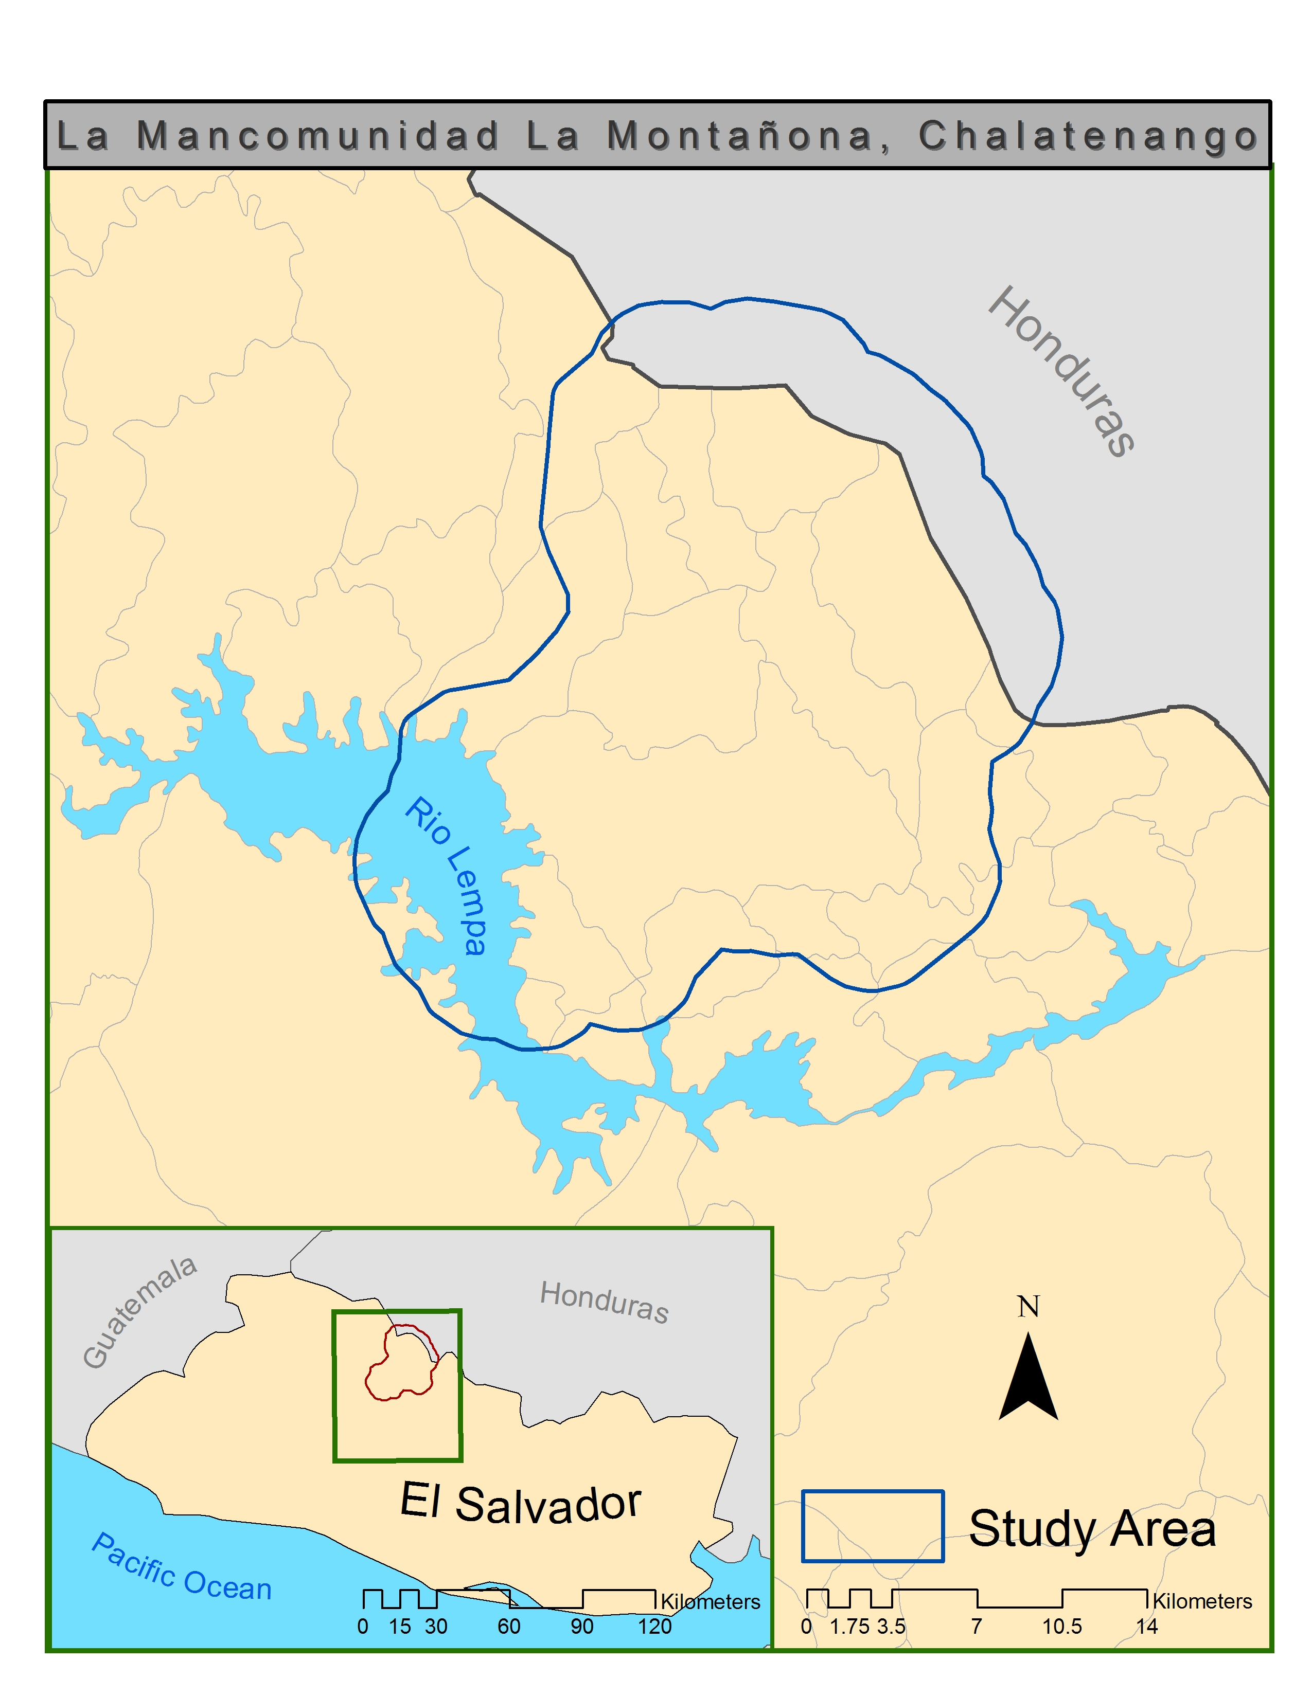
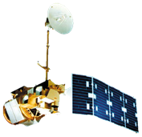
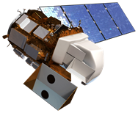
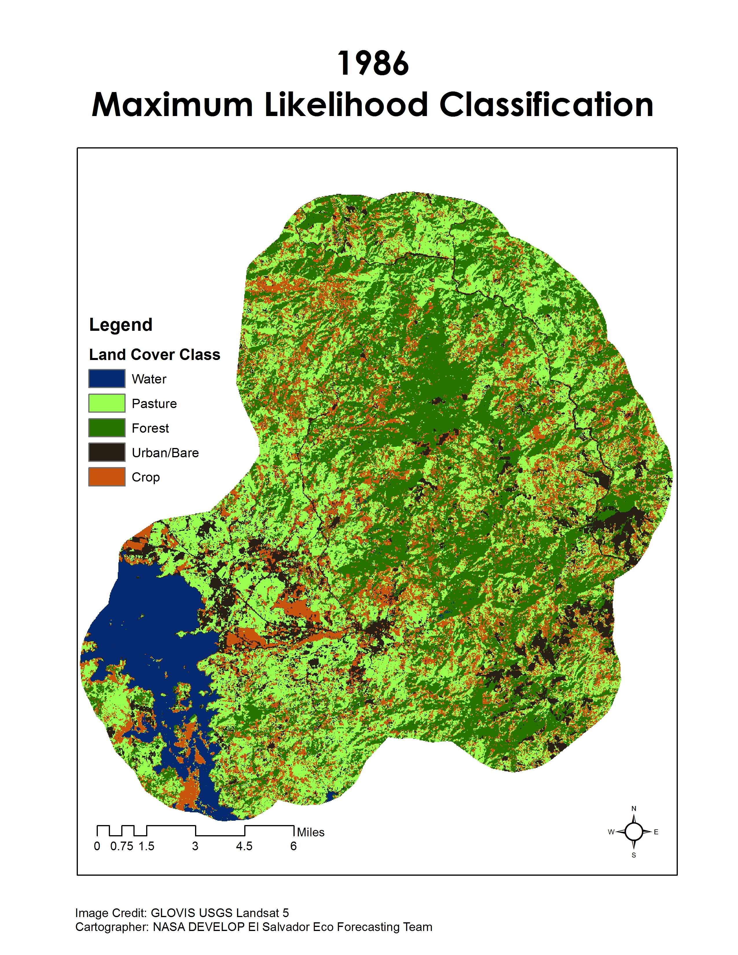
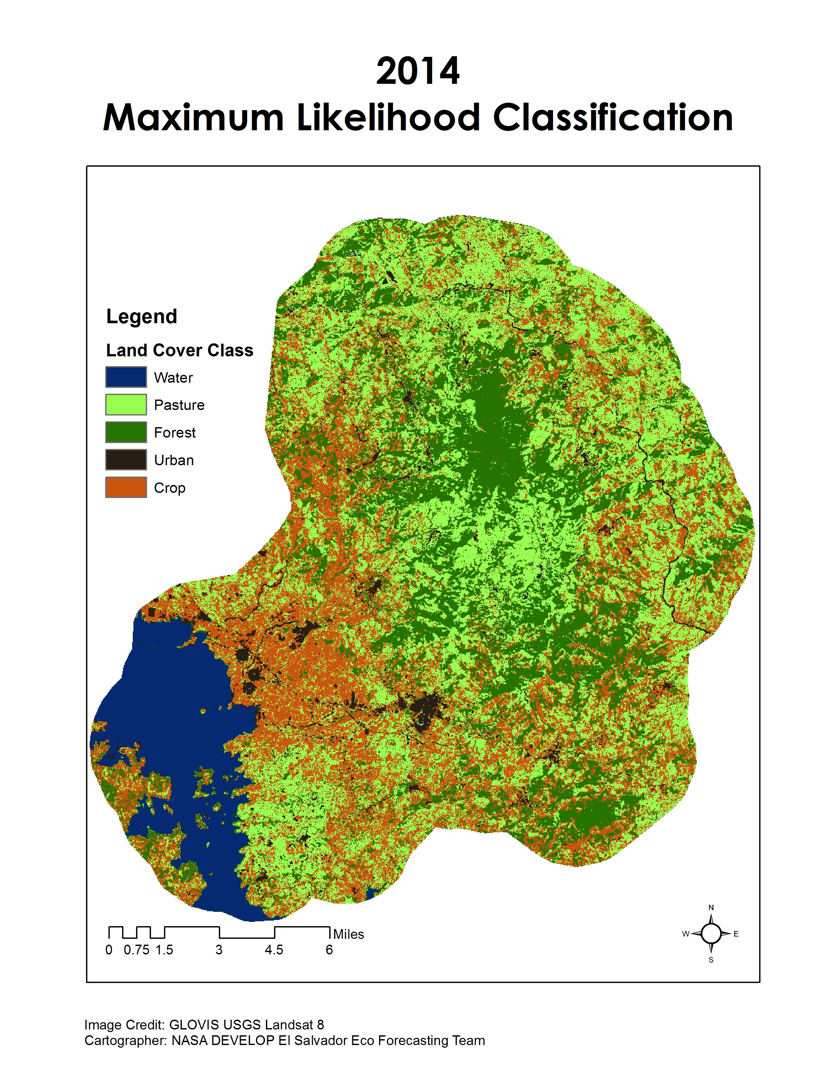
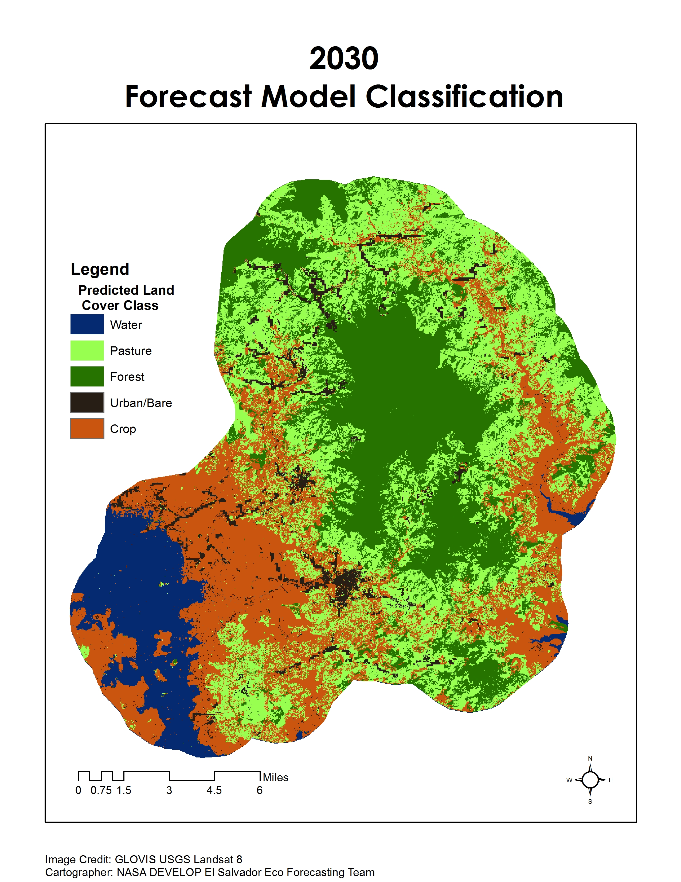
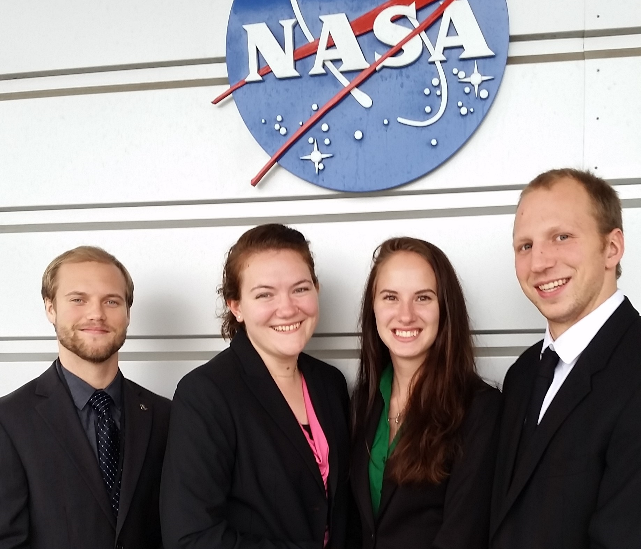
El Salvador Ecological Forecasting
Utilizing NASA Earth Observations to Develop a Historically Based Trajectory of
Deforestation and Degradation in El Salvador
Jordan Ped (Project Lead), Courtney Duquette, Clarence Kimbrell, Susannah Miller, Stephen Zimmerman
NASA DEVELOP National Program at NASA Langley Research Center
Abstract
Objectives
Study Area
Tropical rainforests have been recognized as a major contributor to maintaining the global carbon budget and contain a significant portion of the world's biodiversity. However, these ecosystems are threatened by deforestation and forest degradation and require careful management to retain their ecosystem services. La Mancomunidad La Montañona in Chalatenango, El Salvador is home to the critical Rio Lempa watershed where small scale farmers and pastoralists commonly practice slash and burn agriculture. Using NASA Earth observations in collaboration with Ministerio de Medio Ambiente y Recursos Naturales (MARN) and the Earth Institute of Columbia University, Agroforestry for Biodiversity and Ecosystem Services (ABES) Project, a methodology was developed for stakeholders and policy makers to monitor long-term changes in forest cover and identify indicators of forest degradation. A baseline time series showing forest cover and land-use, land-cover from December 1986 to January 2015 was used to forecast forest cover change. These predictions and tools will help assess priority areas for conservation and development of sustainable agricultural practices.
Land Use/Land Cover (LULC) delineating forest areas, agriculture and pastoral plots, urban development, and water to better understand how the land is being used
Forecasting model of land usage to predict how the land will change and which forest areas are more susceptible to deforestation and degradation
La Moncomunidad La Montañona, Chalatenango, El Salvador
Methodology
DATA ACQUISITION
DATA PROCESSING
DATA ANALYSIS
SRTM, Open Street Map
Landsat & RapidEye clipped using Python
Landsat CDR 4, 5, & 8
  Supervised LULC for 1986, 1996, 2000, & 2014
QuickBird & RapidEye
Resampled
*
Forecasting Model to 2030
ABES Project Data
Validation of GFC at Regional Scale
*
Earth Observations
Global Forest Cover (GFC)
GFC clipped to QuickBird extent.
* Indicates an End Product
Landsat 4-5
Landsat 8
Results
Conclusions
+
→
The accuracy was assessed at 60.1% for the 2014 classification based on ABES plot data and randomly selected points.
Refinement of training sites will increase accuracy of the LULC classifications. Adding more classes will decrease the range of reflectance values for each class and potentially increase the accuracy of the classification.
The forecast model predicts consolidation of land cover types, including an exaggerated expansion of forest extent.
More accurate inputs to the forecast model will increase the predicting capability of this software. Inputs include LULC classifications from various epochs, and variables that influence land cover change such as elevation and slope.
Further research will help develop a methodology that can be applied throughout El Salvador improving MARN’s capacity to mitigate deforestation and forest degradation.
The result of an ArcGIS maximum likelihood classification for December 19, 1986; a Land Use Land Cover
The result of an ArcGIS maximum likelihood classification for January 1, 2015; a Land Use Land Cover
The result of TerrSet Land Change Model with the 1986 and the 2014 LULC as input.
Team Members
Acknowledgements
Project Partners
Left to Right:
Stephen Zimmerman
Susannah Miller
Courtney Duquette
Jordan Ped
Not Pictured:
Clarence Kimbrell
Dr. Kenton Ross
NASA DEVELOP National Program
Colorado Agriculture
NASA DEVELOP, Fort Collins, Colorado, Summer 2015
Collaborator:
The Earth Institute, Columbia University (ABES Project)
POC: Dr. Sean Smukler & Sean Kearney
End Users:
La Mancomunidad La Montañona, Chalatenango
POC: Arnulfo Alberto
Ministerio de Medio Ambiente y Recursos Naturales (MARN)
POC: Giovanni Molina

