Slide 1
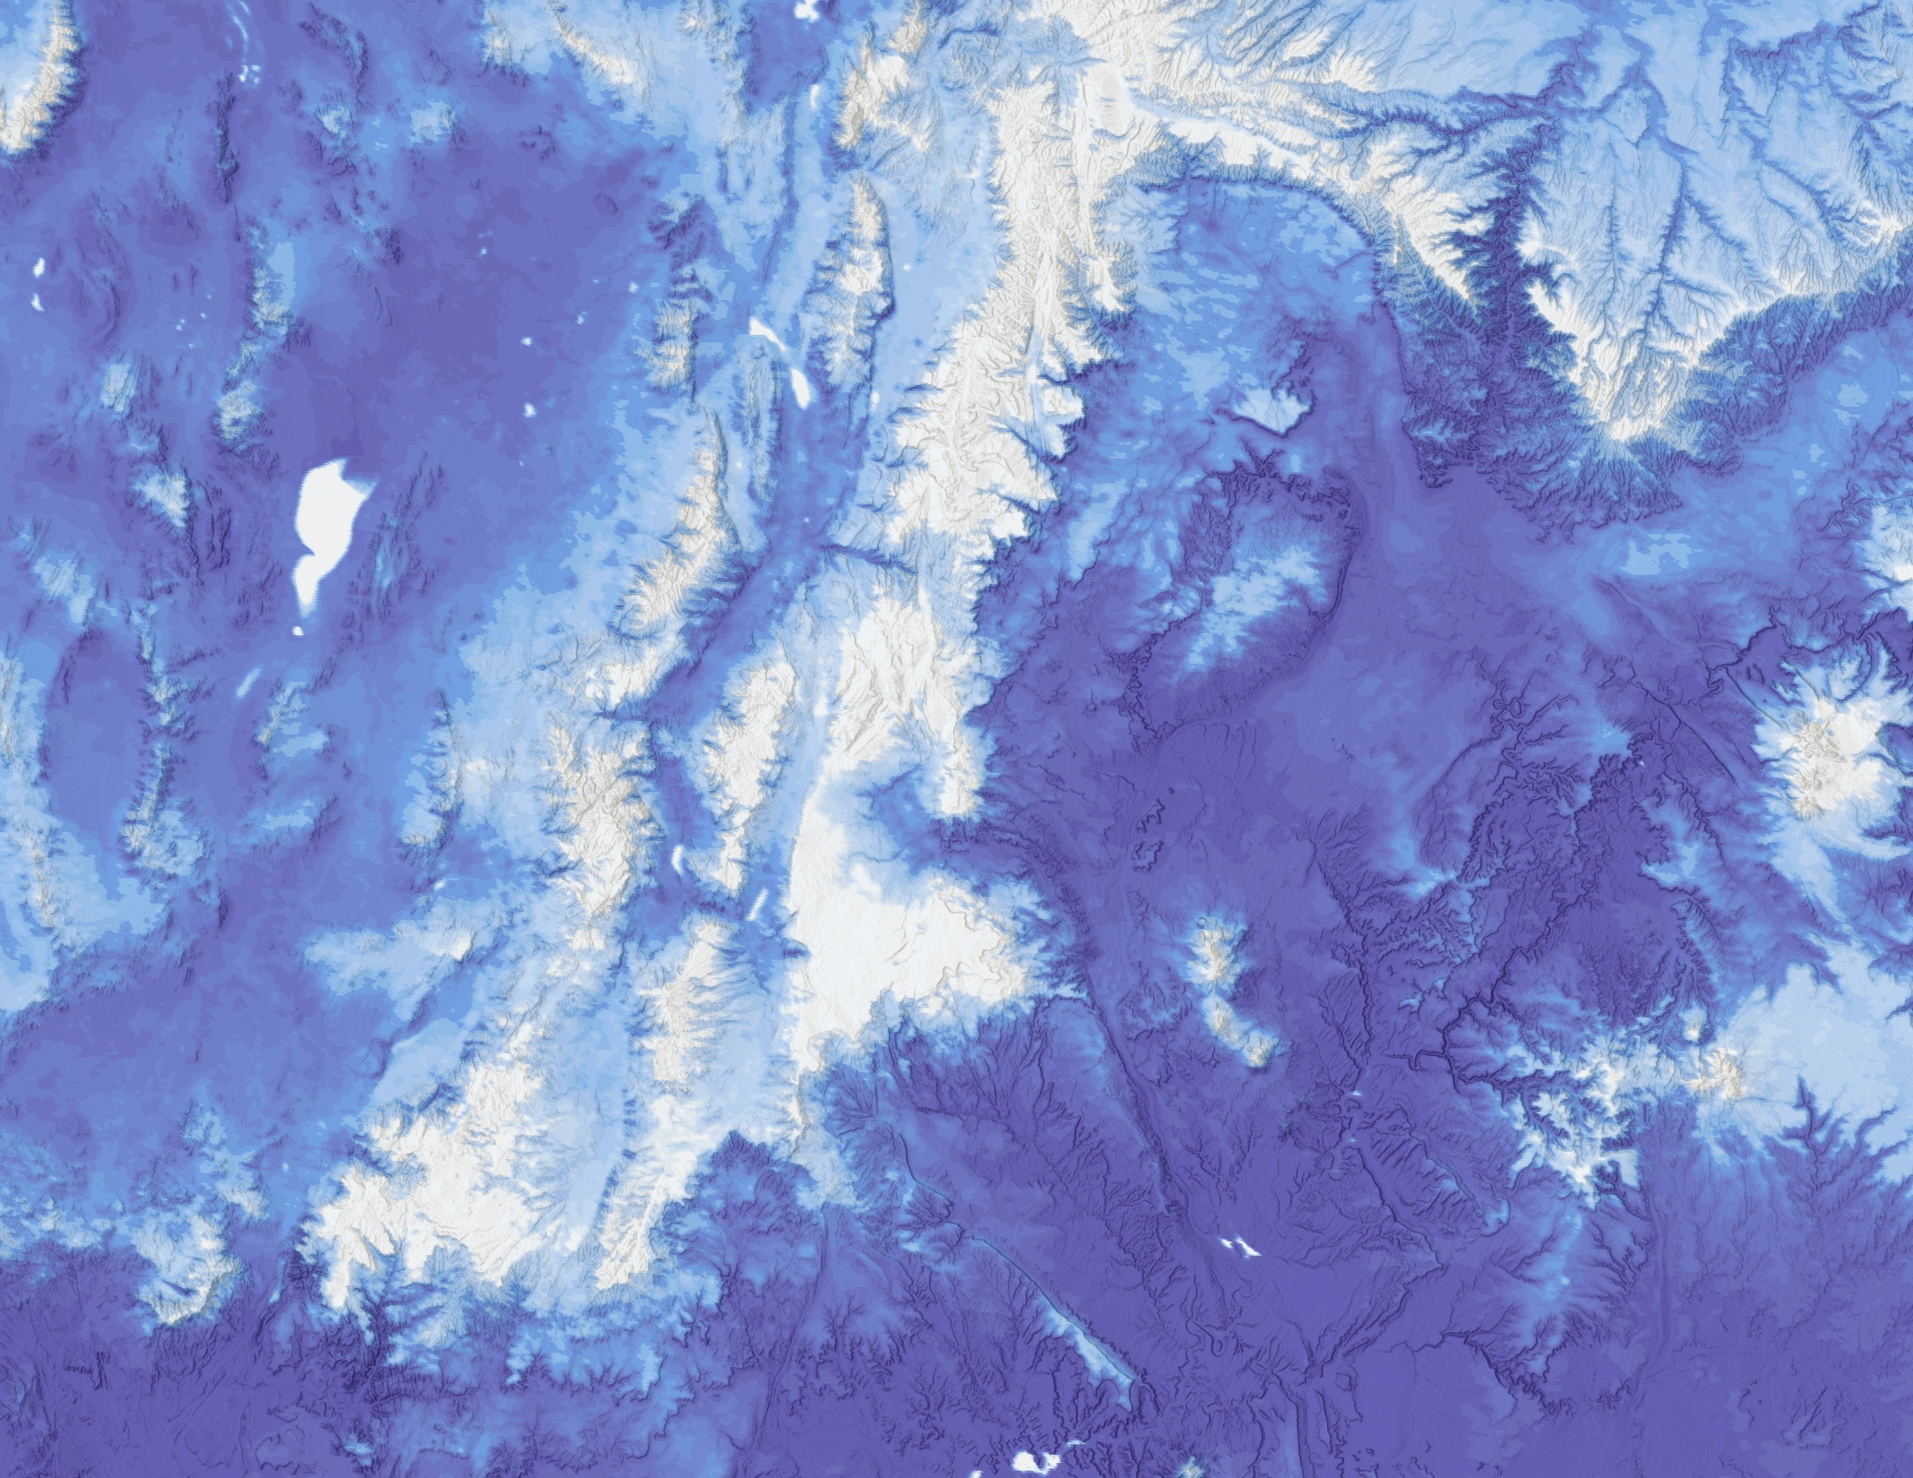
2018 Summer | VA
FREMONT RIVER BASIN WATER RESOURCES II
Water Availability Assessment from Annual Snowpack in the Fremont River Basin Based on NASA Earth Observations and In Situ Data
Jessica Li
Zhuoyan He
Chenyu Shi
Notes:
Script:
Hello! My name is Jessica Li and I am the Project Lead.
I am Zhuoyan He.
I am Chenyu Shi.
We are the Fremont River Basin Water Resources II team. Our project involved modelling water availability from annual snowpack in the Fremont River Basin based on NASA Earth observations and in situ data.

Slide 2
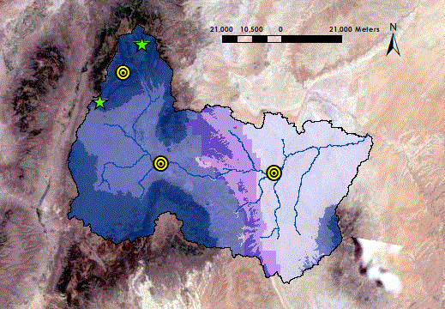
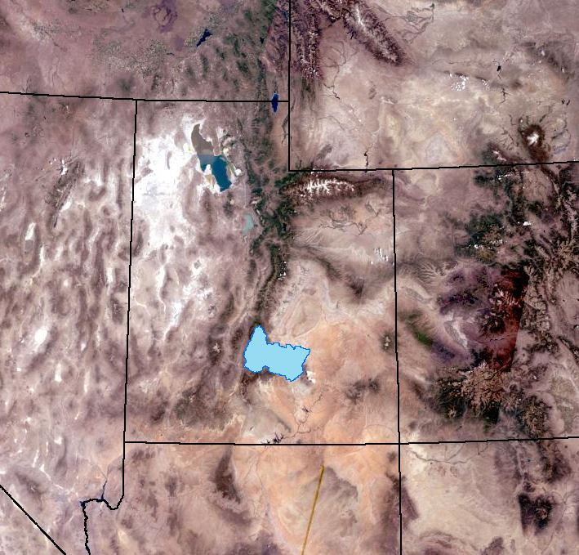
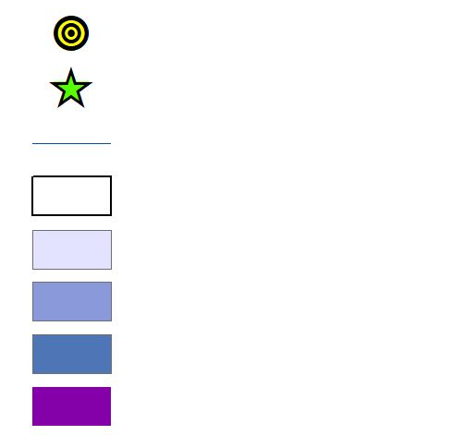
Study Area
ID
WY
Utah
CO
NV
Fremont
Lyman
Bicknell
Hanksville
Torrey
AZ
NM
Teasdale
Stream gauge
SNoTEL station
River
Fremont River Basin
Low Elevation Zone
Moderate Elevation Zone
High Elevation Zone
Capitol Reef National Park
Landsat 8 OLI Natural Color Imagery
SNOTEL site
SNOTEL site
SNOTEL site
Stream gauge
Stream gauge
Stream gauge
River & tributary
River & tributary
River & tributary
Capitol Reef National Park
Capitol Reef National Park
Capitol Reef National Park
Fremont River Basin
Fremont River Basin
Fremont River Basin
Notes:
Script:
Our study area is located in southern Utah and includes the Capitol Reef National Park. There are 5 points for in situ data here. 2 are the SNOTEL sites located in high elevations recording temperature, snow water equivalent, and precipitation. The remaining 3 are stream gauges in Fish Lake, Bicknell, and Caineville recording streamflow for the river. Our main stream gauge of interest is the Bicknell gauge *point to the middle gauge*
Image Source:
Study Area Map created by the Fremont River Basin Water Resources II Team.
Base Layer is Landsat GLA Pansharpened, which includes data from 7 ETM, Landsat 5 TM, Landsat 4.

Slide 3
Community Concerns
Fremont River Basin water flow is dependent on snowmelt
Streamflow is currently predicted utilizing USDA Snowpack Telemetry (SNOTEL) in situ data
Observed streamflow and predicted streamflow from snowmelt are not aligned
Image Credit: National Park Service
Notes:
Script:
For the Fremont River Basin, snowmelt is a primary source of water throughout the year.
The predicted water flow from USDA SNOTEL monitoring station data has not aligned with the observed water flow from stream gauge data in the basin. During the 2016 to 2017 season, the measured snowpack at the two SNOTEL stations, both at the same elevation, showed the year’s snowpack to be 100% to 110%. Thus, a normal water year was expected for irrigation purposes.
Image Source:
National Park Service. Sent directly to the team by the project partners.

Slide 4
Community Concerns
The Utah Division of Water Rights requested reductions in irrigation water from the Fremont River Basin
Image Credit: Terry Fisk, National Park Service
Notes:
Script:
However, by mid-summer 2017, the Utah Division of Water Rights requested reductions in irrigation water allotment from the Fremont River. The park needed to reduce their irrigation to 70% of their allotted amount. The Utah Division of Water Rights does not partition water for the Fremont River, but instead requires a certain volume of water to reach the Dirty Devil River downstream. During years of lower streamflow, they can request reductions in irrigation to be sure the required volume is met.
Image Source:
Terry Fisk, National Park Service. Sent directly to the team by the project partners.

Slide 5
Community Concerns
Capitol Reef National Park manages historic orchards and pastures, which rely on irrigation water from the Fremont River Basin
Image Credit: National Park Service
Notes:
Script:
The Fremont River Basin irrigates approximately 16,000 acres of agricultural land in Southern Utah, including the irrigation of historic orchards and pastures managed by Capitol Reef National Park. In this semi-arid environment, “Water is life” (Terry Fisk), and the Fremont River Basin is the primary source of water in the basin for irrigation.
Image Source:
National Park Service. Sent directly to the team by the project partners.

Slide 6
Community Concerns
The Natural Resources Conservation Service (NRCS) of the USDA creates forecasts for the Dirty Devil River
The NRCS does not predict water availability for the Fremont River
Image Credit: National Park Service
Image Credit: Monet
Notes:
Script:
Currently, the Natural Resources Conservation Service of the USDA creates forecasts for the Dirty Devil River downstream of Capitol Reef National Park, but it does not partition out flows for the Fremont River. As a result, those in the Fremont River Basin currently only rely on the data from the SNOTEL stations. Our project can provide tools for Capitol Reef National Park to better predict water availability each year from snowmelt using NASA Earth Observations.
Image Source:
National Park Service. Sent directly to the team by the project partners.

Slide 7
Objectives
Image Credit: Terry Fisk, National Park Service
Select the most suitable model to forecast streamflow in the Fremont River Basin
Compile an Exploratory Data Analysis report assessing key snowmelt and climate trends over time
Visualize time series of snow cover changes in the Fremont River Basin
Notes:
Script:
Our objectives were:
- To compare between SNOW-M and machine learning models, select the most suitable one and produce a streamflow prediction model for the Fremont River Basin. A user-friendly GUI tool around the code was also created so partners can easily interact with the prediction model.
- To create a series of visualizations that provide insight into how climate variables have been interacting with the environment and help partners uncover patterns occurring in the basin the past 17 years.
- To derive snow maps from Terra MODIS snow indices to detect accumulation and snow cover in the Fremont River Basin, including Capitol Reef National Park.
Image Source:
Terry Fisk, National Park Service. Sent directly to the team by the project partners.

Slide 8
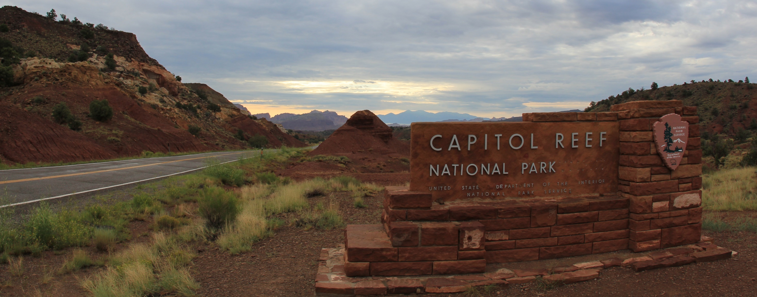
Project Partners
Northern Colorado Plateau Network, National Park Service
Capitol Reef National Park, National Park Service
Image Credit: daveynin
Notes:
Script:
This project was in partnership with 2 partners. Our partners were the Northern Colorado Plateau Network and Capitol Reef National Park, both a part of the National Park Service.
Image Source:
https://flic.kr/p/adXTcc

Slide 9
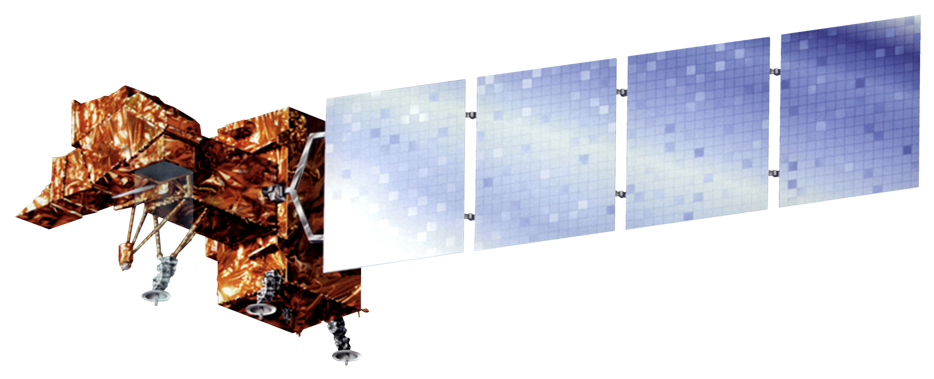
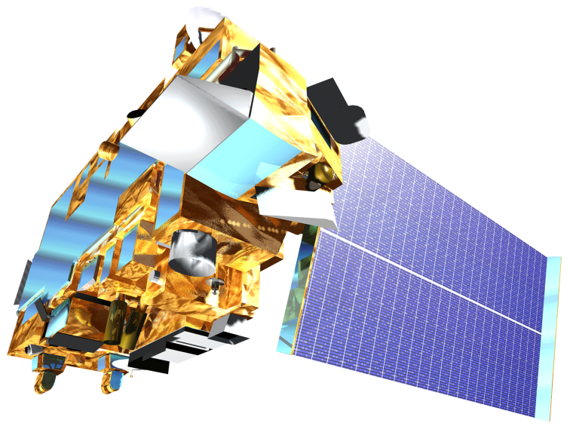
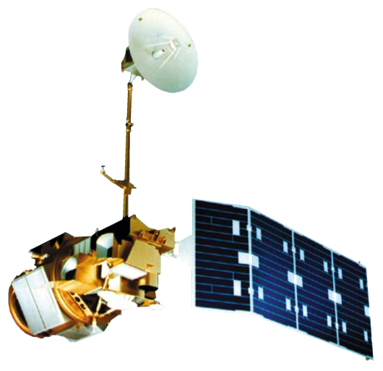
NASA Earth Observations
Terra MODIS
Landsat GLS 2010 (Landsat 4/5 and 7)
Image Credit: DEVELOPedia
Notes:
Script:
The team acquired temperature data and fractional snow coverage data from Terra MODIS earth observation, while Landsat 4,5, and 7 ETM processed into Landsat GLS2010 provided the basis for our study area imagery. Temperature comes from land surface temperature reflectance, and snow coverage product is derived from the Normalized Difference Snow Index.
Image Source:
http://www.devpedia.developexchange.com/dp/index.php?title=List_of_Satellite_Pictures

Slide 10
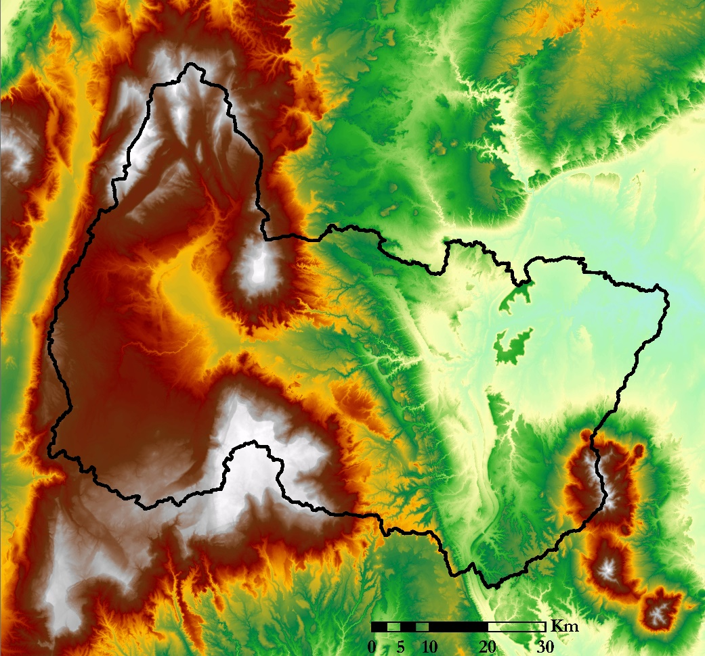
Remote Sensing Imagery
Elevation (m)
Precipitation
⅓ Arc Second
LiDAR DEM
NOAA PERSIANN-CDR
High : 3544.38
High : 145.03
Low : 1270.82
Low : 0
Image Credit: Fremont River Basin Water Resources Team
Notes:
Script:
We also incorporated a 1/3 Arc Second LiDAR DEM from the National Land Cover Database and precipitation data from PERSIANN-CDR. The DEM was used for its high spatial resolution for determining the watershed boundary and elevation zones within the basin. In comparison to alternatives, PERSIANN has shown greater accuracy over TRMM for our study region with the same resolution, while GPM doesn’t cover the entirety of our study time interval.
Image Source:
Fremont River Basin Water Resources Team

Slide 11
In Situ Data
USDA Snowpack Telemetry (SNOTEL) data (Snow Water Equivalent (SWE), precipitation, air temperature)
USGS stream gauge data in Bicknell, Utah
Image Credit: Terry Fisk, National Park Service
Notes:
Script:
For in situ data, we utilized USDA Snowpack Telemetry Snow Water Equivalent data from two different SNOTEL monitoring stations, and USGS stream gauge data. The stream gauge measurements along with the precipitation and temperature measurements from SNOTEL sites are part of the inputs for the machine learning model.
Image Source:
Terry Fisk, National Park Service. Sent directly to the team by the project partners

Slide 12
Models
Soil and Water Assessment Tool (ArcSWAT)
Modified Snowmelt-Runoff Model (M-SRM)
SNowmelt Observational Watershed Model (SNOW-M)
Streamflow Prediction & Assessment Model (SPAM) using Recurrent Neural Networks (RNN), specifically LSTM (Long Short-Term Memory) model
Image Credit: National Park Service
Notes:
Script:
We used Soil and Water Assessment Tool, or ArcSWAT, to determine the boundary of the Fremont River Watershed. The tool utilizes the differences in slope profiles to pinpoint where watershed boundaries are located.
The Modified Snowmelt-Runoff Model was originally created for the Chile Water Resources Project from Fall 2013 and Spring 2014. The previous team updated the code for this model to work for our study area and data sets. The original code was written specifically for their study area in Chile, and the current team has been making updates to improve its prediction results. The updated program is called the SNowmelt Observational Watershed Model tool, and the current team compared its prediction results against SPAM, a model we created using LSTM neural networks.
Citation:
Streamflow Prediction & Assessment Model (SPAM) (NASA DEVELOP)
SNowmelt Observational Watershed Model (SNOW-M) (NASA DEVELOP)
Modified Snowmelt-Runoff Model (M-SRM) (NASA DEVELOP)
Soil and Water Assessment Tool (ArcSWAT) (USDA and Texas A&M)
Image Source:
National Park Service. Sent directly to the team by the project partners

Slide 13
Methodology
Delineate Watershed within ArcSWAT
Create Elevation Zones
Elevation (m)
1296-1966
1967-2601
2602-3544
Notes:
Script:
We used the ArcSWAT plug-in within ArcGIS to delineate our watershed. Within our watershed boundary, we created elevation zones, which is a required input for SNOW-M. We chose three elevation zones, which closely resemble the change in precipitation and vegetation by elevation within our study area. We compared our elevation zones with previous research to determine if the divisions were reasonable.
Source:
https://www.cbrfc.noaa.gov/papers/snow_rs_op_streamflow_prediction_2014WSC.8.pdf
Image Source:
Fremont River Basin Water Resources II Team

Slide 14
Methodology
DEM
ArcSWAT Watershed Delineation
In-situ Stream Gauge Data
MODIS NDSI
MODIS
LST
PERSIANN Precipitation
In-situ SNOTEL Data
AdditionalVariables
Elevation Zones
SPAM
Comparison
SNOW-M
Confidence Intervals
Predicted Streamflow
GUI Tool
Exploratory Data Analysis
Snow cover Maps
Notes:
Script:
This flowchart runs through the methodology employed for our project. The ArcSWAT delineated elevation zones was covered just now. Our next step was to acquire all the data listed in the second row. MODIS NDSI, LST, and PERSIANN data were acquired and pre-processed using Google Earth Engine. Those were further processed in R scripts. SNOTEL and in situ stream gauge data were downloaded from the USDA and USGS respectively. Additional variables were mathematically calculated and derived with the aforementioned variables. These resulted in variables such as temperature lapse rate, snowmelt factor and areas. From there, these variables were taken as inputs into SPAM and SNOW-M to compare their performance. The SNOW-M was a product of the first term of this project whereas the ML algorithms (SPAM) were a proposed alternative in the second term of the project in an effort to produce the most accurate and efficiently designed model. SPAM turned out to model predicted streamflow more consistently than SNOW-M and were able to output other insightful information along with predicted streamflow as were thus chosen for the project. The products created from SPAM were predicted streamflow at the Bicknell stream gauge, corresponding loss functions, and a GUI tool wrapped around the code, as well as additional visualizations that provide interesting insights to how the variables have been interacting the past 17 years.
Both SNOW-M and SPAM are currently going through the NASA Software Release Process.

Slide 15
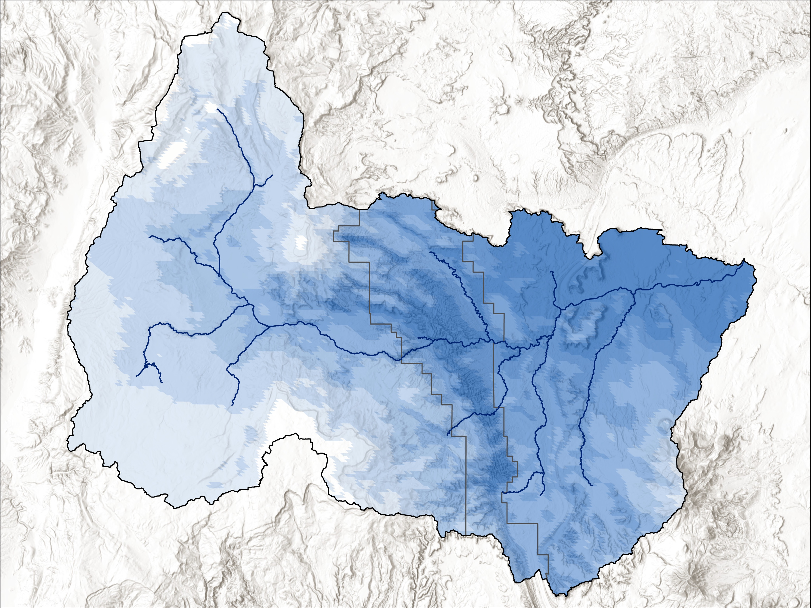
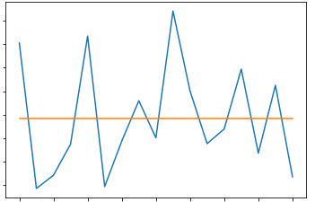
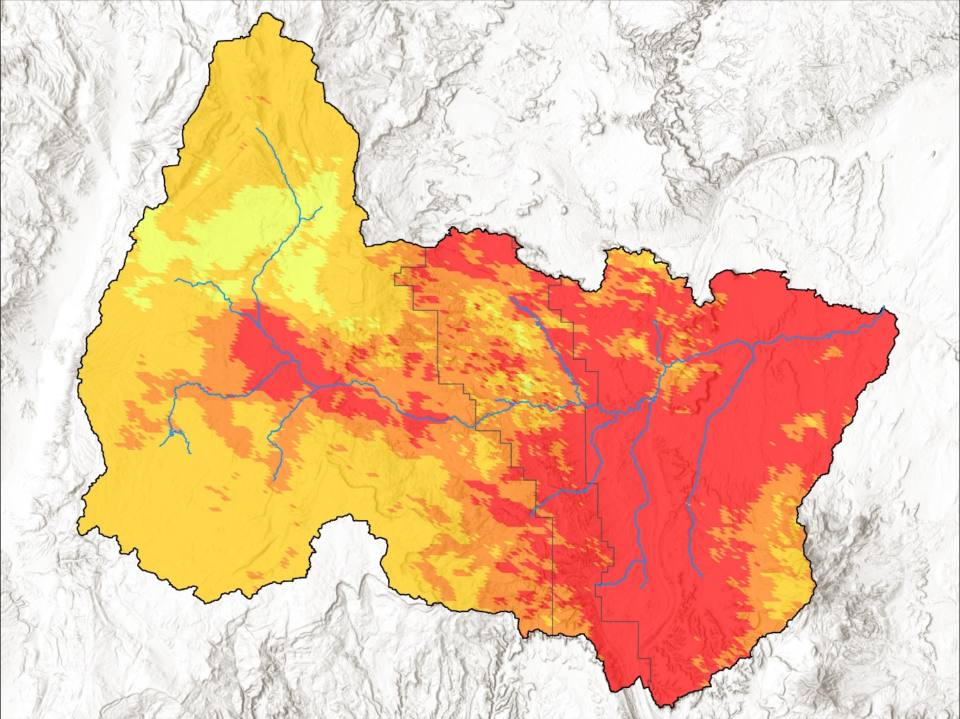
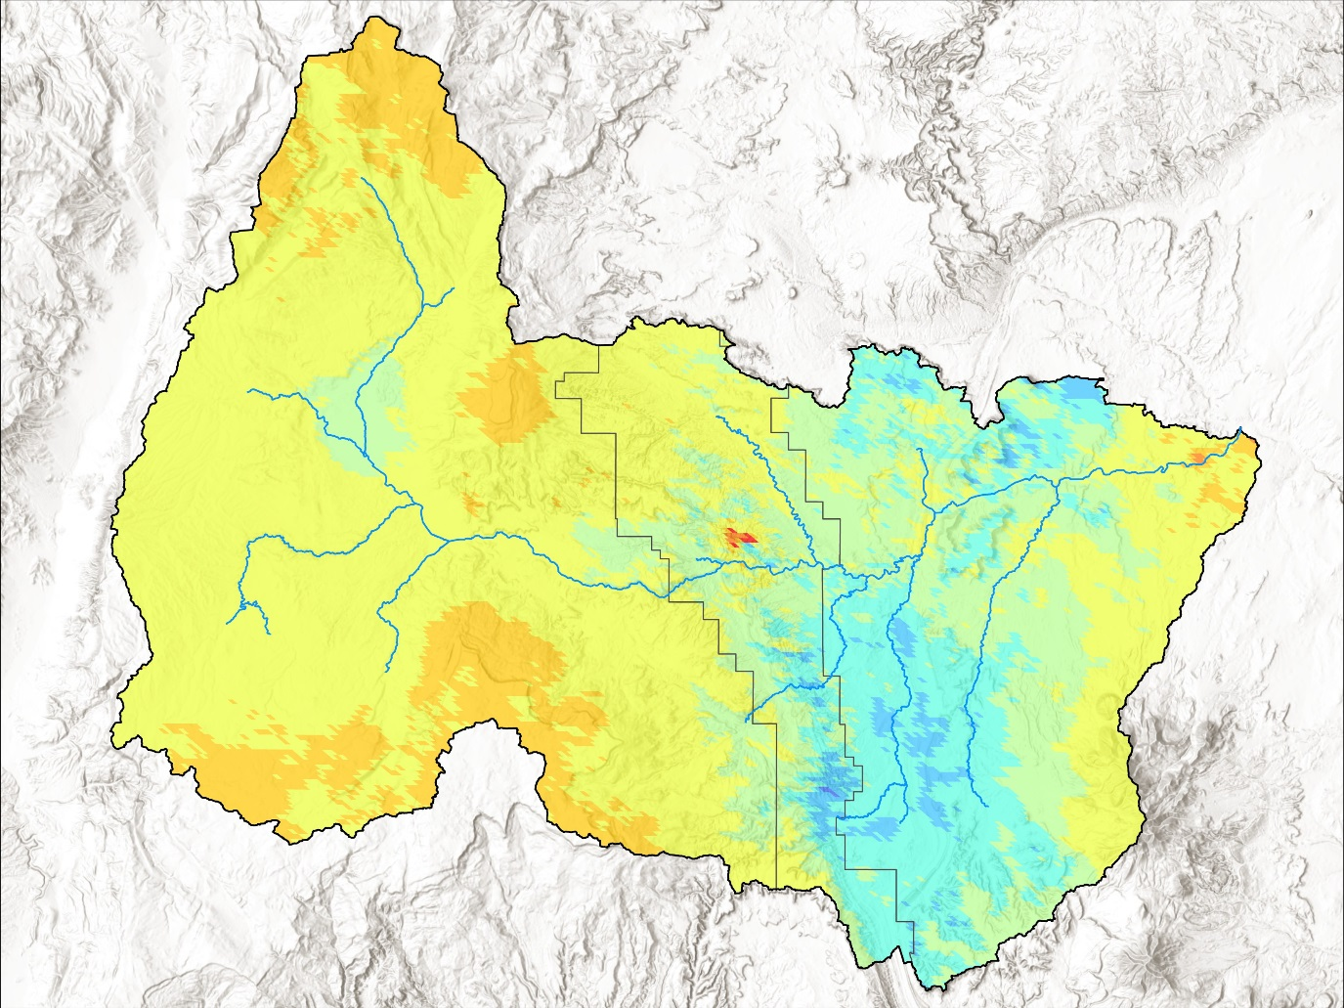
Exploratory Data Analysis
Mean Snow Cover Area (2000-2016)
Annual Snow Cover Area in 2000-2016
Snow Cover
150
Basin
River
140
CARE
130
0 - 1 %
1 – 1.5 %
120
Area(sq. miles)
1.5 – 2.5 %
110
2.5 – 4.5 %
100
4.5 – 9 %
9 – 17 %
90
17 – 34 %
80
34 – 68 %
2000
2002
2004
2006
2008
2010
2012
2014
2016
Snow Cover Area for Minimum and Maximum Years vs. Mean Snow Cover Area
Difference
0
15
30
60
Kilometers
River
Basin
CARE
-100 - -70 %
-70 – -40 %
-40 – 0 %
0 – 150 %
150 – 250 %
250 – 350 %
350 – 550 %
550 – 750 %
2001 (Minimum)
2009 (Maximum)
750 – 1,750 %
Image Credit: Fremont River Basin Water Resources II Team
Notes:
Script:
We explored daily Terra MODIS NDSI imagery to visualize how snow cover patterns have changed in the past 17 years. The mean snow cover area for that period is around 110 sq miles. From there, we took the lowest mean snow year (2001) and highest mean snow year (2009) and mapped out their snow area to that mean value. Interestingly, these maps tell us that the most change in snow cover occurs on the right half of the Fremont River Basin, though on average there is more snow area on the left half of the basin.
Image Source:
Fremont River Basin Water Resources Team

Slide 16
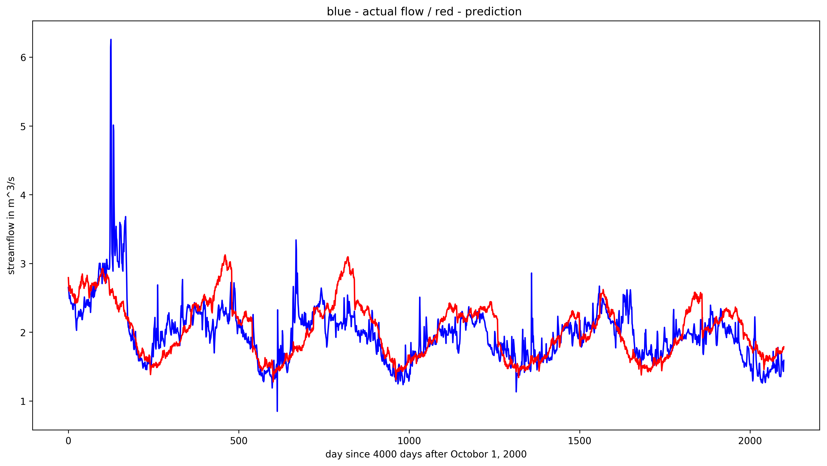
Model Results
Actual vs. Predicted Streamflow by SNOW-M
6
Actual
5
Predicted
4
Streamflow (m³/s)
3
2
1
100
150
200
250
300
350
50
2016-2017 Water Year
Actual vs. Predicted Streamflow by SPAM
6
Actual
5
Predicted
4
Streamflow (m³/s)
3
2
1
0
500
1000
1500
2000
Day since September 14, 2011
Notes:
Script:
Comparing performance for both models in predicting streamflow, our takeaway was that overall SPAM predicts more accurately than SNOW-M does. The SNOW-M model does a remarkable job modeling from precipitation data but had issues incorporating snow data. After unsmoothing, the predictions were particularly unstable.

Slide 17
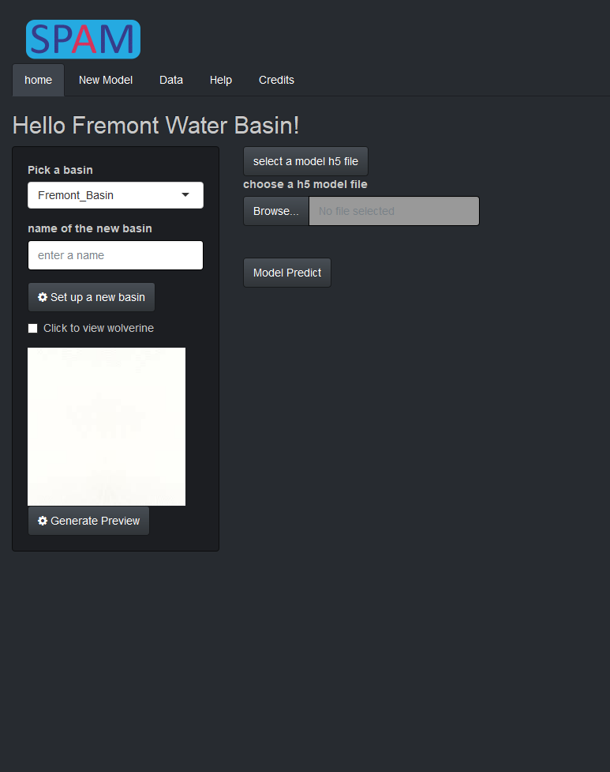
SPAM Tool
Image Credit: Fremont River Basin Water Resources II Team
Notes:
Script:
From there, we developed and fined tuned the LSTM model and turned it into a GUI tool. The tool was written using RShiny. The idea is to give users the option to interact with this GUI instead of the code directly as it’s more user friendly.
Image Source:
Fremont River Basin Water Resources Team

Slide 18
Conclusion
In situ and remotely sensed Terra MODIS data are effective inputs for training machine learning algorithms to forecast streamflow
SPAM exhibited higher accuracy (Mean Absolute Error, Root Mean Squared Error) in modeling streamflow over SNOW-M
The Streamflow variable was most correlated with Precipitation and Snow Cover Area
Mean Snow Cover Area data greatly fluctuated year to year from 2000 to 2017, with 203.15 sq. km in 2001 (min. year) and 399.44 sq. km in 2009 (max. year)
Image Credit: Terry Fisk, National Park Service
Notes:
Script:
In conclusion, our project was successful as we were able to effectively use input data from MODIS to form good streamflow predictions. SPAM displayed both higher MAE and RMSE values than SNOW-M indicating greater statistical accuracy. Our GUI tool gives users the ability to easily interact with the code and extract the data they need without necessarily having to understand the code and how the model works. In addition, our exploratory data analysis showed that streamflow is most closely tied to trends in precipitation and snow cover area more so than land surface temperature and other variables. Another product of our data analysis revealed that mean snow cover greatly fluctuates year by year, ultimately suggesting that there is not a clear decrease trend in snow cover area in recent years.
Image Source:
Terry Fisk, National Park Service. Sent directly to the team by the project partners

Slide 19
Future Work
Obtain precipitation data with higher spatial and temporal resolutions (GPM & TRMM)
Implement cross validation procedure for models to display more meaningful validation values
Design upgrades: Implement input auto-updates, incorporate and improve Terminal, form an ensembled model, generate auto-EDA
Image Credit: Terry Fisk, National Park Service
Notes:
Script:
There are multiple ways the model can be improved to be even stronger. First, our precipitation data from PERSIANN has low temporal resolution of once per year so it is hard to make 60-day real time predictions. Secondly, currently our model validation data only outputs a graph of actual vs predicted values for only 3% of the data. We would ideally like to implement a procedure called cross validation that would be able to validate for all of our data and show a graph for 100% of the data. Last but not least, there are several design updates that can be made to the model, including implementing automatic updates for the input data so partners don’t have to manually download and re-insert data into tables each time they want a more updated model. Improving the Terminal would allow them more flexibility in interacting with the model script. An auto-generated EDA could output an analysis right away given new inputs so users can get a quick sense of what’s happening with their data, popular trends etc.
Image Source:
Terry Fisk, National Park Service. Sent directly to the team by the project partners

Slide 20
Acknowledgements
Joseph Spruce, Lead Science Advisor for NASA DEVELOP VA – Wise County
Dr. L. DeWayne Cecil, Chief Climatologist at NOAA National Centers for Environmental Information and Program Manager of Global Science & Technology, Inc.
Bob VanGundy, Geology Instructor at The University of Virginia’s College at Wise
Dr. Kenton Ross, Lead Science Advisor for NASA DEVELOP National Program
Brooke Colley, Center Lead at NASA DEVELOP Wise County Clerk of Circuit Court’s Office
Michael Brooke, Assistant Center Lead at NASA DEVELOP Wise County Clerk of Circuit Court’s Office
Rebecca Weissinger, National Park Service, Northern Colorado Plateau Network Ecologist
Terry Fisk, Chief of Resource Management and Science at Capitol Reef National Park
Notes:
Script:
The Fremont River Basin Water Resources team would like to thank their team of support, including science advisors, our node leadership at the Wise County Clerk of Circuit Court’s Office, and our partners.

Slide 21
Thank You
Jessica Li
Project Lead
Zhuoyan He
Chenyu Shi
Notes:
Script:
Thank you for taking the time to listen to our presentation. We can take any questions that you may have at this time.

