Slide 1
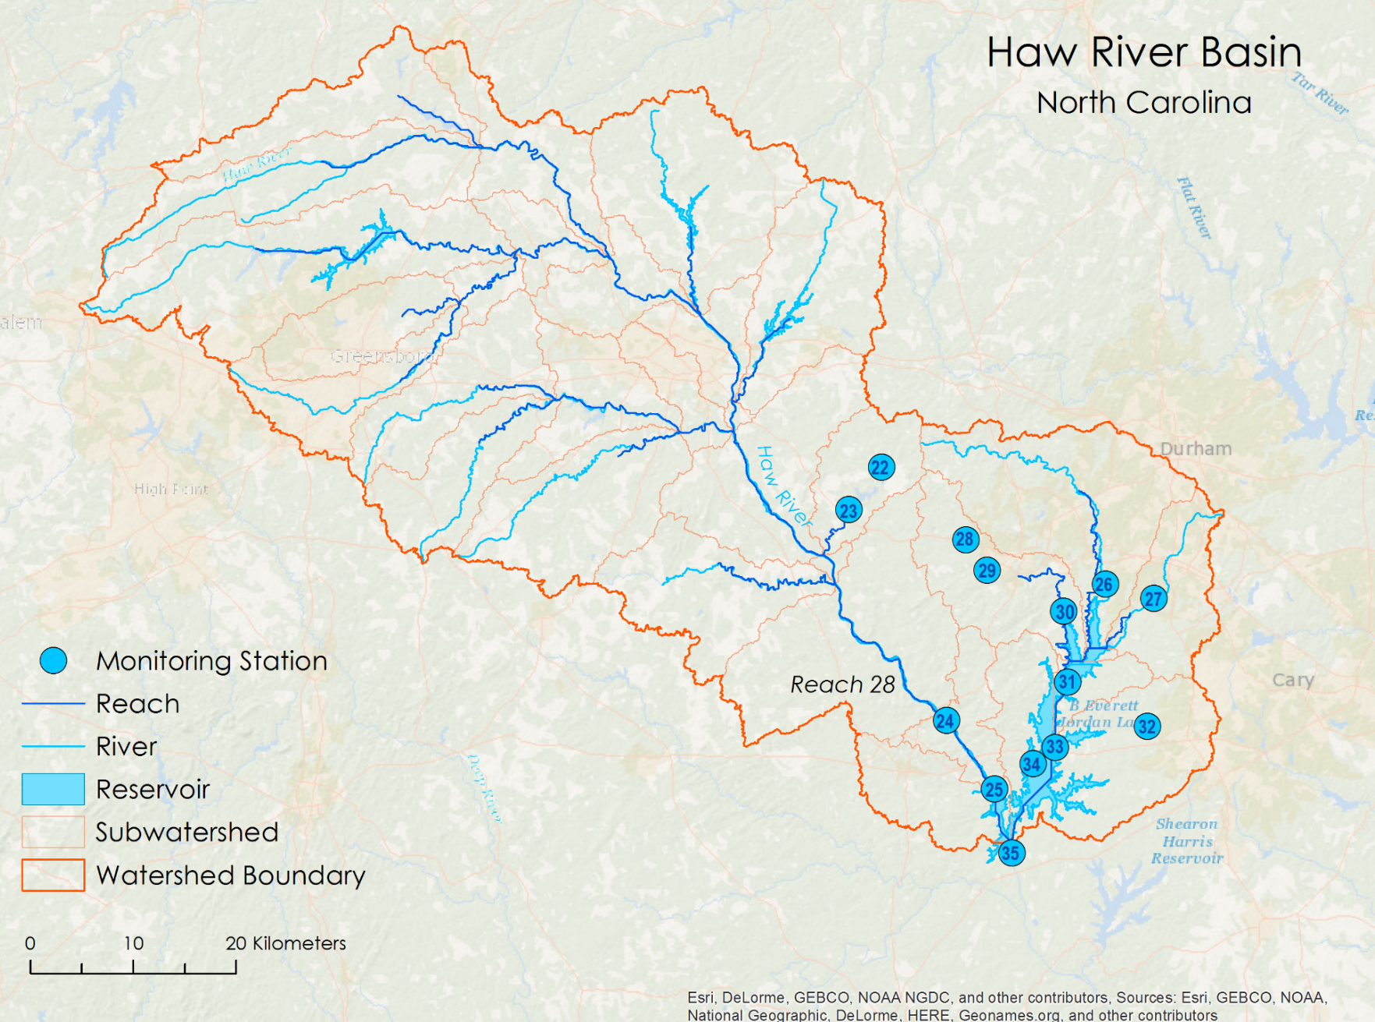
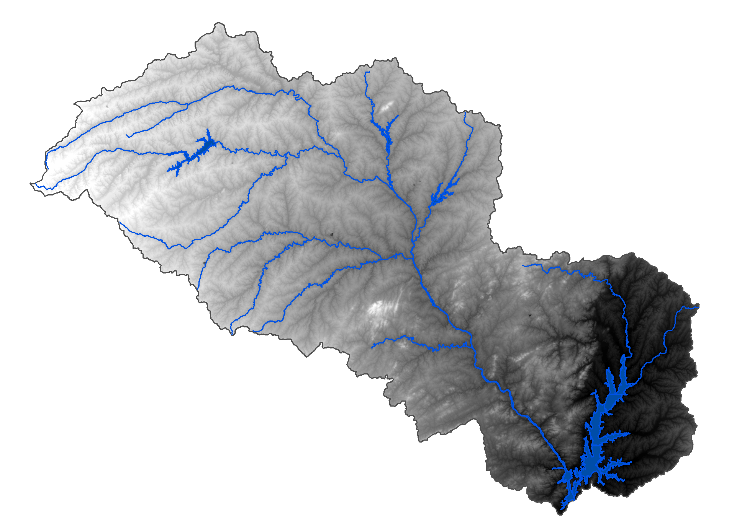
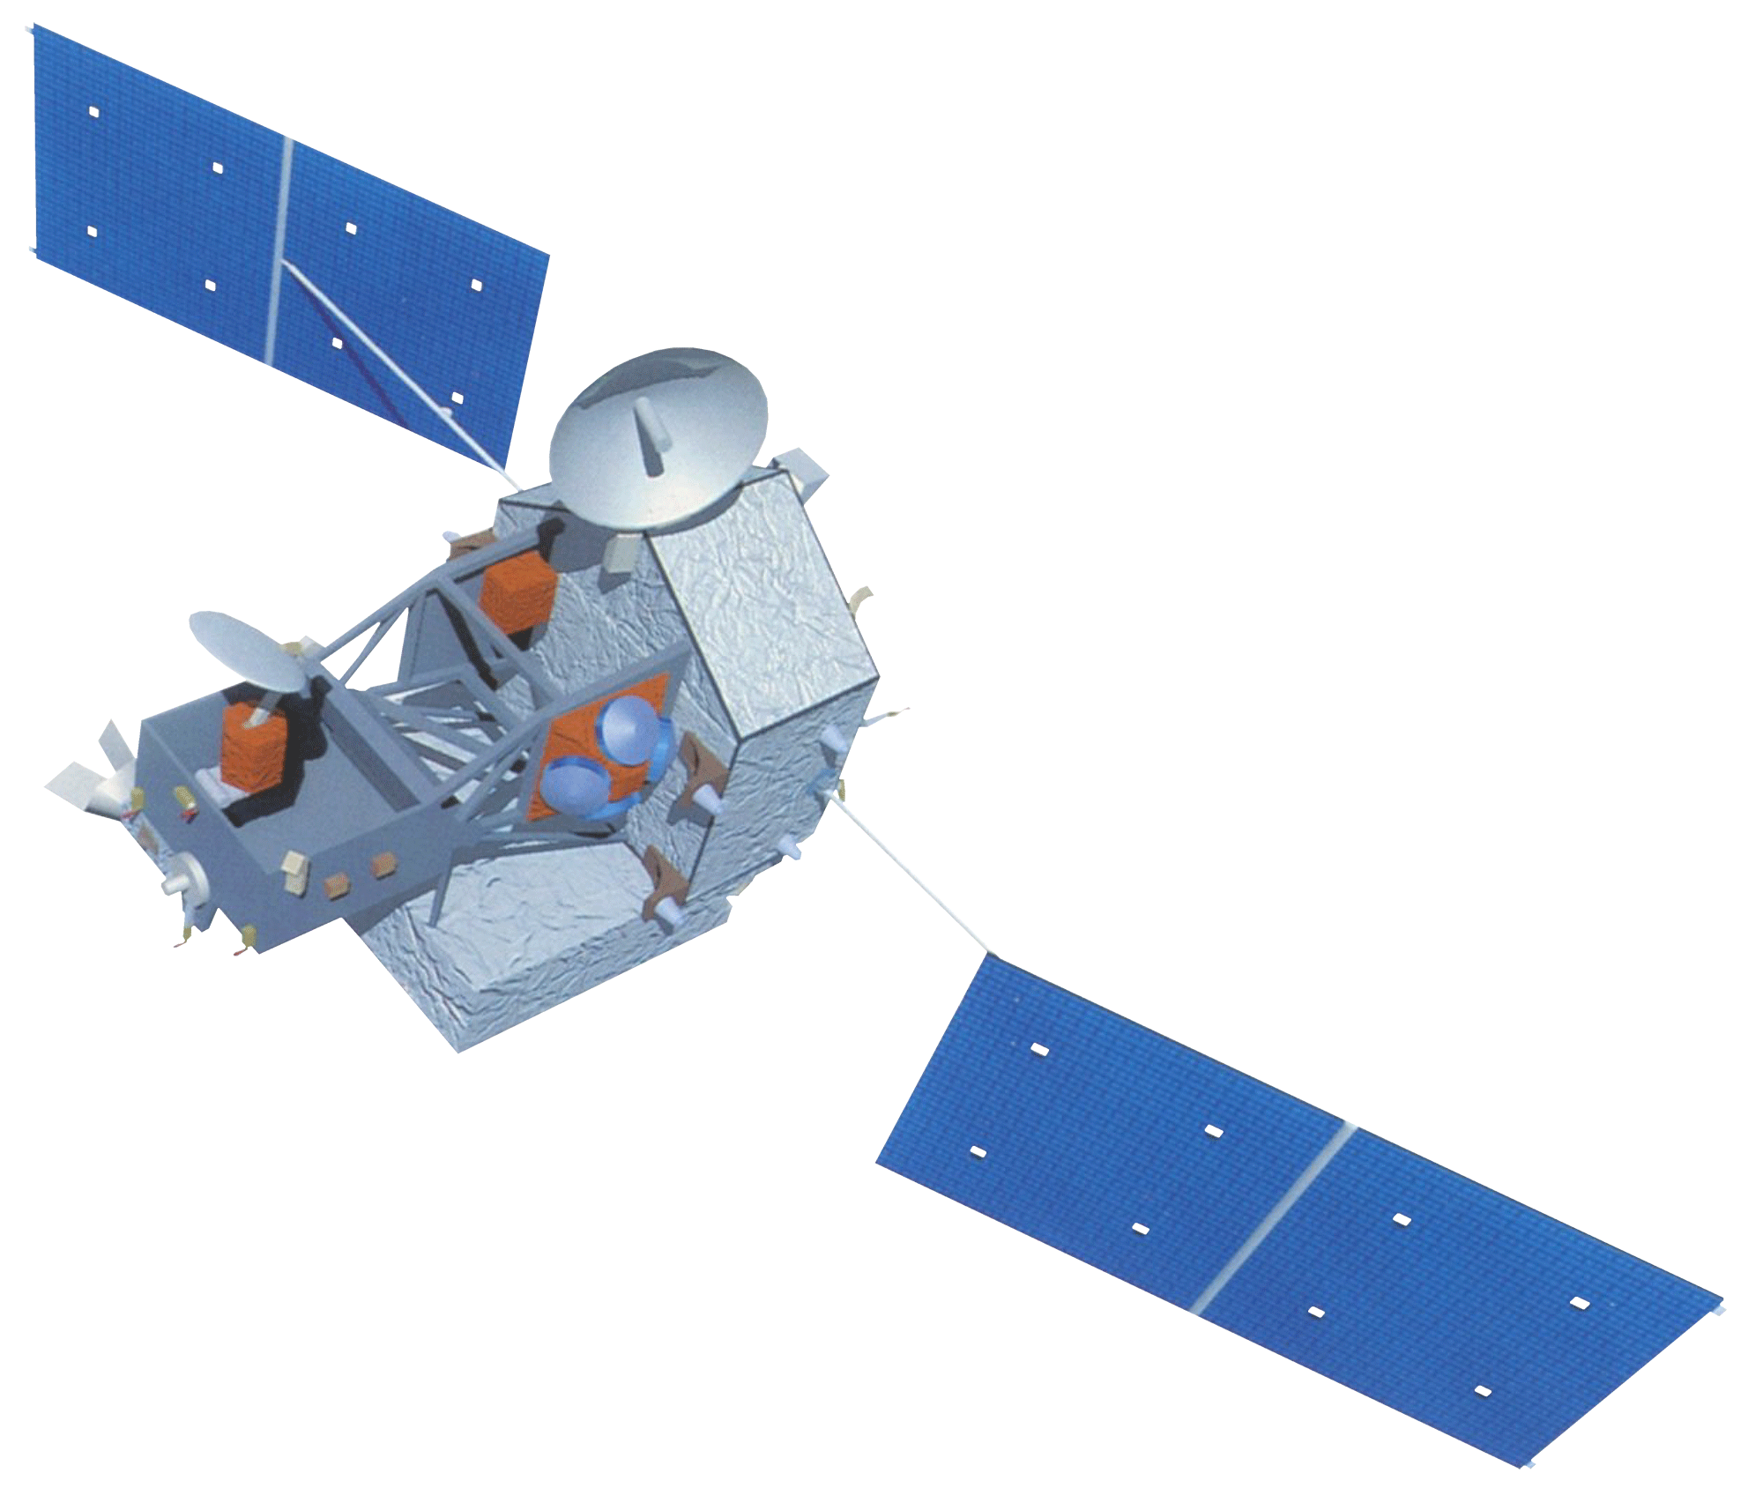
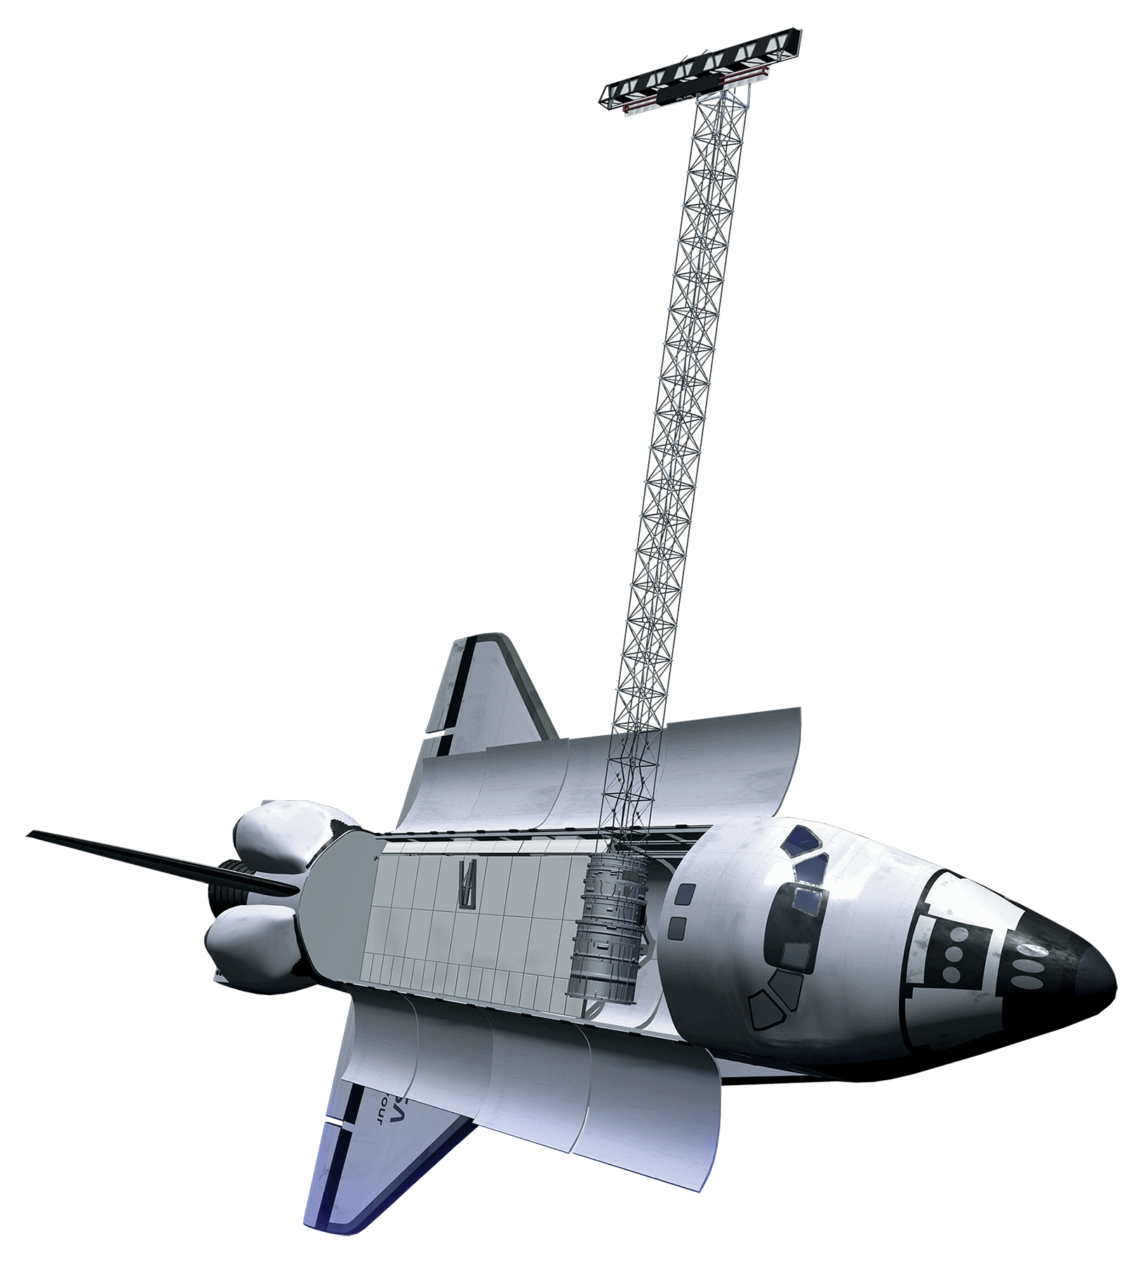
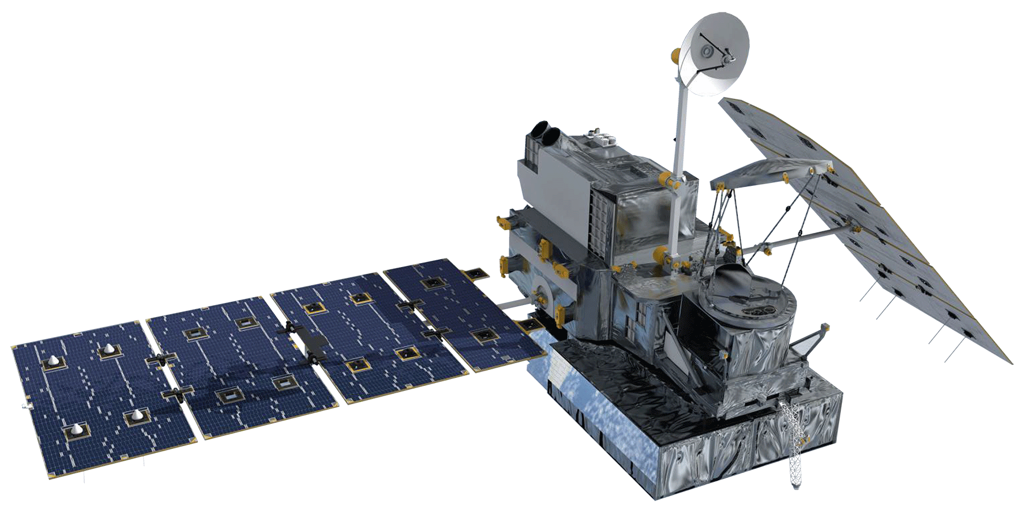






Utilizing NASA Earth Observations and Hydrological Modeling to Monitor Nutrient Levels in Jordan Lake, North Carolina for Improved Water Quality Management
Abstract
Objectives
B. Everett Jordan Lake reservoir, located in Chatham County, North Carolina, provides drinking water for approximately 250,000 people in the state. Since 1974, the same year construction of the reservoir was completed, excessive nutrient levels from wastewater treatment plants and agricultural runoff has led to eutrophic and hyper-eutrophic conditions in the reservoir. As a result, the lake was determined to have Nutrient-Sensitive Waters (NSW) and declared “impaired” by the North Carolina Environmental Management Commission. The Jordan Lake Nutrient Management Strategy was established to improve water quality. Monitoring of water quality is performed by the United States Geologic Survey (USGS) at six sampling sites on a bi-monthly basis in order to guide management and policy decisions. However, more frequent data collection would allow regulators to better understand how nutrient levels and management policies affect the lake. A GIS-based tool was developed to monitor nitrogen and phosphorus levels in Jordan Lake using Earth observations, ancillary data sources, and in situ data. The Soil & Water Assessment Tool (SWAT) was calibrated and validated for Jordan Lake using ArcSWAT. The results obtained from this study are the first to utilize Earth observations when modeling water quality using SWAT in the study area, and provide near-real time monitoring of nutrient levels, both spatially and temporally, for improved water management.
CALIBRATE SWAT model using Earth observations to generate simulated flow, nitrogen, and phosphorus values for Jordan Lake
VALIDATE SWAT model output
PROVIDE DECISION SUPPORT to end-user for water quality management by providing nitrogen and phosphorus data
Study Area
Methodology
Data Acquisition & Preparation
Calibration
Validation
GPM (Global Precipitation Measurement)
Run SWAT Model
Calibrated SWAT Model
TRMM (Tropical Rainfall Measuring Mission)
Simulated
N and P Values
Validate Model with different time period
Earth Observations
Ancillary Datasets
Compare with In situ N and P values
Simulated N and P Data
North Carolina Water Resources
TRMM
Format Data for SWAT Input
Adjust Parameters
(Manual Calibration)
End-User Decision Support
GPM
SRTM
Results
Conclusions
In situ flow data for Station 24 was compared with SWAT monthly flow estimates for Reach 28.
SWAT flow estimates using NASA Earth observation data show less variability with in situ data ( R² = 0.657) compared to SWAT flow estimates using simulated data (R² = 0.0895).
Using NASA Earth observation data instead of simulated weather data significantly increased the accuracy of the SWAT model.
Future work will include comparison of nitrogen and phosphorus estimates with in situ data, calibration of model, and validation using a second time period.
Team Members
Acknowledgements
Dr. Amita Mehta, NASA GSFC-UMBC (Science Advisor)
Dr. Prasad Daggupati, University of Guelph
This material is based upon work supported by NASA through contract NNL11AA00B and cooperative agreement NNX14AB60A. Any mention of a commercial product, service, or activity in this material does not constitute NASA endorsement. Any opinions, findings, and conclusions or recommendations expressed in this material are those of the author(s) and do not necessarily reflect the views of the National Aeronautics and Space Administration and partner organizations.
Tammy Ashraf
Team Lead
Elisa Ahern
Jessica Fayne
Project Partners
John Fitz
Sara Lubkin
Sean McCartney
Dr. Josh Weiss, Water Resources Engineer, Hazen and Sawyer, P.C.
NASA Goddard Space Flight Center – Fall 2016

