Slide 1
The Levant and Central American Climate I
Monitoring Precipitation and Drought to Enhance U.S. Air Force Predictions and Decision-Making in the Levant and Central America
Alec Courtright (Project Lead)
Hayley Hajic
Christie Stevens
Notes:
- Introduce team members and project title.

Slide 2
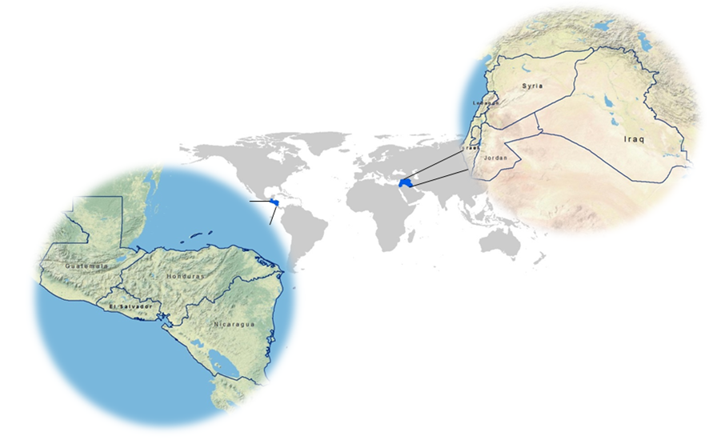
Study Area
Image Credit: Christie Stevens and Hayley Hajic
The Levant: Syria, Lebanon, Israel, Jordan and Iraq
Central America: Guatemala, Honduras, El Salvador and Nicaragua
Study period:
June 1981- December 2015
Notes:
- The study area consists of two regions and nine countries. The Levant covers Syria, Lebanon, Israel, Jordan and Iraq and, for the purposes of our study, Central America is comprised of Guatemala, Honduras, El Salvador and Nicaragua.
- The Levant: has held the position of one of the most arid regions in the world for centuries.
- Central America: these countries comprise the “Dry Corridor” of Central America and experience a variety of climatic extremes.
- The two regions have drastically different geographic characteristics, yet both areas are prone to similar climatic changes that can significantly impact the stability of countries within each region.

Slide 3
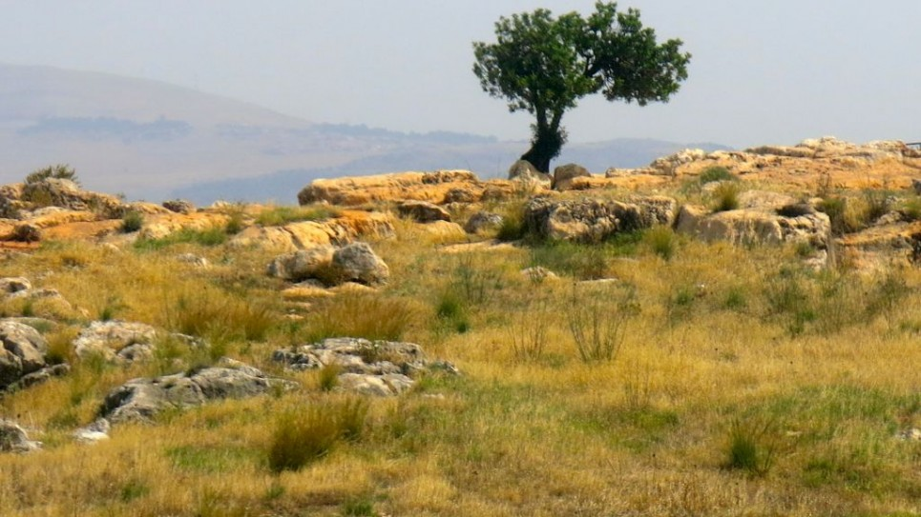
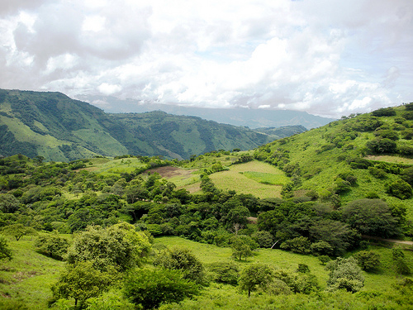
Israel
Image credit: Qanta Ahmed
Nicaragua
Image Credit: Bioclimate.org
The Levant
Climate: hot, arid, dry, desert
Agriculture: cotton, wheat, barely, sheep, olives
Central America
Climate: tropical, humid
Agriculture: coffee, bananas, sugar, cotton, livestock
Notes:
In the Levant temperature and rainfall vary across the region depending on proximity to the sea. In general, summers are hot with high temperatures and winter and spring months bring limited rain. The growing season for this region is September to December. The major staple crops are wheat and barley.
Central America lies within the tropics but for such a small strip of land it has diverse local climates.
Discuss the climate of each study area and what they grow etc.
What is their main water resource?
Israel image: http://www.timesofisrael.com/this-is-the-land/
Central America image: http://www.brdt.org/nicaragua

Slide 4
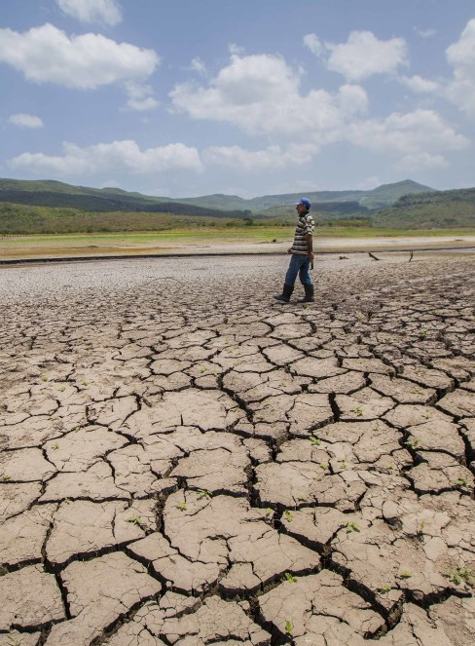
Nicaragua Drought 2014
Dry Las Canoas Reservoir
Image Credit: Diana Ulloa
Community Concerns
Heavy Precipitation
  Flooding, water contamination, landslides
Drought
  Depletion of water resources
  Crop failure and livestock die off
Water Stress
  Agricultural stress, strain on resources, catalyst to conflict
Notes:
Image source: http://www.ticotimes.net/wp-content/uploads/2014/08/140807NicaraguaDrought01-1000x666.jpg
Heavy Precipitation
The first area of concern regarding both regions is that of dense precipitation, which has drastic consequences in the form of extreme weather events.
Flooding, water contamination, and landslides are only a few of the environmental damages resulting from heavy precipitation.
These types of natural disasters greatly impact community life and security
Drought
Drought exacerbates water and food security
Water Stress

Slide 5
Background
Changing Climates
Both Central America and the Levant are vulnerable to drought and changing precipitation patterns
USAF 14th Weather Squadron
Weather and climate data is used to aid in military decision-making
Water stress in both Central America and the Levant Region can catalyze conflict – as seen in Syria in 2011
Conflict
Notes:
-Both of our study regions, the Levant and Central America, are vulnerable to climate changes in precipitation patterns and drought events. In Central America there exists a “Dry Corridor” that is plagued by droughts and the Levant region continually struggles with changing rain patterns.
-Our partners, the United States Air Force’s 14th Weather Squadron is interested in the drought conditions and precipitation patterns of these regions for increased response for military decision making and crisis aid.
-Water and agricultural stress can catalyze conflicts. Water management wars have occurred in Central America and the Syrian conflict in 2011 are good examples.
-Monitoring regions that are vulnerable to water resource stress can prepare the USAF to help and prepare for areas susceptible to conflict.

Slide 6
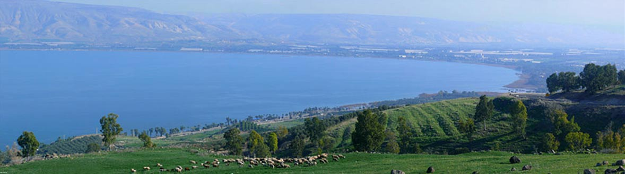
Objectives
1
Analyze Normalized Difference Vegetation Index (NDVI) data and create climatologies from 1981-2015 of both Central America and the Levant region to enhance the 14th Weather Squadron’s decision-making capabilities.
2
3
Document normal and anomalous conditions to assess trends in extreme-weather events
Evaluate and compare capabilities of both NOAA AVHRR and NASA MODIS NDVI in drought and heavy precipitation monitoring
Image credit: Zachi Evenor
Notes:
Image source: http://www.ancient-origins.net/news-history-archaeology/scientists-discover-earliest-known-evidence-plant-cultivation-levant-003494
Analyze NDVI
Using NOAA AVHRR NDVI data, we created difference maps comparing monthly averages over the 30-year period to overall yearly averages.
Calculations in ArcGIS were used to find percent difference and create maps with the results.
NDVI monthly averages over the 30-year period were classified into five NDVI signatures. Percentages were calculated and graphed for both regions.
NDVI yearly averages were classified into wet and dry delineations. Maps of each country were created to show these distinctions.
Document Anomalous Years
Trend maps displaying pixel by pixel _____
Evaluate NOAA and NASA NDVI
Determine the capabilities of both NOAA AVHRR and NASA MODIS to estimate which may be more beneficial and reliable for drought monitoring tools.

Slide 7
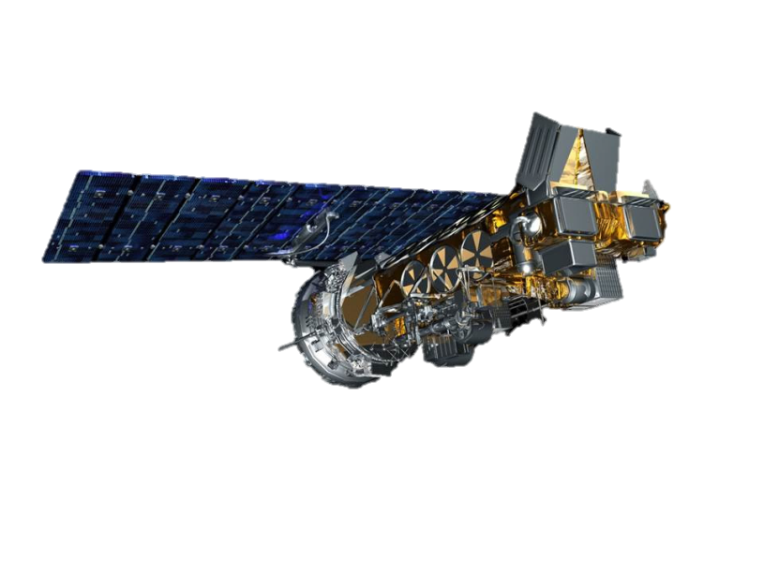

Earth Observations
AVHRR – National Oceanic and Atmospheric Administration (NOAA) – multiple NOAA satellites, NDVI.
0.05 degree resolution daily.
MODIS – National Aeronautics and Space Administration (NASA) product– Terra satellite, NDVI.
1 km resolution every 16 days.
Notes:
NOAA AVHRR has 5 detectors
An AVHRR pixel is 1 square km
Going to compare the data because they are different spatially and temporally?

Slide 8
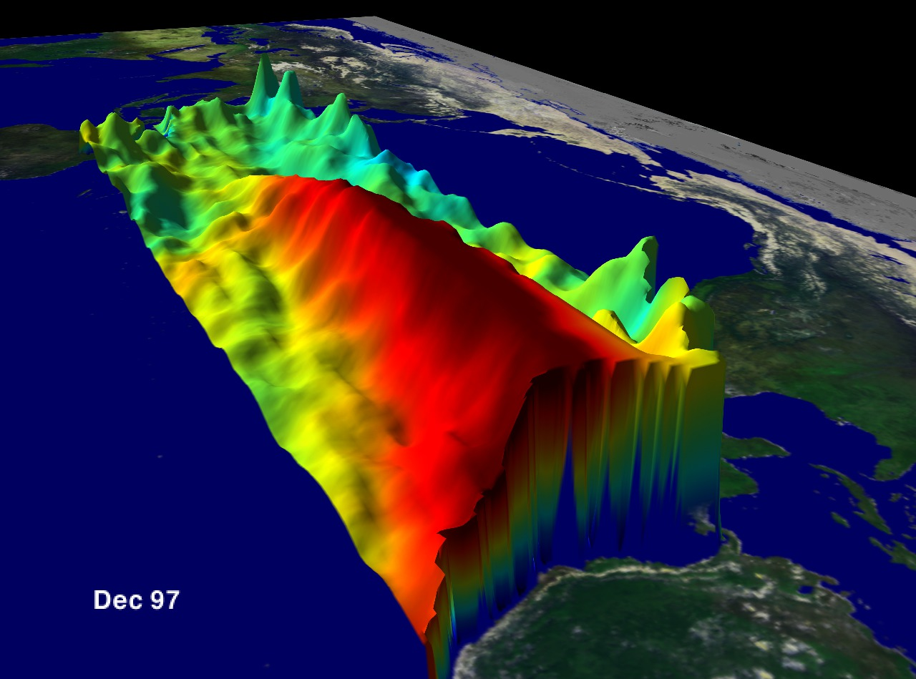
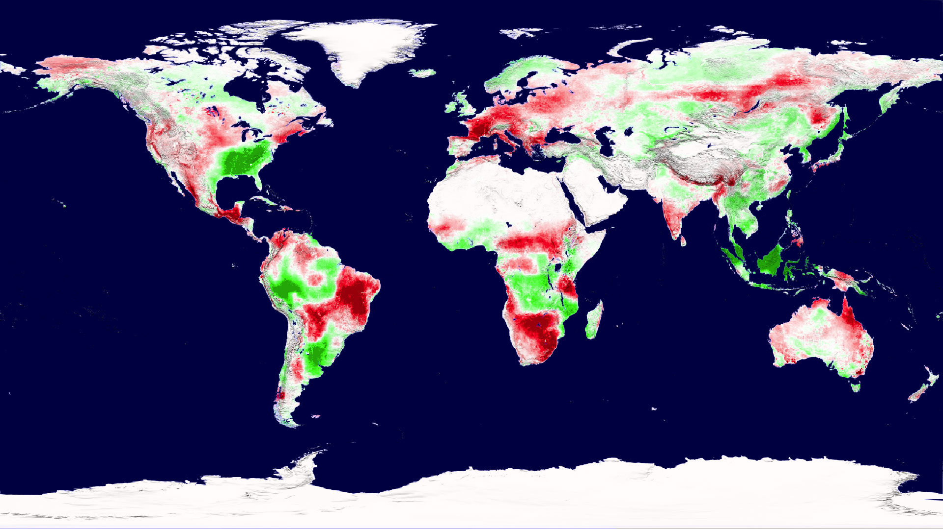

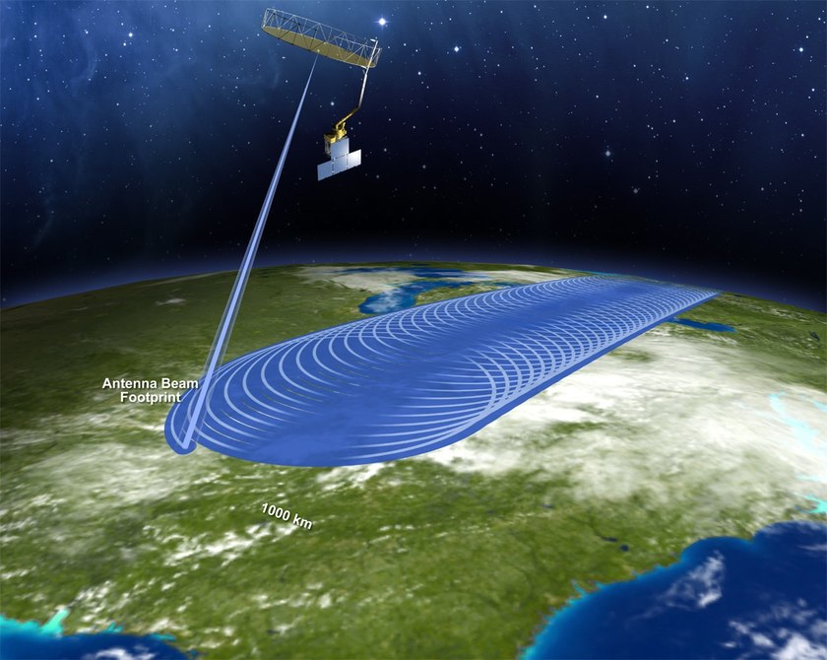
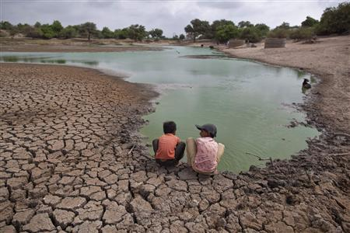
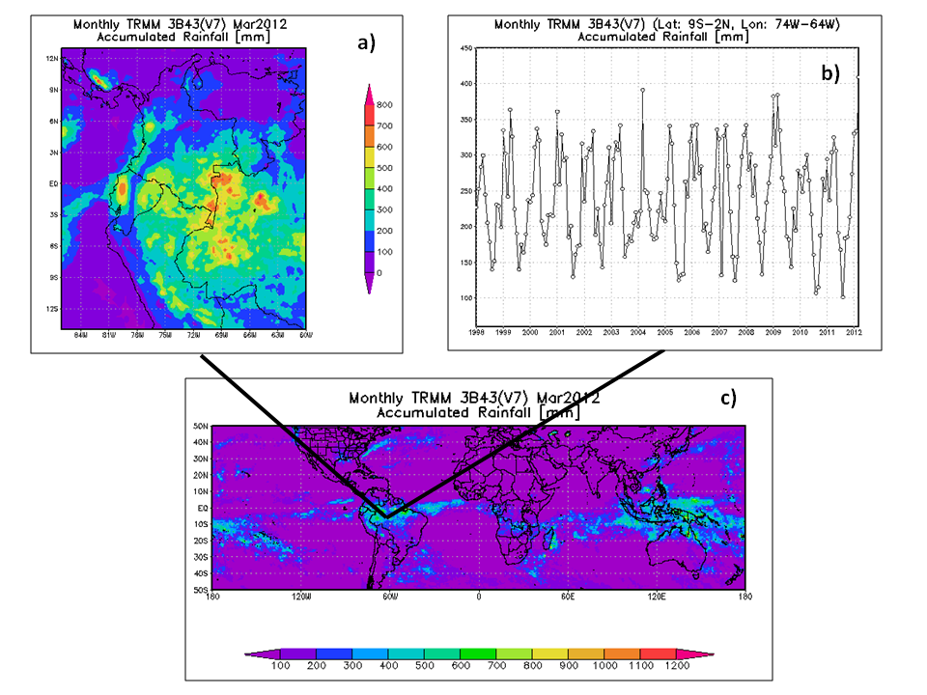

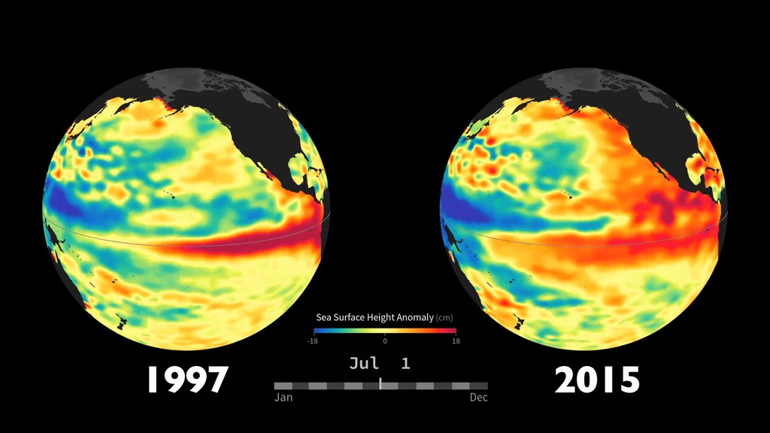
United States Air Force 14th Weather Squadron
Project Partner
Monitoring
End Users
Analysis
Prediction
Notes:
The 14th Weather Squadron is part of the 2nd Weather Group in the United States Air Force.
Mission statement: “Collect, protect and exploit authoritative climate data to optimize military and intelligence community operations and planning.”
Monitoring: Use remote sensing and in situ data for a variety of variables but focus heavily on precipitation.
Analysis:
Prediction:
End Users: Most of their data is used to help the Department of Defense to The Squadron also provides environmental and climatic information to the United States Air Force, the Army and the Intelligence Community.

Slide 9
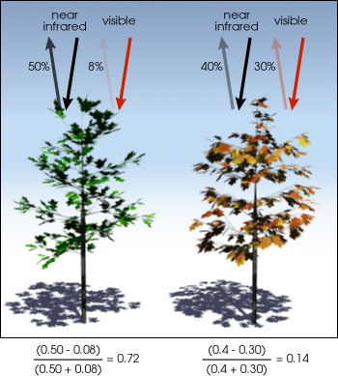
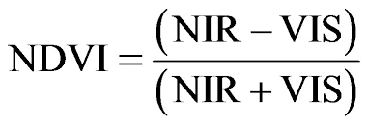
NDVI
Normalized
Difference Vegetation
Index
Notes:
The normalized difference vegetation index measures the density of green in a given area.
The different colors observed are from different wavelengths of visible and near- infrared light reflected from the plants that satellites pick up.
When sunlight strikes the leaves some wavelengths are absorbed while others are reflected. Chlorophyll in plants strongly absorbs visible light to use in photosynthesis but strongly reflects near infrared light.
If there is a large difference between near infrared wavelengths reflected and visible wavelengths reflected then vegetation is dense, green and likely a forest. Very little difference indicates sparse green coverage and may indicate more of a tundra or desert environment.
The different colors observed are from different wavelengths of visible and near- infrared light reflected from the plants that satellites pick up.
The difference formula on the slide is used to quantify the density of greenness with a range from -1 to 1 for each pixel.

Slide 10
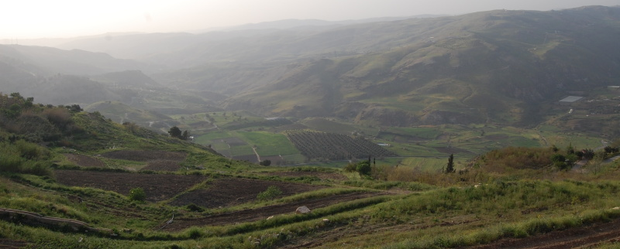
Image Credit: Paul
Methodology
Data Acquisition and Processing
Data Analysis
Results
Notes:
Image Source: http://spankyford.aminus3.com/image/2012-05-08.html
Using R downloaded and subsets MODIS and AVHRR.
Examined NDVI trends, seasonal and wet/dry, comparison of MODIS and AVHRR.

Slide 11
Data Analysis
Climatologies
Created daily and monthly baseline climatology maps averaging 1981-2015
Anomalous Months/Seasons
Identified anomalous months and seasons
Seasonality Trends
Analyzed anomalies for season and ENSO event related trends
Notes:
Data analysis conducted for this project fall in three main categories: climatologies, anomalous months or season, and seasonality trends.
This project utilized R Programming and ArcGIS to evaluate various components of NDVI data and possible current and future trends in terms of seasonality and extreme weather events such as El Niño and La Niña.
Climatologies: Each day was averaged over the 30 year period to use as a comparison with individual years.
Daily averages were aggregated to create Monthly baselines
Anomalous years (including ENSO event focus): Examined the variation in NDVI from a baseline average specifically in the strong El Nino season of 1997-1998.
Seasonality trends: Classified “wet” and “dry” areas using 0.2 as the NDVI cutoff between the two classifications.
Compared the NDVI values of the growing season and regular 4 seasons in each region.

Slide 12
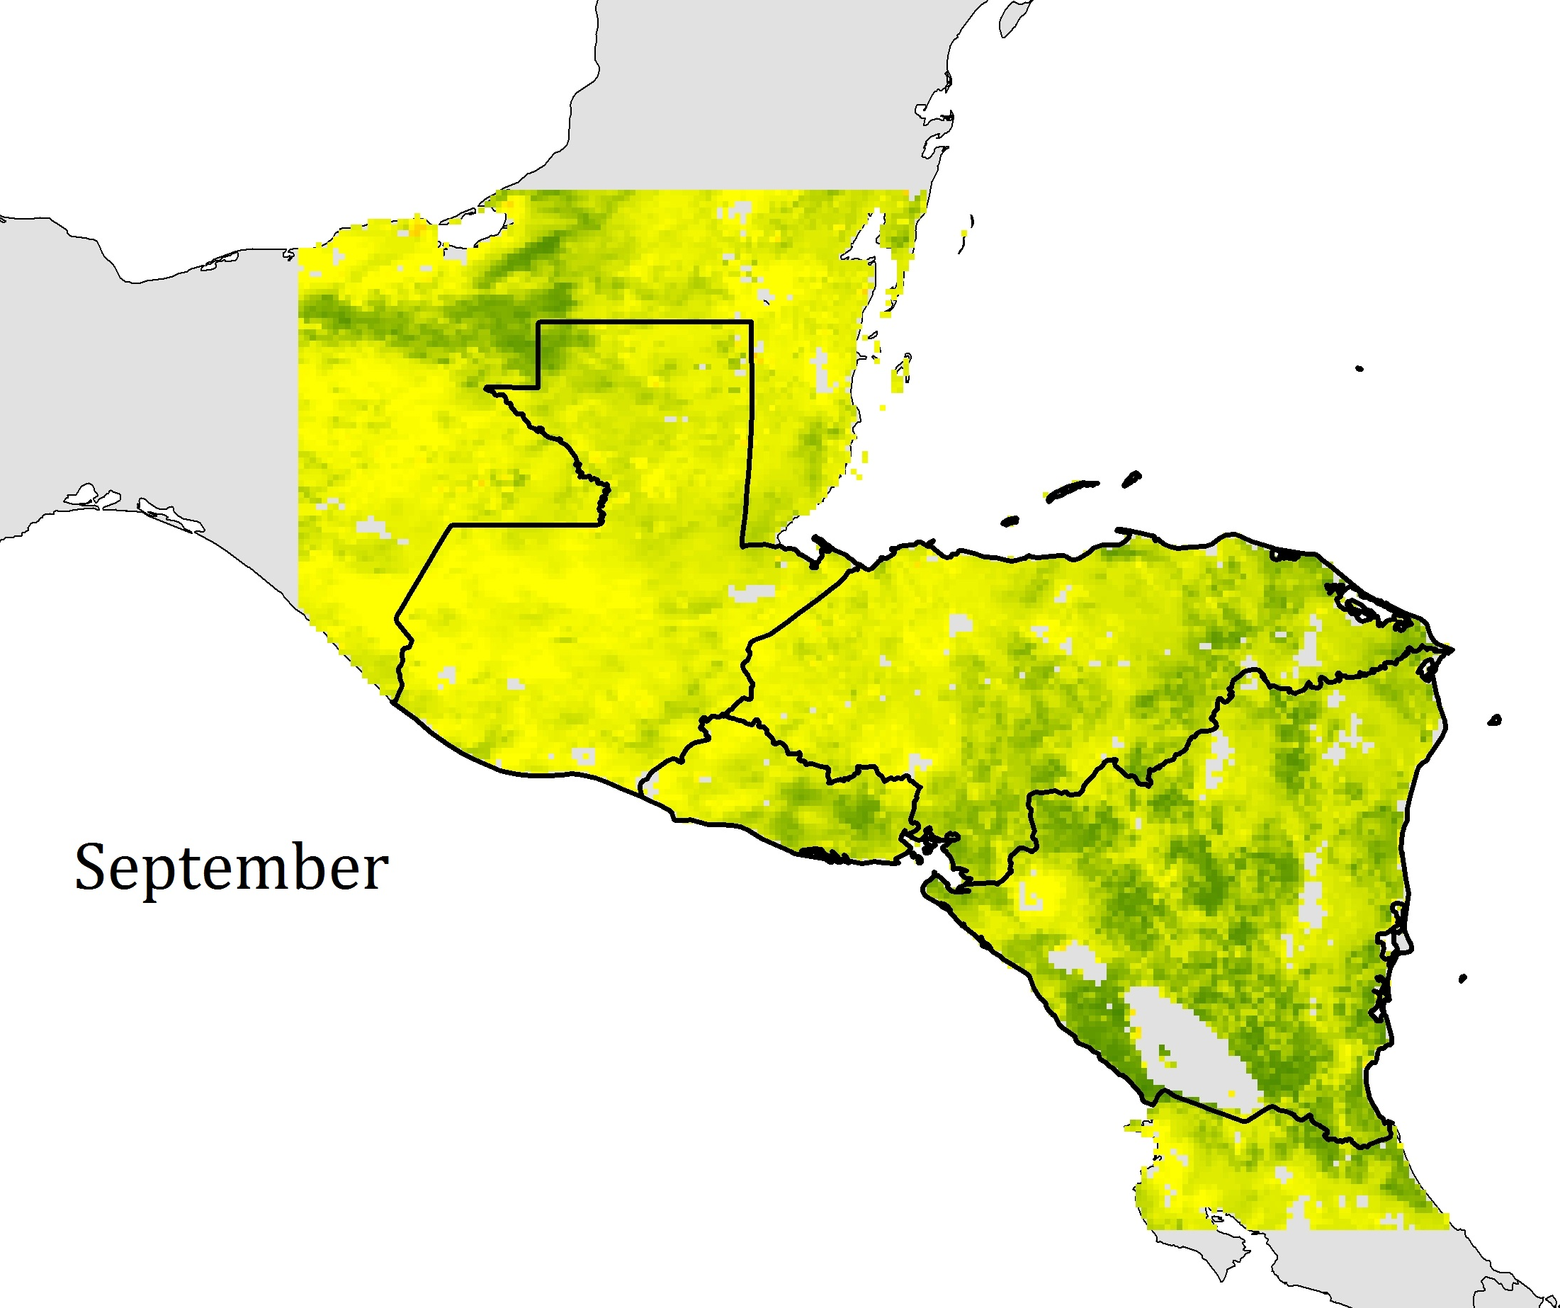
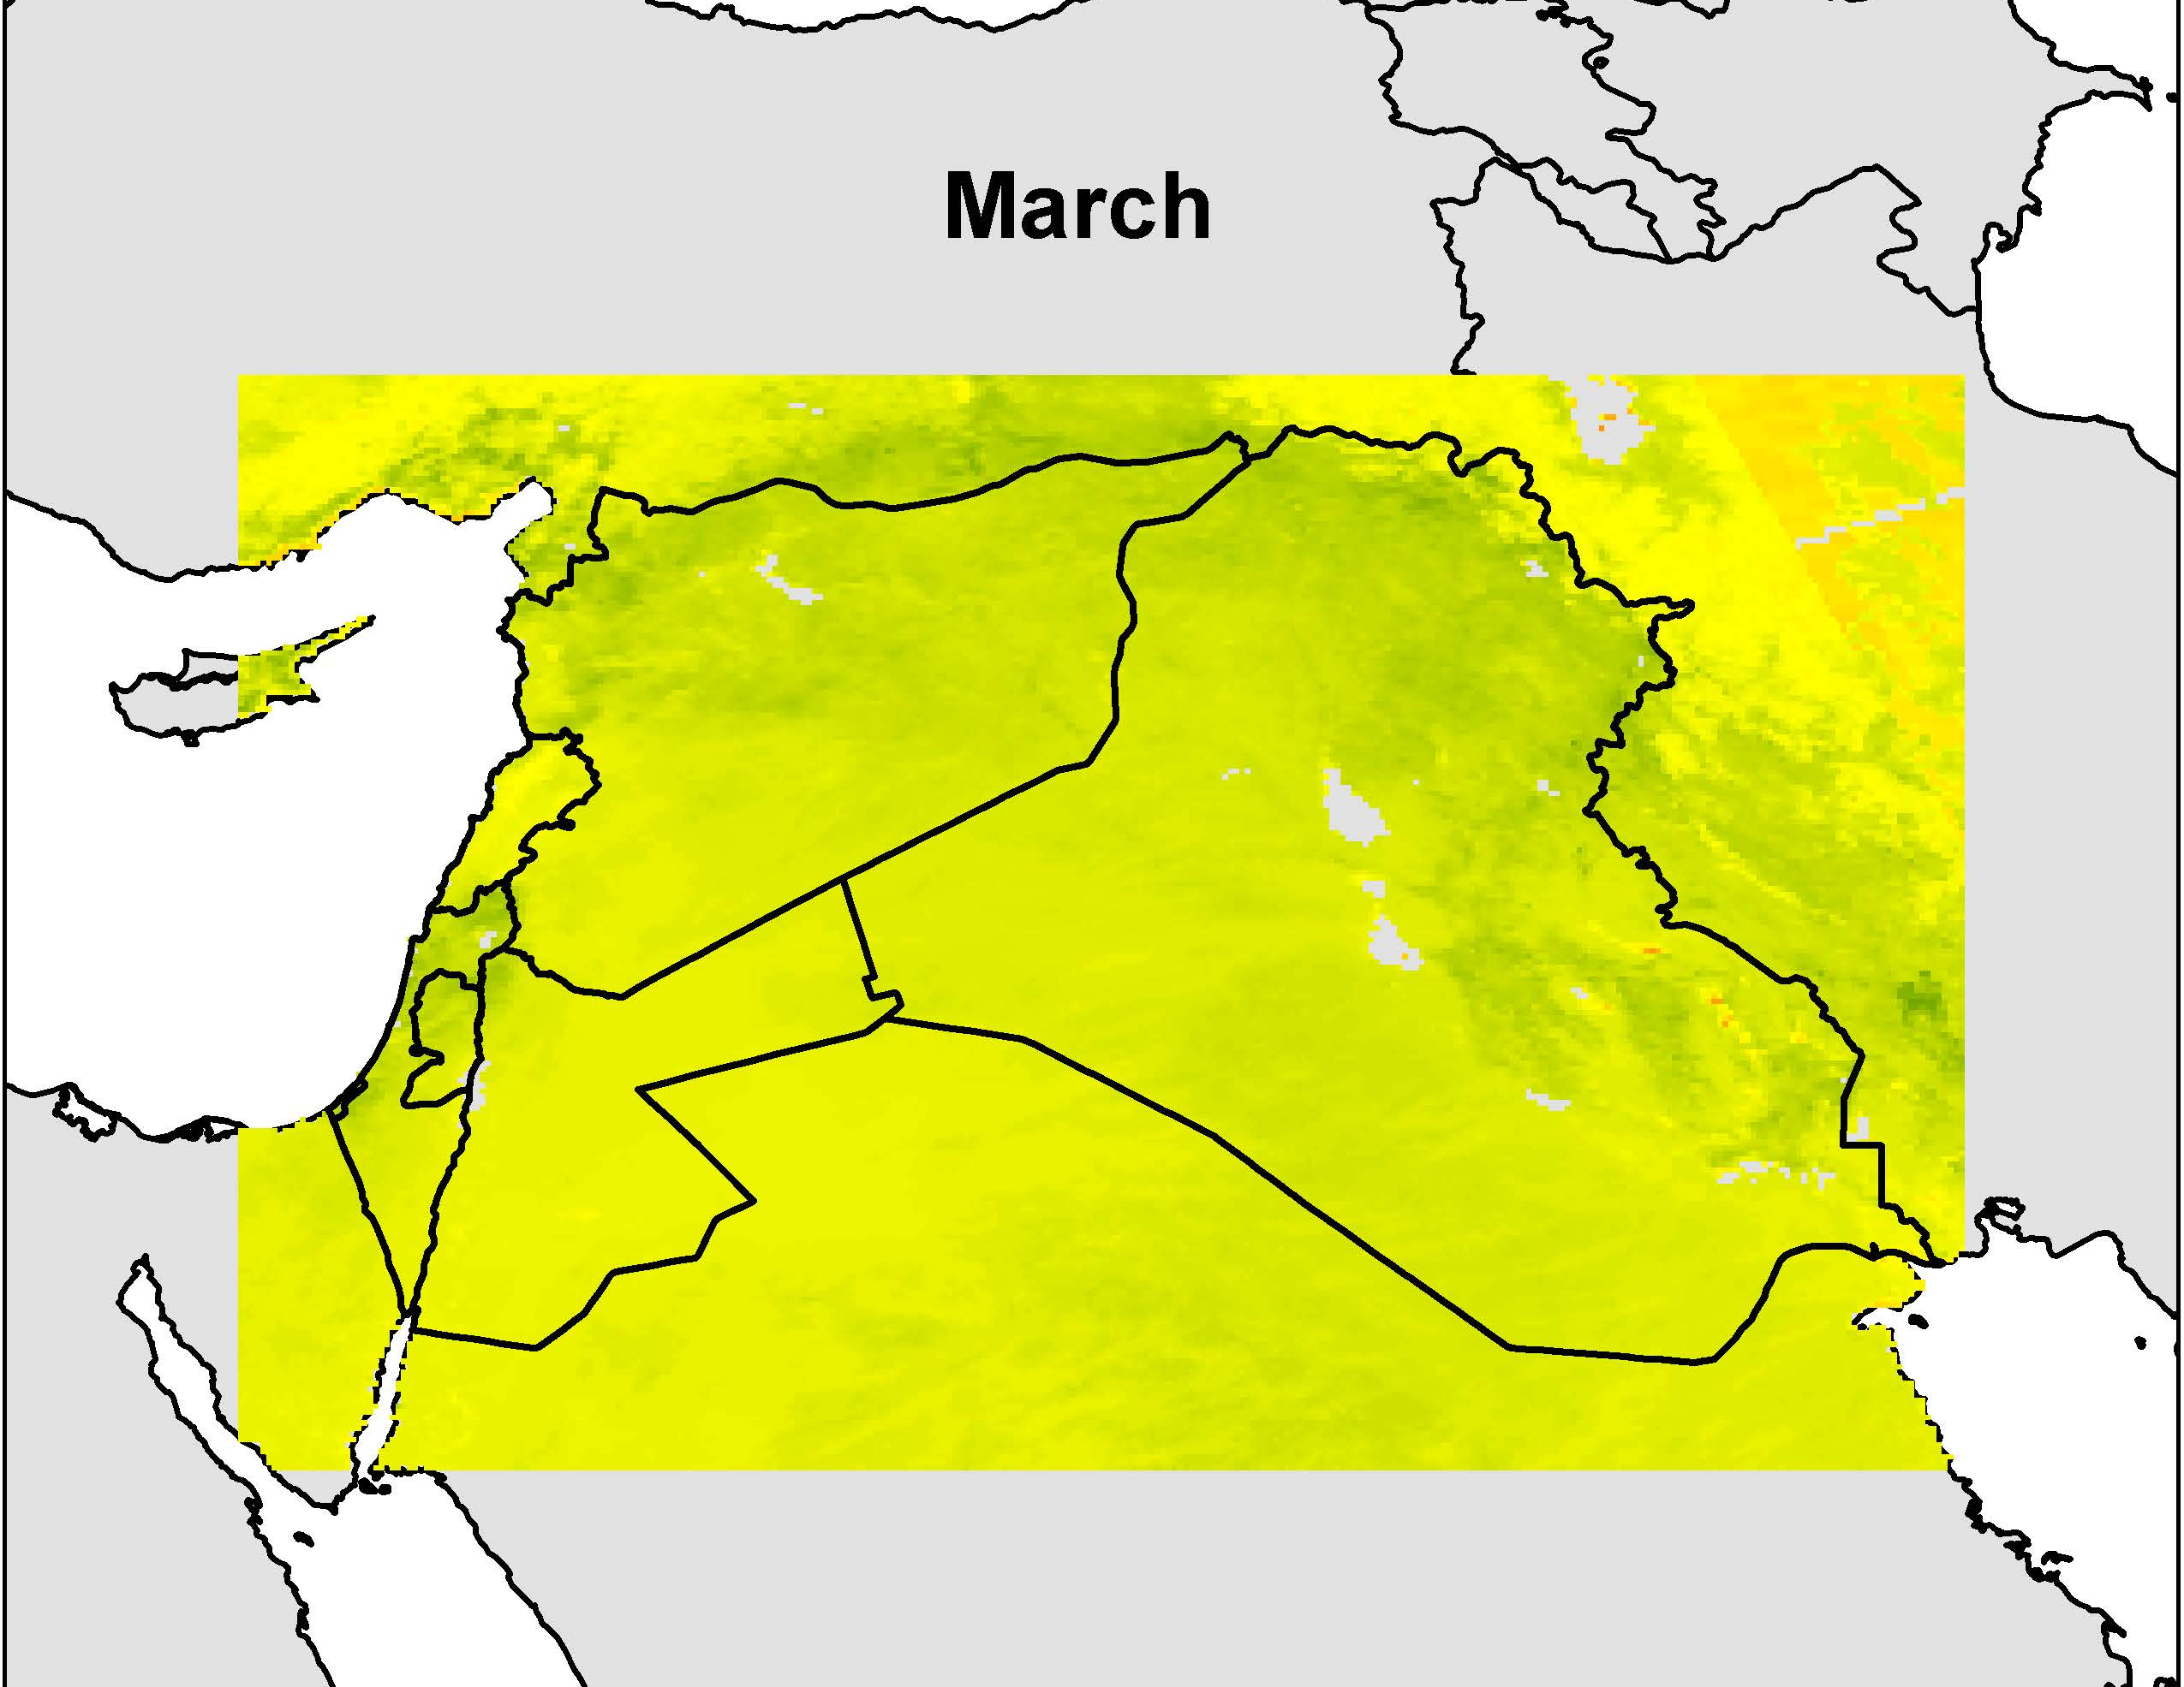
Climatologies
Every year has each month averaged
Each month averaged over the 30 years (baseline)
The difference of months in El Nino years from the baseline monthly
Central America (Placeholder)
Levant Region (Placeholder)
Image Credit: Levant Climate Team
Notes:
Each year has each one of its months averaged
The data was then divided into averages for each month over a 30 year time period.
Specific years were pinpointed that were El Nino years or anomalous years to compare the difference in these years from the baseline months over the 30 years previously created.

Slide 13
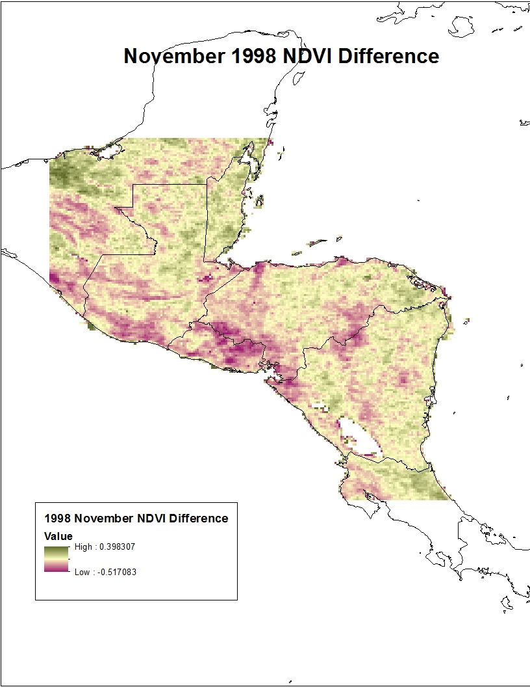
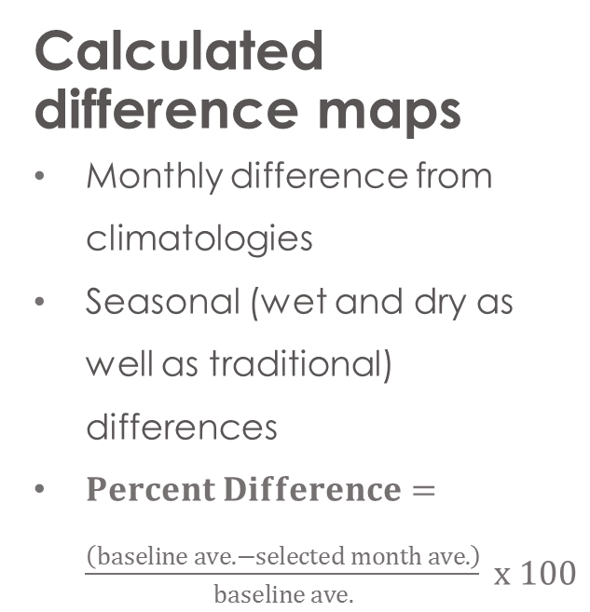
Anomalous
Months and Seasons
Calculated difference maps
Monthly difference from climatologies
Seasonal (wet and dry as well as traditional) differences
$Percent Difference=\frac{\left(baseline ave. −selected month ave.\right)}{baseline ave.} x 100$
Image Credit: Levant Climate Team
Notes:
The difference for the specific month from the baseline was calculated by taking the difference between the month and the baseline average and dividing the difference by the absolute value of the baseline average and multiplying that value by 100.

Slide 14
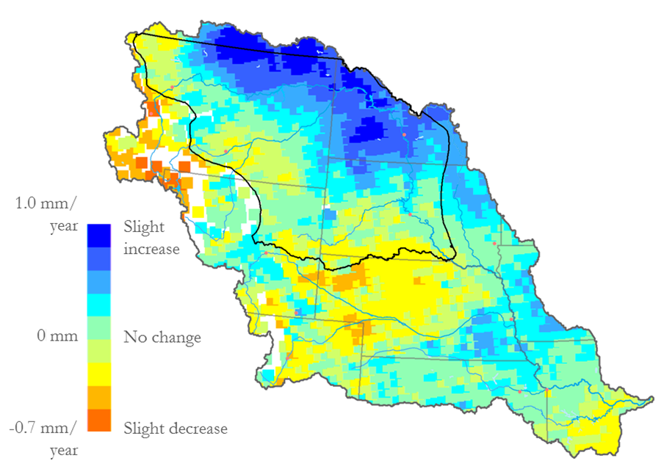
Seasonality Trends
Assess Seasonality
Examine seasonality for 90-day comparisons
Evaluate NDVI trends in wet and dry seasons
Evaluate ENSO event NDVI trends
Example Trend Map Image
Notes:
-We used the monthly averages for each year to analyze the linear regression change over our study period
-We then created maps (like the example above) and separated monthly maps into 90-day seasons as well as Rainy & Dry seasons for each study region to assess trend changes of each season over the study period
-Next we compared anomalous months to ENSO events to find common trends

Slide 15
Seasonality Trends
Classifying NDVI
Examine each region’s overall monthly averages for NDVI values
Divide NDVI values into 5 classes
Create graphs based on percent coverage for each class
Notes:
Using the average NDVI value for each month over 30 years, we converted raster data to point feature classes in ArcGIS.
From this point data the NDVI values were separated into five classes for each month based on NDVI signatures and their corresponding NDVI value ranges.
The NDVI signatures are classified as follows:
Class 1 (NDVI values -1 to 0.1): Barren rock, sand, snow
Class 2 (NDVI values 0.1 to 0.2): Soil
Class 3 (NDVI values 0.2 to 0.3): Shrub and grassland
Class 4 (NDVI values 0.3 to 0.6): Dense vegetative canopy
Class 5 (NDVI values 0.6 to 0.8): Temperate or tropical rainforests
From the separated classes, percentages were calculated based on the number of points in each class and the whole region.
Graphs displaying months, classifications, and percentages were created for the Levant and Central America.

Slide 16
(Placeholder image)
Notes:
- This is an example map of classifications for Central America.

Slide 17
(Placeholder image)
Notes:
- This is an example map of classifications for the Levant.

Slide 18
Seasonality Trends
Alternative Classifications
Utilize percent coverage NDVI classifications to categorize data by wet and dry characteristics
Calculate percentages using overall monthly and overall yearly data by region and by country
Create graphs and maps to display new categorizations
Notes:
Utilizing percentages of NDVI coverage of 5 classes, further classification was used to assess overall aridity and healthy vegetative activity.
NDVI values ranging from -1 to 0.2 were categorized as dry, whereas values ranging from 0.2 to 1 were classified as wet.
Previous graphs displaying classes 1 through 5 assisted monthly trends by region, whereby NDVI values falling in classes 1 and 2 signified dry areas and values in classes 3 through 5 signified wet values.
We created graphs and maps to display these new designations through different temporal and spatial scales.

Slide 19
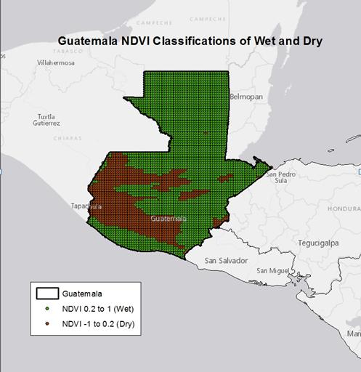
Notes:
- This map is an example of the designation between dry and wet for Guatemala averaged monthly over the 30-year study period.

Slide 20
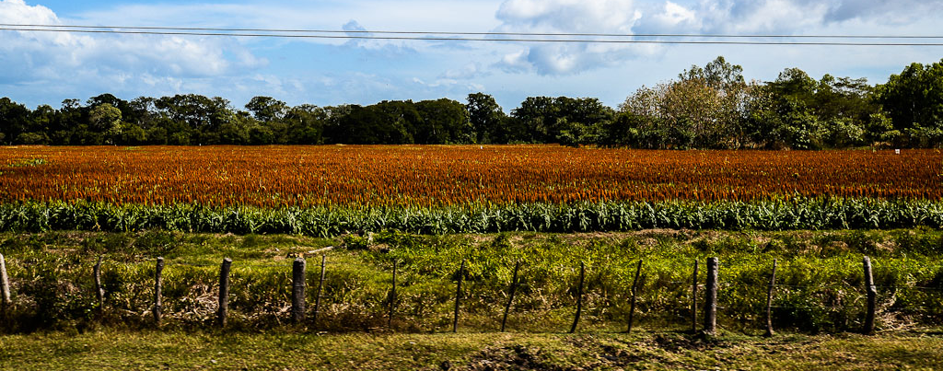
Results
Climatology Maps
Anomaly Maps and Graphs
Seasonal Trend Maps and Graphs
Image Credit: Ben Moffitt and Pegah Pourkarimi
Notes:
Image Source: http://www.tothenextjourney.com/2012/12/28/nicaragua-a-land-of-volcanoes-wind-and-waves/
- We took our results and put them into both graphs and maps.

Slide 21
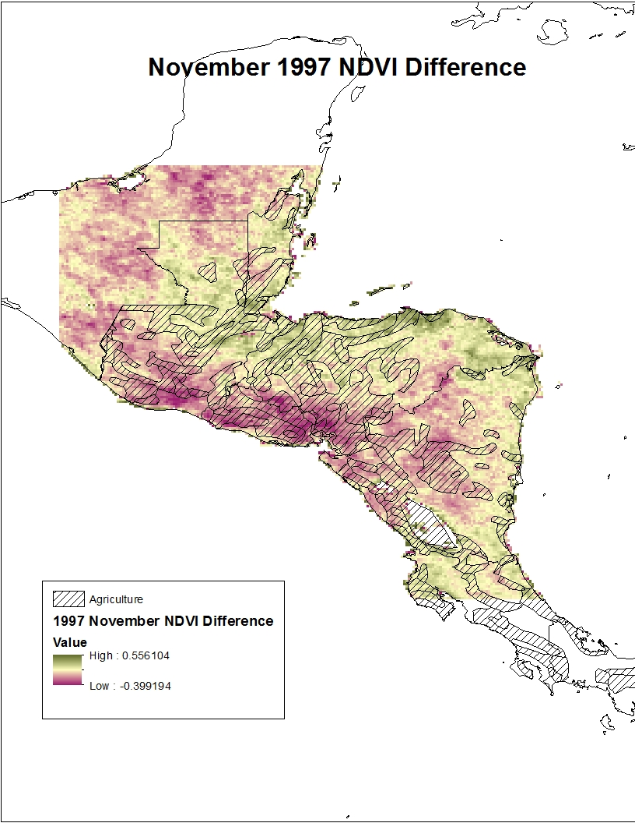
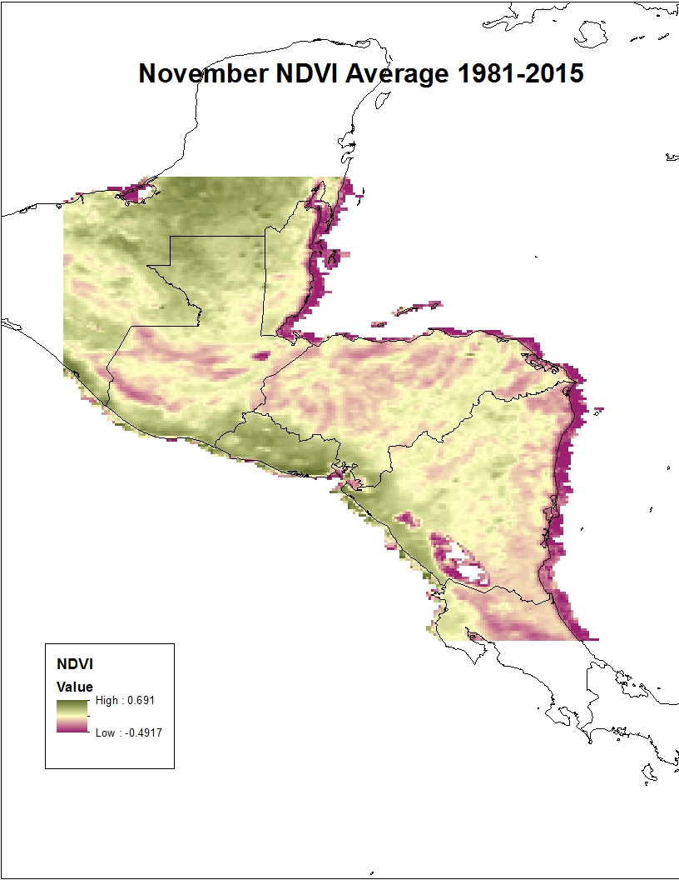
Climatologies
Figures X-Y: (Examples) show the climatology of NDVI in Central America
Notes:
- These maps are representations of NDVI values for the month of November. One map demonstrates the overall average NDVI for 30 years in the month of November. The other two maps are during El Nino years and show the difference that year was from the baseline November 30 year average.

Slide 22
Seasonality
Figure X: Example Trend Map Image
Notes:
-Monthly trend maps (similar to the one above) will be collected into traditional 90-day seasons as well as Rainy and Dry seasons for both regions to see how NDVI has changed over our study period and how we can expect NDVI to change in the future
-Found results will be explained here
-Graphs and maps will be created to analyze expected anomalies in NDVI during ENSO events
-Found results will be explained here

Slide 23
Conclusions
Central America
May – September
Agriculture regions
El Salvador
The Levant
Only 3 classes present
Significantly drier
No significant change seen
ENSO
1997 – 1998
Most effected was El Salvador
Notes:
*conclusions made up
Saw a significant difference in NDVI values during the rainy season in Central America
Most of the agricultural regions had the highest NDVI values during the rainy season but saw the largest change during off months
El Salvador had the lowest NDVI values consistently
The Levant only had 3 of the 5 NDVI signatures present while all were present in Central America demonstrating the Levant is significantly drier and more barren then Central America
There did not appear to be significant change in the Levant NDVI values in different months
Saw a significant increase in NDVI values during the strong ENSO event in 1997-1998. The largest change was seen in El Salvador. This country had the most extreme of both high and low values

Slide 24

Advisors
Dr. DeWayne Cecil, NOAA NCEI
Partners
US Air Force, 14th Weather Squadron
POC: Major Ryan Harris
Raymond Kiess
David Ramsaur
Ryan Smith
Jeremy Anthony
Others
Jessica Sutton, Center Lead, NASA DEVELOP National Program
Emma Baghel, Assistant Center Lead, NASA DEVELOP National Program

