Slide 1

Puerto Rico Health
A Geospatial Assessment of Environmental Variability in Puerto Rico and its Relation to Confirmed Dengue Cases
Andrew Nguyen
Dr. Pablo Mendez- Lazaro
Alannah Johansen
Dr. Roberto Barrera
Martha Sayre
Dr. Juan Torres-Perez

Slide 2
Overview
Community Concerns
Objectives
Study Area
NASA satellites/sensors
Data
Method 1(Maximum Entropy)
Method 2 (Time Series Frequency Analysis)
Results 1(Geospatial Dengue Risk)
Results 2 (Dengue Seasonal Correlation)
Results 3 (SST Correlation Coefficients)
Conclusions
Future Work
Acknowledgements
CC
Object.
Methods
Study Area
NASA Satellites
Data
Results
Con.
Future Work
Acknowledge.

Slide 3
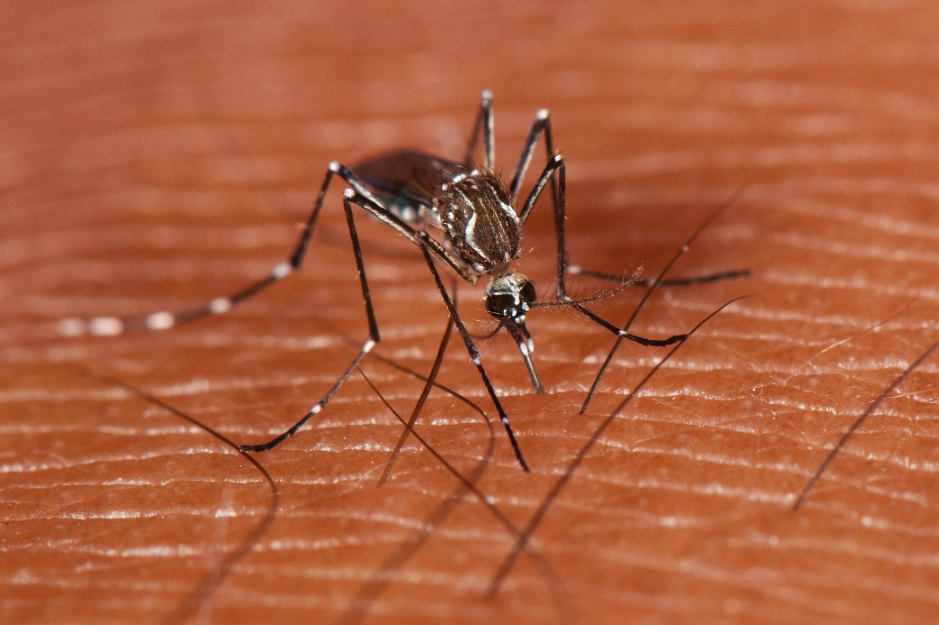
Community Concerns
The dengue virus is the fastest-growing vector-borne pathogen in the world.
Declared endemic in the Caribbean and Puerto Rico.
1994, 1998, 2007, and 2010 outbreaks have recently been recorded in San Juan, Puerto Rico.
Strong correlation between mean sea level, dengue, and mosquito vector populations.
Image Credit: Mark Yokoyama
CC
Object.
Methods
Study Area
NASA Satellites
Data
Results
Con.
Future Work
Acknowledge.

Slide 4

Objectives
Create a Vulnerability Index Method (VIM) for dengue vector habitat
Statistically correlate environmental variables to dengue seasonality
Better understand the relation of Sea Surface Temperature (SST), Confirmed Dengue Fever Cases (CDFC), and environmental variables using time series frequency analysis
Image Credit: Ron Reiring
CC
Object.
Methods
Study Area
NASA Satellites
Data
Results
Con.
Future Work
Acknowledge.
Notes:
Image Source: http://commons.wikimedia.org/wiki/File:Claude_Monet_-_The_Magpie_-_Google_Art_Project.jpg

Slide 5
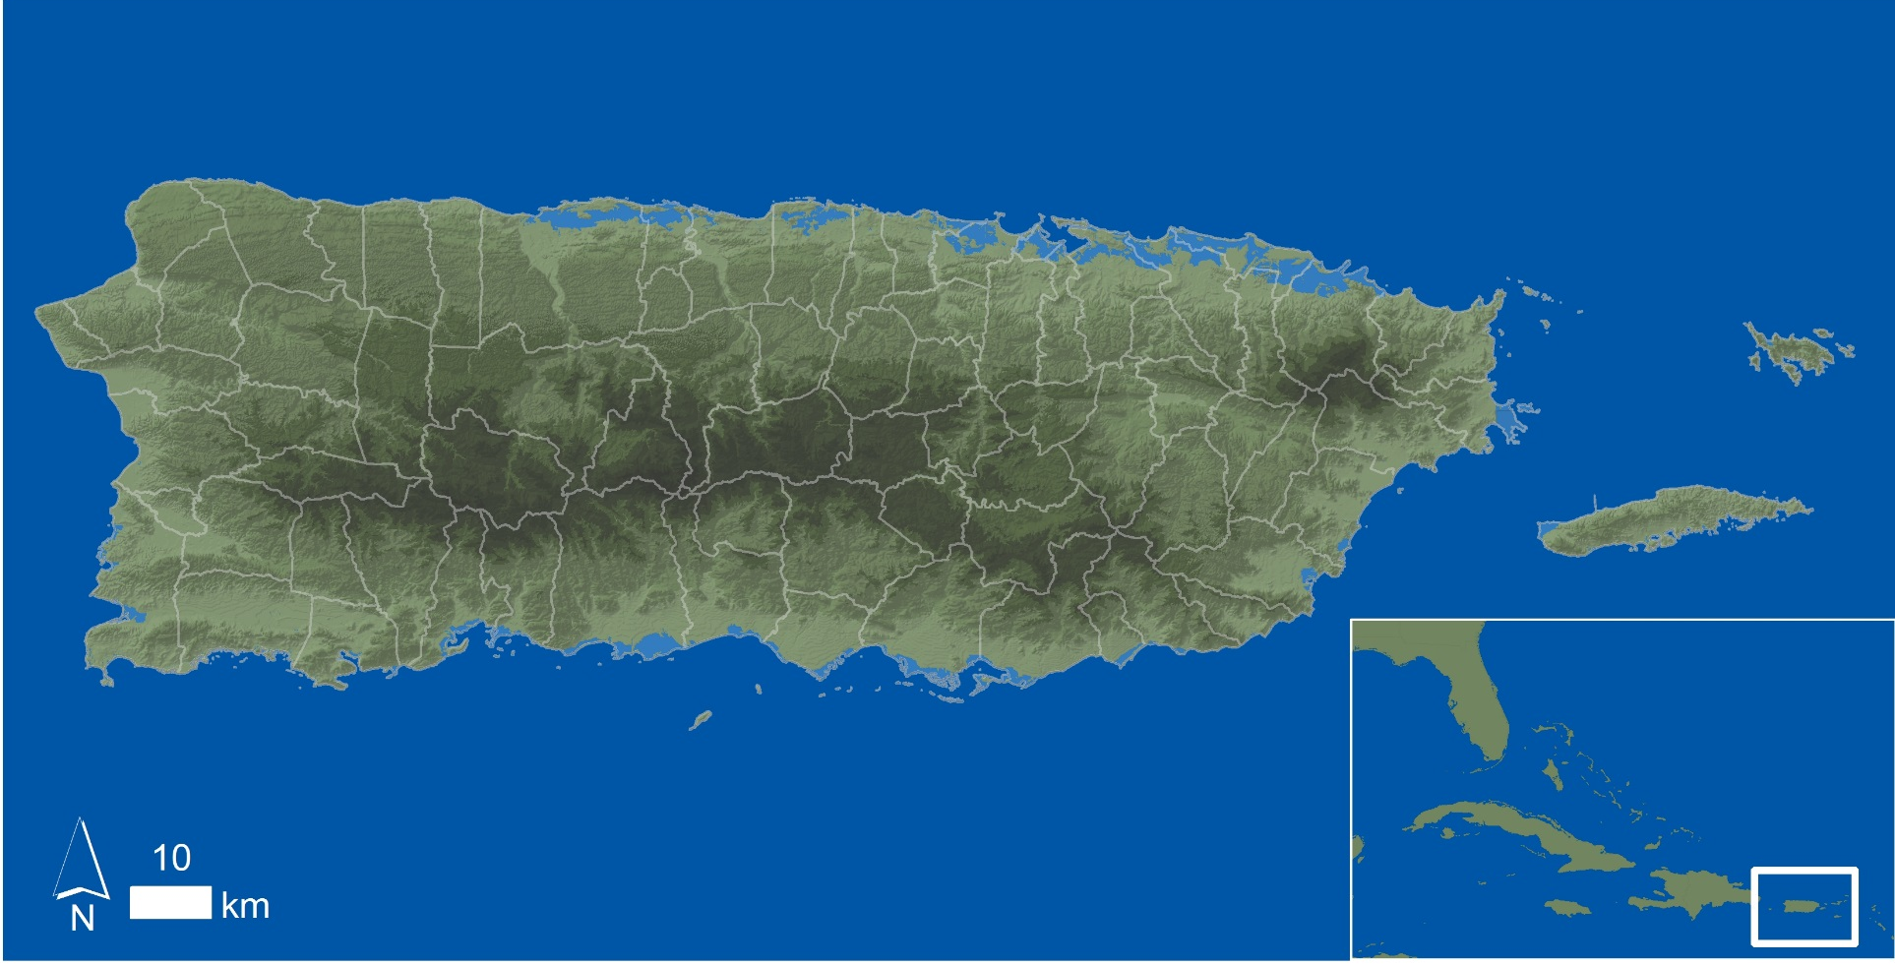
Study Area: Puerto Rico
CC
Object.
Methods
Study Area
NASA Satellites
Data
Results
Con.
Future Work
Acknowledge.

Slide 6

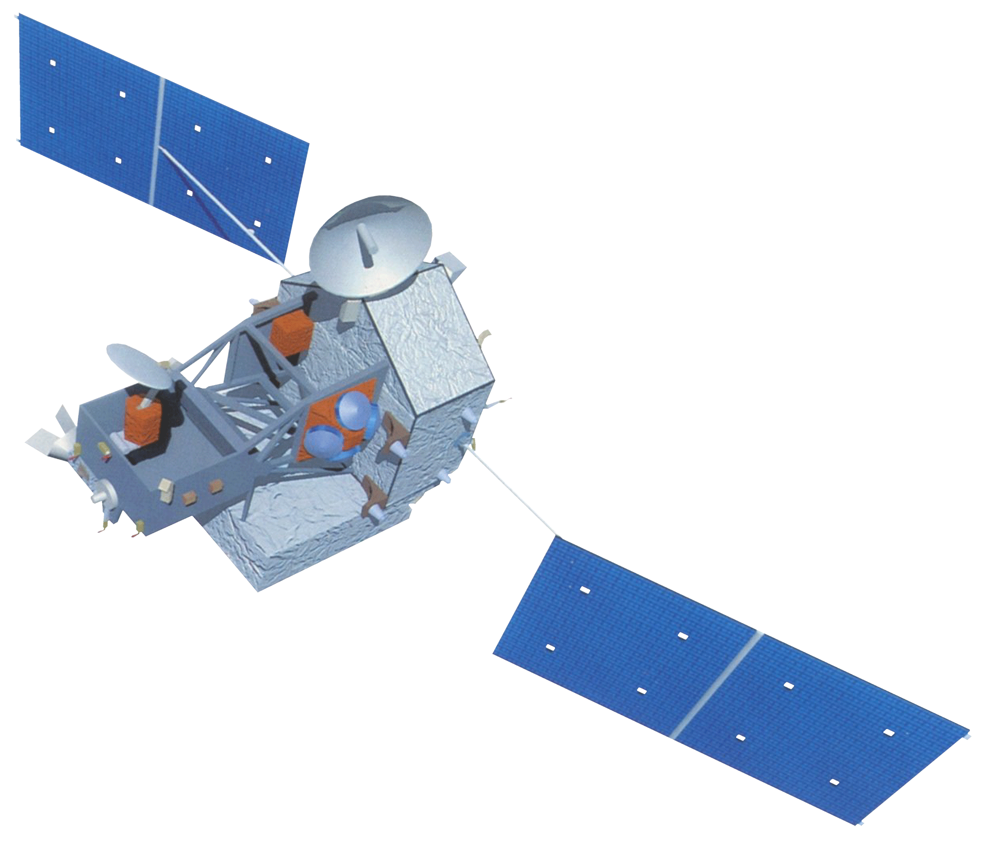
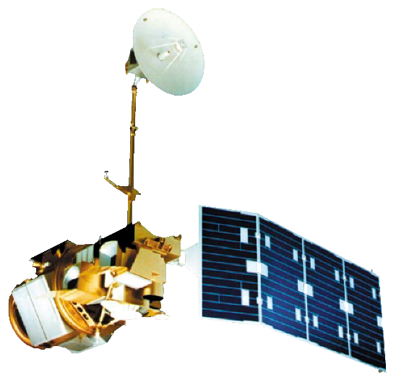

NASA satellites/sensors
Terra-MODIS
TRMM-PR
Aqua-MODIS
Landsat 5-TM
Image Credit: NASA
CC
Object.
Methods
Study Area
NASA Satellites
Data
Results
Con.
Future Work
Acknowledge.
Notes:
These notes should be thorough enough for someone not familiar with the project to clearly present the material.
Image Source: http://commons.wikimedia.org/wiki/File:Claude_Monet_-_The_Magpie_-_Google_Art_Project.jpg

Slide 7


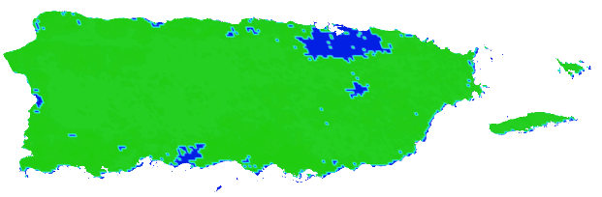
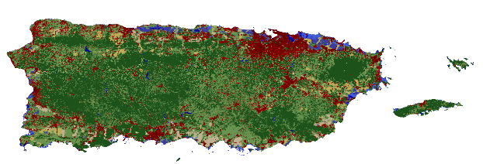
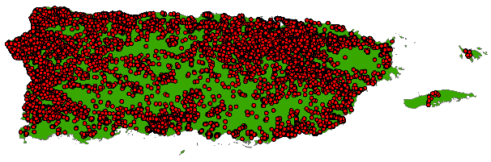
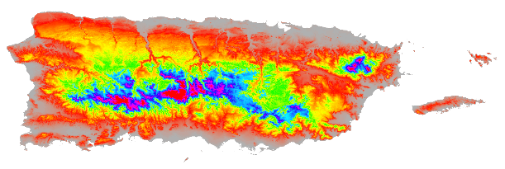
Data
Monthly Jan 2009- Dec 2013
1 & 2) Land Surface Temperature (LST) - Day & Night(1Km) MODIS
3) Total Precipitation (TP)(0.5 Degree)
CHIRPS
4) Evapotranspiration (ET)(1Km)
MODIS
5) Land Cover (30m)
NLCD
6) Confirmed Dengue Fever Cases (CDFC)(In-Situ)
CDC- Dengue Branch
7) Elevation (30m)
USGS
CC
Object.
Methods
Study Area
NASA Satellites
Data
Results
Con.
Future Work
Acknowledge.

Slide 8
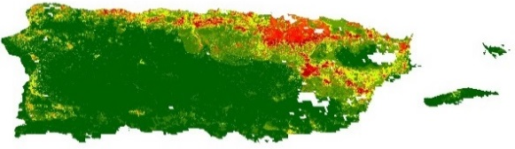
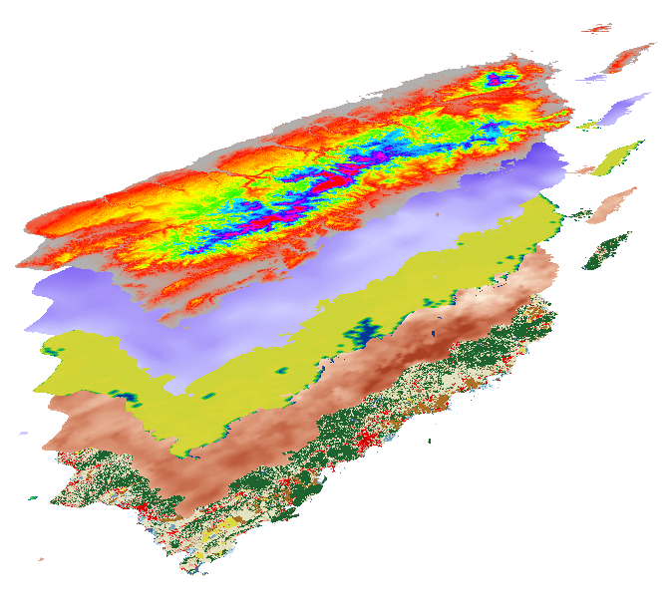
Method 1(Maximum Entropy)
Monthly Jan 2009- Dec 2013
1) Geospatial Dengue
Risk Maps
TerrSet-Habitat and Biodiversity Modeler Maximum Entropy
1) LST- Day (MODIS)
2) LST- Night (MODIS)
3) TP (CHIRPS)
4) ET (MODIS)
5) Land Cover (NLCD)
6) Elevation (USGS)
7) CDFC (In-Situ)
2) Variable Statistical
Significance
to CDFC
CC
Object.
Methods
Study Area
NASA Satellites
Data
Results
Con.
Future Work
Acknowledge.

Slide 9

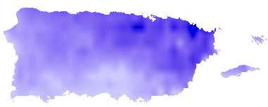
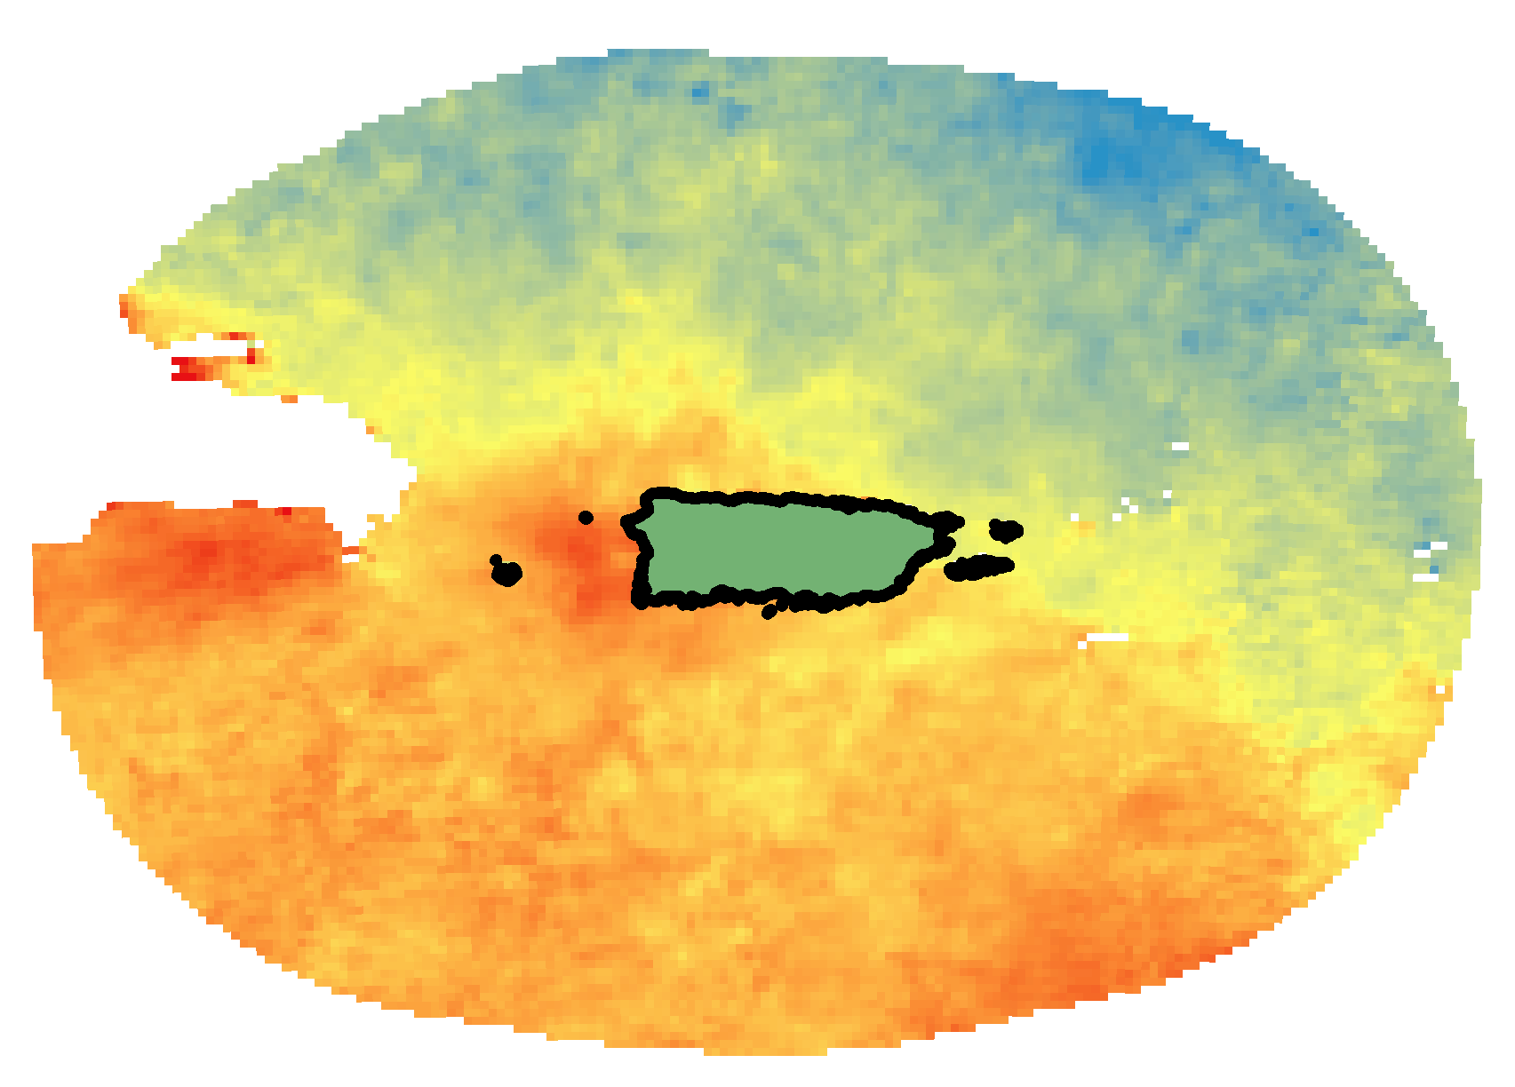
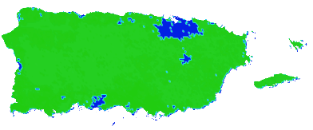



Method 2 (Time Series Frequency Analysis)
Monthly Jan 2009- Dec 2013
]
1 & 2) LST- Day & Night
]
3) TP
]
4) ET
[
Time Series
Frequency
Analysis
Sea Surface Temperature (SST) MODIS
]
[
5) Land Cover
]
6) CDFC
R Value
Correlation Coefficients of Variables to SST
]
7) Elevation
CC
Object.
Methods
Study Area
NASA Satellites
Data
Results
Con.
Future Work
Acknowledge.

Slide 10
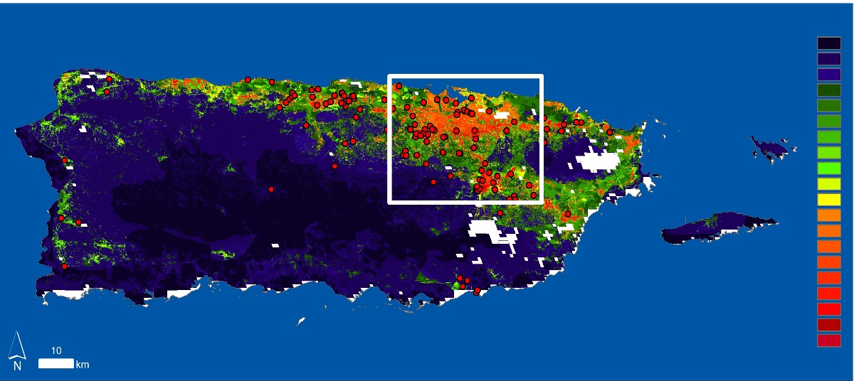
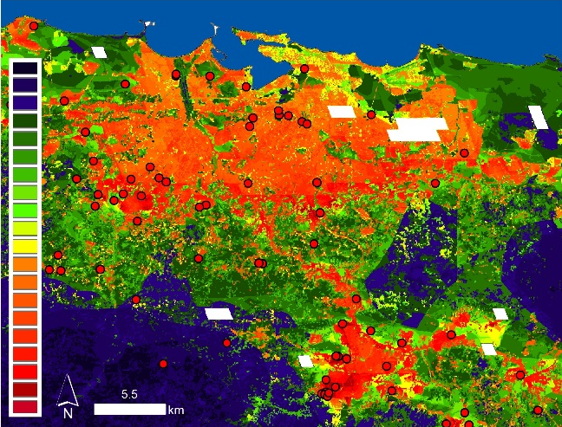

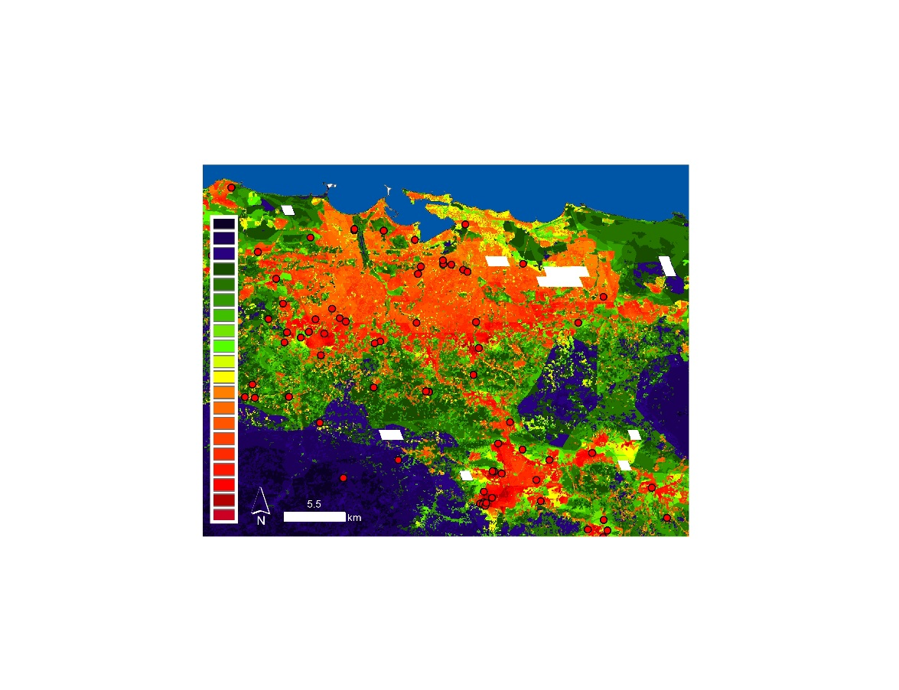
Results 1(Geospatial Dengue Risk)
September 2009
= CDFC
CC
Object.
Methods
Study Area
NASA Satellites
Data
Results
Con.
Future Work
Acknowledge.
September 2010
September 2011
September 2012

Slide 11
Results 2
(Dengue Seasonal Correlation)
CC
Object.
Methods
Study Area
NASA Satellites
Data
Results
Con.
Future Work
Acknowledge.

Slide 12
Results 3
(SST Correlation Coefficients)
CC
Object.
Methods
Study Area
NASA Satellites
Data
Results
Con.
Future Work
Acknowledge.

Slide 13
Conclusions
CC
Object.
Methods
Study Area
NASA Satellites
Data
Results
Con.
Future Work
Acknowledge.

Slide 14
Future work
CC
Object.
Methods
Study Area
NASA Satellites
Data
Results
Con.
Future Work
Acknowledge.

Slide 15
Acknowledgements
List advisors, partners, and others who have contributed in any way to the project.
If your project is a multi-term one, acknowledge past contributors.
Choose one of the two following slides as an acknowledgements page. Feel free to modify them as needed to fit your content.
CC
Object.
Methods
Study Area
NASA Satellites
Data
Results
Con.
Future Work
Acknowledge.
Notes:
Image Source: http://commons.wikimedia.org/wiki/File:Claude_Monet_-_The_Magpie_-_Google_Art_Project.jpg

Slide 16
Advisors
Partners
Others

