Slide 1
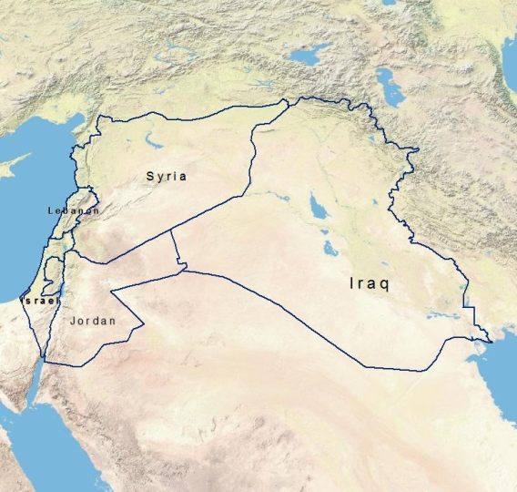
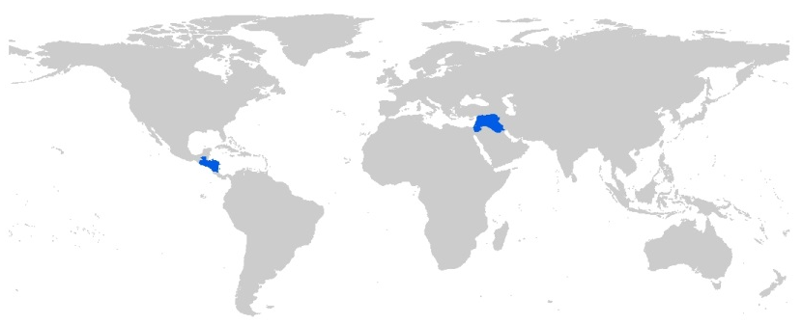
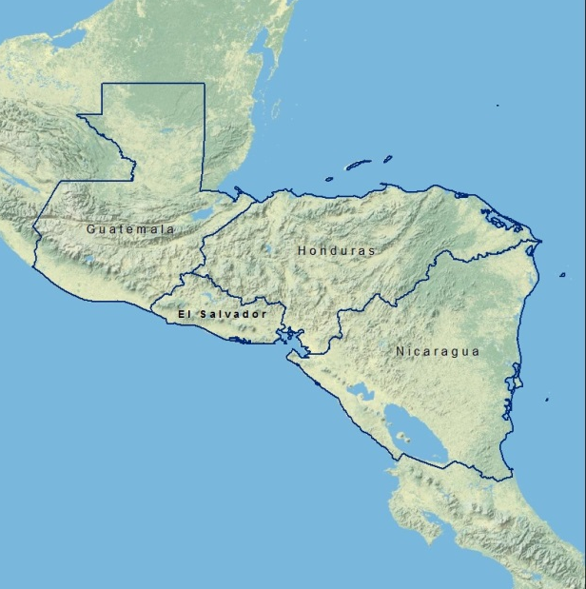
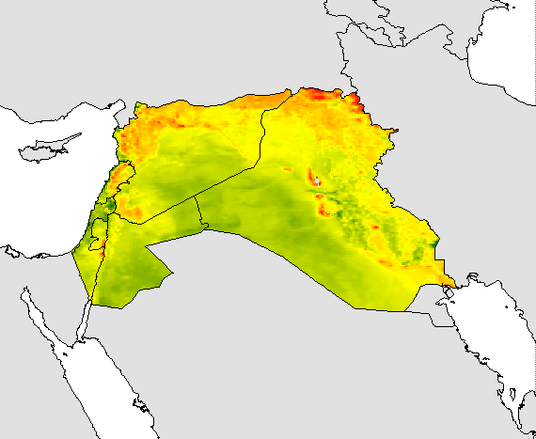
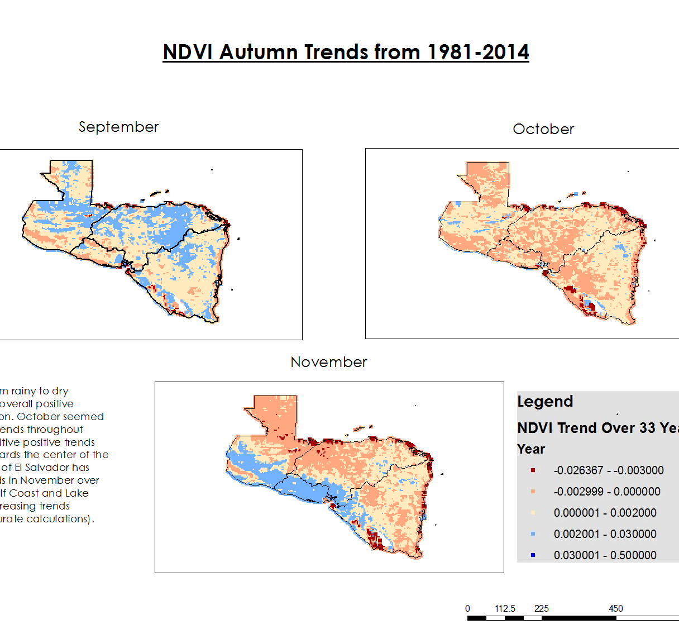
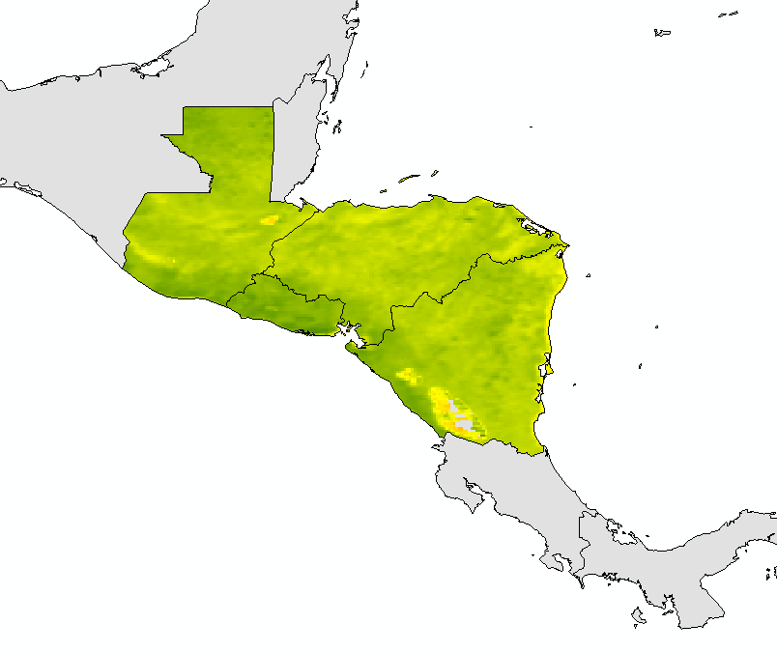
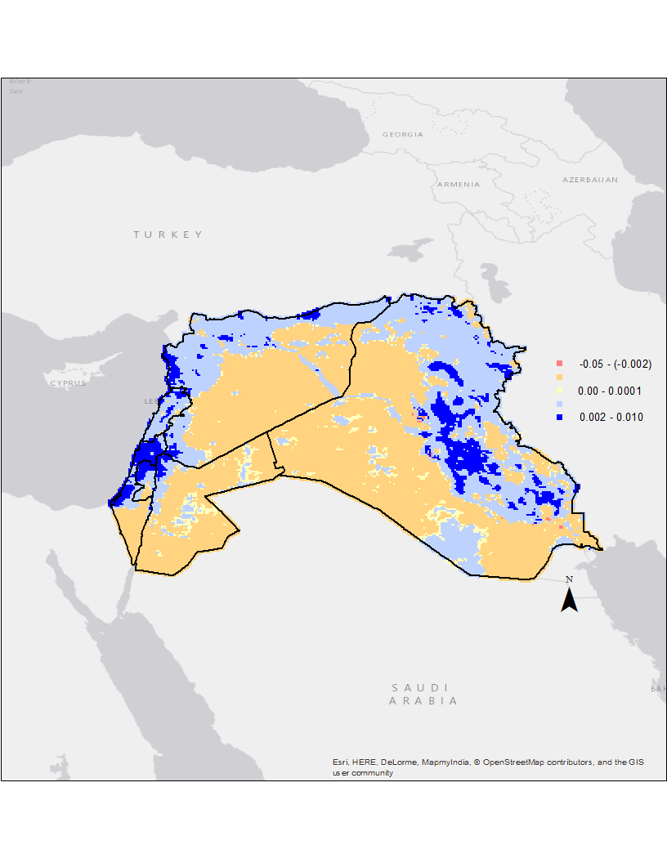
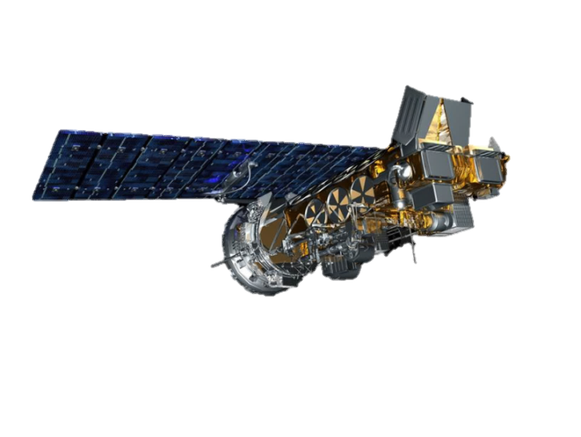
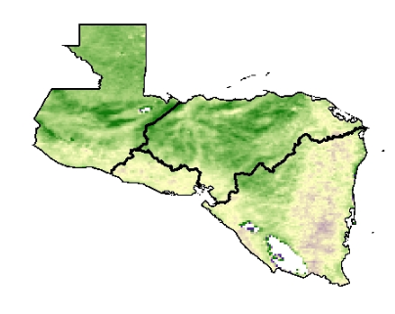
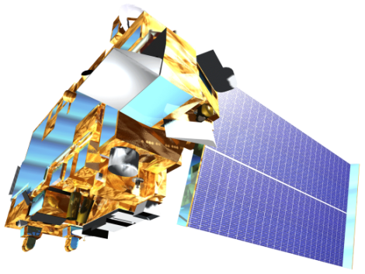
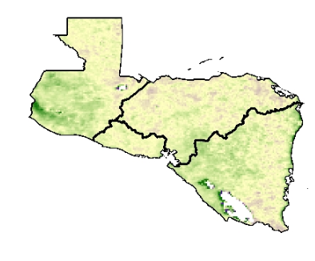





Levant & Central American Climate
Monitoring Precipitation and Drought to Enhance U.S. Air Force Predictions and Decision-Making in the Levant and Central America
Alec Courtright (Project Lead), Christie Stevens, Hayley Hajic
DEVELOP National Program at NOAA National Centers for Environmental Information
Abstract
Study Area
The Levant and Central American regions suffer from frequent drought and heavy precipitation events. Drought induces stress on water resources and the agricultural community and can serve as a catalyst to conflict. Heavy precipitation events affect communities through extreme flooding, water contamination, and crop failure. The US Air Force 14th Weather Squadron uses authoritative climate data to inform military intelligence and planning in regions impacted by extreme weather events. This project seeks to incorporate additional climatic variables to support the Weather Squadron’s current drought-monitoring techniques. Through analysis of Normalized Difference Vegetation Index (NDVI) data, this project examines vegetative trends caused by El Niño Southern Oscillation, drought events, and seasonal climatic changes. Vegetation is closely related to short-term atmospheric dynamics and provides valuable insight into crop assessment and early drought detection when paired with other drought monitoring systems. This project utilizes NASA and NOAA NDVI data for valuable insight into early drought detection and greater efficiency when paired with the 14th Weather Squadron’s current monitoring tools in the Levant and Central American regions.
Central America including Guatemala, El Salvador, Honduras and Nicaragua (left); The Levant study area including Lebanon, Israel, Jordan, Iraq and Syria (right)
Objectives
Methodology
Create comprehensive climatologies of the Levant and Central America to enhance the 14th Weather Squadron’s decision-making capabilities.
Examine neutral and anomalous years to discover trends and determine effects of extreme weather-related events, such as El Niño and La Niña.
Study drought events and seasonal climate changes to evaluate current and future vulnerabilities.
Data Acquisition
El Niño
and
La Niña
Data Processed Using R Programming
Climatologies
Drought
events
End Products
NASA MODIS
Results
NOAA
AVHRR
Normal
Difference Vegetation Index (NDVI)
Central America NDVI Signature Classifications 1981 - 2014
Data Analysis
Enhance monitoring of drought and precipitation to alleviate conflict due to climatic events
The map below displays January trend patterns for the Levant.
Positive trend values reveal areas that have become more green, while negative trend values show areas that are getting less green.
January NDVI Trends
1981 - 2014
Earth Observations
Classification graphs can be used to determine vegetation present throughout the regions and how vegetation varies throughout the year. The above graph displays Central America’s primary classification as shrub and grassland.
NOAA AVHRR
0.5 degrees resolution daily
NASA Terra MODIS
1km resolution monthly
1998
1996
Conclusions
NDVI value classifications indicated that Central America consists mostly of shrubs and grasslands while the Levant remains mostly soil.
NDVI values increased during the Spring of 1998, near the end of the El Niño event in Central America.
During the 2007-2010 drought in the Levant, NDVI values only slightly decreased with the exception of a large decrease in 2008.
Both study regions had statistically significant trends. Central America saw larger trends in NDVI than the Levant.
Percent difference maps demonstrate NDVI changes throughout the 33-year study period. The maps to the left displays percent difference for Central America during February. Spring 1998, during the strong 1997-98 El Niño, had a large increase in NDVI values, especially compared to the year prior to the El Niño.
Team Members
Project Partners
Acknowledgements
We would like to thank Dr. L. DeWayne Cecil, Science Advisor, National Centers for Environmental Information, Jessica Sutton, Center Lead at NOAA NCEI, Emma Baghel, Assistant Center Lead at NOAA NCEI and the U.S. Air Force 14 Weather Squadron, End users.
U.S. Air Force 14th Weather Squadron
National Oceanic and Atmospheric Administration
Christie Stevens, Alec Courtright, Hayley Hajic
NOAA National Centers for Environmental Information

