Slide 1
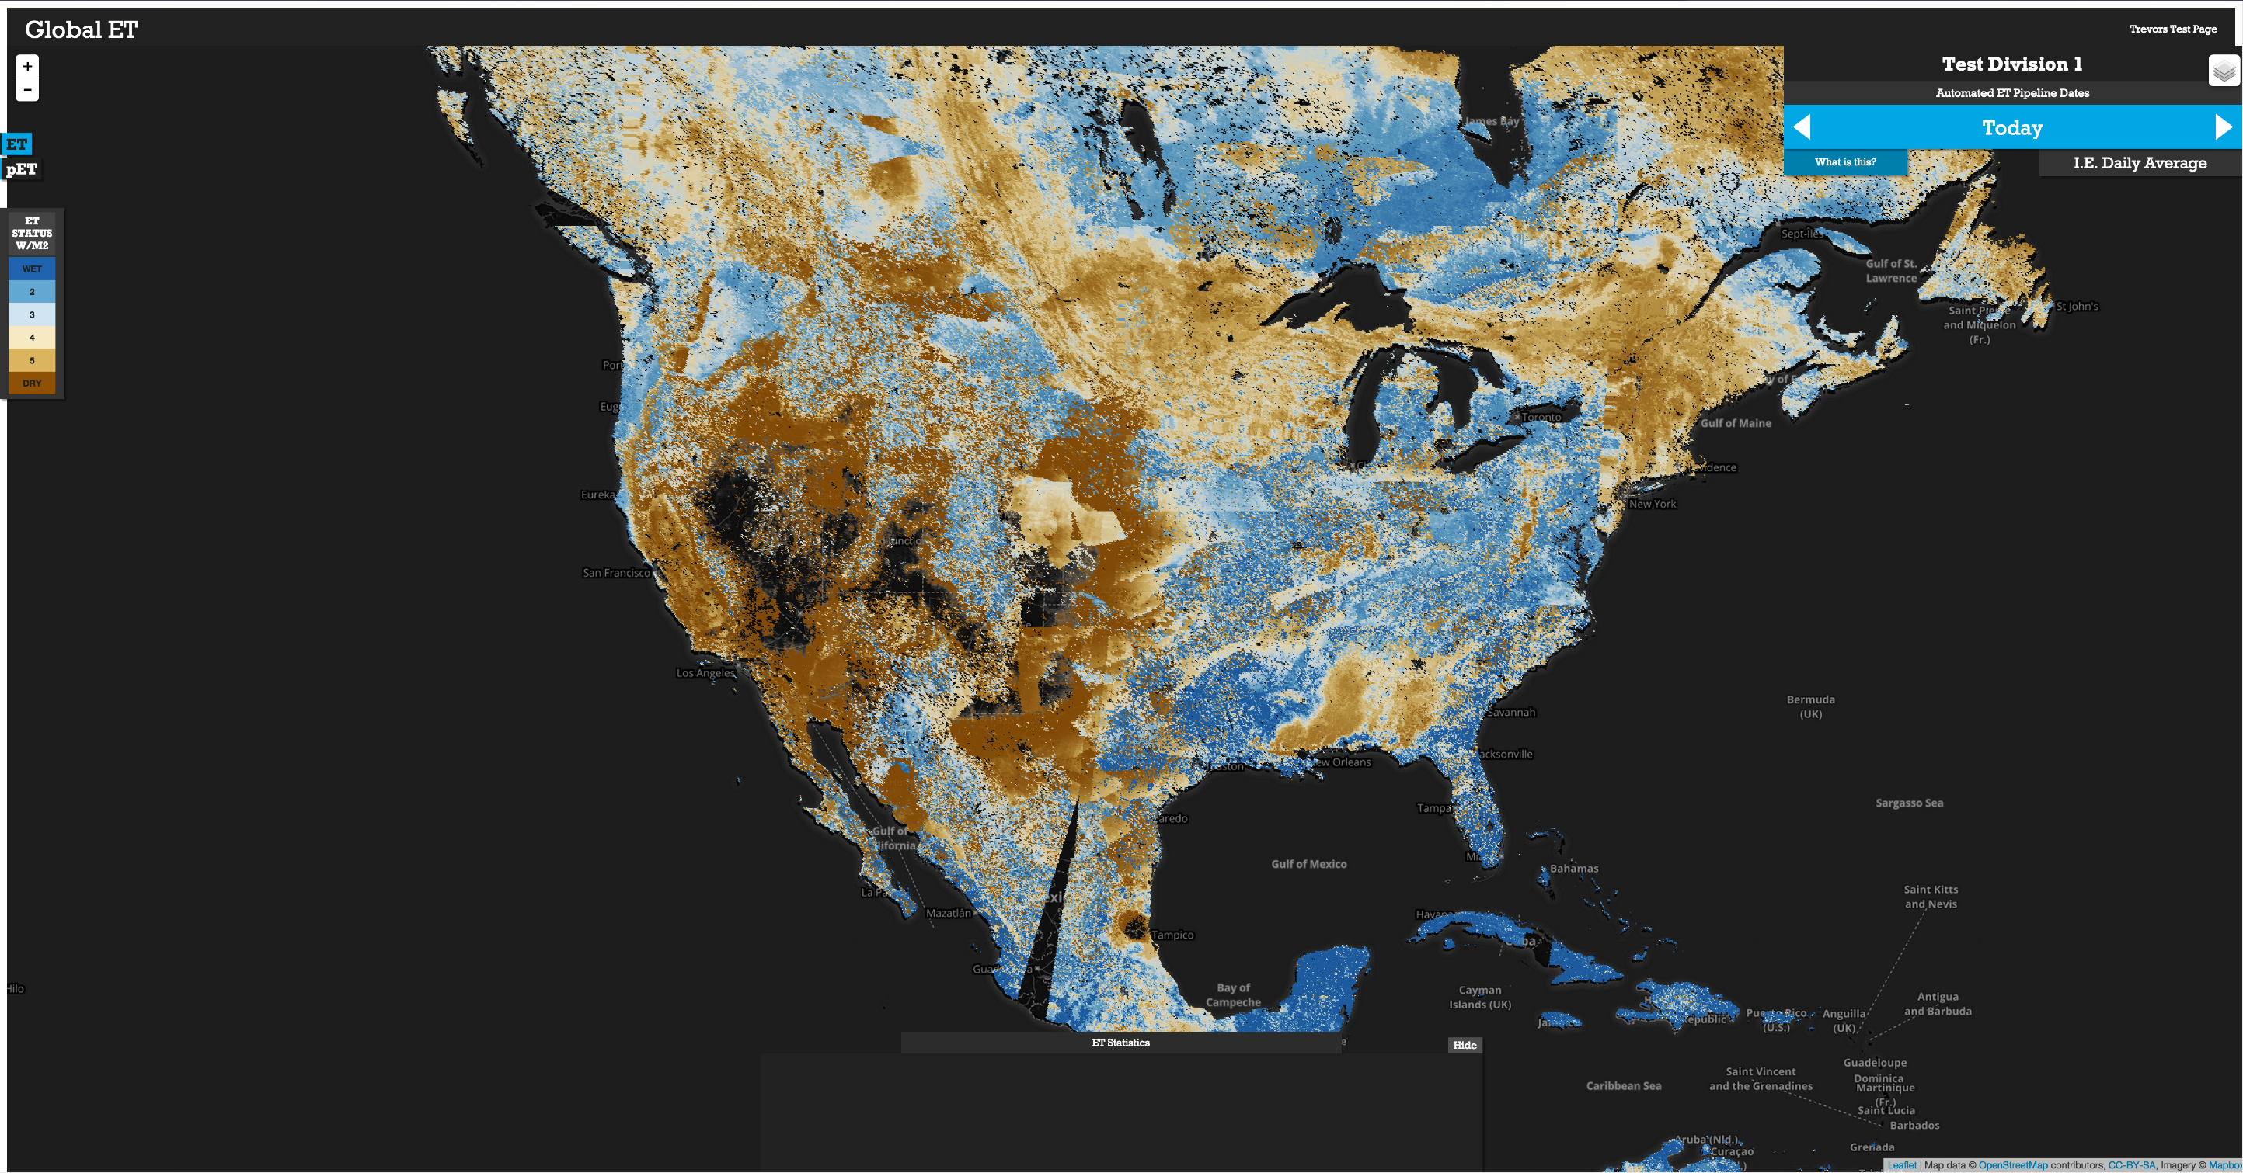
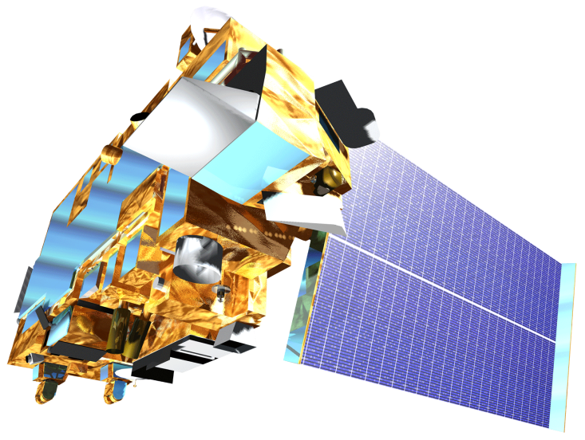

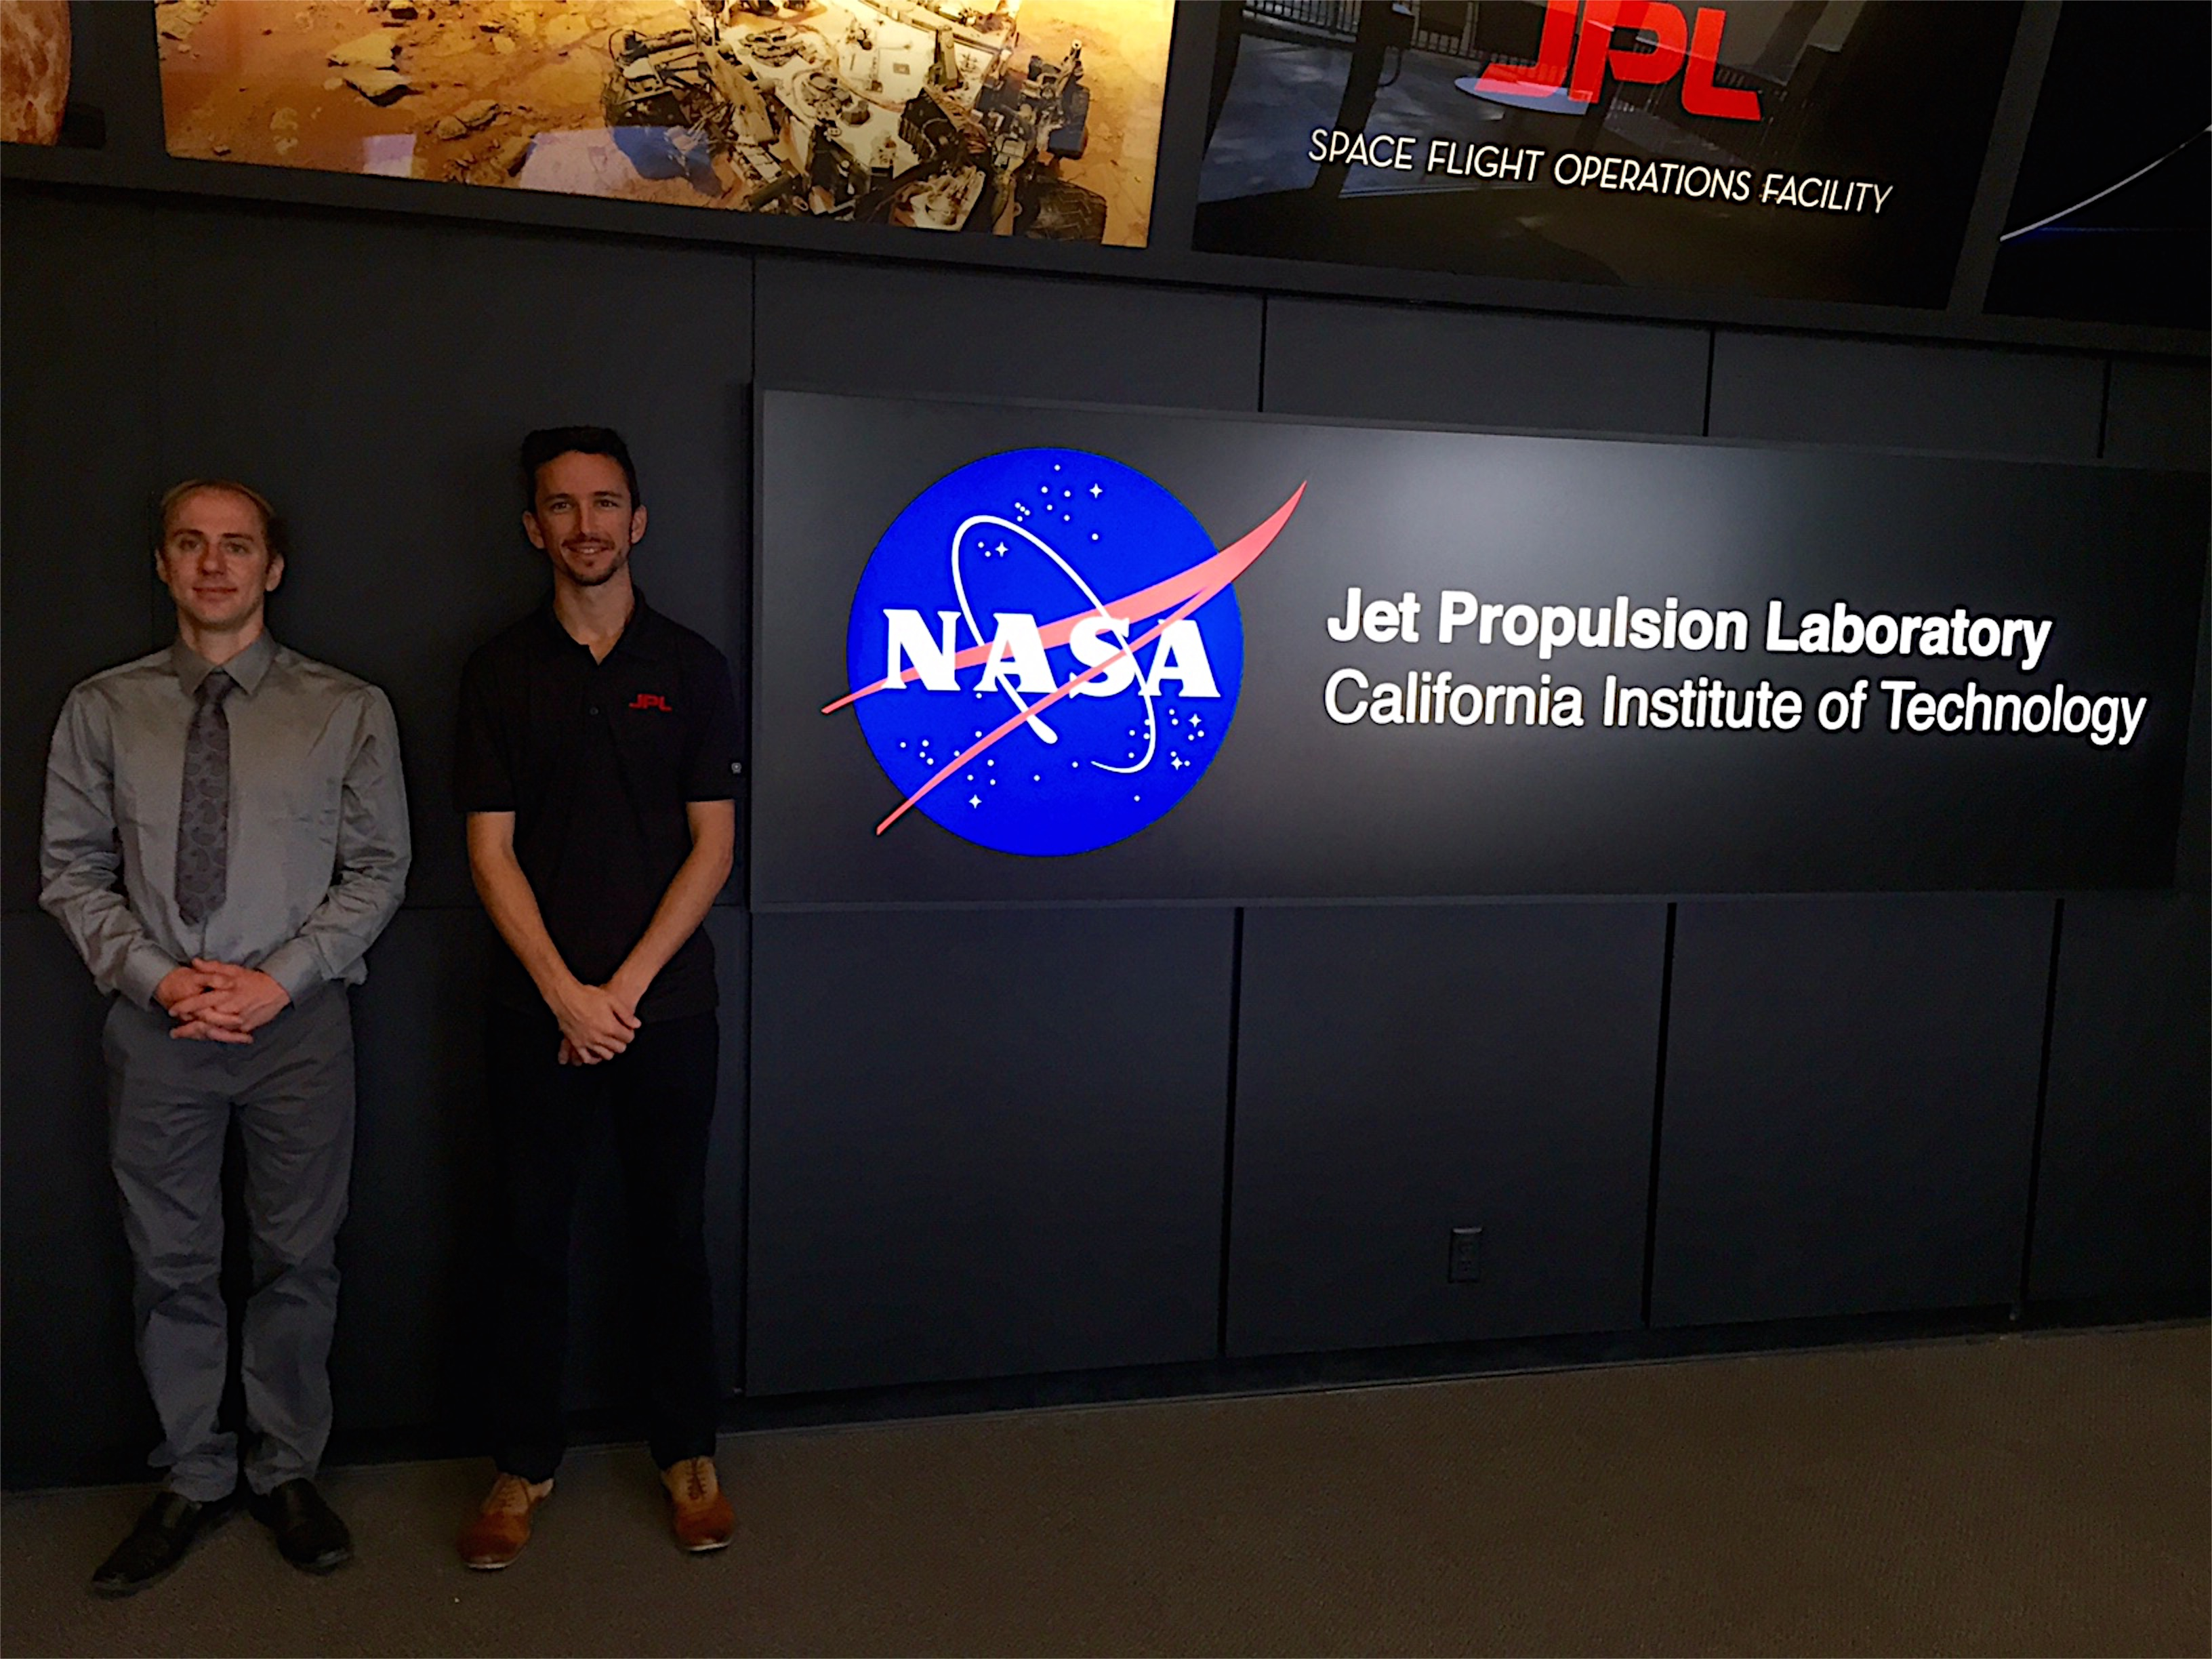
New Mexico Water Resources II
Delivering Automated Evapotranspiration Data To The New Mexico Office Of The State Engineer For Enhanced Water Resource Decision Making In New Mexico
Trevor McDonald (Project Lead), Gregory Halverson
DEVELOP National Program at NASA Jet Propulsion Laboratory
Abstract
Objectives
With the southwestern region of the United States experiencing unprecedented drought conditions, improving and deploying real time applications enable water resource managers to plan and manage more effectively. Dr. Fisher’s daily evapotranspiration (ET) product implemented through our pipeline provide an improved temporal and spatial resolution assessment of rangeland water resource conditions, consequently enhancing decisions related to cattle management, emergency response for rapid rangeland and farmland deterioration, fire management risk decisions, and determining drought severity. The current assessment methods that New Mexico land managers and decision-makers utilize include spatially limited in situ spot check as well as weekly Normalized Difference Vegetation Indices (NDVI) and ET products for New Mexico counties. The current methods are insufficient because of difficult accessibility, limited information, and lack of distribution. Our team’s automated and streamlined pipeline, in combination with Dr. Fisher’s daily ET product delivered to the New Mexico Office of the State Engineer will prove to be critical in enhancing water resource decision-making.
Automate MODIS & NCEP acquisition and processing.
Streamline the PT-JPL evapotranspiration (ET) product through an automated system which generates and delivers ET to the New Mexico Office of the State Engineer .
Disseminate products to decision-makers in the ranching, water resources, drought assessment and fire-response communities in the Eastern Plains Region of New Mexico through an easily-accessed online interface.
Methodology
Study Area
A visual representation of the automated data pipeline architecture. The pipeline initially retrieves the data and sends some data for processing. Once processing is done, all data is fed into the PT-JPL evapotranspiration (ET) algorithm to create ET outputs. This daily ET product will be post-processed and served to a web interface. Our pipeline is coordinated by a master python script automating the flow from process to process.
Data Sources
NCEP
USGS
LAADS
Data Request
Pre-Processing
Post-Processing
Web Interface
Data Acquisition
PT-JPL ET Model
Leaflet
OpenLayers
ET Data Cycle
GeoTIFF
GDAL
CURL
GDAL
HEG
MATLAB
Results
Earth Observations
Modeled Evapotranspiration (ET), blue indicates high ET while brown indicates low ET. ET was derived using PT-JPL model derived from NCEP and MODIS data.
Terra Aqua
Conclusions
Individual components of the pipeline successfully implemented.
Automation and integration of the ET data cycle is in later stages of development.
Front end automation from ET output to web server in development.
Team Members
From Left to Right: Gregory Halverson, Trevor McDonald
Acknowledgements
We thank everyone who helped in our project. Past contributors Sol Kim and Agustin Muniz as well as our science advisors Joshua Fisher, Greg Moore, Munish Sikka and Manish Verma provided insight and expertise that greatly assisted the research. Nick Rousseau, Brittany Zajic, Gwen Miller, Christine Rains, and Daniel Jensen assisted throughout the project guiding us through deliverables and answering research questions.
Project Partners
New Mexico Office of the State Engineer, End-User
NASA Jet Propulsion Laboratory

