Slide 1
DEVELOP National Program
[Project Title]
[Node]
spring 2017
website imagery

Slide 2
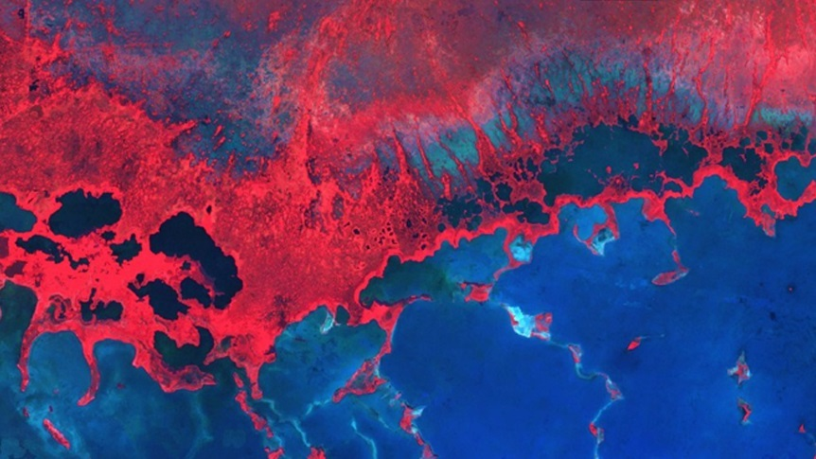
Purposes and Examples
Website Image
An attractive image of your study area to be used as a cover image on the DEVELOP & Applied Sciences websites.
A pretty picture that can be used for aesthetic purposes for future DEVELOP publications.
For examples: https://develop.larc.nasa.gov/projects.php
Delete this slide upon submission.

Slide 3
Image Checklist:
Map resources available on DEVELOPedia
Image is derived from NASA sensor data
Not from an outside source
Not a photograph of the team or landscape
Exception: NCEI projects using CDRs
At least one image provided is derived from recent data (2016-2017)
Some kind of processing has taken place
Not just a raw satellite image or simple re-order of spectral bands
The team actually created the image
There can be NO outside content included (what we mean by this is something some non-DEVELOP person processed/created/picture they took) – including non-NASA data along with NASA data in the creation of your image is fine, but you can’t take a map or diagram someone else made and include it
High-resolution 1920 x 1080 (over 300 dpi) – landscape orientation
White background
Saved as a JPEG or PNG
Delete this slide upon submission.

Slide 4
Website Image Guidelines:
Don’t:
Include text
Include metadata (north arrow, legends, datasets, who made the map, what the projection is, etc.)
Do:
If a legend is required, submit it separately
Choose an image that is aesthetically appealing.
Be thoughtful with color schemes (remember color blind people and be kind to viewers eyes as some colors should not be next to each other!)
Coloration: Sequential and qualitative are great, diverging should be used carefully
Have multiple people look at it the imagery with a critical eye
Can:
Include insets to give a greater context of where in the US or world you are zoomed in on, but no text
Delete this slide upon submission.

Slide 5
Project Short Title Here
Website Image
Caption: Make sure to include what NASA satellite and sensor the image is derived from and the date the data were collected by the satellite. Also include what the image is (ex. NDVI, etc.), and how it can be used for decision making. 25 word limit.
No text allowed on this image!

