Slide 1
Montana Ecological Forecasting
Utilizing NASA Earth Observations to Forecast the Effects of Climate Change on Northern Goshawk Nesting Habitat
Erika Higa (Project Lead)
Sean McCartney
Amanda Clayton
Notes:
We are the Montana Ecological Forecasting team: Erika, Sean and Amanda!

Slide 2
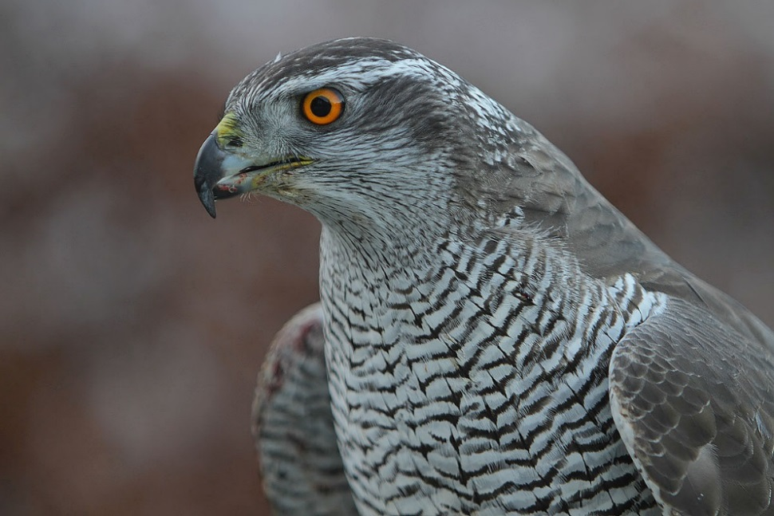
Northern goshawk
Scientific name: Accipiter gentilis
Largest of the three forest raptors in the Accipiter family
Generalist predator
Occupies boreal and temperate forests of the Holarctic
Nests in mature forests with high canopy cover and open understory
Nesting habitat comprises 40 acres directly surrounding nest tree
Mountain pine beetle threat
Photo credit: Steve Garvie
Notes:
The northern goshawk, Accipiter gentilis, is the largest species in the accipiter family. It is a generalist predator occupying boreal and temperate forests throughout North America. They often nest in mature forests with high canopy cover and open understory. Nesting habitat comprises of approximately 40 acres surrounding the nest tree. Currently, mountain pine beetle outbreaks are one of the biggest threats to northern goshawk habitats in the western US.
Image source: https://commons.wikimedia.org/wiki/File:Accipiter_gentilis_-owned_by_a_falconer_in_Scotland_-upper_body-8a.jpg

Slide 3
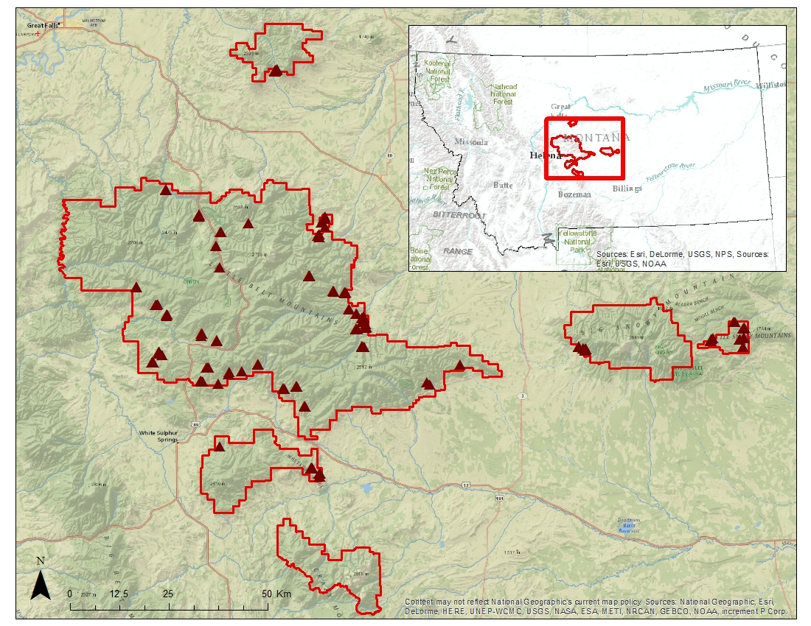

Study Area
Lewis and Clark National Forest (LCNF), Jefferson Division
4,900 km² area located in central Montana
Elevation: 1,200 - 2,800 m
Mixed grassland and conifer forest
190 nest sites collected from 1985 – 2013
LCNF Jefferson Division with nesting sites included
Notes:
We are interested in the northern goshawk habitat within the Jefferson division of the Lewis and Clark National Forest in Montana. Our study site is 4,900 square kilometers in area with elevations ranging from 1,200 to 2,800 meters. Dominant land cover includes mixed grassland and conifer forests. For our project we analyzed 190 goshawk nest sites that were provided by our project collaborator, Dr. Nate Bickford, and Laura Conway (USDA Forest Service). These nest sites were collected from 1985 to 2013.
Base layer sources: Esri, DeLorme, USGS, NPS, HERE, MapmyIndia, Open Street Map, UNEP-WCMC, USGS, NASA, ESA, METI, NRCAN, GEBCO, NOAA, and increment P Corp.

Slide 4
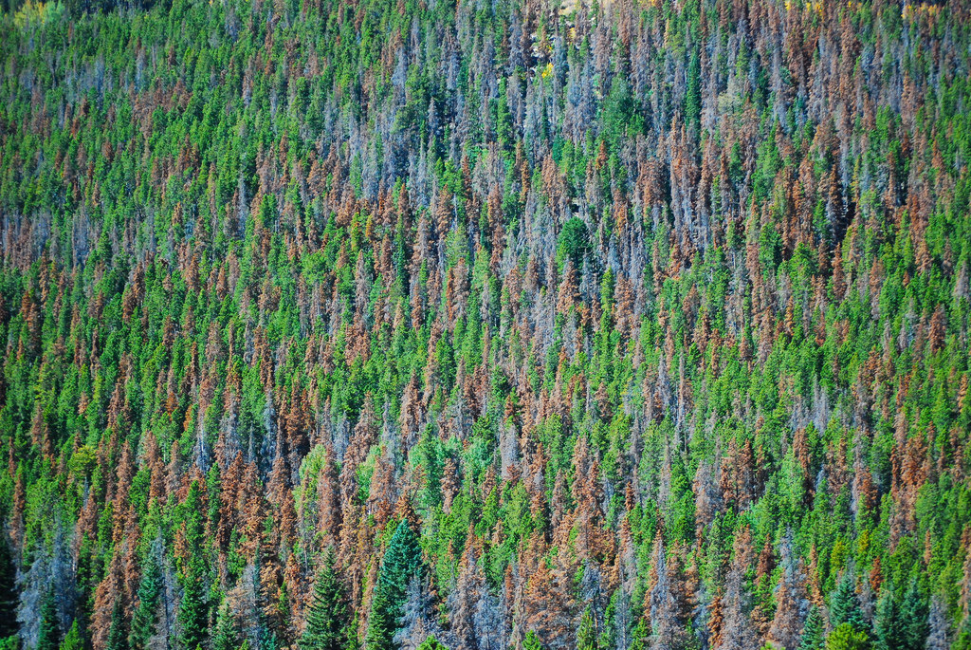
Community Concerns
Northern goshawk is designated as a Management Indicator Species in the LCNF and is protected under the Migratory Bird Treaty Act
Fire, insect blight, and disease, are prevalent in the region, causing widespread changes in the landscape
Projected climate change will affect egg and nestling survival and the availability of suitable habitat
Photo credit: Don Becker, USGS
Notes:
In Montana, the northern goshawk is designated as a Management Indicator Species in the Lewis and Clark National Forest and is protected under the Migratory Bird Treaty Act of 1918. Fire, insect blight, and disease are prevalent throughout the region, causing widespread changes in the landscape. Projected climate change will affect egg and nestling survival and the availability of suitability habitat for the goshawks.
Image source: https://www.flickr.com/photos/usgeologicalsurvey/16612752984

Slide 5
Objectives
Assess the role of NASA Earth Observing Systems (EOS), along with ancillary data, in creating environmental variables as inputs for habitat suitability models
Analyze three different habitat suitability models to form a consensus map for northern goshawk nesting habitat in the Lewis and Clark National Forest
Forecast the impacts of climate change on nesting habitat until the year 2050
Notes:
Our three objectives for the project were to asses the role of NASA Earth Observing Systems (EOS), along with ancillary data, in creating environmental variables as inputs for habitat suitability models, to analyze three different habitat suitability models to form a consensus map for northern goshawk nesting habitat in the Lewis and Clark National Forest, and lastly, to forecast the impacts of climate change on nesting habitat until the year 2050.

Slide 6
HSM
Habitat
Suitability
Modeling
Notes:
We developed a HSM to quantify the habitat needs of the northern goshawk in the LCNF, and to aid in prioritizing areas to be searched for occupancy by nesting goshawks. A consensus map using different modeling approaches can increase search efficiency for nesting sites and help manage goshawk habitat in the LCNF where similar habitat exists. We utilized EOS satellites to create 4 out of 9 environmental input variables for the models.

Slide 7
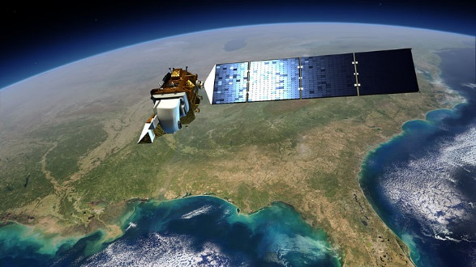
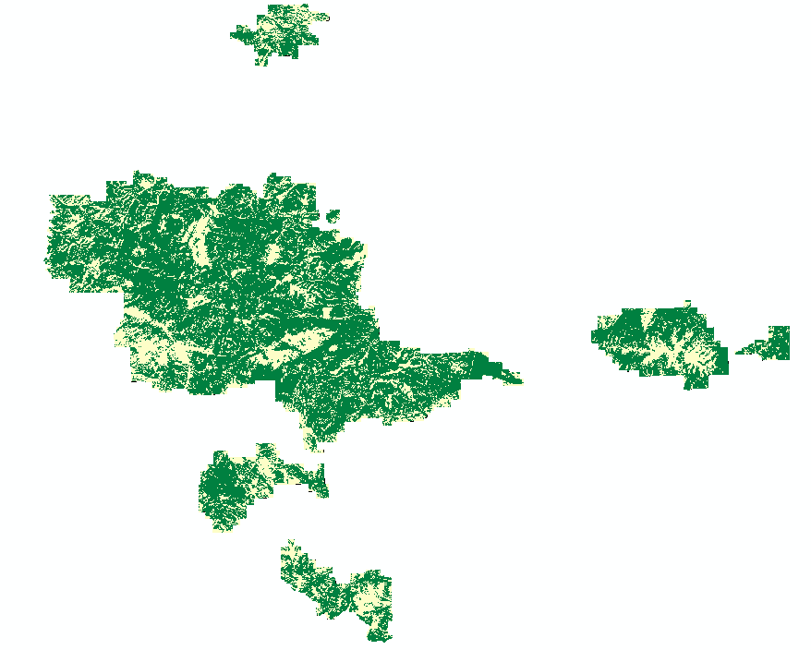
NASA Satellites
Landsat 8 – OLI
Land cover classification
Image credit: NASA GSFC
Overall Accuracy = 88%
Overall Kappa = 0.71
Forest
Non-forest
Notes:
Landsat 8 – OLI data was used to create a forest/non-forest land cover classification. The overall accuracy for the layer was 88% with an overall kappa value of 0.71.
Image source: https://commons.wikimedia.org/wiki/File:Landsat_8_%28LDCM%29_Satellite.jpg

Slide 8
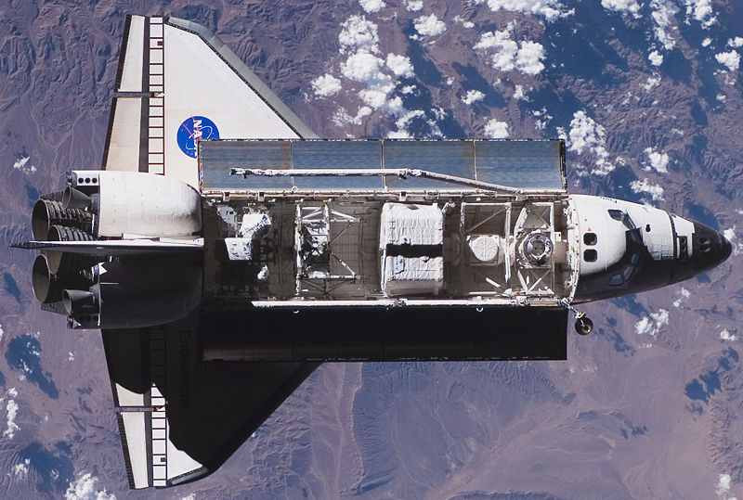
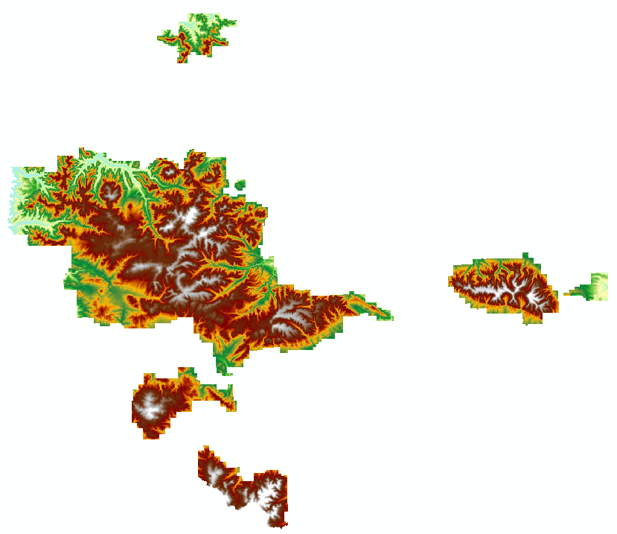
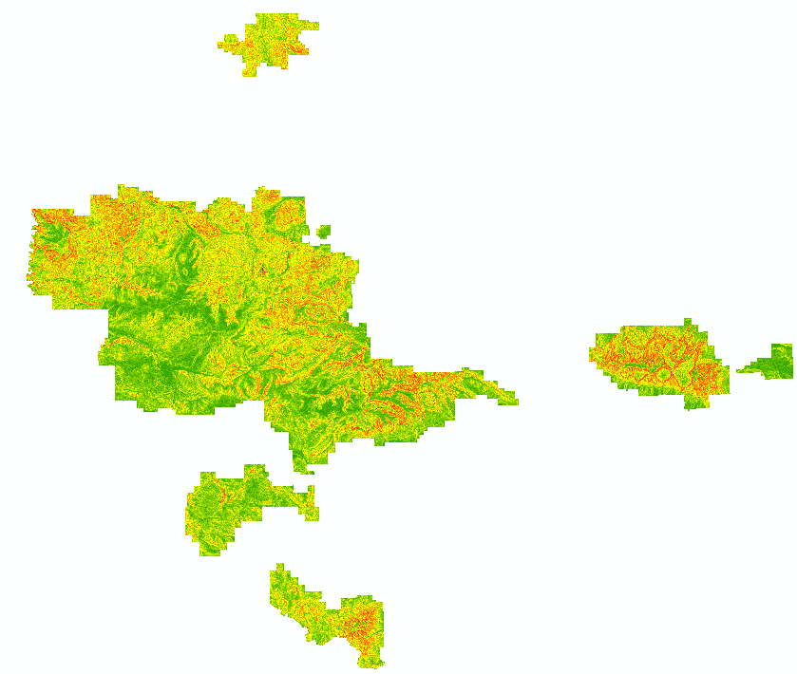
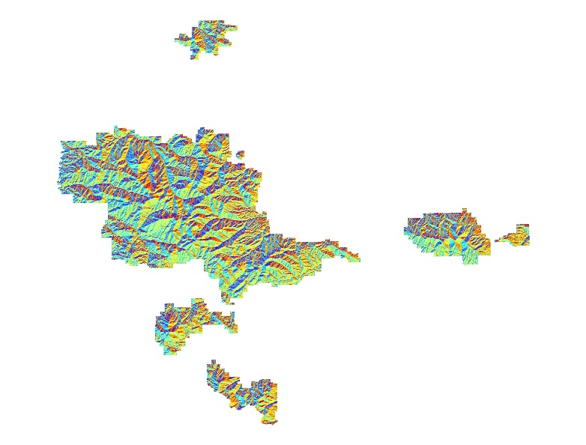
NASA Satellites
Shuttle Radar Topography Mission (SRTM)
Topographic features
Image credit: NASA
DEM
Slope
Aspect
Notes:
Five Shuttle Radar Topography Mission (SRTM) scenes were downloaded and mosaicked to create layers for topographic features including a digital elevation model and percent slope and aspect derivatives.
Image source: https://commons.wikimedia.org/wiki/File:STS-118_approaching_ISS.jpg

Slide 9
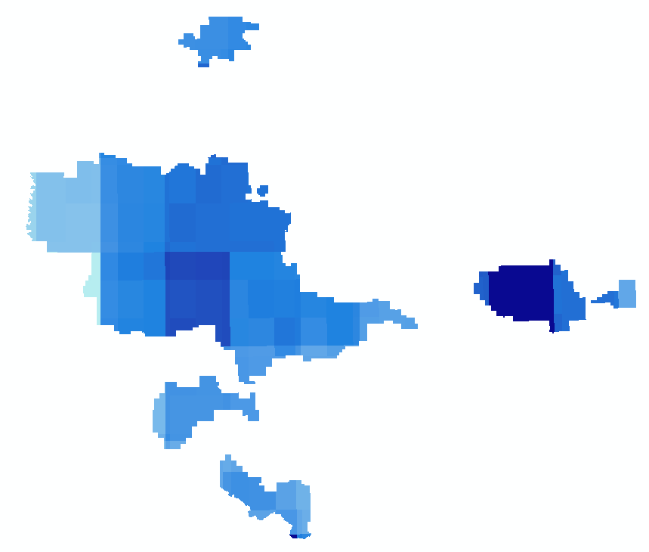
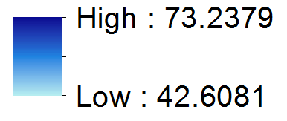
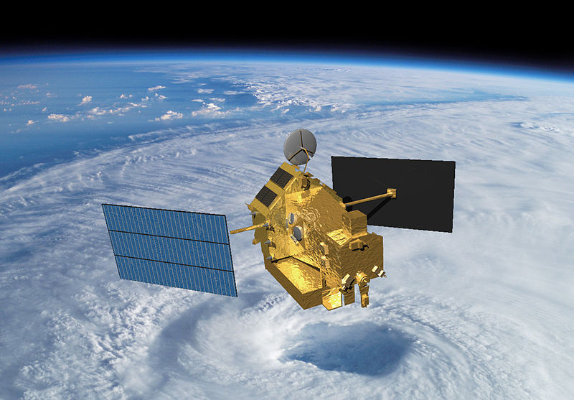
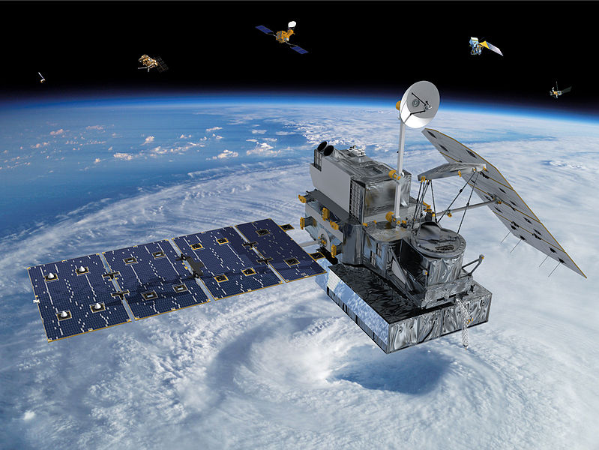
NASA Satellites
Tropical Rainfall Measurement Mission (TRMM)
Global Precipitation Measurement (GPM)
Precipitation 2010 - 2015
Precipitation mm/month
Image credit: NASA
Image credit: NASA
Notes:
We obtained precipitation data from Global Precipitation Measurement (GPM) and Tropical Rainfall Measurement Mission (TRMM) satellites to create a layer for average precipitation for the past 5 years. We downloaded and combined monthly global precipitation from TRMM for the years 2010-2014 and GPM for the most recent year.
Image source: https://en.wikipedia.org/wiki/Global_Precipitation_Measurement
Image source: https://commons.wikimedia.org/wiki/File:TRMM_in_Space_Large.jpg

Slide 10
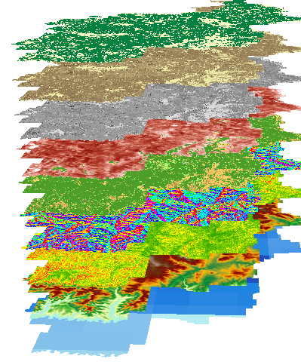
Habitat Suitability Modeling
Land Cover
Tree Canopy Cover
Tree Class Size
Basal Area
Vegetation Height
Aspect
Slope
DEM
Precipitation
Maxent · Mahalanobis Typicality · BioMapper
Notes:
In addition the environmental variable layers created from NASA EOS, four vegetation layers were created using data from the United States Department of Agriculture Forest Service (USDA Forest Service). These layers include tree canopy cover, tree class size, basal area, and vegetation height. These nine variables, along with the 190 nest site locations, were input into multiple habitat suitability modeling software - Maxent, Mahalanobis Typicality, and BioMapper – to create three unique habitat suitability maps.

Slide 11
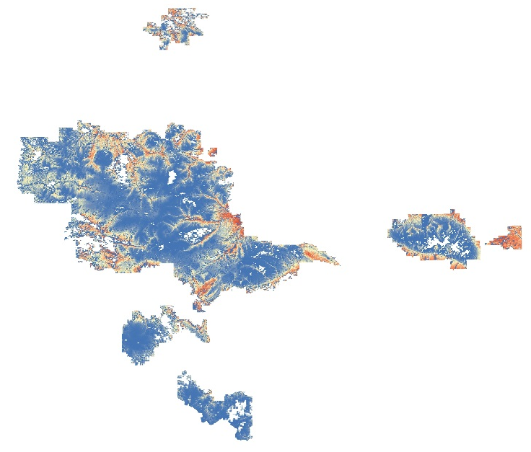

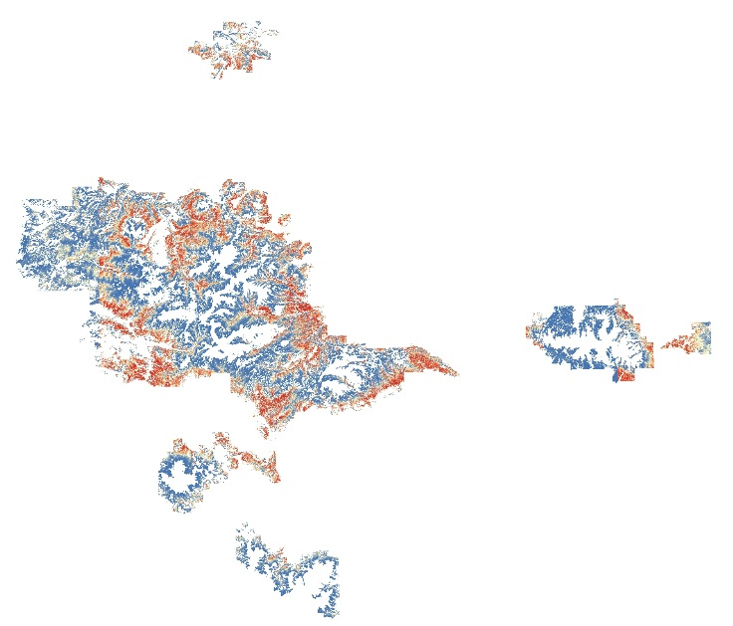
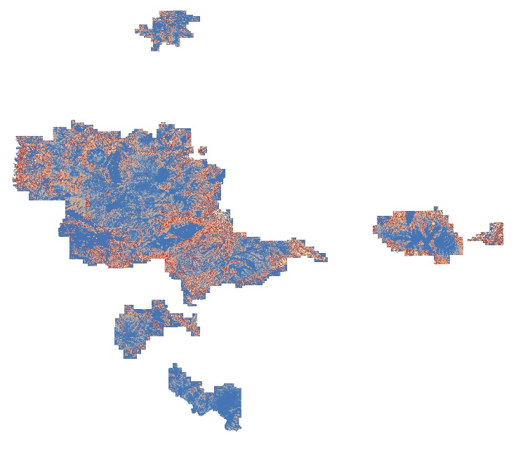
Results: Habitat Suitability Maps
Suitability
Maxent
Mahalanobis Typicality
BioMapper
Notes:
This slide shows the resulting habitat suitability maps for each model. The result from Maxent is at the top center, Mahalnobis Typicality on the left, and BioMapper on the bottom right. Red indicates areas of most suitable habitat; blue areas represent unsuitable goshawk nesting habitat.

Slide 12
Forecasting
Effects of Climate Change and Other Factors
Notes:
The second part of the project focused on forecasting the impact of climate change, mountain pine beetle, timber management, and fires on the goshawk nesting habitat. The goal of this part of the project was to forecast what areas of the Lewis and Clark National Forest will be viable for the goshawks based on the final suitability map and future scenarios.

Slide 13
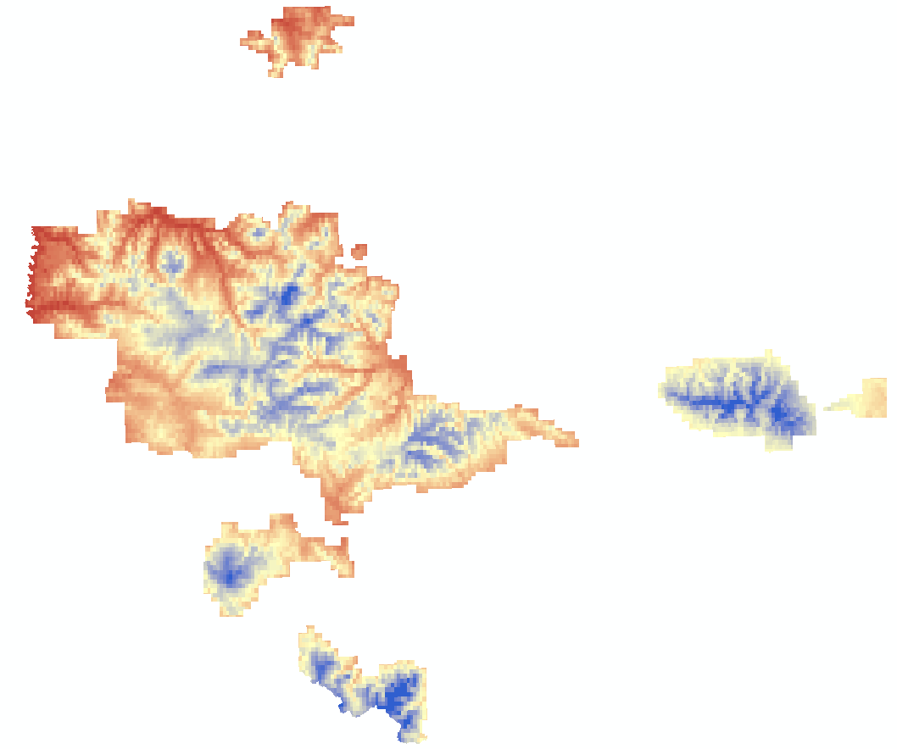
Forecasting
Forecasting…
Climate model + 3 scenarios (GISS-E2-R) – precip + temp
Beetle data/risk
Timber
Fire
<Slide In Progress>
Climate model images for each scenario
**sample image**
Notes:
<In Progress>

Slide 14
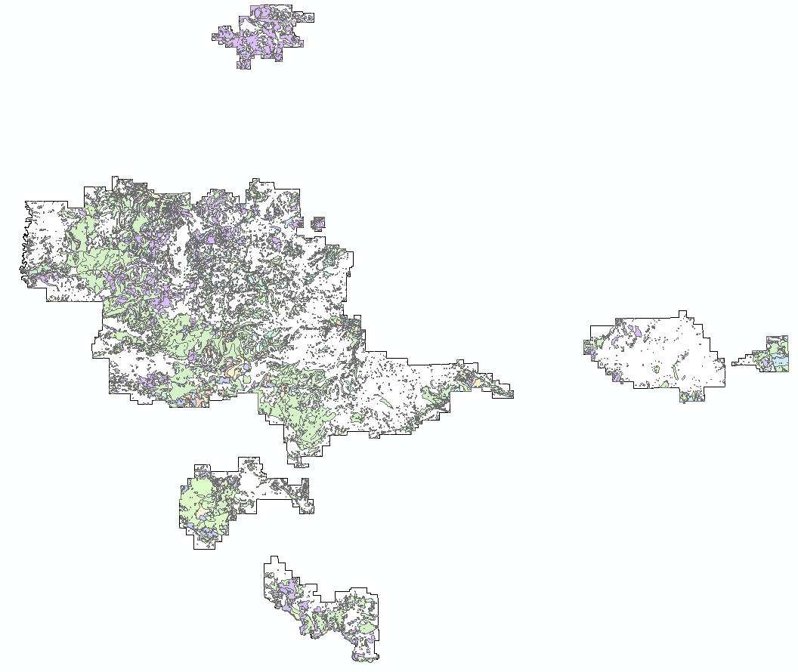
Forecasting
Forecasting – mountain pine beetle
<In Progress>
Map of beetle outbreak (2001-2014)
Map of beetle risk through 2027
**sample image**
Notes:
<In Progress>

Slide 15
Conclusions
Habitat suitability map conclusions
<In Progress>
<combined habitat suitability map>
Notes:
<In Progress>

Slide 16
Conclusions
Forecasting conclusions
<In Progress>
Notes:
<In Progress>

Slide 17
Advisors
Dr. Ross Nelson, NASA Goddard Space Flight Center
Partners
Dr. Nate Bickford, University of Nebraska at Kearney
Oulu University Researchers, Finland
Victor Murphy, USDA Forest Service
Others
Laura Conway, USDA Forest Service
Dr. Lee Vierling, University of Idaho
Dr. Jeff Hicke, University of Idaho
Dr. Nate McDowell, Los Alamos National Laboratory

