Slide 1
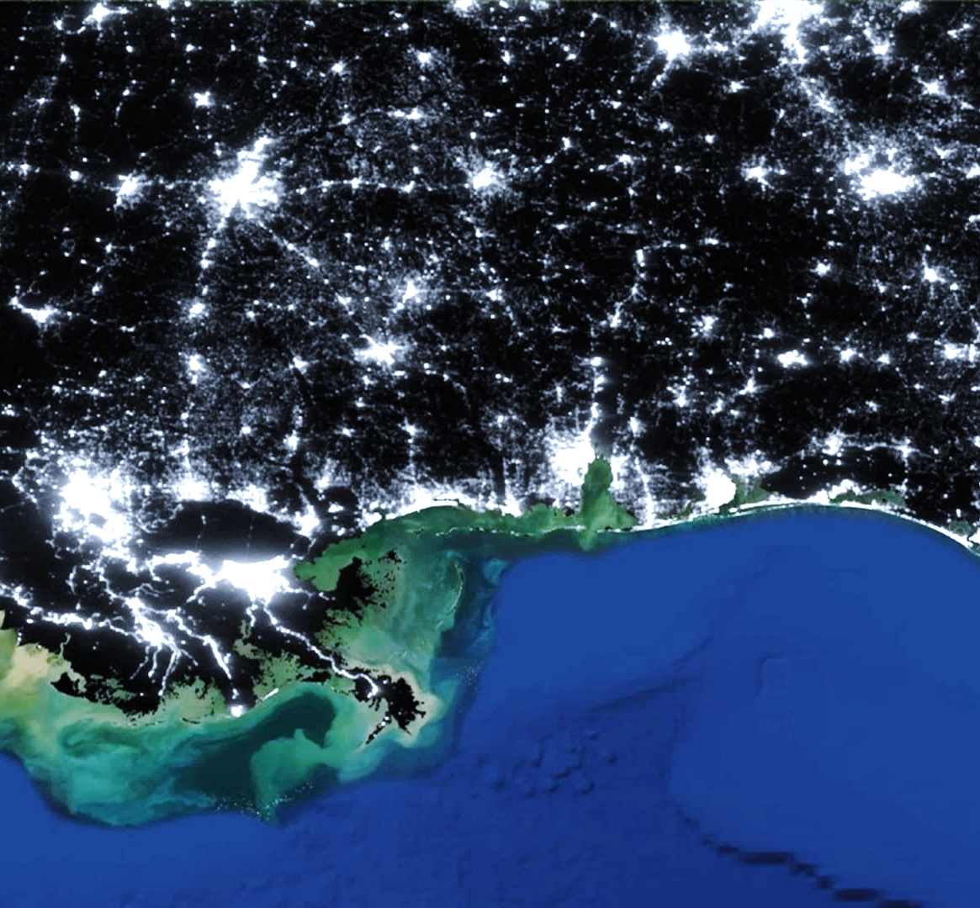
US URBAN DEVELOPMENT II
Utilizing Skyglow Tools to Assist in the Management of Light Pollution in US National Parks
Rachel Luo
Sarah Parker
Charlotte Rivard
Elise Turrietta
Virginia – Langley | Summer 2019
Notes:
[Elise] Good morning everyone, thanks for joining us today.
[Each teammate]
My name is Rachel Luo
My name is Sarah Parker
My name is Charlotte Rivard
My name is Elise Turrietta
We are the US Urban Development II team. This summer, we worked with the National Park Service to finalize a tool that NPS can use to monitor the national parks for light pollution. The tool, called the Skyglow Estimation Toolkit or SET for short, uses Suomi NPP VIIRS satellite imagery to predict sky brightness from the perspective of an observer on the ground.
Image Information
Credit: US Urban Development II Team

Slide 2
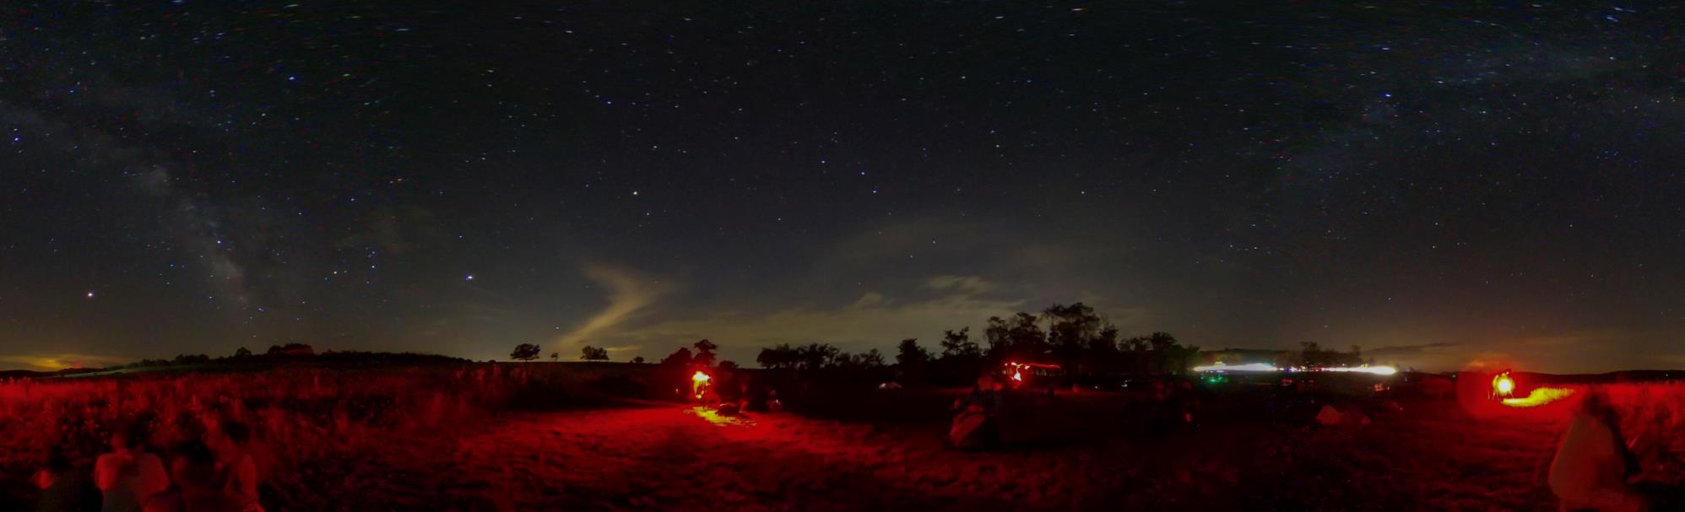
What is Skyglow?
Unshielded light from artificial sources scatters into a visible form of light pollution called skyglow.
Image Credit: National Park Service
Notes:
[Elise]
As urbanization and infrastructure networks continue to expand, light pollution has become one of the most rapidly increasing forms of environmental degradation (Falchi, Cinzano, Elvidge, Keith, & Haim, 2011). When unshielded artificial light from buildings, street fixtures, cars, and other man-made sources shine into the atmosphere, air molecules scatter the light into a visible “skyglow” over the surrounding area (Albers & Duriscoe, 2001; Chepesiuk, 2009). This light pollution has documented social, ecological, behavioral, and physiological effects on human, animal, and plant life (Chepesiuk, 2009; Navaro & Nelson, 2007).
Image Information
Credit: NPS (public domain)
Source: https://www.nps.gov/media/photo/view.htm?id=eb64e3ae-27a4-42ca-9360-83806abdf0fc

Slide 3
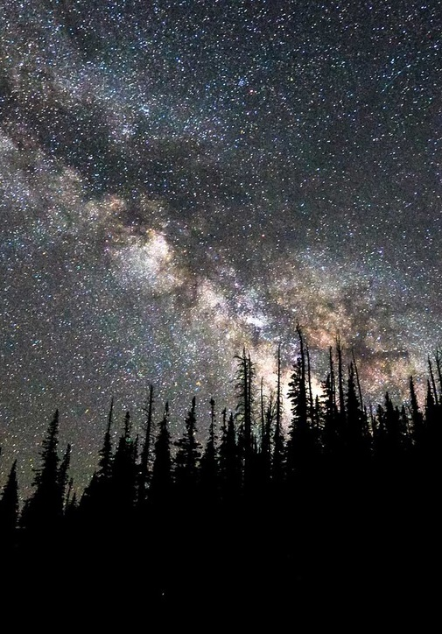
Community Concerns
99% of people in the United States and Europe live in areas with light pollution.
80% of North Americans cannot see the Milky Way with the naked eye.
Image Credit: National Park Service / Zach Schierl
Notes:
[Elise]
Not only does artificial light pollution deter scientific and recreational astronomy, it disrupts the awe-inspiring and uniquely human experience of observing and pondering the night sky (Falchi et al., 2016). The New World Atlas of artificial sky brightness indicates that over 80% of the world’s population and more than 99% of people in the United States and Europe live in areas of light pollution (Falchi et al., 2016). This atlas also shows that nearly 80% of North Americans are unable to see the Milky Way with the naked eye.
Image Information
Credit: National Park Service photo by Zach Schierl (public domain)
Source: https://www.nps.gov/media/photo/view.htm?id=CAD1EE4C-1DD8-B71B-0BA9F7D7E07209F5

Slide 4

Impact on Wildlife
Patterned animal behaviors have evolved around the natural day-night cycle.
The relatively recent changes in nighttime light could affect their survival.
Image Credit: National Park Service
Notes:
[Elise]
So why is NPS interested in estimating and monitoring skyglow? Some instances of light pollution’s impact on wildlife are well known. For example, sea turtle hatchlings are disoriented by lights from beachfront buildings and head inland instead of towards the water after they hatch (Longcore & Rich, 2004). More generally, the patterned physiological behaviors of animals, including foraging, reproduction, and communication, have evolved around the natural day-night cycle. The relatively recent skew in night time lighting could dramatically alter their survival and fitness in ways we have not yet seen. (Longcore & Rich ; Navaro & Nelson 2007)
Image Information
Credit: National Park Service (public domain)
Source: https://www.nps.gov/pais/learn/nature/hatchlingreleases.htm

Slide 5
Impact on Humans
Decreased melatonin production
Sleep deprivation
Obesity
Depression
Heart disease
Cancer
Exposure to artificial light, especially at night, decreases melatonin production.
Notes:
[Elise]
The physiological effects of light pollution also reach humans. Exposure to artificial light, especially at night, decreases melatonin production. When functioning normally, this endocrine process serves as the body’s clock for daily rhythms. Alterations to this circadian clock due to a lack of melatonin increase the risk of health problems including sleep deprivation, obesity, depression, heart disease, and some cancers (Chepesiuk, 2009; Falchi et al., 2011).

Slide 6
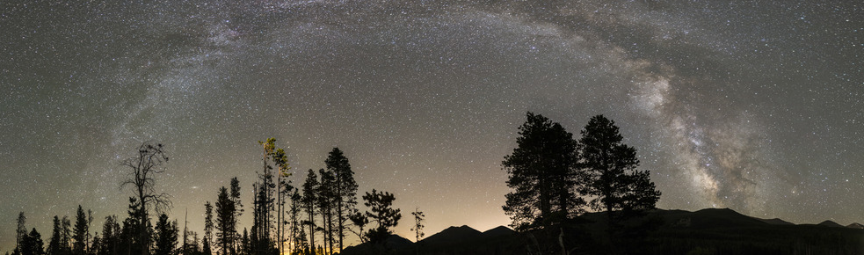

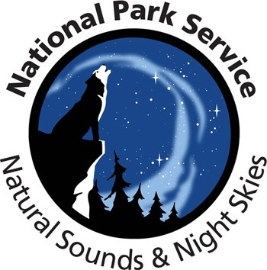
Partners
Image Credit: National Park Service / Jeremy M White
“The Natural Sounds and Night Skies Division works to protect, maintain, and restore acoustical and dark night sky environments throughout the National Park System. We use science, engineering, and technology to understand and better manage these spectacular resources.”
- Natural Sounds & Night Skies Division website
Notes:
[Elise]
Given the mounting scientific evidence behind the biological impacts of light pollution, the National Park Service’s Natural Sounds and Night Skies Division strives to preserve natural night skies. However, monitoring sky brightness with land-based equipment is expensive and limited to only a few days of the year, given the remoteness of some national parks and the need measure only on clear, moonless nights. NPS partnered with DEVELOP to leverage satellite imagery to provide a more comprehensive, less expensive method for light pollution estimation and visualization, with the goal of improving management and increasing public awareness of skyglow. SET is the tool created out of this partnership.
Image Information
NPS Logo
Credit: National Park Service (public domain)
Source: https://commons.wikimedia.org/wiki/File:US-NationalParkService-Logo.svg
NSNSD Logo
Credit: National Park Service National Sounds & Night Skies Division (public domain)
Source: https://www.nps.gov/orgs/1050/contactus.htm

Slide 7
Objectives
Skyglow Estimation Toolbox
Fix
Validate
Train
Troubleshoot
Write unit tests
Streamline the script
Test on study area parks
Compare to NPS ground truth data
Create written tutorial
Train partners in person
Generate hemispheres
Host webinar
Notes:
[Sarah]
Our objectives this summer included validating SET against in situ ground – truth measurements to assess the program’s accuracy and exhibit its ability to perform across diverse geographies. Based on this validation, we made fixes to SET including output calibrations to ensure it functions properly and can produce reliable estimates. A third objective was to create a comprehensive training program for SET, including written instructions and a recorded tutorial, to ensure the tool can be properly operated by our end-users at the NPS Natural Sounds and Night Skies Program officials, and anyone else who takes interest.
Image Information
Credit: US Urban Development Team

Slide 8
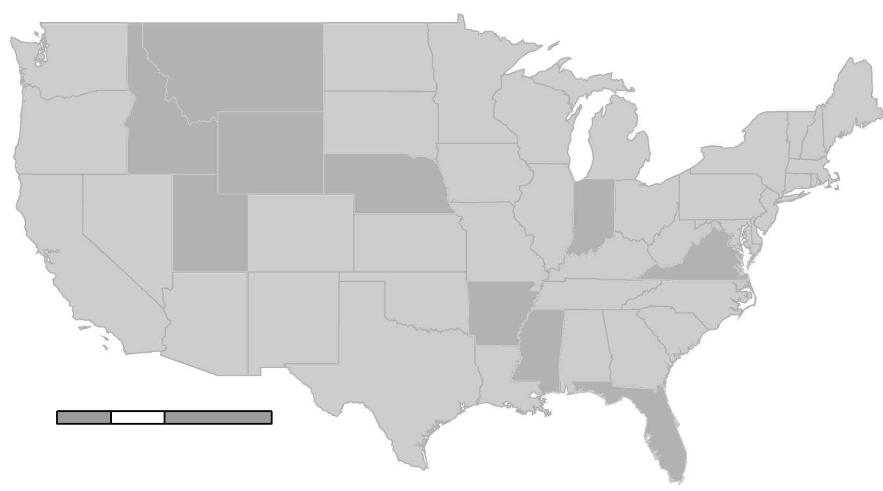

Study Area
1
1
Yellowstone National Park
Arches National Park
Scotts Bluff National Monument
Buffalo National River
Gulf Islands National Seashore
Indiana Dunes National Park
Shenandoah National Park
2
3
6
3
2
7
4
N
4
5
6
5
7
0
400
800
1600
km
Image Credit: US Urban Development II Team
Map Credit: Esri ArcGIS Pro baselayer USA States (Generalized)
Notes:
[Sarah]
To validate SET, the DEVELOP team studied six parks throughout the country with differing levels of skyglow to gain a sense of how SET performs across different scenarios. The sites were selected by NPS based on the current priorities of the Natural Sounds and Night Skies Division, and based on the availability of ground-truth data against which to verify SET outputs.
Image Information
Credit: US Urban Development II Team

Slide 9

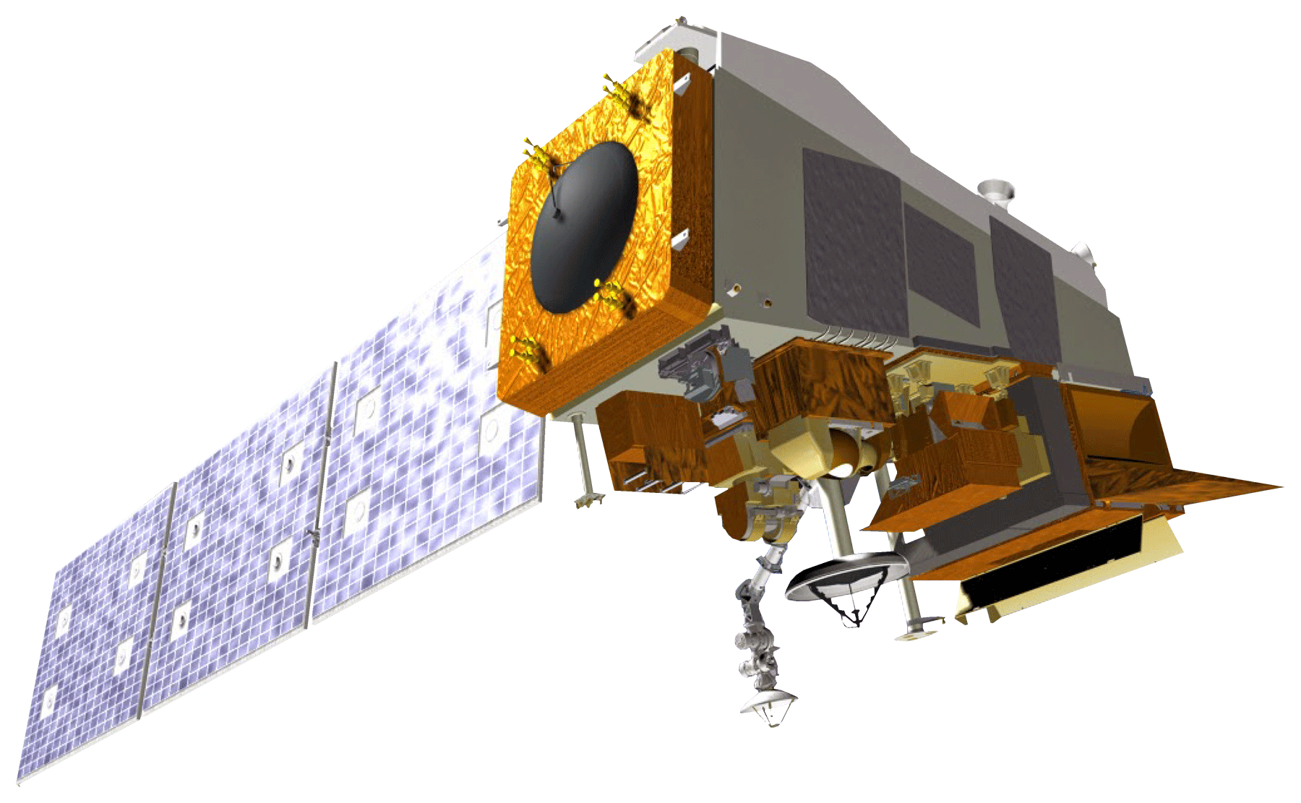
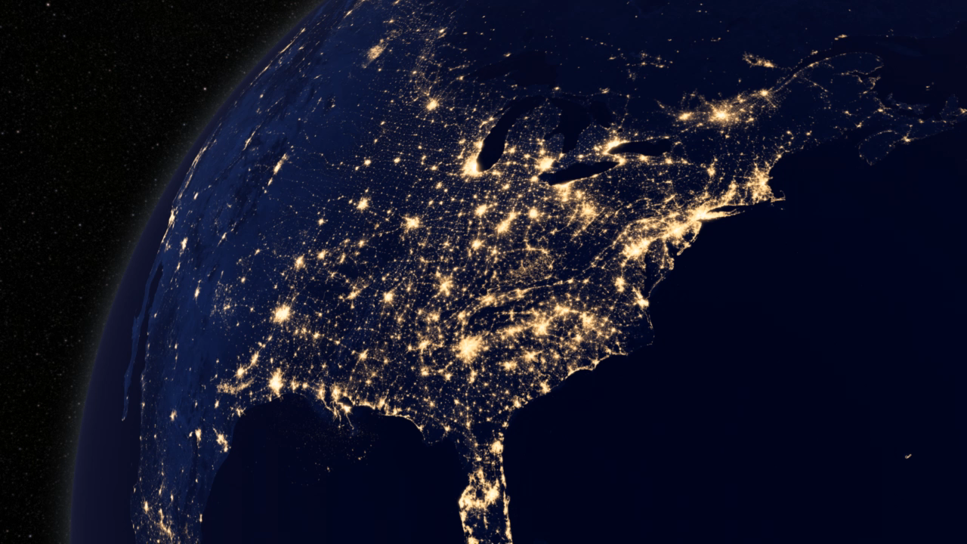

DATA COLLECTION
Suomi National Polar-Orbiting Partnership (Suomi NPP)
Visible Infrared Imaging Radiometer Suite (VIIRS)
Day/Night Band (DNB)
Image Credit: NASA
  500 to 900 nm wavelengths
NOAA’s National Center for Environmental Information (NCEI) Earth Observation Group (EOG)
  Day/Night Band (DNB) data product
  Average monthly radiance composite
  Filtered to remove stray light
  May through October for
  2014 to 2018
Video Credit: NASA Goddard Space Flight Center
Notes:
[Sarah]
To analyze skyglow for these parks, SET uses earth observation data from the Suomi National Polar Orbiting Partnership Satellite, a joint mission between NOAA and NASA. Suomi NPP has a Visible Infrared Imaging Radiometer Suite nighttime sensor with a Day/Night Band which detects light in the range of wavelengths from green to near infrared. The Earth Observation Group at NOAA’s National Center for Environmental Information processes raw Suomi NPP data and produces averaged monthly composite VIIRS DNB images. These products have been filtered to remove most sources of stray light, and have been historically used to study changes over time such as increases in artificial light, economic activity, and development.
Monthly composites are available from 2014 through 2018. We only analyzed summer months in order to take advantage of clear summer skies and also to exclude the impact of snow, which can increase light reflection and artificial sky brightness by roughly 10% (Falchi, 2011). Thus, only data and measurements from May to October for the years 2014-2018 were included in this study.
Note that though the broader concern is with the impact of artificial light (skyglow), our tool currently produces estimates that include natural and artificial light (sky brightness), because we are relying directly on a version of VIIRS DNB data which does not filter out natural light. A next step for this project could be to build in further processing in order to estimate anthropogenic light only.
Earth Observation Group. (2017). Version 1 Nighttime VIIRS Day/Night Band Monthly Composites. NOAA National Centers for Environmental Information. Retrieved July 2, 2018, from https://www.ngdc.noaa.gov/eog/viirs/download_dnb_composites.html
Image Information
Satellite Pic
Credit: NASA (public domain)
Source: http://www.devpedia.developexchange.com/dp/index.php?title=List_of_Satellite_Pictures
Video
Credit: NASA Goddard Space Flight Center (public domain)
Source: http://svs.gsfc.nasa.gov/4019

Slide 10
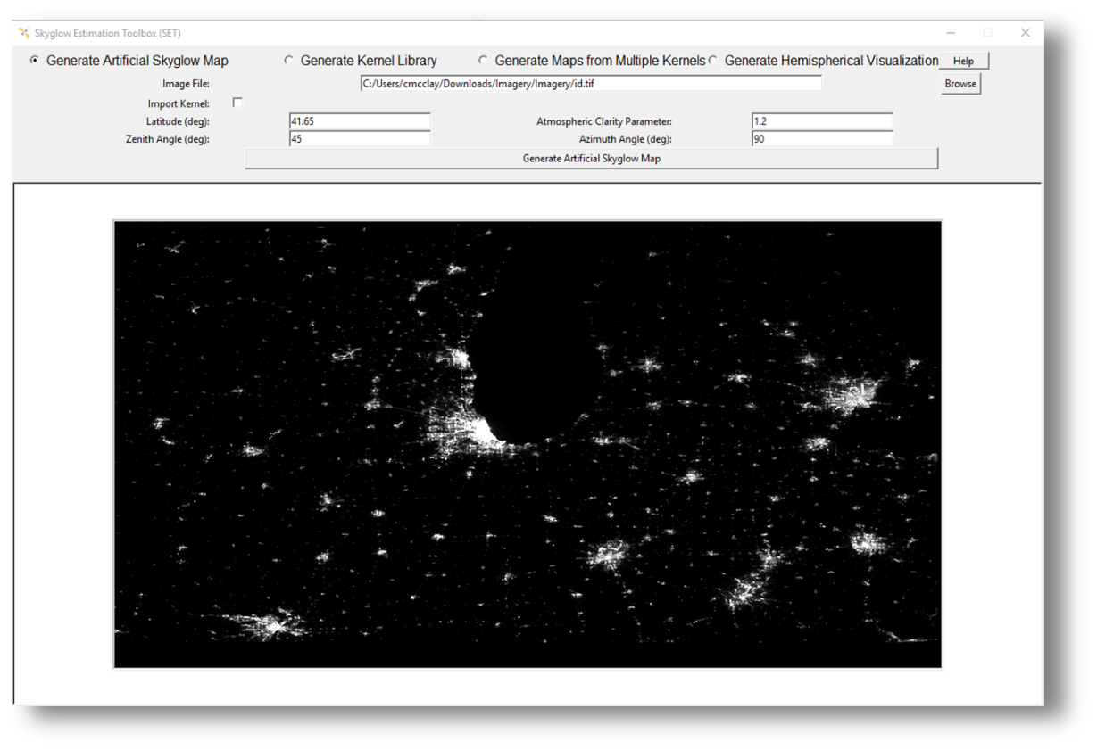
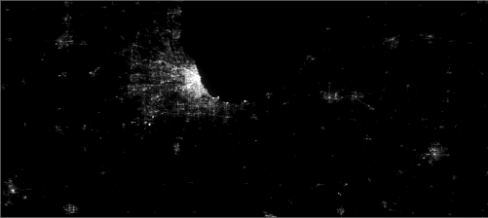
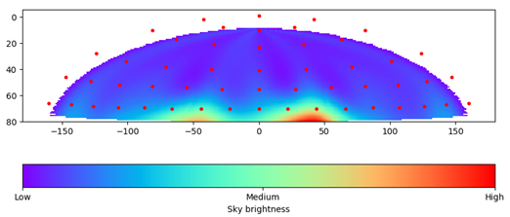
Skyglow Estimation Toolbox (SET)
2D Skyglow Maps
3D Hemispheric Visualizations
Image Credit: US Urban Development II Team
Notes:
[Charlotte]
The Skyglow Estimation Toolbox (SET) is a Python-based software that uses VIIRS images to calculate and visualize artificial sky brightness from any given location and viewing angle. The outputs include 2D skyglow maps and 3D hemispheric visualizations of sky brightness across an observer’s field of view.
Image Information
Credit: US Urban Development II Team

Slide 11

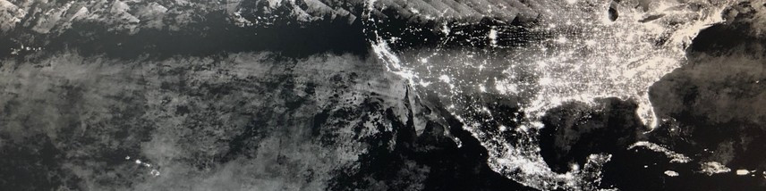
Methodology
1. Data
2. Processing
3. Generate Hemisphere Maps (SET)
4. Analysis
Validate Results
Compare outputs from SET with ground truth data from the National Park Service.
Download VIIRS Data
Access Suomi NPP VIIRS DNB Data from EOG website.
Create Median Images
Calculate the median value of VIIRS images and clip them to the study area.
Estimate Skyglow
Run SET on the median VIIRS image to estimate a 3D hemispheric visualization of light pollution from a specific location.
Image Credit: NASA (top), NOAA NCEI EOG (bottom)
Notes:
[Charlotte] To run SET, we first download VIIRS DNB data and create one baseline image for each park by taking the median of the 2014-2018 data for the summer months. This helps to reduce noise in the image. We then run the baseline image through SET to generate skyglow maps and 3-D hemispheric visualization for a location within the park. These outputs are then validated against NPS data to assess performance accuracy.
Image Information
VIIRS image
Credit: NOAA NCEI EOG
Source: https://www.ngdc.noaa.gov/eog/viirs/download_dnb_composites.html
Validation image
Credit: US Urban Development II Team
Satellite
Credit: NASA
http://www.devpedia.developexchange.com/dp/index.php?title=List_of_Satellite_Pictures

Slide 12
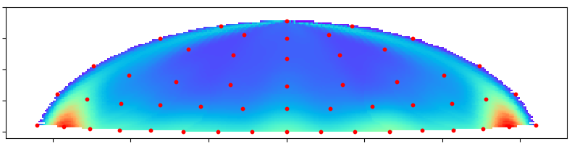
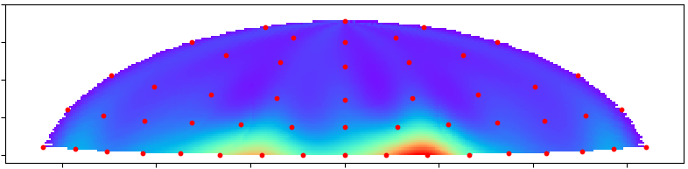
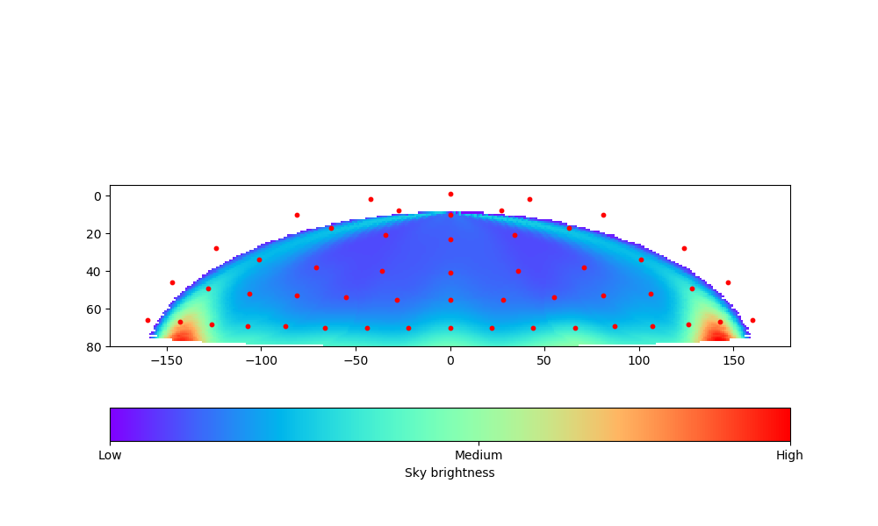
Results
zenith
0
20
Arches National Park
Coordinates: -109.6, 38.7
May through October (2014 to 2018)
40
60
80
-150 -100 -50 0 50 100 150
zenith
azimuth
0
20
Gulf Islands National Seashore
Coordinates: -88.7, 30.2
May through October (2014 to 2018)
40
60
80
-150 -100 -50 0 50 100 150
azimuth
Sky Brightness (relative)
Low Medium High
Notes:
[Rachel]
The main SET outputs of interest to the National Park Service are the hemispheres, two of which are displayed here. Each hemisphere visualizes the amount of sky brightness across an observer’s field of vision at a certain geographical coordinate. The image is plotted with azimuth on the x-axis, representing the direction the observer is facing, with 0 degrees being due north. The y-axis is the zenith, representing how far up the observer is looking in the sky, with 0 degrees being straight up.
Note that though the hemispheres all use the same color scale, the colors within each hemisphere are assigned relative to the values within the hemisphere itself, not to those for other parks.
In addition to training NPS representatives to use SET for the production of these hemispheres, we produced six for the top national parks of concern to the end user. Each hemisphere is located at the coordinate point where NPS takes its ground truth data, so that the SET outputs can also be used for validation against ground-truth data taken by NPS as we worked to calibrate SET.
The top hemisphere on this slide is for Arches National Park. The red patches illustrate light from the town of Moab, Utah south of the park. Even though this is one light source, it shows up on both ends of the hemisphere because the hemisphere wraps around at due south.
The bottom hemisphere is for Gulf Islands, and represents light from two Mississippi towns to the northeast and northwest, Pascagoula and Biloxi.
Source: US Urban II team

Slide 13
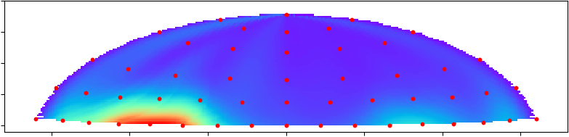
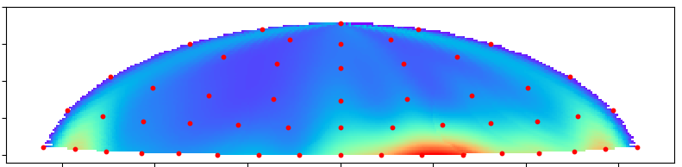
Results
zenith
0
20
Indiana Dunes National Park
Coordinates: -87.0, 41.7
May through October (2014 to 2018)
40
60
80
-150 -100 -50 0 50 100 150
zenith
azimuth
0
20
Scotts Bluff National Monument
Coordinates: -103.7, 41.8
June through October (2014 to 2018)
40
60
80
-150 -100 -50 0 50 100 150
azimuth
Sky Brightness (relative)
Low Medium High
Notes:
[Rachel]
The night skies at Indiana Dunes are affected by one major source—the Chicago metropolitan area.
Meanwhile, Scotts Bluff is affected by its proximity to a string of towns on the park’s eastern border.
Source: US Urban II team

Slide 14
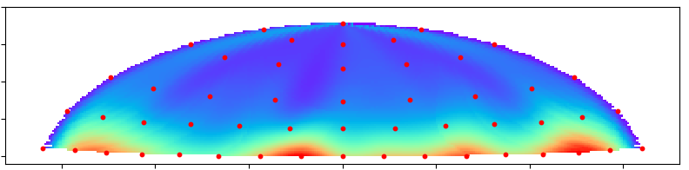
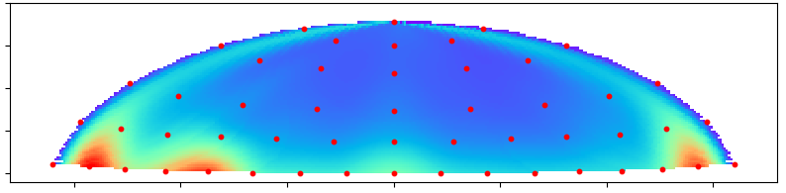
Results
zenith
0
20
Shenandoah National Park
Coordinates: -78.7, 38.2
May through October (2014 to 2018)
40
60
80
-150 -100 -50 0 50 100 150
zenith
azimuth
0
20
Yellowstone National Park
Coordinates: -111.1, 44.7
June through September (2014 to 2018)
40
60
80
-150 -100 -50 0 50 100 150
azimuth
Sky Brightness (relative)
Low Medium High
Notes:
[Rachel]
Shenandoah is exposed to skyglow from most directions, reflecting its location within a ring of Virginian cities.
Yellowstone National Park is remote, and the NPS-chosen observation point is affected mostly by light from the West Yellowstone town and air strip.
Source: US Urban II team

Slide 15
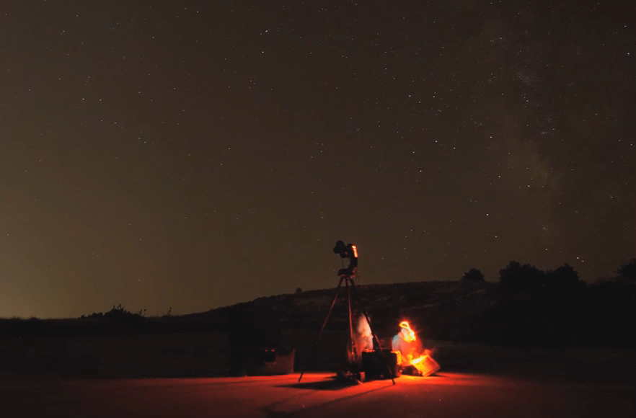
Validation
  Validation was conducted using NPS ground truth measurements.
  Measurements taken with camera for visible zenith, azimuth angles
  Images captured during moonless summer nights
Video Credit: National Park Service, Sharolyn Anderson and Li – Wei Hung
Notes:
[Charlotte]
To validate these outputs from our tool, we used ground truth measurements provided by our partners at the National Park Service. The ground truth data is collected by NPS staff who travel to remote areas of parks during moonless summer nights and conduct their observations using a specialized rotating camera.
Image Information
National Park Service, Sharolyn Anderson and Li-Wei Hung (public domain)
Source: https://www.nps.gov/media/video/view.htm?id=05C100C9-D9FE-C304-5F2BB6CFDB10304F

Slide 16
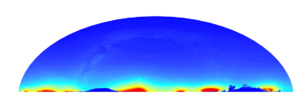
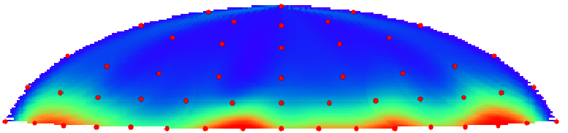
Validation
R² = 0.93
NPS Ground Truth Data
SET 3D Hemisphere
Notes:
[Charlotte]
Conceptually, the validation works by comparing pixel values of select points in our skyglow maps to the corresponding points in the ground truth data. The points can be plotted and should show a strong positive correlation if our model is generating accurate skyglow maps.
However, as you can see from the axes, SET values are considerably lower than NPS ground truth values, which can be expected given that SET performs a discrete summation rather than a continuous integration to calculate the total light visible along an observer’s line of sight.
Image Information
US Urban Development II Team

Slide 17
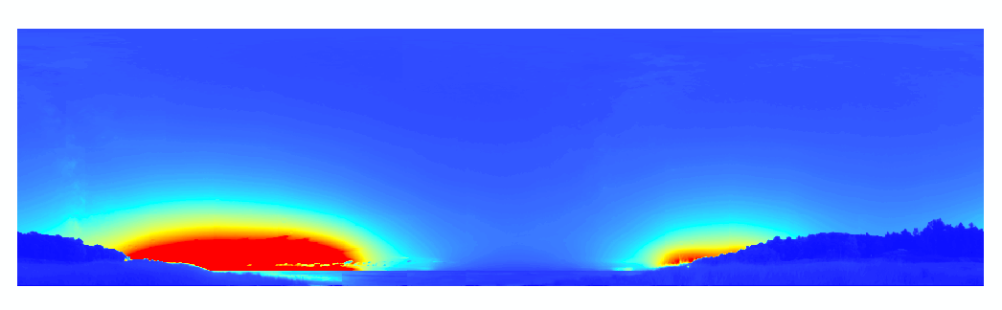
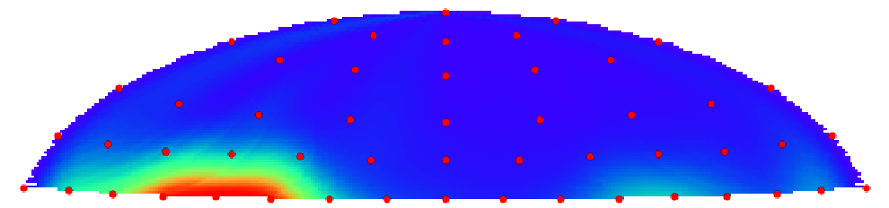
Validation
R² = 0.84
NPS Ground Truth Data
SET 3D Hemisphere
Notes:
[Charlotte]
The top hemisphere is our estimate for Indiana Dunes National Park. When compared to the ground-truth image taken by NPS, you can see that our estimated hemisphere successfully picked up on the strong light source to the west of the observation point, as well as the fainter light dome to the east.
The strong western light source is in fact Chicago. Indiana Dunes represents a case where a park’s sky brightness is strongly affected by one distinct urban source.
Note that although the hemispheres all use the same color scale, the colors within each hemisphere is assigned relative to the values within the hemisphere itself, not to those for other parks.

Slide 18
Validation
Notes:
[Charlotte]
Overall, across all the parks for which we conducted this validation, there is a strong positive correlation between SET and NPS ground-truth values.
However, the relationship between the two are less tight for the brightest areas, which generally tend to occur near the horizon.

Slide 19
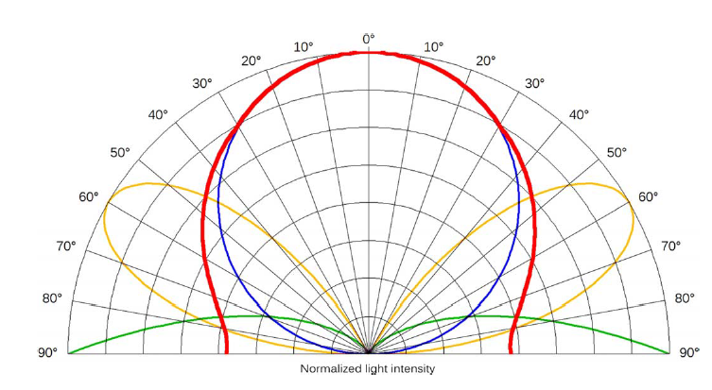
Limitations and Uncertainties: SET
Data
Emission model
VIIRS misses wavelengths <500 nm, i.e. blue light
High-latitude regions are not well-captured by VIIRS
Falchi emissions model uses fixed weights that assume a certain observation environment
Topological shielding not modelled
Snow and water-reflected light need to be separately modelled
Normalized light intensity
Falchi et al. (2016) calibrate fixed weights for a three-part light emission model using a maximum likelihood fit.
Image Credit: Falchi et al. (2016)
Notes:
[Rachel]
SET’s outputs face several limitations due to the data sources we are using for our inputs and due to the underlying emissions model.
On the data side, SET is currently calibrated to run with VIIRS DNB, which misses wavelengths shorter than 500 nm—ie, the blue end of the visible light spectrum. Light fixtures across the world are moving towards LED lighting, which are bluer and therefore not well captured by VIIRS. This means that light pollution from this source is also not well modelled by SET, a problem that will only worsen over time if the current rate of blue light adoption continues. Further, VIIRS data are much more noisy for high latitudes because of snow, aurora, and short summer nights.
Another source of limitations is the emissions model underlying SET, which relies on weights calibrated by Fabio Falchi in his 2016 paper. These weights are fixed and make certain assumptions regarding the form of urban emissions, the hour of observation, atmospheric transparency, and artificial light spectra that do not always perfectly reflect the conditions across our wide range of parks. A more dynamic weighting system would improve the model’s performance. Our model also does not account for topological shielding (e.g., impact of hills in blocking out distant light sources). Snow and water also have unique light scattering properties that SET does not account for.
Source: Falchi, F., Cinzano, P., Duriscoe, D., Kyba, C. C. M., Elvidge, C. D., Baugh, K., & Furgoni, R. (2016). The new world atlas of artificial night sky brightness. Science Advances, 2(6), e1600377. doi:10.1126/sciadv.1600377

Slide 20
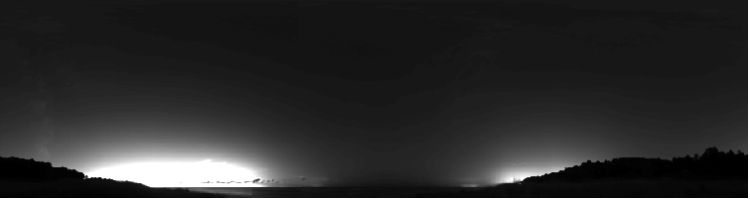
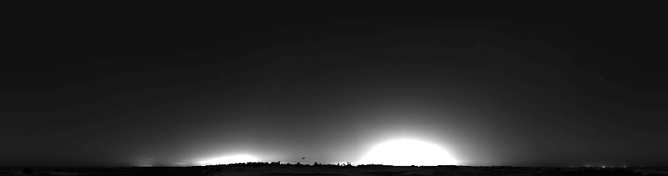
Limitations and Uncertainties: NPS
Uncertainties in NPS data affect SET calibrations.
Equipment setup affects the range of zenith and azimuth available for validation.
NPS instruments are oversensitive to extremely bright lights.
The above are NPS ground truth hemispheres from Indiana Dunes and Gulf Islands.
Source: National Park Service
Notes:
[Rachel]
Another source of uncertainty came from the quirks within the NPS data that we used to calibrate and validate SET. For one, NPS observation equipment can be aligned slightly differently between observations, which means that the range of the dataset (zenith and azimuth covered in an image) differs slightly from image to image, with some missing rows near the edges. This in turn affects the pixels we are able to compare against the SET outputs during validation.
Additionally, NPS instruments are over-sensitive in some contexts such as in the presence of very bright urban lighting. This created outliers that we had to drop during validation, limiting the amount of data we were able to use for calibration.
Source: National Park Service (public domain)

Slide 21
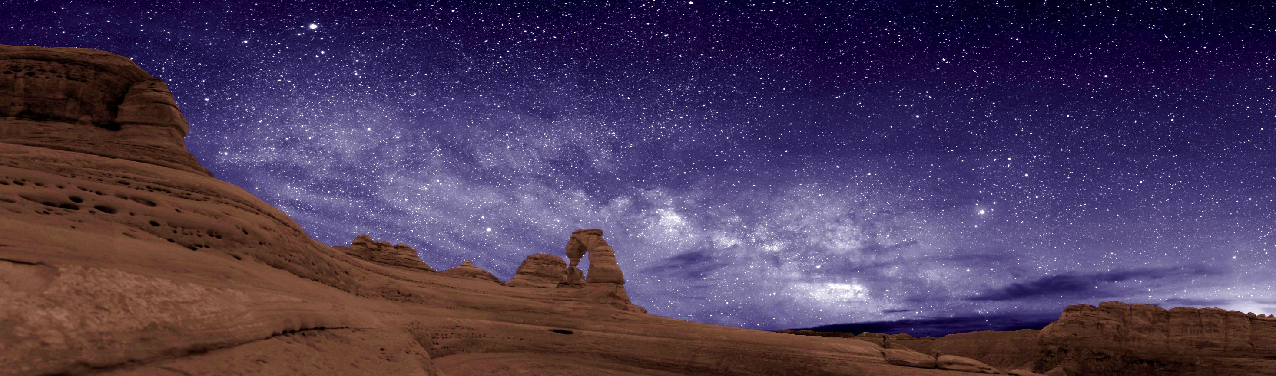
Conclusions
Image Credit: National Park Service / Dan Duriscoe
SET produces 3D sky brightness hemispheres that align well with NPS ground-truth.
Limitations still exist for areas with high snow cover, water, and high latitude.
The tool can be reliably used by NPS to assess skyglow more frequently and in more locations than previously possible.
Notes:
[Rachel]
In conclusion, this year’s team was able to validate SET against ground-truth NPS data and note SET’s limitations in regions with high snow cover, extensive water, and high-latitude regions. The tool can be reliably used by the National Park Service to assess skyglow, which means that the Natural Sounds and Night Skies team will be able to obtain skyglow estimates for areas where they are unable to take ground-based measurements. The hemispheres can also be used for science communications as NPS works with other agencies and the public to manage the night sky for the future.
Image Credit: National Park Service / Dan Duriscoe. https://npgallery.nps.gov/AssetDetail/933695f5-475c-4841-8d3e-5b7ada32c9f8

Slide 22
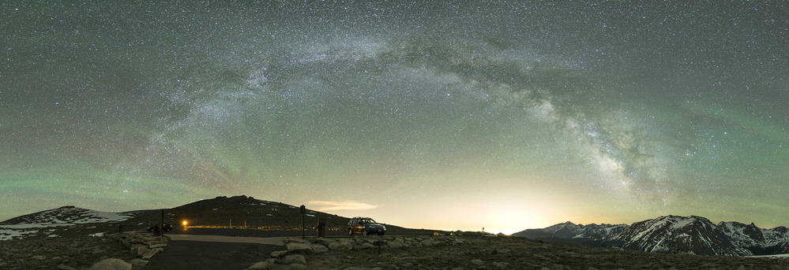
Thank you NPS Night Skies Division!
Dr. Sharolyn Anderson, National Park Service
Dr. Li-Wei Hung, National Park Service
Image credit: National Park Service
Notes:
A huge thank you to Dr. Sharolyn Anderson and Dr. Li-Wei Hung from the National Park Service Night Skies Division for their support, data, and scientific knowledge. We’re excited that they will be taking on this project once we leave, to finish debugging SET and begin using it as a complement to their ground-based observations.
Greater skyglow is not an inevitable part of growing urbanization, and protecting dark skies doesn’t mean throwing civilization back into the dark ages. It simply requires that we efficiently and effectively shield and use proper lighting, respecting our human environment, wildlife, and the night sky we enjoy.
We hope that better understanding our night skies can contribute to our night skies that:
--animals depend on
-- visitors seek for connection
--And is an important part of preserving our heritage of starry skies for the future
https://www.nps.gov/media/photo/view.htm?id=0D6E4D0A-1DD8-B71B-0B7A4D35D9C4A232
Image Information
NPS Logo
Credit: National Park Service (public domain)
Source: https://commons.wikimedia.org/wiki/File:US-NationalParkService-Logo.svg
NSNSD Logo
Credit: National Park Service National Sounds & Night Skies Division (public domain)
Source: https://www.nps.gov/orgs/1050/contactus.htm

Slide 23
Partners
Dr. Sharolyn Anderson, National Park Service
Dr. Li-Wei Hung, National Park Service
Dr. Neil Carter, Boise State University and University of Michigan
Advisor
Dr. Kenton Ross, NASA Langley Research Center
NASA DEVELOP Past Contributors
Summer 2018: Maximilian Ioffe, Julia Hink, Tyler Jameson, Charlie McClay
Fall 2017: Margaret Mulhern, Manda Au, Ian Brastow
Summer 2017: Veronica Warda, Ryan Avery, Steven Chao, Stanley Yu
Spring 2017: Benjamin Marcovitz, Aubrey Hilte, Christine Stevens, Eric White
Notes:
[Rachel]
We’d also like to thank Professor Neil Carter from Boise State University and the University of Michigan, for demonstrating to us the impact of light pollution on wildlife.
Further, we can’t have come this far without Dr. Ross’s coaching and his wealth of GIS as well as science knowledge. Thank you Dr. Ross!
We’d also like to thank the many, many past DEVELOP participants who started and built up SET over the years.

Slide 24







Thank You!
Rachel Luo
Project Lead
Sarah
Parker
Charlotte
Rivard
Elise
Turrietta
Notes:
Script
Thank you for listening to our presentation.
--end--
Image Source: US Urban Development Team

