Slide 1
Lake Victoria Water Resources
Spatio-Temporal Analysis of Lake Victoria Water Hyacinth and Algal Blooms Using NASA Earth Observations for Improved Water Management
Jeanné le Roux (Project Lead)
Sara Amirazodi
Daryl Ann Winstead
Austin Vacek
Christina Fischer

Slide 2
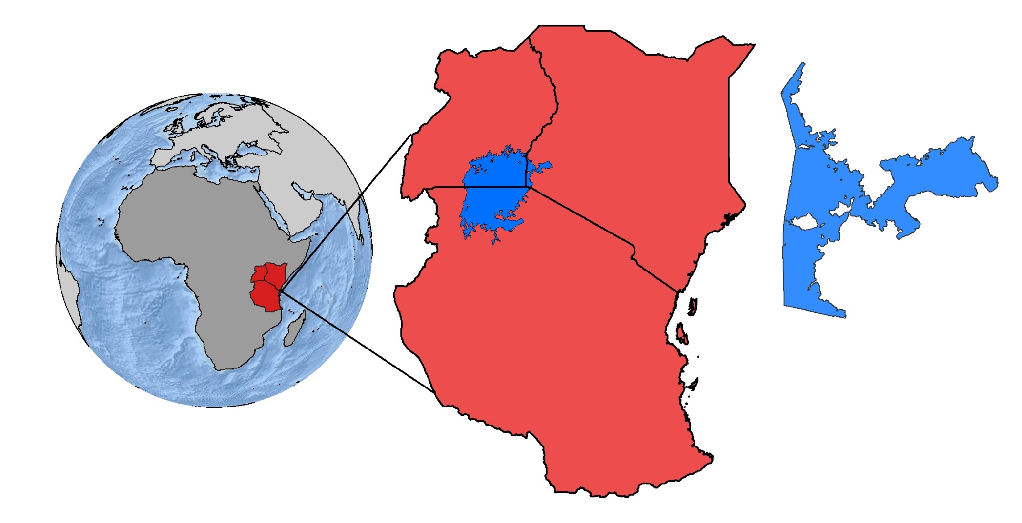
Study Area & Study Period
Uganda
Kenya
Lake
Victoria
Tanzania
Winam Gulf,
Kenya
Winam Gulf in Lake Victoria
August 2000 to Present
Notes:
Lake Victoria borders Uganda, Kenya, and Tanzania. The historical water quality throughout the lake has declined, causing harmful algae blooms and water hyacinth growth. This study focused its efforts on the water quality from August 2000 until the present within Winam Gulf due to its high prevalence of harmful algae blooms and water hyacinth growth.

Slide 3
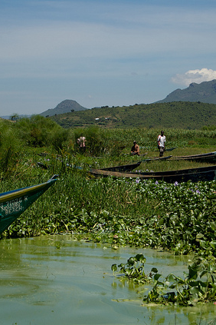
Objectives
Develop an empirical method to distinguish water hyacinth from other algal growth in the Winam Gulf of Lake Victoria, Kenya
Identify the extent of water hyacinth in the Winam Gulf to enhance RCMRD methodologies
Create a time series map of aquatic vegetation
Image Credit: Nikki McLeod
Notes:
The objectives of this project are to:
Develop an empirical method to distinguish water hyacinth from other algal growth in the Winam Gulf of Lake Victoria, Kenya
Identify the extent of water hyacinth in the Winam Gulf to enhance RCMRD methodologies
Create a time series map of aquatic vegetation
This will greatly aid in future mitigation efforts

Slide 4
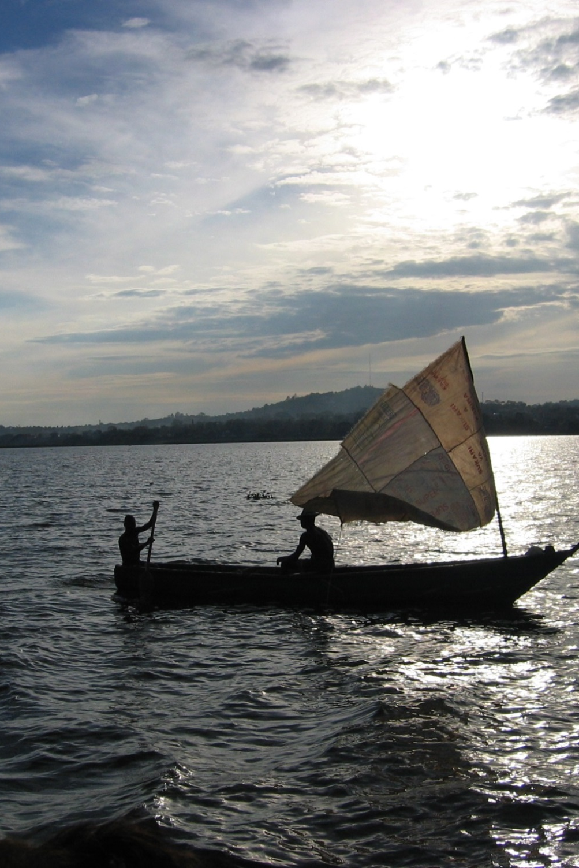
Community Concerns
Human and aquatic health risks from contaminated water
Vector-borne parasitic disease Schistosomiasis from snails living on water hyacinth
Economic losses from blockage of boat traffic
Image Credit: Damiano Luchetti
Notes:
Many people in the community rely on this lake for their livelihoods.
The thick mats clog irrigation canals and prevent business flow, fishing, water treatment, and swimming.
Since the plants impede water flow, insects like mosquitoes thrive and spread disease.
Image Credit: https://commons.wikimedia.org/wiki/Lake_Victoria#/media/File:Victoria_lake.JPG

Slide 5

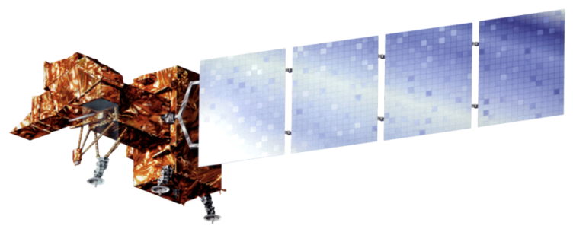

NASA Satellites/ Sensors Used
Landsat 8 Operational Land Imager (OLI)
Landsat 7 Enhanced Thematic Mapper Plus (ETM+)
Landsat 5 Thematic Mapper (TM)
Notes:
The NASA satellites used for this project included: Landsat 8 Operational Land Imager (OLI), Landsat 7 Enhanced Thematic Mapper Plus (ETM+), and Landsat 5 Thematic Mapper (TM). Surface reflectance, land surface temperature, and water quality are the parameters obtained for these satellites.

Slide 6
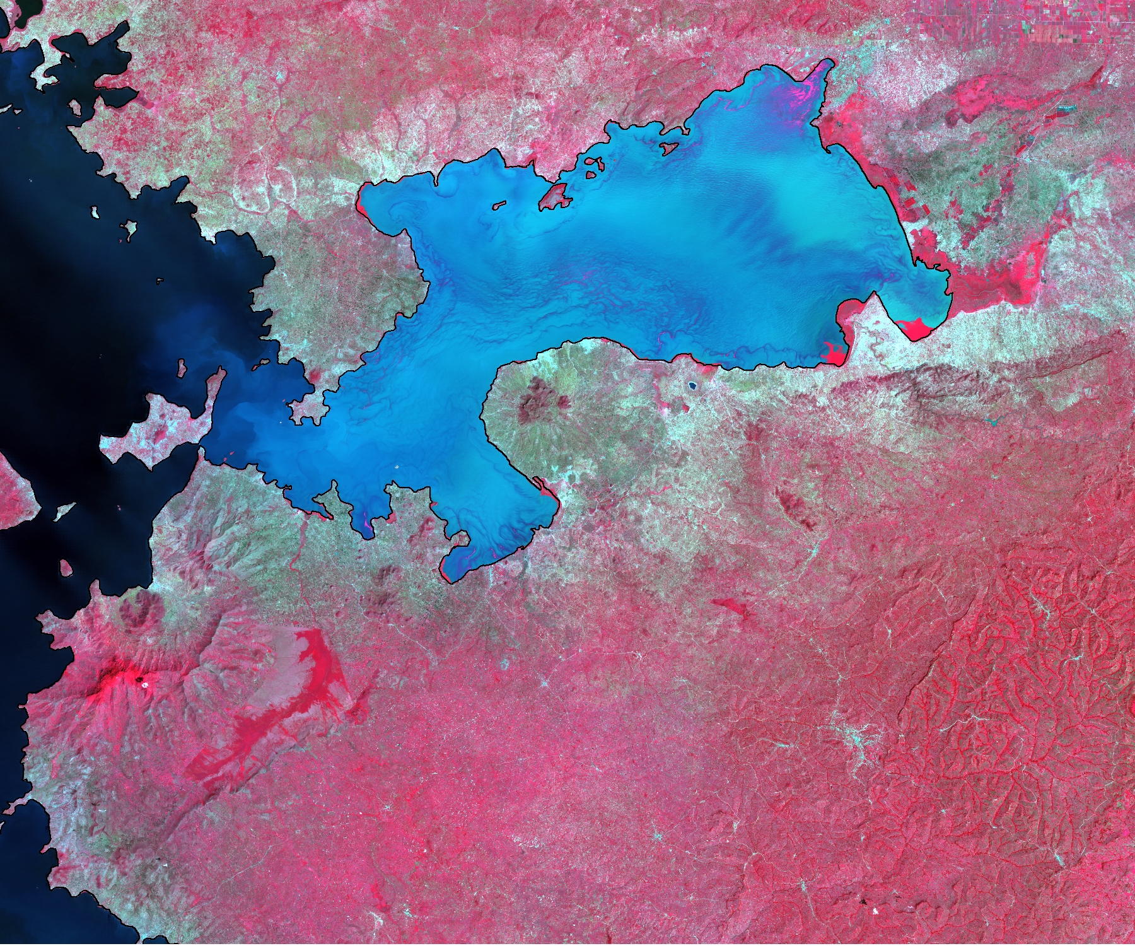
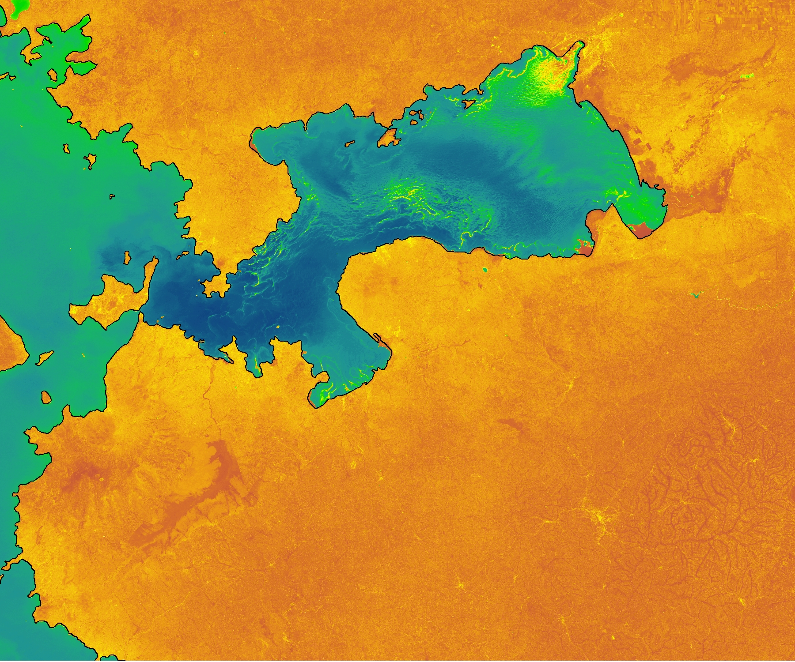
Methodology
Data Acquisition
Landsat 8 surface reflectance data product from USGS
Hyperion Hyperspectral Data
WorldView
GeoEye
Data Processing
NDWI
  NDWI < 0.1 = non-water features
NDVI
  Extract NDVI in areas classified as non-water
Image Credits:
Lake Victoria Water Resources Team
Notes:
Landsat surface reflectance products were ordered from the Earth Explorer website
NDWI = (green – NIR)/(green + NIR). NDWI was used to clearly distinguish water features from non water features in the lake. Areas with an NDVI < 0.1 were extracted and converted to a shapefile representing non- water features.
NDVI = (NIR – red)/(NIR + red). The NDVI index looks at the contrast between red absorption and NIR reflectance to highlight features of vegetation health. NDVI of the entire area was clipped down to the “non-water features” shapefile for focus.

Slide 7
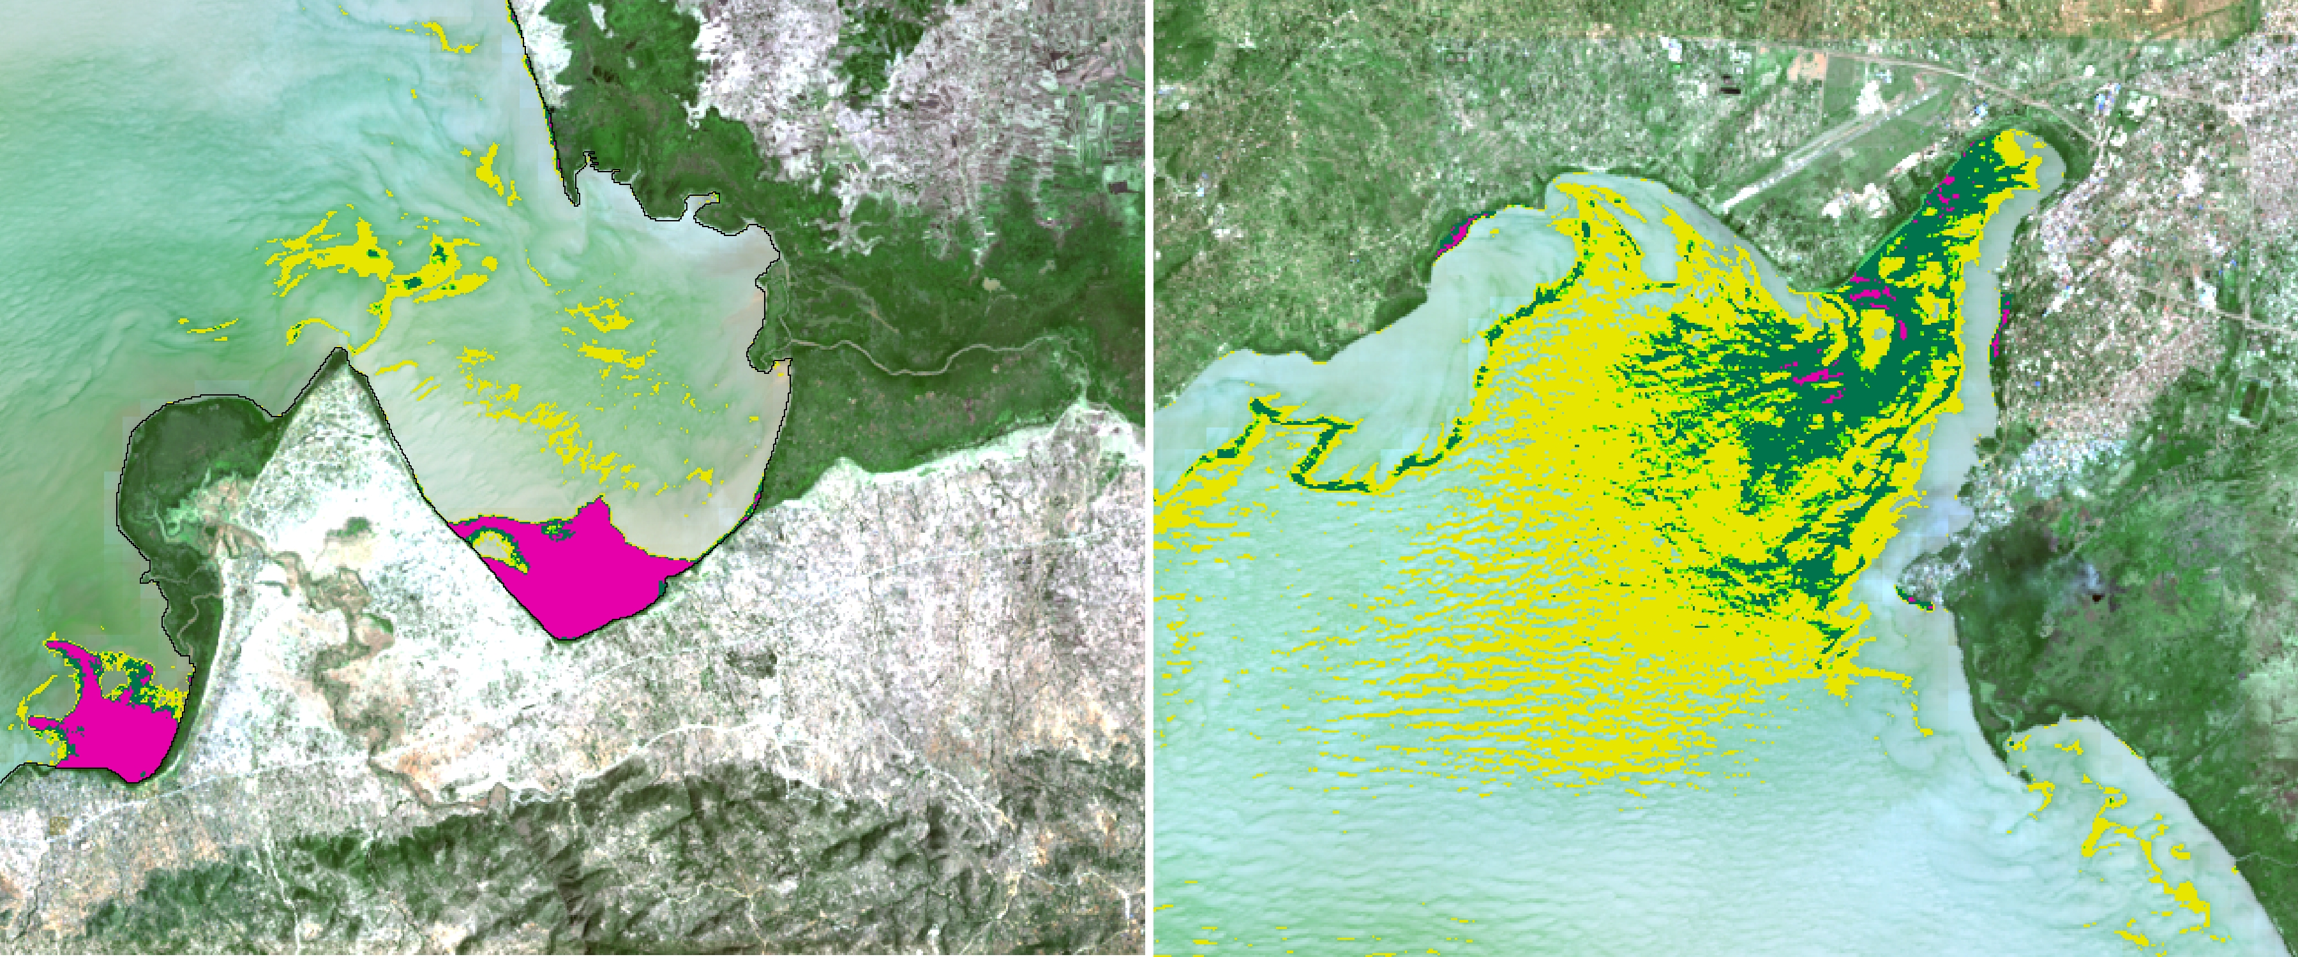
Methodology
Data Processing
Reclassify NDVI values based on Cho et al. 2008:
  min – 0.47 surface and sub surface algae
  0.47 – 0.54 submerged/ unhealthy/ senescing macrophytes
  0.54 – 0.82 moderately dense macrophytes
  0.82 – max healthy, dense macrophytes/ concentrated algal bloom (potentially water hyacinth)
Image Credit:
Lake Victoria Water Resources Team
Notes:
- Clipped NDVI areas were then categorized into 4 classes. The thresholds were partially determined by a study done by Cho et al. 2008 which used in situ spectral measurements of water hyacinth to derive NDVI values using the band designations of Landsat 7.

Slide 8
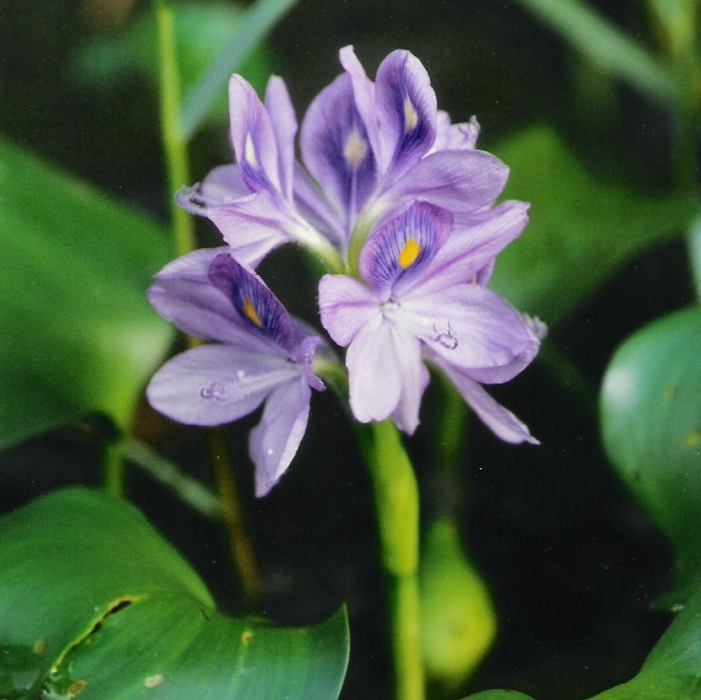
Methodology
Data Analysis
High resolution GeoEye and WorldView imagery to validate presence of algal blooms, water hyacinth, and other macrophytes
Confusion matrix:
Image Credit: USDA
Ground Truth | Class 1 | Class 2 | Class 3 | Class 4 | Total | Omissions | Commissions | Mapping Accuracy
Class 1 | TP | FP | FP | FP | X | Total FP/ Total | FN / Total | TP/(Total FP + FN)
Class 2 | TP | FP | FP | FP | X | Total FP/ Total | FN / Total | TP/(Total FP + FN)
Class 3 | TP | FP | FP | FP | X | Total FP/ Total | FN / Total | TP/(Total FP + FN)
Class 4 | TP | FP | FP | FP | X | Total FP/ Total | FN / Total | TP/(Total FP + FN)
Total | Total Class 1 | Total Class 2 | Total Class 3 | Total Class 4 | Total All
Where TP = true positive, FP = false positive, FN = false negative
Notes:
- Due to lack of in situ data, high resolution from GeoEye and WorldView was used to validate the classifications derived from the NDVI.
A confusion matrix was used to determine accuracy (see sample table in slide).
Image Source: http://www.ars.usda.gov/Main/docs.htm?docid=14222

Slide 9
Results
Seasonal Chlorophyll Concentration Map
TBD – Legend will go here
Map will go here
Notes:
This slide shows the Seasonal Chlorophyll Concentration Map. (talk about what the map shows and what the values mean)

Slide 10
Results
Hyacinth/Vegetation Detection Map
TBD – Legend will go here
Map will go here
Notes:
This map shows the extent of the water hyacinth and other various vegetation that grows throughout the Winam Gulf. This was created by using an algorithm that the team made. (talk about the map and what it shows and its values.)

Slide 11
Conclusions
TBD
Notes:
Our project found that…

Slide 12
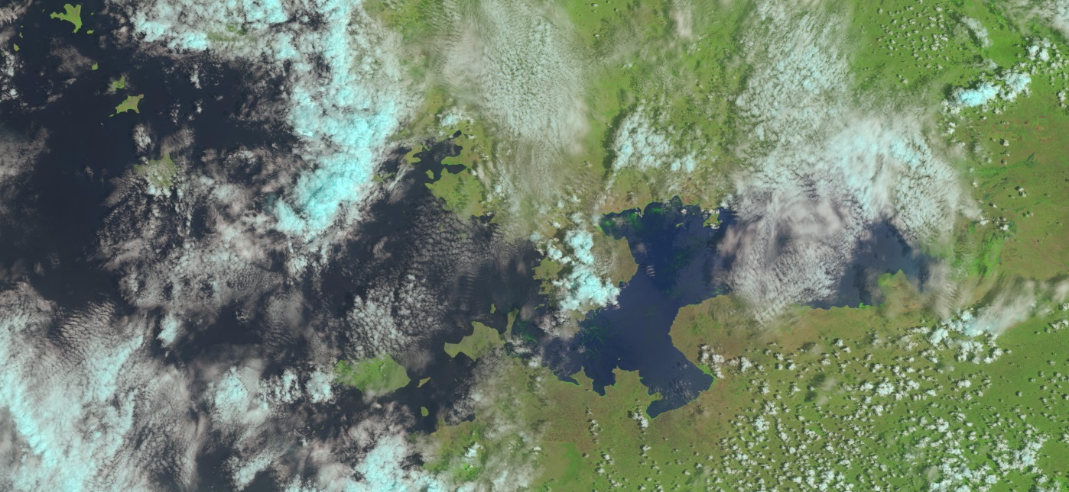
Errors and Uncertainties
Cloud cover in Landsat images
Shapefile of coastline may present inaccuracies
Landsat bands not sensitive enough to distinguish between aquatic species
Dense algal blooms also present high NDVI values, comparable to water hyacinth
Lack of in situ validation
Potential for poor accuracy
Image Credit: USGS 8
Notes:
During the selected study period, a limited number of Landsat images could be implemented due to cloud cover over the Winam Gulf area of Kenya. Since the water level of Lake Victoria is constantly changing, an accurate shapefile of Lake Victoria is unattainable. There are small gaps of spatial data along the coastline of Lake Victoria that would provide water hyacinth and water quality values beneficial to the study. Water hyacinth is difficult to determine through satellite imagery because of similar characteristics other vegetation share within the lake. Water hyacinth experiences different reflectance rates depending on the overall condition of the plant. These reflectance rates are similar to other floating vegetation in the lake and make it hard to distinguish between the two. A limited number of in-situ measurements and observations of water hyacinth correspond with the study period.
Image Source: "USGS Global Visualization Viewer." USGS Global Visualization Viewer. Web. 14 Oct. 2015.

Slide 13
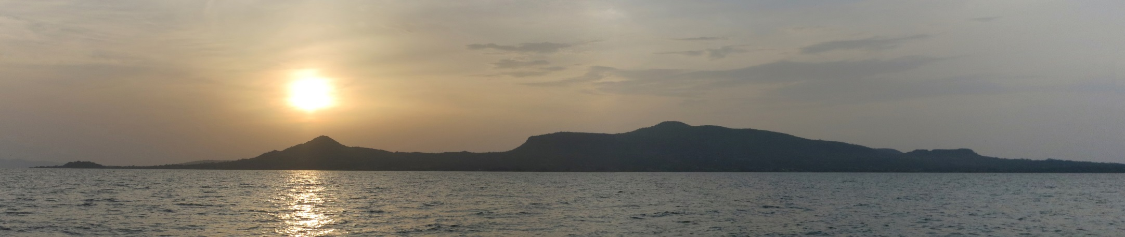
Image Credit: Küchenkraut
Future Work
Algorithm application to expanded study period
Further development of water quality monitoring system
Research into additional water quality parameters
Differentiation between water hyacinth and other vegetation
Multi- instrumental analysis for continual monitoring
Notes:
This is a two-term project. So with our water vegetation extent map and accuracy assessment, the next term can focus more on distinguishing water hyacinth and looking into other parameters that affect the lake’s water quality.
Image Source: https://commons.wikimedia.org/wiki/File:Rusinga_Island_-_Lake_Victoria_-_Kenya.jpg#/media/File:Rusinga_Island_-_Lake_Victoria_-_Kenya.jpg

Slide 14
Advisors
Dr. Jeffrey Luvall (NASA at NSSTC)
Dr. Robert Griffin (University of Alabama in Huntsville)
Partners
Africa Flores, SERVIR Coordination Office
Dr. Robinson Mugo, SERVIR Africa Team
James Wanjohi Nyaga, RCMRD
Others
Leigh Sinclair, NASA DEVELOP

