Slide 1
Caribbean Oceans
Utilizing NASA Earth Observation to Detect, Monitor, and Respond to Unprecedented Levels of Sargassum in the Caribbean Sea
Jordan Ped (Project Lead)
Emma Accorsi
Erica Scaduto
Notes:
Hello everyone!
I am _______ from (university), I am ______ from (university), and I am _______ from (university). We are the Caribbean Oceans DEVELOP team at the NASA Ames Research Center in Mountain View, CA, and today we will be speaking about …

Slide 2
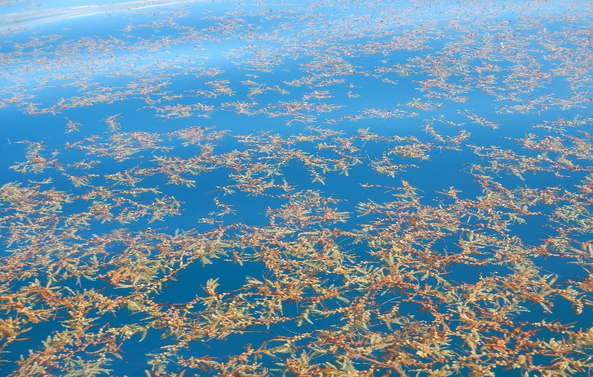
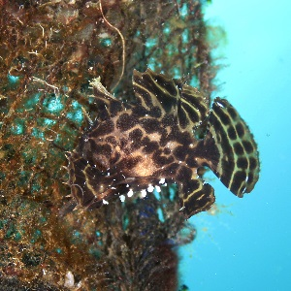
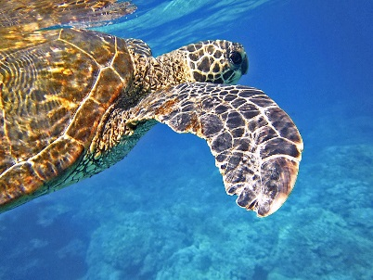
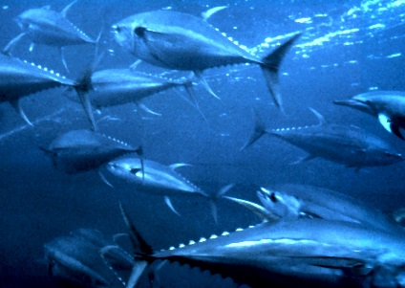
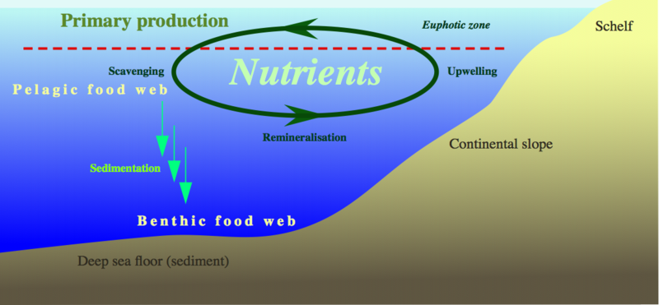
What is Sargassum?
Sargassum is the only holopelagic seaweed in the world
The floating mats provide ecosystem services:
Image Credit: Roy Armstrong
Habitat for diverse species
Source: Wikimedia
Source: Pixabay
Source: Wikipedia
Ocean nutrient cycling
Source: Wikipedia
Notes:
Who has heard of Sargassum? How about Seaweed?
Sargassum is actually a brown seaweed that lives all of its life floating in the ocean.
Completing its entire lifecycle at sea, makes it the world’s only holopelagic seaweed and a crucial part of the marine ecosystem
Species include the highly adapted Sargassum Anglerfish, juvenile sea turtles, etc.. These pelagic ecosystems are also thought to be critical destinations for migratory species , such as whales and tunas
Nutrient cycling to the ocean floor
Beached Sargassum provides shelter to sea turtle hatchlings and reduces shoreline erosion
Image URL:
Sargassum Anglerfish: https://commons.wikimedia.org/wiki/File:Philippines,_Batangas_Bay,_Suspended_Reef,_Sargassum_Fish_at_8m_of_depth,_April_2013.jpg
Turtle: https://pixabay.com/static/uploads/photo/2014/11/27/02/55/sea-turtle-547163_960_720.jpg
Tuna: https://en.wikipedia.org/wiki/Yellowfin_tuna
Cycling: https://upload.wikimedia.org/wikipedia/commons/1/13/Nutrient-cycle_hg.png

Slide 3
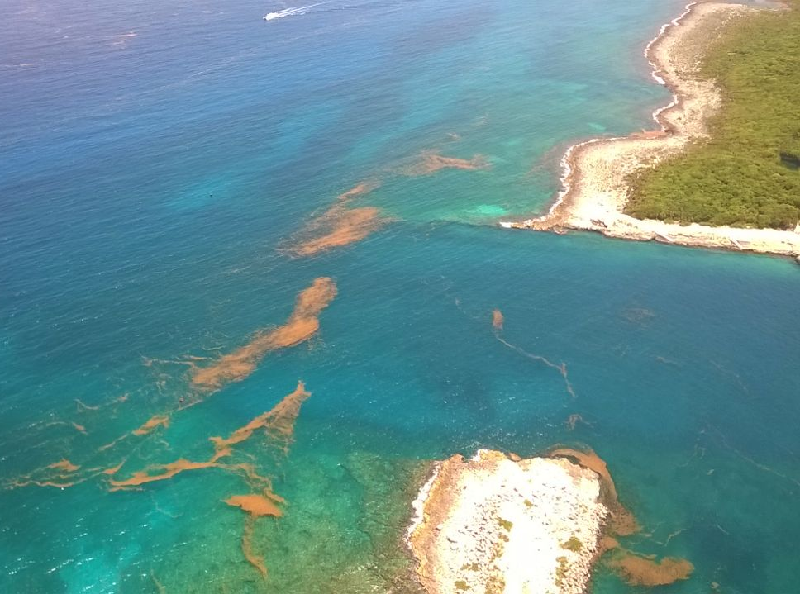
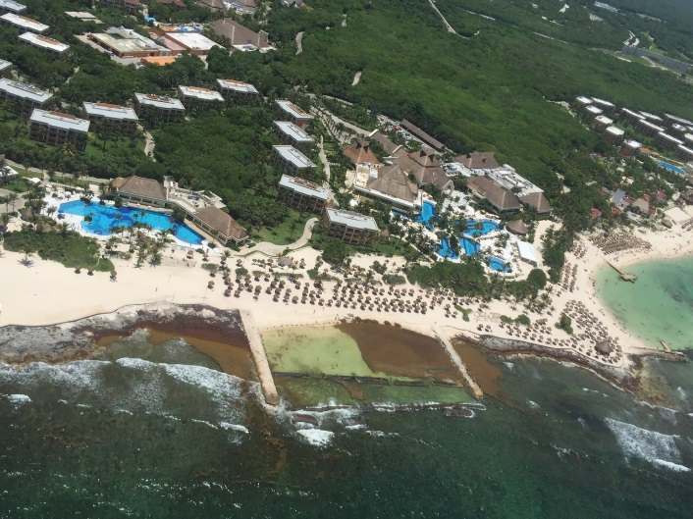
Caribbean Influx
In a survey of 21 marine researchers, 71% (15/21) agreed that the amount of Sargassum in the Caribbean in 2015 was significantly higher than in previous years.
Community Concerns
Environmental
+
Economic
Image Credit: Roy Armstrong
Image Credit: Roy Armstrong
Significant influx in Caribbean in 2011
Growing concern for Caribbean nations
Notes:
-Caribbean nations are becoming increasingly interested in the origin and drivers of the pelagic seaweed Sargassum, which has inundated their shorelines in recent years
- In particular, observers have reported higher than normal levels of Sargassum since 2011, with levels reaching a critical high in 2015. In a survey of 21 marine researchers, 71% (15/21) agreed or highly agreed that the amount of Sargassum in the Caribbean in 2015 was significantly higher than in previous years, although they also reported major Sargassum events occurring in the previous four years
-Sargassum has caused both economic and environmental concerns
-The large mats flood shallow bays and reefs, compressing sand and trapping sea turtles in their nests. One observer in Belize describes, “When the Sargassum comes...and stays there for months and starts to rot, everything dies - sea grass, crabs, conch, snail, fish, the list goes on,” and another reports “fish and crustacean kills” in the British Virgin Islands
-tourism is economically vital, tourists are deterred by seaweed-covered beaches and the smell of decomposing biomass. The tourist industry has faced a considerable financial burden, as many tourists have cancelled trips within these regions.
-Heavy machinery has been used in some locations to clear the beaches, further exacerbating the ecological problems

Slide 4
Image Credit: Caribbean Oceans Team
Objectives
Detect Sargassum: Floating Algal Index (2002-2016) – MODIS data
Validate identified Sargassum: Maximum Chlorophyll Index (2011, 2013) – MERIS data and Sea Education Association Cruise data
Model relationship: Sargassum & oceanic variables
Notes:
-Our study encompasses the Caribbean and a small section of the Western Atlantic from 2002 until March of 2016
-The objectives of our project 1,2,3 are designed to inform our partners and address the concern of the Caribbean community surrounding Sargassum

Slide 5
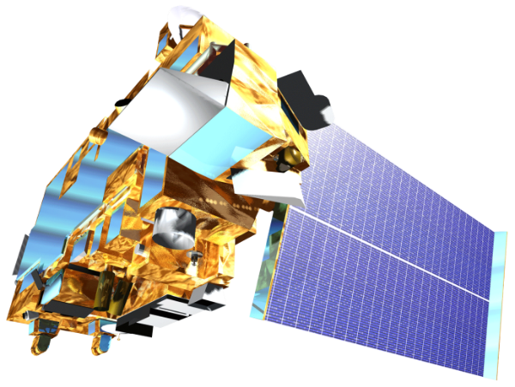
Data Acquisition
Terra
MODIS
NOAA ERDDAP
Notes:
-To better detect Sargassum in the Caribbean, Terra Moderate Resolution Imaging Spectroradiometer (MODIS), and Medium Resolution Imaging Spectrometer (MERIS) Envisat imagery were obtained through Atmosphere Archive and Distribution System (LAADS) web FTP servers and European Space Agency (ESA) Merci Product Query
-oceanic variables were obtained from the NOAA Coastwatch Environmental Research Division’s Data Access Program (ERDDAP)

Slide 6
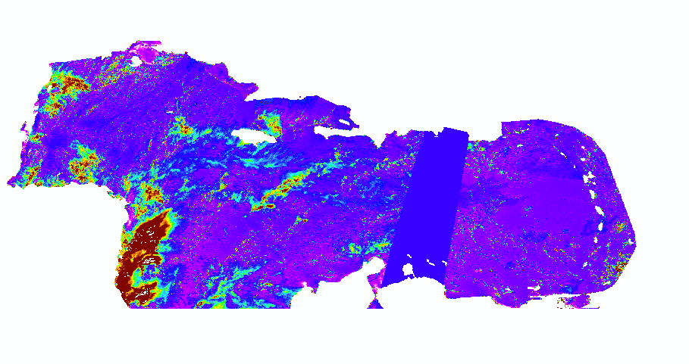
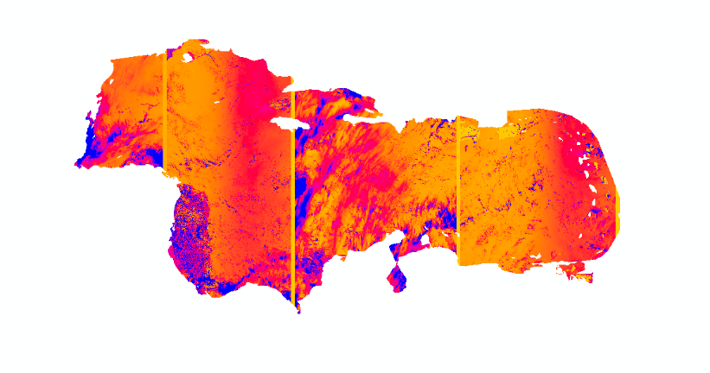
Methods I
Floating Algal Index
Oceanic Variables:
Photosynthetically Available Radiation
Chlorophyll-a
Primary productivity
Wind stress
Wind diffusivity
Sea surface salinity
Sea surface temperature
TerrSet
Earth Trends Modeler
Maximum Chlorophyll Index
Notes:
-To reduce atmospheric noise, cloud masking was performed using a scripted unsupervised classification
-Data processing of the MODIS imagery was automated using a Python script that calculates the Floating Algal Index (FAI) and Normalized Difference Vegetation Index (NDVI ) to detect the presence of Sargassum.
-In addition, the Maximum Chlorophyll Index (MCI) was calculated for the MERIS imagery.
-A threshold value was determined for both indices that best represented Sargassum detection
-The correlation between Sargassum presence and oceanic variables was tested via Terrset Earth Trends Modeler (or spatial regression).

Slide 7
Methods II (PLACEHOLDER)
Floating Algal Index
Oceanic Variables:
Photosynthetically Available Radiation
Chlorophyll-a
Primary productivity
Wind stress
Wind diffusivity
Sea surface salinity
Sea surface temperature
TerrSet
Earth Trends Modeler
Maximum Chlorophyll Index
Notes:
-To reduce atmospheric noise, cloud masking was performed using a scripted unsupervised classification
-Data processing of the MODIS imagery was automated using a Python script that calculates the Floating Algal Index (FAI) and Normalized Difference Vegetation Index (NDVI ) to detect the presence of Sargassum.
-In addition, the Maximum Chlorophyll Index (MCI) was calculated for the MERIS imagery.
-A threshold value was determined for both indices that best represented Sargassum detection
-The correlation between Sargassum presence and oceanic variables was tested via Terrset Earth Trends Modeler (or spatial regression).

Slide 8
Methods III (PLACEHOLDER)
Floating Algal Index
Oceanic Variables:
Photosynthetically Available Radiation
Chlorophyll-a
Primary productivity
Wind stress
Wind diffusivity
Sea surface salinity
Sea surface temperature
TerrSet
Earth Trends Modeler
Maximum Chlorophyll Index
Notes:
-To reduce atmospheric noise, cloud masking was performed using a scripted unsupervised classification
-Data processing of the MODIS imagery was automated using a Python script that calculates the Floating Algal Index (FAI) and Normalized Difference Vegetation Index (NDVI ) to detect the presence of Sargassum.
-In addition, the Maximum Chlorophyll Index (MCI) was calculated for the MERIS imagery.
-A threshold value was determined for both indices that best represented Sargassum detection
-The correlation between Sargassum presence and oceanic variables was tested via Terrset Earth Trends Modeler (or spatial regression).

Slide 9
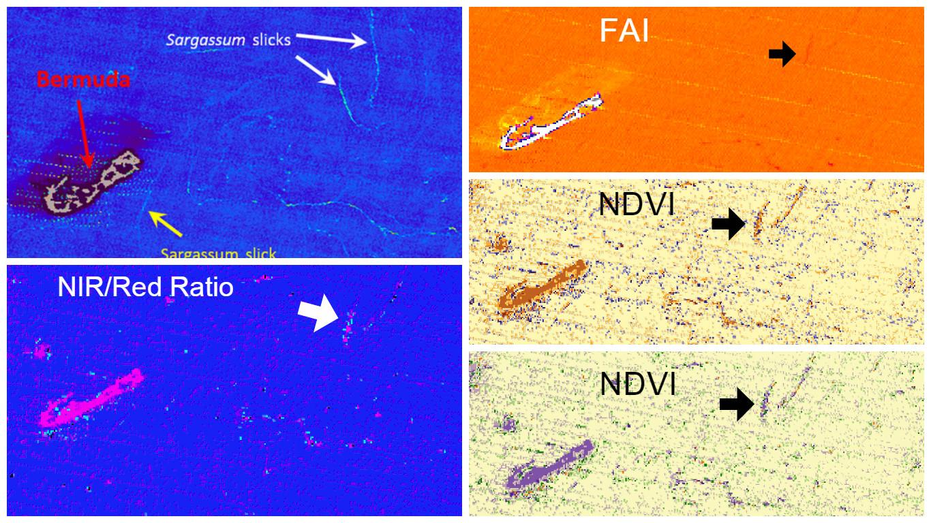
Results
Source: Caribbean Oceans Team; initial results, will be replaced
Notes:
-Detection of Sargassum slicks using Terra MODIS Terra near Bermuda in December 2009 using various indices including: NIR/Red Band Ratio, NDVI, and FAI. Compared with the Hu detection method (upper-left), all three detection methods were able to detect Sargassum strips at the same, or similar, locations. However, the NDVI (lower-right) exhibited more spectral noise than the FAI (upper-right). The detection of Sargassum using NIR/Red Band Ratio (lower-left) was less distinct than the other two methods.

Slide 10
Conclusions (PLACEHOLDER)
Great job!
Source: Chippie Kislik

Slide 11
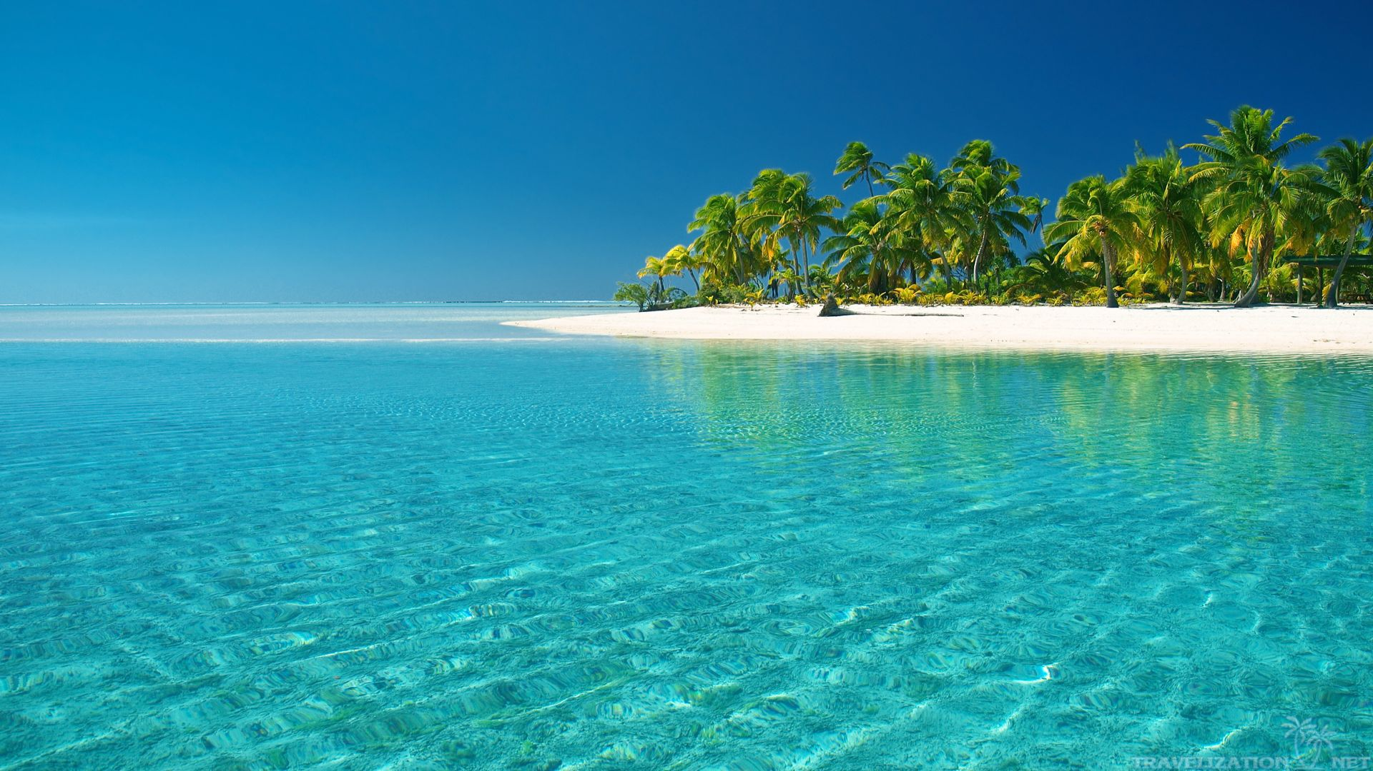
Future Work (PLACEHOLDER)

Slide 12
Advisors
Dr. Juan Torres-Pérez, Bay Area Environmental Research Institute
Partners
Dr. Porfirio Alvarez Torres, Executive Secretary at Consorcio de Instituciones de Investigación Marina del Golfo de México y del Caribe (CiiMarGoMC)
Dr. Roy A. Armstrong, Bio-optical Oceanography Laboratory University of Puerto Rico, Department of Marine Sciences
Dr. Sergio Cerdeira, Marine Monitoring Coordinator at Comisión Nacional para el Conocimiento y Uso de la Biodiversidad (CONABIO)
Dr. Deb Goodwin, Dr. Jeff Schell, Dr. Amy Siuda Sea Education Association
Others
Chippie Kislik (NASA Ames DEVELOP Center Lead) Victoria Ly (NASA Ames DEVELOP Assistant Center Lead)

