Slide 1
Lake Tahoe Water Resources
Creating a Global Continuous Lake Level Monitoring Algorithm using Landsat Imagery
Nolan Cate (Project Lead)
Anton Surunis
Chelsea Ackroyd

Slide 2
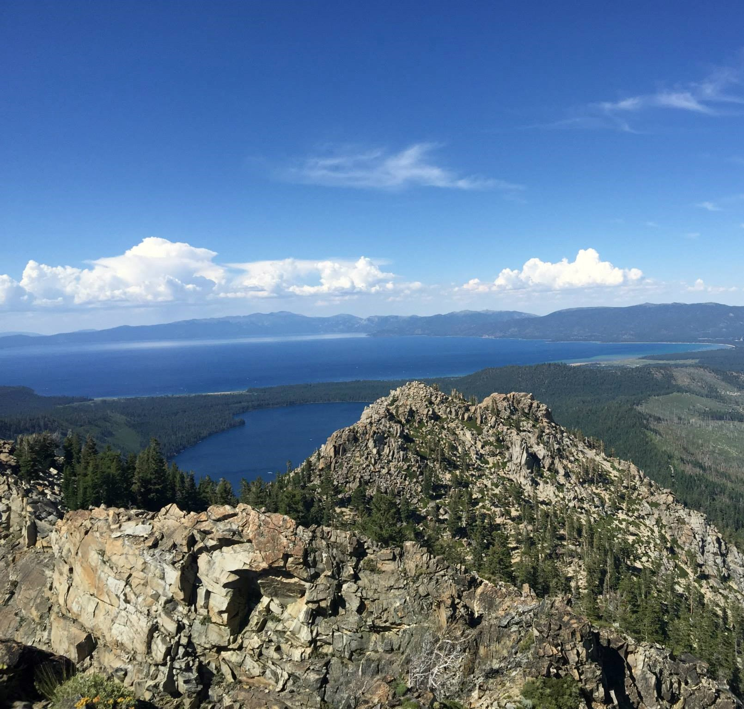
Background
The Lake Tahoe Basin Management Unit (LTBMU) rarely takes lake level measurements.
Lake level is measured by time intensive fieldwork.

Slide 3
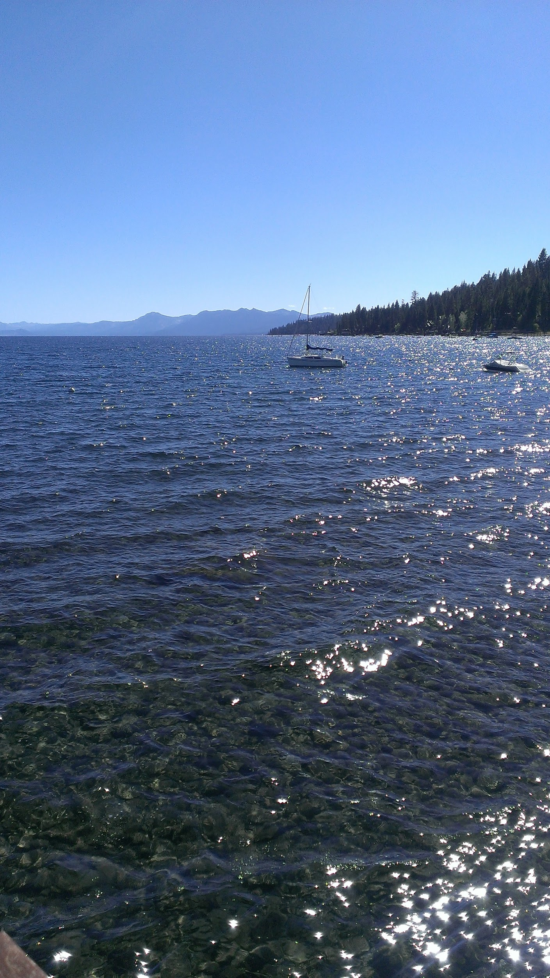
Community Concerns
Drought: 2015 CA State of Emergency
Endangered species at risk: Tahoe yellow cress
Economic importance: 3 million tourists per year
Notes:
About three million people visit Lake Tahoe each year. This is comparable to the numbers of visitors to Grand Canyon National Park (3.2 million) and Yellowstone National Park (2.7 million). - http://www.tahoefund.org/about-tahoe/recreational-paradise/

Slide 4

Objectives
Create a tool that continually monitors the level of Lake Tahoe and surrounding lakes
Provide a method to regularly measure lake turbidity
Generalize tool for water managers worldwide
Notes:
Photo will be changed in final draft.

Slide 5
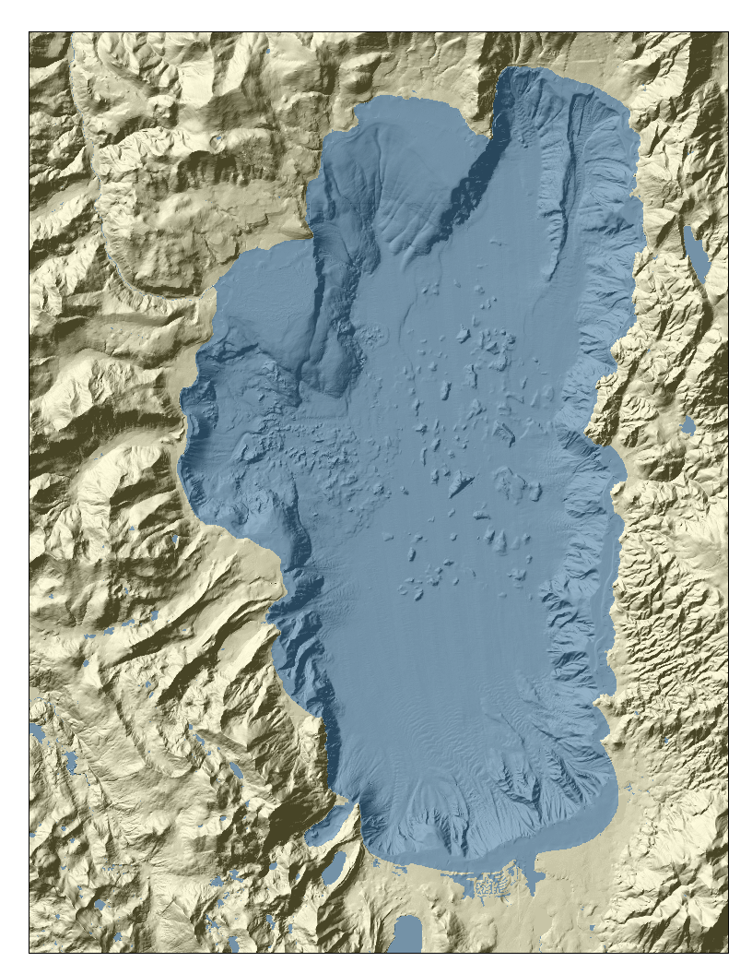
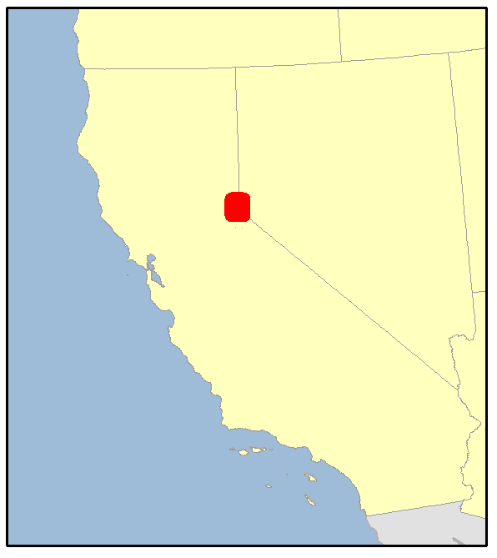
Study Area
Lake Tahoe
1984 - Present

Slide 6
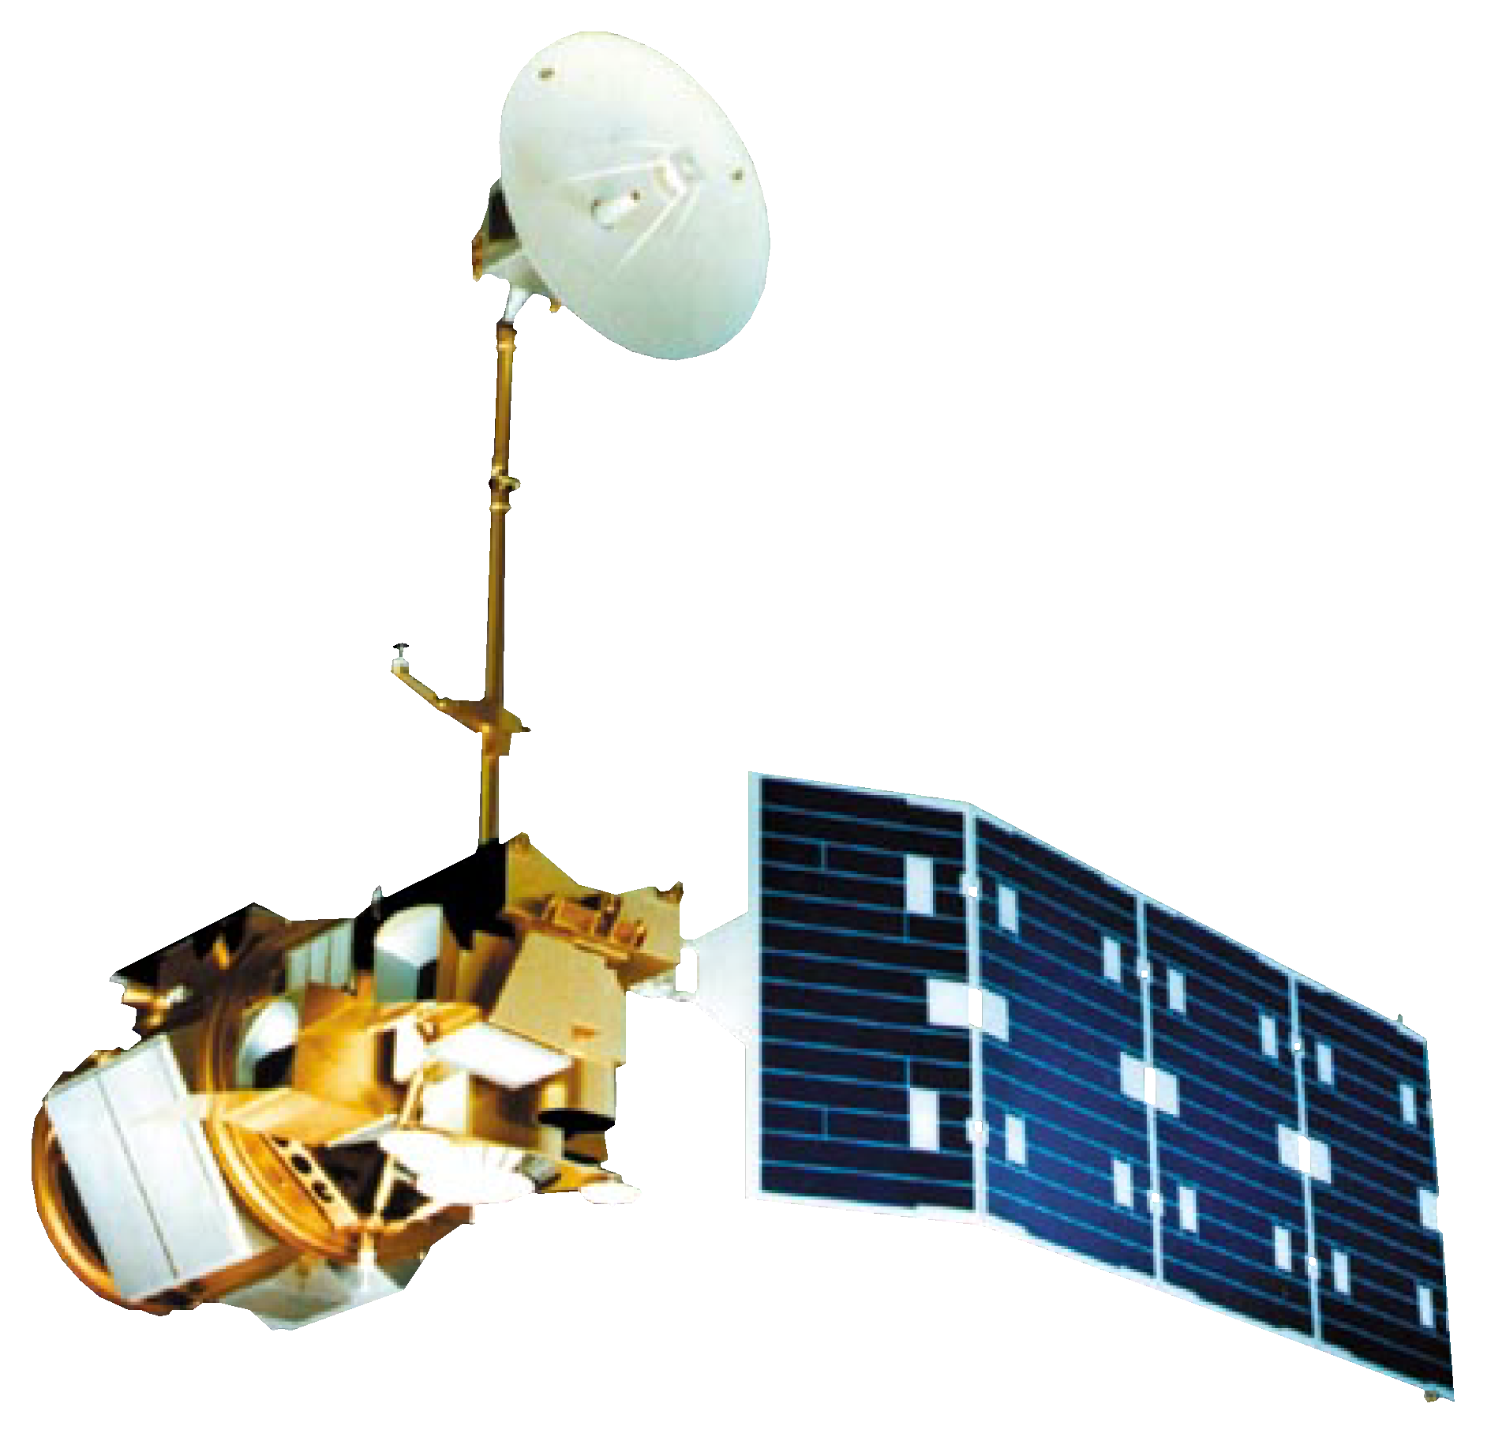

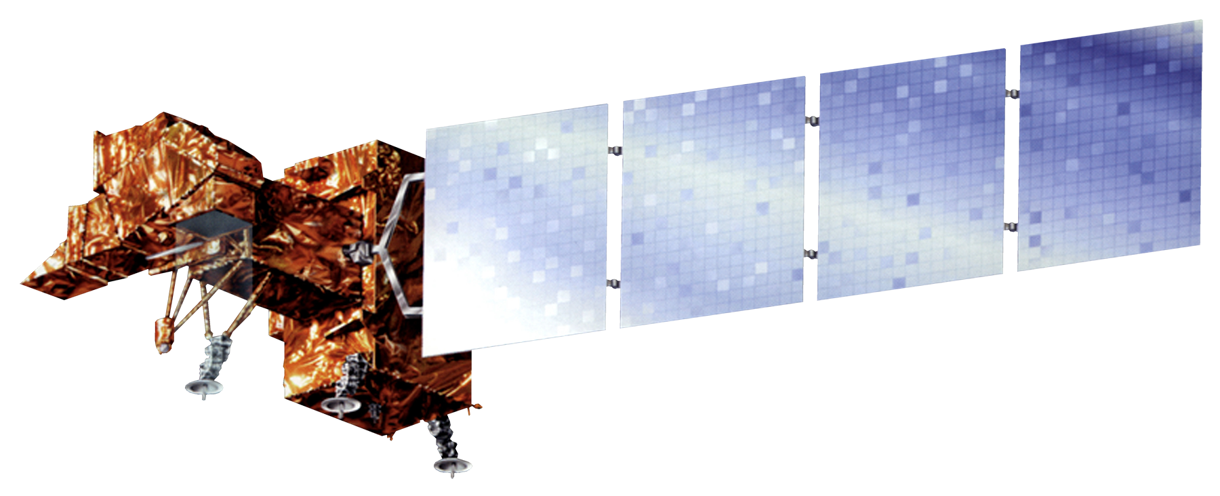
Earth Observations
Landsat 4-5 (TM) Landsat 7 (ETM+) Landsat 8 (OLI)

Slide 7

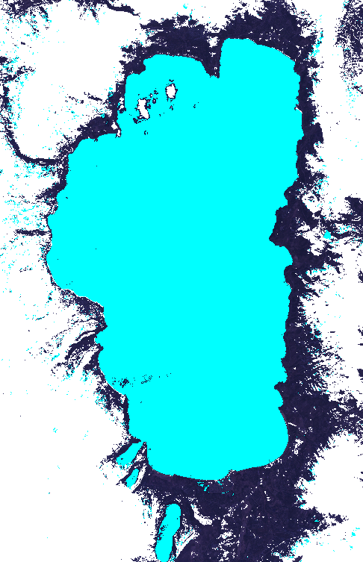
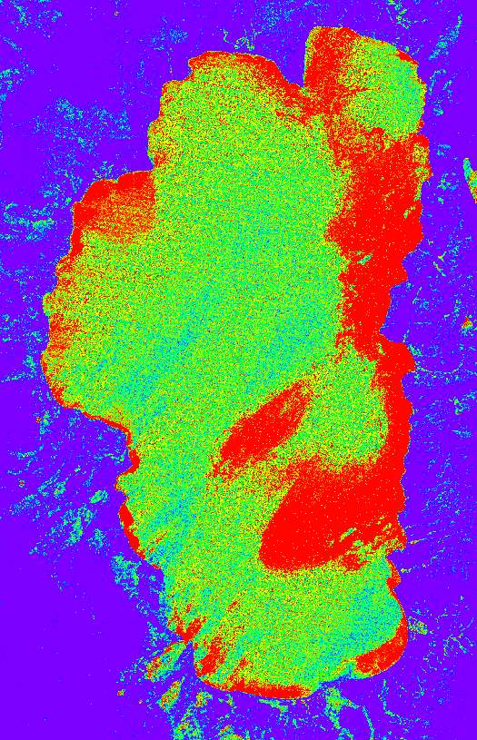
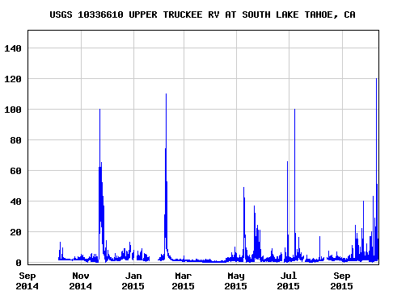
Methodology
Overview:
Lake Level Automated Monitoring Algorithm (LLAMA)
Locate water body
Four step water detection process
Calculate turbidity and algal information
Output statistics
Notes:
Graph is a USGS graph but it is just a place holder. Code will output a graph that will actually go here.

Slide 8
Methodology
Water body is located via kml polygons located in a Google fusion table
Code is limited to approximately 3,700 existing polygons
More polygons can be added
Notes:
Talk about tutorial created for adding more

Slide 9
Methodology
Four step water detection process
Step 1 - Modified Normalized Difference Water Index
Assigns pixel values between -1 and 1
Water has a High Value
Snow is also assigned a high value
Green - SWIR
Green + SWIR
MNDWI=
Notes:
mention that same index is used for snow mapping and thats why we need the remaining steps. MNDWI is from Xu, 2006. He says water can be anything above 0 and the MNDWI gives a lower value to vegetated and urban environments.

Slide 10
Methodology
Four step water detection process
Step 2 - Dark Objects
Water is spectrally dark
LLAMA looks for pixels that are relatively dark in Landsat visible bands
Darker objects are more likely to be classified as water

Slide 11
Methodology
Four step water detection process
Step 3 - Blue Band Reflectance
LLAMA is more likely to accept a pixel as water if its reflectance is higher in the blue than in other visible bands

Slide 12
Methodology
Four step water detection process
Step 4 - Temperature Band
LLAMA examines the thermal bands of the Landsat instruments
Verifies if pixel is above freezing (273 K)

Slide 13
Methodology
Additional Indices
LLAMA calculates a series of additional indices to provide users with more water information
  Floating Algal Index
  Normalized Difference Turbidity Index

Slide 14
Results

Slide 15
Conclusions

Slide 16

Advisors
Dr. Brian Coltin (NASA Ames Research Center)
Dr. Juan Torres-Perez (Bay Area Environmental Research Institute)
Partners
Joey Keely (Lake Tahoe Basin Management Unit,
USDA Forest Service)

