Slide 1
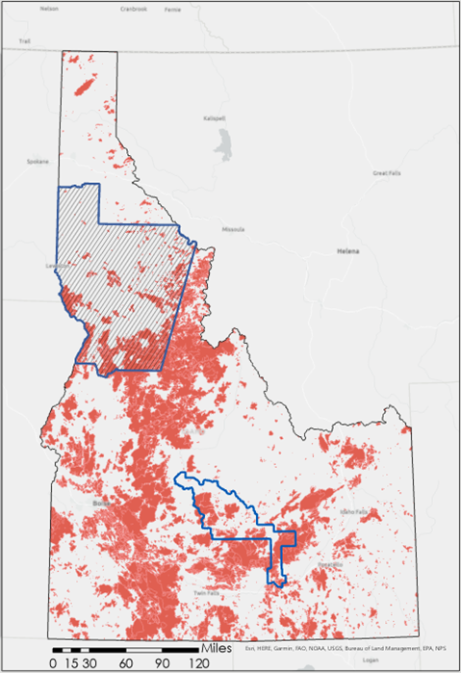
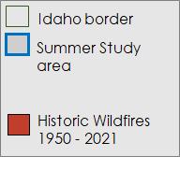
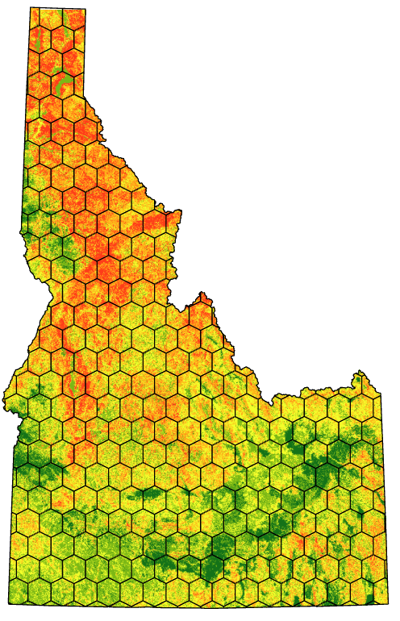
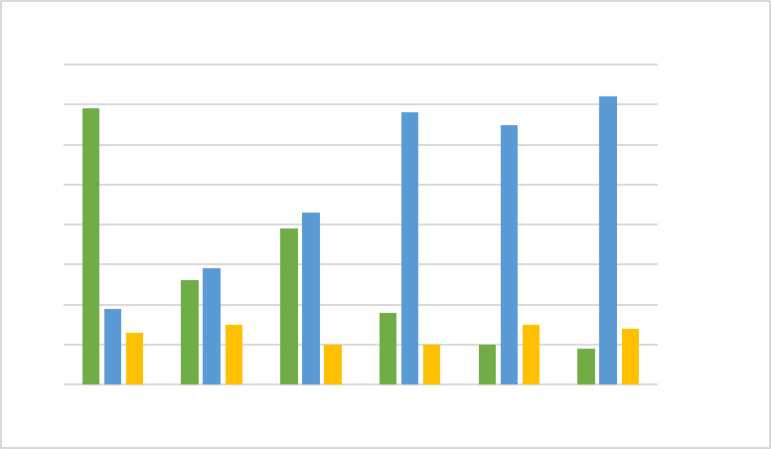
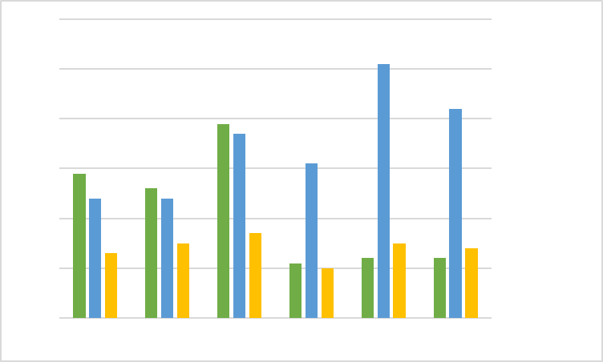
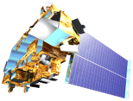
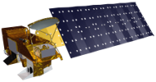
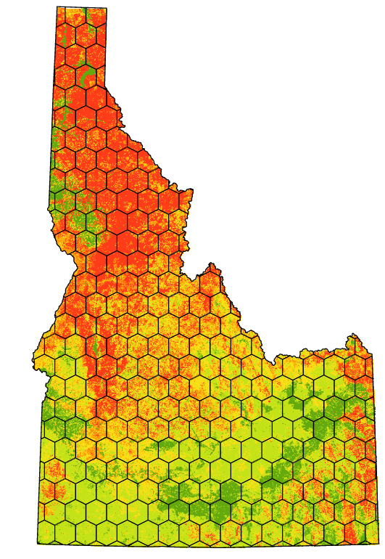
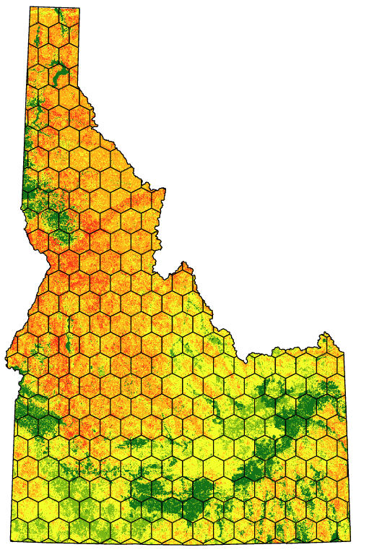
Assessing Drought and Fire Conditions, Trends, and Susceptibility to Inform State Mitigation Efforts and Bolster Monitoring Protocol in North Central Idaho
Abstract
Study Area
Project Objectives
The western United States has experienced twenty years of increased and prolonged drought which have exacerbated wildfire hazards. Combined, these jeopardize population centers through increased risks to ecosystem services, local economies, and livelihoods. In Idaho, the Idaho Office of Emergency Management (IOEM), Idaho Department of Water Resources (IDWR), and Idaho Department of Lands (IDL) are seeking methods to effectively monitor these conditions and dynamically update models that inform hazard mitigation planning and allocation of emergency and land management resources. To accomplish this, these agencies partnered with NASA DEVELOP to produce drought-enhanced wildfire hazard models. Part of a two-term project, the teams revised the state’s current wildfire hazard model with refined data layers and remotely-sensed drought indicator data, to reflect dynamic ecosystem responses to temporally and spatially variable nexuses of drought and wildfire potential. The team distinguished between rangeland and forestland ecosystems and investigated relationships between a multitude of drought metrics and the Normalized Difference Vegetation Index (NDVI) within these using Idrisi TerrSet Earth Trends Modeler (ETM). This analysis determined that total precipitation at a 5-month interval (r² = 0.72) and the Evaporative Stress Index (ESI; r² = 0.69), and precipitation at a 4-month interval (r² = 0.51) were important drivers for vegetation condition in rangeland and forestland, respectively. These variables were used to create dynamic wildfire hazard models augmented to reflect these relationships. The team used linear regression to explore augmented model hazard ratings and wildfire occurrence to validate these model efficacies against the state static model.
Idaho Wildfires II
Idaho border
Summer study area
Enhance current state fire hazard model with drought indices
Compare different vegetative stress and drought indices to see which is best to incorporate
Blaine County
Historic wildfires 1950–2021
Integrate Earth observation data into the model
Create tutorial for project partners to build a fire and drought model
N
E
METHODOLOGY
W
S
Linear Modeling of Variables
Assign Variable Weights
Build Model
Final Model Outputs
Hex-bin Analysis
Model Validation
Earth Observations
RESULTS
IDL
2022 Model
Landsat 8 OLI
Rangeland Variable Importance
0.6
Forestland Variable Importance
Landsat 9 OLI
0.8
0.5
0.7
Precipitation
Precipitation
0.6
0.4
N
R² value
0.5
ESI
R² value
0.3
ESI
W
E
0.4
S
Terra MODIS
0.3
0.2
0.2
EDDI
0.1
EDDI
0.1
0
0
4-month
5-month
0
Aqua MODIS
Time
Lag:
1-month
2-month
3-month
Time​
Lag:
0
1-month​
2-month​
3-month​
4-month​
5-month​
CONCLUSIONS
The results of Linear Modeling using NDVI as the dependent variable indicated that ESI had the highest R² value of 0.69 followed by precipitation at 0.68 with a 3-month time lag
EDDI produced a non-significant R² value of 0.15
The strongest trend between 2010–2020 was maximum temperature at 0.25
Static variables and remotely-sensed dynamic variables were assigned weights, which introduced spatial and temporal variation into the static model's performance
We identified key areas for future research to enhance this model's performance and capacity for predicting wildfire hazard across the state of Idaho
Enhanced 2020 Model
Enhanced 2018 Model
W
N
E
S
1- Low
2- Moderate
3- High
4- Very high
5- Extreme
0 15 30 60 90 120
Acknowledgements
Miles
Tyler Morvant
Participant
Project Partners
Idaho Department of Lands​
Tyre Holfeltz, Wildfire Risk Mitigation Program​
Idaho Office of Emergency Management​
Susan Cleverly, Mitigation Section Chief​
Lorrie Pahl, Mitigation Planner​
Mary Mott, Mitigation Program Assistant​
Idaho Department of Water Resources
David Hoekema, Hydrologist
Keith Weber​
Idaho State University, GIS Training and Research Center​
Brandy Nisbet-Wilcox​
Science Systems and Applications, Inc., NASA DEVELOP National Program​
Talissa Cota
Project Lead
Idaho Office of Emergency Management
Susan Cleverly, Lorrie Pahl, Mary Mott, Traci Stewart
Idaho Department of Water Resources
David Hoekema
Idaho Department of Lands
Tyre Holfetz
Dana Drinkall
Participant
Ryan Healey
Participant
Image Credits: NASA, USGS, PowerPoint, Tyler
Idaho - Pocatello

