Slide 1
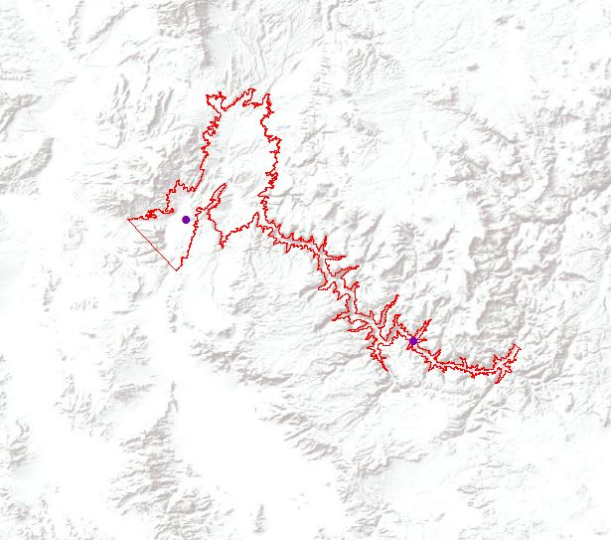
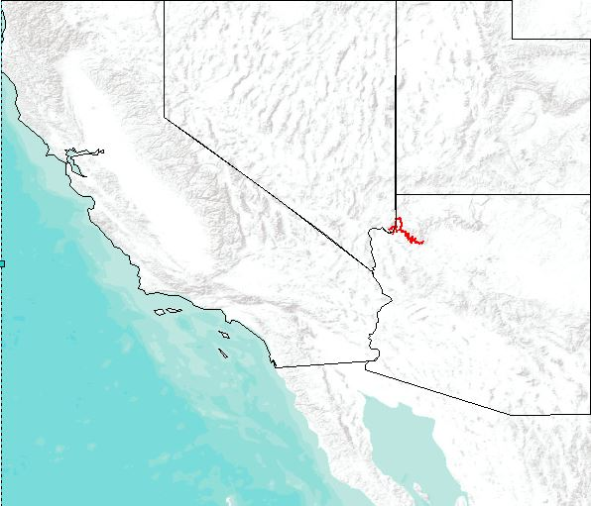
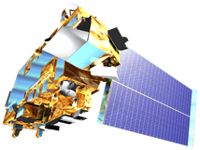
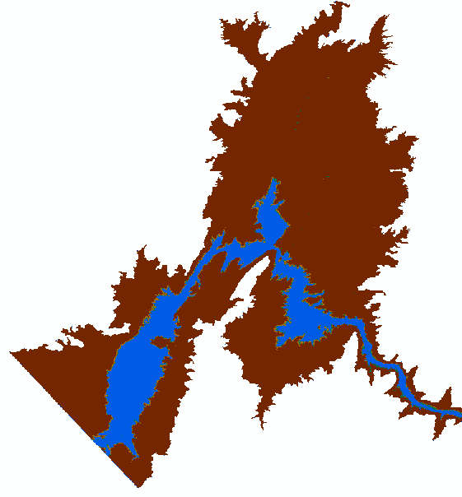
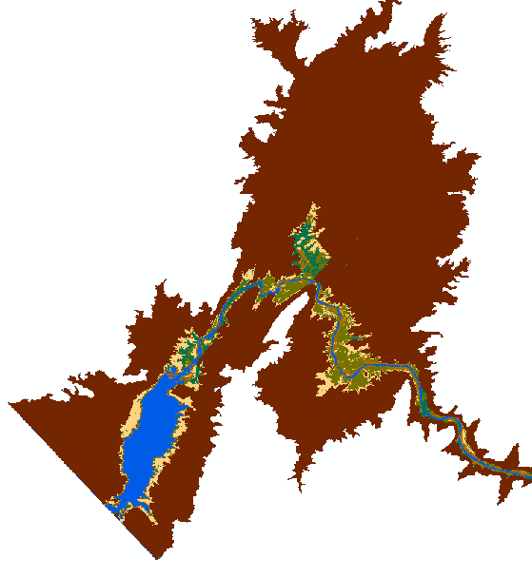
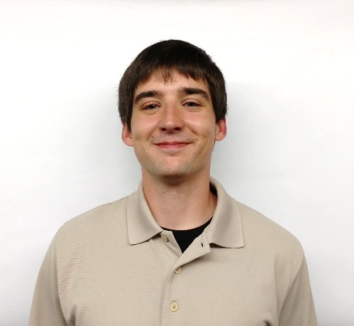
Utilizing NASA Earth Observations to Assist the National Park Service in Monitoring Shoreline Land Cover Change in the Lower Grand Canyon
Abstract
Sustained drought conditions have contributed to a significant decrease in the volume of the Colorado River in the Lake Mead reservoir and lower portion of the Grand Canyon. As a result, changes in riparian conditions have occurred in the region, such as sediment exposure and receding vegetation. These changes have large negative impacts on ecological health, including water and air pollution, aquatic, terrestrial and avian habitat alterations, and invasive species introduction. Scientists at Grand Canyon National Park seek to quantify changes in water surface and land cover area in the Lower Grand Canyon from 1998 to 2016 to better understand the effects of these changing conditions within the park. Landsat imagery was used to detect changes of the water surface and land cover area across this time period to assess the effects of long-term drought on the riparian zone. The resulting land cover and water surface time-series from this project will assist in monitoring future changes in water, sediment, and vegetation extent, increasing the ability of park scientists to create adaptation strategies for the ecosystem in the Lower Grand Canyon.
Study Area
Objectives
Lake Mead & Lower Grand Canyon Boundaries
Study Period: 1998 - 2016
Create a replicable land cover classification process to provide a baseline model for ongoing assessments
Provide end-user with land cover and water surface change maps and surface area statistics
Enhance understanding of changing conditions due to drought
South Cove
Separation Canyon
Earth Observations
Methodology
Landsat 5 TM
Landsat 8 OLI
Terra ASTER
Data
Analysis
End-Products
Conclusions
Landsat 5
Water Feature Extraction
Water Surface Change Map & Statistics
Results indicate persistent decline in water surface in the lower Grand Canyon with rapid change occurring from 2000 – 2002
Water surface area changes correlate with high intensity drought periods in the Grand Canyon recorded by the United States Drought Monitor
Exposed sediment provides habitat for aggressive invasive plant species
Highly variable vegetative cover alters habitats for terrestrial organisms
Landsat 8
Seasonal Image Composites
Normalized Difference Vegetation Index
Normalized Difference Water Index
Modified Normalized Difference Water Index
Grand Canyon Water Resources
Landsat Bands
Land Cover Classification
ASTER DEM
NDVI
Random Forest Classifier
Land Cover Change Map & Statistics
Elevation & Slope
Training Areas
Accuracy Assessment
Distance to Water
Results
Land Cover Type
Water
Riparian Vegetation
Riparian Sediment
Dead Vegetation
Exposed Lake Bed
Bare Canyon
Figure 1: Declining water surface area over the drought period.
1998
2016
Figure 3: Comparison of surface areas of land cover types from classified image years.
Figure 2: Land cover classifications from 1998 and 2016.
Acknowledgements
Team Members
Project Partners
Thanks to Ed Schenk, physical scientist at Grand Canyon National Park, for guidance throughout the project. Special thanks to our science advisors, Dr. Kenton Ross, Dr. DeWayne Cecil, and Bob VanGundy who contributed expertise and direction to the project. Finally, thanks to our Center Lead, Michael Brooke and Assistant Center Lead, Kimberly Berry.
This material is based upon work supported by NASA through contract NNL11AA00B and cooperative agreement NNX14AB60A. Any mention of a commercial product, service, or activity in this material does not constitute NASA endorsement. Any opinions, findings, and conclusions or recommendations expressed in this material are those of the author(s) and do not necessarily reflect the views of the National Aeronautics and Space Administration and partner organizations.
Andrew Phillips
Team Lead
Sydney Young
Austin Counts
Christine Stevens
Grand Canyon National Park
Wise County Clerk of Courts – Fall 2016

