Slide 1
DEVELOP National Program – WEEKLY REPORT
Team Location – Center Lead’s Name
Activities and Accomplishments Ending: Friday 01/29/16
Location Activities
Project Reporting
Partner Interaction
What to include: List any interactions with partners during the week - calls, emails, meetings, presentations, etc. Make sure to include the POC’s name, partner’s organization name, and date of interaction.
Date - Interaction (including POC and org name, no acronyms please!)
Ex. 1/28 - Telecon with Dr. George Glass from USDA Agricultural Research Service
Science Advisor Interaction
Catalog any meetings/happenings with advisors here.
Date - Interaction (including advisor name)
Ex. 1/28 - Met with Dr. Advisor to discuss (X) and (Y)
Meetings & Presentations
What to include: These are non-conference presentations and meetings - perhaps at your center to management, telecons/videocons with potential partners, webinar trainings, etc. Only include events and happenings that don’t fit in the conference/outreach/partner interaction/science advisor categories.
Date - Event
Ex. 1/28 - Presentation on previous project work to NASA Chief Scientist, Dr. Ellen Stofan, who was visiting NASA Center X.
Issues / Problems
List any office-related issues that have arisen and need to be addressed. Do not use this to report personnel issues, report those by phone!
Ex. Computer #2400873 keeps crashing
Center Lead Duties
Bulleted list of achievements for the week
Ex. collecting schedules, contracts, maintaining performance metric tracking spreadsheet, application review, interviews, etc.
[Project A Short Title]
Status:
Milestones:
Accomplishments relating to the project - items completed, etc.
Other accomplishments
Issues / Problems:
Any issues that has arisen and needs to be addressed.
Change the color of the box as fits. Refer to DEVELOPedia for description of what each color means. Add/delete projects here depending on how many are at your node. Delete this note.
[Project B Short Title]
Status:
Milestones:
Accomplishments relating to the project - items completed, etc.
Other accomplishments
Issues / Problems:
Any issues that has arisen and needs to be addressed.
[Project C Short Title]
Status:
Milestones:
Accomplishments relating to the project - items completed, etc.
Other accomplishments
Issues / Problems:
Any issues that has arisen and needs to be addressed.
Future Activities
Upcoming Events & Activities
This is the calendar for upcoming events that have concrete dates. Include what event/activity is, where (if applicable), and date.
DEVELOP Summer Term begins 6/1
Annual Earth Science Applications Showcase – Washington, DC (7/30)
AGU Science Policy Meeting – Washington, DC (6/24-26)

Slide 2
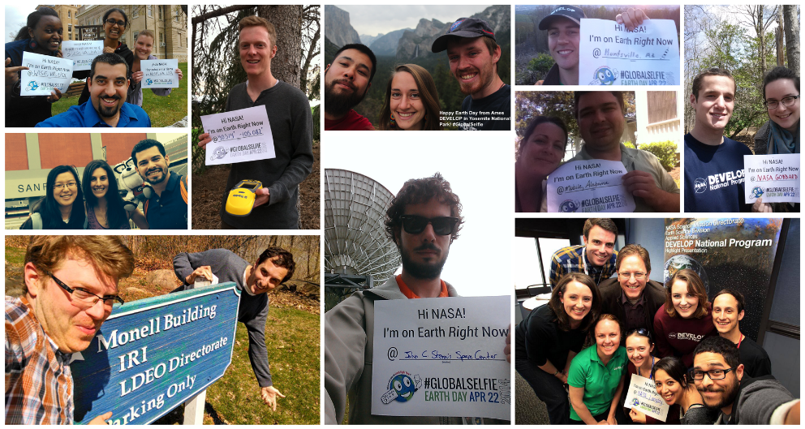
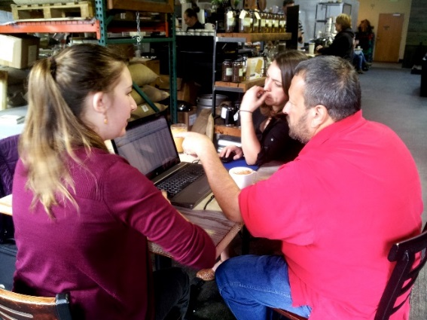
Team Imagery & Photos for Social Media
Caption describing the picture, be succinct but clear. Make sure no NASA badges are in the picture, that all people have signed a media release who are visible, and that there are no people under the age of 18.
Caption describing the picture, be succinct but clear. Make sure no NASA badges are in the picture, that all people have signed a media release who are visible, and that there are no people under the age of 18.
Ideas of things to put in this section:
Cool imagery from a project (or projects!) at your location
Pictures of DEVELOPers presenting their work
Final products used during or photos of a partner hand-off
Pictures of your location, teams at work, or other everyday scenes at your node
Team building activities (as long as they’re appropriate for Capacity Building/Applied Sciences consumption [read: you’d be comfortable with Nancy Searby seeing it])
Other cool accomplishments or events you take part in!
Things to remember:
Provide a caption or text box for project imagery or photos; explain what’s happening in the photo/being shown in the imagery, and include the names of any individuals in the photos
Make sure you have a signed media release form for anyone appearing in a photo
Feel free to send photos as attachments when submitting your quadchart - we love high-res imagery/photos!

Slide 3
Outreach Activities
Node Activities (if need more space, duplicate slide) Report: Recruiting Events, Closeouts, Hand-off Events | Activity 1 | Activity 2
Title of Event/ Activity
Activity Type: Hand-off Event, Recruiting Events (Presentations not emails), Closeout
Description (max 2 sentences)
City
Country
State FOR US ONLY
Date (month/day/year)
Format: In-Person, Virtual
List Related Project Short Titles (For closeout events, list all projects presented. For recruiting events, write “N/A”.)
Total Number of Participants Present
Number of Male Participants
Number of Female Participants
List Partner Organizations Present
Total Number of Partners Present (count all individuals from partner organizations attending, even if multiple from same organization)

Slide 4
Conference & Publication Activities
Conference Presentations (Duplicate Slide if more space is needed) | Presentation 1 | Presentation 2
Title of Meeting/Conference
Type of Meeting/Conference: Science or Policy
City
Country
State FOR US ONLY
Date of Meeting/ Conference
Name of Presenter (First Name Last Name)
Title of Presentation
Was this a Poster Presentation (Yes/ No)?
Was this a Paper Presentation (oral) (Yes/ No)?
Was the presenter a guest speaker /panel member (Yes/ No)?
List all presentations given. Like the old tracking metrics, please make one entry for each presentation given at a conference. If one project has both a poster/oral presentation at a conference, make one entry.
For Type: Select “Science” or “Policy”
Publications & Articles
Name/ Title
Type: Peer reviewed, Grey Literature, About DEVELOP (not written by DEVELOP)
Target User (list and if more than 1 place SEMICOLON between groups): Scientific Community, General Public
Is it posted online? (Yes/ No)
URL/link (if available)
Purpose/Objective of the Product ( 2 sentences max)
Publication Venue
"What is the current STATUS?" (In-Design = Submitted to NPO for review; In-Progress = Submitted to venue for publication; Completed = Published)
If completed, Date of posting/ publication
Related Project Short Title
List any publications once they have gotten to the stage of being submitted to NPO for review. Note: If a team is planning on writing their tech paper for publication (i.e. before it would reach the review stage), you must email Tiffani and Lauren.
For Type: Select “Peer Reviewed”, “Grey Literature” or “About DEVELOP”
For Target User: Select “Scientific Community” or “General Public”
For Status: Select “In-Design”, “In-Progress”, “Completed”

