Slide 1
Mississippi Ecological Forecasting
Utilizing NASA Earth Observations to Locate Potential Habitat for the Dusky Gopher Frog
Ross Reahard (Project Lead)
James Brooke
Rudy Bartels
Meredith Williams
Notes:
Introduction

Slide 2
Study Area
Hancock County
Harrison County
Jackson County
St. Tammany Parish
Study Period
January 2005-Present
Notes:
The focus for the project consists of the following three Mississippi counties and one Louisiana Parish: Hancock county (533 sq mi), Harrison county (976 sq mi), Jackson county (1,043 sq mi), and St. Tammany Parish (854 sq mi).
These three counties are located south of Hattiesburg, Mississippi and all border the Gulf of Mexico.
St. Tammany Parish is located north of New Orleans, is west/borders Hancock county, Mississippi.
The total combined areas of the three counties and parish is approximately 3,406 square miles, with a total population of about 613,000 according to the 2013 census. St. Tammany has a population of approximately 242,000, Hancock 44,000, Harrison 188,000 and Jackson 140,000.

Slide 3
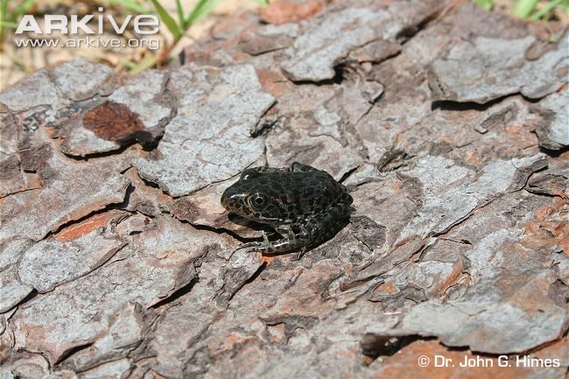
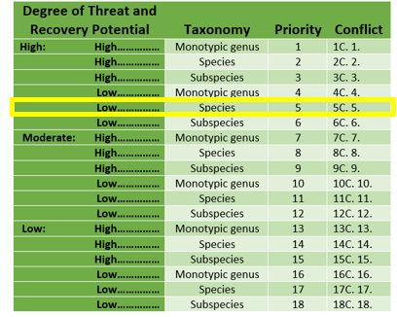
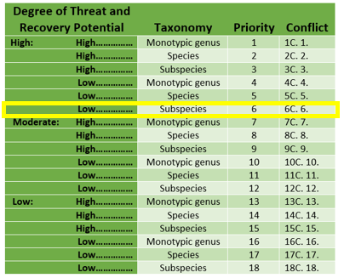
Background
Dusky Gopher Frog
The most endangered species of frog in North America
In the top 100 endangered species in the world
U.S. Fish and Wildlife Service listed Mississippi Gopher Frog under the Endangered Species Act on December 4, 2001
Recovery priority number of 6, with low potential recovery and considered a subspecies in 2001
June 12, 2012, USFWS changed taxonomic status to “species” and changed the name to the dusky gopher frog (Rana sevosa) based on taxonomic changes
The recovery priority number has been changed to 5 reflecting this taxonomic change; however the high degree of threat and low potential of recovery are unchanged
Credit: Dr. John G. Himes
Notes:
http://www.arkive.org/dusky-gopher-frog/lithobates-sevosus/
https://www.fws.gov/endangered/esa-library/pdf/1983_LPN_Policy_FR_pub.pdf
The U.S. Fish and Wildlife Service (USFWS) listed the Mississippi gopher frog (Rana capito sevosa) under the Endangered Species Act (Act), without critical habitat, as an endangered distinct vertebrate population segment (DPS) of the gopher frog (Rana capito) on December 4, 2001(66 FR 62993; USFWS 2001). At the time of listing, the frog was given a recovery priority number of 6 (48 FR 43098), indicating a high degree of threat, a low potential of recovery, and a taxonomic classification as a subspecies.
On June 12, 2012, USFWS published a final rule (77 FR 35118; USFWS 2012) designating critical habitat for this listed entity and changing its status to “species” and its name to the dusky gopher frog (Rana sevosa) based on taxonomic changes and the acceptance of these changes by the herpetological scientific community. The recovery priority number has been changed to 5 reflecting this taxonomic change; however the high degree of threat and low potential of recovery are unchanged.

Slide 4
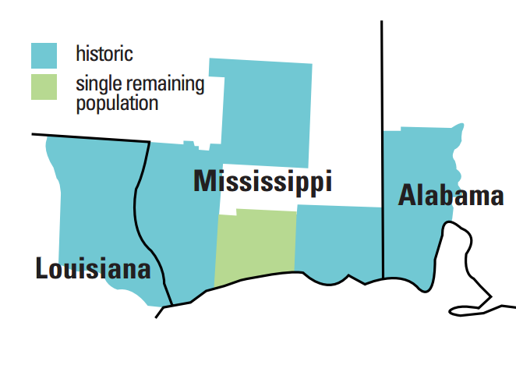
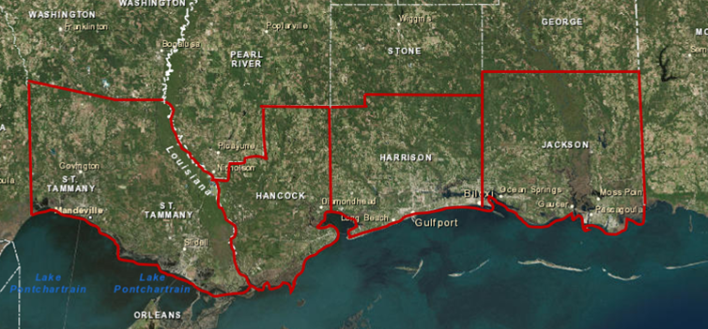
Background
Historic records indicate, the Dusky Gopher Frog existed from East of the Mississippi River to the West of Mobile Bay.
Credit: USFWS
Notes:
Historically, the DGF inhabited the Gulf Coastal Plain in Southwest Alabama, Southern Mississippi, and Southeast Louisiana from east of the Mississippi River Delta to Mobile Bay.
http://www.fws.gov/southeast/publications/gopher.pdf

Slide 5
Background
Known Dusky Gopher Frog breeding ponds
Glen’s Pond
Pony Ranch
Mike’s Pond
McCoy’s Pond
Notes:
Currently only four population of the species are known and are located in Southern Mississippi
Glen’s Pond was originally the only known pond to inhabit the DGF but
Currently Glen’s Pond, two naturally-occurring populations and a fourth pond which was established as a recovery plan using translocation experiments are the only known ponds
U.S. Fish and Wildlife Service. 2014. Technical/Agency Draft Recovery Plan for the Dusky Gopher Frog (Rana sevosa). Atlanta, Georgia. 90 pp.

Slide 6
Partners
Focus on conservation of the Dusky Gopher Frog
End-Users/Partners/Boundary Organizations
End-Users
Partners
Boundary Organizations
The Nature Conservancy
The Nature Conservancy
USDA Forest Service: DeSoto Ranger District
US Fish and Wildlife Service
US Fish and Wildlife Service
US Army Corp of Engineers

Slide 7
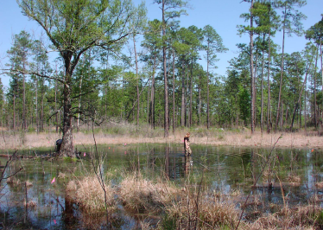
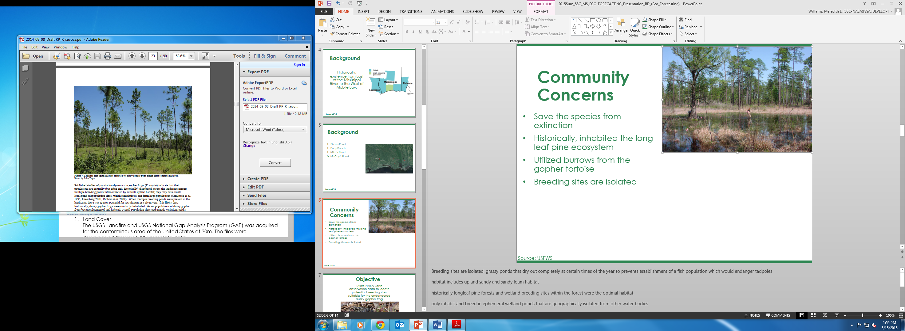
Community Concerns
Save the species from extinction
Historically, inhabited the long leaf pine ecosystem
Utilized burrows from the gopher tortoise
Breeding sites are isolated
Credit: USFWS
Credit: USFWS
Notes:
Breeding sites are isolated, grassy ponds that dry out completely at certain times of the year to prevents establishment of a fish population which would endanger tadpoles
habitat includes upland sandy and sandy loam habitat
historically longleaf pine forests and wetland breeding sites within the forest were the optimal habitat
only inhabit and breed in ephemeral wetland ponds that are geographically isolated from other water bodies
making rainfall the only source of water for these ponds.
Ponds must also be hard bottomed, drain almost completely during the non-breeding season, have emergent and submergent vegetation present for egg attachment,
open canopy cover which is essential for tadpole development.
abandoned gopher tortoise burrows however a decline in gopher tortoises has resulted in the DGF living in stump holes or small mammal burrows
U.S. Fish and Wildlife Service. 2014. Technical/Agency Draft Recovery Plan for the Dusky Gopher Frog (Rana sevosa). Atlanta, Georgia. 90 pp.

Slide 8
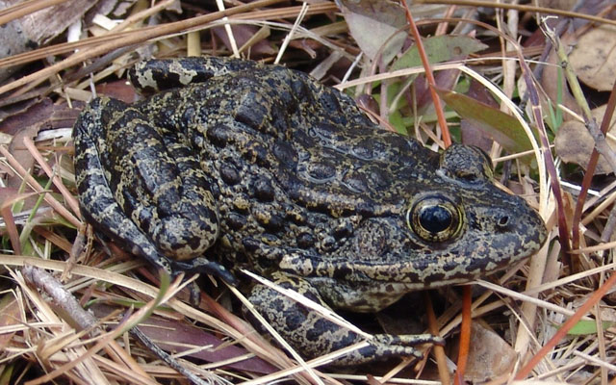
Objective
Utilize NASA Earth observation data to locate potential breeding sites suitable for the endangered dusky gopher frog
Credit: The Nature Conservancy
Notes:
Utilize NASA Earth observation data to locate potential breeding sites suitable for the endangered dusky gopher frog
http://www.nature.org/ourinitiatives/regions/northamerica/unitedstates/mississippi/explore/dusky-gopher-frog-profile.xml

Slide 9
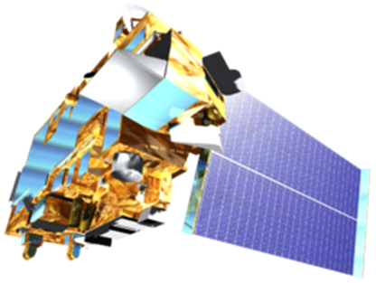
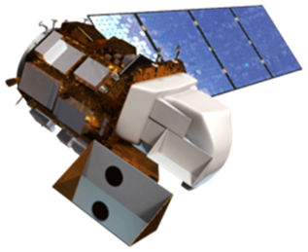
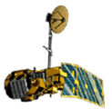
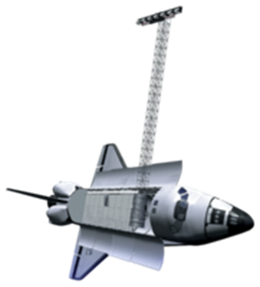
NASA Earth Observations
Terra
Landsat 8
Landsat 5
Space Shuttle
Notes:
DEVELOPEDIA image sources
Landsat 8 OLI was used for vegetation NDVI Normalized Difference Vegetation Index and NDMI and Land Use Land Cover Data
Landsat 5 TM was used for historical imagery, vegetation indices
Terra, ASTER, was used for NDVI, water quality indices
Space Shuttle, SRTM, was used for elevation data and DEMs

Slide 10
Methodology
Elevation
Soil Type
Precipitation
Final Habitat Prediction
Landcover
Imagery
Notes:
Landcover, soil type, elevation, precipitation and multi spectral imagery were the five methodologies used in project. These layers were overlaid to create a habitat suitability map.

Slide 11





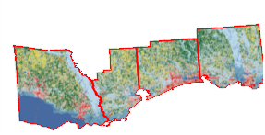
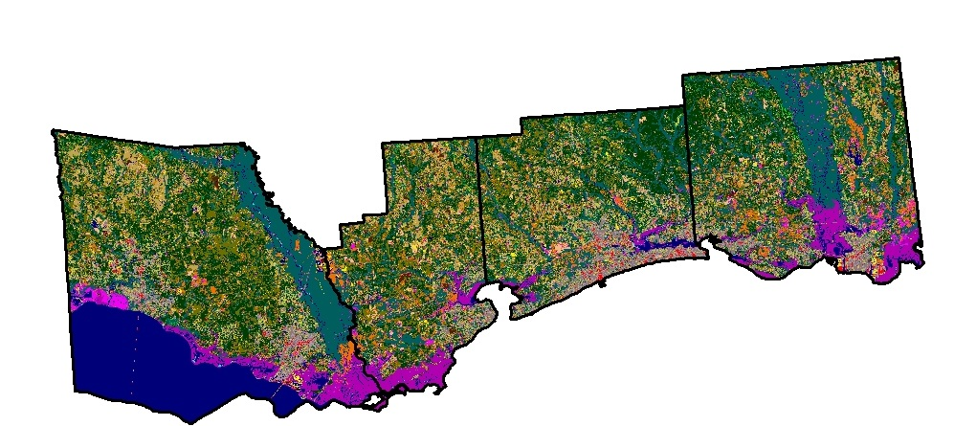
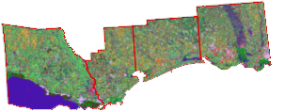
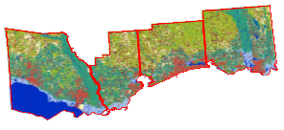
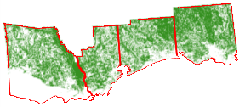
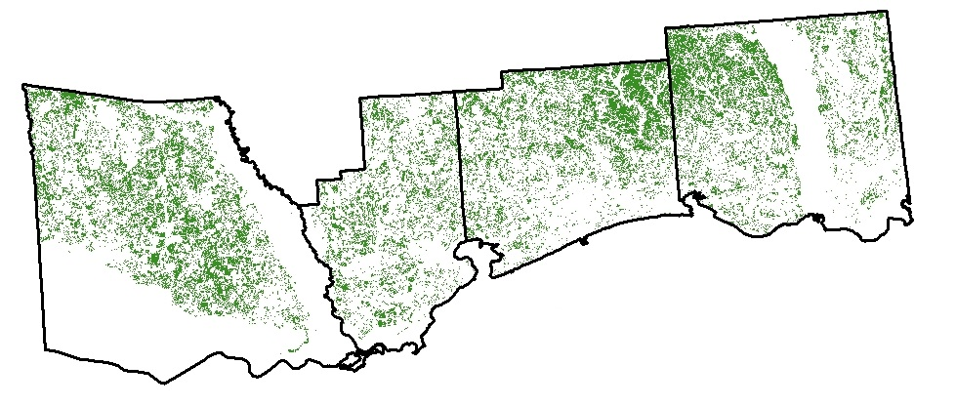
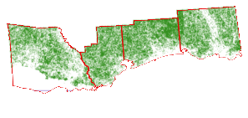
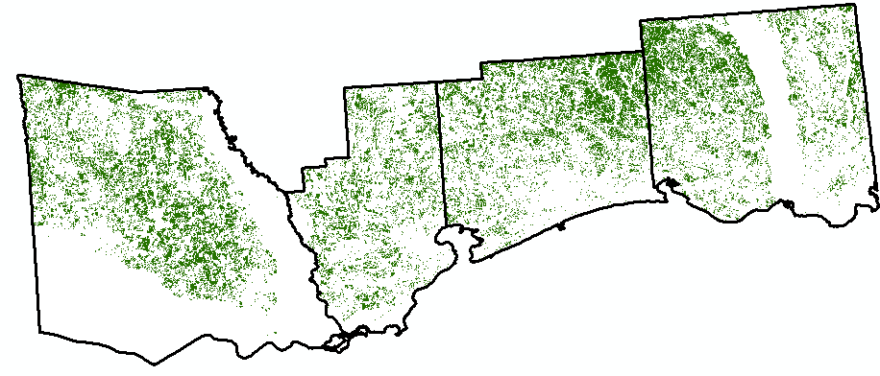
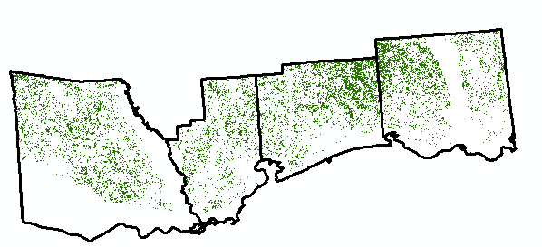
Methodology- Landcover
Source
Clipped
Weighted by habitat preferences
Notes:
Features used to delineate National Vegetation Classification (NVC) levels:
Class-dominant general growth forms adapted to basic moisture, temperature, and/or substrate or aquatic
Subclass-global macroclimatic factors driven primarily by latitude and continental position, or reflect overriding substrate or aquatic conditions
Formation-global macroclimatic conditions as modified by altitude, seasonality of precipitation, substrates, hydrological conditions
Division-continental differences in mesoclimate, geology, substrates, hydrology, disturbance regimes
Macrogroup-sub-continental to regional differences in mesoclimate, geology, substrates, hydrology, disturbance regimes

Slide 12
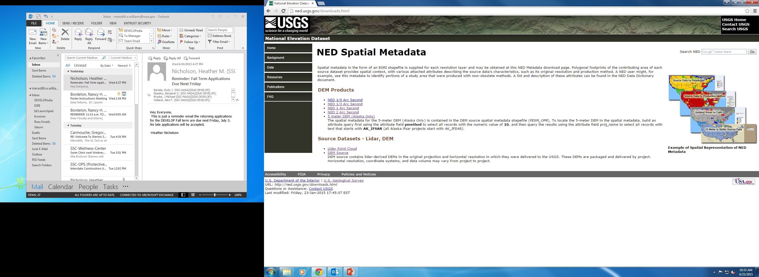
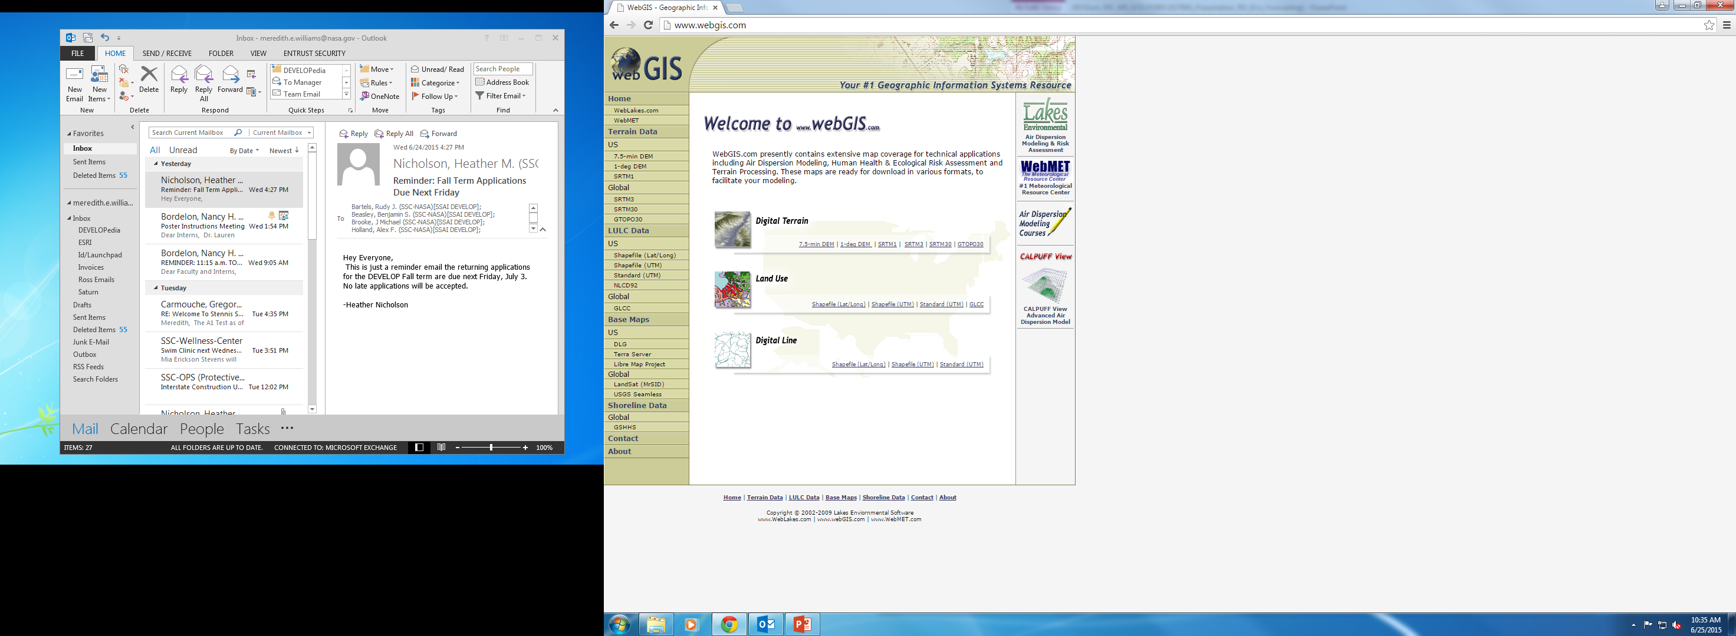
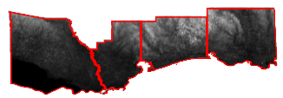
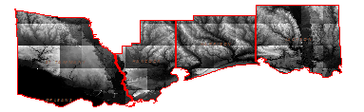
Methodology- Elevation
Acquired Data
Clipped to Study Area
Clipped to Study Area

Slide 13
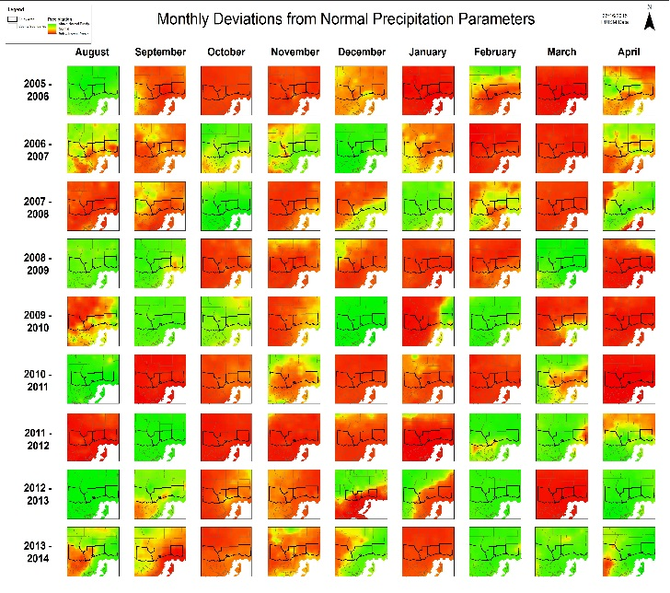

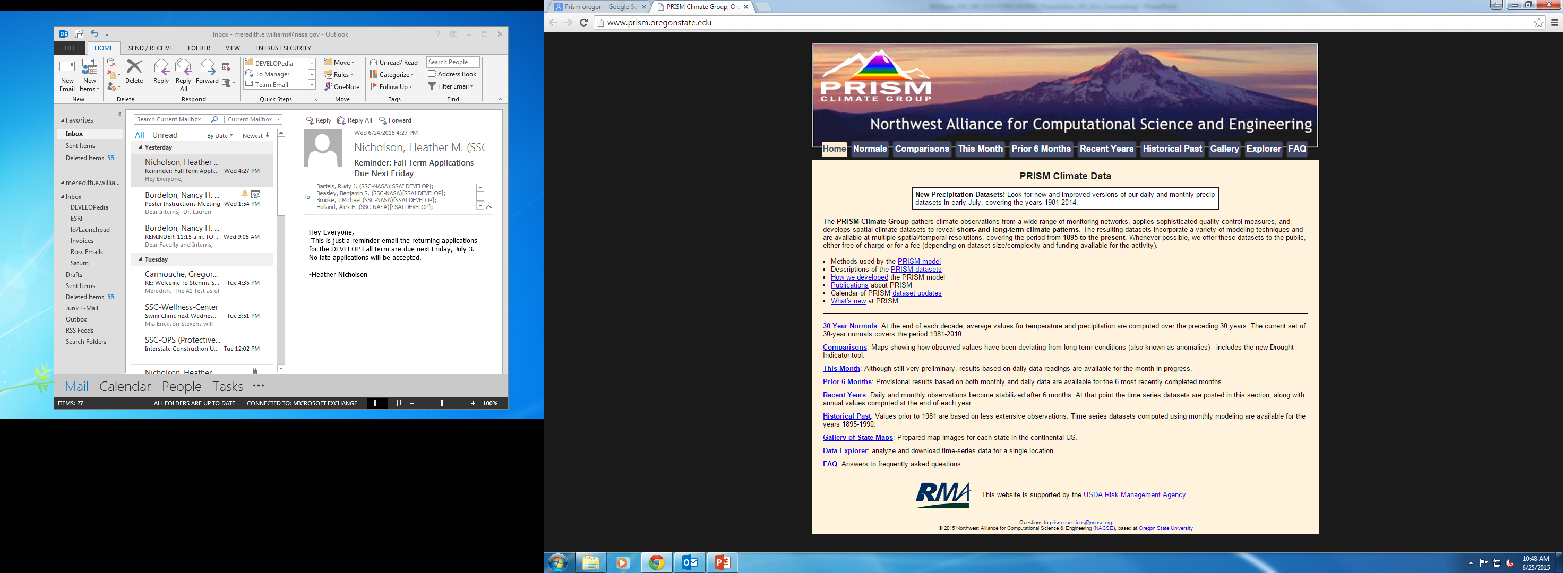
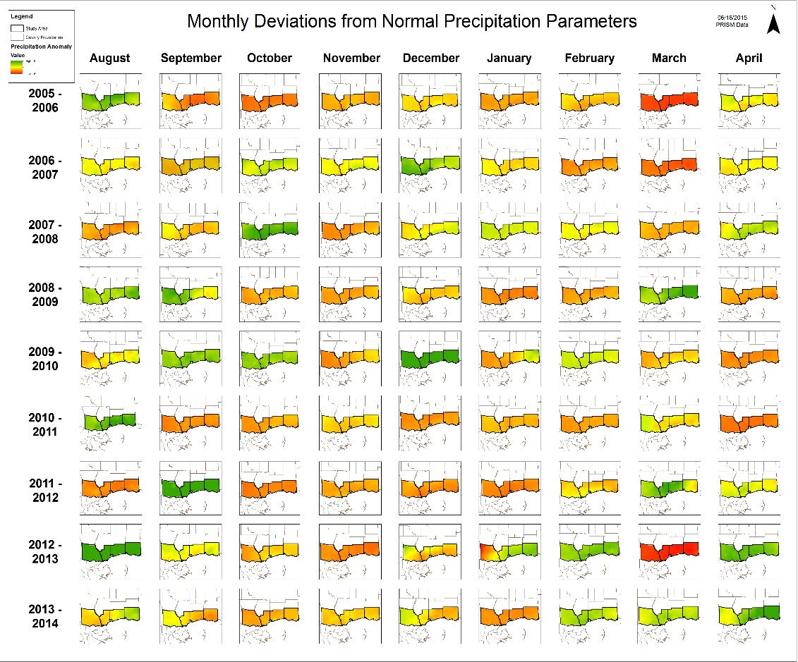
Methodology- Precipitation
Normalization and Anomalies
Clipped to Study Area and Normalized to scale
Notes:
The precipitation was gathered from PRISM Climate Group and NOAA. The data was in raster form, using GIS the data was normalized on a 0 mean and 1 standard deviation scale. Next the data was subtracted by the monthly means from 1980-2010 to calculate the anomalies. Once the anomalies were calculated, the data was clipped into the study area parameters. Lastly the scale was normalized to range from a -6 to 6 inch range to determine extreme wet and dry months.

Slide 14
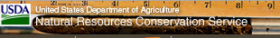
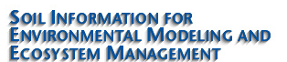
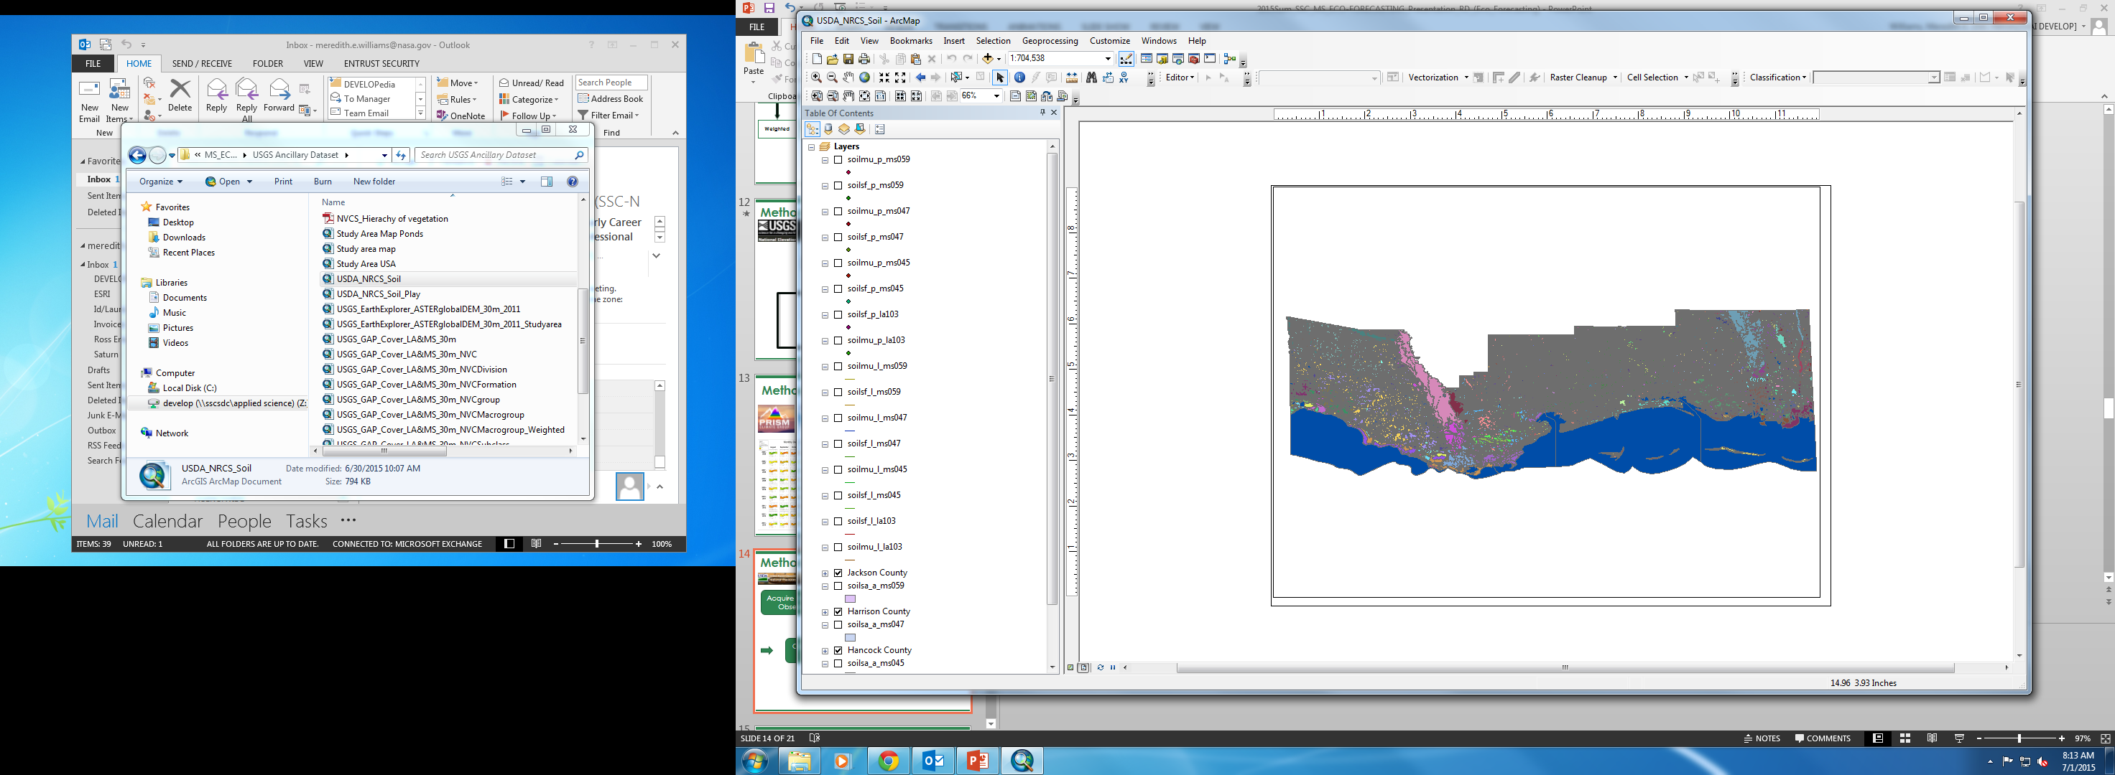
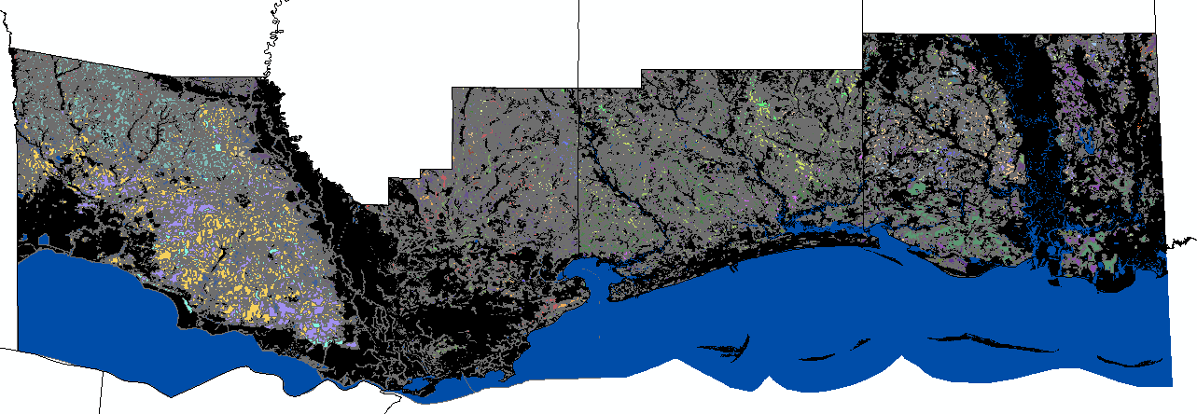
Methodology- Soils
Acquired Data
&
Clipped to Study Area
Weighted
Weighted

Slide 15
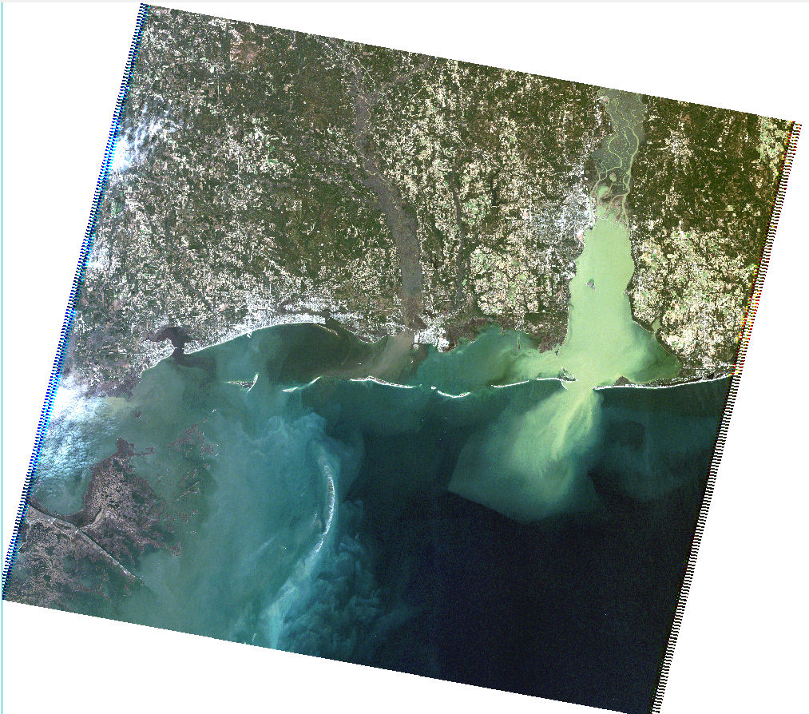

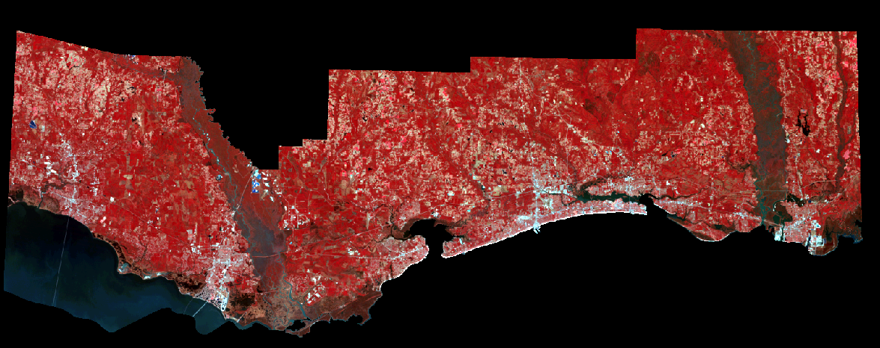
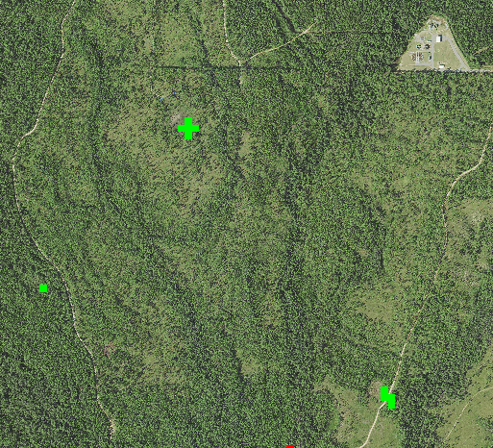
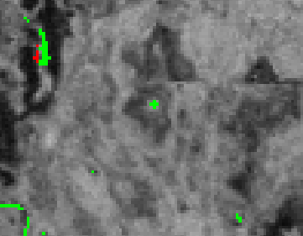
Methodology-Imagery
Preprocessed
in
ENVI
Applied NDWI, NDPI, WV-WI for Summer & Winter in ERDAS
Mosaicked Scenes & Clipped Scenes to Study Area in ERDAS Imagine
Change Detection of Indices, Used Existing DGF ponds to QC Results & Determine Most Effective Index

Slide 16
Results
Potential DGF Habitat maps
Updated Landcover maps
Elevation Maps
Maps of potential DGF habitat interactions with anthropogenic activity
Notes:
The overlay and layer preparation are almost complete.

Slide 17
Accuracy Assessment and Field Surveys
Notes:
The overlay and layer preparation are almost complete.

Slide 18
Conclusions
    To be determined
Notes:
The layering is still in progress.

Slide 19
Limitations and Future Work
Limitations
Data Resolution
  Lack of High Resolution data
Scarce Point Data
  Lack of Accurate Point Data
Future Work
Expand the Study Area
Create multiple Habitat Models
Notes:
The Data Resolution available for some of the layers was low and at times difficult to interpret. Higher Resolution Imagery and Precipitation would be helpful for future work. Also, point data was difficult to gather as many places in the study area are recovering from hurricanes or other issues.
For future work the team suggests to expand the study area to counties around the original study area for this project. Expanding the study area may find more suitable places for the Dusky Gopher Frog to live. Different types of models should be created using different layers and data sources. A different combination and figuring out more about the suitable habitat for the Dusky Gopher Frog may be beneficial for its future.

Slide 20
Advisors
Joseph Spruce, NASA Stennis Space Center
James “Doc” Smoot, NASA Stennis Space Center
Dr. Kenton Ross, NASA Langley Research Center
Partners
Jim Lee, The Nature Conservancy
Linda LaClaire, US Fish and Wildlife Service
Others
Ed Moody, USDA Forest Service
Danny Hartley, US Army Corps of Engineers
Notes:
Read from slide mostly.

Slide 21
References
U.S. Fish and Wildlife Service. 2014. Technical/Agency Draft Recovery Plan for the Dusky Gopher Frog (Rana sevosa). Atlanta, Georgia. 90 pp. Available online at http://www.fws.gov/endangered/species/recovery-plans.html
National Gap Analysis Program Land Cover Data. US Geological Survey. U.S General Land Cover Map. Available online at http://gapanalysis.usgs.gov/gaplandcover/viewer/.
National Land Cover Database. US Geological Survey. Conterminous United States Land Cover. Available online at http://www.mrlc.gov/nlcd2011.php.
LANDFIRE. US Geological Survey. Conterminous United States Land Cover. Available online at http://www.landfire.gov/
The National Elevation Dataset, US Geological Survey. U.S General Elevation Map. Available online at http://ned.usgs.gov/.
WebGIS. Geographic Information Systems Resource. Elevation Map Available online at http://www.webgis.com/.
Soil Survey Staff, Natural Resources Conservation Service, United States Department of Agriculture. U.S. General Soil Map (STATSGO2). Available online at http://sdmdataaccess.nrcs.usda.gov/.
Soil Information for Environmental Modeling and Ecosystem Management. US Conterminous Soil Map. Available online at http://www.soilinfo.psu.edu/index.cgi?soil_data&conus&data_cov&texture
Coastal Change Analysis Program Regional Land Cover and Change. NOAA Digital Coast Office for Coastal Management. Available at
http://coast.noaa.gov/dataregistry/search/collection/info/ccapregional
PRISM Climate Group, Oregon State University. US Conterminous Precipitation Data. Available online at http://www.prism.oregonstate.edu/

Slide 22

Questions?

