Slide 1
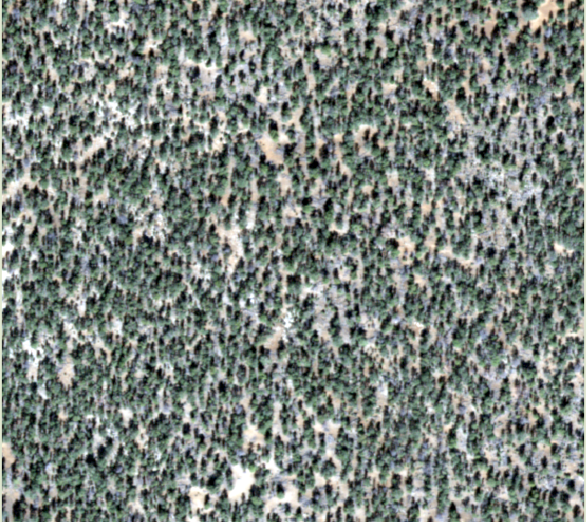
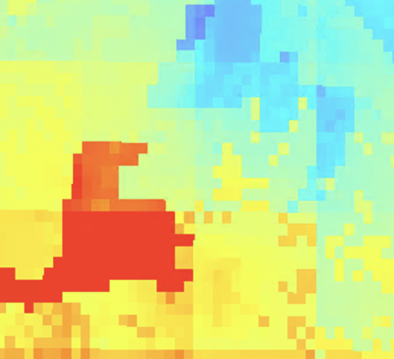
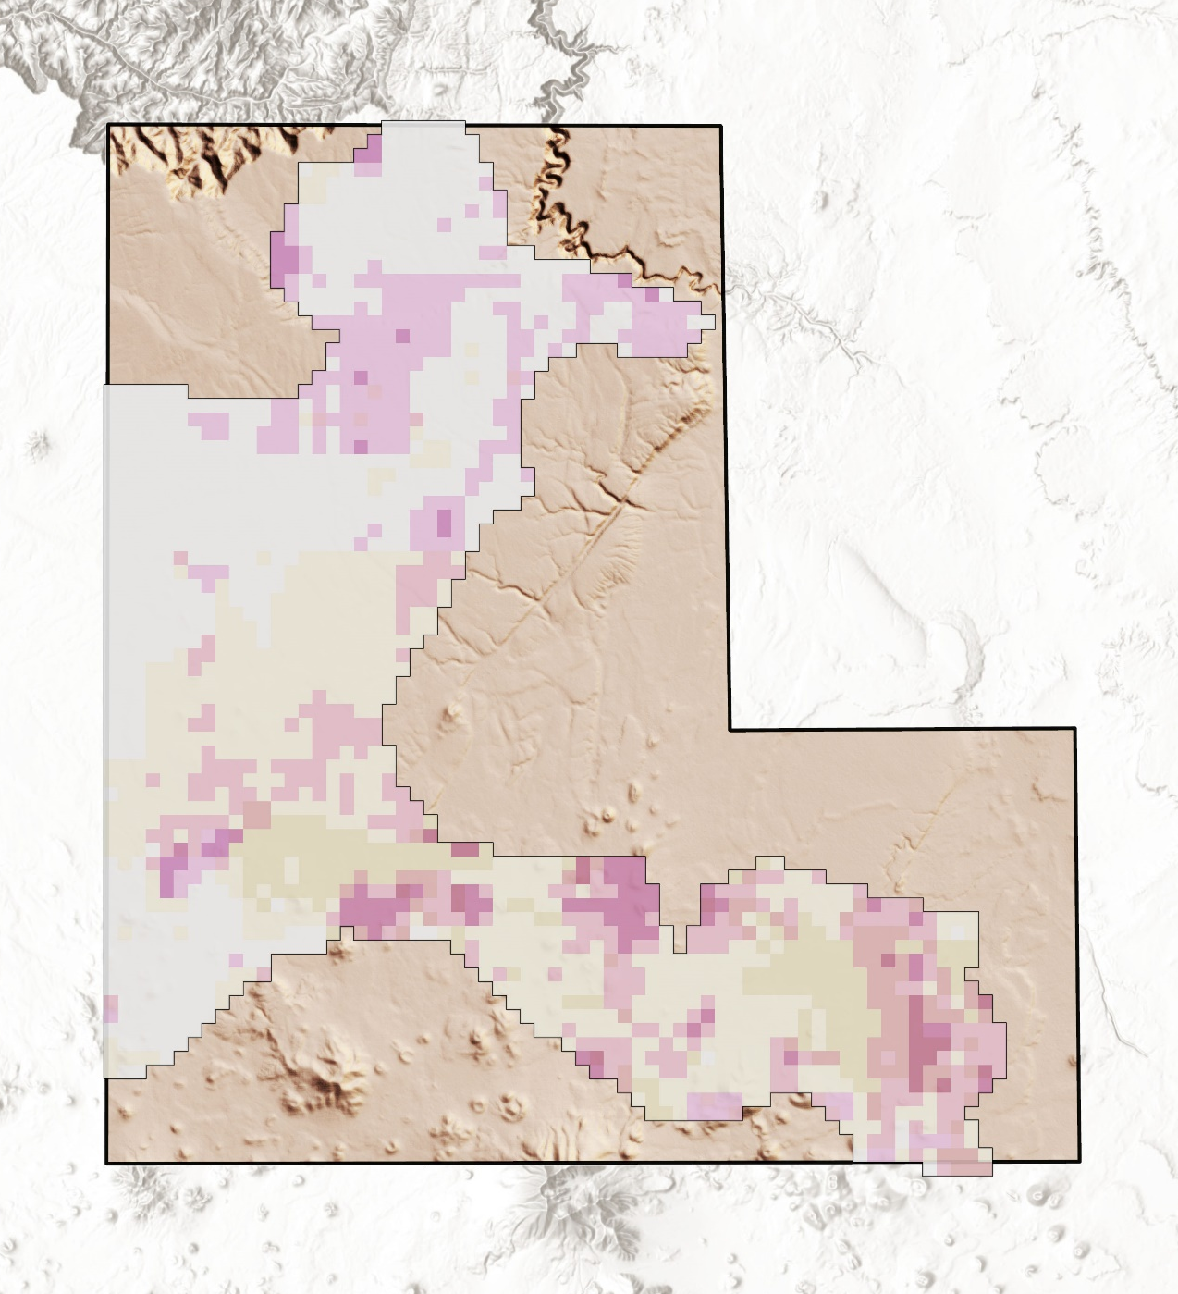
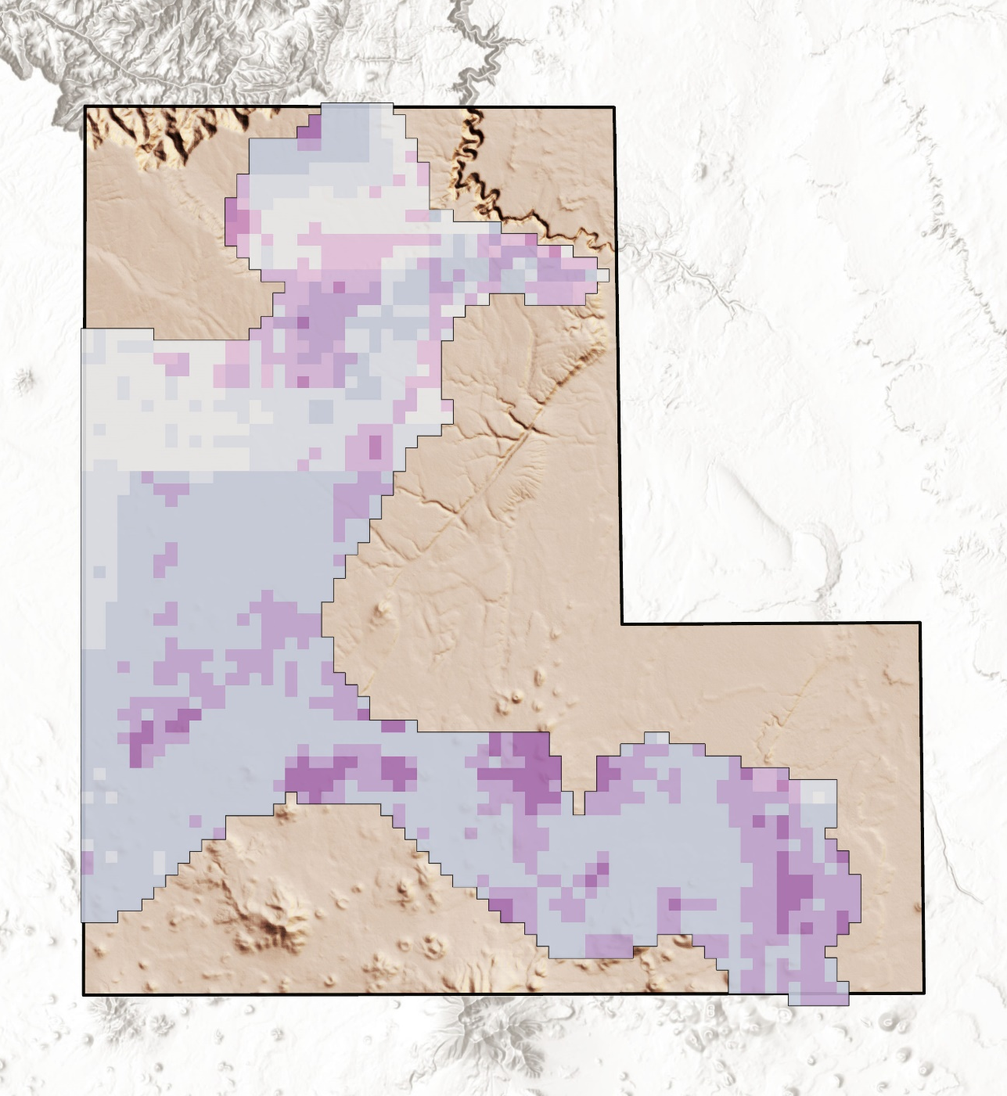
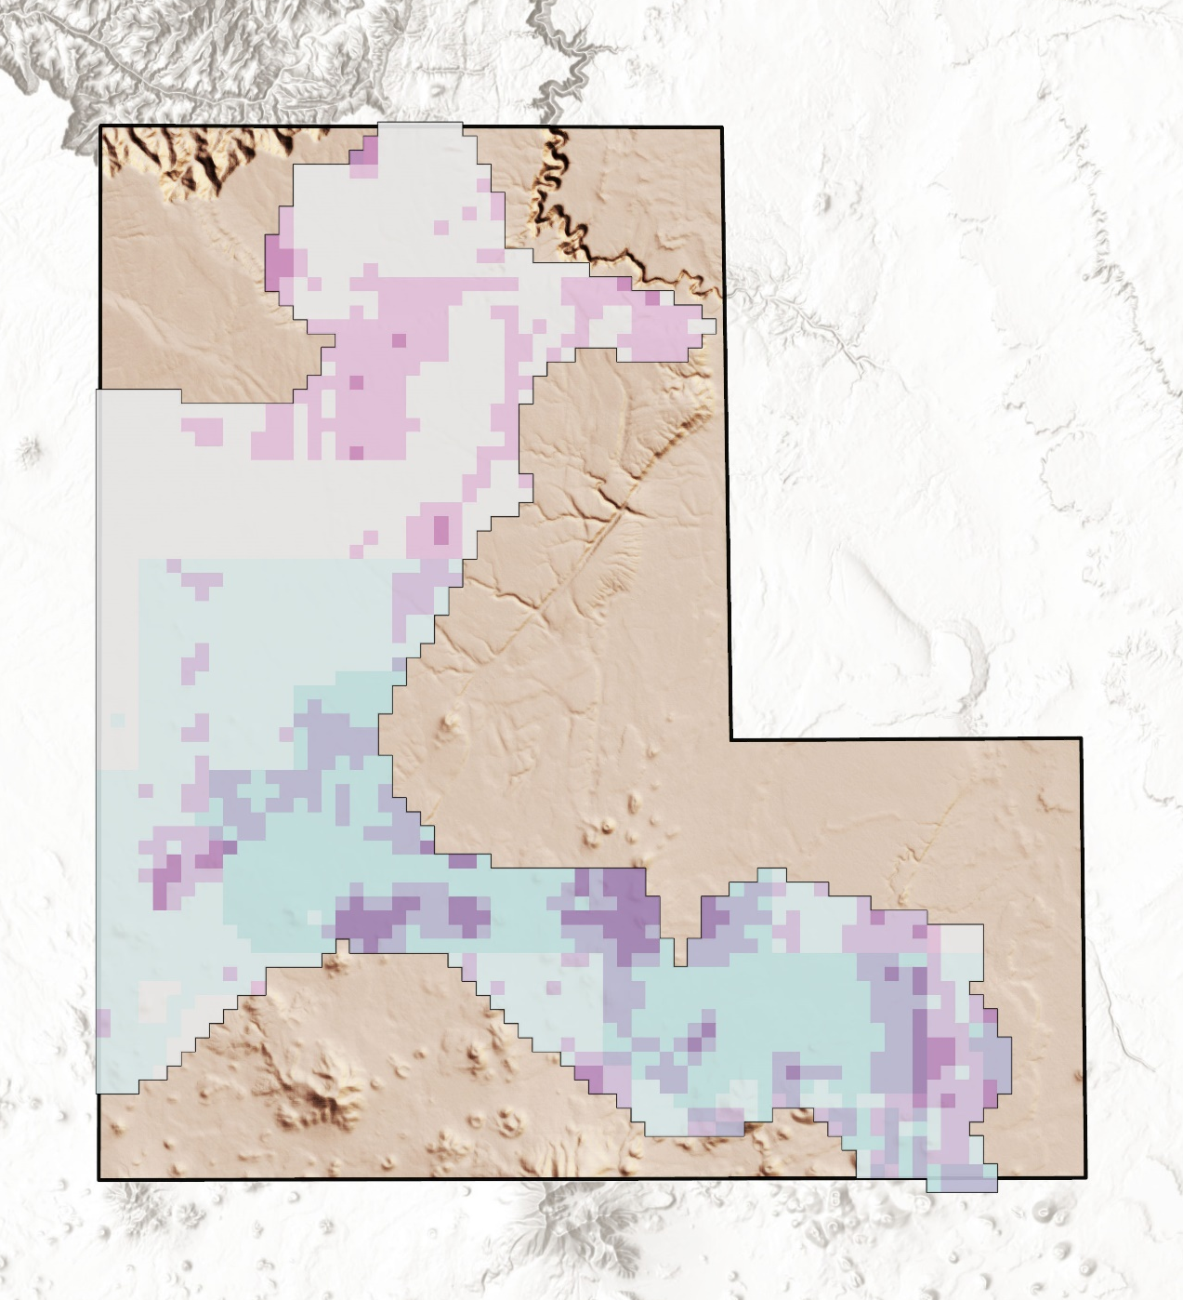
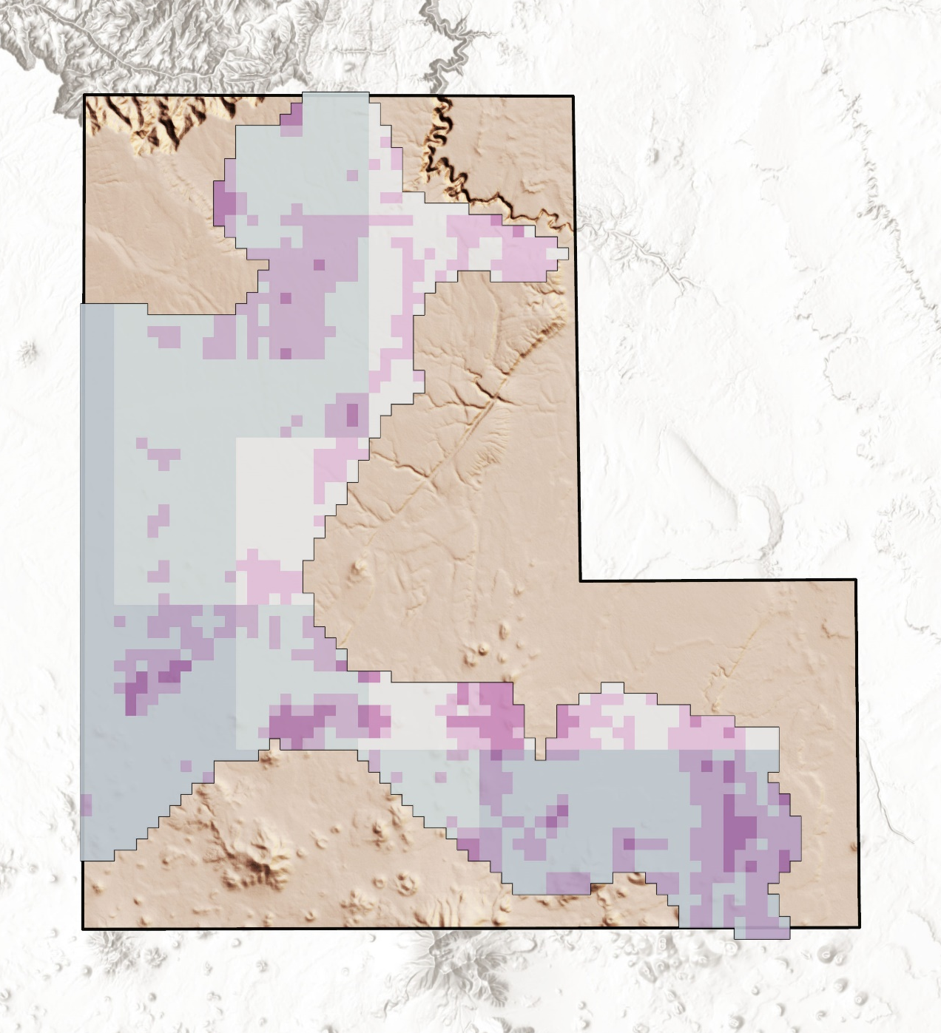
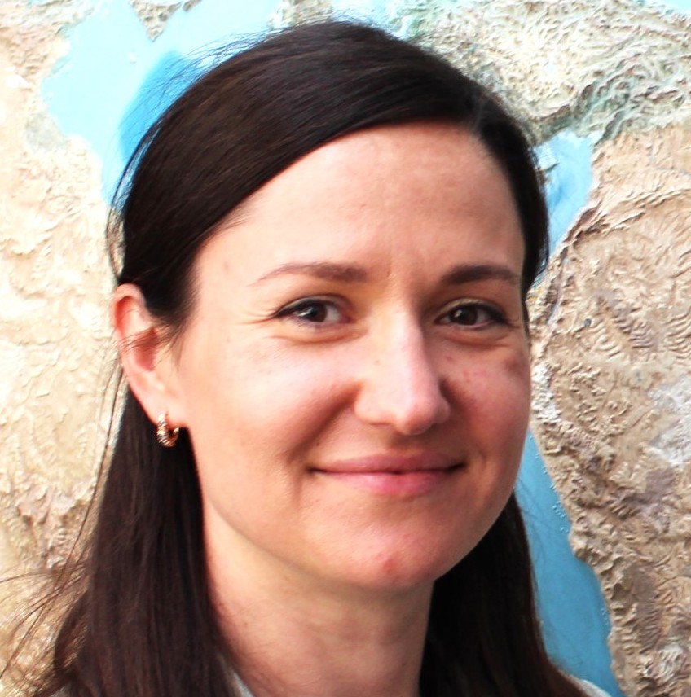
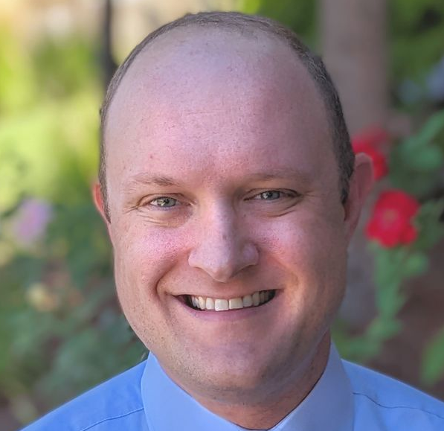
Arizona Water Resources II:
Utilizing Earth Observations to Refine Juniper Tree Mortality Assessments in Flagstaff, Arizona
When in drought – map it out:
What is happening to the trees in Arizona?
Vulnerability to disease and infestation
Changes to local fire regimes
Loss of traditional resources for Indigenous Peoples
Arizona Water Resources II
After more than two decades of prolonged drought in the American Southwest, culturally and ecologically vital Pinyon-Juniper Woodlands are experiencing widespread mortality, which poses a major concern for the National Park Service.
NASA DEVELOP is using aerial imagery and modelled climactic data to quantify mortality of Pinyon-Juniper Woodlands between 2015 and 2021 in Flagstaff Area National Monuments, AZ.
National Agriculture Imagery Program (NAIP) Imagery
Unsupervised Classification
Western Land Data Assimilation System (WLDAS) Model
Images provided by Flagstaff Area National Monuments.
22
°C
%
mortality of Pinyon-Juniper Woodlands from 2015–2021
Based on classification analysis
0.5
rise in average annual temperature over the past 20 years
Based on WLDAS data
+
Bare Soil Evaporation
Rainfall
Nearly one in every four Pinyon-Juniper trees have experienced mortality over the last 7 years with the majority of mortality occurring from 2019-2021. Classified NAIP imagery from 2021 proved to be over 87% accurate, demonstrating the effectiveness of this method.
Low → High
Mortality
Low → High
Mortality
Low → High
Bare Soil Evap.
Low → High
Rainfall
5
Environmental Variable ​ | Average Correlation​
Bare Soil Evaporation​ | 0.15​
Rainfall ​ | 0.14​
Groundwater Storage​ | 0.13​
Wind Speed​ | 0.12​
2019-2021
0 10 20 km
2
2
5
Groundwater Storage
Wind Speed
Low → High
Mortality
Low → High
Mortality
Low → High
Gr.Water Storage
Low → High
Wind Speed
2
Correlation results from climactic data highlight how and where climate change-induced drought is accelerating the dieback of these important woodlands.
2019-2021
0 10 20 km
2
2
5
Project Partners
The Team would like to thank everyone who made this project possible:
Partners: Mark Szydlo and Julie Long (National Park Service)
Advisors: Sean McCartney (GSFC/SSAI) and Joe Spruce (SSAI)
Fellow: Carli Merrick (DEVELOP, GSFC )
Arina Morozova
Project Lead
Greg Peargin
Jamal Jaffer
Jessica Birk
Goddard Space Flight Center

