Slide 1
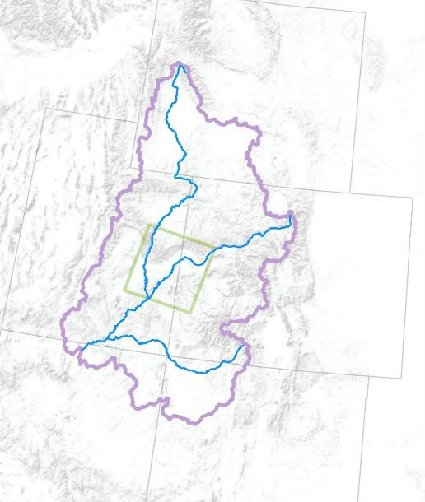
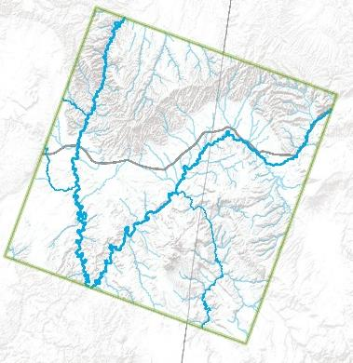


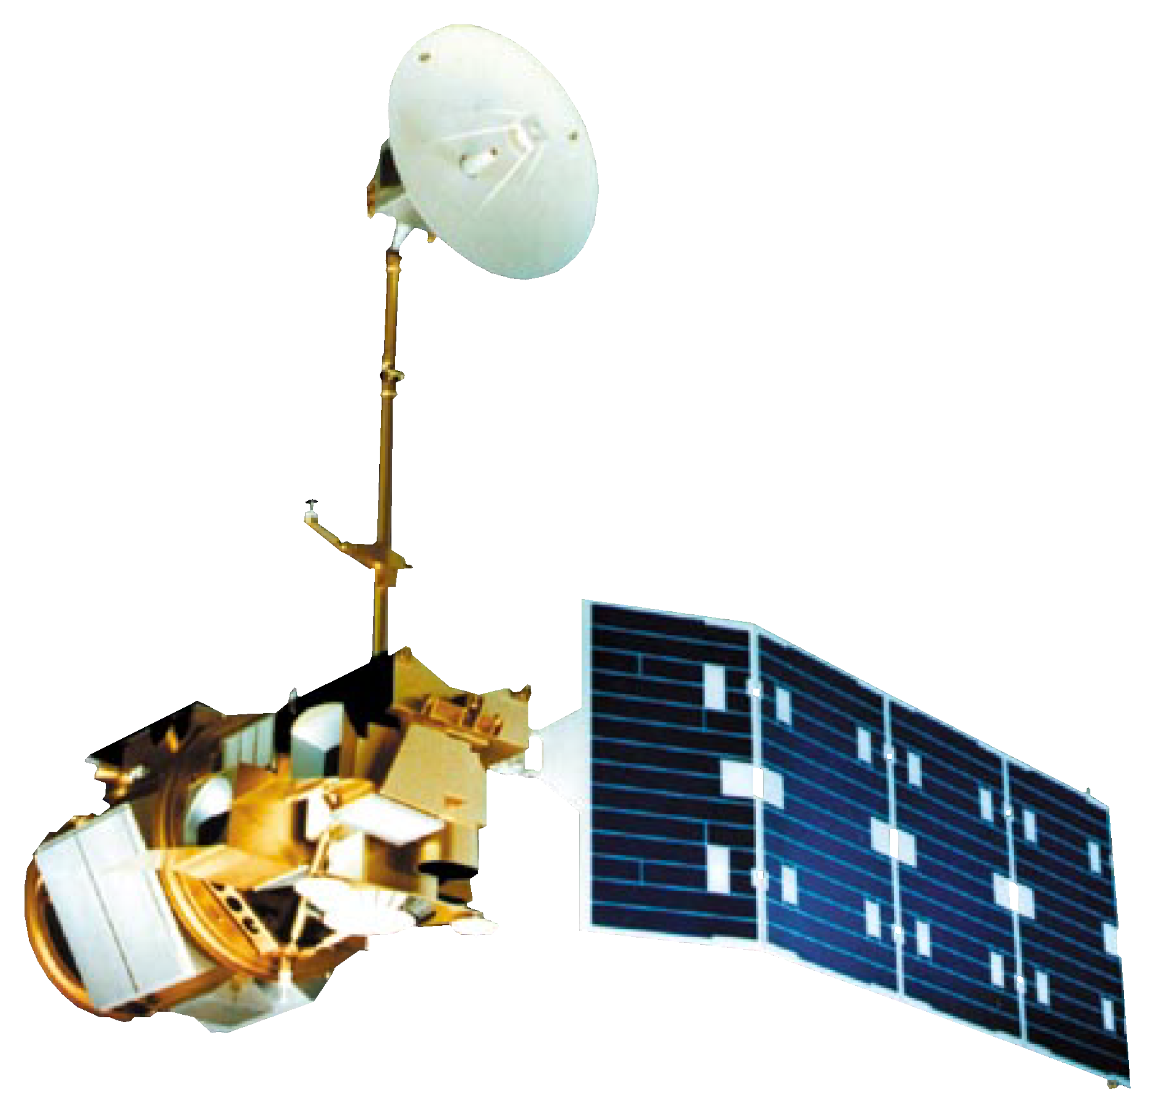

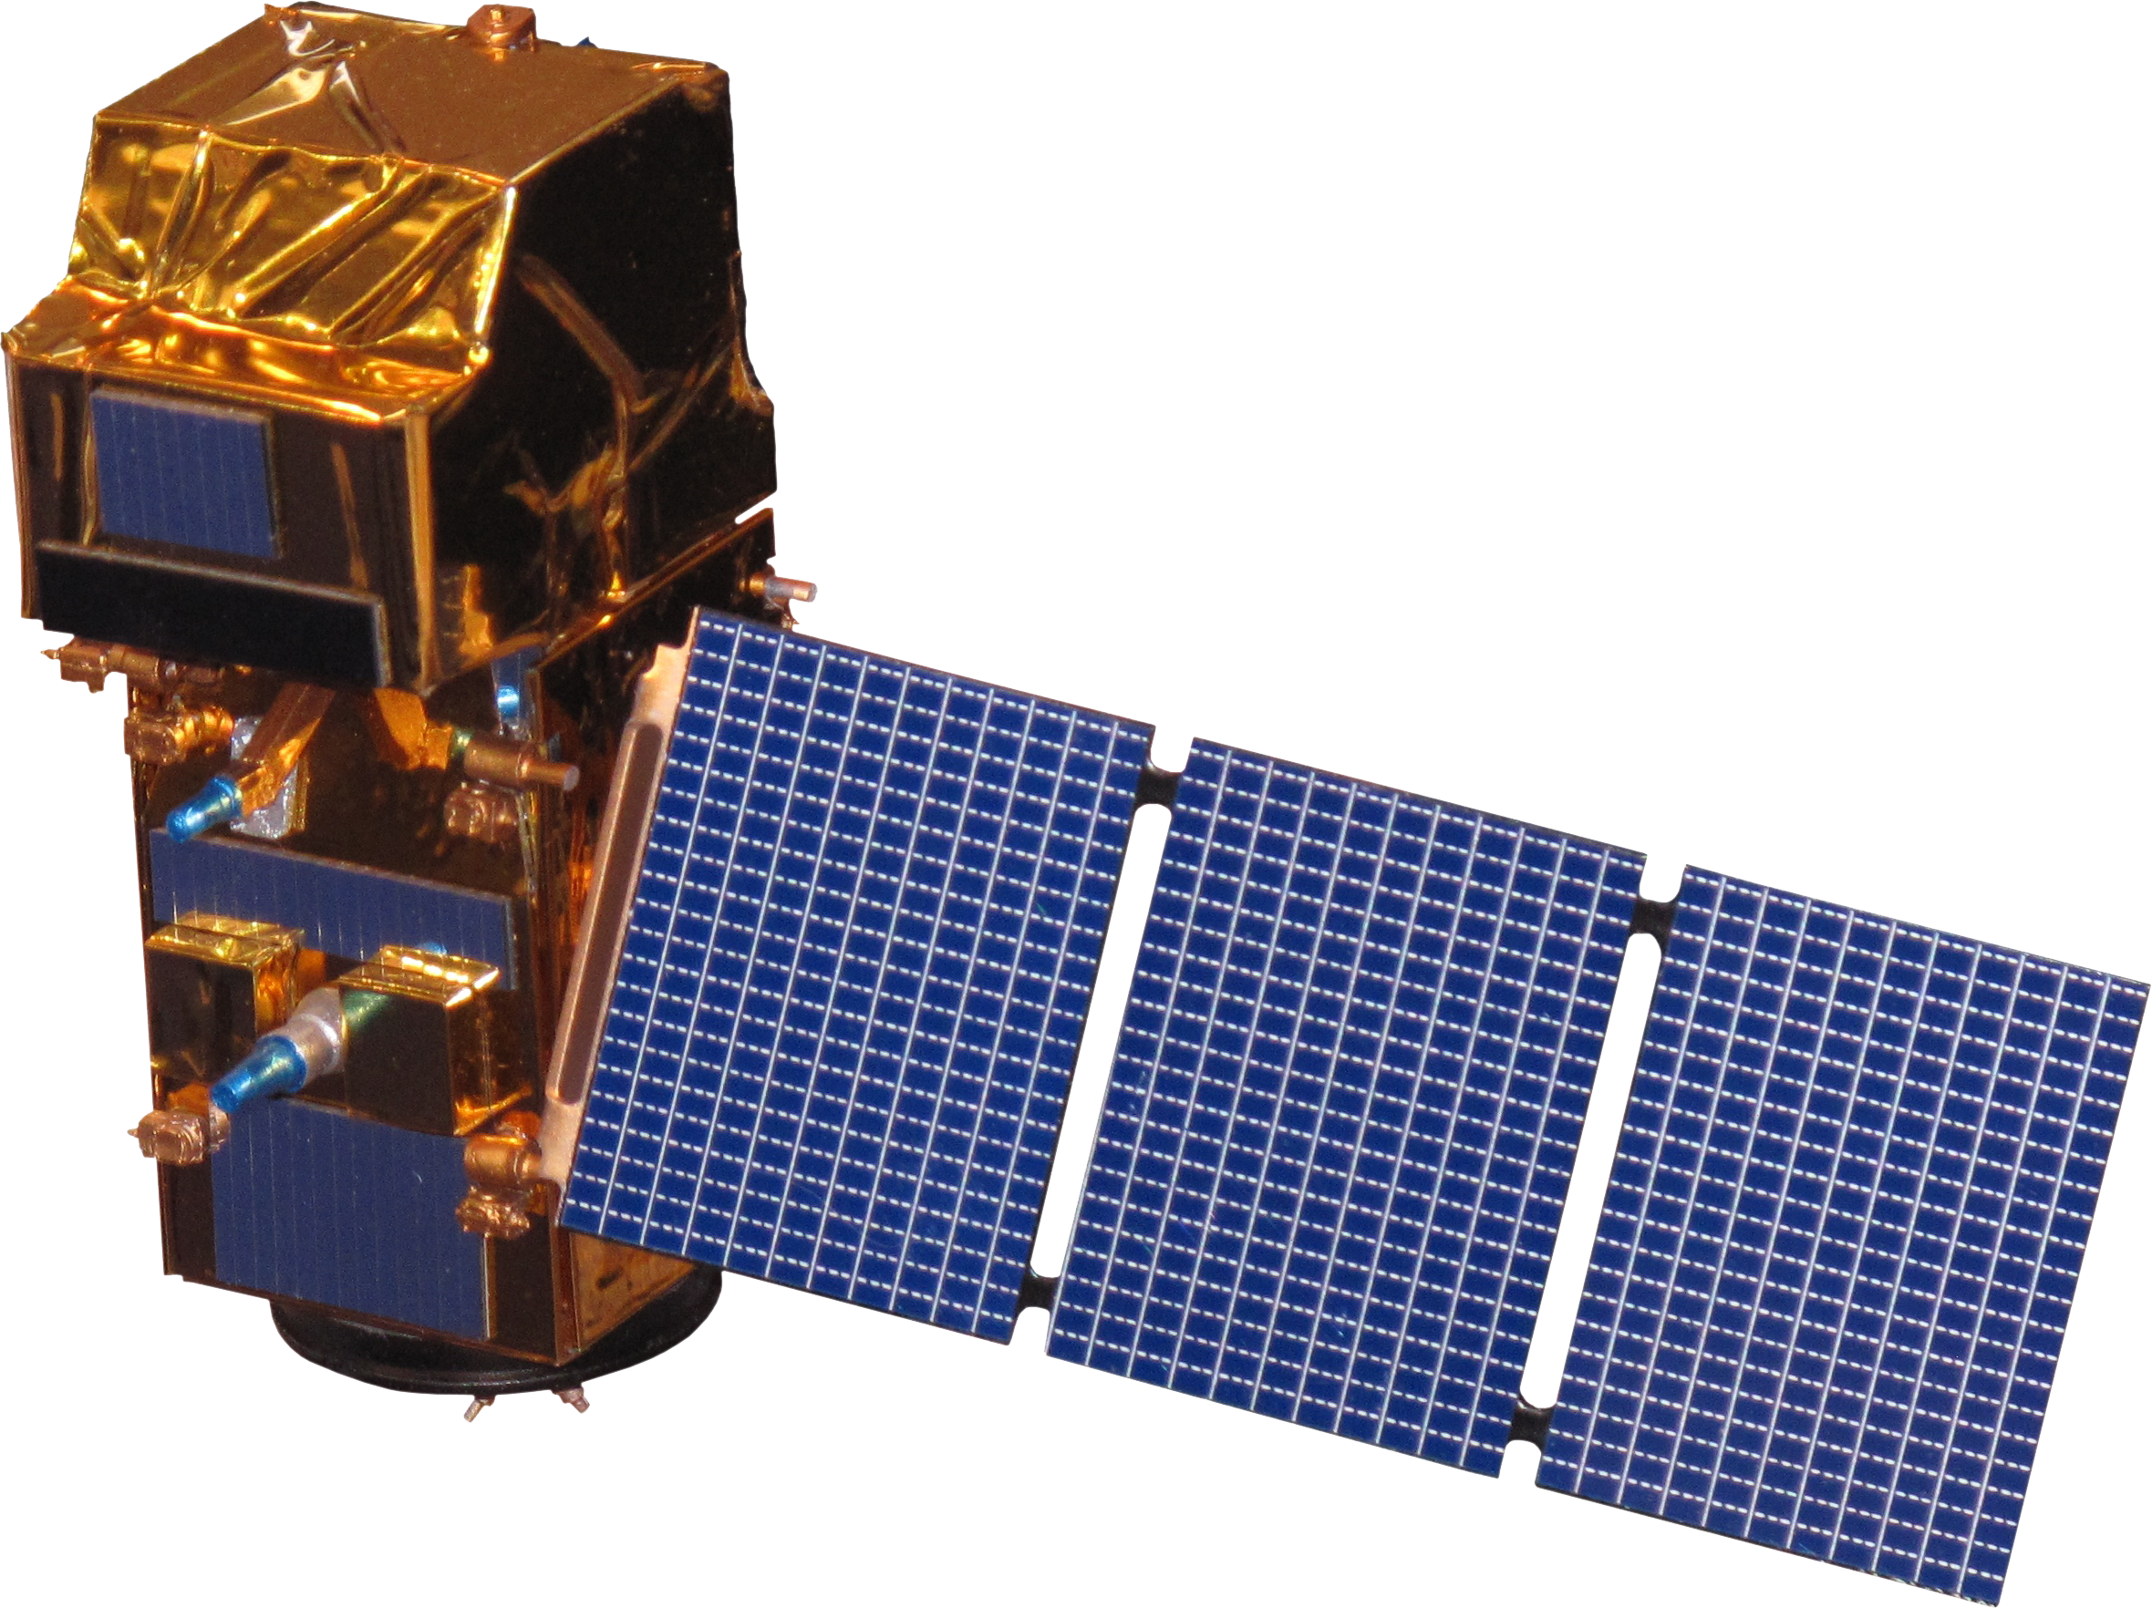
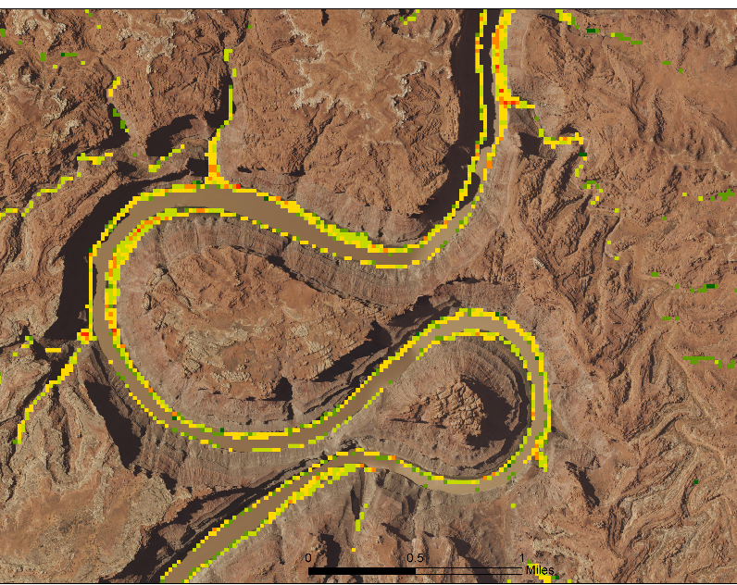
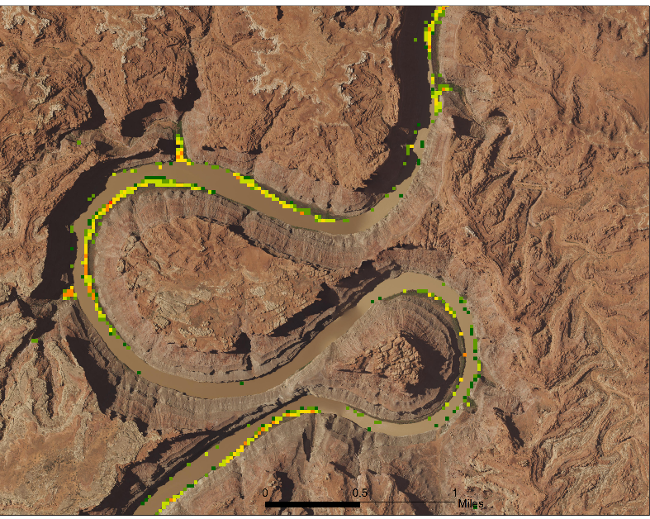
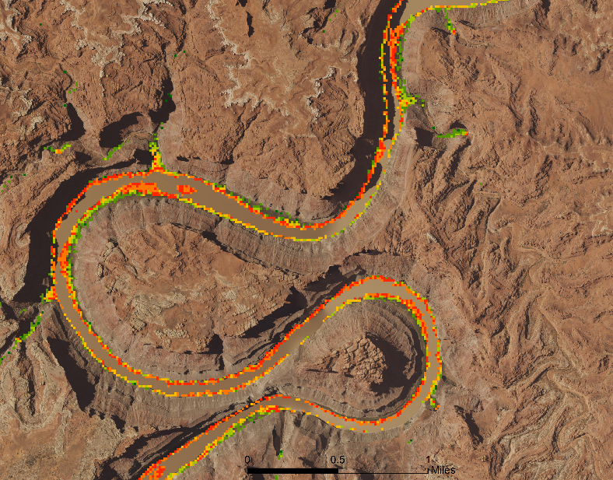

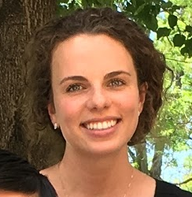
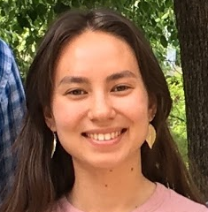
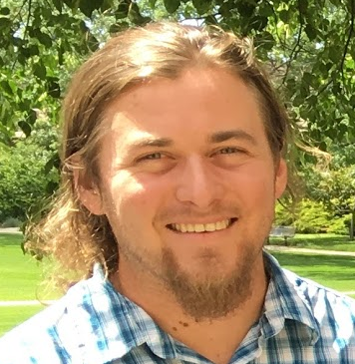


Utilizing NASA Earth Observations to Evaluate Invasive Species Cover in Riparian Areas of the Colorado River Basin
Abstract
Objectives
Riparian corridors are inhabited by unique and biodiverse plant communities that control erosion, manage sediment loads, and filter pollutants. These ecosystems are transitional zones between terrestrial and aquatic systems that provide important wildlife habitat and maintain the overall health of rivers. The Colorado River Basin not only serves as an important ecological system, but also provides a water supply to more than 40 million people in the western United States. However, the spread of invasive species such as tamarisk (Tamarix spp.) impacts the ecosystem functionality of this river basin by altering flow regimes, sediment loads, and evapotranspiration rates. This project utilized Shuttle Radar Topography Mission (SRTM) topographic data, Landsat 8 Operational Land Imager (OLI) and Thermal Infrared Sensor (TIRS), Landsat 7 Enhanced Thematic Mapper Plus (ETM+), and Landsat 5 Thematic Mapper (TM) to map and distinguish tamarisk cover from that of riparian species in 2006 and 2016 in the Green River watershed of the Colorado River Basin. Further, for 2016 tamarisk cover maps, we compared Landsat 8 to Sentinel-2 Multispectral Instrument (MSI) in a cross-platform analysis. Invasive species cover maps and an in-depth tutorial allow partners at the Walton Family Foundation to create effective management plans and to reproduce this methodology for future planning.
Quantify area inhabited by invasive tamarisk (Tamarix spp.) in riparian corridors of the Green River, a tributary of the Colorado River
Map predicted tamarisk presence and percent cover
Evaluate changes in tamarisk cover between 2006 and 2016
Compare 2016 maps created with Landsat 8 and Sentinel-2 data
Provide tutorial to end users to facilitate future development of yearly tamarisk maps
Methodology
Study Area
Large Area
Map
Wyoming
Study
Area
Multi-date imagery from Sentinel-2 MSI, Landsat 5 TM, and Landsat 8 OLI and TIRS
Variable Selection
Predictive variables of highest ecological importance and low correlation
Model Predicted Tamarisk Cover
Random Forest in R and Software for Assisted Habitat Modeling
Tamarisk cover maps for
2006 and 2016, and difference between years
Study Area
Map
Landsat Path 36
Row 33
Green
River
Upper CRB
Green River
Utah
Colorado
River
Rivers
Derived indices (e.g. NDVI, EVI, Blue)
I-70
I-70
Presence and absence field data points for tamarisk in study area
Dolores River
Colorado
Colorado River
Arizona
San Juan
River
Project Partners
Utah
Colorado
New Mexico
Walton Family Foundation, Peter Skidmore, Program Officer
US Geological Survey Fort Collins Science Center, Dr. Catherine Jarnevich, Research Ecologist
US Geological Survey North Central Climate Science Center, Gabriel Senay, Research Scientist
Earth Observations
Colorado River Basin Water Resources
Landsat 5
Sentinel-2
Landsat 8
Results
2006 Predicted Percent Tamarisk Cover
Landsat 5 TM
2016 Predicted Percent Tamarisk Cover
Landsat 8 OLI & TIRS
2016 Predicted Percent Tamarisk Cover
Sentinel-2
Predicted
Percent Cover
Predicted
Percent Cover
Predicted
Percent Cover
< 10
10 – 20
20 – 30
30 – 40
40 – 50
> 50
< 10
10 – 20
20 – 30
30 – 40
40 – 50
> 50
< 10
10 – 20
20 – 30
30 – 40
40 – 50
> 50
Team Members
Conclusions
Tamarisk cover detected by our models decreased from 2006 and 2016.
Models using Landsat 8 imagery predicted considerably lower tamarisk cover than models that use Sentinel-2 imagery.
More cover data, particularly for areas with high tamarisk cover, could improve model predictability.
Megan Vahsen
(Team Lead)
Emily Campbell
Daniel Carver
Acknowledgements
We thank the following scientists from the Natural Resource Ecology Laboratory at Colorado State University for providing mentorship for this project:
Dr. Paul Evangelista, Dr. Amanda West, Brian Woodward (DEVELOP Center Lead), Anthony Vorster, and Nicholas Young.
Julia Sullivan
Chanin Tilakamonkul
USGS at Colorado State University – Summer 2017

