Slide 1
Northwest United States Agriculture III
Assessing Current and Future Plant Hardiness Zones for Apple Production in Washington State using Climate Models and NASA Earth Observations
Madeline Ruid (Team Lead)
Teresa Fenn
Matthew Mullen
Sarah Philbrick
James Hendrickson
Notes:
*** Introduce further ***

Slide 2
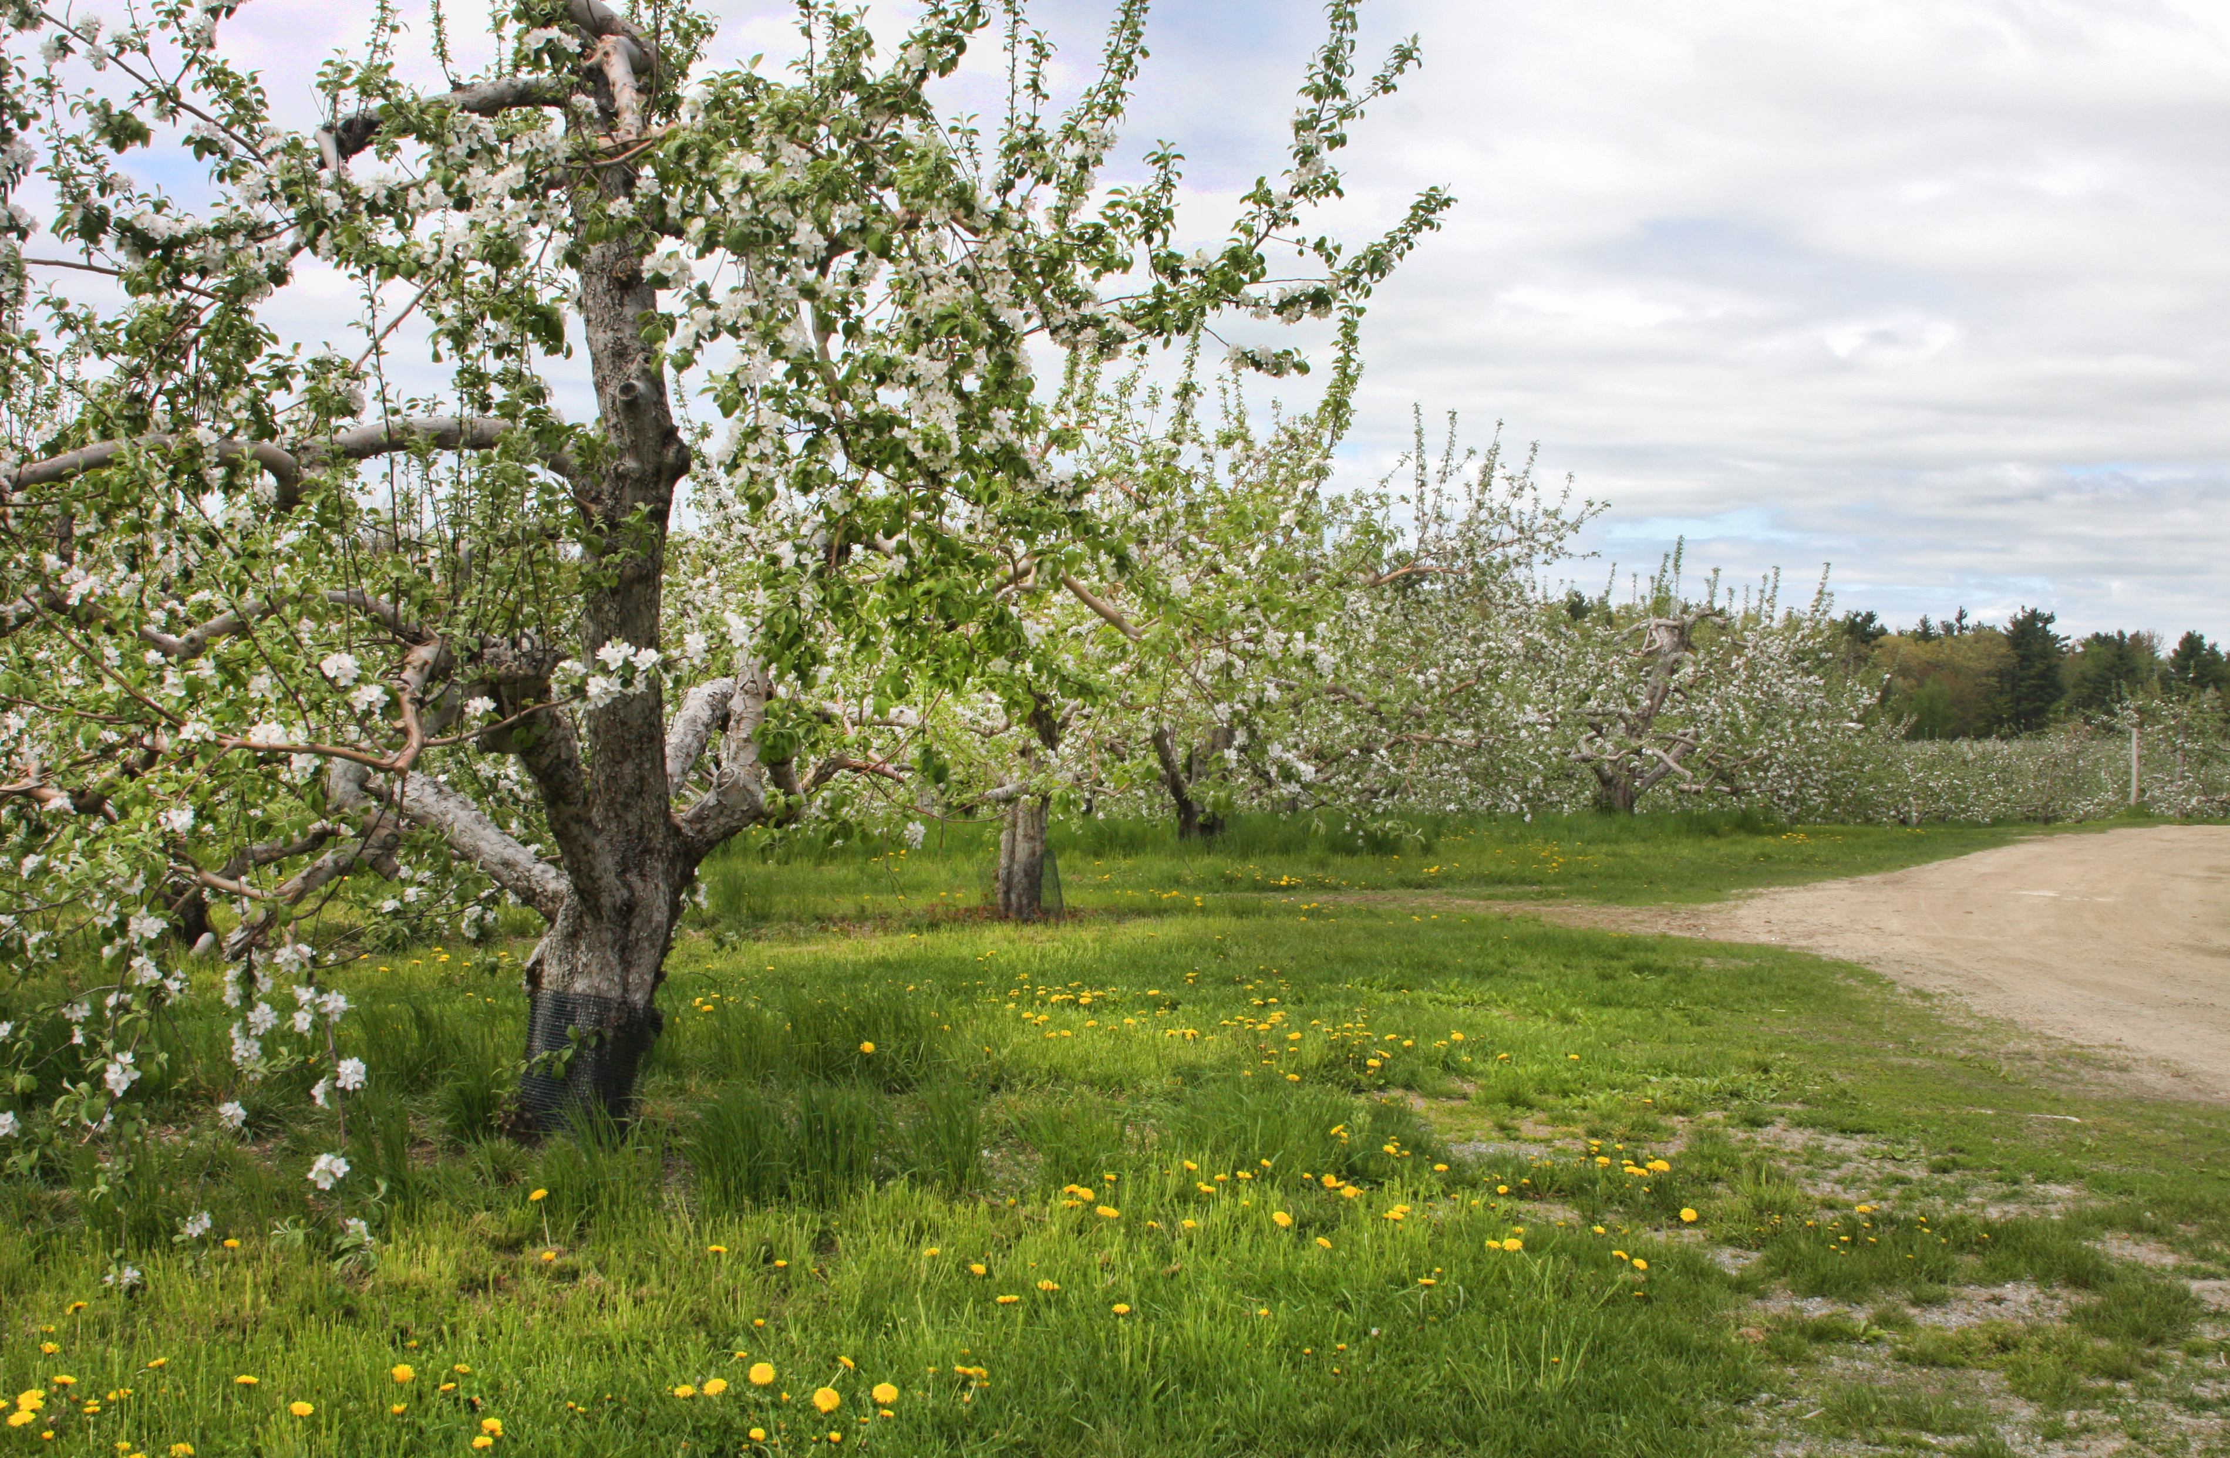
Community Concerns
Washington climate is currently well-suited to apple production
Produces 65% of the nation’s apples, adds $2.2 billion to economy
Future climate change may result in a shift of these ideal locations
Image Source: Liz West, Flickr
Image Credit: NRCS
Notes:
Washington State is famous for its apples. The warm, dry summers and cool, wet winters provide excellent climate conditions for production. As a result, 65% of apples grown in America come from Washington, and the industry makes up 2.2 billion dollars of the nations economy. However, there is a concern that future climate change could shift these ideal conditions, and Washington’s suitability could decrease as a result.

Slide 3
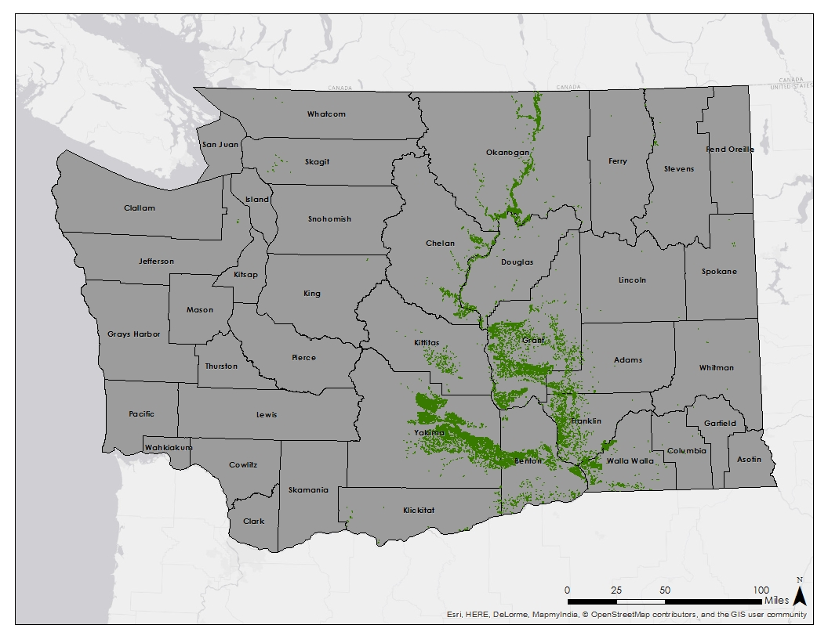
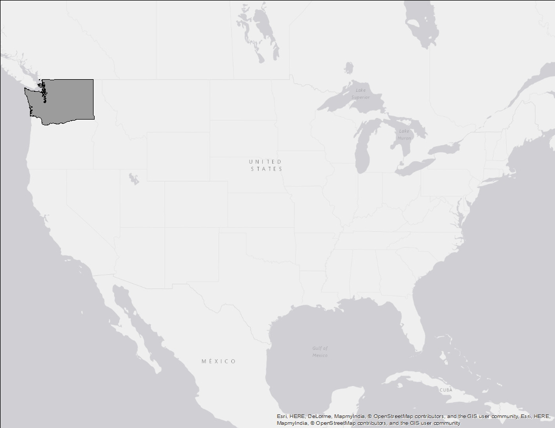
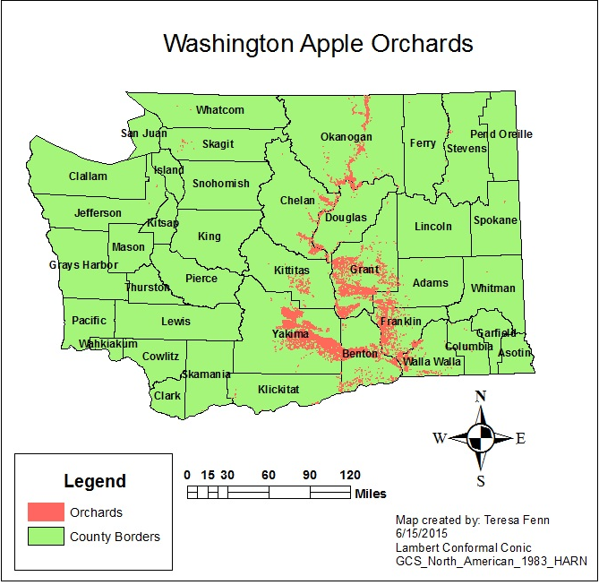
Study Area: Washington, USA
Study Period:
Current
  2002-2015
Future
  2045
  2065
  2095
Apple Orchards in Washington State
Notes:
Apples are currently grown in the central part of the state, just east of the Cascade mountains. Current climate conditions were measured by obtaining data from January 2002 to June 2015. The climate was then projected into the years 2045, 2065, and 2095.

Slide 4
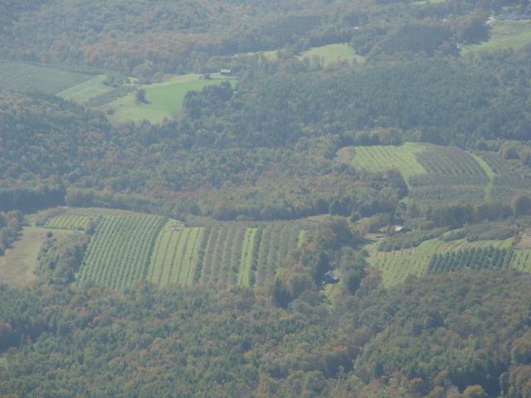
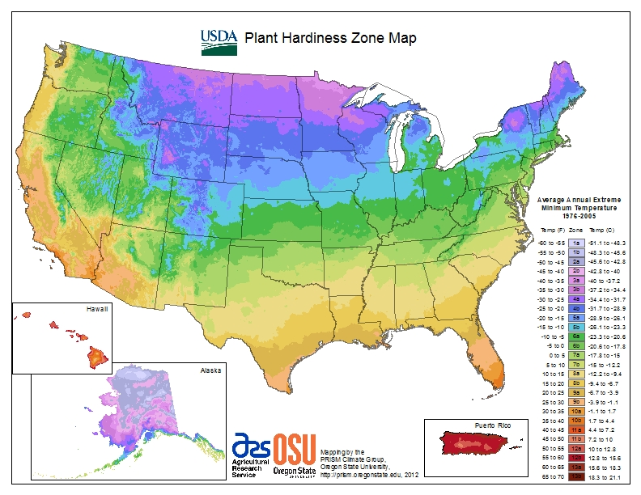
Plant Hardiness Zones
Guide as to which plants will thrive at a given location
Based on annual extreme minimum temperature
Divided into 10 degree Fahrenheit zones
Apples grow best in zones 5 through 7
Image Source: Placeuvm, Flickr
Notes:
One of the simplest ways to determine plant suitability is with Plant Hardiness Zones. These 10 degree F zones are calculated based on average annual extreme minimum temperature, which is a suitability predictor for all crops, not just apples. If a winter is too cold, winter injury and possibly tree death will result. If the winter is too warm, the trees will not accumulate enough chill hours (hours the tree remains dormant), to be productive during the growing season. Apples grow best in zones 5 - 7, but can also grow in zones 4-9.

Slide 5
Apple Suitability
Plant Hardiness Zones
Based on average annual extreme minimum temperature
Growing Degree Days
Heat accumulation formula:
([Tmax + Tmin]/2) - 10 °C
Growing Season Temperature
Ideal average temperature of 19 °C
Notes:
In addition to Plant Hardiness Zones, three major factors in determining a location’s suitability for apples are Growing Degree Days and Average Growing Season Temperature. GDDs are a measure of the heat accumulation over a 10 °C. This is the threshold beyond which codling moths thrive. Codling moths are pests that feed on apples, and a greater accumulation of GDDs allows more generations to hatch. Ideally the AGST will be around 19°C.

Slide 6

Objectives
Project Partner
Map Plant Hardiness Zones
  Current
  Forecasted (2045, 2065, and 2095)
Map areas suitable for apple growth
  Current
  Forecasted (2045, 2065, and 2095)
Dr. Michael Glenn, Ph.D. United States Department of Agriculture – Agricultural Research Service
Notes:
In partnership with Dr. Michael Glenn from the UDSA’s Agricultural Research Service, we created current and forecasted PHZ maps; as well as suitability maps that combine PHZs, GDDs, and AGSTs.

Slide 7
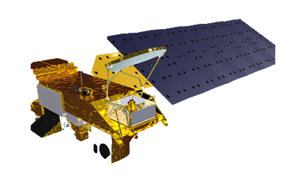
Earth Observations & Projections
MODIS Land Surface Temperatures in Washington State from 2002-2015
NASA Earth Exchange Downscaled Climate Projections (NEX-DCP30) for 2045, 2065, and 2095
Aqua
March 2009
March 2045
Notes:
The project uses 2 NASA datasets to complete our objectives. The present-day maps were calculated based on daily land surface temperature measurements from the MODIS instrument on NASA’s Aqua satellite from January 2002 to June 2015. MODIS was chosen because it captured images of the study area each day and each night – allowing us to calculate maximum and minimum temperatures for each day in the study period. Future temperature projections used NASA’s Earth Exchange Downscaled Climate Projections, or the NEX-DCP30 dataset. With 800m resolution, the NEX-DCP30 dataset has much higher resolution than many other climate projections.

Slide 8
Project Methodology
 | Plant Hardiness Zones Suitability Maps
 | Validation Assessment Change Analysis
Pre-Processing
Download MODIS LST Data
Estimate air temp from LST
Remove outliers
Create rolling averages
Mosaic images
Download Climate Model Data
Mask to study area
Convert K to C
Project data
Data Analysis
Four time periods (present day, 2045, 2065, 2095)
Find minimum value per year for each pixel and average from 2002-2015
Calculate GDD
Calculate avg temp
Import PHZ
Classify into PHZ
Apply weights and classify into Suitability Regions
Post Analysis
Compare MODIS produced PHZ maps to PRISM produced PHZ maps to compare validity of data
Quantify degree of plant hardiness zone change
Notes:
Once the data was processed, it was converted to air temperature using a linear regression obtained from historic weather station data, then combined into five day rolling averages to calculate GDD.

Slide 9
Project Methodology
 | Plant Hardiness Zones Suitability Maps
 | Validation Assessment Change Analysis
Pre-Processing
Download MODIS LST Data
Estimate air temp from LST
Remove outliers
Create rolling averages
Mosaic images
Download Climate Model Data
Mask to study area
Convert K to C
Project data
Data Analysis
Four time periods (present day, 2045, 2065, 2095)
Find minimum value per year for each pixel and average from 2002-2015
Calculate GDD
Calculate avg temp
Import PHZ
Classify into PHZ
Apply weights and classify into Suitability Regions
Post Analysis
Compare MODIS produced PHZ maps to PRISM produced PHZ maps to compare validity of data
Quantify degree of plant hardiness zone change
Notes:
Once the data was processed, it was converted to air temperature using a linear regression obtained from historic weather station data, then combined into five day rolling averages to calculate GDD.

Slide 10
Project Methodology
 | Plant Hardiness Zones Suitability Maps
 | Validation Assessment Change Analysis
Pre-Processing
Download MODIS LST Data
Estimate air temp from LST
Remove outliers
Create rolling averages
Mosaic images
Download Climate Model Data
Mask to study area
Convert K to C
Project data
Data Analysis
Four time periods (present day, 2045, 2065, 2095)
Find minimum value per year for each pixel and average from 2002-2015
Calculate GDD
Calculate avg temp
Import PHZ
Classify into PHZ
Apply weights and classify into Suitability Regions
Post Analysis
Compare MODIS produced PHZ maps to PRISM produced PHZ maps to compare validity of data
Quantify degree of plant hardiness zone change
Notes:
Once the data was processed, it was converted to air temperature using a linear regression obtained from historic weather station data, then combined into five day rolling averages to calculate GDD.

Slide 11
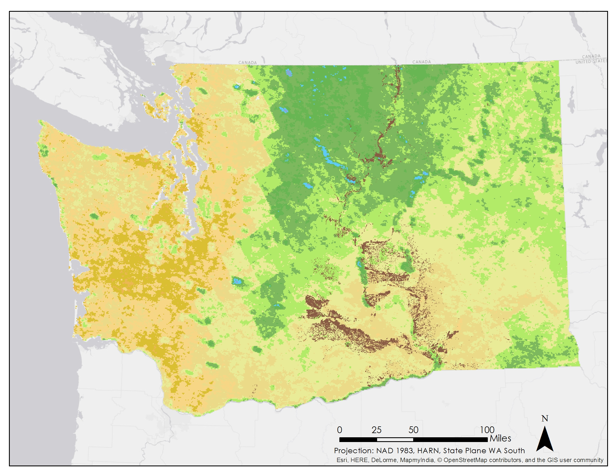
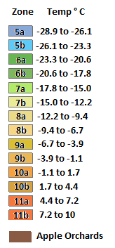
Results: Current PHZ
2002 - 2015
Plant Hardiness Zone Map
Notes:
Currently, the orchards are primarily located in zones 6b - 8a. Although very few orchards are within the ideal zones 5 and 7, all are within the acceptable PHZ range of 4-9.

Slide 12
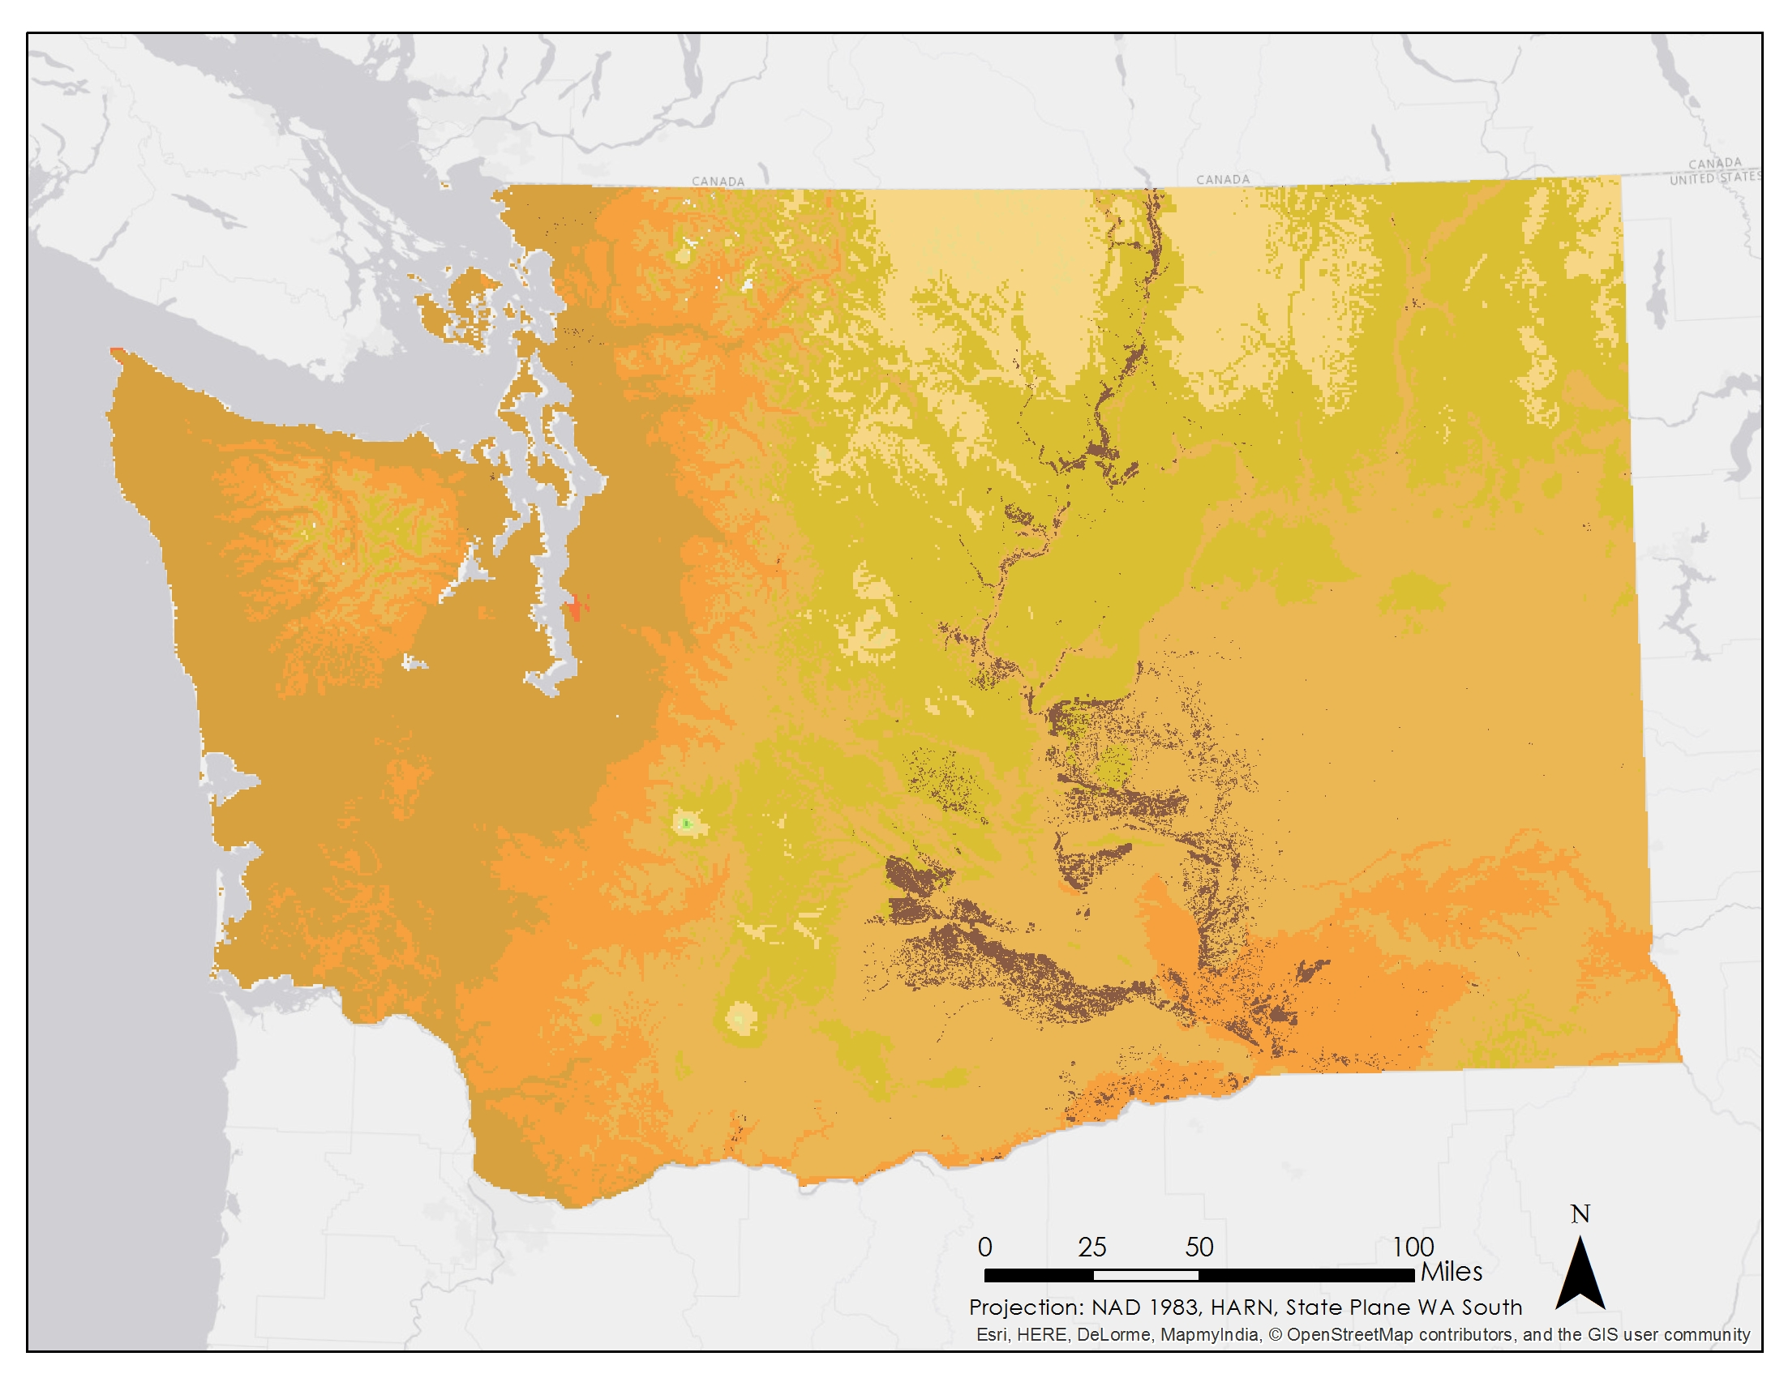
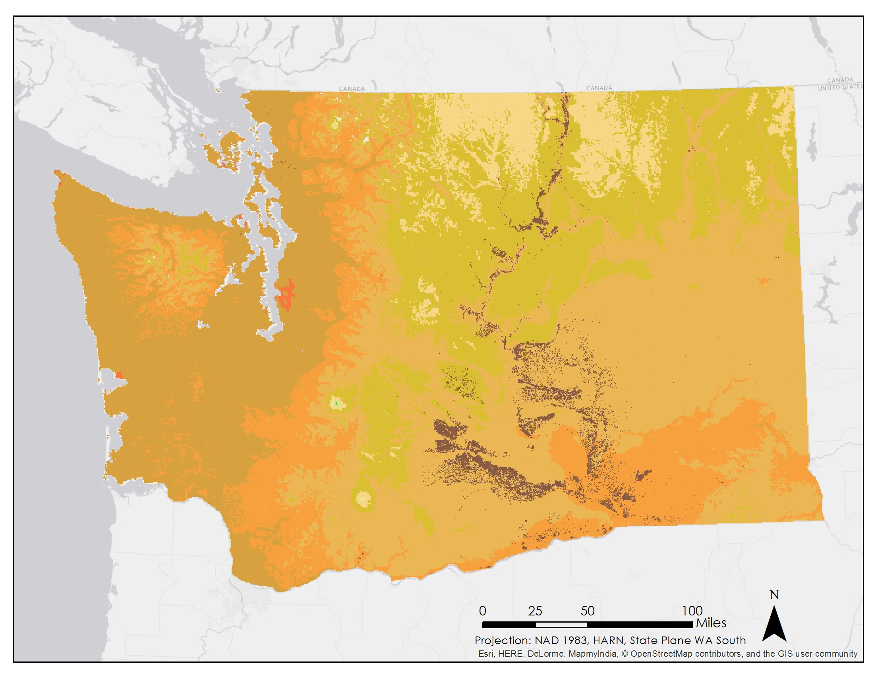
Results: PHZ 2045
Moderate Scenario: RCP 4.5
Extreme Scenario: RCP 8.5
Notes:
2045 tells a different story. Apples are now in zones 9a through 10a. In the south of the state, the orchards are no longer within acceptable zones.

Slide 13
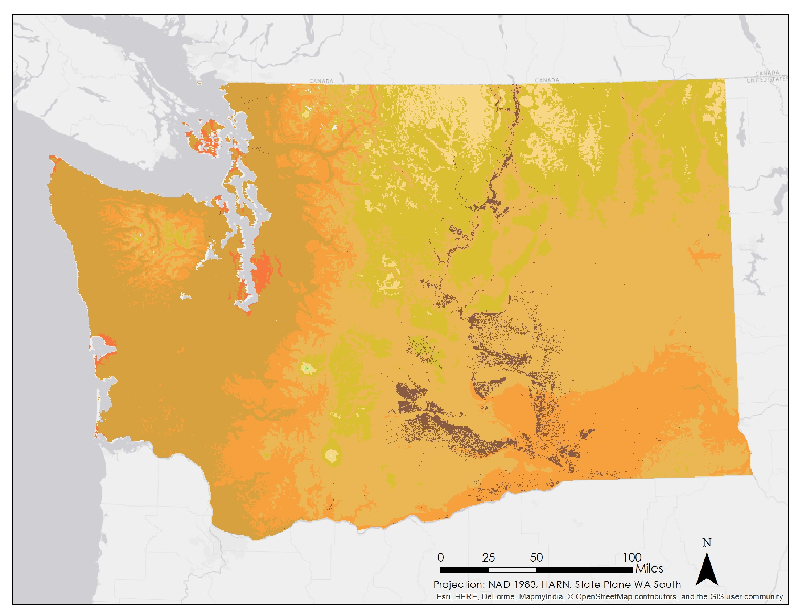
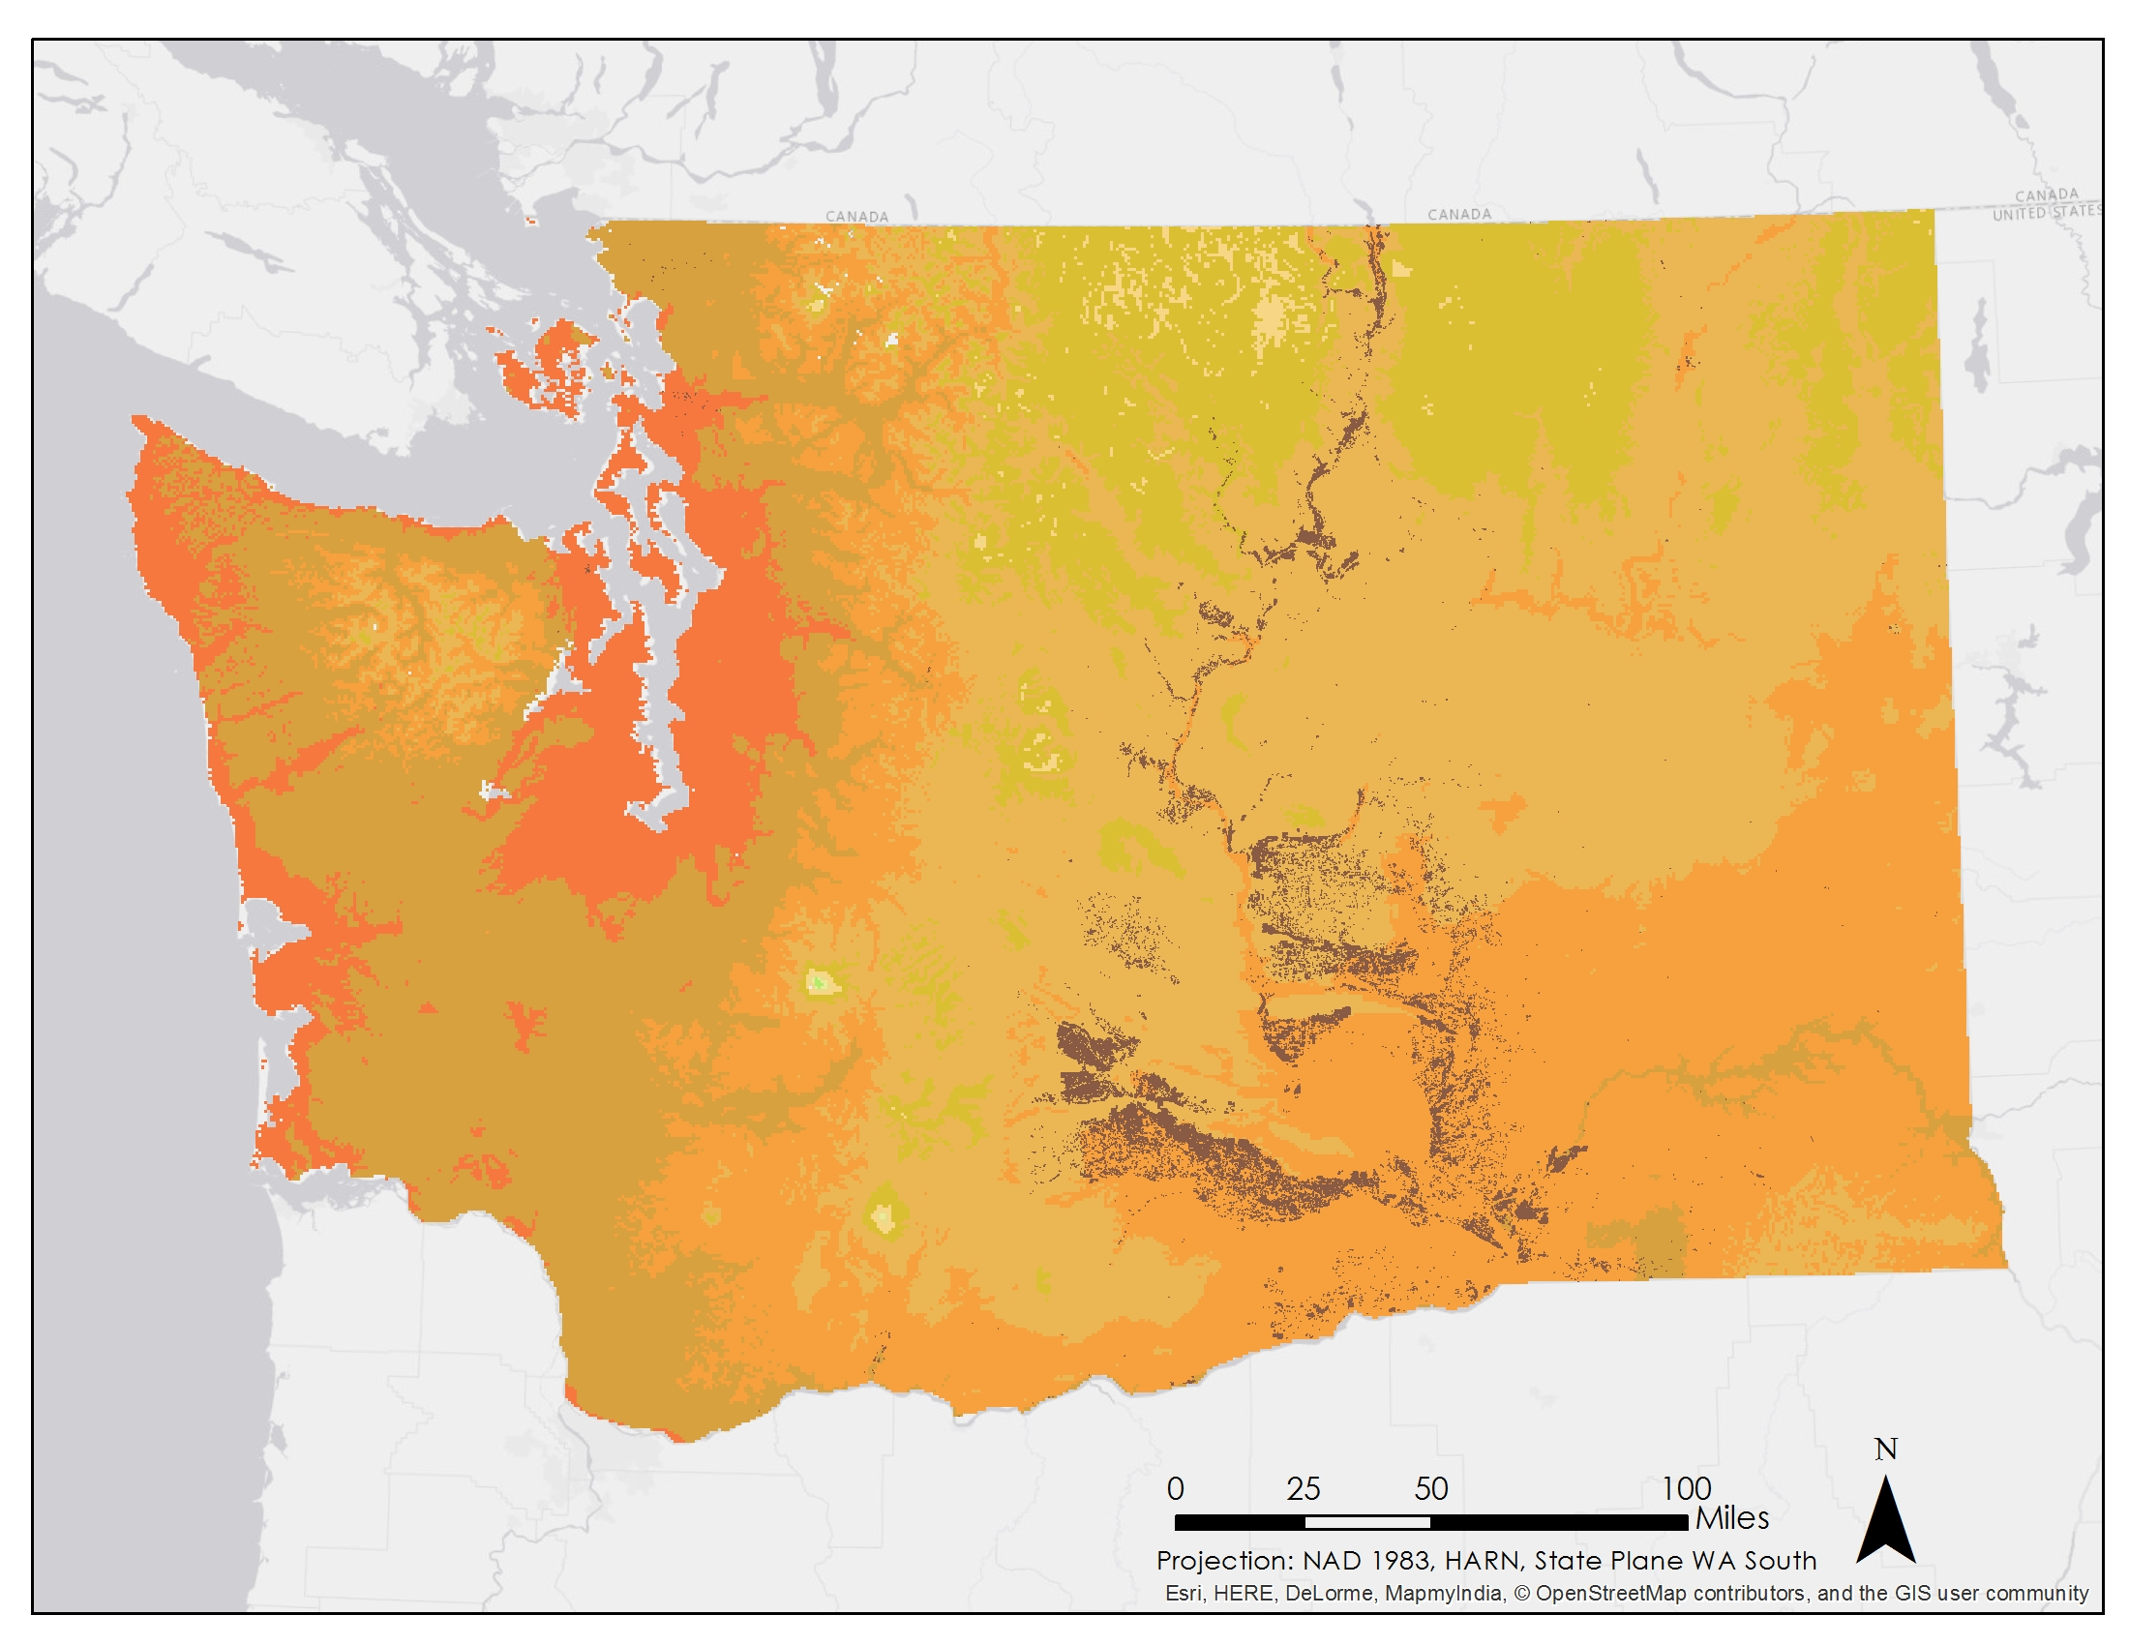
Results: PHZ 2065
Moderate Scenario: RCP 4.5
Extreme Scenario: RCP 8.5
Notes:
By 2065, the area covered by zone 10a has expanded, while zone 8b has almost completely disappeared.

Slide 14
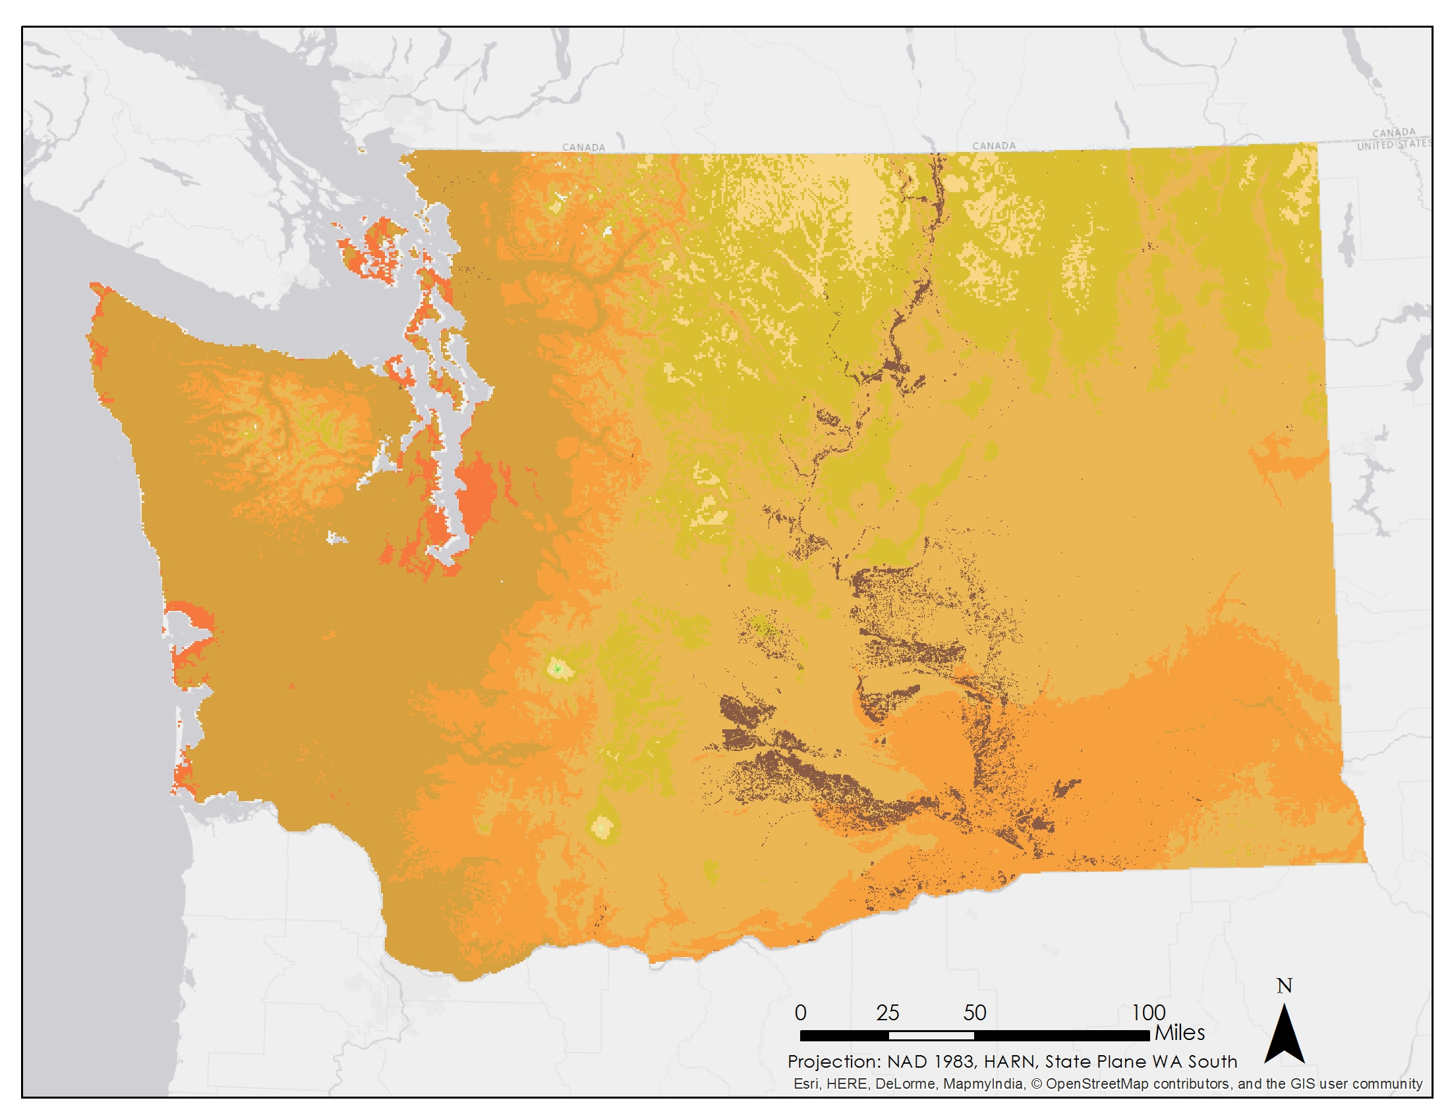
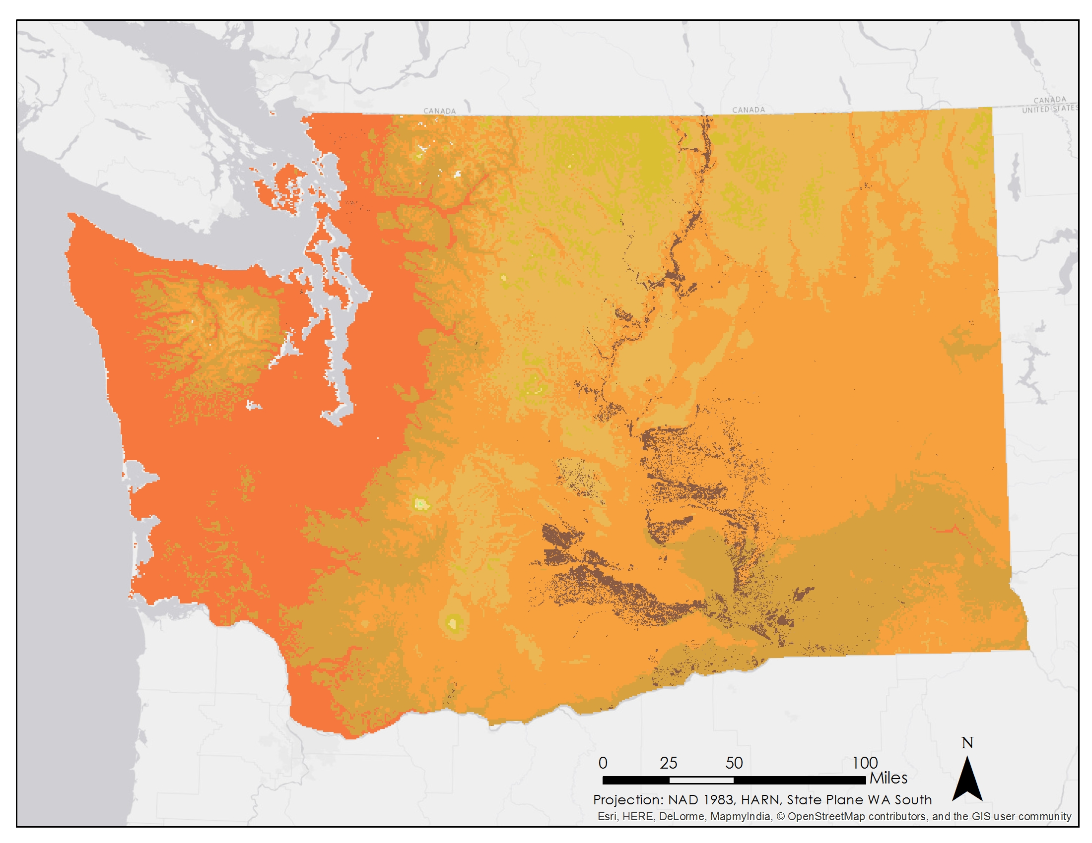
Results: PHZ 2095
Moderate Scenario: RCP 4.5
Extreme Scenario: RCP 8.5
Notes:
Finally, by 2095, the moderate scenario shows only a slight change in the zones, while the extreme scenario puts almost all of the orchards within zones 10a and 10b; which is too warm for apples.

Slide 15
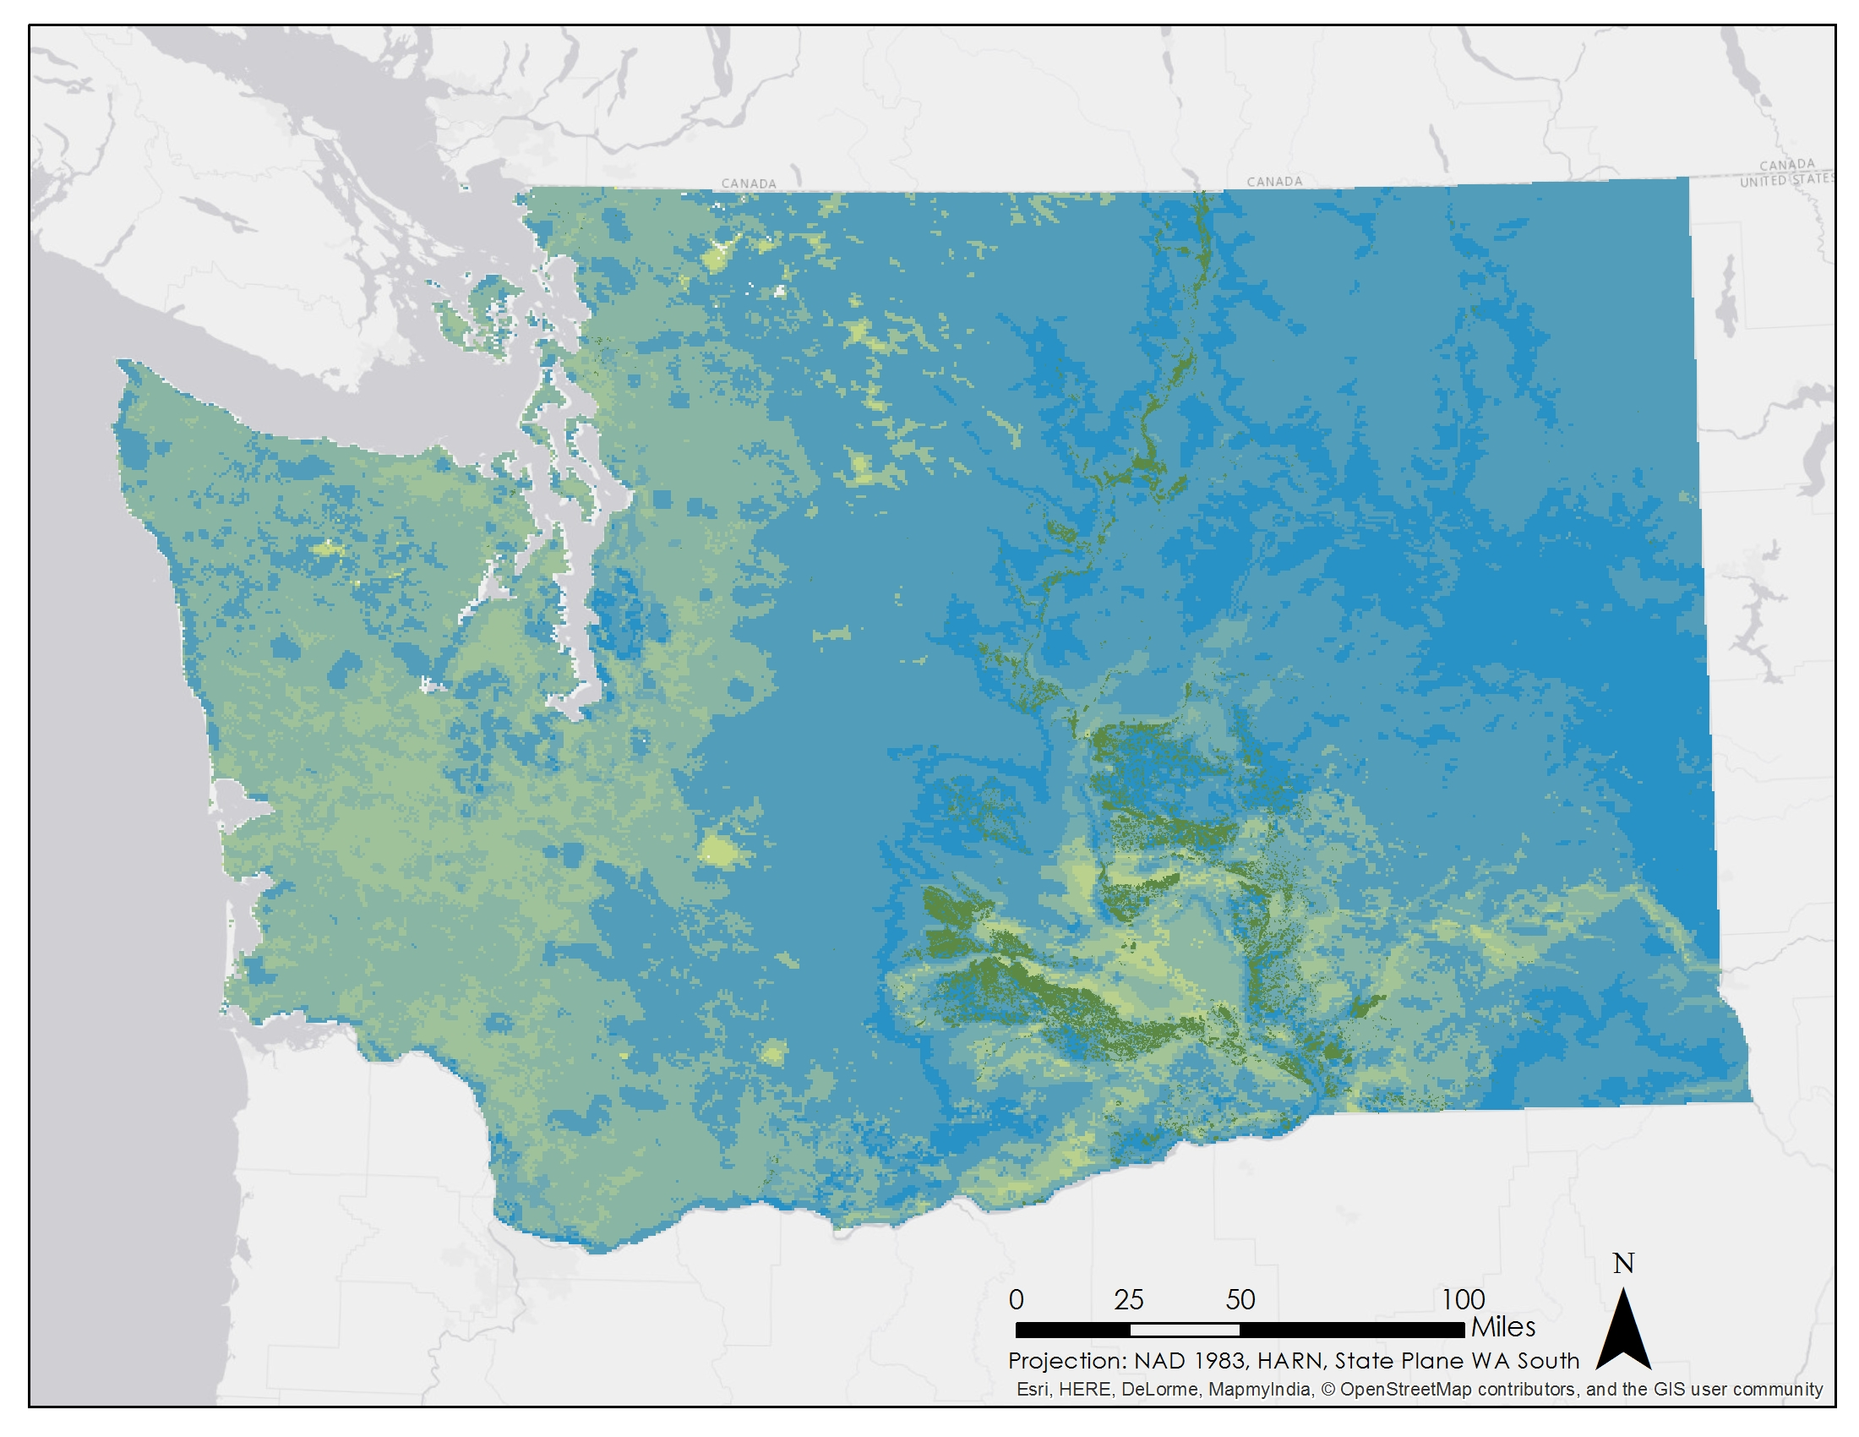

Results: Current Suitability Map
2002- 2015 Suitability Map
Notes:
By combining PHZ, GDD, and AGST, we created suitability maps for Washington state. Suitability is ranked on a scale of 0 to 100, 100 being the most suitable. Currently, orchards are within zones of high to moderately high suitability.

Slide 16
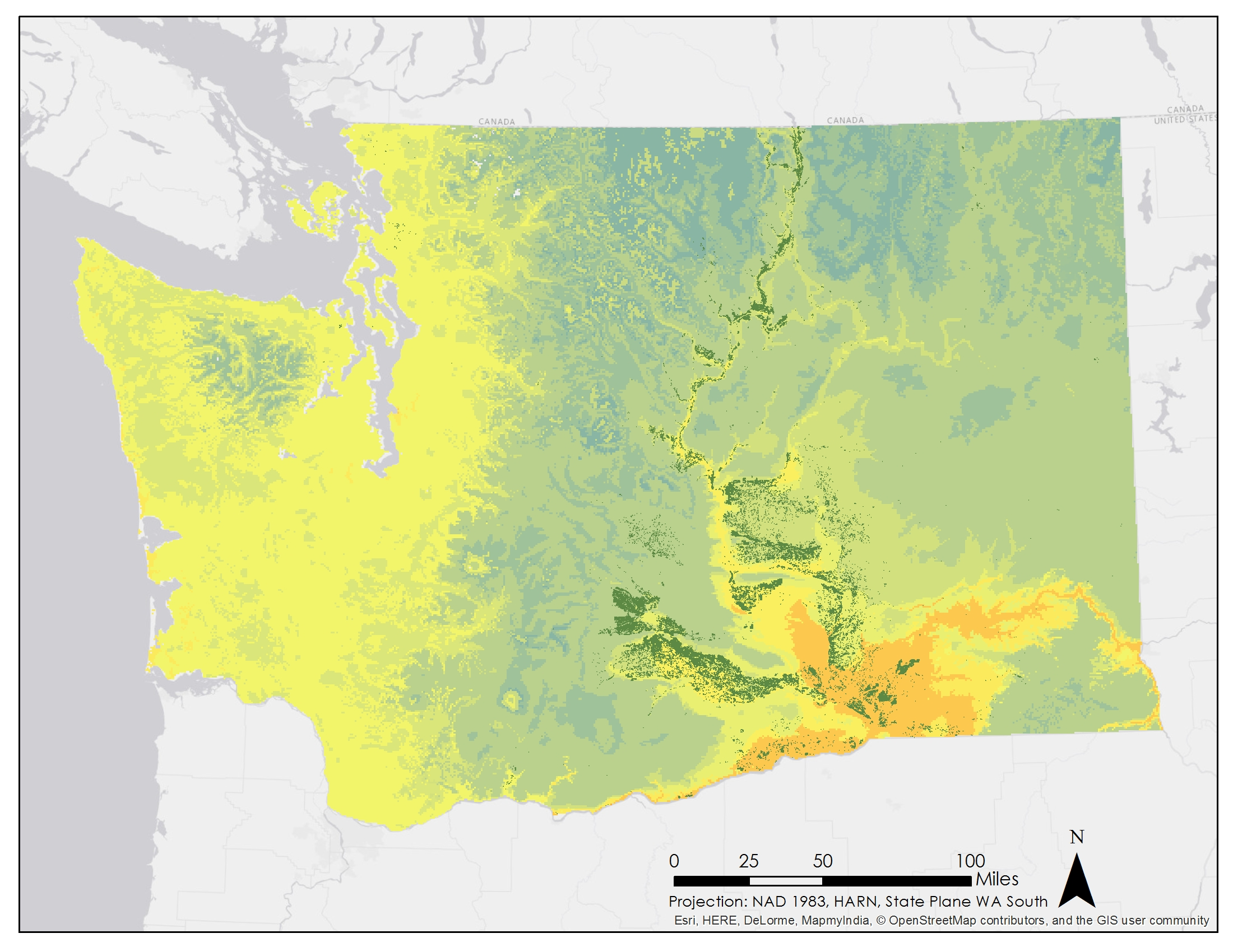
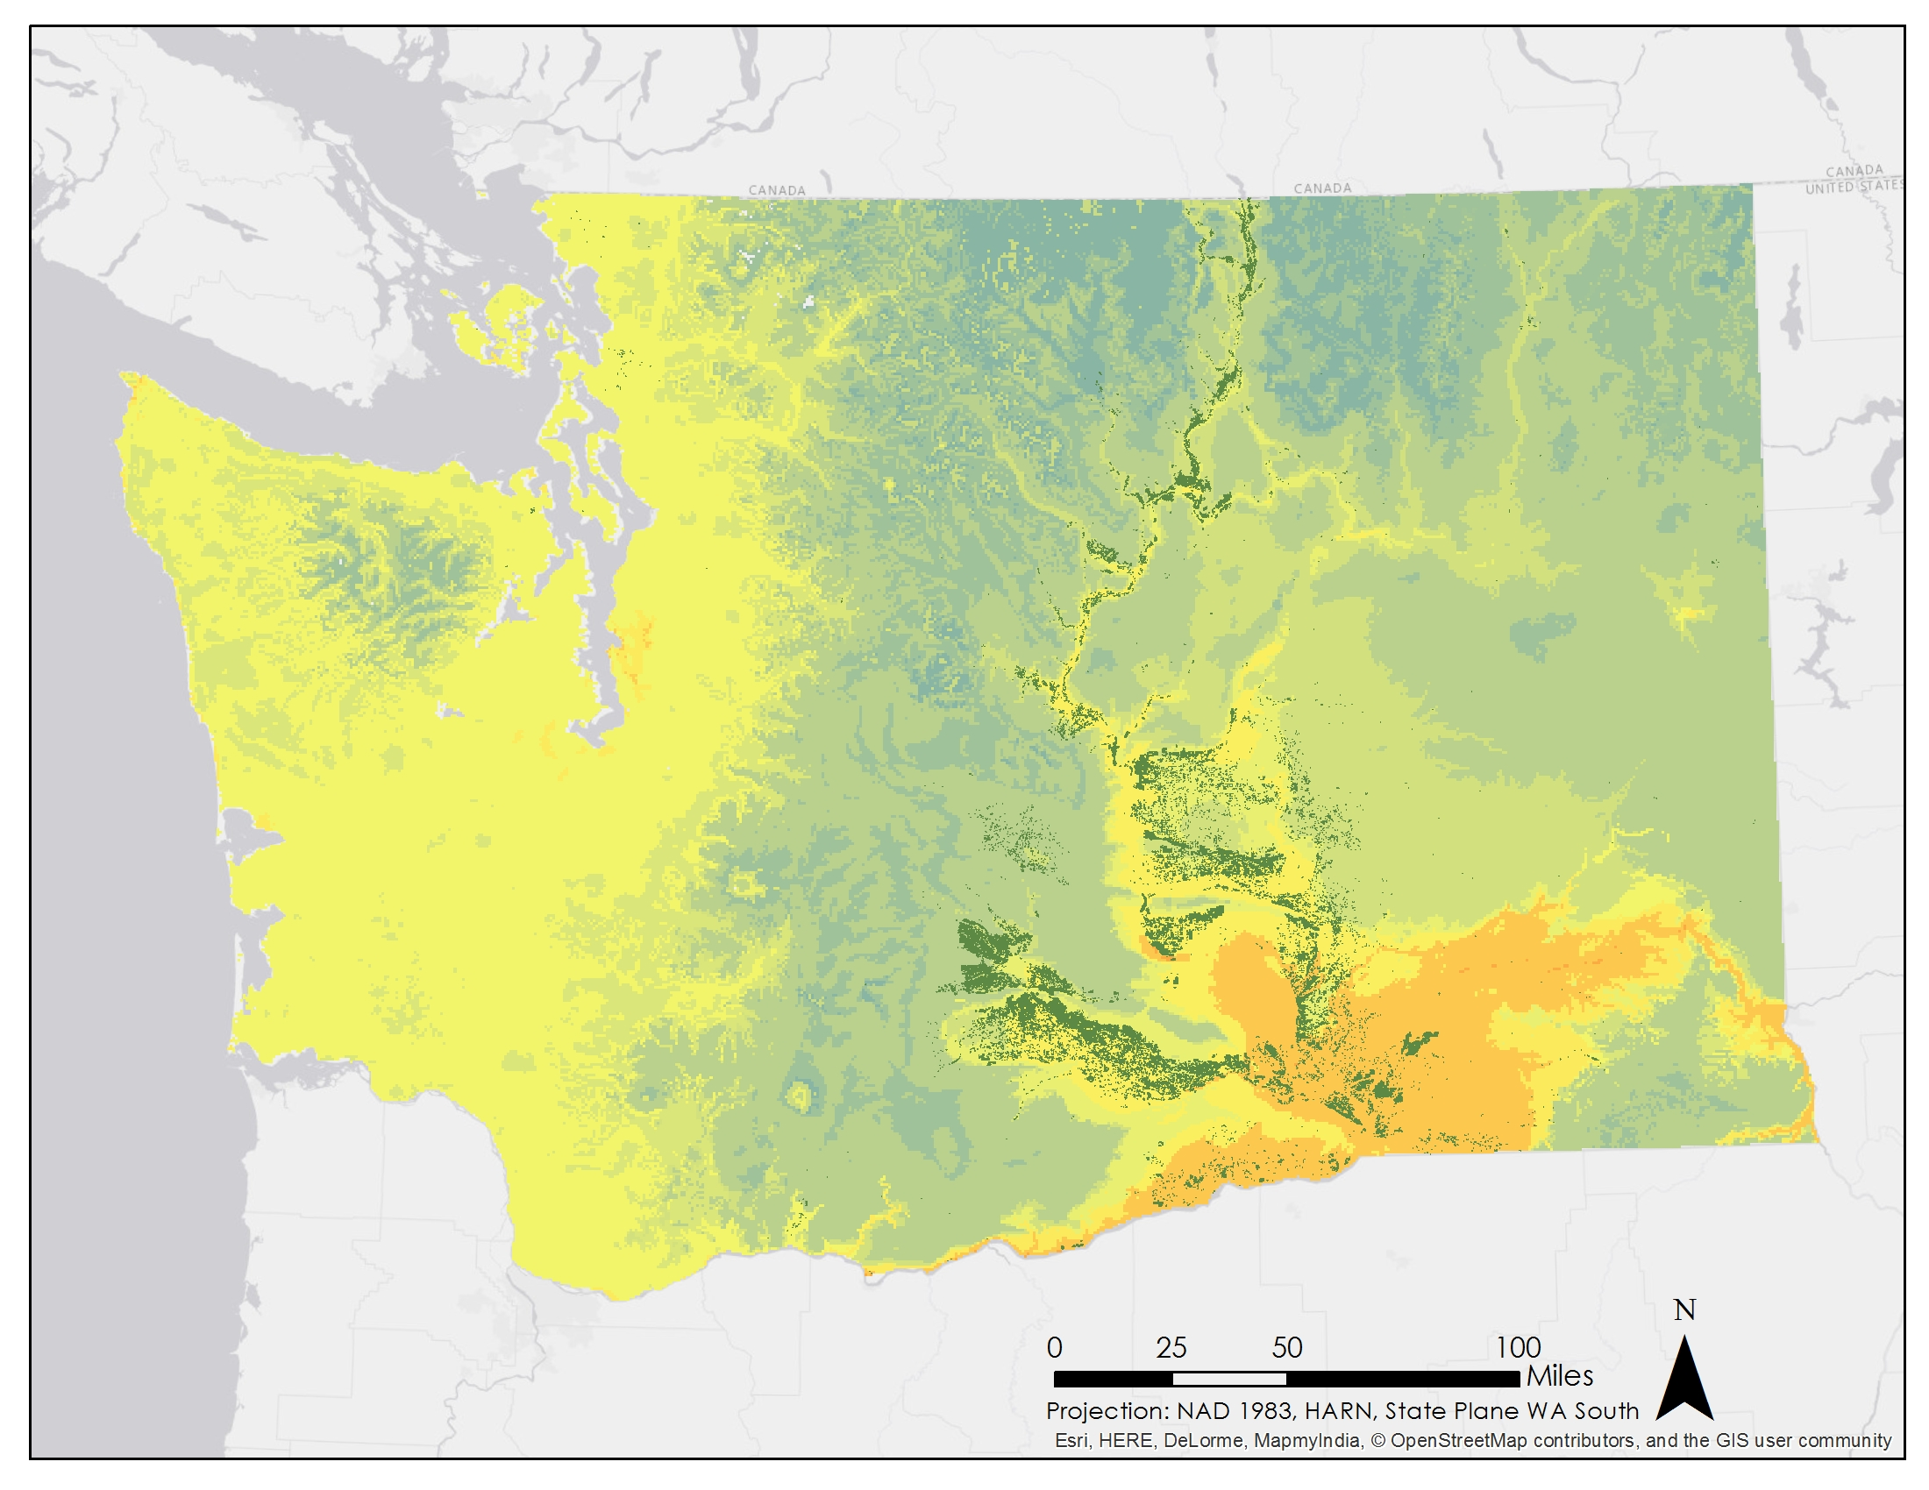
Results: 2045 Suitability Map
Moderate Scenario: RCP 4.5
Extreme Scenario: RCP 8.5
Notes:
Suitability significantly decreases in 2045. In the north, conditions are moderately suitable; while in the south, conditions are moderately unsuitable.

Slide 17
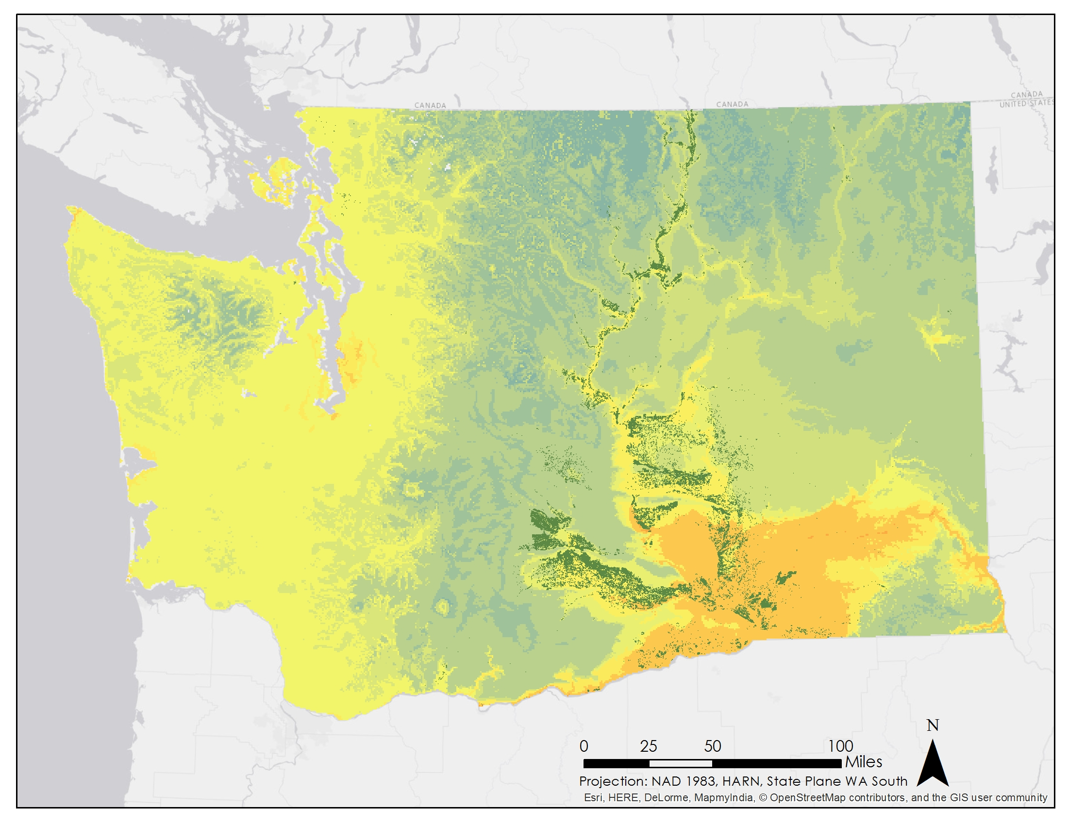
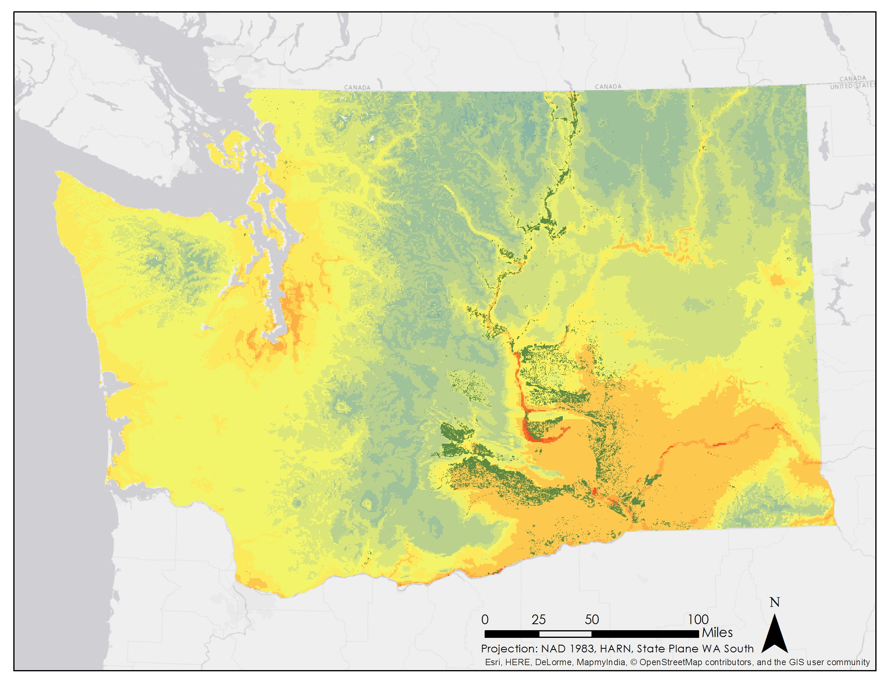
Results: 2065 Suitability Map
Moderate Scenario: RCP 4.5
Extreme Scenario: RCP 8.5
Notes:
In 2065, the unsuitable areas have expanded. The extreme scenario shows strips of very low suitability appearing in the south.

Slide 18
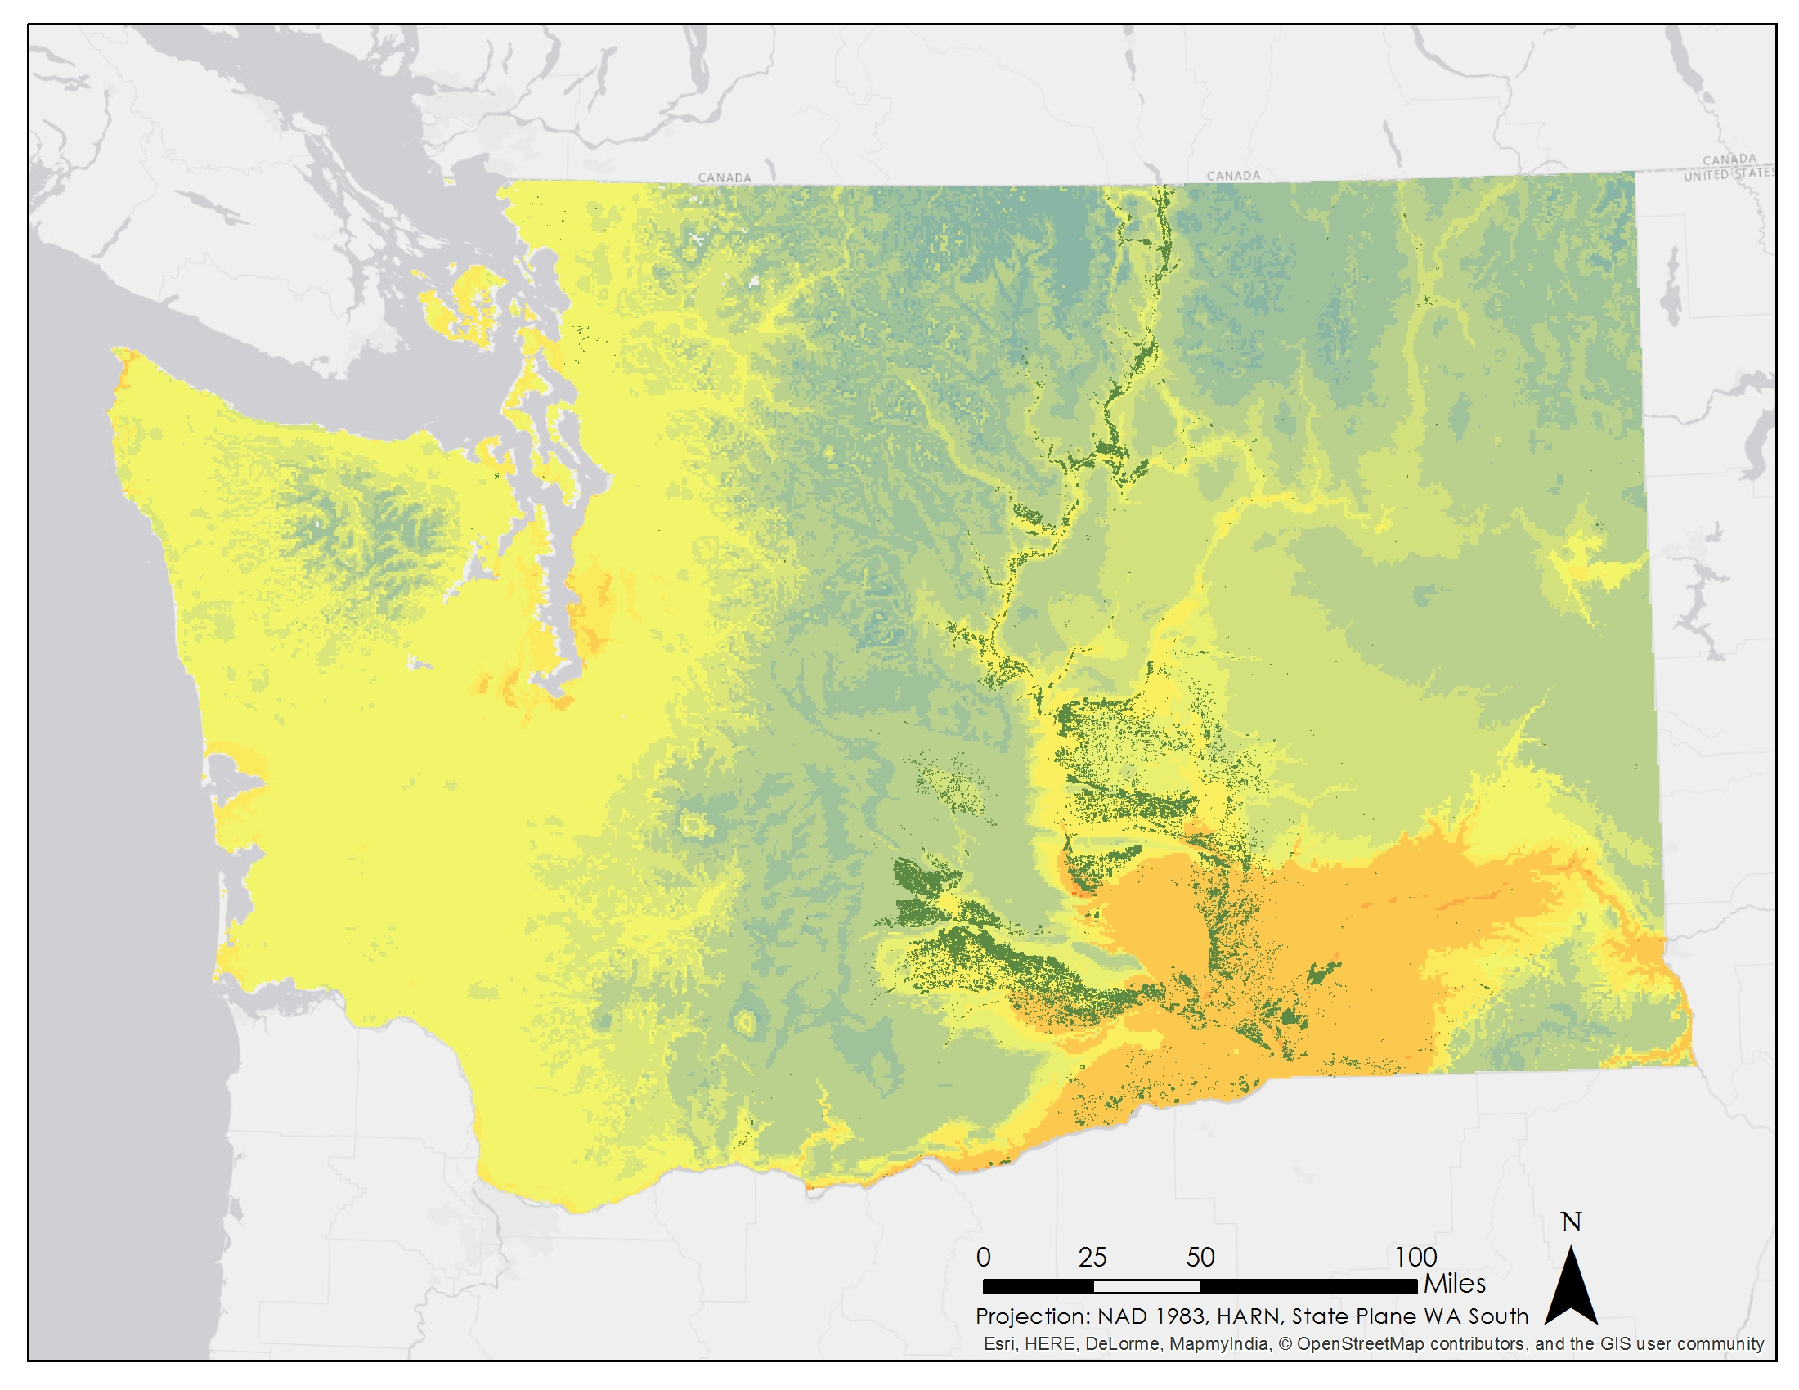
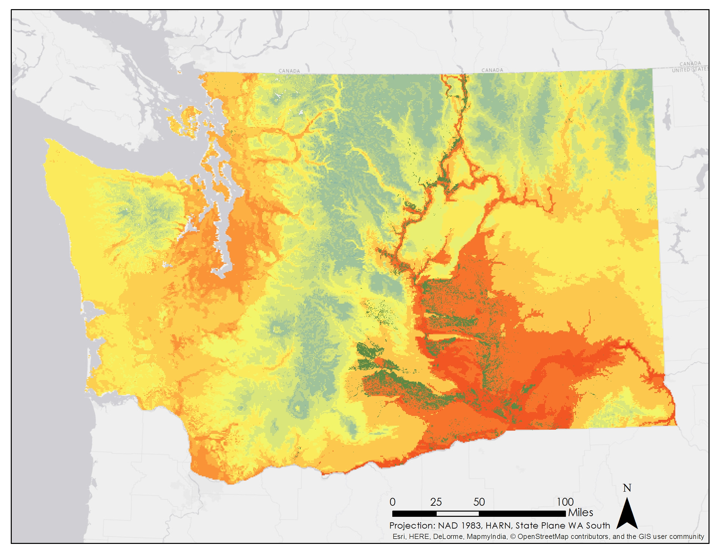
Results: 2095 Suitability Map
Moderate Scenario: RCP 4.5
Extreme Scenario: RCP 8.5
Notes:
The moderate scenario shows very little change between 2065 and 2095; however, the extreme scenario shows a drastic change in conditions. Suitability is extremely low for all apple orchards.

Slide 19
Conclusions
Current Conditions
PHZ and suitability maps show good conditions for apples.
Moderate Scenario
Conditions steadily worsen.
Marginally suitable in the north by 2095.
Extreme Scenario
Significant worsening of conditions.
By 2095, Washington will be very unsuitable.

Slide 20
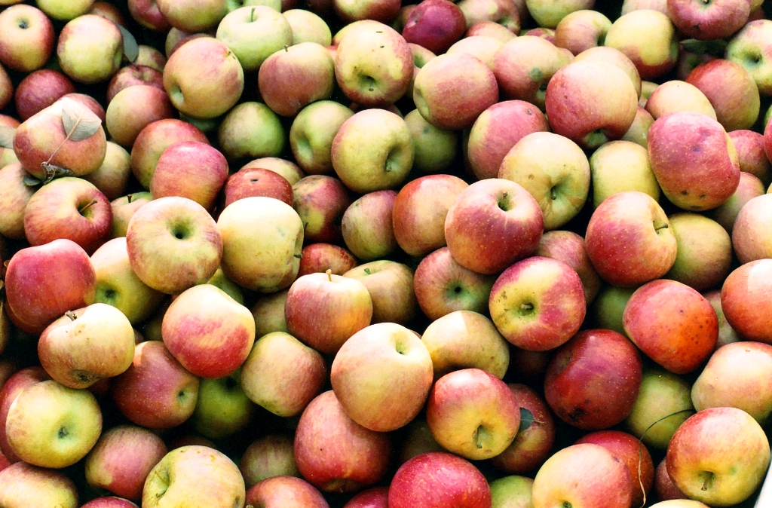
Future Work
Interactive program to allow for analysis of other crops
Improve MODIS data processing method
Incorporate precipitation, wind, and soil data
Image Source: John Chamberlain, Flickr
Notes:
(Mention SMAP with the soil data).

Slide 21
Advisors
Dr. Kenton Ross, NASA DEVELOP National Program Science Advisor
Dr. Noel Baker, NASA Postdoctoral Program Fellow
Jeffry Ely, NASA DEVELOP Geoinformation Scientist
Partners
Dr. Michael Glenn, USDA-ARS Appalachian Fruit Research Station
Others
Northwest United States Agriculture I, Fall 2014
Northwest United State Agriculture II, Spring 2014

