Slide 1
Idaho Disasters III
Using Landsat Earth Observations to Identify Increased Fire Susceptibility Due to Invasion of Cheatgrass (Bromus tectorum)
Jeff May (Project Lead)
Zach Simpson
Jenna Williams
Notes:
The Idaho Disasters project began during the fall 2014 DEVELOP term. Throughout the life of this project, the Idaho Disasters team has studied the relationships that exist between wildland fire and the environment and some of the primary drivers that are changing wildfire regimes. This term, the Idaho Disasters III team applied work from the previous two terms to create a fuel model with the goal of identifying the distribution of invasive specie, Bromus Tectorum, more commonly referred to as cheatgrass. This nasty annual grass is responsible for the expansion of wildfire throughout the great basin, and largely responsible for ecosystem change in the semi-arid savanna regions of southeast Idaho.

Slide 2
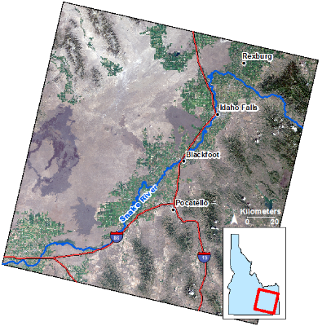
Project Overview
Study area
SE Idaho WRS-2 Path 39 row 30
Study period
March-June 2013, 2014 & 2015
NASA satellites/sensors used
Landsat 8 Operational Land Imagery (OLI)
Notes:
This is a natural color composite image taken from Landsat 8’s Operational Land Imagery showing the extent of the study region. For this study, early growing season imagery was acquired from Landsat 8 OLI for years 2013, 2014, and 2015. The early growing season was studied because this is the time of year that coincides with the “green-up” phase of cheatgrass, which occurs much earlier than the germination of native vegetation species. Cheatgrass germination can also occur in the late fall, going dormant during the winter months, and becomes active once temperature rises in spring.

Slide 3
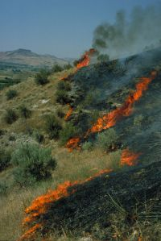
Objectives
Create a vegetation map that can be used to improve fire susceptibility models
Create a fire susceptibility map using vegetation mapping results
Benefit end-users by identifying high fire susceptibility areas
Image Credit: Bureau of Land Management
Notes:
The objectives of this study are twofold. The first being the creation of a fuel model which accurately identifies areas of cheatgrass, understanding that this specific plant, along with climate change, drives the increase in wildfire frequency and is most susceptible to fire due to it’s 1-hr fuel type classification. This means that cheatgrass responds to changes in the climate rapidly, within 1 hr. It means that fires that ignite in cheatgrass dominated areas will move faster, burning more areas, and create opportunities for cheatgrass to increase its prominence in the rangelands. The second objective is to incorporate better fuel models into fire susceptibility models that include species specific information that can help fire managers and researchers predict how a fire will behave given the dominant vegetation type. Other vegetation classes of concern include several varieties of sagebrush and montane forest regions, which include western juniper, a large shrub species responsible for the Charlotte fire, an uncharacteristic wildfire than burned in southeast Idaho in 2012.
Image Source: http://www.blm.gov/style/medialib/blm/id/fire/fire_recruitment.Par.98393.Image.200.299.1.gif

Slide 4
Image Credit: Ryan Howerton
Community Concerns
The 2012 Charlotte Fire cost Idaho $211 million dollars in fire suppression expenditures.
In Idaho, climate change, wildfire, and invasive species have created a positive feedback environment leading to increased wildfire frequency and duration.
Expanded wildfire regimes significantly alter semi-arid savanna ecosystems.
Notes:
The Charlotte fire was one of the most economically impacting fire that southeast Idaho had seen in decades. Suppression expenditures alone cost the state approximately $211 million dollars. This fire destroyed 66 homes, 96 buildings in total and caused the evacuation of over 1000 people. Justification for mapping fire susceptibility is to identify areas with perceived fire risk and mitigate this risk.
Wildfire coupled with the presence of cheatgrass creates a positive feedback cycle which further promotes the expansion of cheatgrass, wildfire frequency, and wildfire season duration. These three factors are to blame for the rapid degradation and change in Idaho’s rangelands, rapidly changing the sagebrush dominated region, to grasslands dominated by invasive and aggressive species. This change affects critical habitats of endangered species including the Greater Sage Grouse, the migration patterns of range roaming ungulates, and grazing operations on public lands.
Image Source: http://commons.wikimedia.org/wiki/File:Claude_Monet_-_The_Magpie_-_Google_Art_Project.jpg

Slide 5
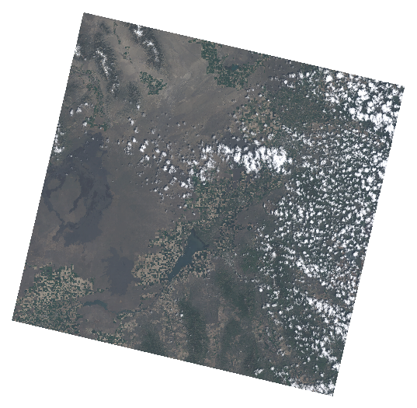
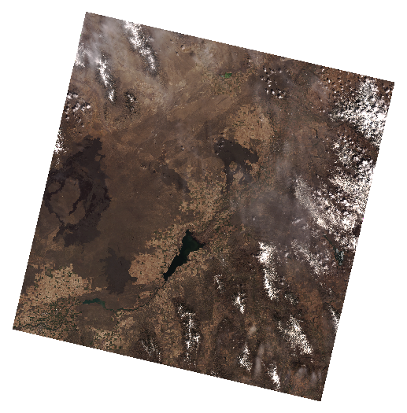
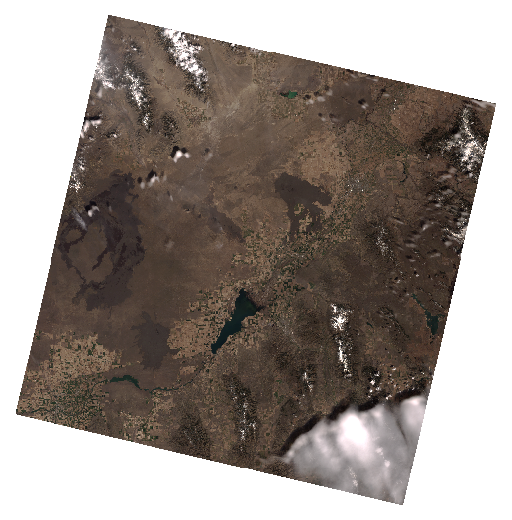
Methodology
Image Selection
2013
2014
2015
Criteria for image selection and Pheno-Calc
Base Temperature of 35 ° F
Growing Degree Day (GDD) of 400 with 10% tolerance
Less than 20% cloud cover
Closest Phonologically similar Days |  |  | Closest Landsat days to Phenology Days
Year | Julian Day | GDD | Julian Day | GDD
2013 | 125 | 406.435 | 135 | 652.385
2014 | 107 | 403.71 | 106 | 390.11
2015 | 103 | 406.25 | 109 | 466.55
Notes:
Imagery selected for processing was considered to be at the green-up phase of cheatgrass.The phenology of a region changes between years and the phenological synchronizations of satellite imagery using Pheno-Calc, a software package developed at the GIS Training and Research Center and available at the organization's website (http://giscenter.isu.edu), in combination of AgriMet historical meteorological records, to determine growing degree days (GDD) for cheatgrass green-up in each study year. Pheno-Calc was used to match days of the year that are phonologically similar to selected days of another year. The time period identified as meeting this criteria was a base temperature of 35 degrees Fahrenheit a GDD of 400 with a 10% tolerance. The 400 GDD was selected after Pheno-Calc and AgriMet historical meteorological records analysis of the results for early spring cheatgrass phenology by Boyte, S. P., Wylie, B. K., Homer, C. G., & Major, D. J.. The ideal imagery that met our study window and was available as Landsat 8 OSI with less than 20% cloud contamination were selected.

Slide 6
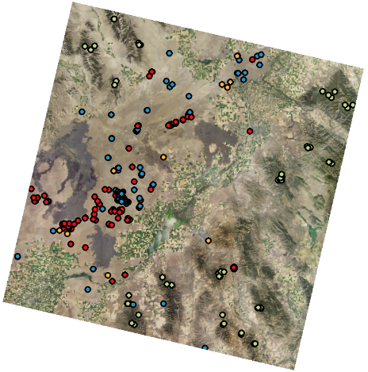
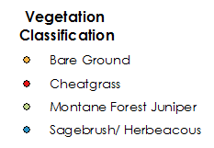
Methodology
Classification site creation
Classification sites were created using;
2013 NAIP imagery with a .5m resolution
2015 UoG ground truth observations
cheatgrass points from Cliton et al., 2010
Field observations collected by ISU GIS TReC staff during summer months of 2014 and 2015
Vegetation Type | Number of Points
Bare Ground | 12
Cheatgrass | 104
Sagebrush/ Herbaceous | 111
Montane Forest | 82
Notes:
To help delineate vegetation dominance in the study area five classifications of land cover were determined; bare ground, cheatgrass, mixed vegetation, montane forest/ western Juniper, and sagebrush/ herbaceous. Classification sites were created using 2013 NAIP imagery with a .5m resolution, 2015 UoG ground truth observations, cheatgrass points from Clinton et al., 2010 study that used remote sensing and a based time-series analysis to detect cheatgrass phenology, and field observations collected by Idaho State University GIS Training and Research Center staff during the summer months of 2014 and 2015.

Slide 7
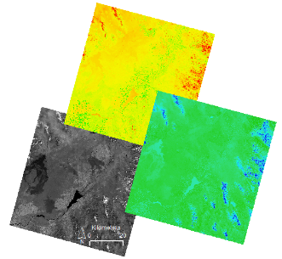
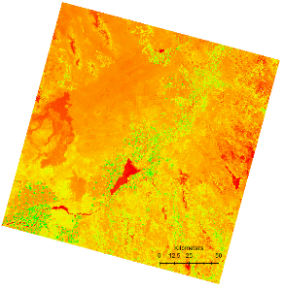
Methodology
Image Processing
Performed using IDIRISI TerrSet VegIndex Modules
Modified Soil-Adjusted Vegetation Index (mSAVI2) | Tasseled Cap Transformation (TCT)
Notes:
Two spectral indices were derived from the Landsat 8 imagery. mSAVI2, which stands for modified soil adjusted vegetation index, and Krauth and Thomson’s Tasseled Cap Transformation which provides brightness, wetness, and greenness values to in image classification. Unlike NDVI, mSAVI2 is not as sensitive to reflectance of bare-ground, making it an appropriate index to use given the sparsely vegetated nature of Idaho rangelands. NDVI has been observed to produce erroneously high values in areas where no vegetation exists, such as the basaltic lava flows at craters of the moon, and Hell’s half acre.
Add Bare soil Index!!!----------------------------------------------
Explain the masking process!!!------------------------------------

Slide 8
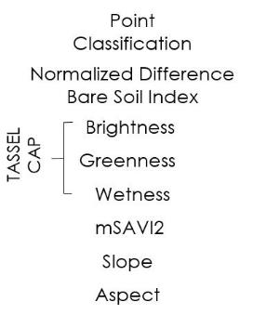
Methodology
Classification Tree Analysis
Notes:
Once the vegetation indices were derived, they were combined with 30m slope and aspect and input to IDRISI TerrSet’s Classification Tree Analysis module. CTA is a statistically based, supervised, classification method that automatically determines which of the input data is most useful in performing the classification, disregarding any inputs that do not help differentiate between the designated classes. The points used for training the model and validation of the results comprised of points generated from in-situ observations as well as points assumed to be cheatgrass dominated due to the spectral response of these pixels during times of the year when such a response is not expected from any native vegetation.
Slope and aspect were included after receiving expert knowledge that described cheatgrass prominence as being greater on southward facing aspects, which are generally dryer due to prolonged exposure to the sun, and slopes less than 30 degrees.

Slide 9
Methodology
Spectral purification and spectral
Ambiguity assessment
Notes:
Here we include the methods used to spectrally purify and identify ambiguity in our training and validation sites. This is where we effectively refine our model and produce better results than what was first obtained.

Slide 10
Methodology
Fire Susceptibility Model
Notes:
We put our fuel model derived from CTA into a fire susceptibility model that examines fuel, slope and …. …. To identify areas with higher susceptibility to fire.

Slide 11
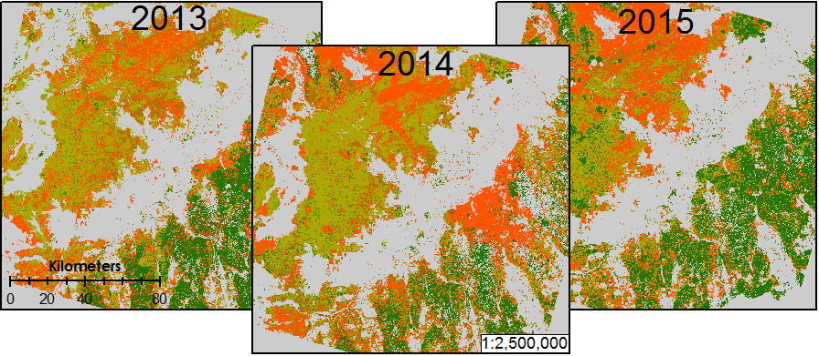
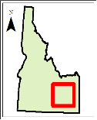
Results
Year | Overall Accuracy | Kappa
2013 | 64.706% | 0.487962
2014 | 78.992% | 0.692347
2015 | 64.706% | 0.482983
Notes:
These results show varying distribution between sagebrush/herbaceous and cheatgrass classes for the study years. Overall accuracy for each year is shown along with corresponding kappa coefficients. You can see that the greatest model accuracy was obtained for 2014 with an overall accuracy of about 79%.

Slide 12
Accuracy Assessment
2013
 | Sagebrush/ Herbaceous | Cheatgrass | Bare ground | Montane Forest | Total | ErrorC
Sagebrush/Herbaceous | 24 | 12 | 2 | 2 | 40 | 0.4
Cheatgrass | 10 | 27 | 2 | 2 | 41 | 0.341463
Bare ground | 4 | 1 | 1 | 0 | 6 | 0.833333
Montane Forest | 5 | 2 | 0 | 25 | 32 | 0.21875
Total | 43 | 42 | 5 | 29 | 119
Error0 | 0.44186 | 0.357143 | 0.8 | 0.137931 |  | 0.352941
2014
 | Sagebrush/ Herbaceous | Cheatgrass | Bare ground | Montane Forest | Total | ErrorC
Sagebrush/Herbaceous | 33 | 6 | 2 | 1 | 42 | 0.214286
Cheatgrass | 5 | 35 | 2 | 2 | 44 | 0.204545
Bare ground | 3 | 0 | 1 | 1 | 5 | 0.8
Montane Forest | 2 | 1 | 0 | 25 | 28 | 0.107143
Total | 43 | 42 | 5 | 29 | 119
Error0 | 0.232558 | 0.166667 | 0.8 | 0.137931 |  | 0.210084
2015
 | Sagebrush/ Herbaceous | Cheatgrass | Bare ground | Montane Forest | Total | ErrorC
Sagebrush/Herbaceous | 23 | 10 | 3 | 2 | 38 | 0.394737
Cheatgrass | 11 | 29 | 1 | 2 | 43 | 0.325581
Bare ground | 1 | 1 | 0 | 0 | 2 | 1
Montane Forest | 8 | 2 | 1 | 25 | 36 | 0.305556
Total | 43 | 42 | 5 | 29 | 119
Error0 | 0.465116 | 0.309524 | 1 | 0.137931 |  | 0.352941
Notes:
Shown here are the error matrices for each of the study years. It is observed that in most cases, users accuracy is almost equal to producers accuracy. The lowest levels of classification error were found for the montane forest class which had a users accuracy of approximately 90% in 2014. Bare ground was consistently our most erroneous class, which in 2015, missed the target entirely. Though this was due to the low number of training sites able to be obtained for pixels that were comprised of nothing else but bare ground.

Slide 13
Conclusions

Slide 14
Advisors
Keith Weber (ISU)
Mark Carroll (GSFC)
John Schnase (GSFC)
Partners
Mike Kuyper (BLM)
Michelle Mavers (BLM)
Collin Homer (USGS)
Past Contributors
Kiersten Newtoff (DEVELOP)
Kyle Sowder (DEVELOP)
Andrea Boddenberg (DEVELOP)
Katherine Bradford (DEVELOP)
Eric Smith (DEVELOP)
Others
Ryan Howerton (ISU)

