Slide 1
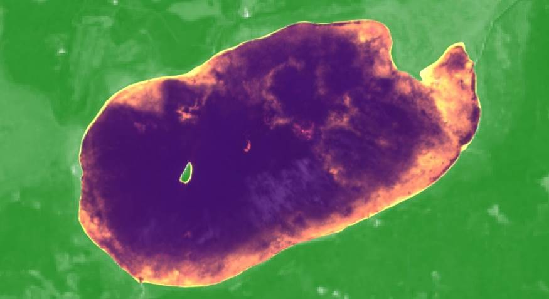
MINNESOTA AGRICULTURE & FOOD SECURITY
Implementing NASA Earth Observations to Validate Spectral Detection Models of Northern Wild Rice
Vanesa Martín
Kristen Dennis
Leorah McGinnis
Eli Simonson
Colorado – Fort Collins | Spring 2019
Notes:
Title: Implementing NASA Earth Observations to Validate Spectral Detection Models of Northern Wild Rice
This project was built off of a model created by a previous by the Wisconsin Agriculture & Food Security DEVELOP project in 2018. We now validated the model with in situ data and refining methods.

Slide 2
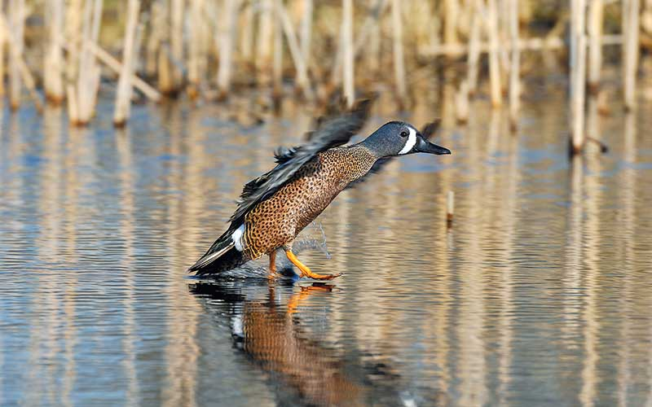
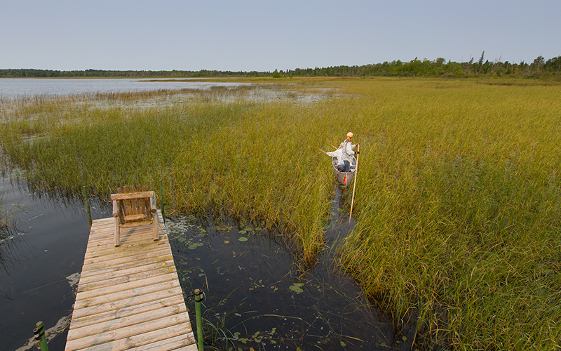
COMMUNITY CONCERNS
Habitat loss has led to a decline in abundance of wild rice across its natural range
Critical to Native American communities who depend on it nutritionally and culturally
MN and CA produce about 99% of the national wild rice supply
Crop wild relatives function as genetic repositories for cultivated crops
Image Credit: Minnesota Department of Natural Resources
Notes:
Habitat loss has lead to a decline in abundance of wild rice across its natural range. Wild rice is a critical component of local Native American communities and also provides a crucial nesting place for water fowl. Minnesota produces about 99% of wild rice for the nation and general rice consumption in the US is 18-26 lbs. on average per person annually. Wild rice also functions as a crop wild relative, maintaining genetic repositories that may be important to cultivated crops in the future.
------------------------------Image Information Below ------------------------------
Image Credit (waterfowl): MN DNR, permission from partners given, source: https://www.dnr.state.mn.us/mcvmagazine/issues/2018/sep-oct/duck-banding.html
Image Credit (rice): MN DNR, permission from partners given, source: https://www.dnr.state.mn.us/mcvmagazine/issues/2015/nov-dec/wild-rice.html

Slide 3
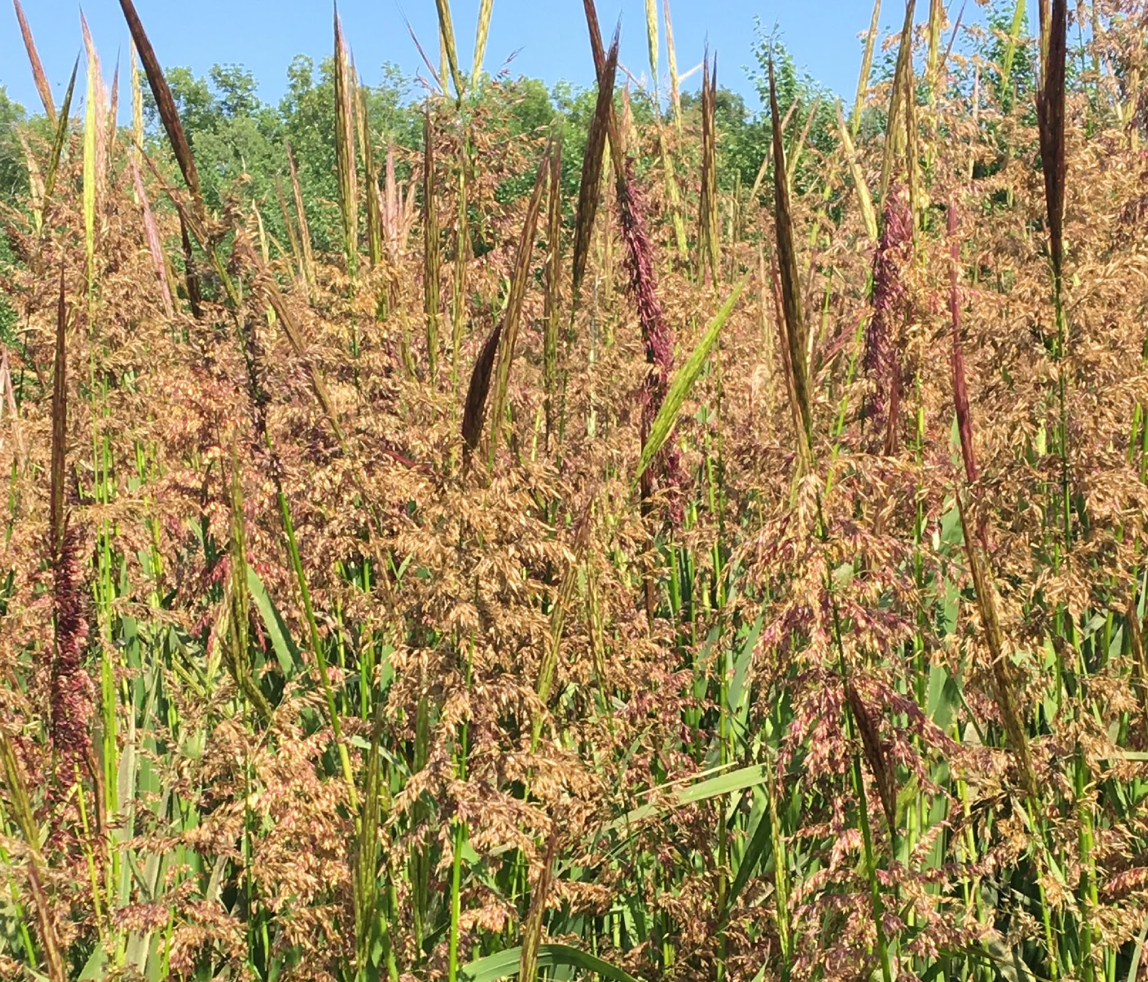
BACKGROUND
Can grow 3 to 10 feet by early July and in water depths of 6 inches to 3 feet
Traditionally harvested using canoes during the late growing season (August to September)
Common co-occurring species include bulrushes, cattails, and waterlilies
Found in approximately 1,200 rivers and lakes across Minnesota
Tends to recur in the same places every year, but quantity varies year to year
Northern wild rice (Zizania palustris L.)
Image credit: Jillian LaRoe
Notes:
Wild rice is found in approximately 1,200 rivers and lakes across Minnesota, particularly in the northern and central regions. It can grow to between three and ten feet by early July in non-stagnant water depths of between six inches and three feet. The rice is traditionally harvested using canoes during the late growing season of August and September. Common co-occurring species include bulrushes, cattail, and waterlilies. Rice tends to recur in the same places every year, though density can vary dramatically year to year based on a variety of environmental factors.
------------------------------Image Information Below ------------------------------
Image credit: Jillian LaRoe. Used with permission. (DEVELOPer photo)

Slide 4

PARTNERS
Minnesota Department of Natural Resources
Paul Radomski, Nicole Hansel-Welch, Donna Perleberg, Josh Knopik, Annetta Drewes
USDA, Agricultural Research Service, National Plant Germplasm System
Dr. Colin Khoury,
Dr. Stephanie Green
University of Minnesota
Dr. Anthony Kern, Dr. Jennifer Kimball
Notes:
We partnered with the Minnesota Department of Natural Resources or MN DNR and the USDA Agricultural Research Service as end-users. We also collaborated with researchers at the University of Minnesota Twin Cities and Crookston. These partners are interested in monitoring and managing northern wild rice for a variety of reasons, including it’s significance as a natural resource and a crop wild relative to cultivated rice.

Slide 5
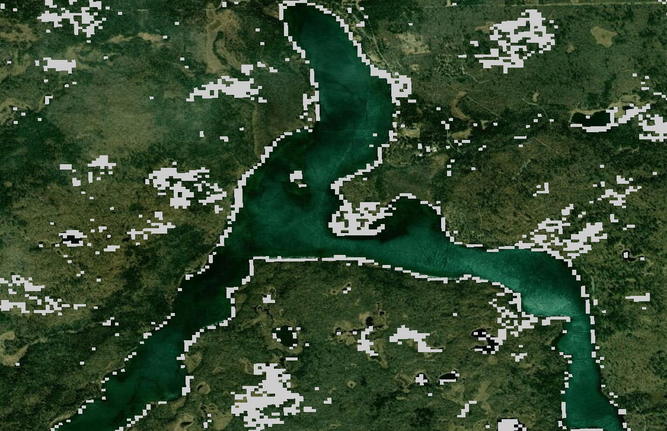
OBJECTIVES
VALIDATE:
Previous NASA DEVELOP models from Spring 2018
2018 Detection Model - Wild Rice
REFINE:
Detection modeling process by comparing Digital Ocular Sampling-trained models with in situ data-trained models
Lake Itasca
Notes:
Our primary objectives for the project were to validate a previous model and mask created by DEVELEOPers in Spring 2018 for detecting wild rice remotely and to refine and improve the model and masks. This image shows the predicted presence of wild rice in one lake from the 2018 detection model.

Slide 6
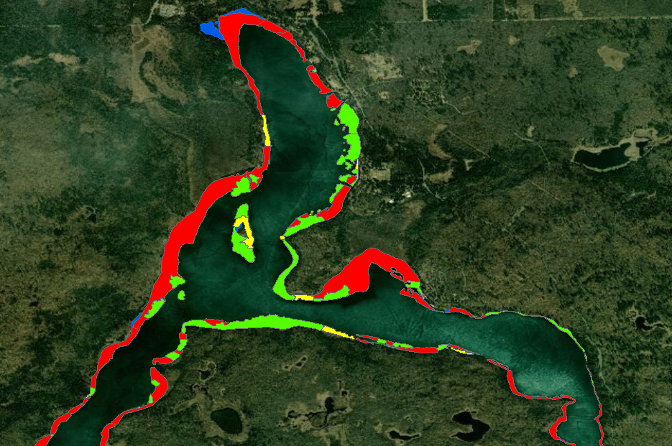
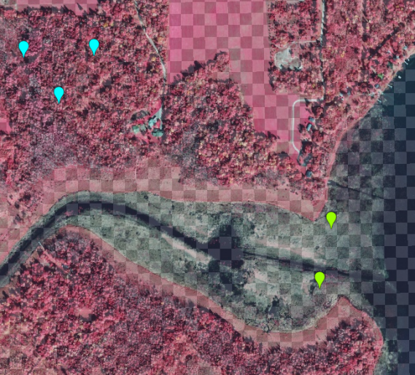
DEFINING OBJECTIVES
In Situ: field data collected by the MN DNR
Digital Ocular Sampling (DOS): manually placing presence/absence points on high-resolution imagery
Aquatic Vegetation Polygons
Cattails
Wild Rice
Bulrush
Waterlilies
Lake Itasca
Notes:
In situ data, provided by the Minnesota DNR, is data that was collected in-person in the field. The result is the colored polygons you see here delineating different vegetation classes. Digital Ocular Sampling (DOS) data is collected by placing our own presence and absence points over high resolution imagery. These are the two types of data we used to train our models for the sake of comparison.

Slide 7
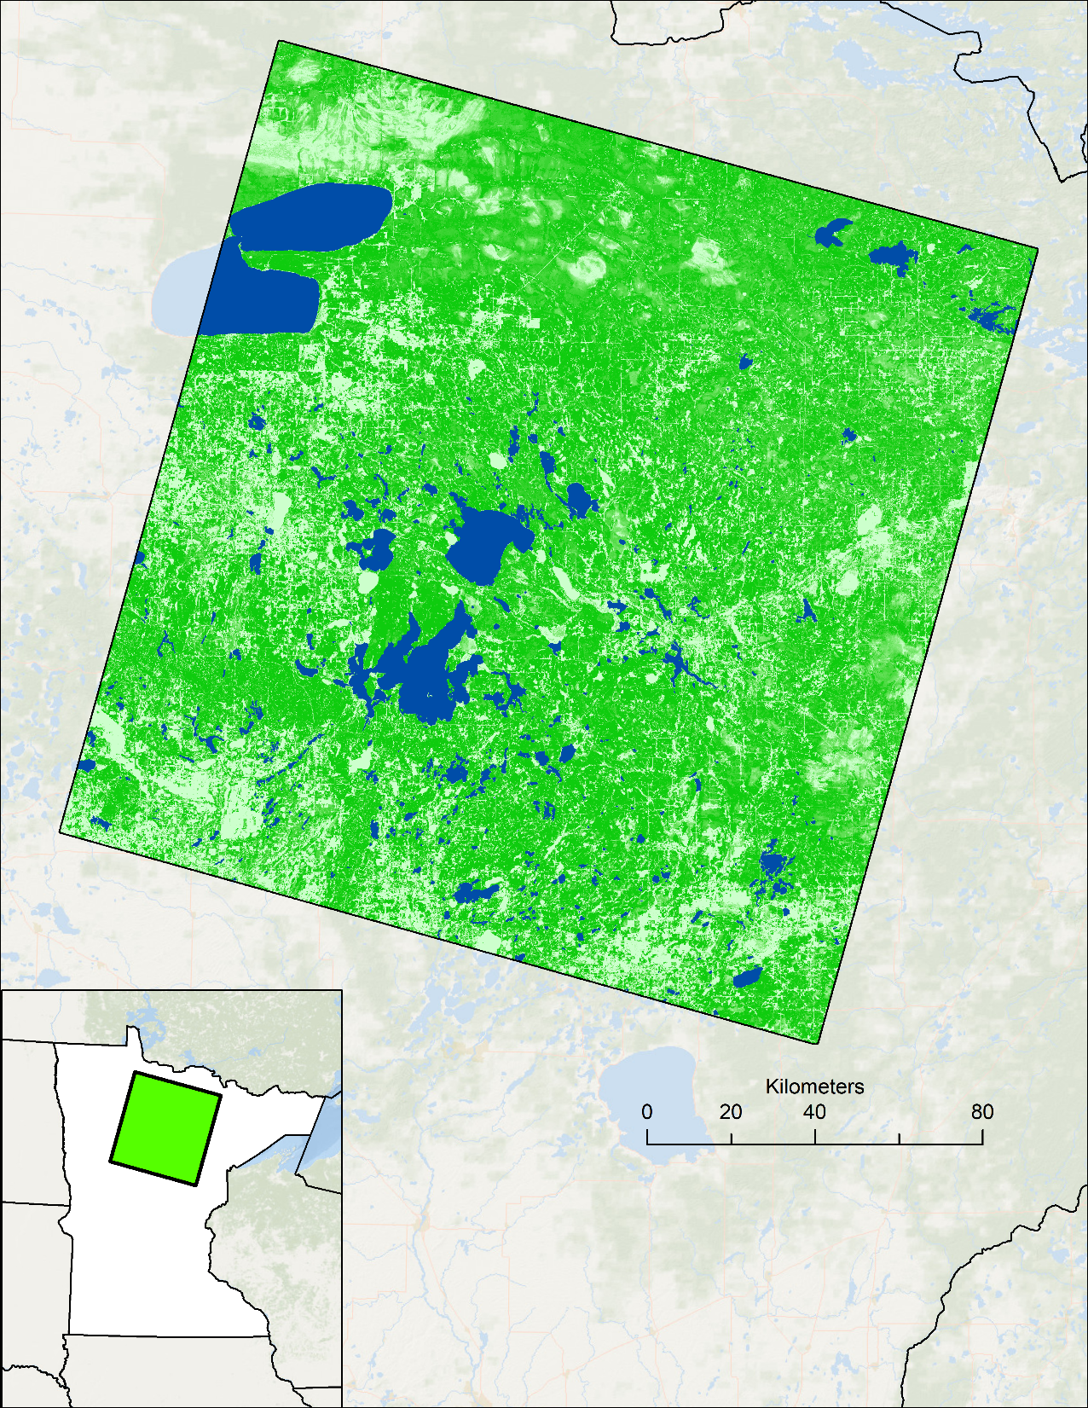




STUDY AREA
Study Period: 2015 to 2017 (June through September)
Beginning and end of growing season for rice
Available in situ data is clustered in this scene (Path 28, Row 27)
Canada
kilometers
P 28
R 27
ND
Study Area
State Boundaries
SD
MN
WI
Rice Lakes Identified by DNR
100% Forest Cover
IA
0% Forest Cover
Notes:
Our study area focused on a single Landsat scene in north-central Minnesota where much of our in situ data for validation is clustered, but we also looked at state-wide application. We used data from June through September for the years 2015 through 2017 which is before and after emergence. Later in the presentation we will also briefly address a case study from a similar region that we performed in response to certain data availability. We also performed a case study in an additional region which we will address shortly.

Slide 8
MODEL VALIDATION

Slide 9
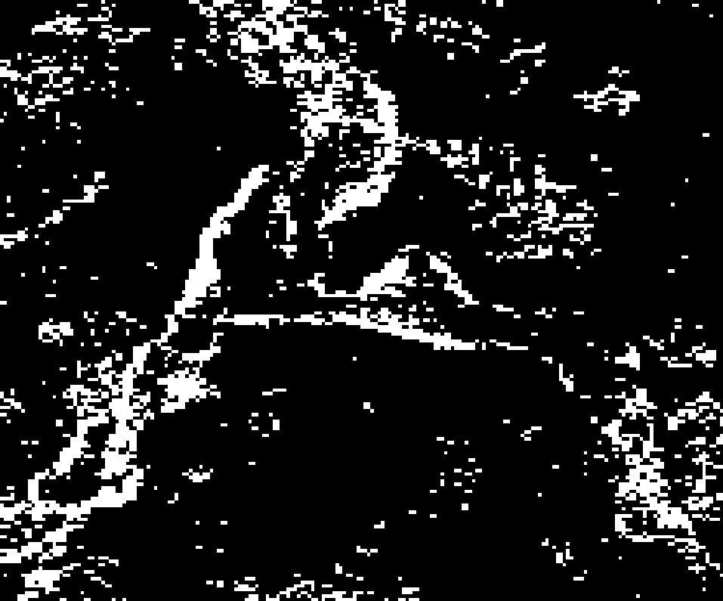
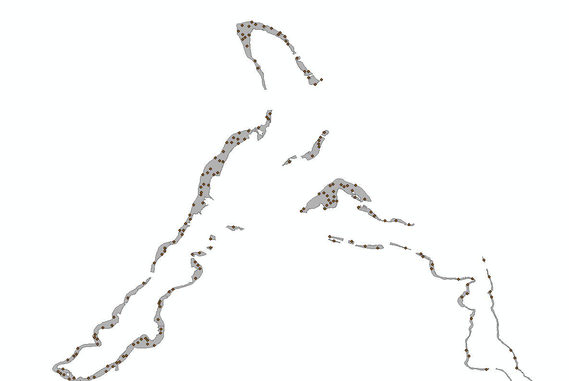
VALIDATION METHODOLOGY
Aquatic Vegetation DNR Polygons
Raw Model Output
Generate Points over Vegetation
Predicted class
P
N
True Positives (TP)
False Negatives (FN)
P
Actual class
False Positives (FP)
True Negatives (TN)
N
Notes:
On the left hand side, we have Spring 2018’s raw and masked model outputs (SAR mask with threshold of 30) for Ripple Lake on the left and Elm Island Lake on the right. With our MN DNR in situ data, we generated random points in their polygons to validate model trained with digital ocular sampling. A Confusion Matrix was used at the end.
Eventually the team reran models trained with DNR data instead to compare to this. Also this mask was made with SAR Variance, and we eventually made different masks using SAR range (VV and VH) to compare and refine.

Slide 10
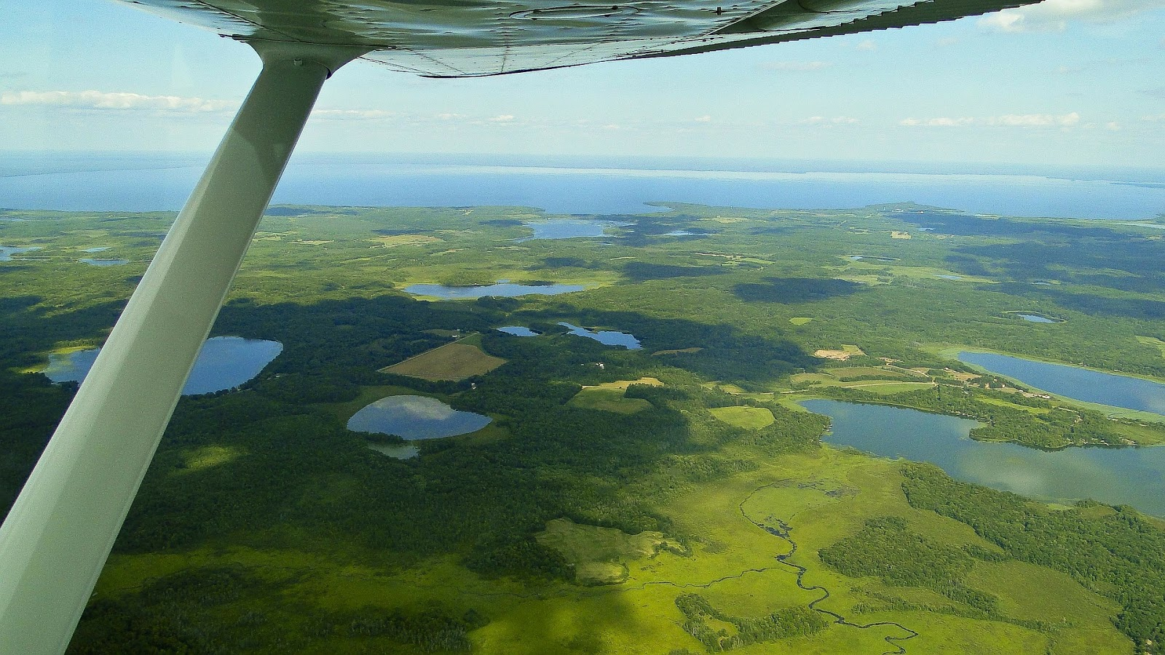
VALIDATION RESULTS
Model #1
Findings:
High misclassification of other vegetation when training with DOS
Absence points were not sampled over co-occurring aquatic vegetation
% Wild Rice Classified as Wild Rice: | 68%
% Other Vegetation Classified as Wild Rice: | 54%
Image Credit: Lisa Baird
Notes:
On the left, we have a raw model output and a masked output (variance threshold 30), and in the center we have the statistical outputs for these spatial outputs. The model misclassified at nearly 50%, while the mask was far more conservative (only 1% misclassification) but it only captured about 15% of the DNR’s survey. Refinements that we decided to make based on these findings: using other radar variables in our models that Spring 2018 did not use, and using different time periods than they did (June-September, representing pre- and post-emergence of rice)
Image credit: Pixabay. Free for commercial use; No attribution required. https://pixabay.com/photos/flying-aerial-shot-minnesota-173776/ (Creative Commons)

Slide 11

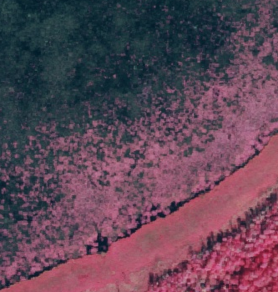
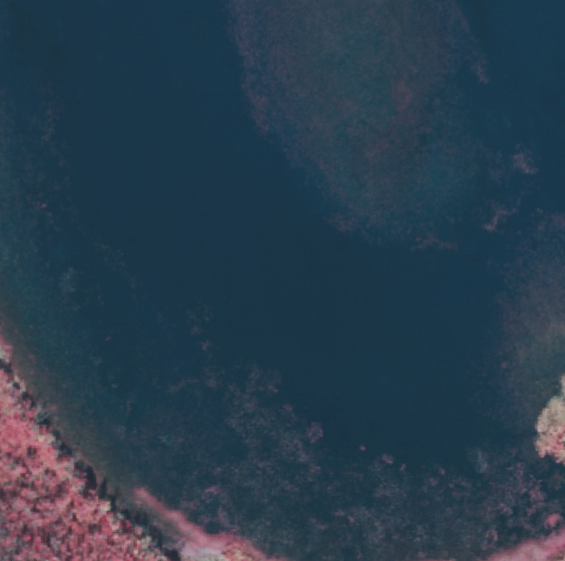
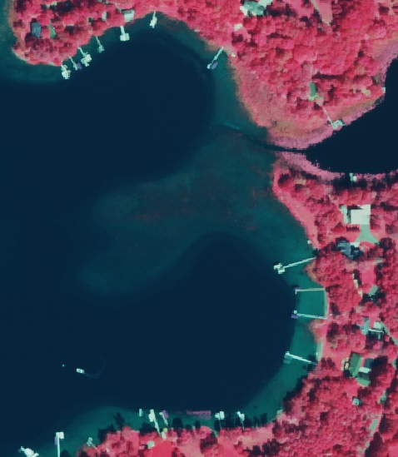
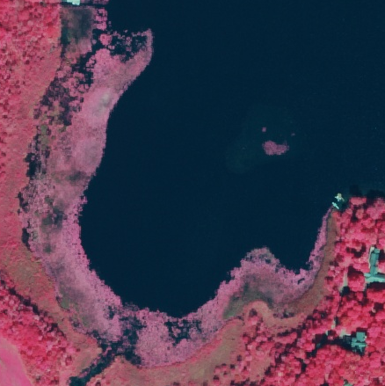
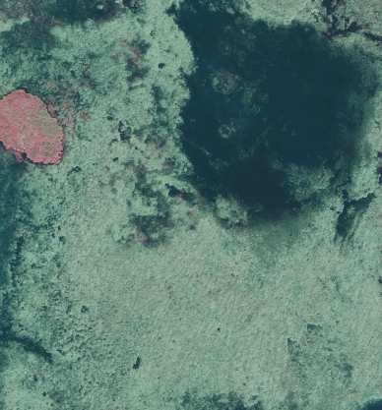
DOS Analysis
Bulrushes + WR
Bulrushes
Wild Rice
Bulrushes
Bulrushes
Waterlilies
Wild Rice
Notes:
Given their lack of access to field data, the Spring 2018 team only sampled in high density areas. They placed their absence points over the entire landscape, so their raw model misclassified co-occurring vegetation often. How did we try to improve their DOS method?
We tried our hand at digital ocular sampling as well, adding presence points within our scene and more importantly, adding absence points within the lakes (meaning we tried to make it so our model was able to distinguish between different types of vegetation).
Pictures:
Left Column: Are they the same species or different? —-> Both bulrushes
Middle Column: Are they the same species or different? —->Waterlilies and wild rice (nearly indistinguishable)
Right Column top: Here we have seemingly similar patches, but one includes wild rice and the other does not
Right Column Bottom: A different species? We haven’t mentioned cattails...actually it’s just another way Wild Rice can look
Conclusion: DOS analysis is fairly unreliable

Slide 12
MODEL REFINEMENT

Slide 13
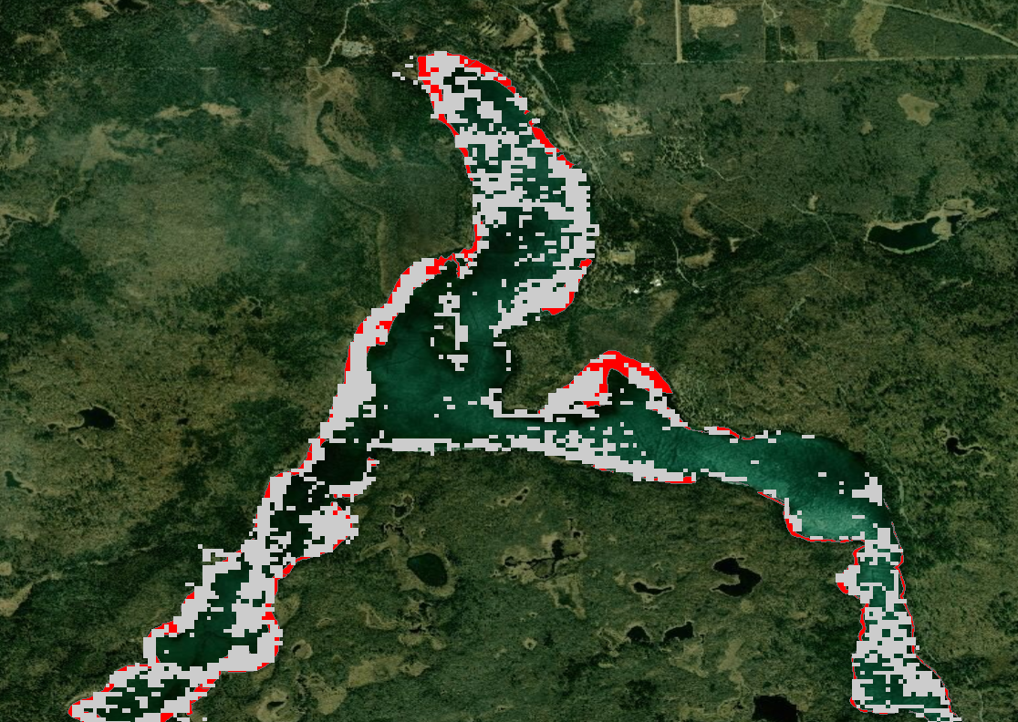
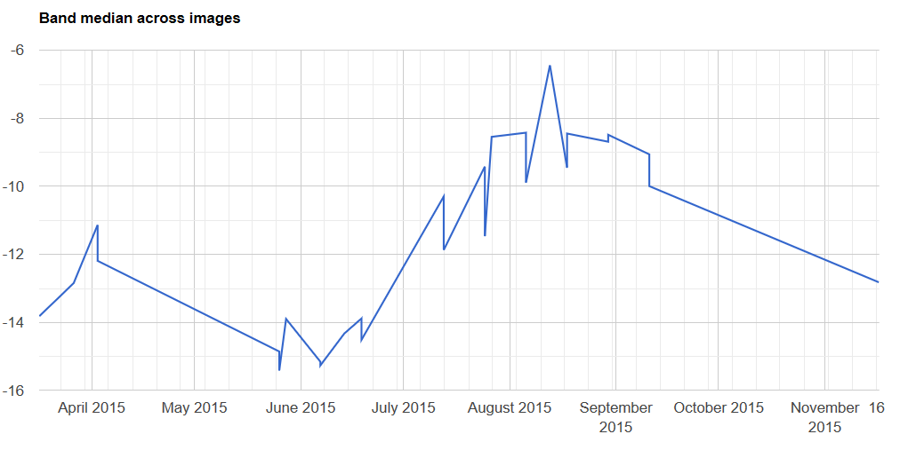
Modeling Refinements
Trained model with MN DNR field data as opposed to DOS data
Incorporated new radar variables, filtered to new temporal periods
Increased resolution of predictor variables
DNR Survey – Wild Rice
Detection Model –
Wild Rice
Lake Itasca

Slide 14
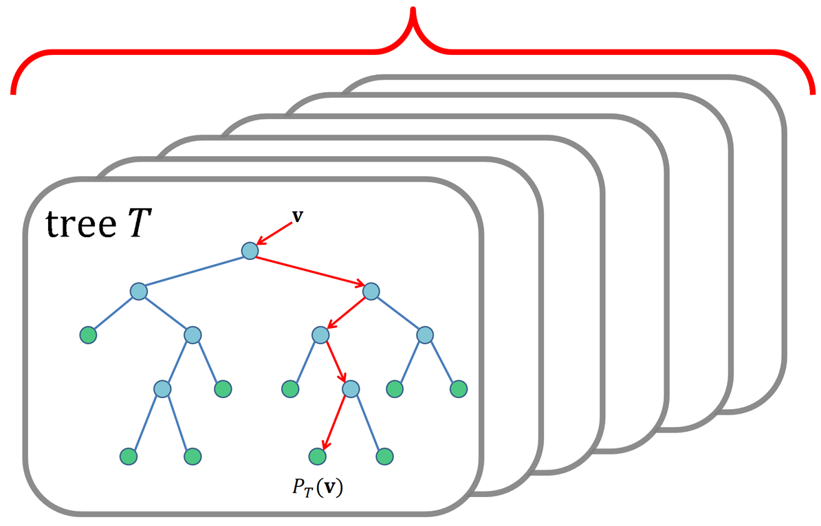
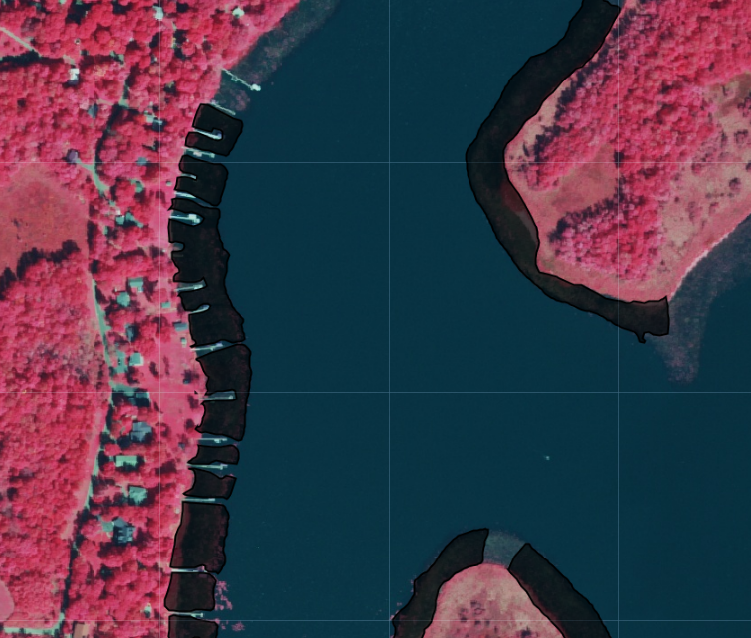
MODELING METHODOLOGY
Digital Ocular Sampling
Derive Predictor Variables from
VSURF & Random Forest
Landsat 8 OLI
Sentinel-1
C-SAR
Sentinel-2 MSI
Wild Rice Presence
Wild Rice Absence
Point Sampling over DNR Field Survey
Notes:
DERIVE PREDICTOR VARIABLES + VSURF
Resampled in GEE and reprojected in ArcMap, reuploaded and eventually stacked those bands
then extracted values to CSV’s that we ran through VSURF, came up with top predictors, then we created new stacks with just the top predictors and extracted those values to csv’s
predicted upon those CSV’s in R with our training data and got a CSV output
we then validated with validation points to get our final model performance output

Slide 15
MODELING RESULTS
Model # | Training Data Used | Satellites/Sensors Used | Resolution (meters) | Top 4 Predictors
1 | DOS | Landsat 8 OLI Sentinel-1 C-SAR | 30 | VV range, Cross Ratio (VH/VV) T2, Cross Ratio (VV/VH) T2, Band 5 T2
2 | MN DNR | Landsat 8 OLI Sentinel-1 C-SAR | 30 | VV range, Tasseled Cap Wetness T1, VV median T1, Band 2 T1
3 | MN DNR | Sentinel-1 C-SAR | 10 | VV range, VH range, VV median T1, Cross Ratio (VH/VV) T1
Notes:
We ran three models without including our case study, and in this table we have them numbered between 1 and 3 will continue to refer to them as such.
Model 1 was the model from the Spring 2018 term that was trained with digital ocular sampling and run with 30 m Landsat and 30 m synthetic aperture radar variables. The top predictors were different from the other models—VV range was still at the top, but it had two cross ratios (radar variables) and Landsat’s Band 5 from time period 2, August-September
Model 2: The same model except it was trained with DNR field data rather than DOS, and also had VV range as a top predictor
This, as you’ll see in a moment, was our top-performing model
Model 3: This model was trained with field data and exclusively radar variables at 10 m. We believed this model would perform well, seeing as radar variables were very important for detecting rice in these models.

Slide 16
MODELING RESULTS CONTINUED
54%
68%
AUC: 0.9365
22%
81%
AUC: 0.8270
25%
67%
AUC: 0.6728
n = 500
n = 500
Notes:
As was mentioned earlier, the green bars in this graph represent the percentage of wild rice that our models correctly classified as wild rice, and in yellow, you have the percent of DNR wild rice that our models misclassified as other vegetation.
We began by validating the model from the last DEVELOP term which was trained with DOS, with 30 m Landsat and SAR variables. It misclassified almost 50%.
Next, we ran a comparable model with 30 m Landsat and SAR variables, but we trained it with DNR-data. It was our best performing model, as it classified 81% of the DNR’s wild rice survey, and only misclassified 22% of other vegetation as wild rice.
Subsequently, we ran another DNR-trained model, but this time we only used radar variables at 10 m resolution. We thought this might be more accurate since SAR variables were consistently found to have some of the highest explanatory power when we ran them through the VSURF program and because they were at higher resolutions—however, it did not outperform our model with a combination of spectral and radar variables at 30 m.

Slide 17
MODEL MISCLASSIFICATIONS
n = 110
Notes:
Breakdown of misclassified vegetation types looks the same across model outputs. Mixed classification types (where rice was dominant or nondominant species) were also considered presence points, which may have affected why bulrushes were misclassified more often than waterlilies. Generally, bulrushes were the species that was almost always misclassified for rice, with waterlilies always taking up second place. Cattails were third.

Slide 18
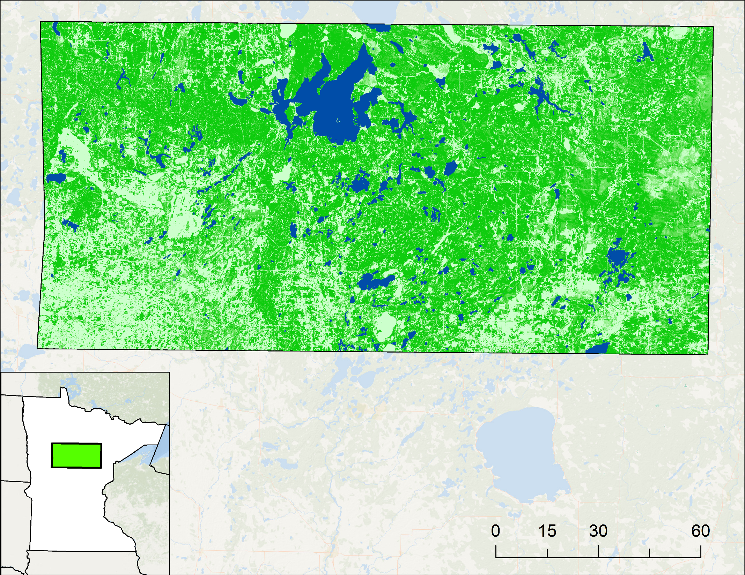
SENTINEL-2 MSI CASE STUDY
Study Period: June through September 2017
Sentinel-2, SAR, and MN DNR data availability
% Wild Rice Classified as Wild Rice | 77%
% Other Vegetation Classified as Wild Rice | 20%
Study Area
State Boundaries
Rice Lakes Identified by DNR
AUC: 0.8525
Kilometers
100% Forest Cover
0% Forest Cover
Notes:
Our case study area falls largely within our original Landsat scene. The reason we chose it was because Sentinel-2 data was not available for our entire study area, and in this particular case study area we had Sentinel-2 data, SAR data, and DNR in situ data. The reality of data availability also led us to choose a different time period for our case study area-- 2017.
As you can see, the breakdown of misclassified vegetation is a bit more drastic than what we’ve seen in the other models, but essentially follows the same patterns. Bulrushes, waterlilies, and cattails.

Slide 19
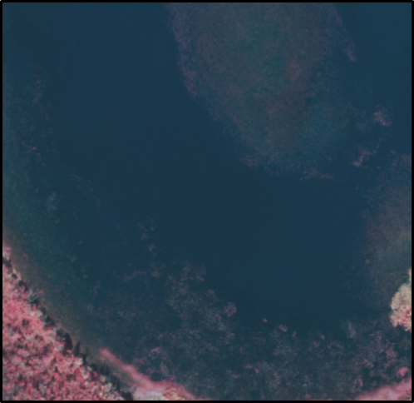
CONCLUSIONS
Bulrushes + WR
Not all emergent aquatic vegetation (EAV) is distinguishable using high resolution NAIP imagery
  Bulrushes and waterlilies commonly misclassified as wild rice due to their spectral similarities
Bulrushes
Training a model with digital ocular sampling was not optimal for distinguishing EAV, whereas training with MN DNR data was
We can detect rice with higher accuracy by combining spectral and radar variables, rather than employing radar exclusively
Higher resolution variables do not necessarily result in higher detection accuracy
Notes:
All of these results have led us to a handful of findings that might be of value to our partners and any future efforts to detect aquatic vegetation.
These mostly deal with the idea that because distinguishing EAV even with high resolution aerial imagery is nearly impossible, the training a model with DOS trained data is not ideal.

Slide 20
LIMITATIONS & FUTURE WORK
Limitations
Data Availability
Spatially limited year to year (MN DNR)
Dependent on where DNR surveyed each year
Satellite imagery and MN DNR imagery did not always align
Future Work
Data Availability
Selecting a location and time period where data are available for ease of comparison
Exploring Sentinel-2’s higher resolution in a model that is directly comparable to Landsat models
Testing models over different years
SAR and rice detection
Differing combinations of radar variables and detection models to reduce misclassification
Image Credit: Lisa Baird
Notes:
Image credit: Pixabay. Free for commercial use; No attribution required. https://pixabay.com/photos/flying-aerial-shot-minnesota-173776/

Slide 21
The Minnesota Agriculture and Food Security team would like to thank our partners at the USDA, the MN DNR, and the University of Minnesota for engaging with NASA DEVELOP to make this research possible.
A special thanks to Kristen Dennis (Colorado – Fort Collins Node Center Lead), Tony Vorster (Science Advisor), Paul Evangelista (Science Advisor), and Dr. Colin Khoury (USDA ARS) for working closely with our team throughout this research project.
This material contains modified Copernicus Sentinel data (2015-2017), processed by ESA.
Notes:
Thank you to our partners and collaborators for this project, as well as the Colorado node leadership.

