Slide 1
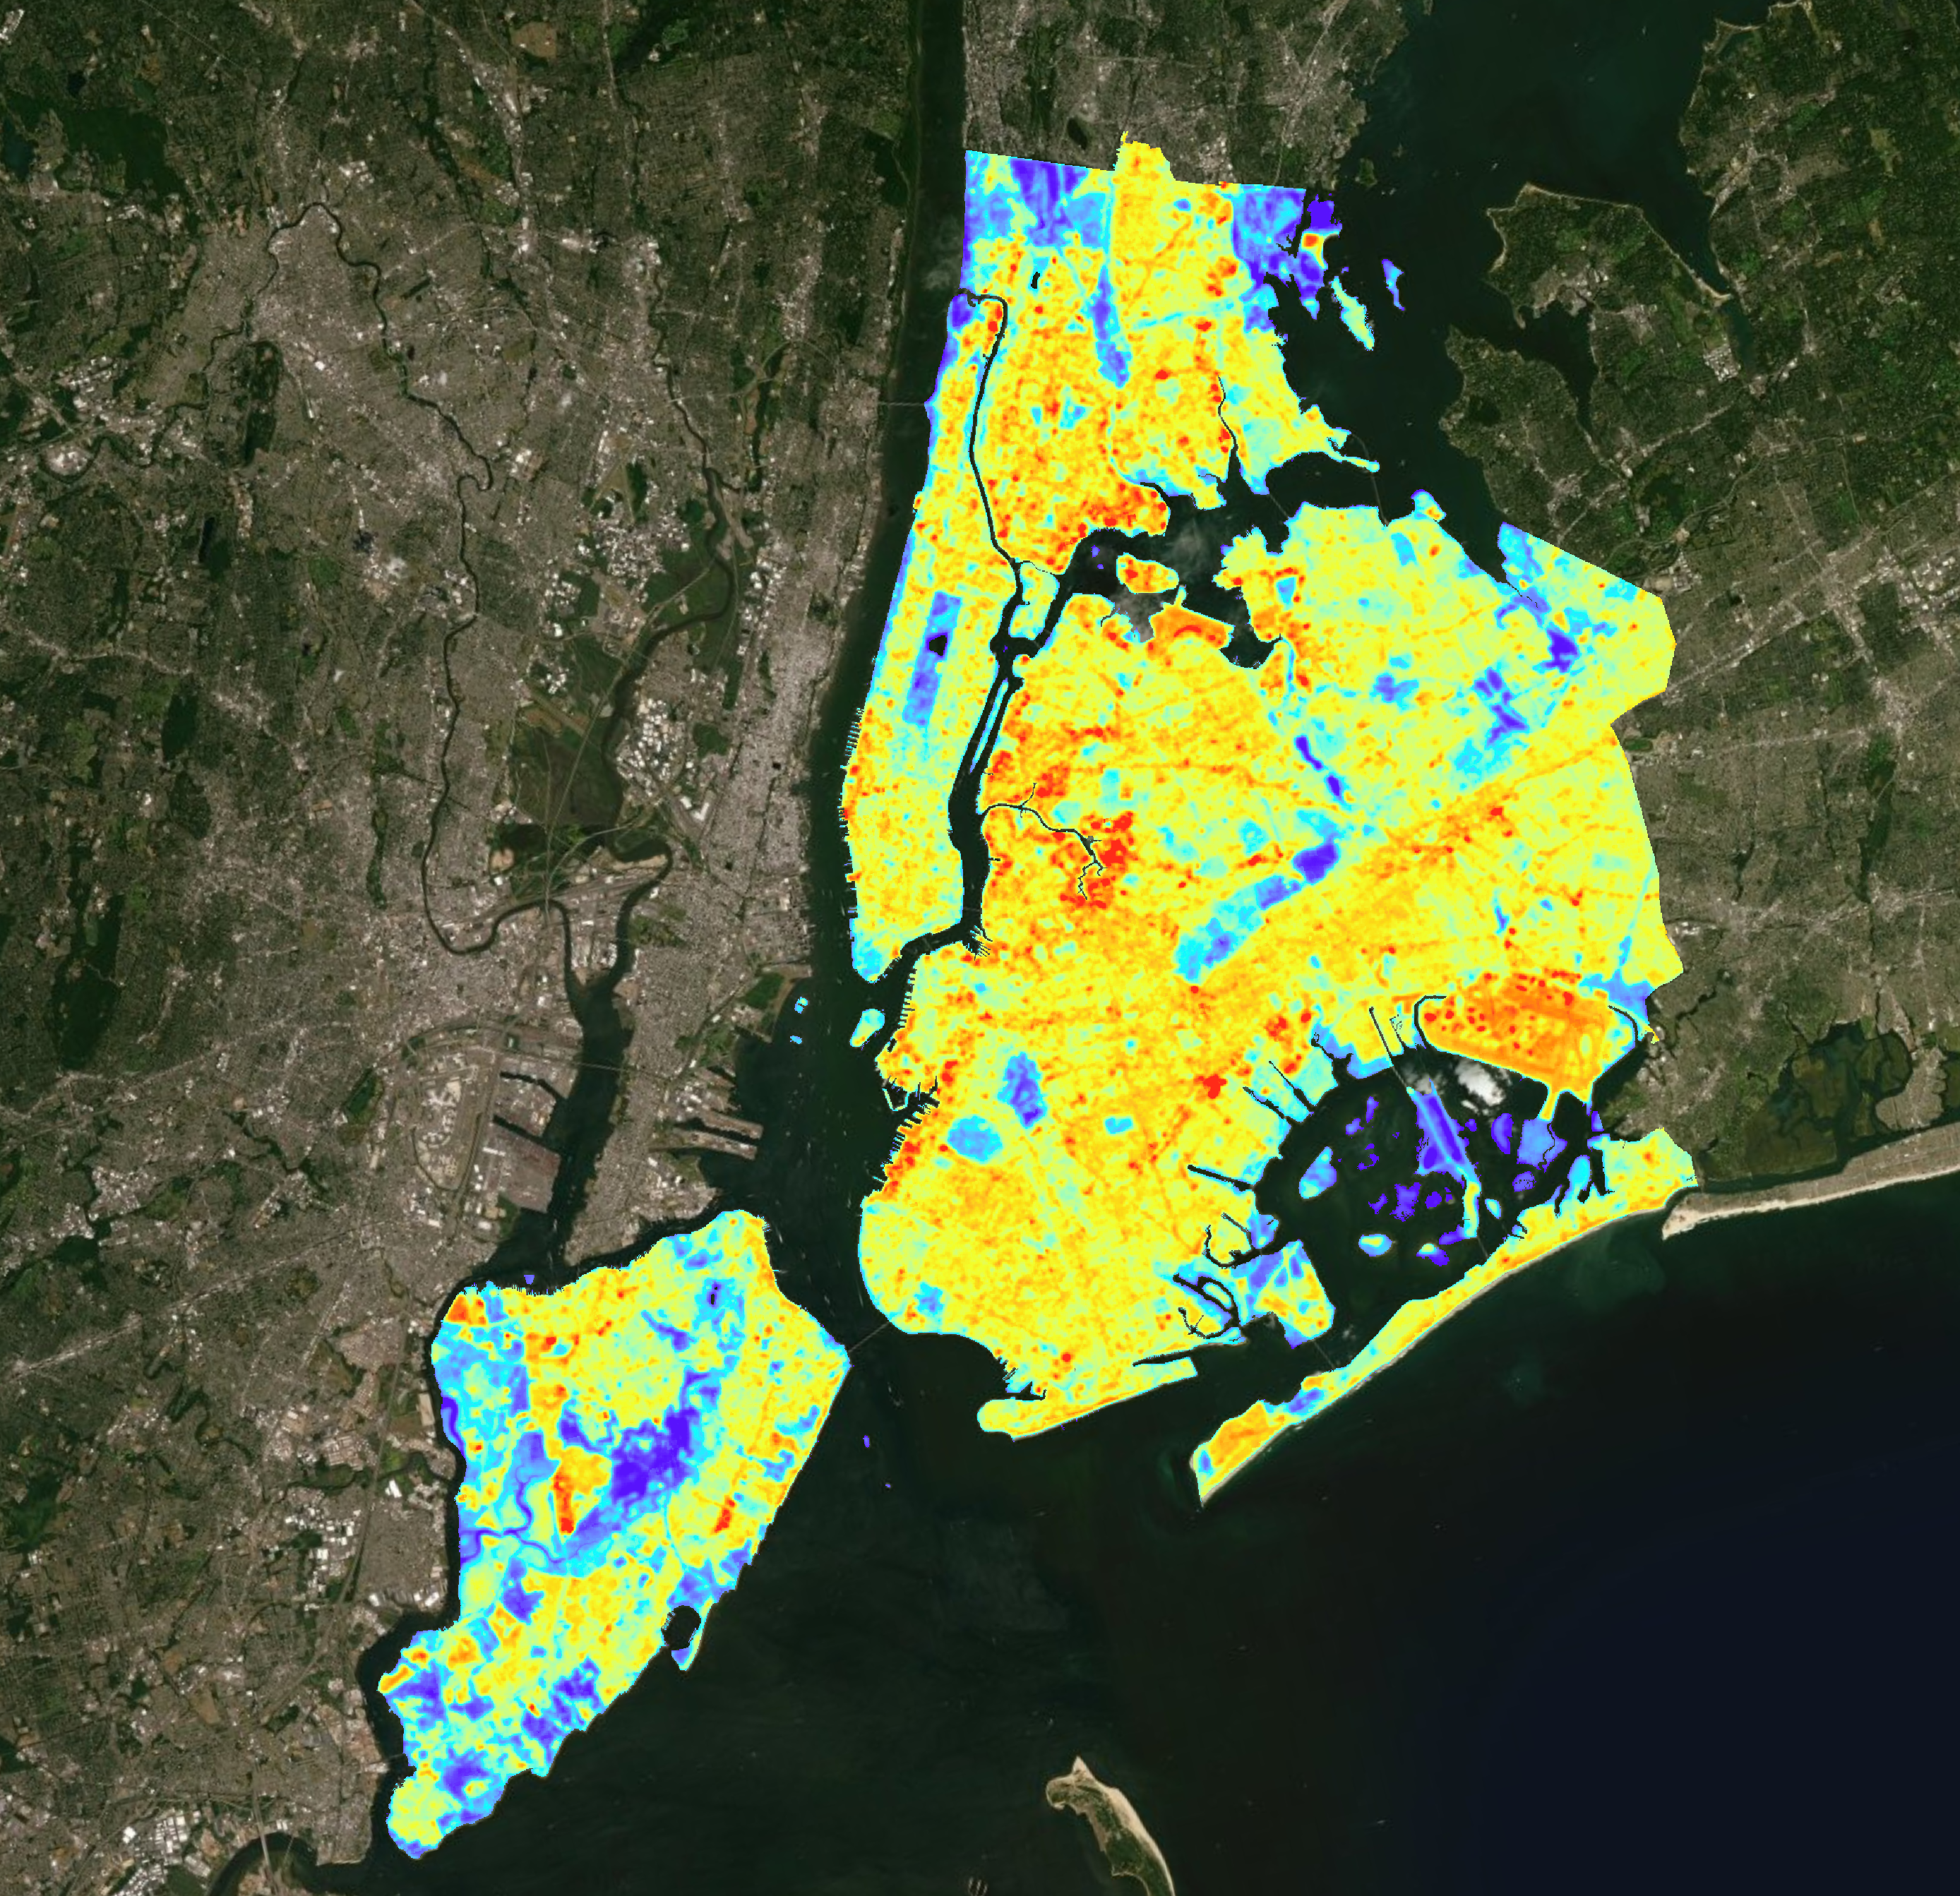
NEW YORK CITY URBAN DEVELOPMENT
Mapping Urban Hotspots using NASA Earth Observations to Inform Future Green Initiatives in New York City
Scott Harrison
Josi Robertson
Luis Garcia Falcon
Brianna McCardle
Virginia – Langley| Fall 2019
Notes:
Luis: Hello Everyone, I am Luis and I am with the New York Urban Development Team. Next to me is my team, Scott, Josi and Breezy. Our goal for this project was to map Urban Hotspots using Earth Information to aid the Mayor’s Office of Resiliency of New York City in creating future green initiatives.

Slide 2
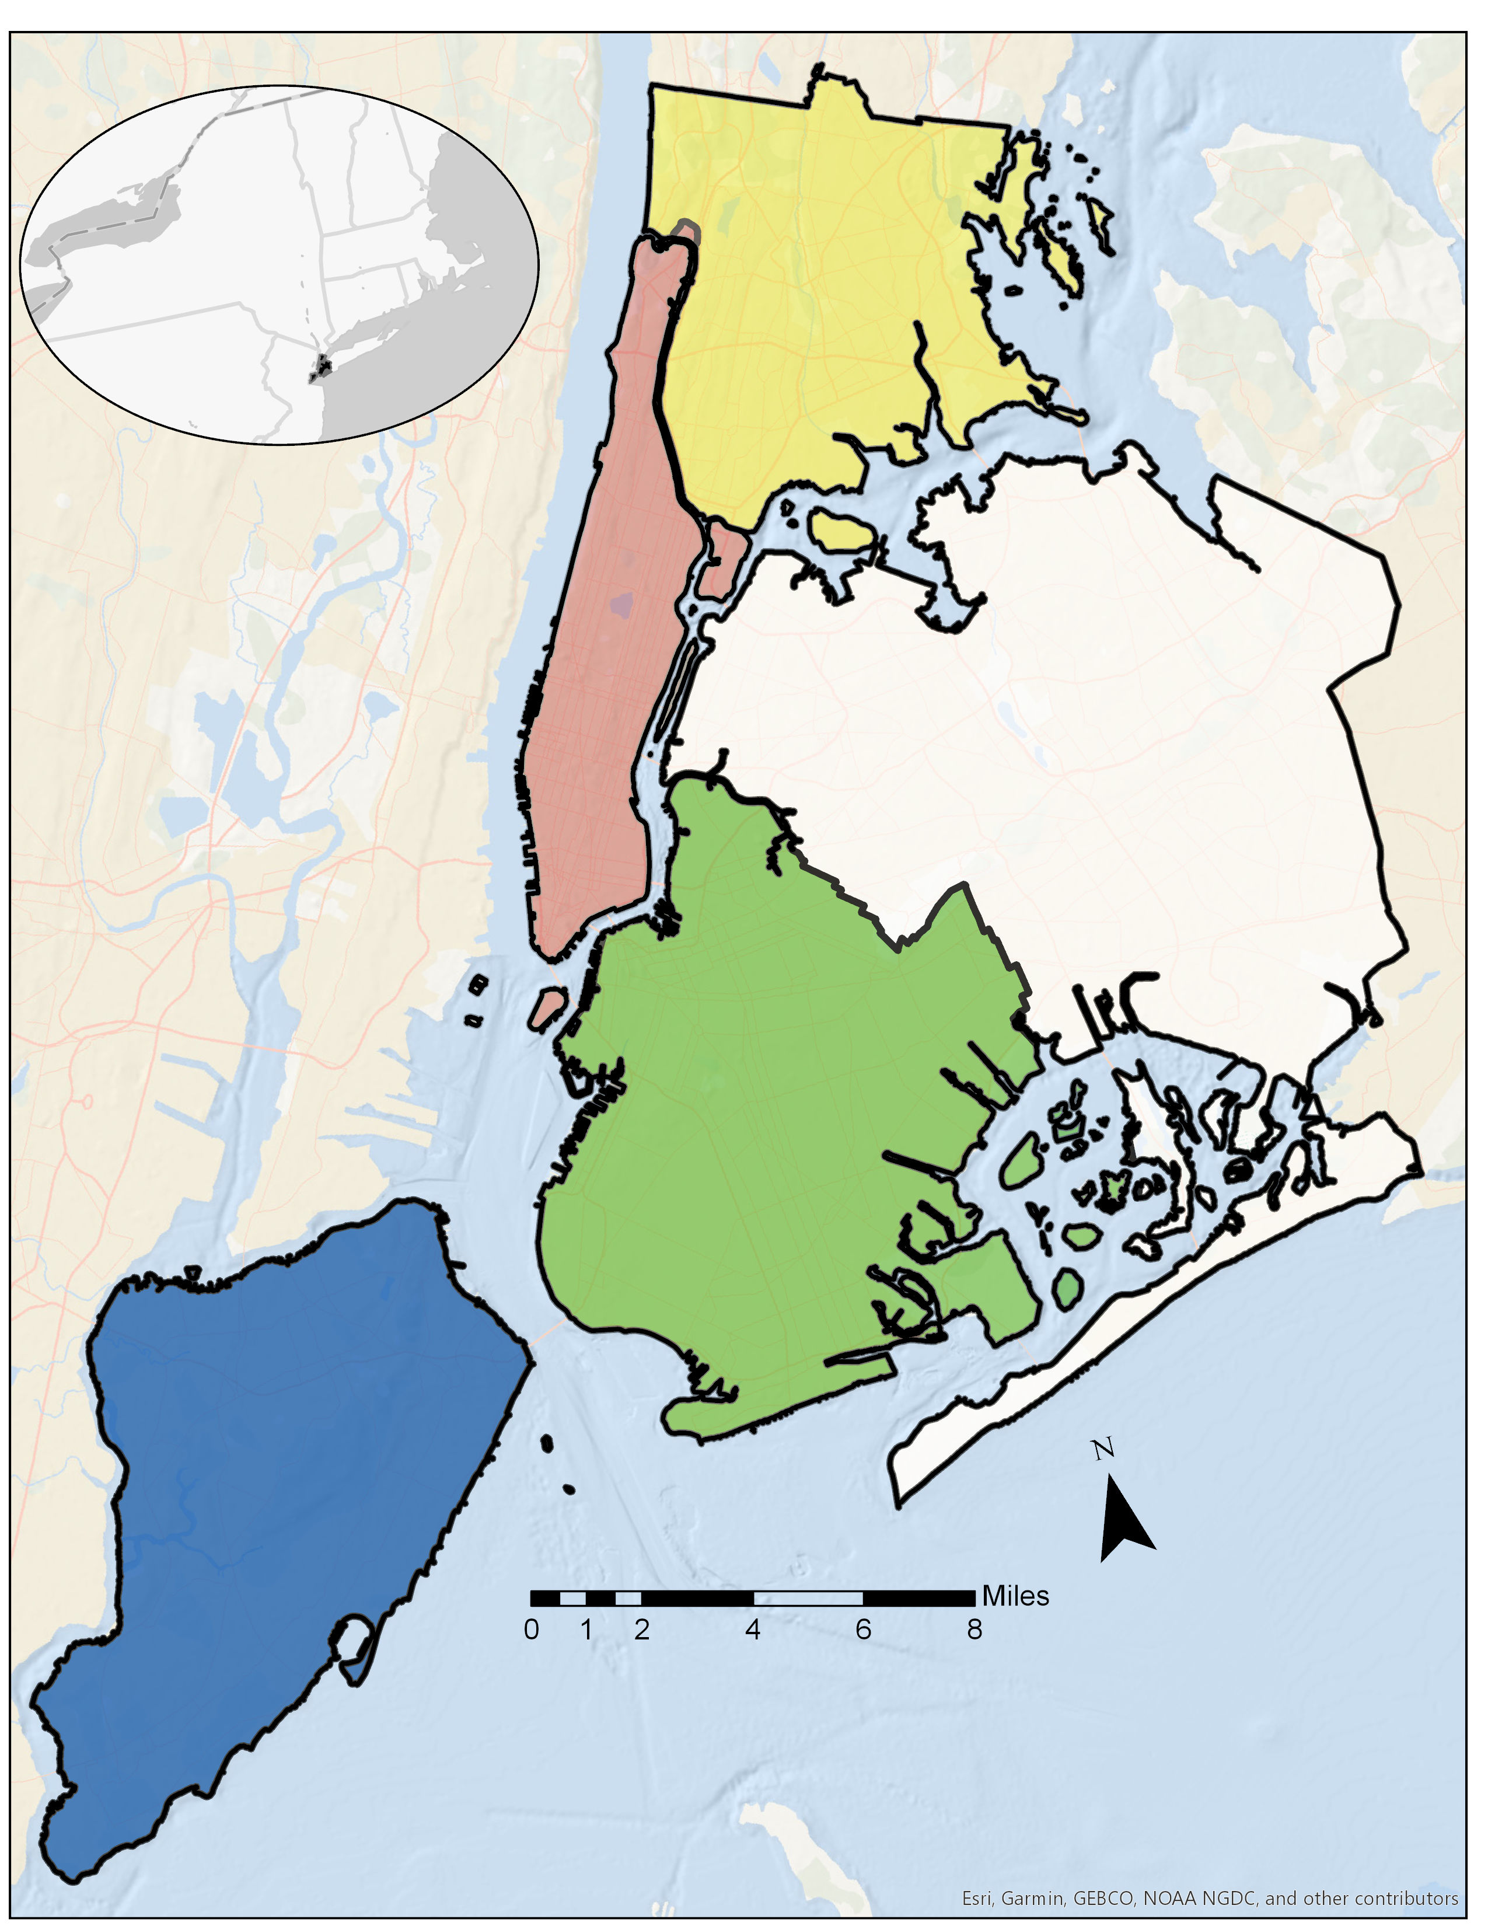
STUDY AREA New York City, New York, USA
Study period
Months: May-October
Years: 1990-2019
NYC Boroughs
Manhattan
The Bronx
Brooklyn
Queens
Staten Island
Notes:
Our study area is New York City, and our study period uses imagery from the months of May-October, between years 1990-2019.
We chose to use months May-October since these can be considered summer months when New York City experiences higher heat levels.
Luis: Our Study Area was the City of New York looking at summer months from 1990 to 2019 to analyze for thermal hotspot locations and land use/land change over time.

Slide 3
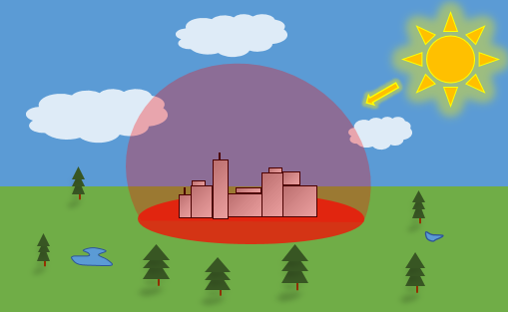
BACKGROUND
The urban heat island (UHI) effect
Thermal hotspots
Sun heats up city
Impervious surfaces retain heat
Urban areas experience higher temperatures than surrounding land
Vegetation, water, and soil dissipate heat
Notes:
The Urban Heat Island Effect occurs as heat is trapped in a city, making the urban area much hotter than surrounding areas. This effect can be caused by impervious surface material on buildings, roads, etc. absorbing heat, as well as transportation emissions, and more.
Hotspots are spots within the city that have excessive amounts of heat compared to the surrounding urban area.
Luis: How do Thermal Hotspots occur? They are a result of the larger Urban Heat Island effect wherein cities are much hotter than there surrounding rural or suburban areas. Which is caused by the many types of surface materials that absorb heat. Hotspots form within these cities, in areas with higher amounts of these impervious surfaces and experience relatively higher temperatures than other parts of the city.

Slide 4
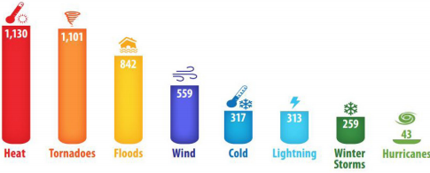
COMMUNITY CONCERN
COMMUNITY CONCERN
NYC is the most densely populated city in the United States
Every year, ~600 New Yorkers encounter heat-related illness with ~128 deaths
Nine million inhabitants in NYC by 2050
Estimated warming of +5.7^{૦}F by 2050
U.S. Fatalities by Weather Hazzard (2006-2015)
Source: NOAA National Weather Service, 2016.
The incidences of heat related illness are sure to rise.
Notes:
New York City is the most densely populated city in the United States. Every year there are 128 deaths due to high heat.
With nine million inhabitants projected to live in NYC by 2050 and an estimated warming of 5.7 degrees Fahrenheit, the incidence of heat related illness is sure to rise.
As you can see, the graph demonstrated on the right shows that heat related fatalities were higher than any other hazards between the years on 2006-2015.
https://www1.nyc.gov/assets/orr/pdf/Cool_Neighborhoods_NYC_Report_FINAL.pdf
Luis: Why is it important to identify these hotspots? Because, high temperatures can lead to heat related illnesses. Which over 600 New Yorkers encounter every year with an estimated 130 deaths. Likewise, these hotspots will only continue to become hotter as temperatures are estimated to rise by 5.7 degrees by 2050.

Slide 5
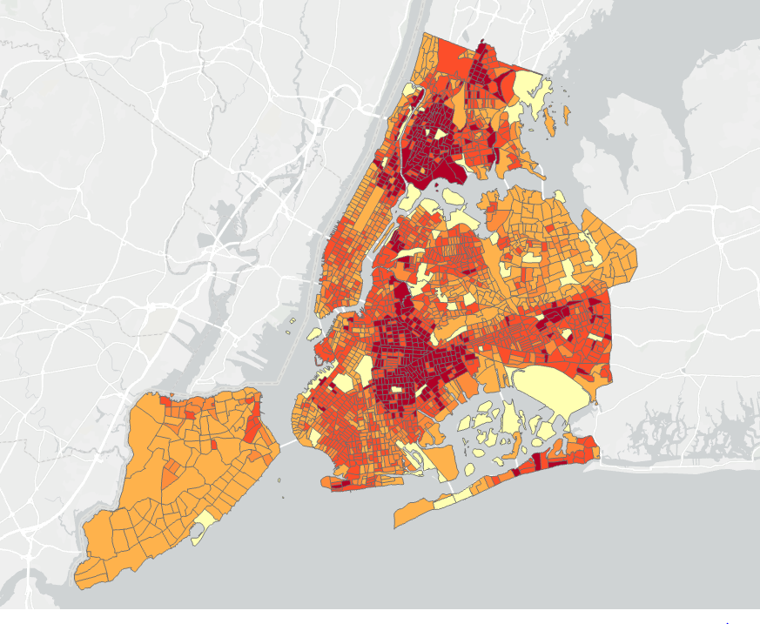
NYC HEAT VULNERABILTY INDEX (HVI)
Index created by Columbia University and NYC Department of Health
Measures relative vulnerability of neighborhood to heat related health risks
Environmental factors
Social factors
NYC HVI Index
High
Low
Notes:
This is the Heat Vulnerability Index created by Columbia University and the New York City Department of Health – measuring vulnerability of communities most at risk for heat related illness, this can be based off of environmental factors, which includes, daytime summer surface temperature and green space, such as tree, shrub and grass cover. The HVI also accounts for social factors which includes, poverty, race, and age.
Luis: Columbia University and the NYC Department of Health have taken steps towards identifying at risk communities in the city. They have created a Heat Vulnerability Index map for the city that takes into account environmental and social factors to identify neighborhoods most at risk for heat related illnesses. With this Heat Vulnerability Index we will be able to compare it to land surface temperature maps that identify thermal hotspots to verify which communities are most in need of green initiatives.

Slide 6
PROJECT OBJECTIVES
Analyze temporal and spatial changes in NYC urban hotspots
Examine the correlation of land-use change and major transportation corridors to hotspot locations
Compare Hotspots in NYC to the Heat Vulnerability Index to identify vulnerable communities
Generate a geodatabase of hotspot and land-use changes
Create a script for an ArcGIS model to produce updated layers for future datasets
Develop an ArcGIS StoryMap to convey findings to end users
Notes:
Luis: The objectives for this project where to visualize and map thermal hotspots in the city of New York as well as examine correlations between transportation corridors and land use change over time with the hotspots. Along, with creating an ArcGIS Model to be used by the Mayor’s Office of Resiliency to create future hotspot maps with new data.

Slide 7
SATELLITES & SENSORS
Landsat 7
ETM
Landsat 8
OLI
TIRS
Landsat 4/5
TM
Notes:
The imagery utilized within our project was from Landsat satellites, including that of Landsat 8 with Operational Land Imagery and Thermal Infrared Sensors, Landsat 7 with Enhanced Thematic Mapper Plus sensor, and Landsat 4&5 with the thematic mapper sensor.
NOTE: For every image on the slide include an image source in the speaker notes (ex. URL; Name, Affiliation, etc.). ALL images need to be created by a DEVELOPer, in the public domain (federal agency), or published under a creative commons license (if attributed correctly). See an example citation below:
------------------------------Image Information Below ------------------------------
•Image Credit: Claude Monet
•Image Source: http://commons.wikimedia.org/wiki/File:Claude_Monet_-_The_Magpie_-_Google_Art_Project.jpg (insert here whether this image is provided by a DEVELOPer/partner, public domain, or the type of creative commons license the image was published under – e.g. CC BY-SA)

Slide 8
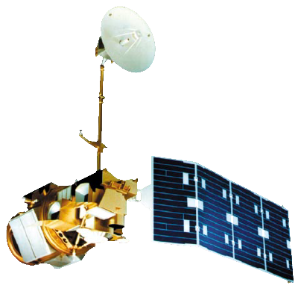
USGS PRODUCT
Landsat 4/5
Landsat 7
Landsat 8
1982
Landsat 4 launches
1984
Landsat 5 launches
1999
Landsat 7 launches
2013
Landsat 8 launches
1983
Beginning USGS provisional land-surface temperature product
1990
Study period begins
Notes:
Our project used provisional land surface temperature data collected by the USGS available through Earth Explorer, which contains Landsat data starting from years 1983 to today.
Our project used imagery starting from 1990 going until 2019. Additionally, we were only concerned with images taken during the warmer months (May-October) as this would be the time of the year hotspots would most impact human health.

Slide 9
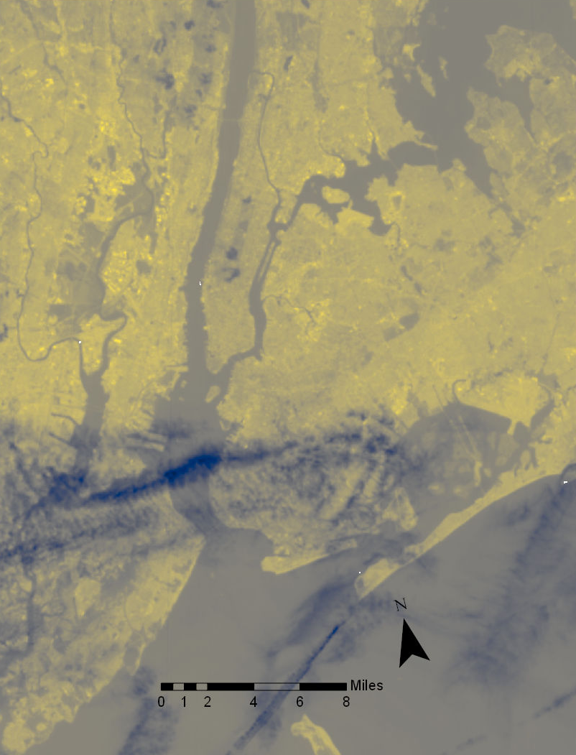
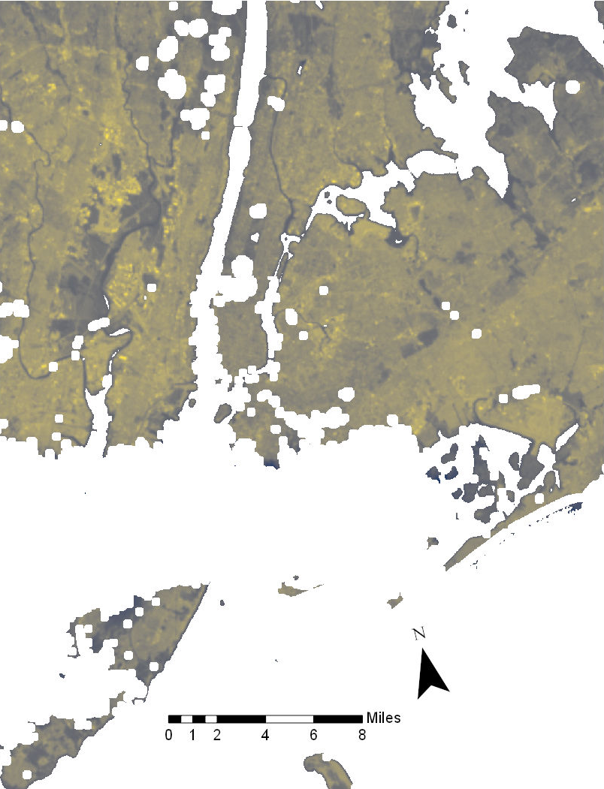
DATA PROCESSING
Before Masking
After Masking
Using R-Studio, create code to:
Crop images
Cloud mask images
Water mask images
Notes:
Using R-Studio scripting, we were able to crop the Landsat images to our study area shapefile.
Then, using R-Studio again, we can “take out” clouds and water, that was disrupting our data so we can retrieve more accurate results.

Slide 10
ArcGIS Model Overview
File of Processed Landsat Images
Clip to Study Area
&
°F Conversion
Calculate Mean Temperature of Image
Processed Rasters
Raster Iterator
Calculate Average Distance From Mean over study period
Calculate Distance From Mean Temperature
Raster of Avg. Difference from Mean Surface Temperature
Notes:
This is an overview of the ArcPro Model Builder workflow we created. This model takes cloud masked USGS provisional Temperature product images and outputs “difference from the mean” land surface temperature (LST) raster Images. LST is the temperature you would feel if you placed your hand on the ground surface. We choose to use a “difference from the mean” analysis because LST raster maps alone can be confusing due to the very high LST readings vs. ambient air temperature. The outputs from this model are either positive or negative values corresponding to above or below mean LST.

Slide 11
DATA PROCESSING – Model Workflow
Batch Raster Setup
Raster Iteration
Clipping to Extent
Temperature Conversion
Load Processed Landsat Data
Raster Iteration
Clip to Study Extent & Convert to ˚F
Notes:
The first step in the model is to load masked USGS LST raster’s. The model then clips the rasters to the NYC study extent and converts the values from Kelvin to Fahrenheit. This step also sets up the raster iterator, which will run all of the inputted raster through the model in sequence.

Slide 12
RASTER CALCULATIONS – Distance from Mean
2. Raster Math
Masking
Zonal Statistics
Mean Subtraction
Clipped & Converted Raster
Calculate Each Image Raster Mean
Subtract Mean From Original Raster
Distance From Mean Raster
Iteration
Notes:
This second portion of the model is primarily raster math. The overall mean of each raster is calculated, this is not the pixel by pixel raster mean! This is one number for the whole raster. This mean is then subtracted from the raster it was calculated from creating a difference from mean image. The model then goes back to the very beginning and repeats the process with the next raster in sequence. Hypothetically you can load as many images as desired.

Slide 13
DATA CALCULATION – Average over Years Intervals
3. Create 5 year Bins
Simple cell stats for raster mean
Daily Difference from Mean Temperature Images
2000
2001
Average Temperature Difference Raster Image (2000-2004)
2002
2003
2004
Notes:
The last step is to sum all of the individual “difference from mean” rasters to get an average difference from mean raster. This raster will be binned by whatever year images are initially inputted into the model. We choose 4-5 year bins to ensure a robust ~30+ images batch for each bin.

Slide 14
SURFACE VS. AIR TEMPERATURE
Positive correlation between measured land surface temperature (LST) and ambient air temperature
Overall Regression (R²=0.51)
Ambient Air Temperature Stations
Staten Island (n=26)
Brooklyn W (n=31)
Brooklyn S (n=20)
East Village (n=20)
LaGuardia (n=45)
JFK (n=32)
Notes:
Landsat imagery captures land surface temperature values (LST) and it was these temperatures that we conducted the all of our analyses on. However, land surface temperatures can be different from the air temperatures that we actually feel. Anybody who has walked outside on a hot summer day will now that the concrete touching your feet typically much hotter than the air above it.
So in order to understand the relationship between actual air temperature to our LSTs we gathered air temperature data from 6 different weather stations throughout our study area and matched recorded air temperatures at the times Landsat was passing over. We matched these values with the LST values and as you can see from the graph they have a pretty strong positive correlation; higher land surface temperatures correlate to high ambient air temperatures.

Slide 15
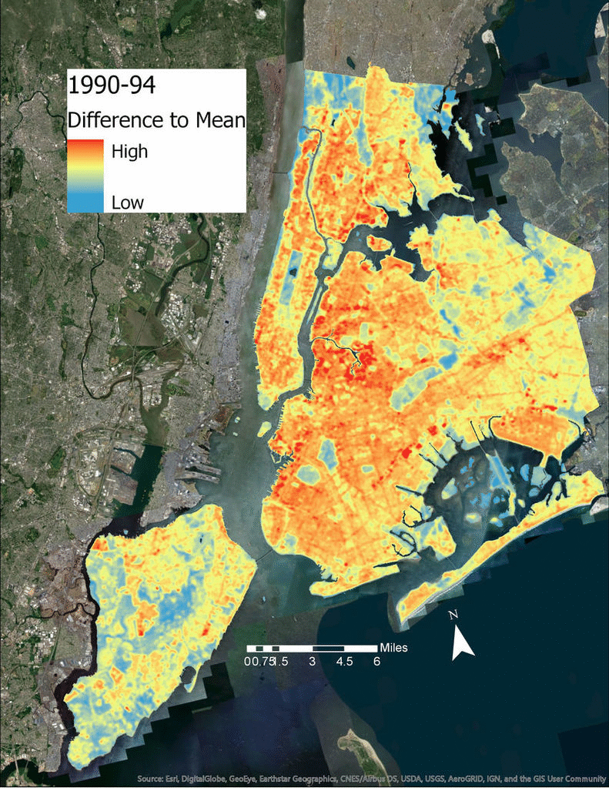
HOTSPOT LOCATIONS OVER TIME
Warmer
1990-1994
2000 - 2004
Colder
2015 - 2019
Cooler
Warmer
Cooler
Warmer
Land Surface Temperature Hotspot locations from 1990-2019
Average mean has increased throughout time
Because of increased mean LSTs over time, hotspots appeare reduced
Cooler
Warmer
Notes:
Example images from the start (1990-1995), middle (2000-2004), and end (2015-2019) of period of study.
This series of images are the final LST “difference from mean” hotspot maps. Although it appears the city is getting cooler this is not actually the case, the overall mean is increasing giving the appearance of cooling.

Slide 16
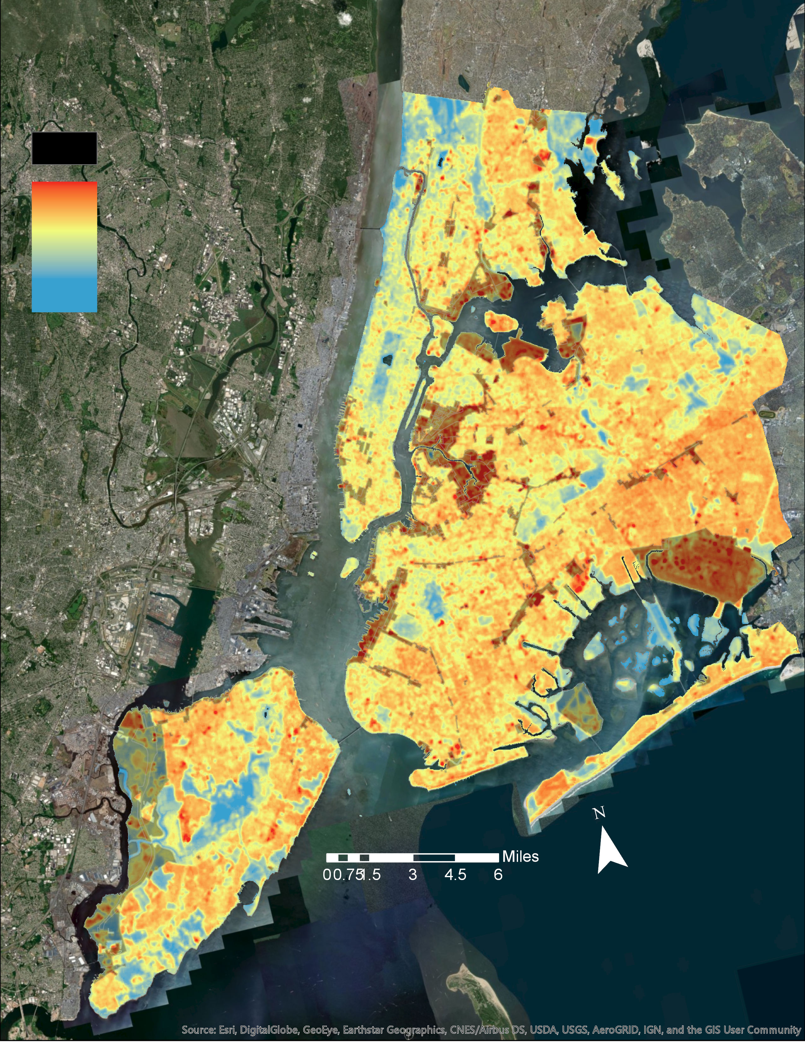
NYC ZONING CLASSIFICATION VS. LST
New York City Major Zoning Classes:
-Parks
-Manufacturing
-Residential
-Commercial
Distance to Mean LST 2015-2019
Zoned for Manufacturing
High
Low
Notes:
The “difference from mean” LST hotspot maps were also analyzed in conjunction with NYC zoning data. The majority of hotspots were found in areas zoned for manufacturing. The plot on this slide illustrates this. Also, the plot on this slide is city wide, the manufacturing zoning LST is actually being deflated by undeveloped land on Staten Island zoned for manufacturing. For most locations zoning subcategories were less important than major zoning categories. For example, an area zoned as high intensity manufacturing was not necessarily warmer than one zoned for low intensity manufacturing. This is because the intensity designation by the city is more a measure of the type of manufacturing happening and not a direct relation to impervious surface which largely control LST.

Slide 17
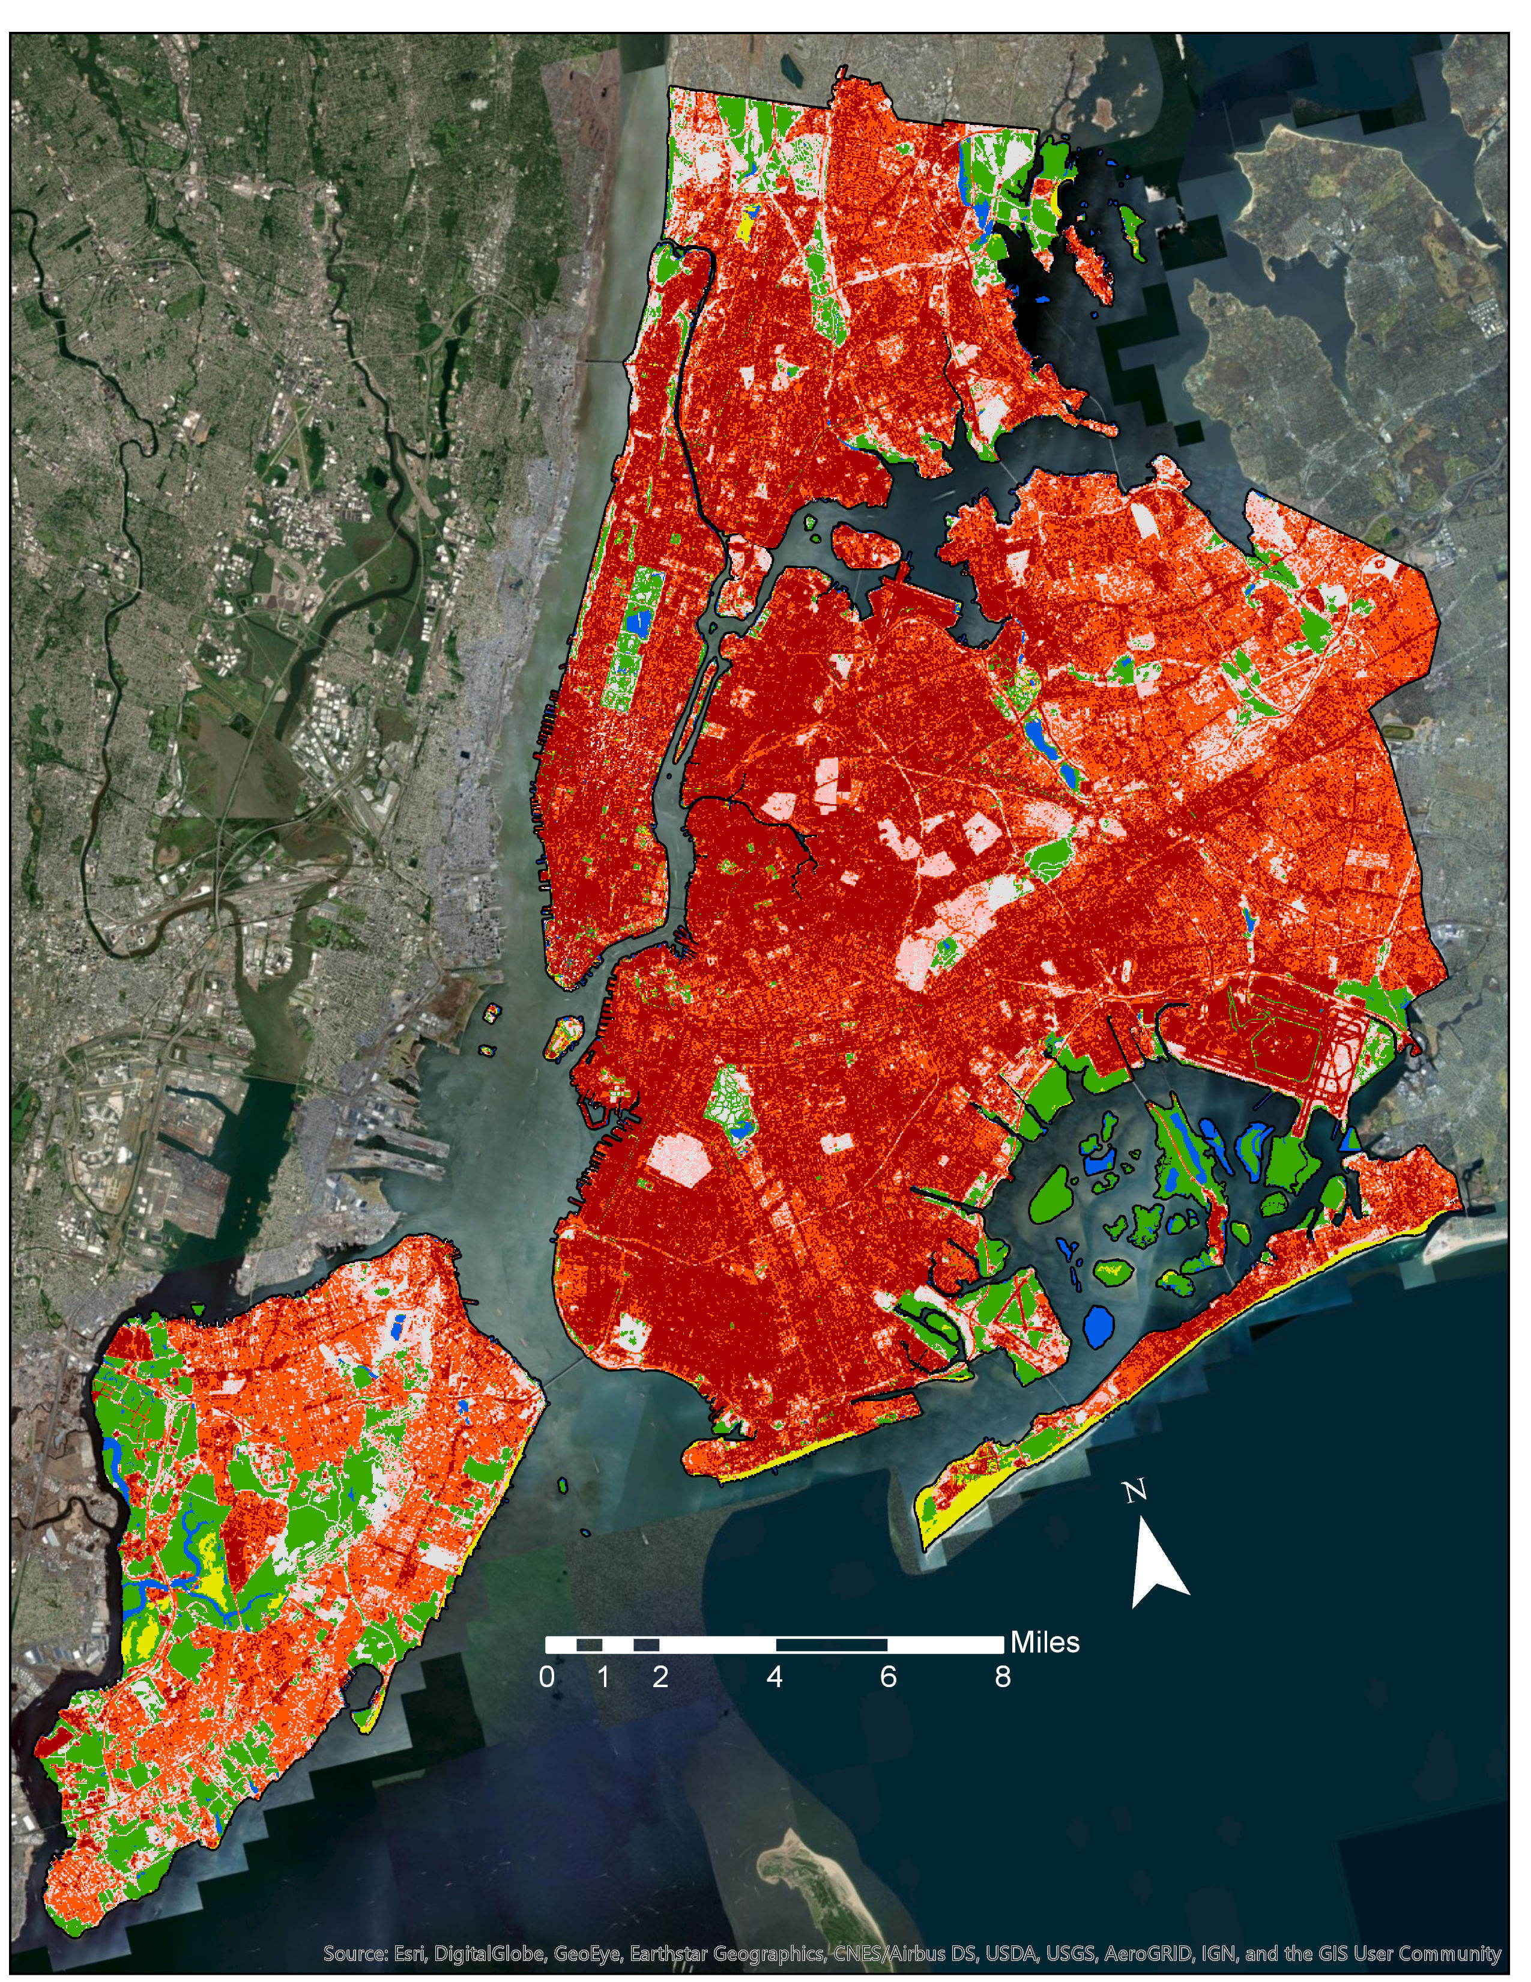
LAND COVER AND TEMPERATURE
Land Cover Classifications
High Intensity Developed
Medium Intensity Developed
Low Intensity Developed
Open Developed Space
Vegetation
Bare Land
Water
National Land Cover / Land Classifications: 1996, 2001, 2006, 2011, 2016
Used model outputs to find average LST differences for each land cover class
NLCD Year | Land Surface Temperature Years
1996 | 1995-1999
2001 | 2000-2004
2006 | 2005-2009
2011 | 2010-2014
2016 | 2015-2019
Notes:
One of the major interests of this project was examining the influence and relationship of land cover to LST. Land cover datasets were take from the National Land Cover Database for 5 years throughout our study period. From these data sets we clipped images to our study area as well as merged all vegetation subcategory classifications into a single vegetation classification.
NLCD data was then paired with the corresponding LST years that it fell into (see table) and the average temperature differences between land cover classes were found for each year as well as the over all average LSTs for each land class across the entire study period.

Slide 18
AVERAGE LAND SURFACE TEMPERATURE (ºF) DIFFERENCE (1996-2019)
Land Cover Classifications
High Intensity Developed
Medium Intensity Developed
Low Intensity Developed
Open Developed Space
Vegetation
Bare Land
Water
Notes:
This Figure is a 95% confidence interval plot that shows the average difference from the mean LST for each of our land cover classes. Notice how the two most intensely developed classes (those with the greatest amount of impervious surfaces) have the hottest temperature differences.
Contrastingly, land cover classes such as water and vegetation contain the coolest temperature differences.

Slide 19
Influence of Land Cover Change on LST
Found land cover changes between years
Calculated average temperature differences between changed land classes
- Vegetation to Developed (20-100% impervious surface cover)
- Developed open space (< 20%) to High Developed (80-100% impervious surface cover)
Notes:
An additional interest of our project was to look at and compare the resulting LST change in areas were land cover type changed.
We were interested in two main land cover changes 1) land that changed from primarily vegetation to some sort of developed land (20-100% impervious surface cover) and 2) land that increased in developed intensity (< 20% to 80-100% impervious surface cover).
Overall, land that used to be primarily vegetation saw a significant average of about 5 degrees F after being converted to more developed type of land cover.
Similarly as land was converted to more intensely developed categories saw a corresponding increase of almost 2F.
Overall, this information shows that changes in land cover do relate to a change in corresponding temperature.

Slide 20
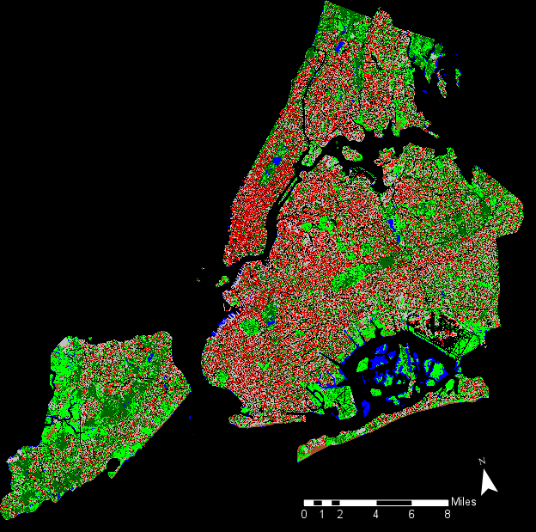
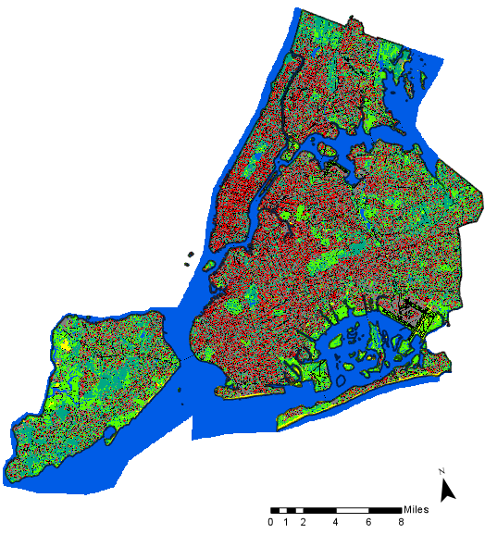
Land Cover – LiDAR 2010 and 2017
2010
2017
Utilized 2010 & 2017 NYC LiDAR to calculate percent cover of land classes
Coarsen 6” to 30 m x 30 m spatial resolution
Compare land cover types to LST data from years 2010-2014 and 2015-2019
Tree Canopy
Grass/Shrubs
Bare Soil
Water
Buildings
Roads
Other surfaces
Tree Canopy
Grass/Shrubs
Bare Soil
Water
Buildings
Roads
Other Impervious
Railroads
Notes:
Utilized 2017 NYC LiDAR (6” spatial resolution) to calculate percent cover of land classes. Coarsen 6” to 30 m.
Match up to Landsat raster and compare percent vegetation and percent impervious surface to land surface temperatures (2015-2019)

Slide 21
LiDAR RESULTS
Land Cover Classification | LiDAR 2010 (regression coeff., R²) | LiDAR 2017 (regression coeff, R²)
% Tree Canopy | -0.09, 0.17 | -0.08, 0.18
% Grass/Shrubs | -0.07, 0.01 | -0.05, 0.08
% Buildings | 0.06, 0.10 | 0.06, 0.09
% Roads | 0.10, 0.09 | 0.05, 0.05
% Water | -0.16, 0.08 | -0.16, 0.10
% Soil | 0.01, < 0.01 | -0.03, < 0.01
% Other Surfaces | 0.16, 0.31 | 0.09, < 0.01
Grouped Classifications
% Vegetation | -0.08, 0.29 | -0.07, 0.29
% Impervious Surfaces | 0.12, 0.52 | 0.08, 0.39
Combined vegetation and impervious surface classes:
Vegetation Group: Tree Canopy + Grass
Impervious Cover Group: Buildings + Roads + Other impervious surfaces
% Vegetation = negative correlation
% Impervious Surfaces = positive correlation
Notes:
.
Tree canopy and building were the greatest single predictors.
BUT combining individual classes in to similar classes (vegetation and impervious surfaces) yielded much higher correlation values.
As you might expect, impervious surfaces had a positive correlation to land surface temperature while vegetation had a negative correlation.

Slide 22
LiDAR 2010 & 2017 RESULTS
2010
1% increase in vegetation cover
= decreased temperature ~0.08°F
1% increase in impervious cover
= increased temperature ~0.12°F
2017
1% increase in vegetation cover
= decreased temperature ~0.07°F
1% increase in impervious cover
= increased temperature ~0.08°F
Notes:
We rand linear regression analysis between both LST and % vegetation cover and LST vs. % impervious surface cover.
Linear regression analysis showed that for 2010 every 1.0% increase in vegetation cover, difference from mean surface temperature decreases 0.08°F and for every 1.0% increase in impervious cover, difference from mean surface temperature increases about 0.12°F.
For 2017, every 1.0% increase in vegetation cover, difference from mean surface temperature decreases 0.07°F and a 1.0% increase in impervious cover, difference from mean surface temperature increases about 0.08°F.

Slide 23
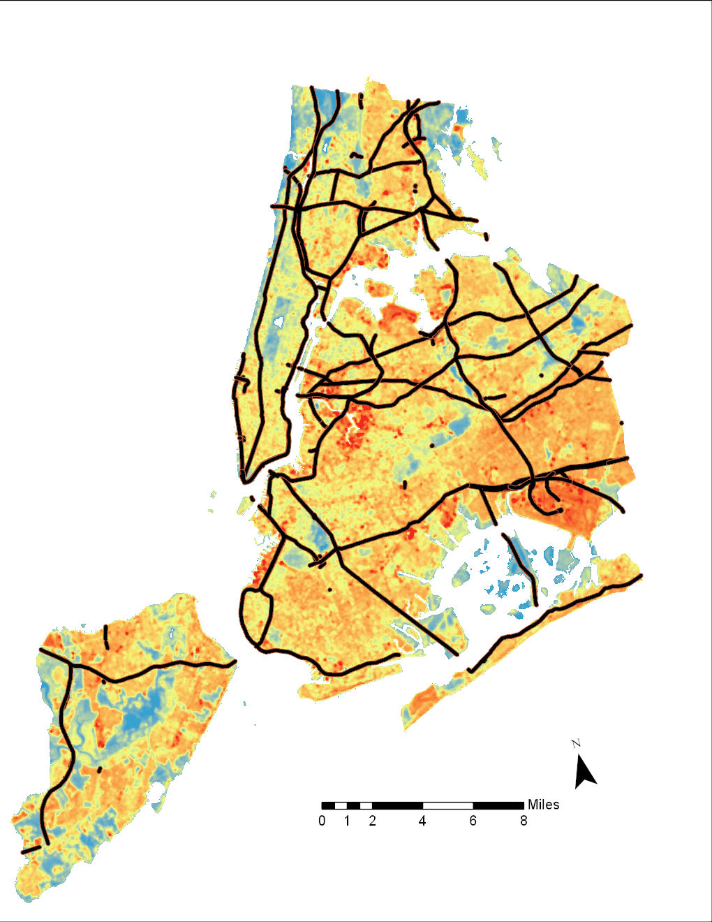
LST and Transportation Corridors
Major Roads in New York City
Correlation between LST and distance from roads is low (R² = 0.02)
Low correlation likely due to resolution of the data and variety of road types
Regression does show significance but this is likely due to large sample size (n=855,697)
Major Roads
Notes:
We also ran regression analysis to compare Land surface temperature values to the Euclidian distance from major roads and transportation corridors.
Regression results showed a significant relations ship, but if you look at the actual correlation value, it’s exceedingly low.
Part of the reason we may not have been able to tease out any major differences is that the resolution of our LST data is 30m which maybe too large to pick up temperature differences caused by the skinnier roads.
Additionally, NYC is literally covered in roads and the great variation between them (i.e. Parkways or avenues lined with trees) is likely further confounding our results.

Slide 24
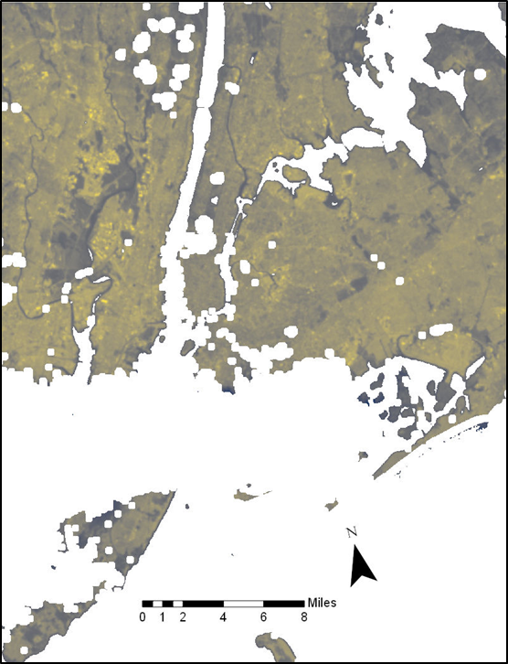
ERRORS & UNCERTAINTIES
Did not have uniform amounts of data points throughout various years
Cloud masking buffer
NLCD spatial resolution
Newness of provisional surface temperature data
2019 Landsat 8 dataset in Model Builder
Notes:
The number of USGS Provisional Temperature images increases though the years. For example we have around 30 images for the fist bin and 60+ for the last few bins.
The cloud making range factor cannot be accurately estimated for all images due to different cloud types on different days. Some images my include slightly colder cloud shadows and some may cut out more data than is necessary.
The exact contents of the NLCD data is not know, this present uncertainty when preforming statistics with this data.
There could be uncertainties in the emissivity calculations the USGS used.
We had issues getting the 2019 Landsat 8 data to run in our model, however this is a small amount of data. We still have Landsat 7 data from 2019 and 50+ images total for the 2015-19 bin.

Slide 25
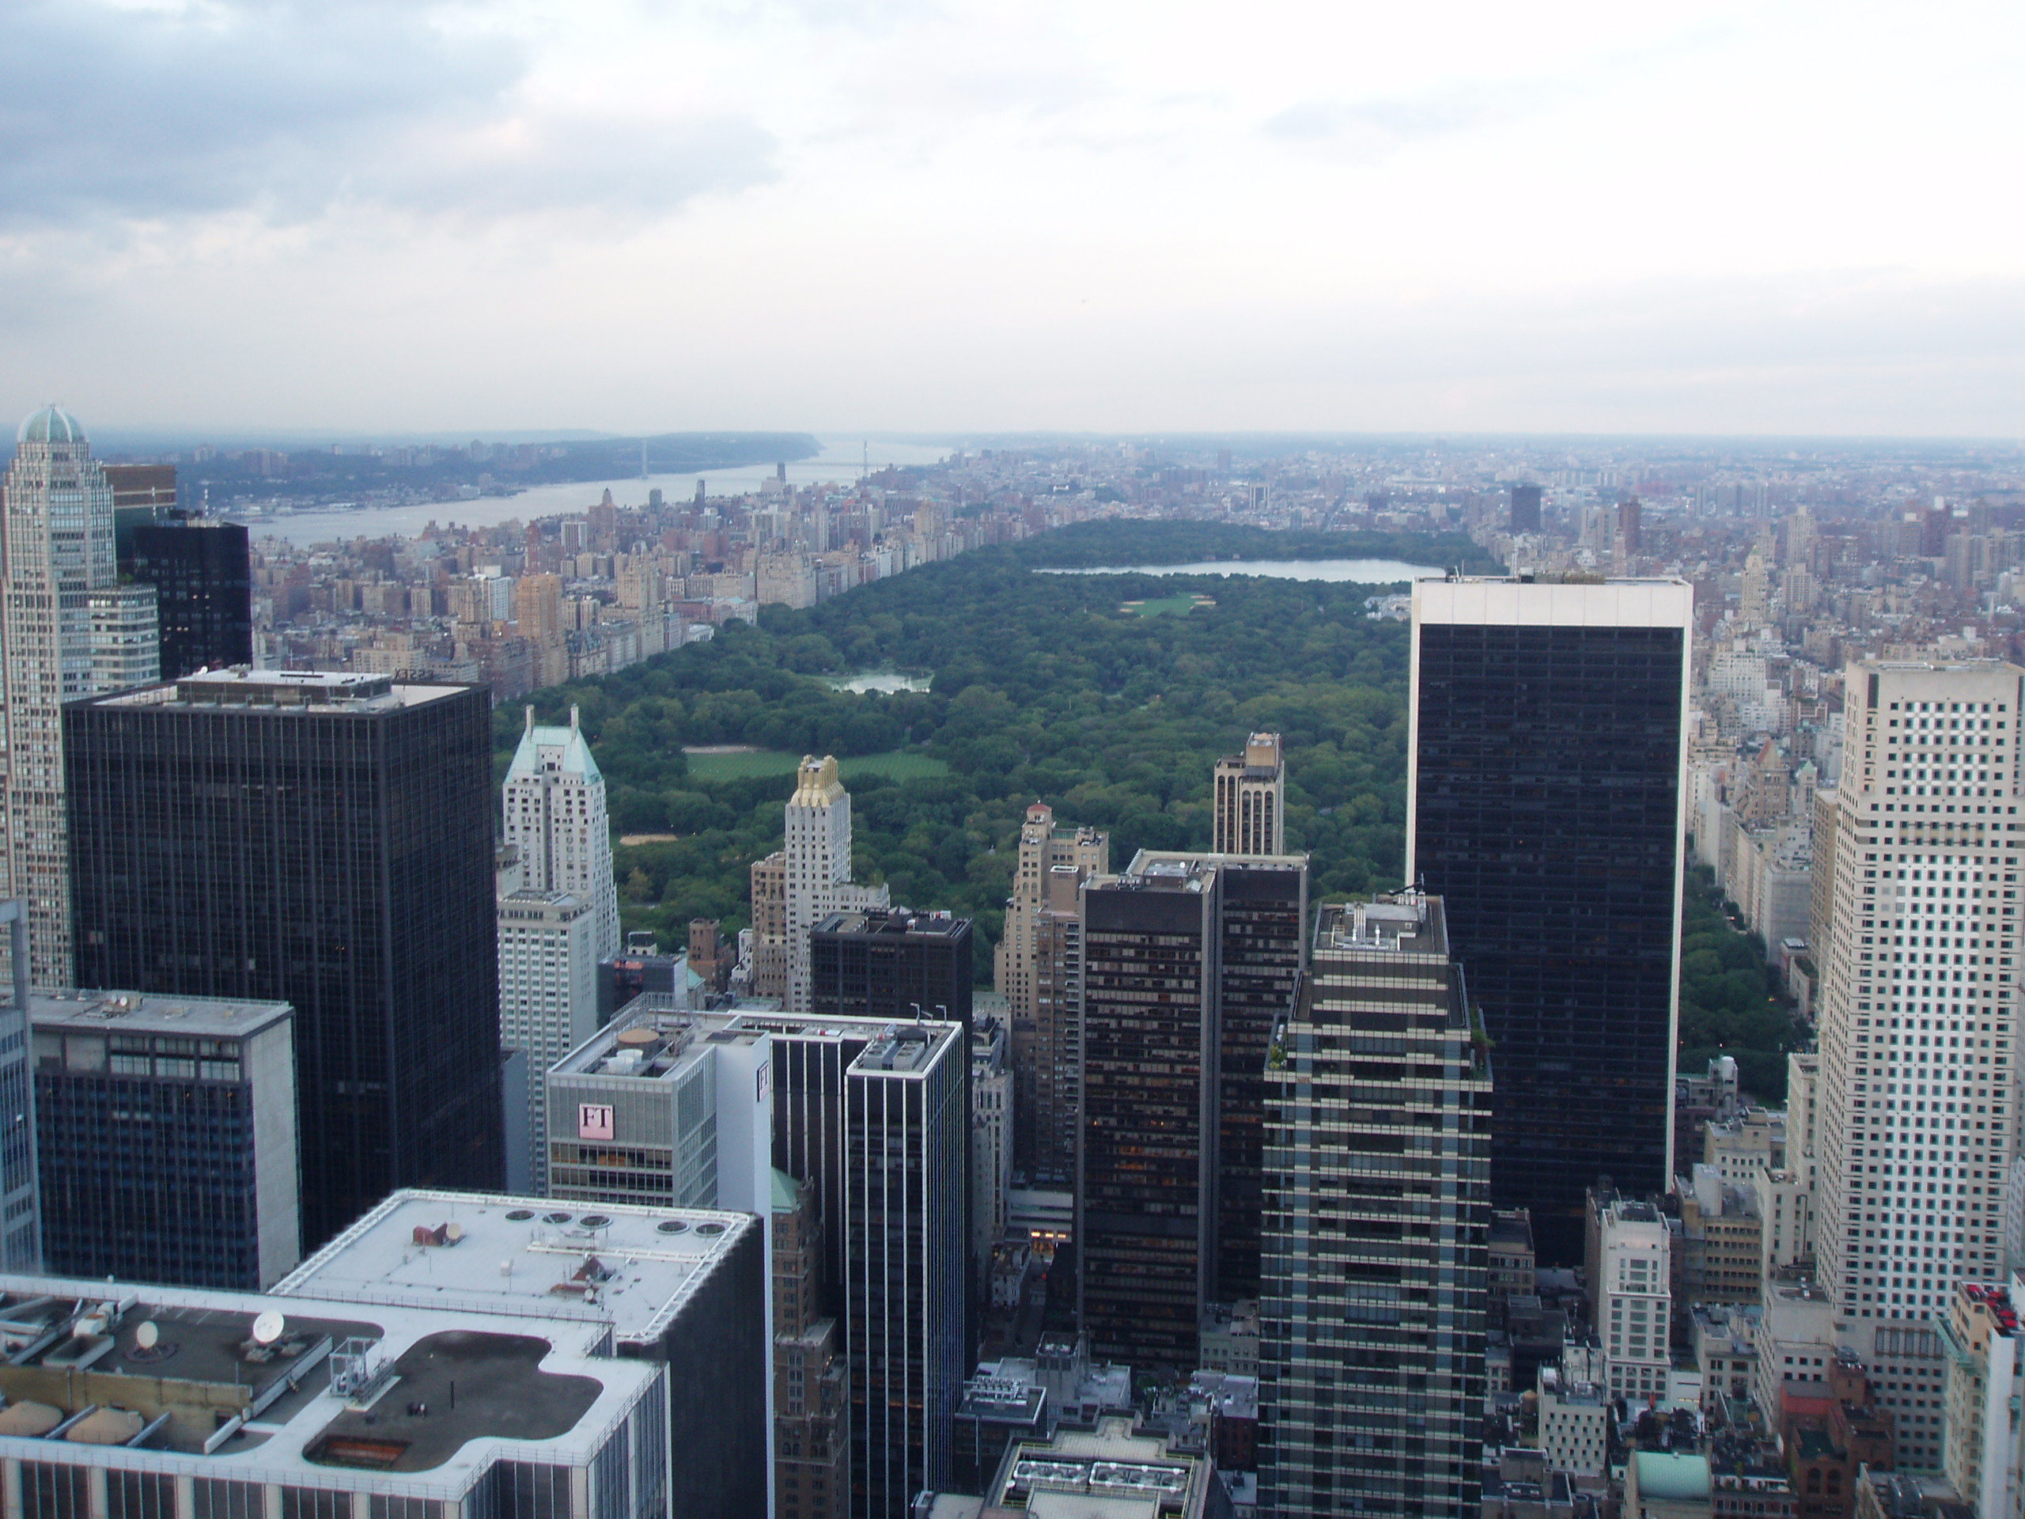
FUTURE USES
Methodology applicable to future urban heat studies
Arc Model can be used to track future hotspot changes with new Landsat data
Source: Piotr Kruczek
Notes:
https://commons.wikimedia.org/wiki/Central_Park#/media/File:Central_Park-from_Rock_Center2.jpg
The same methodology can be used for future studies with different cities or urban centers.
The Model can be used to process new Landsat data uploaded from USGS.

Slide 26
Dr. Kenton Ross: NASA Langley Research Center (Science Advisor)
Sydney Neugebauer: NASA Langley Research Center (DEVELOP Fellow)
Partners and Contributors:
New York City Mayor’s Office of Resiliency
Daphne Lundi, Kizzy Guzman
New York City Department of Health and Mental Hygiene
Sarah Johnson
Goddard Institute of Space Studies
Dr. Christian Braneon

