Slide 1
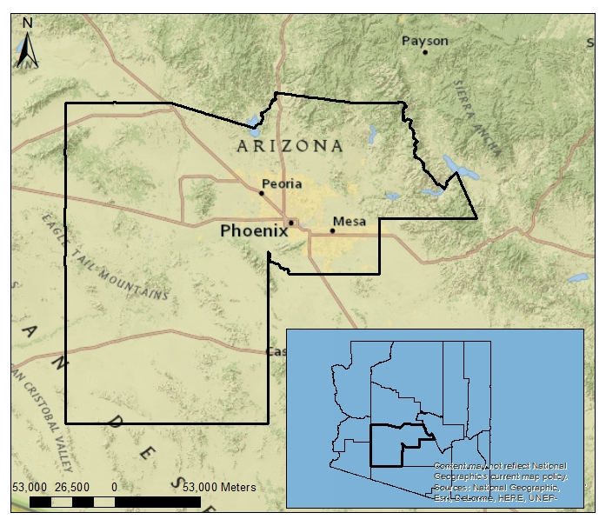
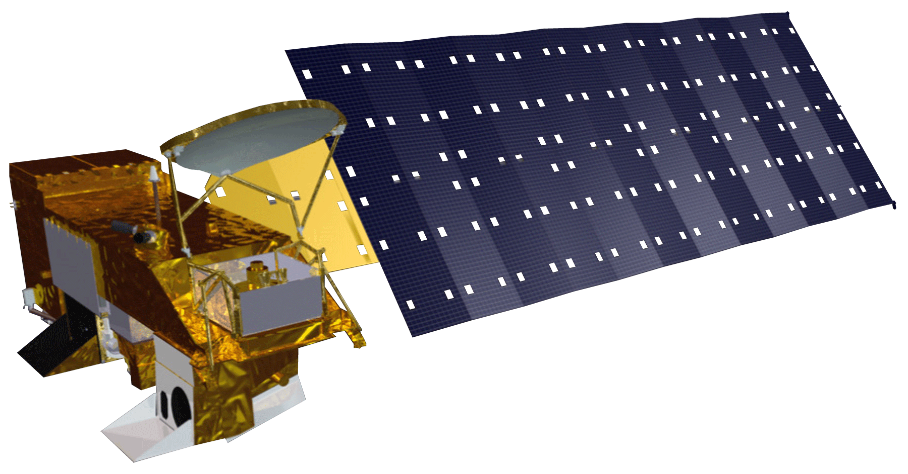
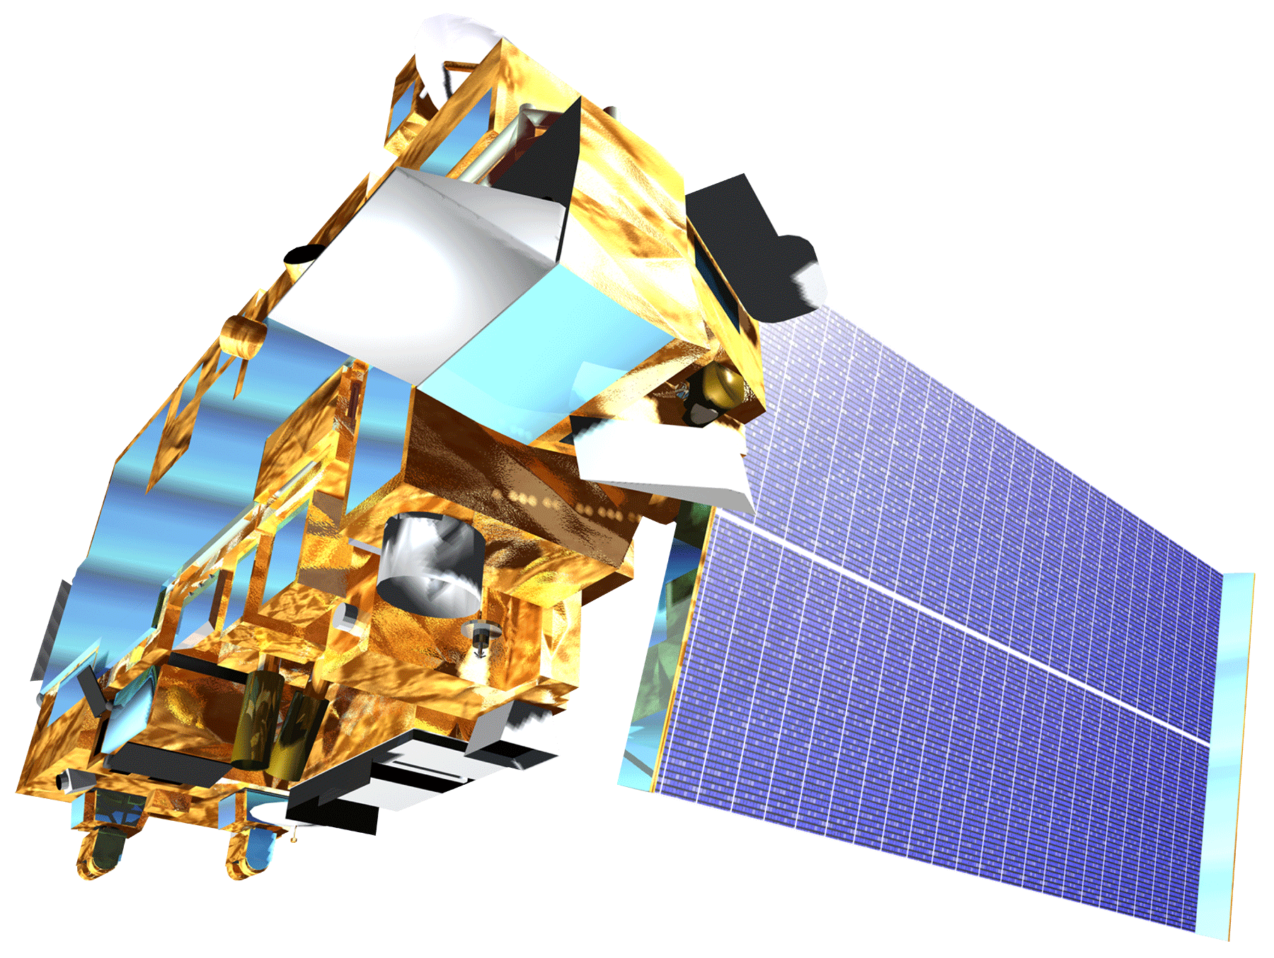
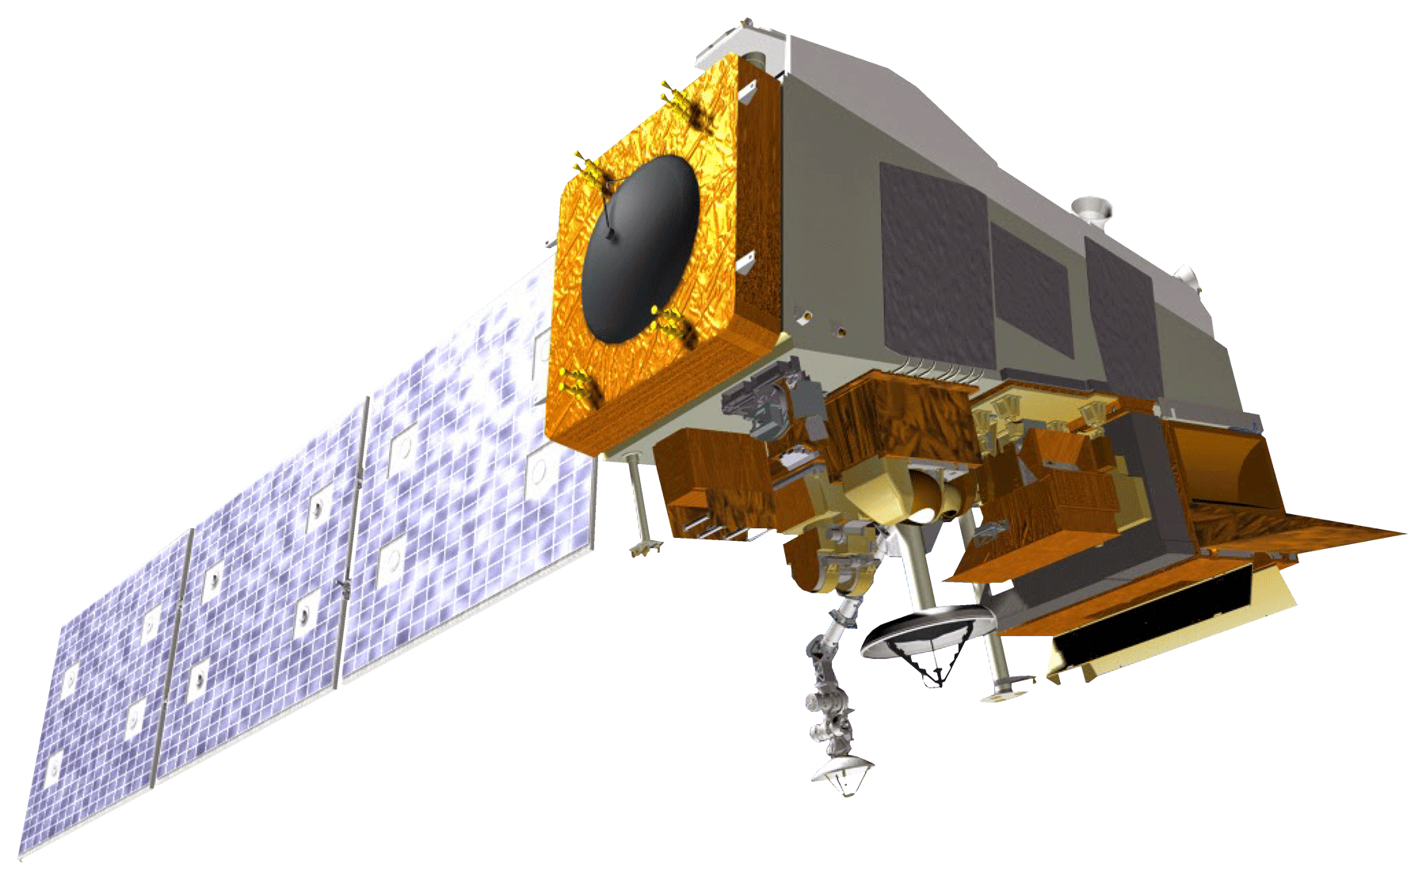
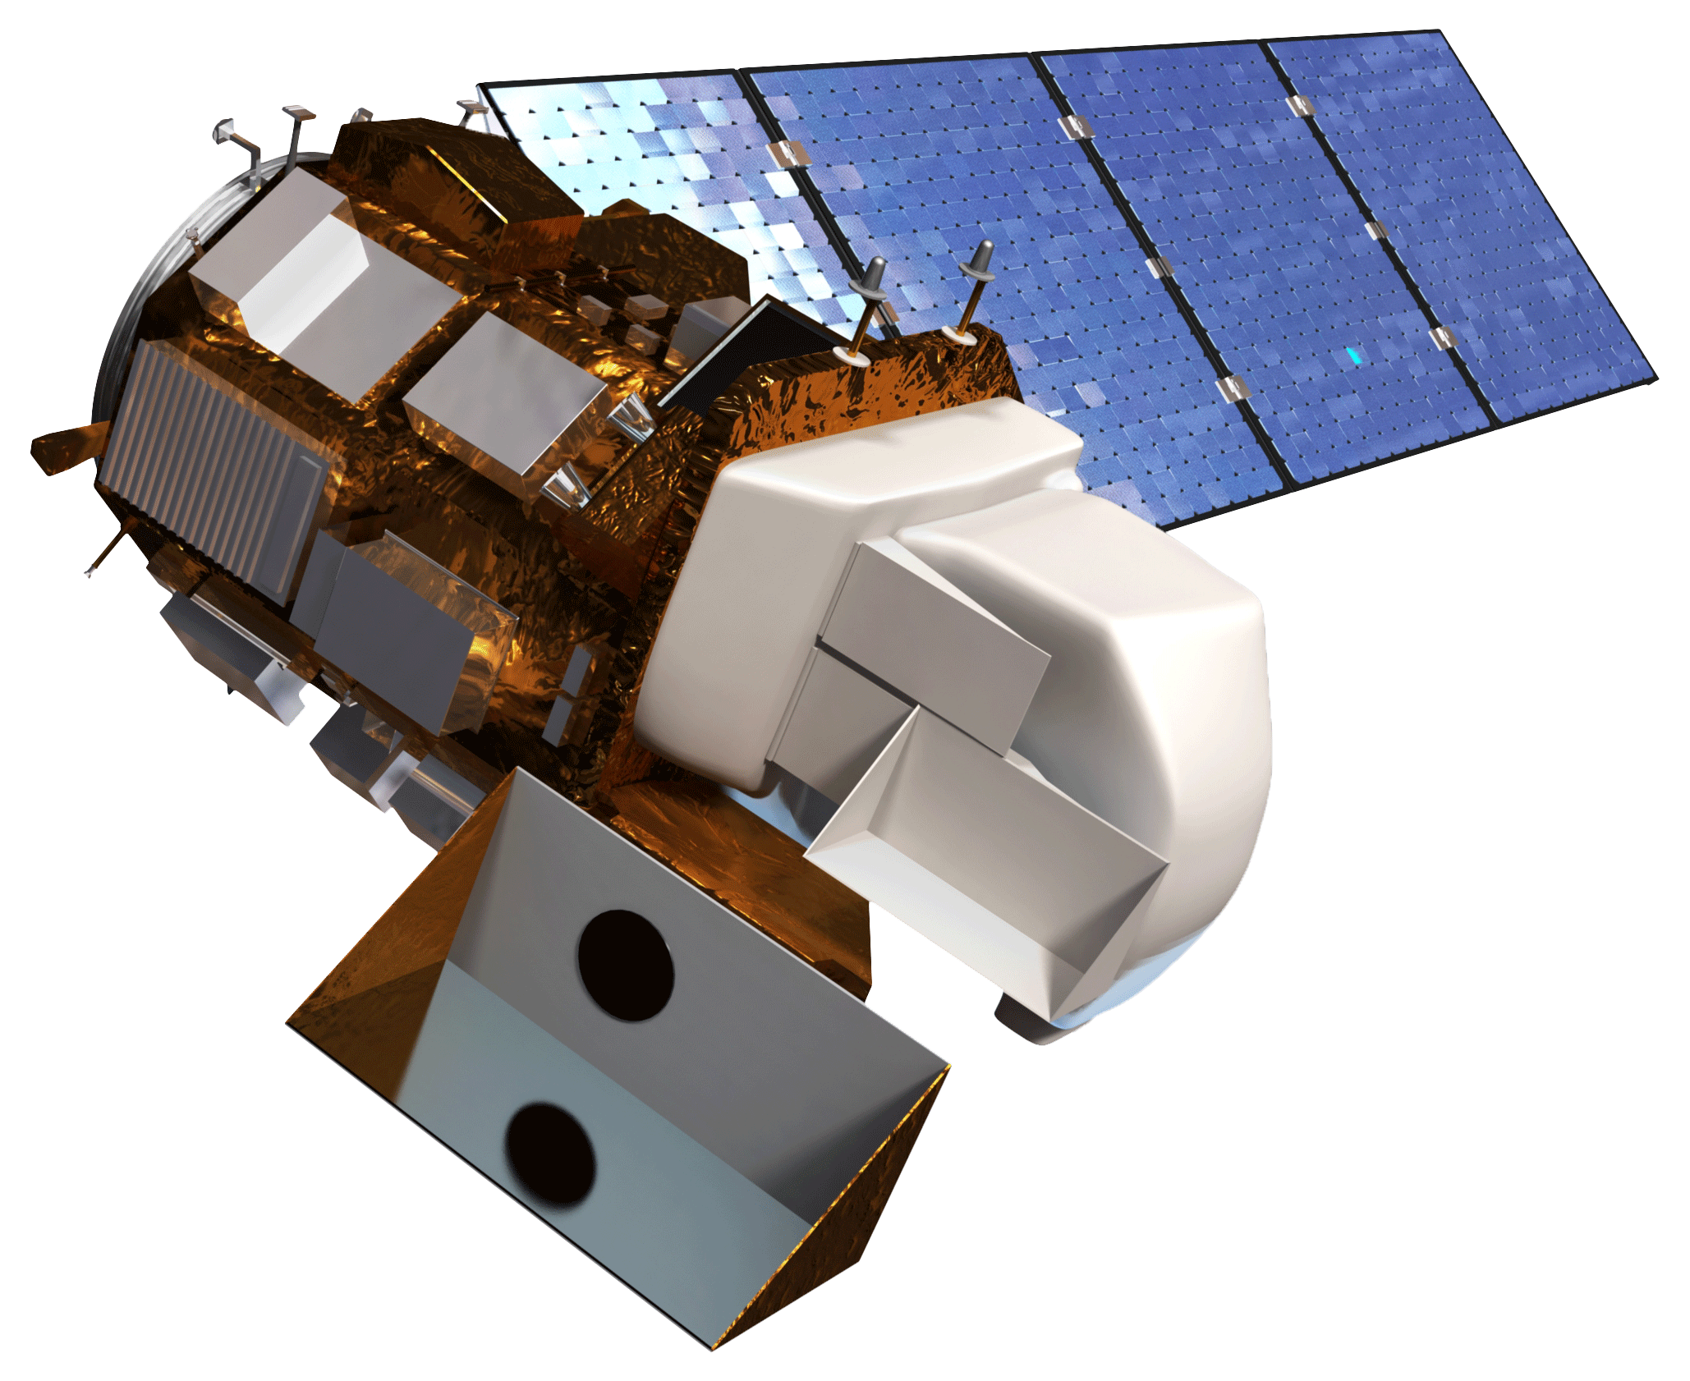
Arizona Health and Air Quality II
Enhancing extreme heat intervention and preparedness activities in Maricopa, Co. Arizona with NASA Earth observations
Daniel Finnell (Project Lead), Teresa Fenn, Ashley Brodie, Richard Muench
DEVELOP National Program at NASA Langley Research Center
Abstract
Objectives
Keep this blank for now.
Body text point size should be at least 24.
Caption text point size should be at least 16.
Feel free to rename, move, and resize sections as needed.
Automate the creation of heat vulnerability maps in Maricopa County, AZ
Create a tool to monitor heat severity
Connect to OPeNDAP for access to near real-time data
Study Area Temporary map, Will be made editable
Maricopa Co., Arizona
Methodology
Data Sources
Data Products
Processing
Mesowest & Synoptic Labs
Weather Station:
Daily High, Daily Low, Pressure, Humidity
Python Scripts from Term 1
Aqua MODIS:
Land Surface Temperature
Compiling and automation of scipts
Earth Observations
Earthdata Search manual data collection
Terra ASTER:
Elevation
Terra ASTER
Connection to OPeNDAP servers
Suomi NPP VIIRS: Population
Landsat 8 OLI:
Land Surface Temperature
Aqua MODIS
Survey Results; CASPER
Landsat 8 OLI
Suomi NPP VIIRS
Results
Conclusions
Use images.
Make sure that it has some sort of flow, that it makes sense. Show your results in a logical order.
No bullets.
Use bullets.
Use complete sentences with periods.
Team Members
Project Partners
Acknowledgements
Daniel Finnell (Project lead), Teresa Fenn, Ashley Brodie, Richard Muench
Arizona Department of Health Services (ADHS)
Phoenix Heat Relief Network
National Weather Service Phoenix Forecast Office
Environmental Remote Sensing and Informatics Lab (ERSL) at Arizona State University
Center for Policy Informatics (CPI) at Arizona State University
We would like to thank the Arizona Health & Air Quality Term 1 team: including Amy Stuyvesant, Geordi Alm, Rocky Garcia, Emma Baghel, April Rascon, Bernardo Gracia.
We would also like to thank Brian and Matt Tisdale from the ASDC for assisting us with OPeNDAP.

